Slide 1
ERR-2 MOLLER Target 2025
Integration and Compatibility
David Meekins
MOLLER Target Design Authority and System Owner

Slide 2
Outline
Fitment of MOLLER Target in Hall A
  Interferences and critical connections
  Vibrations
Interfaces
  Differentially pumped region
Environmental Factors
  Radiation

Slide 3
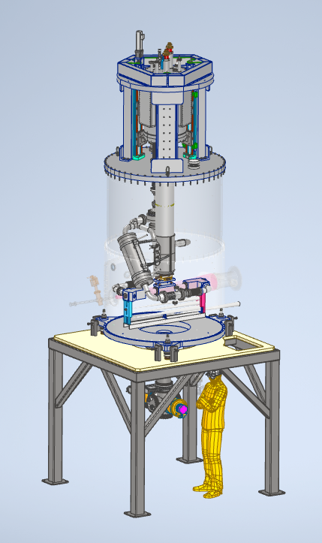
MOLLER Target Assembly
MOLLER Target will be installed 4.5m upstream from the nominal target position
Interfaces with
  Hall Infrastructure
    Shielding
    Shielding
    Fire
  Upstream beamline
  Spectrometer
Piping runs interface with Hall A structure and HRS
Interfaces are documented in ICDs
  ICD0203 Target-Spectrometer
  ICD0206 Target-Infrastructure
  ICD0702 DAQ-Target
Requirements given in
  TGT-SOW-21-001
  MOLLER-Target-SRD-0
Cryostat
Motion system
Scattering Chamber OVC
Heat Exchanger
Cell positioning system
Beam
Solid Targets
Chamber positioning system
Cell
In Beam Stand
Loop piping
Pump/gauge system

Slide 4
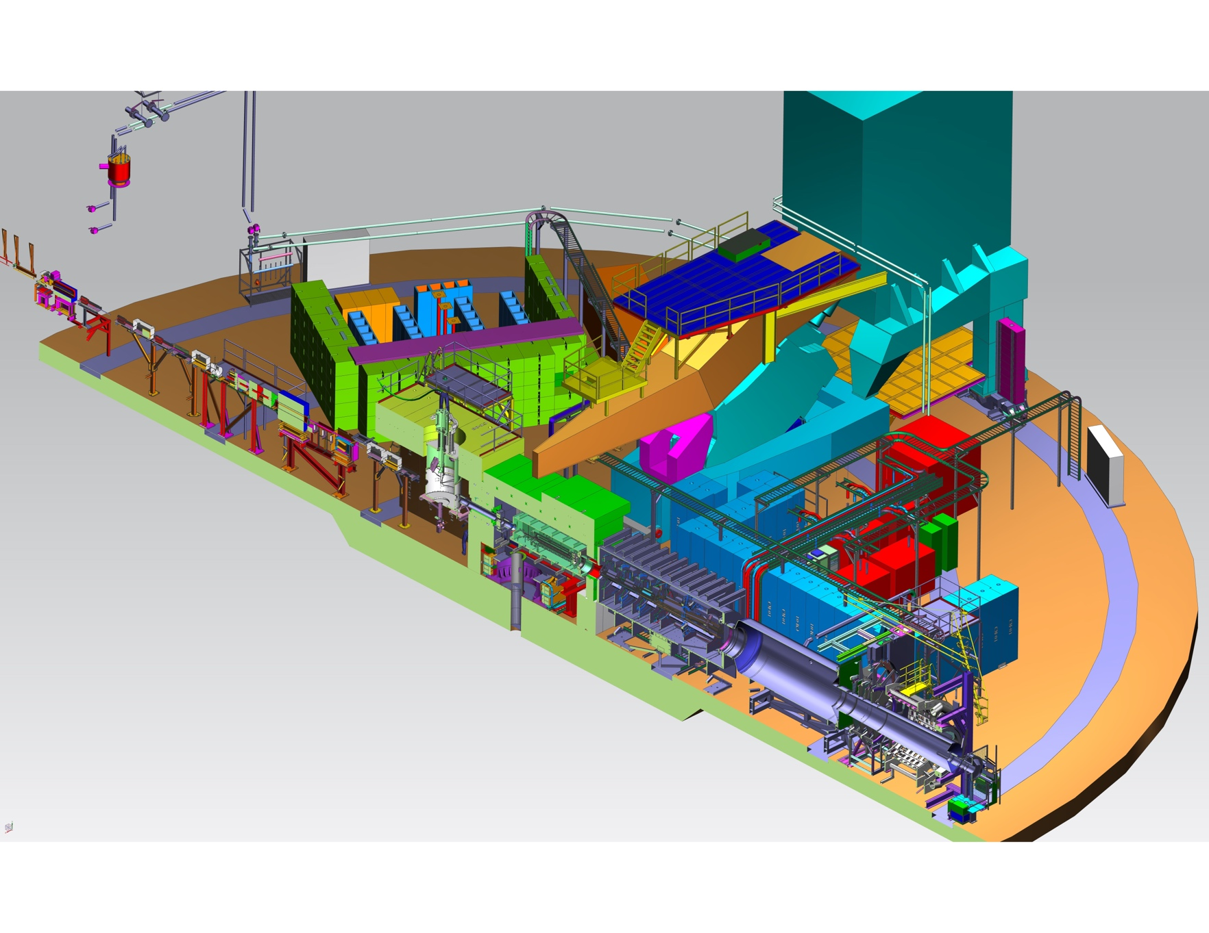
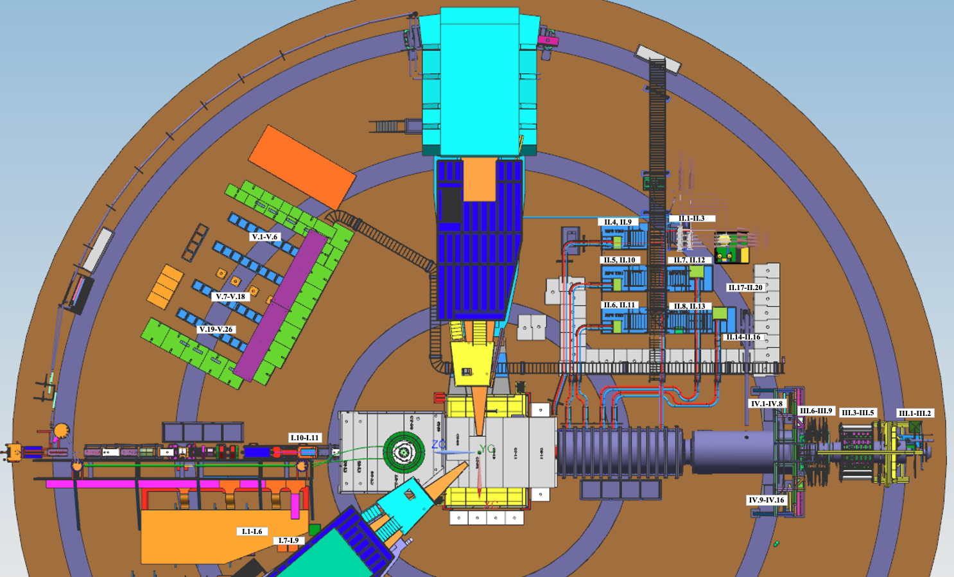
MOLLER Target Assembly
Beam
Target
Target
Beam
Target location in Hall A

Slide 5
Beamline Interfaces
The MOLLER Target System interfaces with the upstream beamline via the vacuum subsystem
  Interface at fast acting isolation gate valve.
  Valve is controlled remotely in MCC by operator
  Valve is also controlled by vacuum gauge on the chamber
    Fault on pressure above 10^-5 torr closes valve and issues FSD
  This is a simple CF connection
    A short section of beam tube with CF flanges and a makeup bellows will be field fit when appropriate and installed close to the commissioning time
The MOLLER Target System interfaces with the spectrometer via the vacuum subsystem
  Interface with differentially pumped section – orifice pair with dedicated pump system

Slide 6
Hall Infrastructure and DAQ Interfaces
Interface to Hall infrastructure is more complicated to describe
  Target stand located on Hall deck
    Target surrounded by shielding – interference check done through integrated CAD model
  Connect to Hall A AC power
    Power outlet installation must be outside of shielding “bunker”
  Piping hangs on wall and is routed through HRSR
    As shown in previous presentations
    Piping through and along the Hall wall will be field fit.
    Piping in truck ramp will be straight stick
DAQ interfaces through EPICS
  This is standard practice for all our targets at JLAB

Slide 7
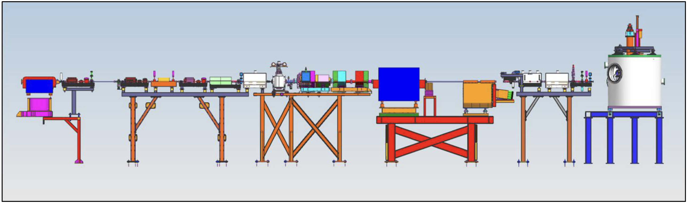
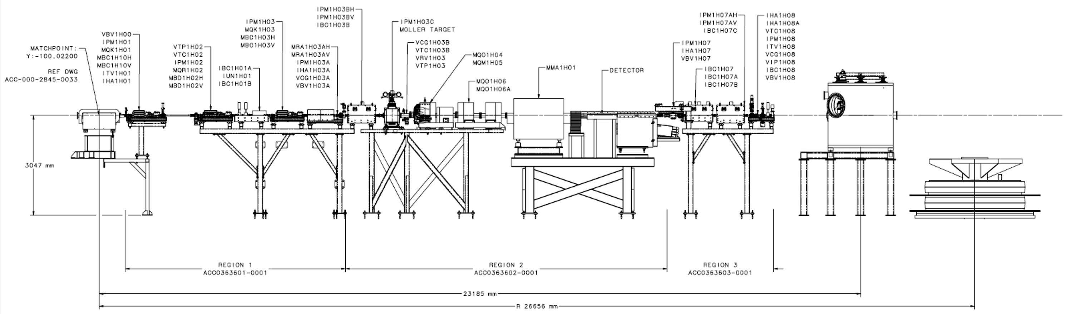
MOLLER upstream beamline
Last Compton chicane dipole
Fast raster magnets
Moller Polarimeter:
Target
Magnets
Detector
MGC corrector magnets
nA BPM
nA BPM
UNSER
XYQ
QQQ
XYQ
MOLLER target
beam
Region 1
Region 2
Region 3
Note:
Drawing/model are a bit outdated

Slide 8
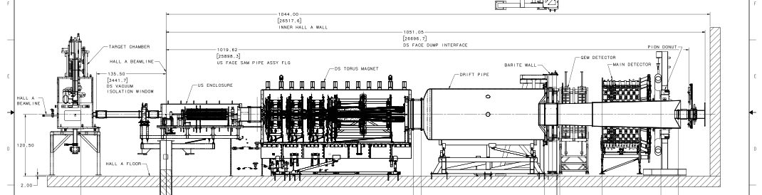
Downstream Beam Line

Slide 9
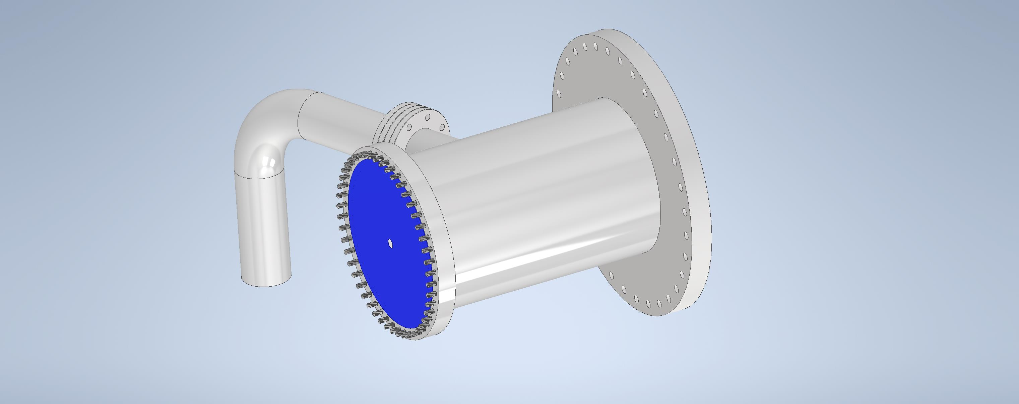
Differentially Pumped Region
System replaces vacuum separation window between Spectrometer and Target vacuum spaces.
Will allow for reduced background from aluminum -> improved physics
Will also enhance safety by eliminating the need for maintenance on the window and thereby reducing radiation exposure (ALARA – As Low as Reasonably Achievable).
Will fit into the designed space for the window and adapter and replace both components.
Simple orifice pair system with intermediate pump.
Pump exhausts for the diff-pump region and the spectrometer vacuum space must be connected to the H2 exhaust system.
There are no ignition sources in the spectrometer vacuum space all components are intrinsically safe for unexpected H2 exposure.

Slide 10
Vibration Analysis
Recommendation from PDR to perform a vibration analysis for ALL components.
  This is in practice difficult to address at the design stage.
Vibrations
  Acoustic or Flow induced (AIV) and (FIV)
  Sources of vibration
    Flow induced turbulence: branch connections, bends, orifices, quality of construction, etc.
    Flashing and two-phase flow
    Compressors and turbomachinery
  Typical frequencies range from 1 to 2500 Hz
Perform an analysis based on the Energy Institute Guidance for the Avoidance of Flow Induced Fatigue Failure in Process Pipework
  Qualitative assessment of likelihood of failure (LOF) classifications (High, Medium, Low)
  Quantitative assessment of LOF at High and Medium locations
Specific analysis on the pump shaft and bearings was performed.
  Prototype testing was also performed on the shaft.

Slide 11
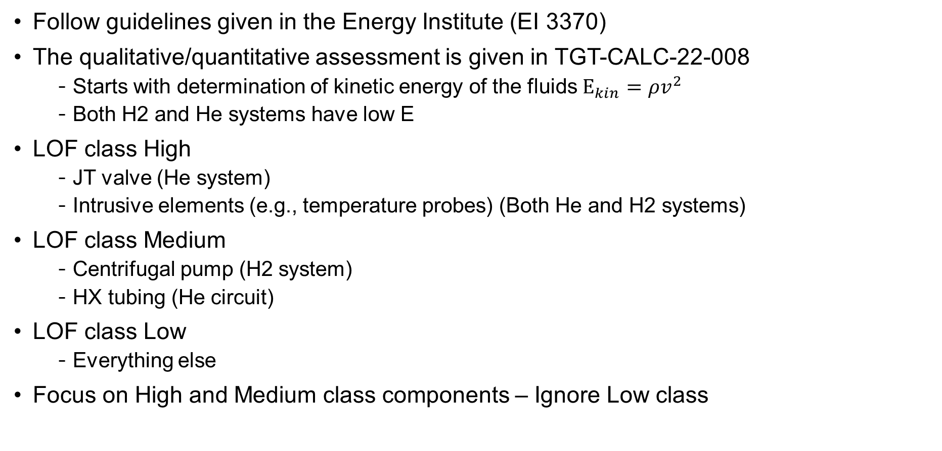
Vibration Analysis
Follow guidelines given in the Energy Institute (EI 3370)
The qualitative/quantitative assessment is given in TGT-CALC-22-008
  Starts with determination of kinetic energy of the fluids $E_{kin}=ρv^{2}$
  Both H2 and He systems have low E
LOF class High
  JT valve (He system)
  Intrusive elements (e.g., temperature probes) (Both He and H2 systems)
LOF class Medium
  Centrifugal pump (H2 system)
  HX tubing (He circuit)
LOF class Low
  Everything else
Focus on High and Medium class components – Ignore Low class

Slide 12
Vibration Analysis
The qualitative assessment relies on energy/mass flow, temperatures, and various design factors for geometries and stiffness.
  Determine LOF using these factors
  LOF < 0.3 means that this condition is unlikely to be a vibration issue
Temperature probes are assessed using vortex wake shedding and Strouhal number
  Ensure that natural frequency of probe is significantly larger than shedding frequency.
The highest LOF throughout the analysis is 0.29
  Temperature probe
  JT valve
Shaft vibrations from the pump shall be measured prior to installation
  Balanced components
  Designed to minimize vibrations
    Standard analysis for shaft vibrations in pumps

Slide 13
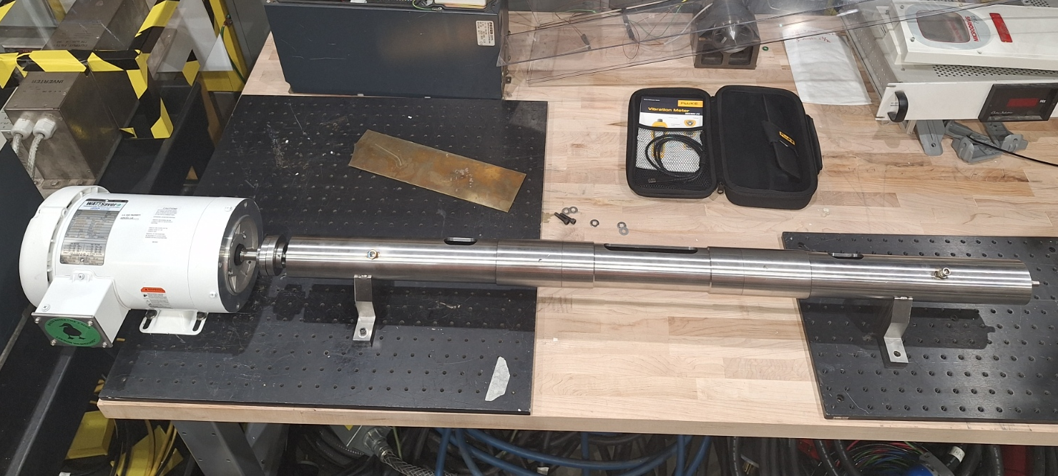
Pump Shaft Vibration Testing
Modal analysis of shaft assy has been performed TGT-CALC-22-005
Investigate fabrication strategy and vibration
Measured typical vibrations
  0.11 g
  9 microns amplitude
Lessons learned
  Shaft to case flange redesigned (more simple) Fabrication underway.
  Inner shaft and bearing design is acceptable
  Outer shaft has been redesigned (simplified). Fabrication underway.
Re-Design process and procurements have been completed

Slide 14
Environmental Factors
Ambient temperature, pressure, and humidity do not really affect the target
  Ambient temperature swing of 30K would only change the target density by 0.1%
Many target components are exposed to an extremely high radiation field
  Loop, cryostat, piping in Hall, electronics, cables, motion systems, etc.
Electronics are shielded if installed in the Hall
  IOC is located in the labyrinth.
Loop components, H2 and He piping
  Exposed to highest radiation fields
    All metal aluminum, SST, copper including seals
  H2 and He piping are all metal with metal seals with exception of relief devices.
Vacuum components
  Exposed to highest radiation fields
    All metal aluminum, SST, copper including seals
  Rubber O-rings chamber top, section, side rollup, and base flanges
    Lower radiation fields off beam access

Slide 15
Summary
Target interfaces to the upstream beamline and spectrometer with custom field fit connections.
  Absorb small misalignments between components
Interferences with other components and subsystems is avoided with integrated CAD model
  Some flexibility is built into the target system
Addressed charge items:
  3.1) How does the target integrate with surrounding equipment, specifically the upstream and downstream beamlines?
  3.2) Are there any potential interference or vibration issues that could affect stability?
  3.3) Have environmental factors, such as temperature, humidity, and radiation exposure, been accounted for?

