Slide 1
ERR-2 MOLLER Target 2025
Safety Systems and FMEA
David Meekins
MOLLER Target Design Authority and System Owner

Slide 2
Outline
Introduction
EHS Requirements for design and construction
Hazards and mitigations
  Electrical/Fire
  Pressure/Mechanical
  FMEA for safety
Personnel Training/Qualifications
Calculations and analyses
  FPE Analysis
    Recommendations
Safety Systems and Interlocks

Slide 3
Codes and Standards
One of the principle methods we employ to ensure that our systems are designed, constructed, altered, repaired, operated, inspected and maintained safely is to employ nationally/internationally recognized Codes and Standards.
Electrical equipment
  NFPA 70 – National Electrical Code
Fire protection – DOE 1066 (2016)
For Pressure Equipment we have the ASME Pressure Safety Codes
  1915: 1st edition of the BPVC published with 114 pages 5” x 8” booklet
  2020: Pressure codes are contained in 28 books with more than 16000 pages
    Many other Codes and Standards are incorporated by reference
  These Codes cover not only design:
    Personnel and institutional qualifications/responsibilities and scope
    Design/operational criteria: temperature, pressure, fluid service, fatigue requirements, etc.
    Design requirements
    Materials and Fabrication processes: Material types and grades
    Examination, Testing, Inspection
    Unlisted components and materials
  We can have a high degree of confidence in the safety of systems constructed to these Codes
    Performance – That’s a separate issue

Slide 4
ESH Requirements for Design/Construction
MOLLER target is JLAB Pressure System #PS-TGT-19-001
  Must comply with JLAB Pressure Safety Supplement (PSS)
    Comply with 10 CFR 851
  All design calculations, drawings, SOW, engineering documents, etc. shall be filed in DCG repository (in process)
    Links in PS folder on DocuShare
  Fabrication and procurement documentation must be filed in the PS folder in DocuShare
  Calculations reviewed/signed by two JLAB DAs
  Effectively means that all pressure components comply with ASME B31.3, B31.12, and VIII D1 where applicable
Fire protection analysis
  Independent review by FPE at Mason and Hanger was completed in 2022. All recommendations have been/will be implemented.
  JLAB FPE to complete review (in process)
ASCE7 is used for design loads on structures and supports
  Stands
  Piping and supports etc.
  Calculations are reviewed by RE
AISC and AWS is used for steel and aluminum construction
ASME BTH used for lifting fixtures
  Requires load tests are complete
  Calculations are reviewed by RE and filed in DCG
Electrical systems/components must comply with NFPA 70

Slide 5
Applicable Codes and Standards
MOLLER Target is a JLAB pressure system (PS-TGT-19-001)
  Must meet the requirements given in the JLAB PSS.
  Project start date: 1 Oct 2020
Applicable ASME Codes:
  ASME BPVC VIII D1 (Various)
    HX and H2 storage vessels
    Large H2 storage vessels to be modified/repaired by “R” stamp holder.
  ASME B31.3 Process piping (2018)
    He piping and H2 exhaust system purged with inert gas
  ASME B31.12 Hydrogen Piping and Pipelines (2019)
    H2 loop (cryogenic)
    H2 Service piping (ambient)
AWS (American Welding Society)
  D1.1 Structural Welding Code – Steel
  D1.2 Structural Welding Code – Aluminum
  D1.6 Structural Welding Code – SST
NFPA
  70
  2 Hydrogen Technologies Code
Compressed Gas Association
  CGA G-5.5 (2021) Standard for Hydrogen Vent Systems
Many Others incorporated by reference

Slide 6
Pressure System Construction
A JLAB DA is assigned for New Construction, Alterations, Repairs to pressure equipment
  The Design Authority is responsible for ALL aspects of the work
  An abbreviated list
    Design Requirements
    System Parameters
    Code of Record
    Operating Conditions
    Calculations
    Material Selection
    Component Selection
    Pressure Relief
    Welding Parameters
    Drawings
    P&ID
    Reviews
    Purchasing
    Receipt Inspection
    Fabrication
    Assembly
    Installation
    Welding Examination
    Mechanical Examination
    Pressure/leak Testing
    Final Inspection
    System Turnover
    Documentation
For the MOLLER Target system
  The DA is David Meekins
  The System Owner is David Meekins
  The Responsible Engineer for structural components is David Meekins

Slide 7
Requirements for Structures
Each structure must have a JLAB Responsible Engineer (RE)
  RE determines applicable Codes
    Example: AWS D1.1, 1.2, 1.6 for structural welding Codes
Work Stand and In-Beam Stand
  Welding Code: AWS D1.1
  Design
    ASCE 7 for design loading including seismic
    AISC Manual for Steel Construction
Lifting Fixture
  Welding Code: AWS D1.1
  Design: ASME BTH
Piping/vessel supports
  Welding Code: AWS D1.1, D1.2, D1.6 (material dependent)
  Design
    ASCE 7 for design loading including seismic
    AISC Manual for Steel Construction

Slide 8
Quality Control/Quality Assurance
All pressure components 100% VT (Visual examination) with 5% in process (welding) for dimension, materials, assembly etc.
  Examiner ASNT TC1-A Level II or III
  Formal receipt inspections are performed on critical components and filed in PS folder
  Formal welding/mechanical examinations are filed in PS folder
All pressure equipment welding
  ASME IX
  Pipe welds examined 100% VT 5% in-process
  Examiner ASNT TC1-A Level II or III
  H2 piping 10% random PT (penetrant test) in addition to 100% VT and 5% in-process
  Inspected by JLAB Certified Welding Inspector (CWI)
All structural welding
  AWS D1.1, 1.2, 1.6
  Inspected by JLAB CWI
Final pressure system inspection
  Final mechanical examination 100% VT on all joints
  ASME “Owners Inspector” is JLAB CWI
Interlocks are confirmed by Hot Checkout system
Documentation is filed as required by JLAB policy (detailed in Pressure Safety Supplement)

Slide 9
Documentation
DOE/JLAB requires that critical documentation is filed appropriately
CAD models to be stored on UPChain (AWS server meeting DOE requirements)
Document Control Group (DCG) Repository
  E-signed and filed with number/rev control with offsite backup. Meets DOE requirements.
  Design drawings, Engineering Reports (TGT-RPT), Change Orders (TGT-ECO), Statements of Work (TGT-SOW), Procedures (PROC), Calculations (TGT-CALC)
Primary repository for fabrication documents
  DocuShare folder PS-TGT-19-001
  Links to drawings, PS forms, DP forms, CMTR/MTR/COC, WPS/WPQ/BPS/BPQ and PQRs
  Overpressure protection documentation
  Examination and test reports
  Inspections

Slide 10
Hazards
There are multiple hazards associated with the MOLLER target system
Five main hazards
  Pressure
    Stored energy pressure: 400,000 ft-lbf
    Vacuum 450,000 ft-lbf
  Electrical
  Fire/Chemical
    Stored energy H2: 1,100,000,000 ft-lbf
  Cryogenic – burns and ODH
  Radiation exposure
Main sources of failure
  Operator error
    Operators for multiple systems
  Beam excursions
  Electrical ignition of flammable material (especially GH2)
    Most likely source of ignition in Hall A
  Overpressure from Insulating Vacuum loss
    Rapid scattering chamber vacuum loss
A more detailed and complete analysis is given in FMEA for safety which is a working document

Slide 11
Mitigations
Strict adherence to applicable Codes and Standards
  Design and construction of pressure equipment
  Design and construction of electrical equipment
  Fire protection systems and building Codes
Trained personnel in areas near the target
Fire suppression/detection system: VESDA
Minimal fire load maintained while target is operational
Trained target operator 24/7
  While target is in operation – cold and filled with LH2
Interlocks
  Kill power in off normal situations
  Fast shut down (FSD) of beam
Overpressure protection that cannot be valved out
Radiation hazards are mitigated by standard RadCon processes and ALARA principles

Slide 12
Cryogenic Hazard Mitigation
Chief hazards from cryogens
  Overpressure from insulation loss
  ODH
  Cryo-burn from contact with cold surfaces
  Obstructions caused by fluid impurities and leaks
1 b) and c) are not readily applicable
  Hall A is large volume and shielding bunker is open at the top; volume of LH2 is 66 liters or less.
  Cryogenic surfaces are protected by thick walled vacuum system with limited/difficult access.
1 a) Overpressure and Purification
  See pressure safety mitigations

Slide 13
Pressure Safety Mitigation
MOLLER target is JLAB pressure system PS-TGT-19-001
  Applicable H2 Code ASME B31.12 (2019)
  Piping: ASME B31.3 (2018)
  Vessels: ASME BPVC VIII D1 (various ed.)
Design in full compliance with applicable Code with experienced JLAB DA
Limit access to trained/escorted personnel
Dedicated trained target system operator when target is operational (cold AND liquified)
Ensure gas purity through leak tight design and operational controls
Overpressure protection (H2 piping and loop)
  Standard relief path is thru H2 piping system back to tank (includes loss of vacuum and 50 kW/m² heat flux)
  Redundant safety reliefs each with capacity required to handle relief event from worst case failure

Slide 14
Radiation Hazard Mitigation
Design with ALARA principles
Use of light metals in beam interaction regions wherever possible
  Cell body and windows are aluminum
  Differentially pumped section between the chamber and the spectrometer
Seals fabricated from aluminum.
Differentially pumped section as interface between chamber and spectrometer
  Obviates vacuum separation window removing radiation source
Reduce mass as much as possible along beam line.
  More challenging due to thermal and structural requirements.
Ensure pressure retaining components especially seals are metallic and/or radiation resistant
Components are bolt on
  Cutting, welding, etc. not required for most maintenance, alterations, and repairs.
Other measures are operational

Slide 15
H2 Hazard Mitigations
Dominant source of stored energy
  Most likely source of ignition is electrical
  Smoking/open flames not allowed
  Access controls for personnel in Hall A
Consult FPE for full assessment
  Work closely with JLAB FPE
H2 in loop (specifically the cell) has 2 layers of containment/confinement
  Confinement differs from containment as it directs released H2 to safe location
  Containment: all H2 is kept inside the system
Compliance with applicable NFPA, IBC, ASME, and CGA Codes
  Includes electrical installations near target or possible source of H2 leakage
    Does not include piping necessarily.
  Includes vent system
  Volume of H2 below limits for special provisions
  Use of intrinsically safe equipment
Not required by Code:
  Extensive leak testing beyond Code requirements
  Purged exhaust system terminating in atm vent
  100% visual examination of joints
  Remote H2 gas detection system with gas suction near target areas
  Alarms and interlocks described in detail later

Slide 16
H2 Gas Detection
A remote hydrogen gas detection system shall be installed and integrated with the VESDA system.
  A suitable number of sniffers shall be installed in the shield bunker near the target chamber. Fabricated from rad-resistant material.
On alarm the system shall perform the following functions:
  Issue FSD
  Remove Power to CC gauge.
  Close all vacuum gate valves
  Issue audible alarm in counting house/Hall
  Remove power to pump motor, heater, and all other possible sources of ignition where H2 exposure could reasonably be present.

Slide 17
Electrical Installation: Ignition Prevention
Volume of Hall A is large, volume of H2 is below therefore we only
Electrical service is determined to be:
  Class 1, Div 2, Group B
NFPA 70 – 500 Location
  Use of H2 in location where H2 is confined under normal operations
NFPA 70 – 500.7 Protection techniques
  (E) intrinsically safe, (J) Hermetically sealed, (K) gas detection (VESDA)
Electrical outlets to be installed outside bunker
NFPA 70 – 501.1 (B)
  (1) General: use of metal conduit and liquid tight listed fittings
  (2) Flexible Connections
    Use of liquid tight (metal, nonmetallic) with listed fittings
In truck ramp H2 piping is high on wall to avoid accidental contact and resulting piping failure
  Normal electrical installation is acceptable
In Hall on wall and thru spectrometer piping is hard to reach/contact
  Normal electrical installation is acceptable
  For critical lifts and heavy material handling operations: Inert H2 piping

Slide 18
FMEA For Safety
Brief introduction to the formalism used in the analysis
Drive our car home without accident over 10 years
One failure mode is that we loose control of the car- One potential cause is that we get a flat tire
If we do nothing to maintain the car, what is the probability (occurrence) that the tire goes flat--- assign a value between 1 and 10 (very likely to fail 10)
What is the severity --- assign a value between 1 and 10 (10 fatal)
What is the chance that this failure mode would be detected before it causes the failure. (9 unlikely)
Risk Priority Number = Severity*Occur*Detect
  (RPN) is 900 in this case 10*10*9. This is above 200 which is a somewhat arbitrary threshold triggering action.
What can we do to mitigate this failure mode
  Lower the probability
    Regular alignment, regular check of tire pressure and condition, replace defective tires, driver training (4)
  Lower consequence
    Not much we can do here accept train the driver (9)
  Increase detection
    Install sensors on tire pressure, pre-trip inspection, driver training
    Go from 9 to 3
  New RPN=108 so we are happy(er)

Slide 19
FMEA For Safety
Formal FMEA for safety is in process
  Working document filed in pressure system folder
Covers all reasonable failure modes
  Loss of insulating vacuum
  Overpressure incidents for warm gas systems
  Power failure
  Overpressure incidents for cryogenic systems
    H2 loop
  Human error
Off normal events such as relief of the system during catastrophic vacuum loss or power failure shall be handled by engineered controls with no operator input required.
Operator input shall not be required for activation and proper function of safety systems.
Operators are to address alarms only and contact system experts as needed.

Slide 20
FMEA For Safety
Occurrence and Detection criteria are the same as for the Performance FMEA
Criteria for Severity reflects extent of injury to personnel
Largest RPN is 1000:
  Multiple fatalities possible
  Likely hood of detection low
  Occurrence highly likely over target lifetime
Most high RPN are mitigated by constructing pressure systems in compliance with JLAB PSS -> Codes
There are still some items where the RPN is above 100.
  These typically involve human error
Criteria for Severity
Value | Level | Description
1 | Very Low | No effect
2 | Low | slight injury no ER
3 | Low | multiple slight injury no ER
4 | Moderate | Injury requiring ER
5 | Moderate | Multiple injury requiring ER
6 | Moderate | Injury <2 days in hospital
7 | High | Serious Injury long term hospital
8 | High | Multiple Serious Innjury long term hospital
9 | Very High | Possible Fatality. Irreversible damage
10 | Very High | Possible multiple fatality

Slide 21
FSD Logic
FSD Logic is defined in TGT-1060-4001-0001
FSDs are issued
  VESDA H2 Sniffer
  Loop temp 1
  Loop temp 2
  Gas panel pressure low
  Exhaust purge pressure low
  Target Motion
  Ion Chamber trip
Fast shutdown system takes beam away in less than 1 second.
Issues alarm on specific channel that tripped

Slide 22
Fast Shutdown (FSD) System
JLAB drawing: TGT-1060-4001-0001
Included in docs
FSD 24V signal supplied to module - Fault on 0 V
  Power failure/broken cable trips fault
8 FSD signals are expected

Slide 23
Fast Shutdown System Summary of Channels
ID Number | FSD Description | FSD Fault Condition | Supplied by
FSD-001 | Target Motion | Target motion system enabled | Target
FSD-002 | Vacuum Pressure Mech/CC | Vacuum > 2e-5 torr or 1 torr | Target
FSD-003 | Loop Temperature 1 | Any temp > 25K | Target
FSD-004 | Loop Temperature 2 | Any temp > 25K | Target
FSD-005 | Gas panel pressure | H2 pressure less than 20 psia | Target
FSD-006 | Exhaust line pressure switch | Fault on pressure in exhaust line less than 1 psig. | Target
FSD-007 | Hydrogen sniffer/VESDA | Fault on H2 detection in sniffer | Target/FML-FPE
FSD-008 | Target Ion Chamber | Signal above threshold calibrated at run start. | RadCon

Slide 24
Interlocks and Alarms
Interlocks described in TGT-1060-4001-0002 and P&ID TGT-1060-4000-0000
Interlocks are designed to
  Prevent H2 exposure to possible ignition sources
  Prevent sub atm pressure which can lead to contamination
Interlocks are integrated with target controls
Alarm box in counting house near target control PC
  Visual and audible alarms
  Trigger alarms in EPICS
Interlocks:
  Vent pressure low: Alarm in CH and FSD
  Gas Panel Low Pressure: Alarm in CH, FSD, Kill power to pump and heater
  Chamber vac switch: Alarm in CH, FSD, Kill power to CC gauge, pump, and heater
    Close gate valve on turbos
  VESDA H2: Alarm, FSD, Kill power to pump and heater
  Chamber CC gauge
    FSD, Close upstream gate valve

Slide 25
Alarm Logic
Gas panel
Exhaust purge
Chamber
P-switch
H2 sniff
Chamber
pressure
Taken from Drawing:
TGT-1060-4001-0002

Slide 26
Personnel Training
Personnel working on the Target system are trained in JLAB standard working practices as well as system specific training and general pressure system training
  Workers SAF130A
  DA and System Owner SAF130B and 130C
  Currently all workers are trained
Target operators
  The target is staffed 24/7 when LH2 is in the loop.
  Operators shall be formally trained and tracked in the JLAB LMS
  The following training is required
    PH019, PH019T (test), Sit ½ shift as practical exam
    PH020 MOLLER target training
  Operation procedure/manual for target will be developed next year and filed in the PS folder.
    Copy located in counting house and on HA-web site
  Operators are to address alarms and immediately contact the target on call for off normal events
    On call personnel shall contact system experts to address issues beyond the usual reboot type scenarios.

Slide 27
Procedures
Currently there are no procedures/guidelines governing operations published or under development
Procedures covering appropriate processes shall be developed and filed in the DCG. Links to these procedures shall be filed in the PS folder
Partial list of expected procedures
  FSD Checkout
  Lifter checkout
  Alarm/VESDA checkout
  Electrical installation inspection (FPE)
  Gas panel operations
  System startup and commissioning
  General target operations
Each procedure shall be numbered rev controlled and filed in DCG with links in PS folder.

Slide 28
MOLLER Scattering Chamber Analysis
This is a large vacuum component (JLAB Cat 2 large)
  Stored energy (vacuum only) of more than 600 kJ
Design loads (applied in 20 steps)
  1 atm pressure load
    Vacuum load 55000 lbf on top face
  Target weight 6500 lbf on top face
  Seismic moment applied normal to window central axis at C.M. of target
    26000 in-lbf
Analysis software
  Nastran – Inventor in CAD
Material model: Al 6061-T6 forged hot rolled. (Actual material is forged 2219 which is ~1.5 x strong)
  Sy = 45397 psi
  Sut = 49313 psi
  Ey = 1.05 e+7 psi
  Tangent modulus 1e+6 psi
  Bi-linear
Contacts are bonded (lots of bolts)

Slide 29
MOLLER Scattering Chamber Analysis
Methodology
  Linear buckling
    Assumes linear material model and element order
    Repeat for 2, 1, 0.75 inch elements (mesh quality fail 0.01%)
    Convergence is good
      max von-mises 1715 psi
      Max displacement 0.0025 inch
      Eigenvalue 89
  Linear static
    Check for large stresses
    Max von-mises 1814 psi
  Non-linear buckling
    Non-linear (bi-linear material model)
    Convergence is good
      max von-mises 1685 psi
      Max displacement 0.0025 inch
      Eigenvalue 89
Remaining tasks
  Formalize calc with correct material, review and file in DCG

Slide 30
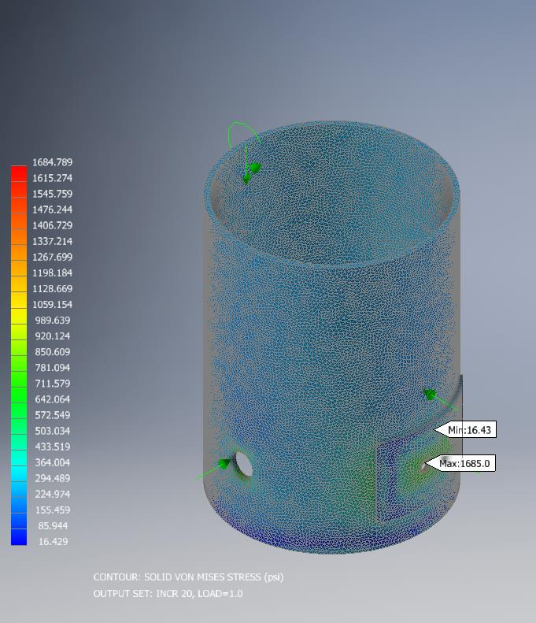
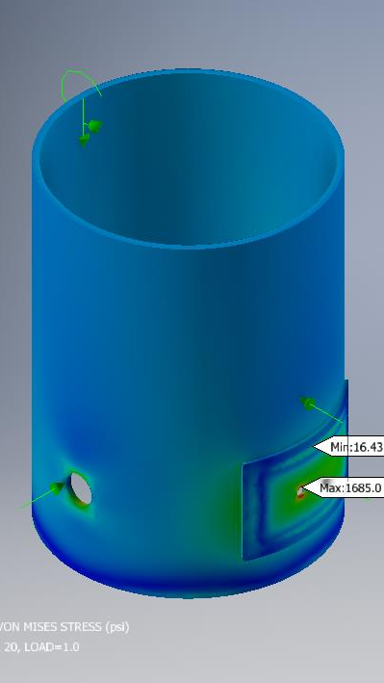
MOLLER Scattering Chamber Analysis

Slide 31
H2 Component Calculations
Calculations demonstrating Code compliance for the following are fully complete
  Loop: Heat exchanger, Loop Piping, Flex lines (braided flex hose), Cell body, Cell entrance window, heater, pump case
  Conflat flanges both SST and Al
  Piping run to storage system, gas panel
  Overpressure protection for storage vessels
Calculations for the following components are in-process at about the 50% to 60% level
  Cell exit window, Flexibility analysis for piping runs (CAE-Pipe no longer available)
  Loop piping supports
  Overpressure protection for loop
  Exhaust system calculations
    Stack and vent

Slide 32
He Piping Component Calculations
Calculations demonstrating Code compliance for the following are fully complete
  Cryostat
  Transfer lines
  Bayonets, JT-valves, instrumentation
  Overpressure calculations for storage system
  Piping supports for warm piping and He system
Calculations for the following components are in-process at about the 90% level
  He service cans and piping
    Calculation needs to be reviewed.
    Very similar to other He systems

Slide 33
Structural Component Calculations
Completed calculations
  In-beam stand
  Lifting fixtures
  Piping supports for warm piping run
  Lifter brakes
  Lifter drive shaft
  Work stand
In process
  Stack calculations using ASME STC. Will need exact location as this will be field fit as we work around PSS components
  Based on what we see after blue structure is removed we may need to verify designs for He piping system

Slide 34
Overpressure Protection for Storage and Exhaust
Overpressure protection for storage vessels
  Calculation and analysis follows API 520 and 521
  Greatest source of overpressure is from liquid hydrocarbon fuel fire
  Relief valves have been sized for each of the storage vessels
  FlowSafe F85 series valves shall be used with set point of 100 psi
  Locking isolation valves shall be installed in compliance with appendix M
Exhaust Stack relief
  Exhaust system is kept at positive pressure ~ 1.5 psi
  End of line relief has been received:
    Protecto-Seal 7800 series set at 1.5 psi
    Weighted soft seat stainless vent
  Exhaust system is purged continuously with He or N2

Slide 35
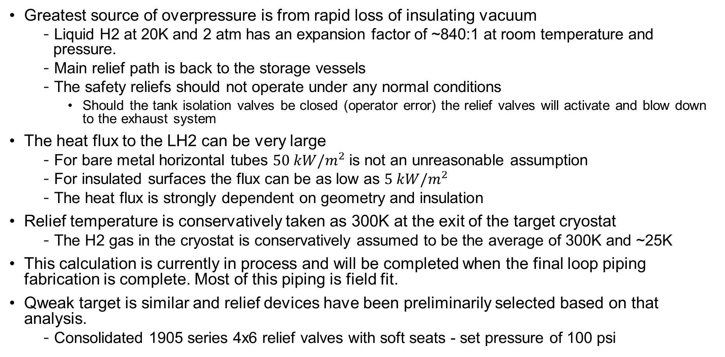
Overpressure Protection for Target Loop
Greatest source of overpressure is from rapid loss of insulating vacuum
  Liquid H2 at 20K and 2 atm has an expansion factor of ~840:1 at room temperature and pressure.
  Main relief path is back to the storage vessels
  The safety reliefs should not operate under any normal conditions
    Should the tank isolation valves be closed (operator error) the relief valves will activate and blow down to the exhaust system
The heat flux to the LH2 can be very large
  For bare metal horizontal tubes $50 kW/m^{2}$ is not an unreasonable assumption
  For insulated surfaces the flux can be as low as $5 kW/m^{2}$
  The heat flux is strongly dependent on geometry and insulation
Relief temperature is conservatively taken as 300K at the exit of the target cryostat
  The H2 gas in the cryostat is conservatively assumed to be the average of 300K and ~25K
This calculation is currently in process and will be completed when the final loop piping fabrication is complete. Most of this piping is field fit.
Qweak target is similar and relief devices have been preliminarily selected based on that analysis.
  Consolidated 1905 series 4x6 relief valves with soft seats - set pressure of 100 psi

Slide 36
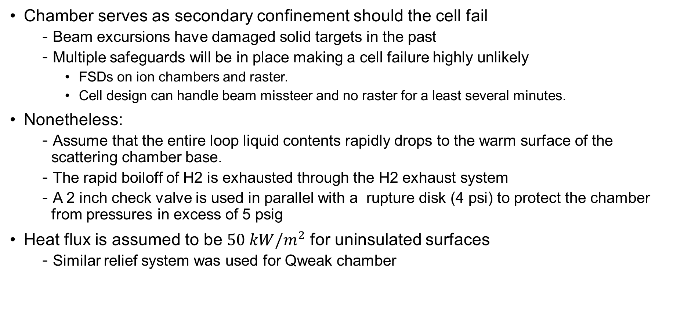
Chamber Overpressure Protection
Chamber serves as secondary confinement should the cell fail
  Beam excursions have damaged solid targets in the past
  Multiple safeguards will be in place making a cell failure highly unlikely
    FSDs on ion chambers and raster.
    Cell design can handle beam missteer and no raster for a least several minutes.
Nonetheless:
  Assume that the entire loop liquid contents rapidly drops to the warm surface of the scattering chamber base.
  The rapid boiloff of H2 is exhausted through the H2 exhaust system
  A 2 inch check valve is used in parallel with a rupture disk (4 psi) to protect the chamber from pressures in excess of 5 psig
Heat flux is assumed to be $50 kW/m^{2}$ for uninsulated surfaces
  Similar relief system was used for Qweak chamber

Slide 37
NFPA Analysis
Independent review of the MOLLER target hydrogen systems
  Performed by FPE at Mason and Hanger
  Final report filed with pressure system documents and with FML
All recommendations (*) and requirements have been incorporated in the target design
  Vent and exhaust system meet requirements from NFPA 2/CGA 5.5
  Grounding systems have been specified in the target SOW (TGT-SOW-22-001) as required in NFPA 70
  Intrinsically safe electrical components/installation for area that could be exposed to H2
  Locking manual isolation valves are installed on each tank.
    This is standard practice for all existing hydrogen target systems
Additional mitigations
  Include H2 sniffer integrated with existing VESDA equipment
    Sniffer to be located in bunker with ODH sensor
    24/7 operator when target is filled with LH2
    Alarms in counting house addressed by target operator
Needs review by “new” JLAB FPE
* Upgrade of existing fire protection system is responsibility of FML and not with the scope of the MOLLER project.

Slide 38
Partial List of Calculations
Document Number | Author | Completion | Status | WBS | Subject/Title | Link to DCG
TGT-CALC-20-010 | D. Meekins | 100 | A/C | 1.02.05 | MOLLER Target adequacy of Qweak HX | JLab Docs - View Document
TGT-CALC-20-011 | D. Meeins | 100 | A/C | ALL | Acceptable thermal limits for condensation | JLab Docs - View Document
TGT-CALC-22-001 | D. Akers | 100 | A/C | 1.02.04 | Cryostat vacuum and pressure calcs | JLab Docs - View Document
TGT-CALC-22-002 | D. Akers | 70 | IP | 1.02.03 | Unistrut H2 Pipe Support Analysis
TGT-CALC-22-004 | D. Akers | 100 | A/C | 1.02.06 | Ball screw column loading | JLab Docs - View Document
TGT-CALC-22-005 | D. Akers | 60 | IP | 1.02.03 | H2 Pump Shaft and Bearing Analysis
TGT-CALC-22-009 | D. Meekins | 80 | IP | ALL | Vibration analysis qualitative assessment
TGT-CALC-22-010 | D. Akers | 100 | A/C | 1.02.06 | An analysis of the Ball Screw Load and Torque | JLab Docs - View Document
TGT-CALC-22-039 | D. Meekins | 80 | IP | ALL | Vibration analysis Quantitative assessment
TGT-CALC-22-016 | D Akers | 60 | IP | 1.02.05 | Loop Heat Exchanger Support Rod Analysis
TGT-CALC-22-018 | D. Akers | 100 | A/C | 1.02.02 | AISC and ASCE analysis of Hall A MOLLER Hall Stand. | JLab Docs - View Document
TGT-CALC-22-019 | D Akers | 70 | IP | 1.02.04 | Helium Service ASME Analysis
TGT-CALC-22-022 | D. Akers | 100 | A/C | 1.02.02 | ASME BTH Analysis of Lifting Fixture for Hall A MOLLER | JLab Docs Details for version 1
TGT-CALC-22-023 | D Akers | 80 | UR | 1.02.02 | Ansys Analysis of TGT-1061-0030-0000 Target Stand for AISC
TGT-CALC-22-025 | D. Akers | 80 | IP | 1.02.02 | AISC and ASCE analysis of Hall A MOLLER Working Tripod Stand.
TGT-CALC-22-026 | D Akers | 80 | UR | 1.02.05 | Heat Transfer Analysis for Heater
TGT-CALC-22-028 | D Akers | 70 | IP | 1.02.04 | Helium Distribution Piping ASME Analysis
TGT-CALC-22-029 | D Akers | 80 | IP | 1.02.03 | Hydrogen Distribution Piping ASME Analysis
TGT-CALC-22-030 | D Akers | 70 | IP | 1.02.05 | Loop Piping ASME Analysis
TGT-CALC-22-031 | C Flannagan | 70 | IP | 1.02.06 | Calculations for Moller Scattering Chamber Adjustment Assy
TGT-CALC-22-032 | C Flannagan | 70 | IP | 1.02.06 | Ball Screw Calculations
TGT-CALC-22-033 | D. Meekins | 50 | IP | 1.02.02 | Scattering chamber PSS analysis
TGT-CALC-22-036 | D. Akers | 100 | A/C | 1.02.04 | Design by Analysis Documentation for TGT-1061- 5015-0000 | JLab Docs Details for version 1
TGT-CALC-22-037 | D. Meekins | 100 | A/C | 1.02.02 | Beam energy loss in vacuum isolation window | JLab Docs Details for version 1
TGT-CALC-22-038 | D Akers | 70 | IP | 1.02.05 | Heater Support AISC Analysis

Slide 39
Key Calculation Tasks to be Completed
Currently we have nearly 100 separate calculations
  Many have been formally reviewed and filed appropriately
  Others shall be reviewed as required and filed
WBS 1.02 Vacuum
  Overpressure protection for chamber (real loop LH2 volume needed)
  Formalize existing chamber calculations and file
WBS 1.03 H2 system
  Overpressure protection for loop
  Formal flex analysis for piping run
WBS 1.04 He system
  Review and file existing calculations
WBS 1.05 Loop
  Complete cell calculations and file

Slide 40
Summary
Most calculations have been completed, however many critical calculations are not finalized. Others will need to be formalized and filed appropriately.
  These are not required to be completed at this time. Only needed prior to final pressure system inspection/walkdown. (late 2026)
JLAB FPE approval of H2 safety plan is in process
Procedures for operations have not been developed
  Procedures have been identified but will not be developed until mid 2026 not needed until commissioning (late 2026)
  Fabrication procedures, specifications, SOWs, etc. are fully developed and have been filed in the PS folder.
Training shall be developed and incorporated into the LMS. Operators shall be formally trained. This shall be tracked in the LMS. (Late 2026)
Emergency shutdown shall be handled by engineered controls without operator input.
Addressed charge items:
  2.1) What are the emergency shutdown and venting guidelines in the event of an anomaly?
  2.2) Have potential failure modes for hydrogen containment (loop and/or target chamber) been thoroughly analyzed, and are sufficient controls in place to ensure safe operation?
  2.4 Are personnel adequately trained to handle unexpected situations?
  2.5) What safety systems are in place to prevent unsafe situations (e.g., overpressure, fire hazards)?

