Slide 1
ERR-2 MOLLER Target 2025
Introduction and operational performance
David Meekins
MOLLER Target Design Authority and System Owner

Slide 2
Outline
General principles of high-power cryogenic targets
MOLLER Target subsystem overview
  Vacuum subsystem
  Hydrogen gas subsystem
  Helium subsystem
  Loop (cell, pump, heater, etc.)
  Motion systems (lifter, chamber positioning, cell alignment)
  Controls (epics based slow controls, alarms, interlocks)
Operational characteristics
  Cell performance
  Heat exchanger performance
  Pump performance
  Instrumentation
Summary

Slide 3
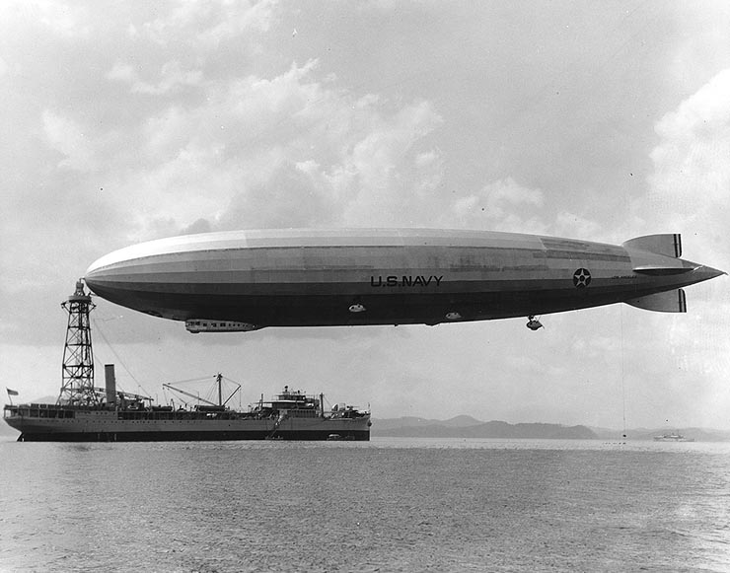
Principles of Cryogenic Targets for Electron Scattering
Why LH2
There are lot of reasons to NOT use LH2
  Hazardous: H2 is explosive in air (LEL is 4%)
  LH2 requires cryogenic support -> complicated and costly
  Why not just use H2O, LiH, or FeTiH2 (density H is ~6x higher than LH2) Or He
The case for LH2
  Hydrogen is the most simple nucleus. Even the complexity of He4 can force calculations to be almost impossible
  Need pure H2 to reduce background from other elements
  Why liquid
    Liquid H2 compared to gas H2 at room temp/pressure is ~840 times more dense. Shortens run times to something that can finish in our lifetime.
So we are stuck with liquid H2

Slide 4
Principles of Cryogenic Targets for Electron Scattering
Electrons and High Power Targets
What do we mean by “high power” -> few 10s of Watts and higher.
  Where does this heat come from: beam, conduction, heat radiation, pump losses, etc.
Electron beam deposits energy into the target in the form of heat.
  0.37 W/(microA*cm)
We require the target density to be stable
  Short term stability/boiling effects will affect quality of the asymmetry measurement
  Long term stability will also affect the asymmetry but also the count rate
The density depends on temperature and pressure
  For a 1K change in temperature we get about 1.6% change in density
  For a 1 psi change in pressure we get about 0.017% change in density
We operate our high power LH2 targets in the subcooled region
  We typically run at ~20K and between 25-35 psia
  The only way to do this is to use forced convection with a temperature stabilizing heater

Slide 5
Principles of Cryogenic Targets for Electron Scattering
Simplified schematic of the target system
Not shown are the motion subsystem (WBS 1.02.06) and the control subsystem (WBS 1.02.07)

Slide 6
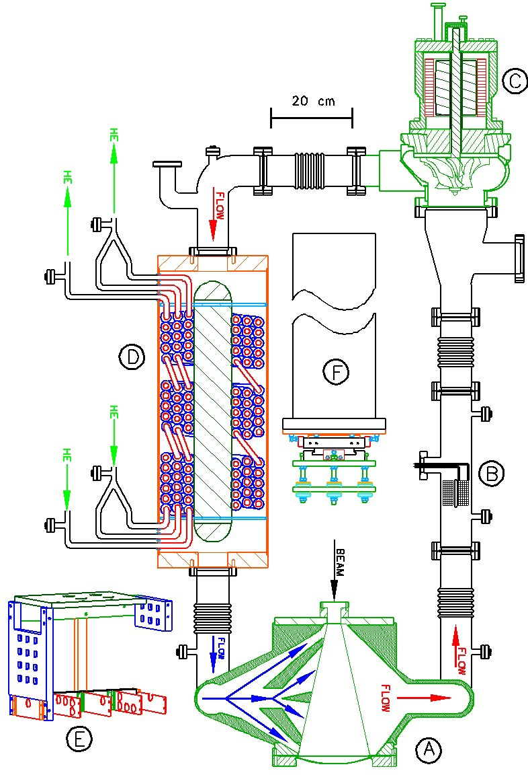
Principles of Cryogenic Targets for Electron Scattering
Key Components of a High Power Cryotarget
Insulating vacuum system
  Required to reduce heat load from the ambient air
Target cell
  Where beam interacts with LH2. This typically has thin “windows” for beam traverse and recoil particle paths to spectrometers
Heat Exchanger (HX)
  Heat is removed from the LH2 target fluid and dumped into the cooling gas from the ESR
Temperature stabilizing heater
  Maintains target temperature
  Replaces beam heat load when beam is removed
Recirculating pump
  Pumps LH2 at the necessary flow rate to maintain the temperature and reduce boiling in the target cell
Instrumentation
  Thermometry etc.
Gas handling system
  Purification, filling, pressure, blowdown …
LH2 pump motor
Supporting pipe
LH2 pump
Heat Exchanger (HX)
Heater
Target Cell

Slide 7
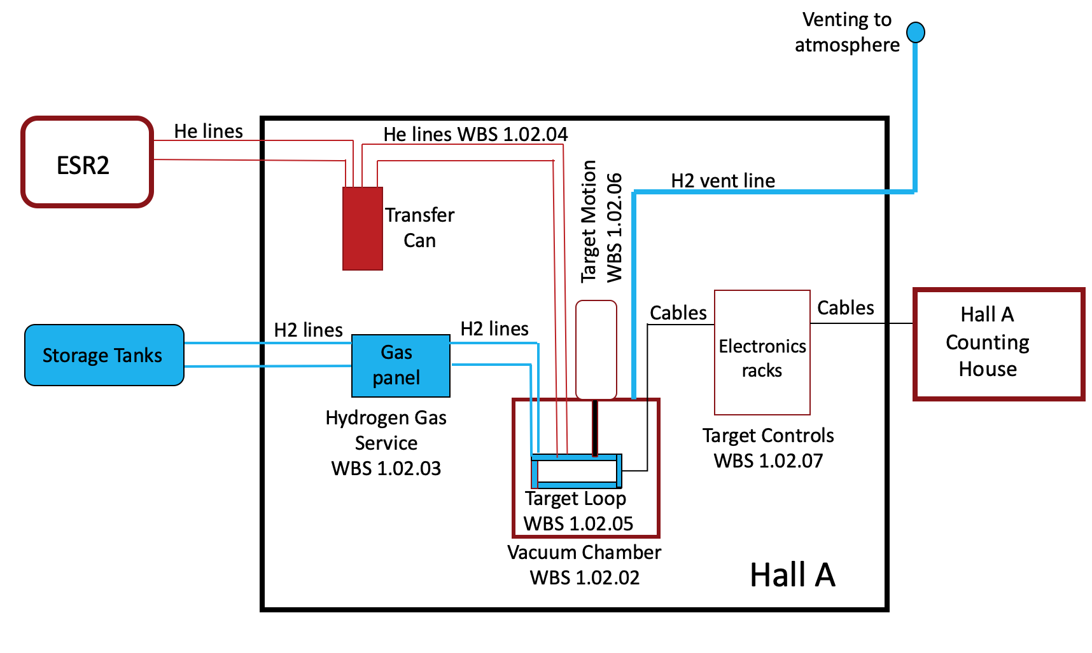
MOLLER Target Subsystem Overview
1.02.02 Vacuum System
  Target scattering chamber and stand
  Vacuum pumping stations
1.02.03 Hydrogen Gas Service
  Storage vessels, piping
  Gas panel
  Hydrogen vent
1.02.04 Helium Gas Service
  He Lines
  He Cryostat
1.02.05 Target Loop
  Liquid Hydrogen Pump
  Heat Exchanger
  Cell and plumbing
  High Power Heater
  Solid Targets
1.02.06 Target Motion
  Vertical lifter and alignment
1.02.07 Target Controls
  Software and Hardware controls and instrumentation

Slide 8
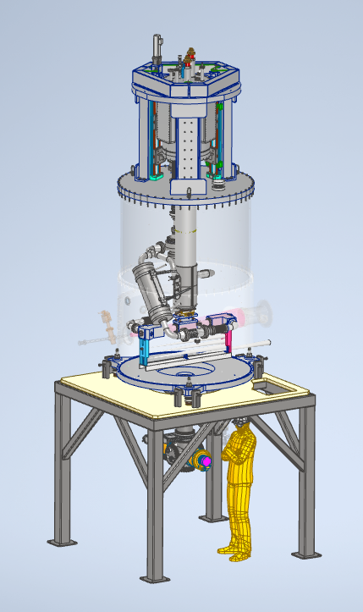
MOLLER Target Assembly
MOLLER Target will be installed 4.5m upstream from the nominal target position
Interfaces with
  Hall Infrastructure
    Shielding
    Shielding
    Fire
  Upstream beamline
  Spectrometer
Piping runs interface with Hall A structure and HRS
Interfaces are documented in ICDs
  ICD0203 Target-Spectrometer
  ICD0206 Target-Infrastructure
  ICD0702 DAQ-Target
Requirements given in
  TGT-SOW-21-001
  MOLLER-Target-SRD-0
Cryostat
Motion system
Scattering Chamber OVC
Heat Exchanger
Cell positioning system
Beam
Solid Targets
Chamber positioning system
Cell
In Beam Stand
Loop piping

Slide 9
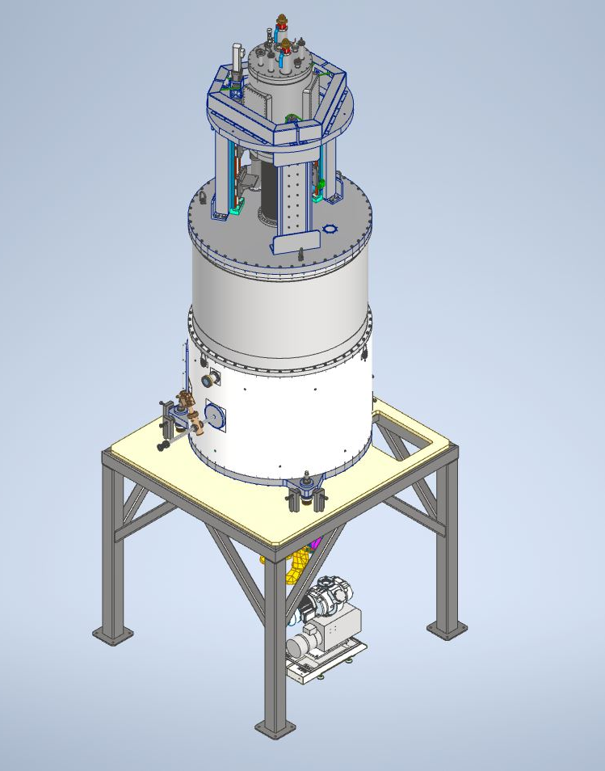
WBS 1.02.02 Vacuum System
Scattering Chamber
Stand
  Positions the scattering chamber on the beam line at the correct height and allows for some coarse adjustments in position.
Pump system
  Includes two 1000 l/s turbos and blower system.
  This is similar to existing cryotargets
Differential pumping region
  No exit “window” spectrometer and target vacuum spaces are linked
  Better performance and ALARA (window would likely need to be replaced at set intervals)
Upstream beamline connections
  All components are complete. Field fit for final connection. Fast acting gate valve isolates target vacuum from upstream beamline vacuum.
Chamber
Beam
Stand
Pump system

Slide 10
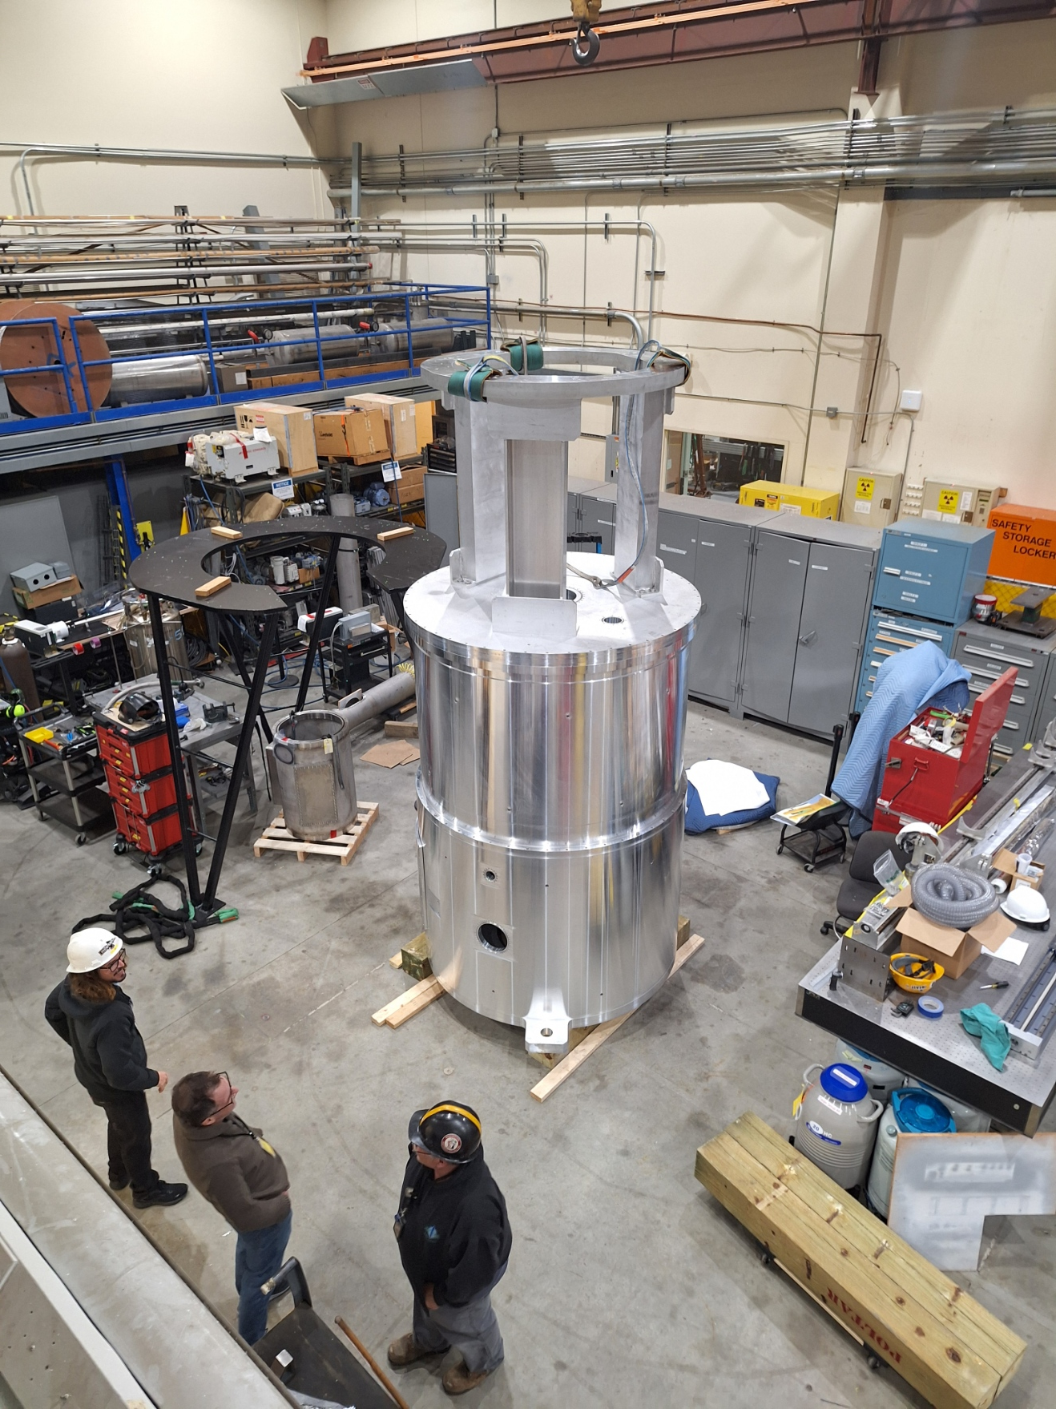
WBS 1.02.02 Target Chamber
Scattering Chamber Shell Fabrication is complete
Fabrication is two step process
  1) Forging/rough machining
  2) Final machining
Forging vendor:
  Southwest Aluminum Forging (Shipped from China)
Final Machining:
  Major Tool (USA)
All components have been received/inspected and test assembled.

Slide 11
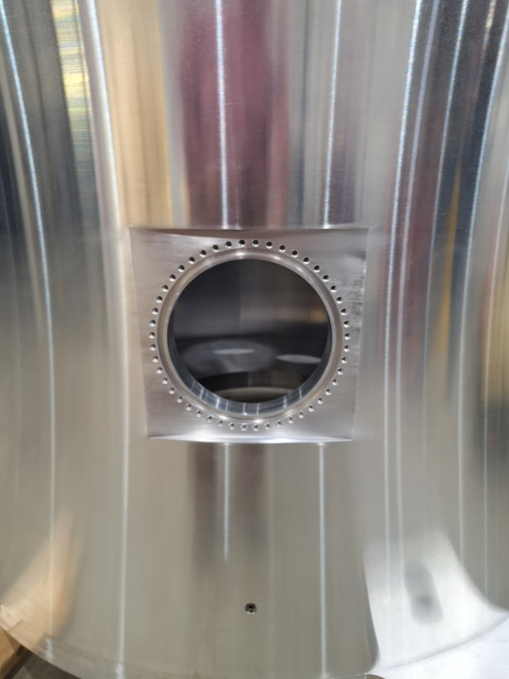
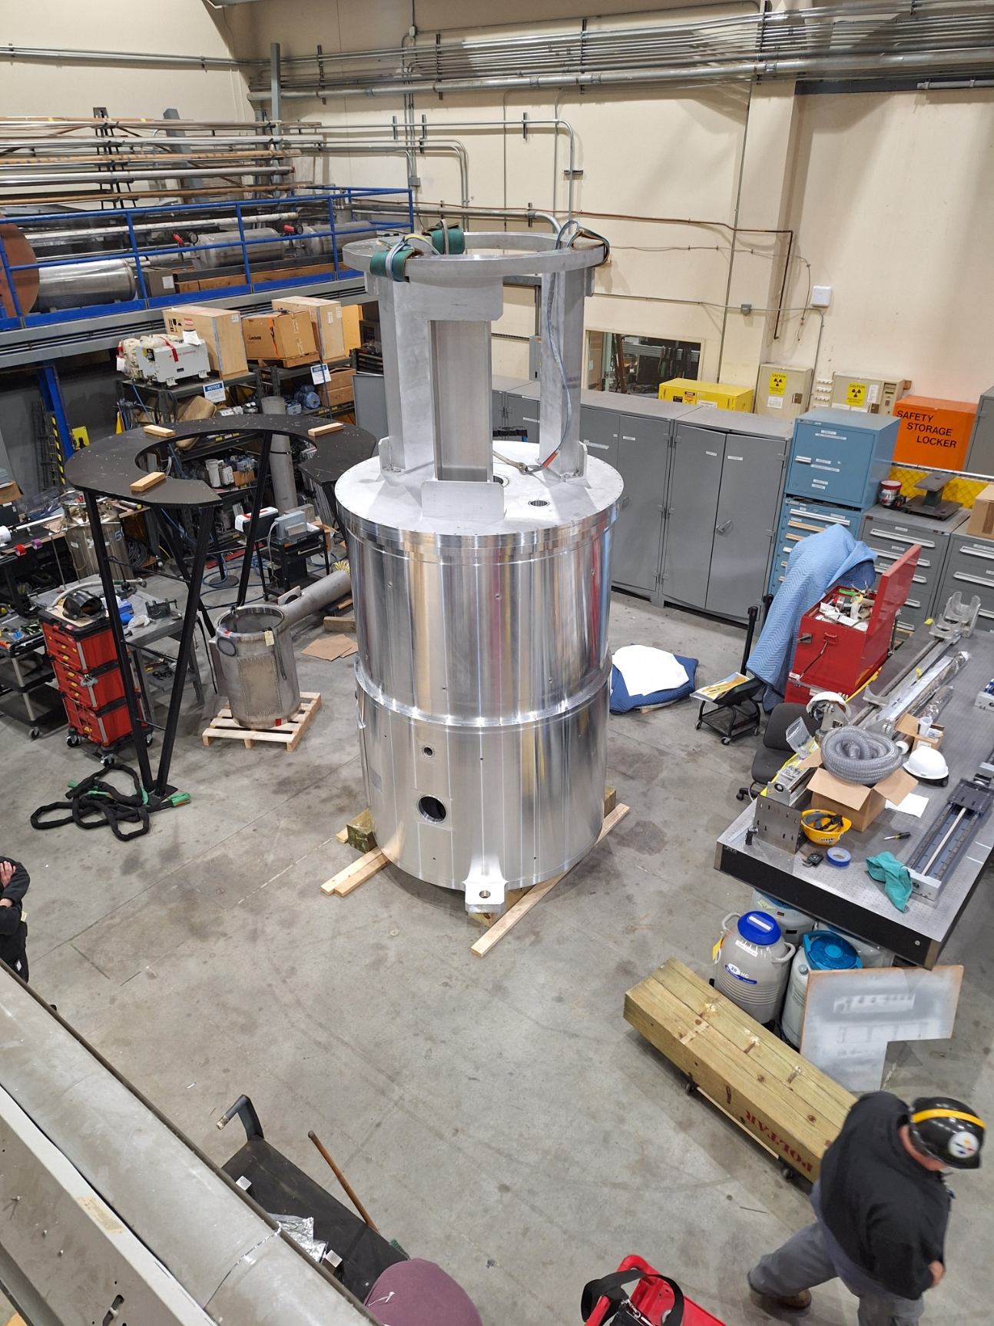
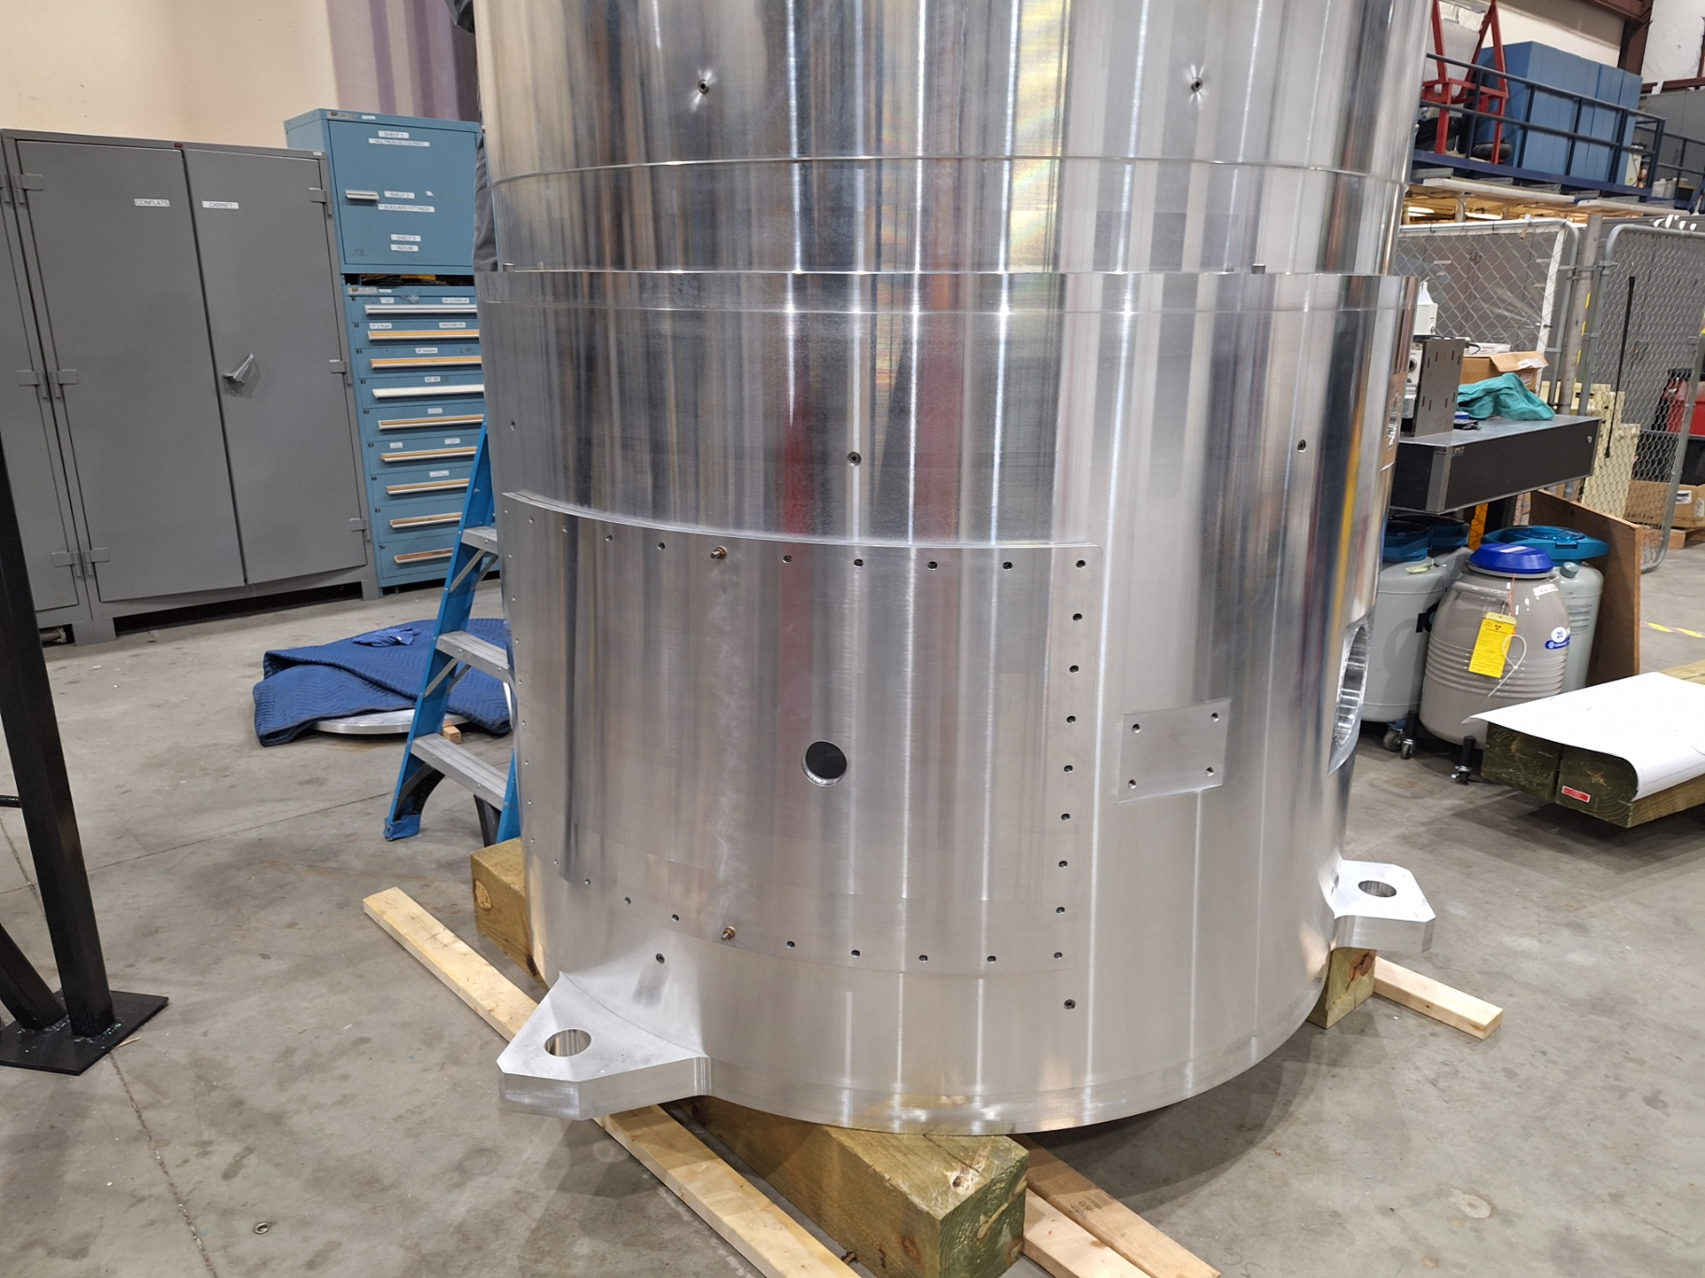
WBS1.02.02 Chamber Test Assembly
Scattering chamber test fit completed early January
Components have been re-crated for storage in Physics facility

Slide 12
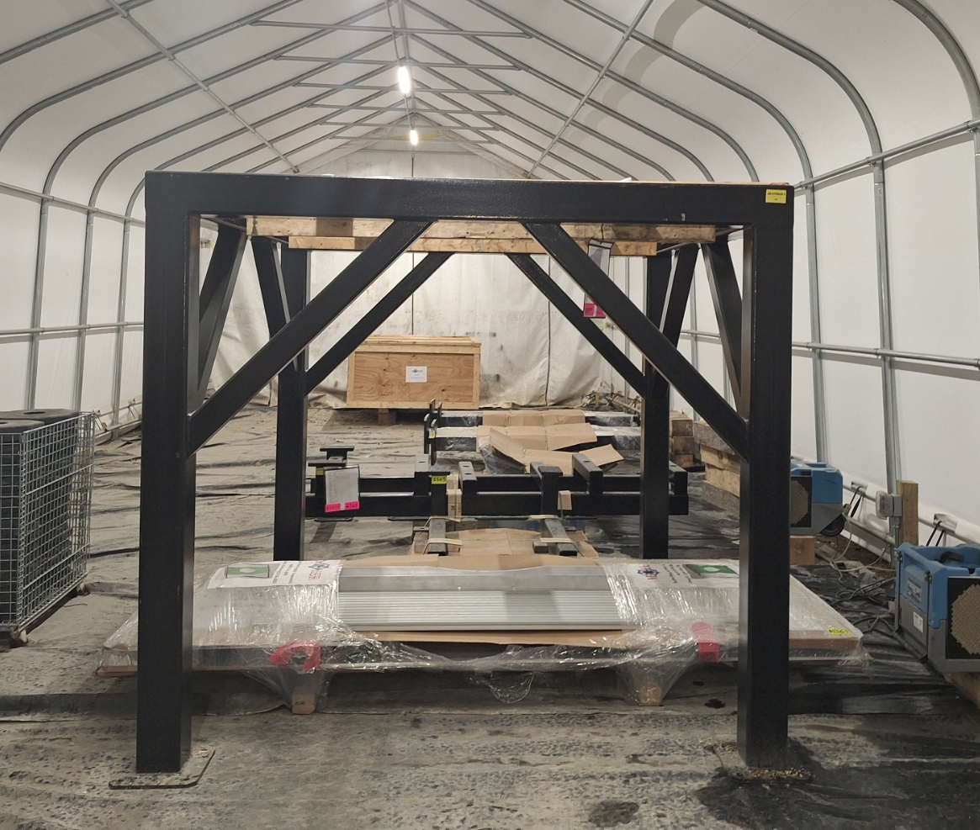
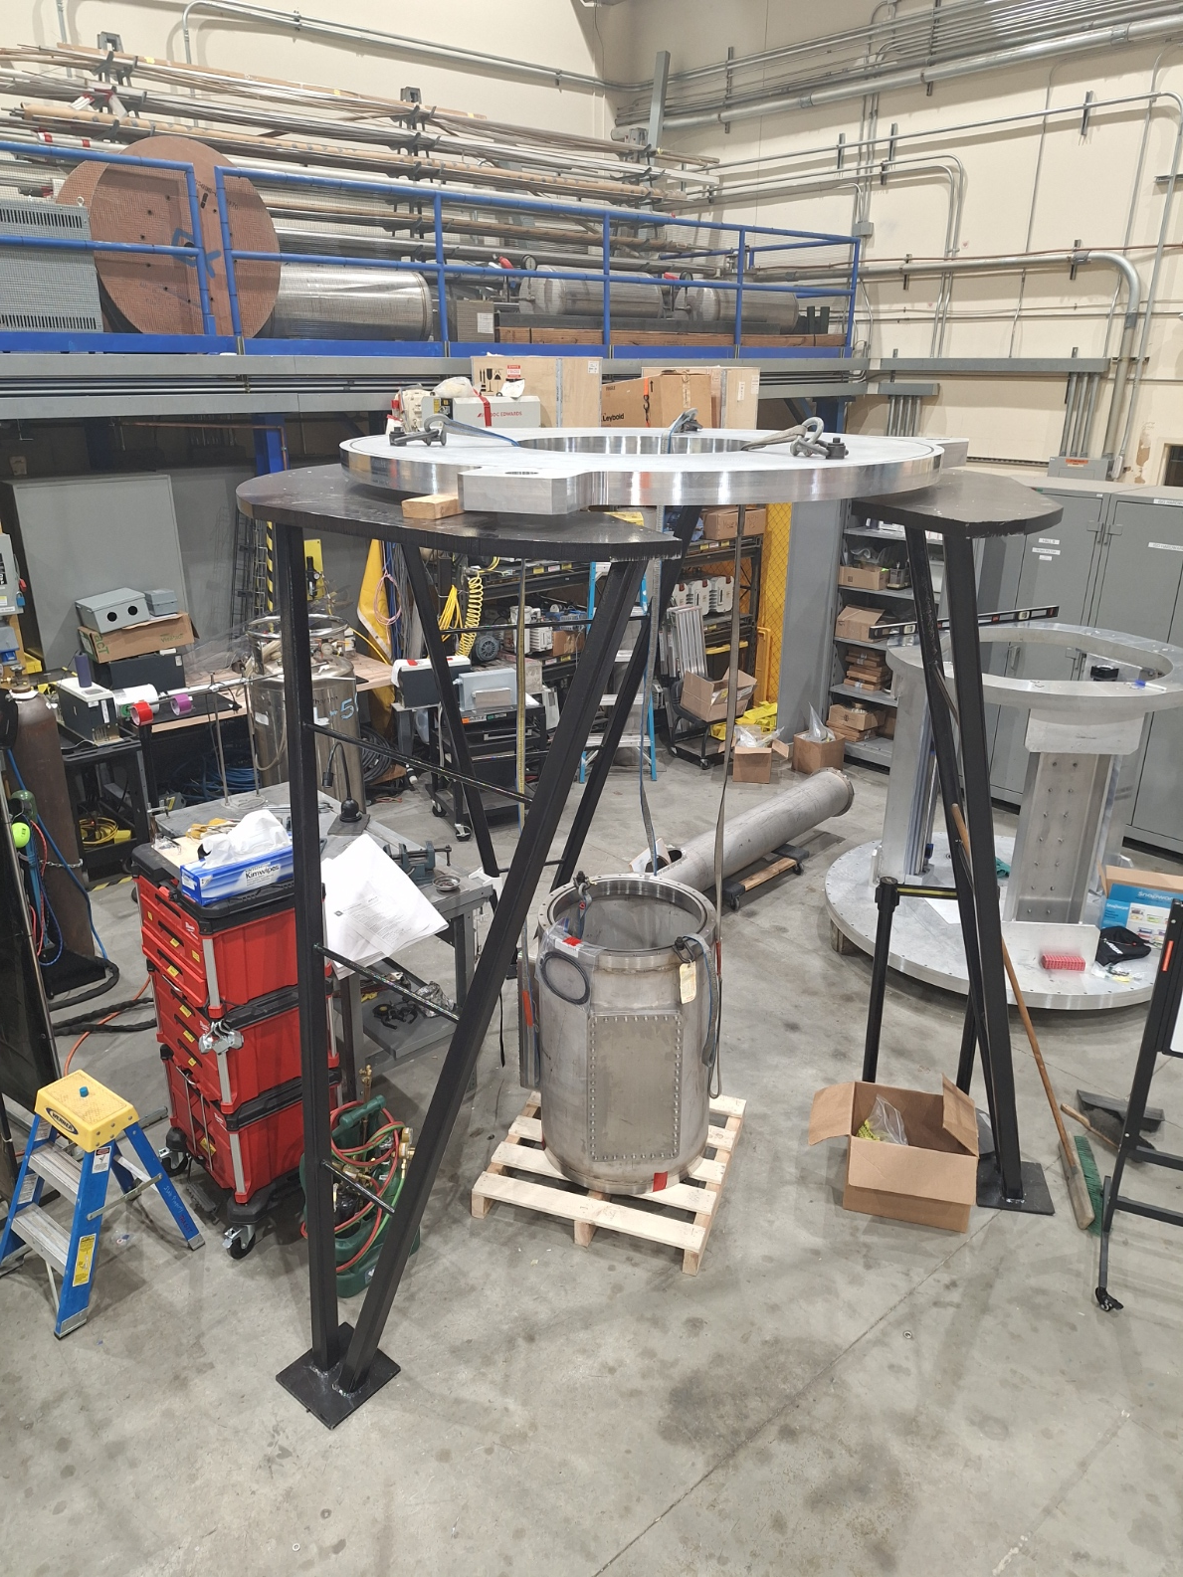
WBS 1.02.02 Stands
Work stand in use in EEL
Both stands have been completed
Hall/beamline stand in storage

Slide 13
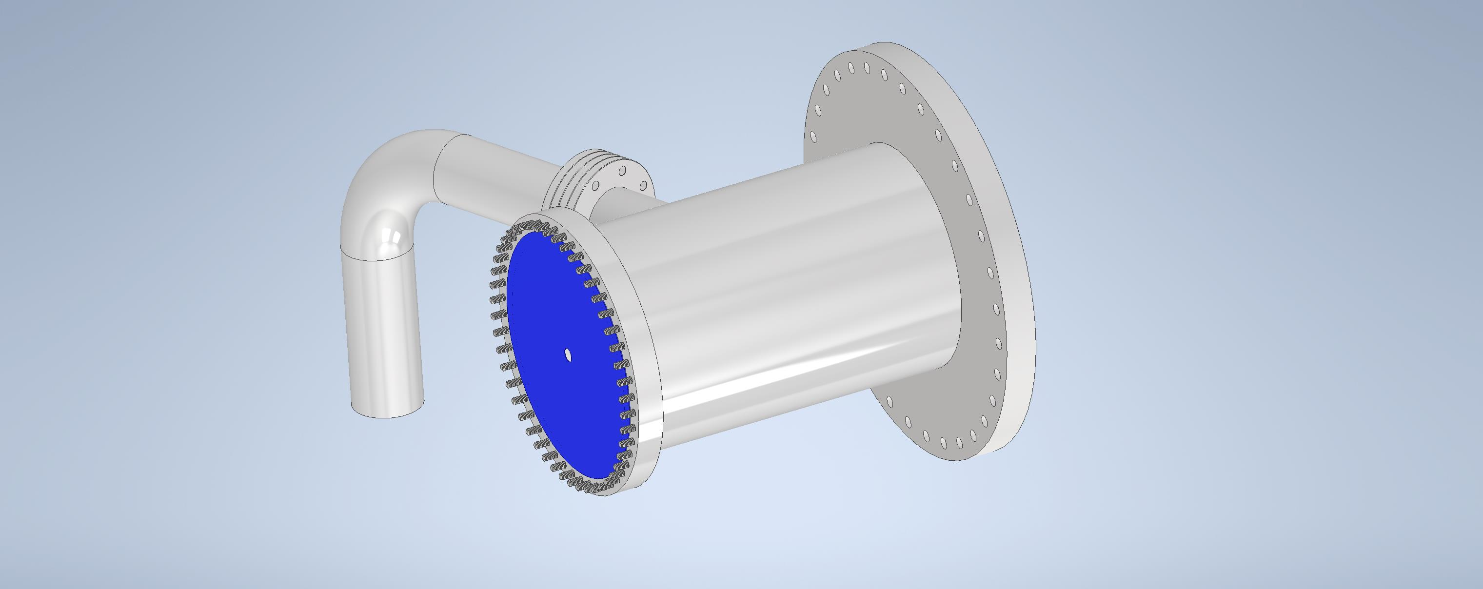
Differentially Pumped Region
System replaces vacuum separation window between Spectrometer and Target vacuum spaces.
Will allow for reduced background from aluminum -> improved physics
Will also enhance safety by eliminating the need for maintenance on the window and thereby reducing radiation exposure (ALARA – As Low as Reasonably Achievable).
Will fit into the designed space for the window and adapter and replace both components.
Simple orifice pair system with intermediate pump.
Pump exhausts for the diff-pump region and the spectrometer vacuum space must be connected to the H2 exhaust system.
There are no ignition sources in the spectrometer vacuum space all components are intrinsically safe for unexpected H2 exposure.

Slide 14
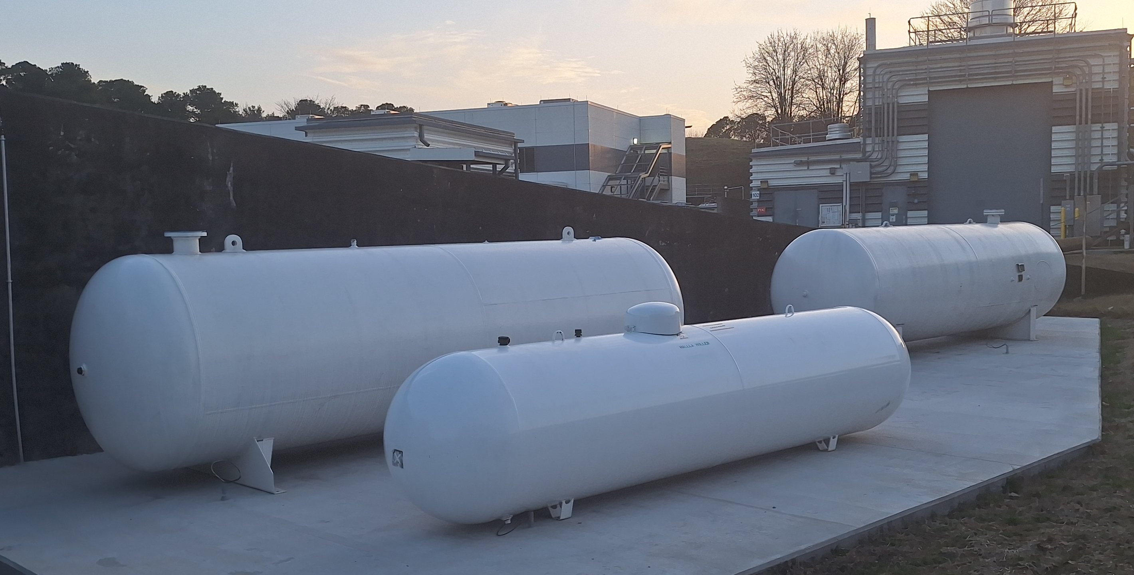
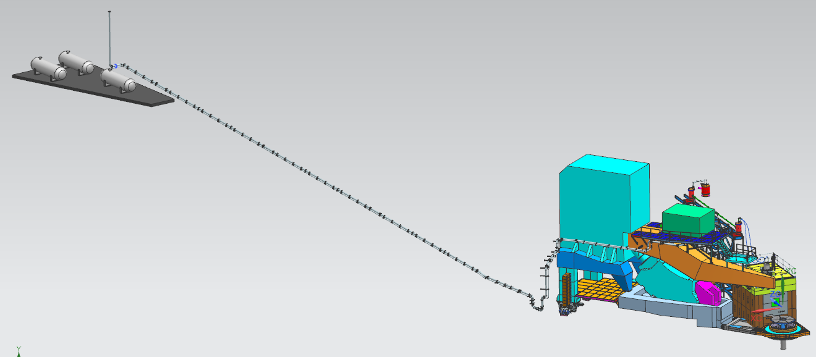
WBS 1.03 Hydrogen Gas Service
Gas Panel
H2 storage system
  Three ASME pressure vessels which provide 6000 liters of storage volume.
Supply/Return Piping
  Procurement process has started
Overpressure protection
  Procurement process has started
Exhaust system and vent
  Procurement process has started
Constructed to B31.12 and VIII
Vent to NFPA 2 and CGA G5.5
External Storage
6000 gal and Stack
Route thru Spectrometer
Ramp
Piping

Slide 15
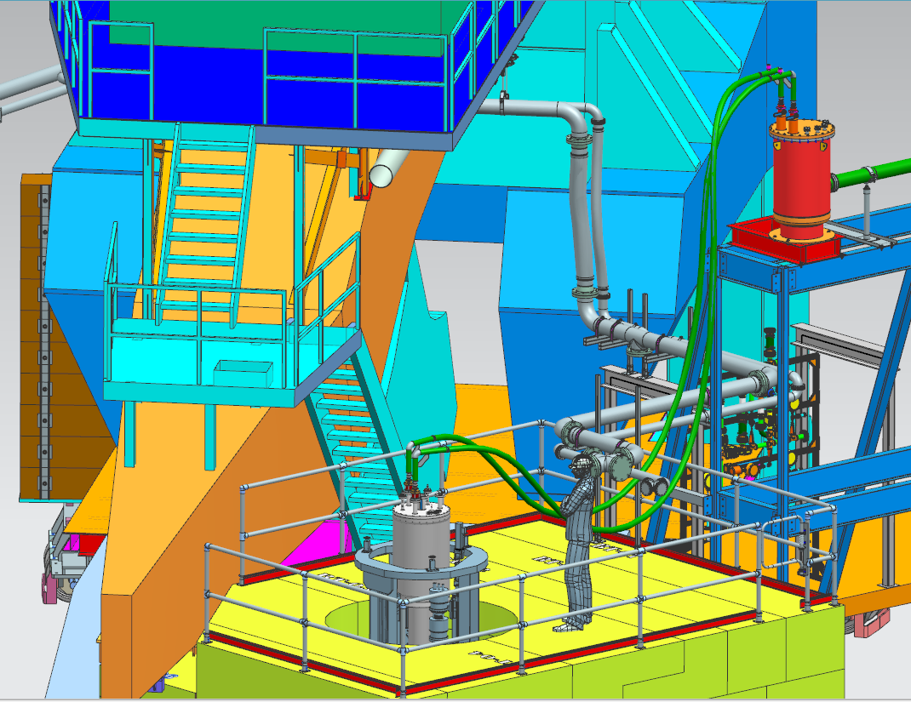
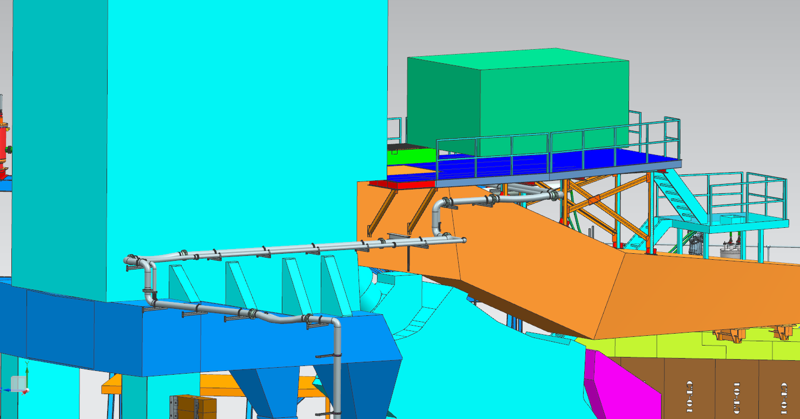
WBS 1.02.03 Hydrogen Gas Service
Final design is complete but piping sections will need to be field fit.
Gas Panel
Details at Top
of TGT
Details thru Spectrometer

Slide 16
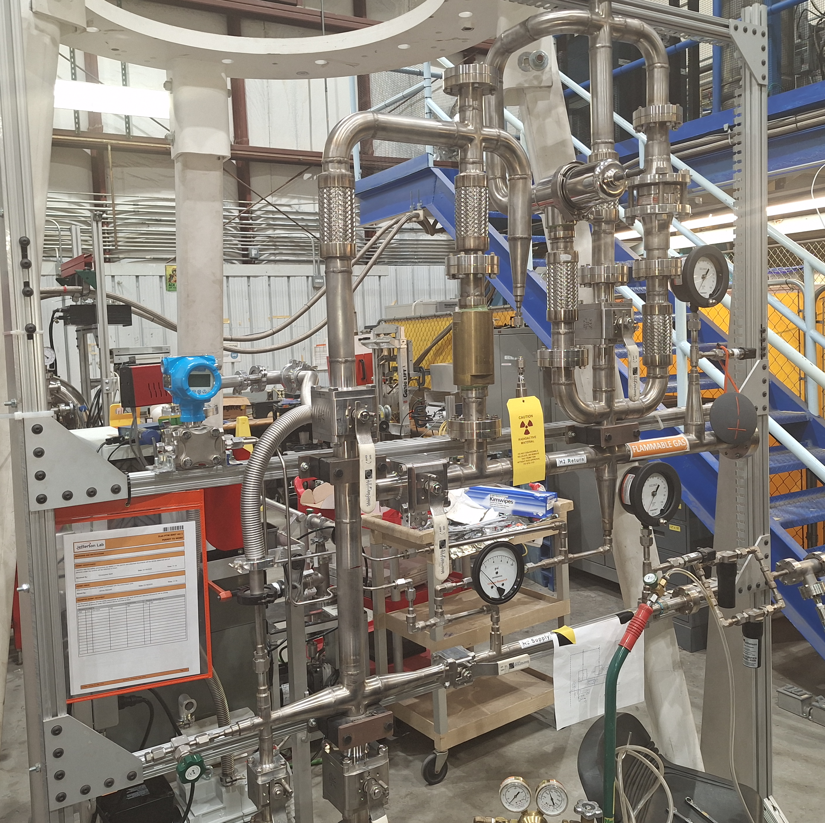
Gas Panel
Functions of the gas panel
  Provide means to monitor pressure at high and low side of pump (~3.5 psi difference is expected)
  Provide process relief during warmup and reasonable failure modes
  Provides system purification functions
  Fill and blow down operations
Gas panel is the refurbished Qweak panel and was completely rebuilt.
  New valve seats, gauges, PTs, etc.
  Leak test passed 3/6/2025
Calibrations
  Pressure gauges are factory calibrated prior to installation
  PTs are calibrated to the pressure gauges at the start of run periods

Slide 17
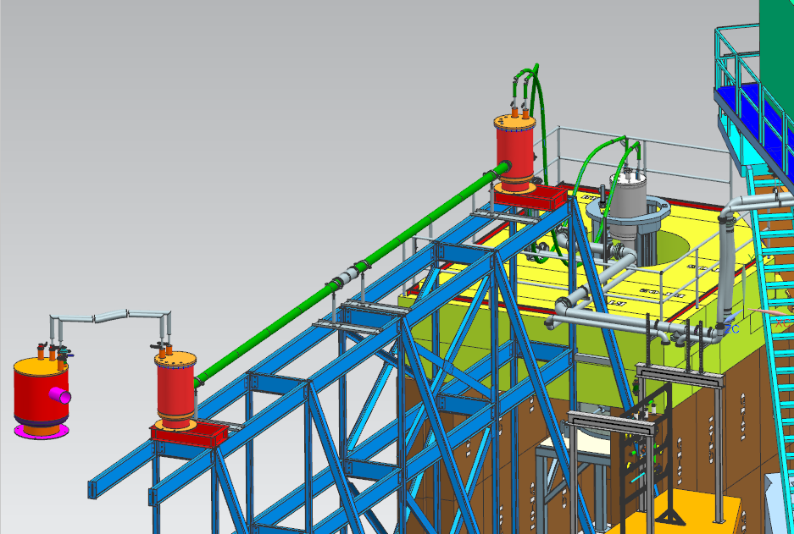
WBS 1.02.04 Helium Gas Service
The He gas service provides cold helium from the ESRII to the target to remove heat generated by multiple processes.
The He system has three main components
  Cryostat at the top of the target to interface the ESRII to the target
  Flexible transfer lines that can accommodate the motion
  Distribution system to transfer He from the ESR can to a location near the target.
The existing system in Hall A does not meet the needs for MOLLER must be removed.
Only 12-15K gas is needed
New distribution system
  Added to WBS 1.02.04 in FY23
  Fabrication by JLAB SRF group is nearly complete
New transfer lines
  T-lines are complete and tested
T-lines
Target Cryostat
Distribution System

Slide 18
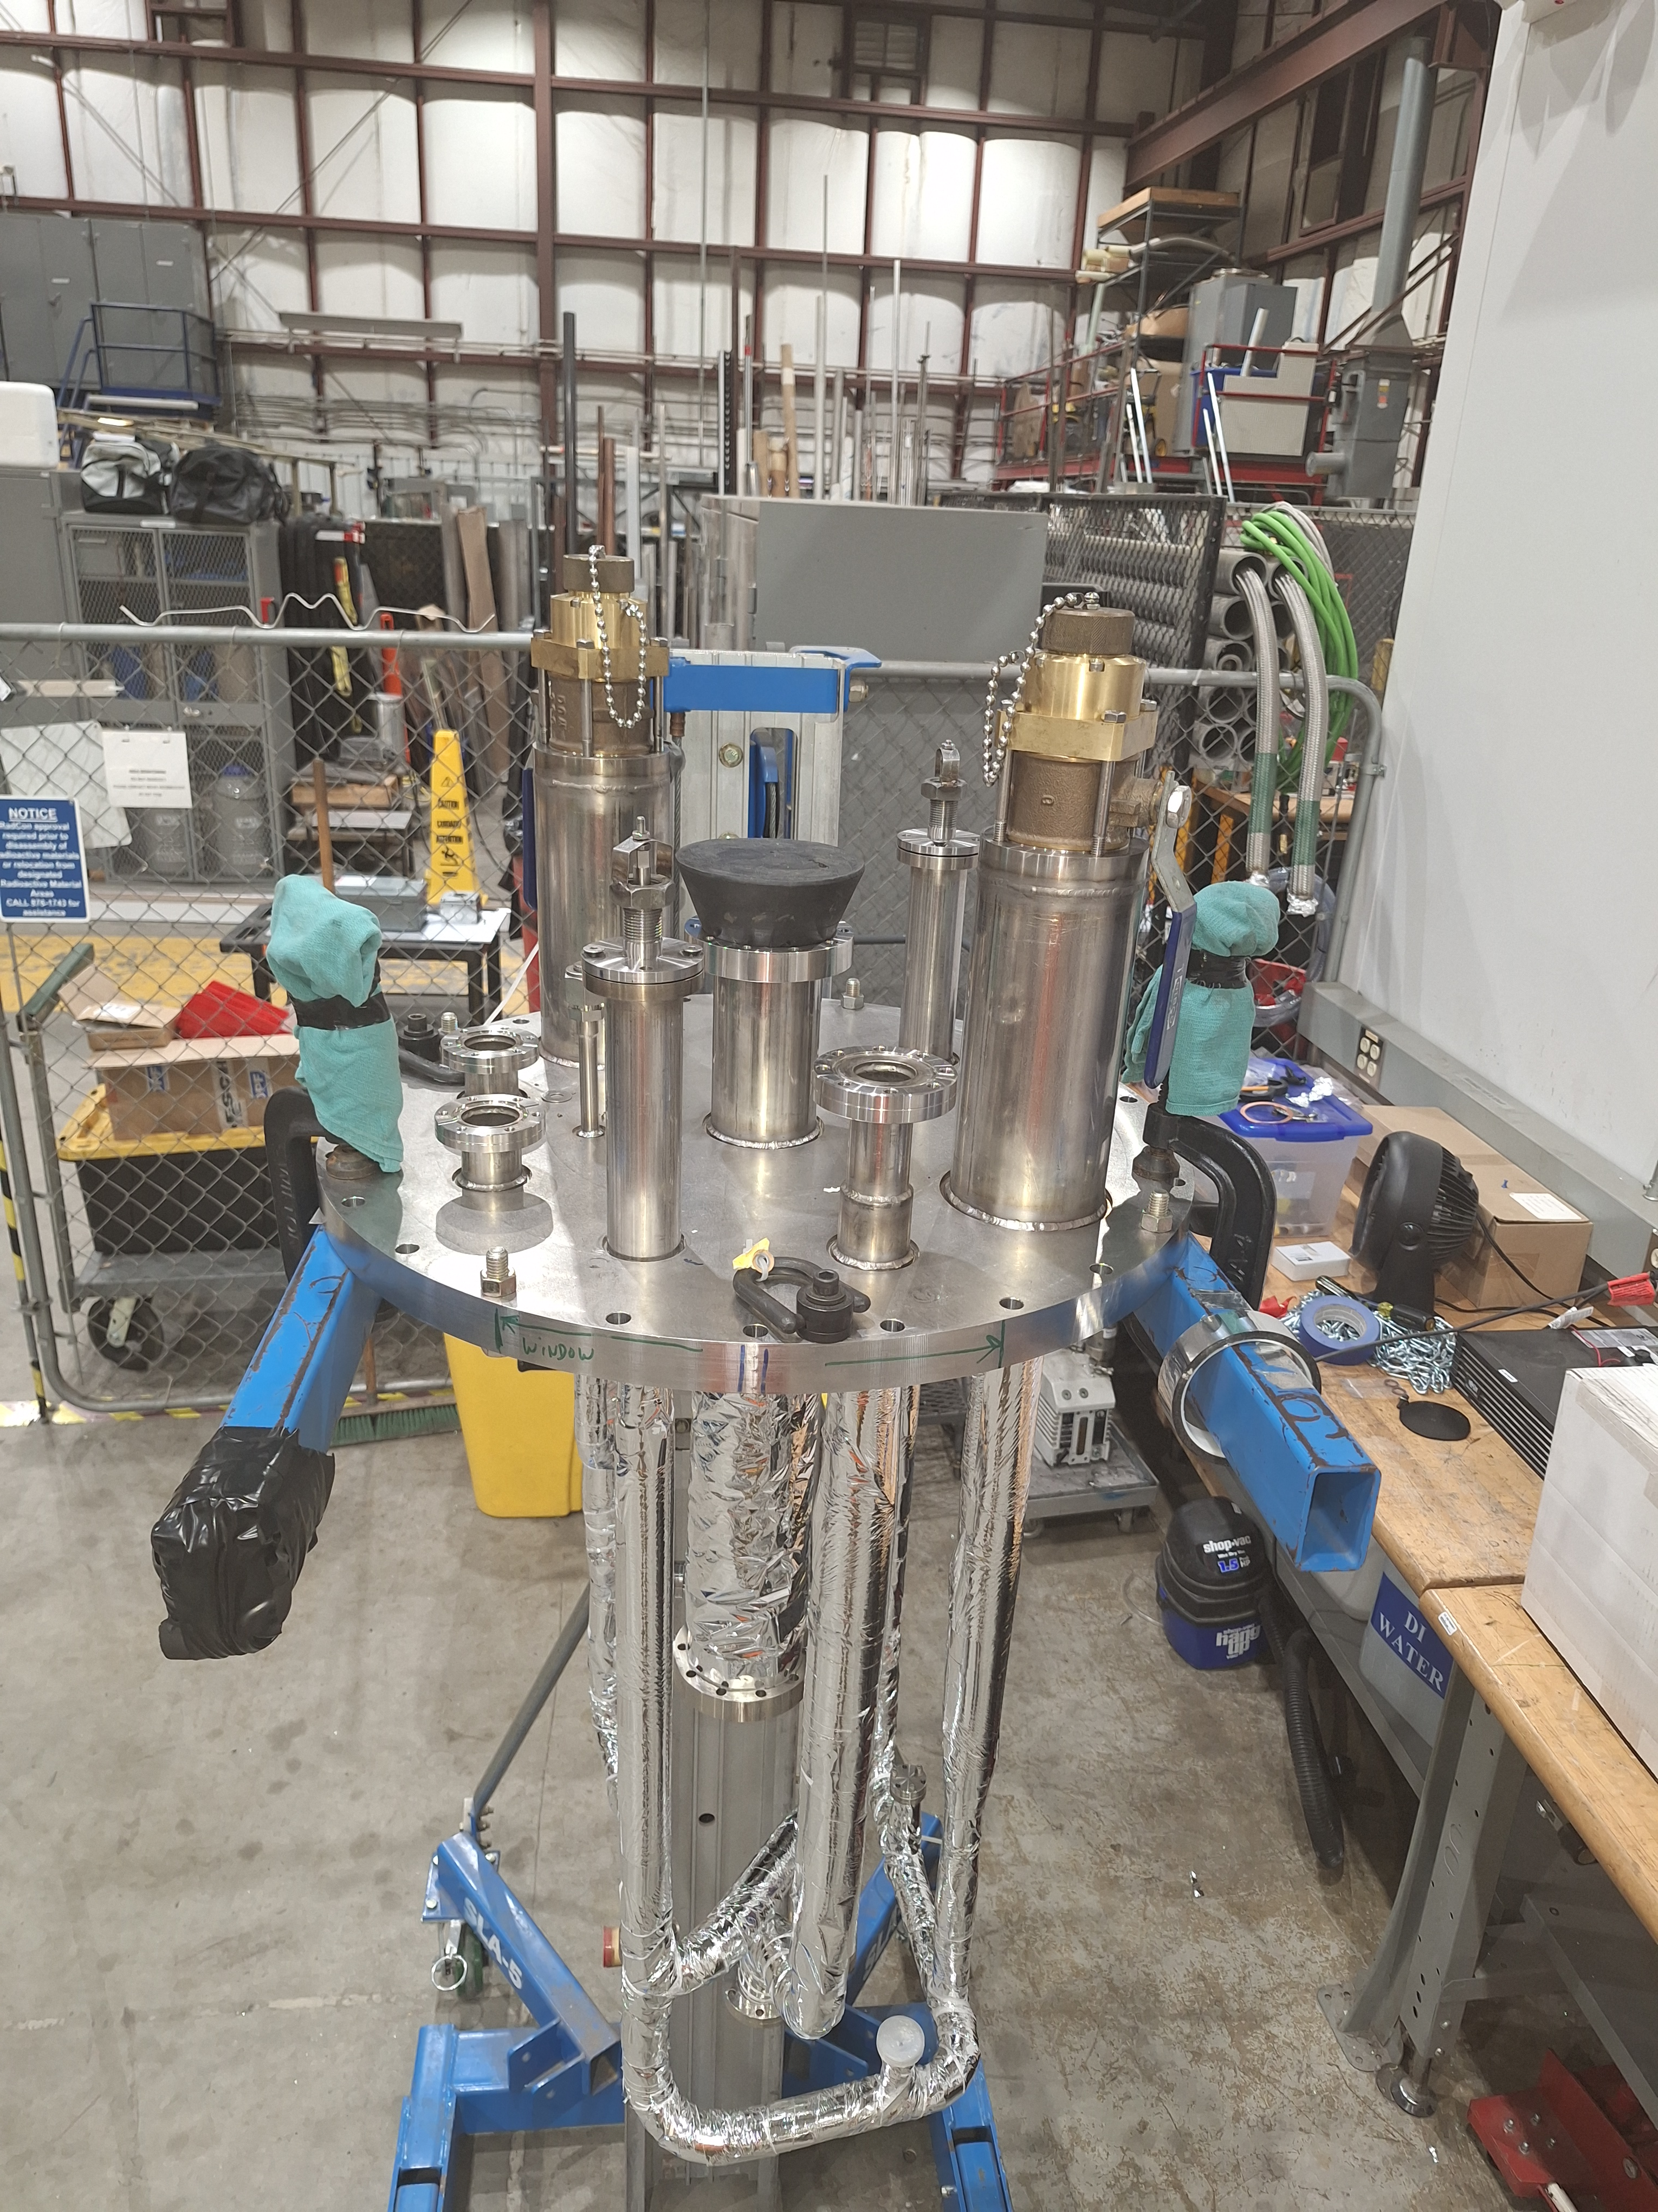
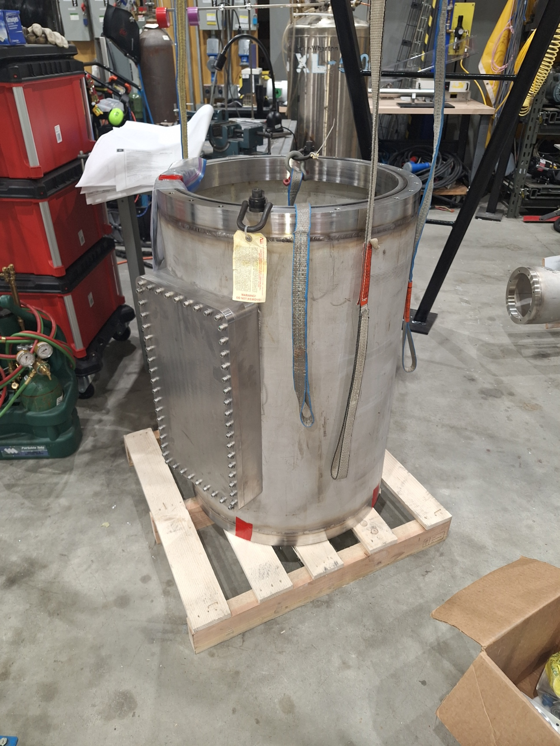
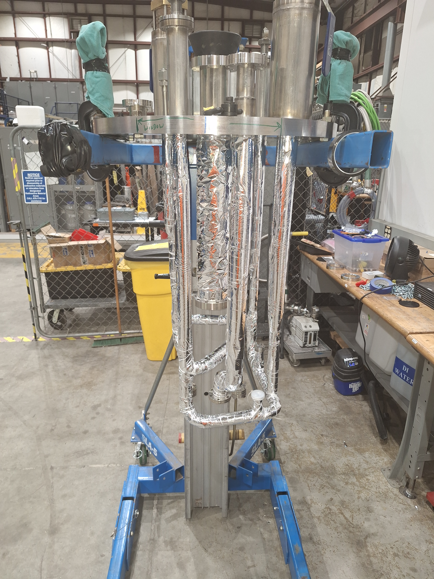
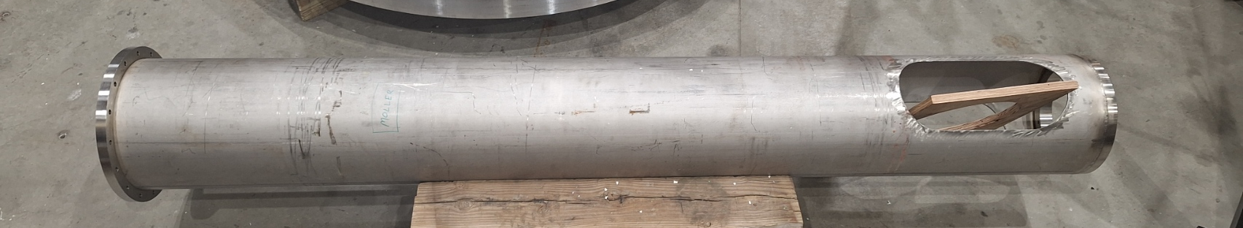
Completed Cryostat Components
Components have been test fit. Disassembled for fit-up with lifter components.

Slide 19
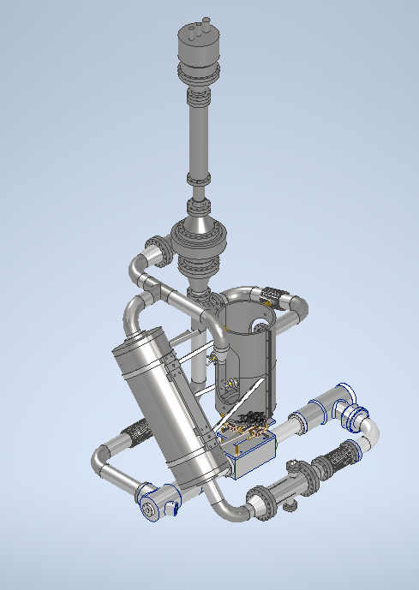
WBS 1.02.05 Target Loop
Hung from main support pipe
Major components
  Heat exchanger
  5 kW Heater
  Cell
  Pump (rework small part of design based on lessons learned in prototype testing)
  Instrumentation (thermometers)
  Solid target (not shown) are complete
Loop is connected to H2 and He services thru the cryostat
Thermally isolated from atmosphere
Cell flow space has been designed with extensive CFD (S. Covrig-Dusa)
Loop components are “bolt on”. Components can be replaced without cutting/welding-ALARA
PUMP
MOTOR
PUMP
HX
HEATER
BEAM
CELL

Slide 20
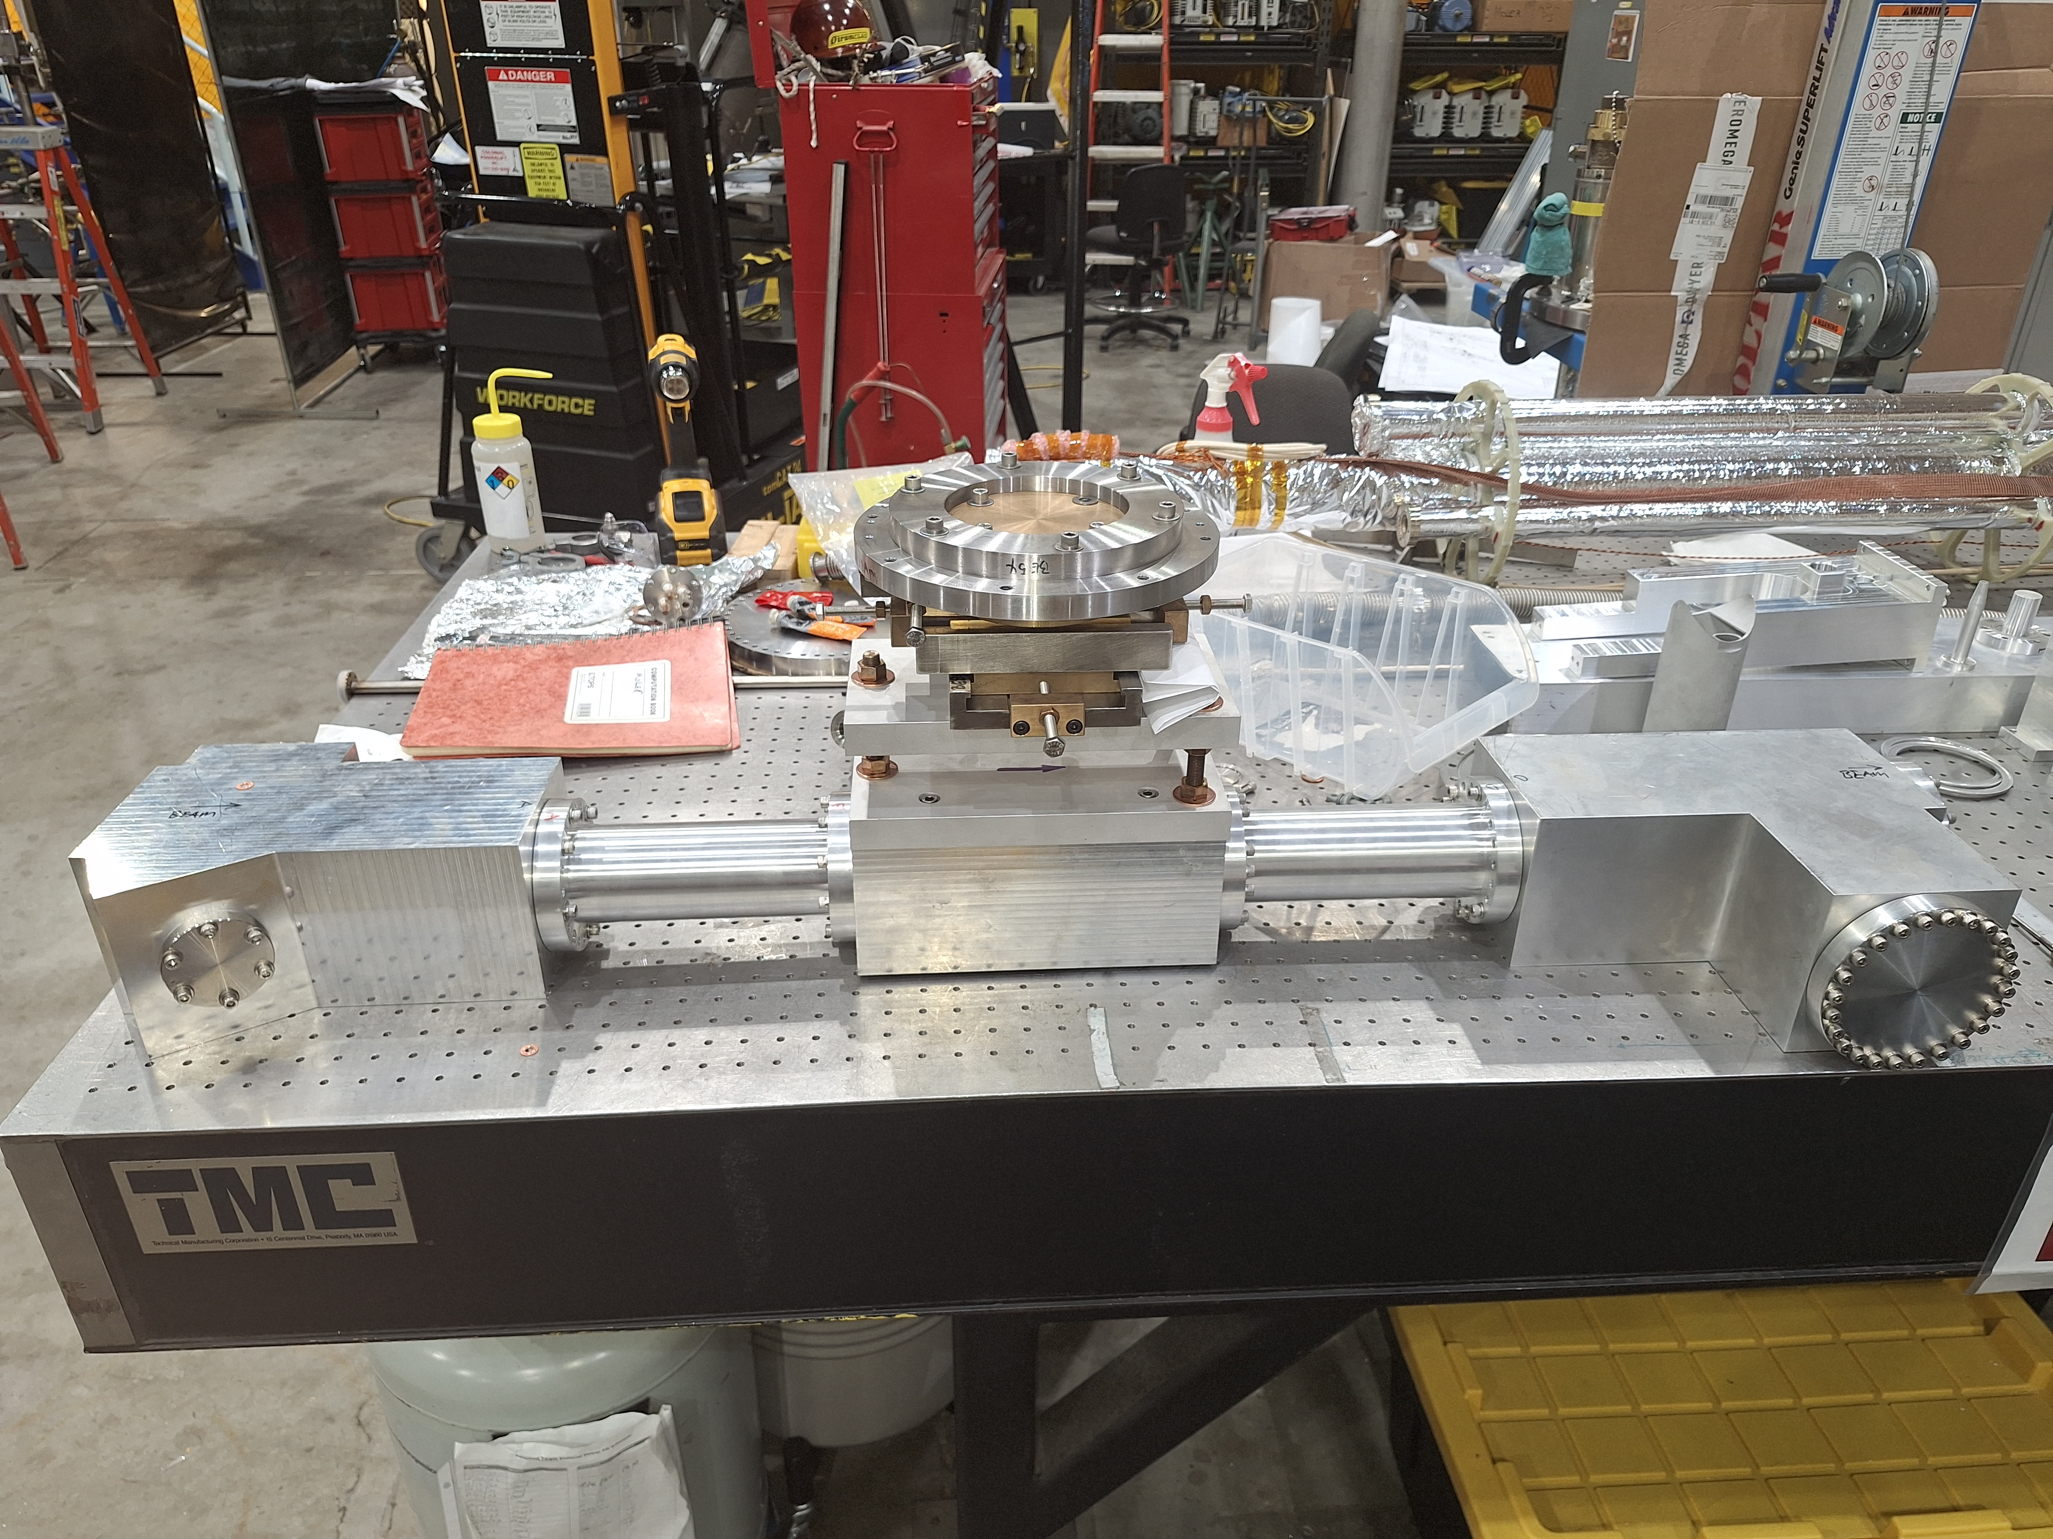
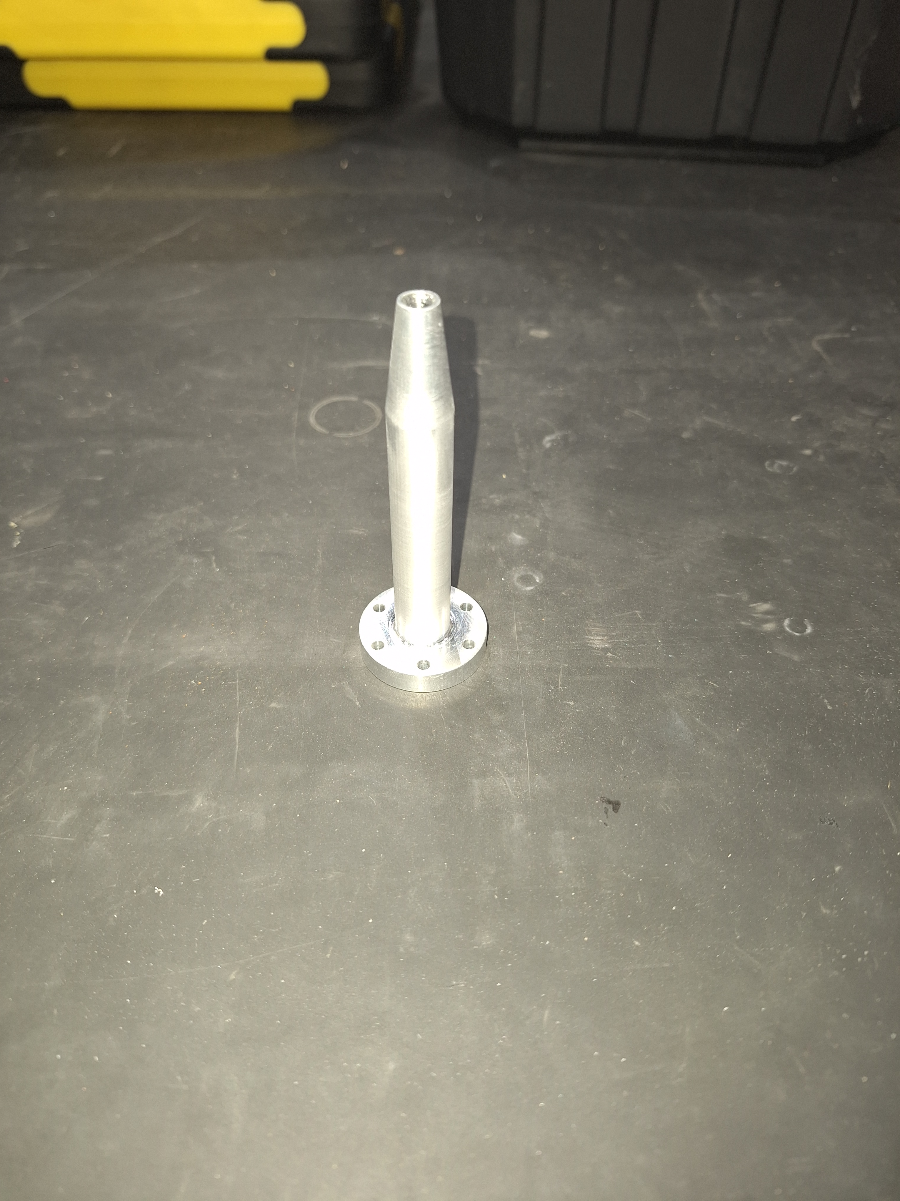
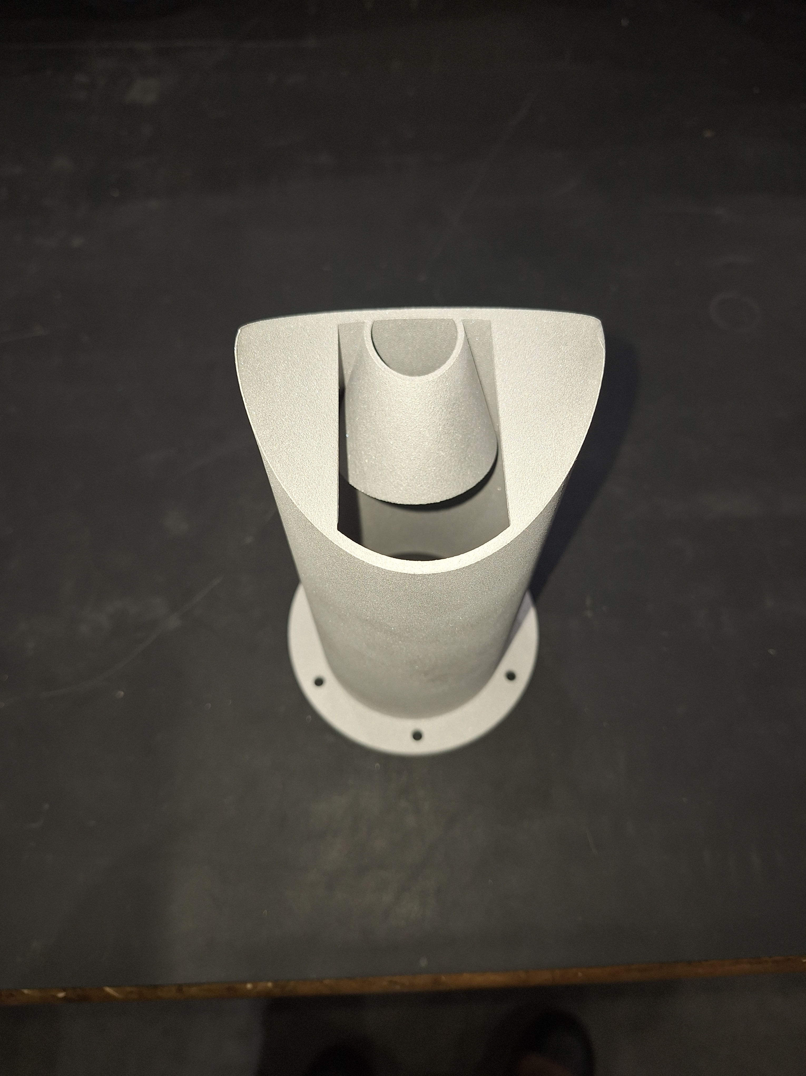
Target Cell
Target cell fabrication and testing is complete, Test fit up is complete.
Fabricated from B209 Al7075-T651 No welding is required
All joints are CF with Ti hardware
Extensive experience with AL CF joints
  Gaskets 1100-O
  0.120” instead of 0.08” for cold joints
  Leak tight < 10^-11 mbar l/s helium in reverse mode at pressure and at 20K
Design pressure 100 psi.
  All components meet or exceed this requirement.
Fit up for loop piping fabrication is in process
Cell Positioning System
Entrance window flow diverter
Exit window flow diverter

Slide 21
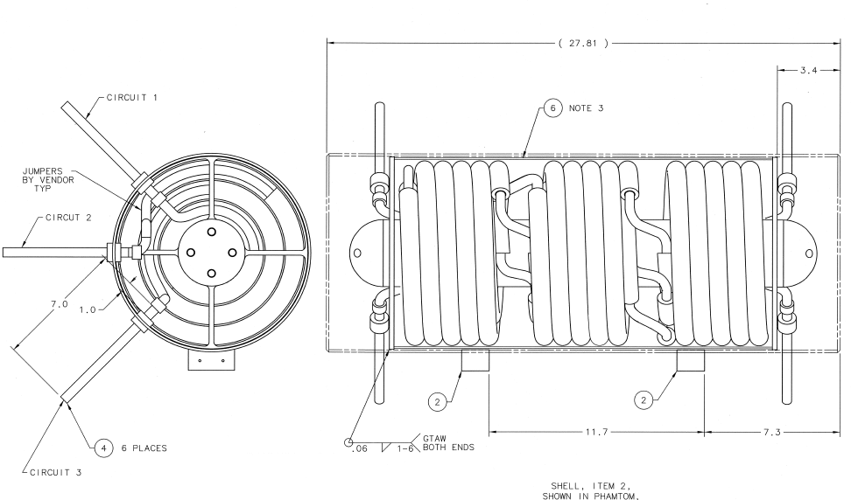
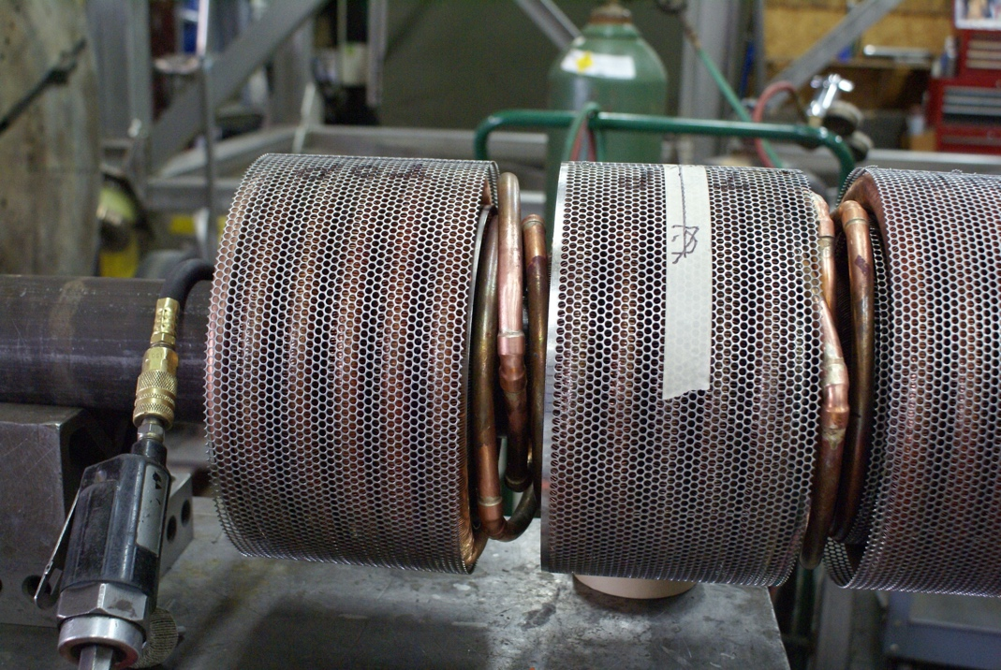
WBS 1.02.05 Target Loop
Heat Exchanger
Design is fully complete
  Reusing Qweak HX
  Calculations are complete and show almost 2x larger than needed
Can remove 5kW with comfortable margin
ESRII (2020)
  11.7 K inlet 19 K outlet
  15 atm supply 3.8 return
  85 g/s

Slide 22
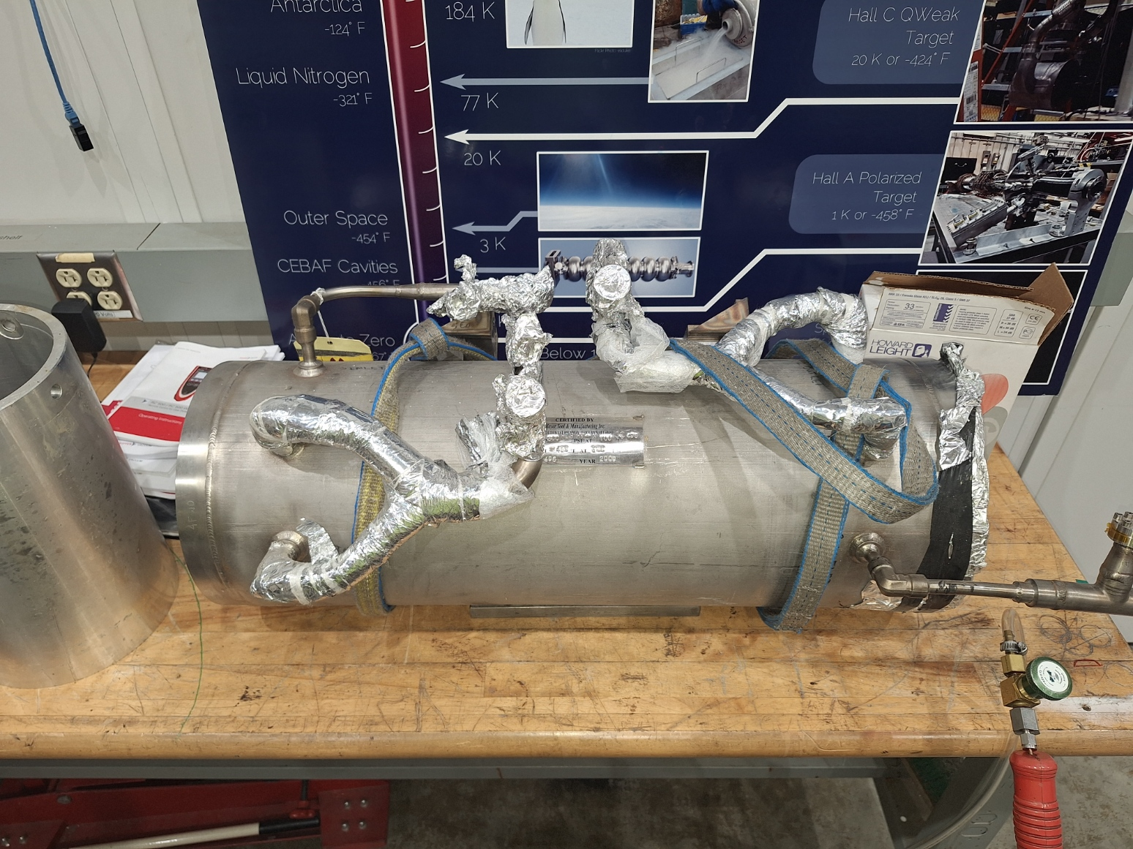
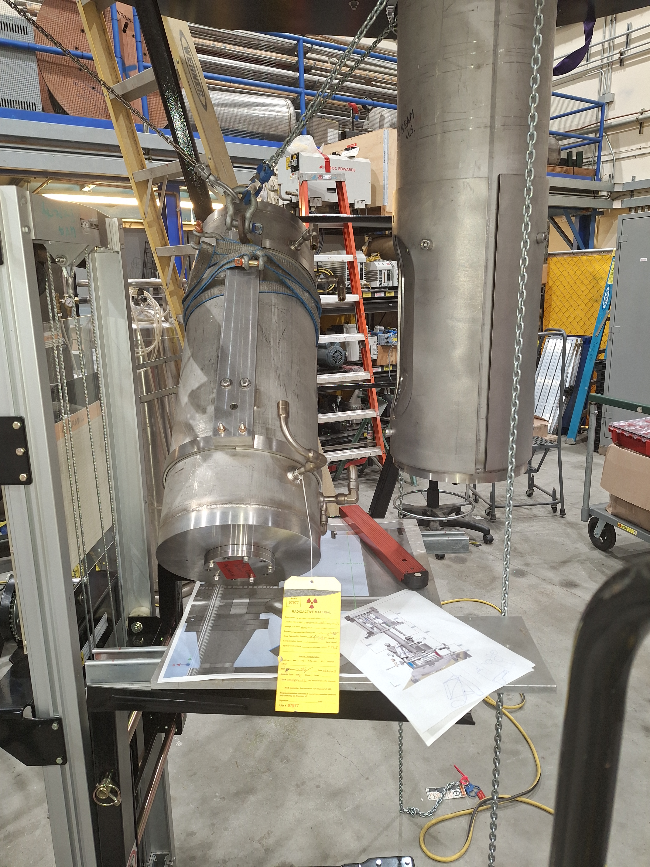
WBS 1.02.05 Target Loop
Heat Exchanger
Heat exchanger fabrication is complete
  Reuse Qweak HX
Leak testing is complete.
  Visible examination indicates that the HX is in excellent condition.
  Full leak test at 110% of design pressure showed no leaks to better than 10^-10.
HX installation is in process.

Slide 23
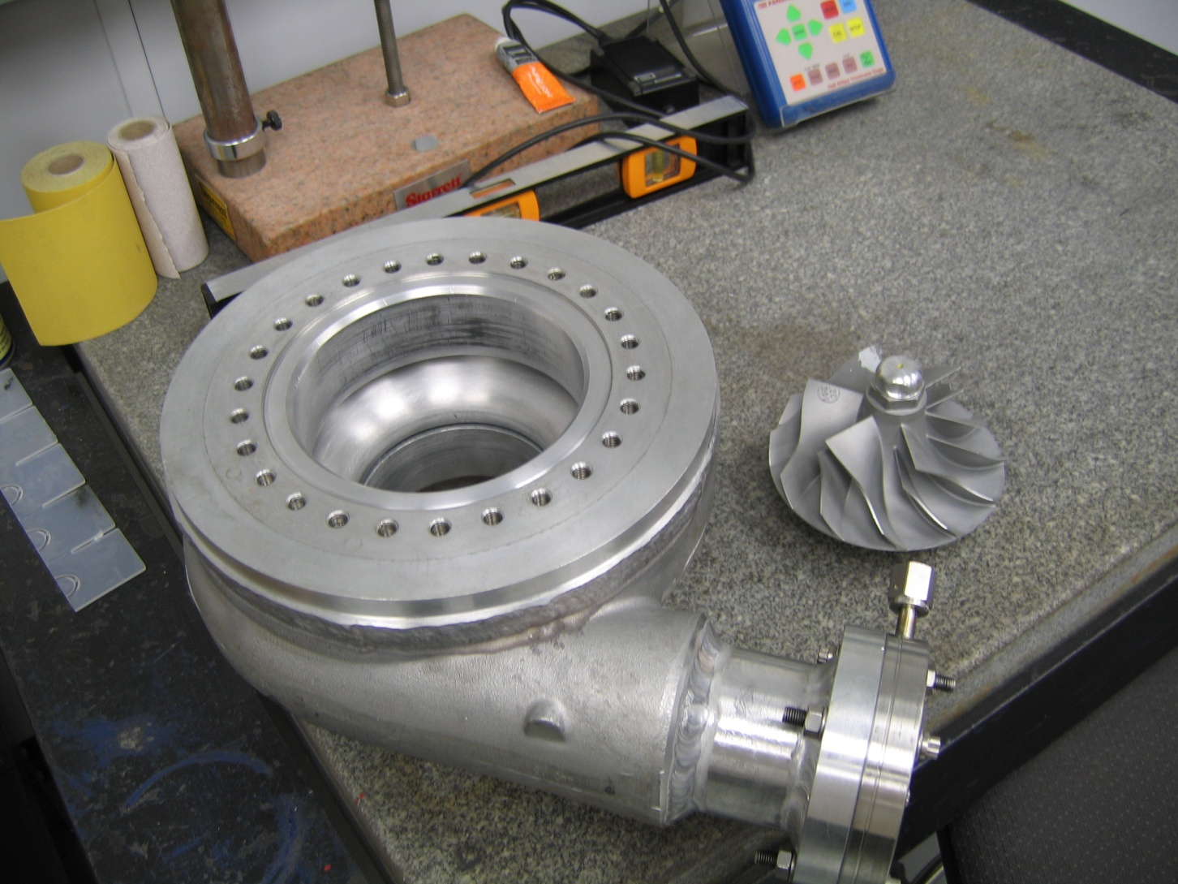
LH2 Pump
Same design for Qweak but will run 1.6 x faster
Impeller: Turbonetics “Thumper” modified slightly
  More commonly comp wheel
Case
  E-Garret turbo
Impeller and case have complimentary dimensions
Case modified to have CF flange seals
Impeller balanced at Turbonetics
  Typical shaft speeds 10000 rpm

Slide 24
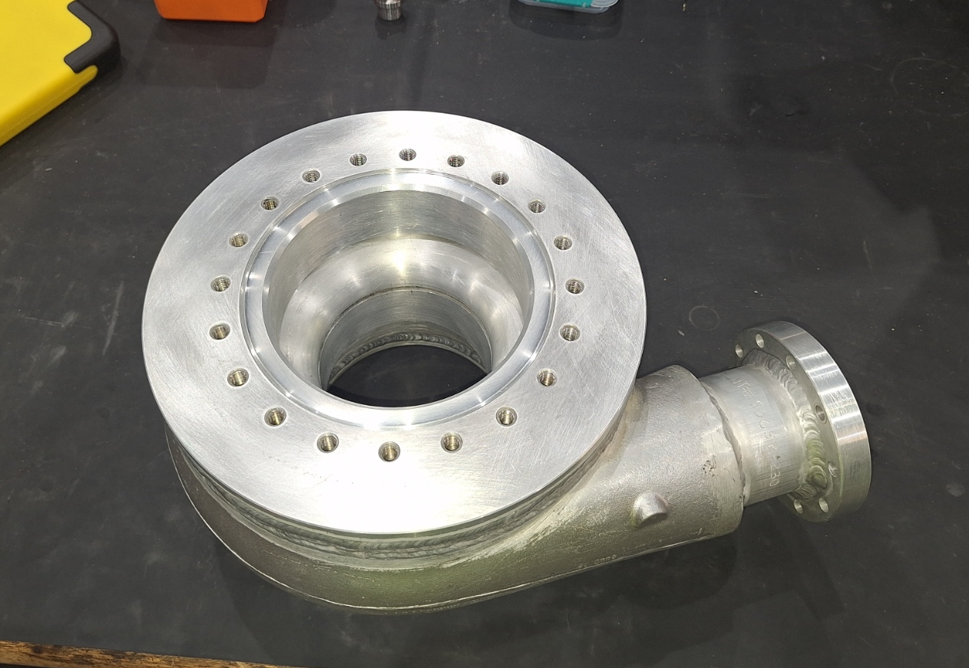
Pump Case (Volute)
Target Loop
Pump Case is complete
  Multistep process for machine/welding
Leak testing is complete.
Pump back flange is complete
Note: The only component on the pump assembly that is needed for loop piping fit-up is the pump case.
The pump case is ready for integration with loop piping.
In process of dry fit/testing of pump and shaft.

Slide 25
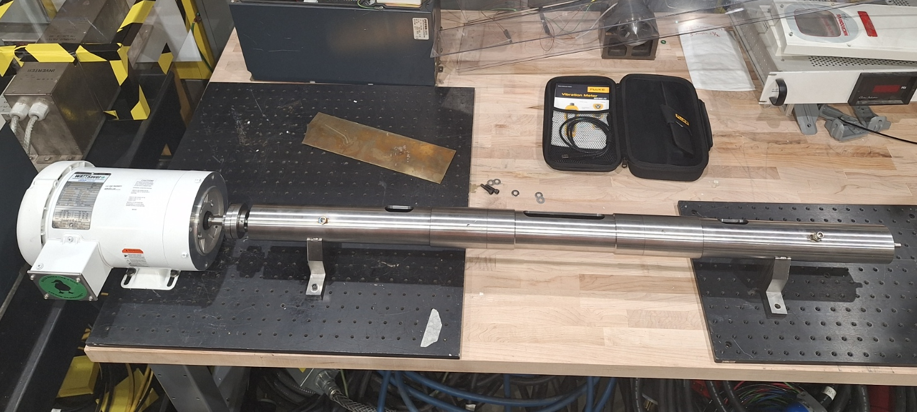
Pump Shaft Testing
Target Loop
Prototype Shaft Testing
Investigate fabrication strategy and vibration
Measured typical vibrations
  0.11 g
  9 microns amplitude
Lessons learned
  Shaft to case flange redesigned (more simple) Fabrication underway.
  Inner shaft and bearing design is acceptable
  Outer shaft has been redesigned (simplified). Fabrication underway.
Re-Design process and procurements have been completed

Slide 26
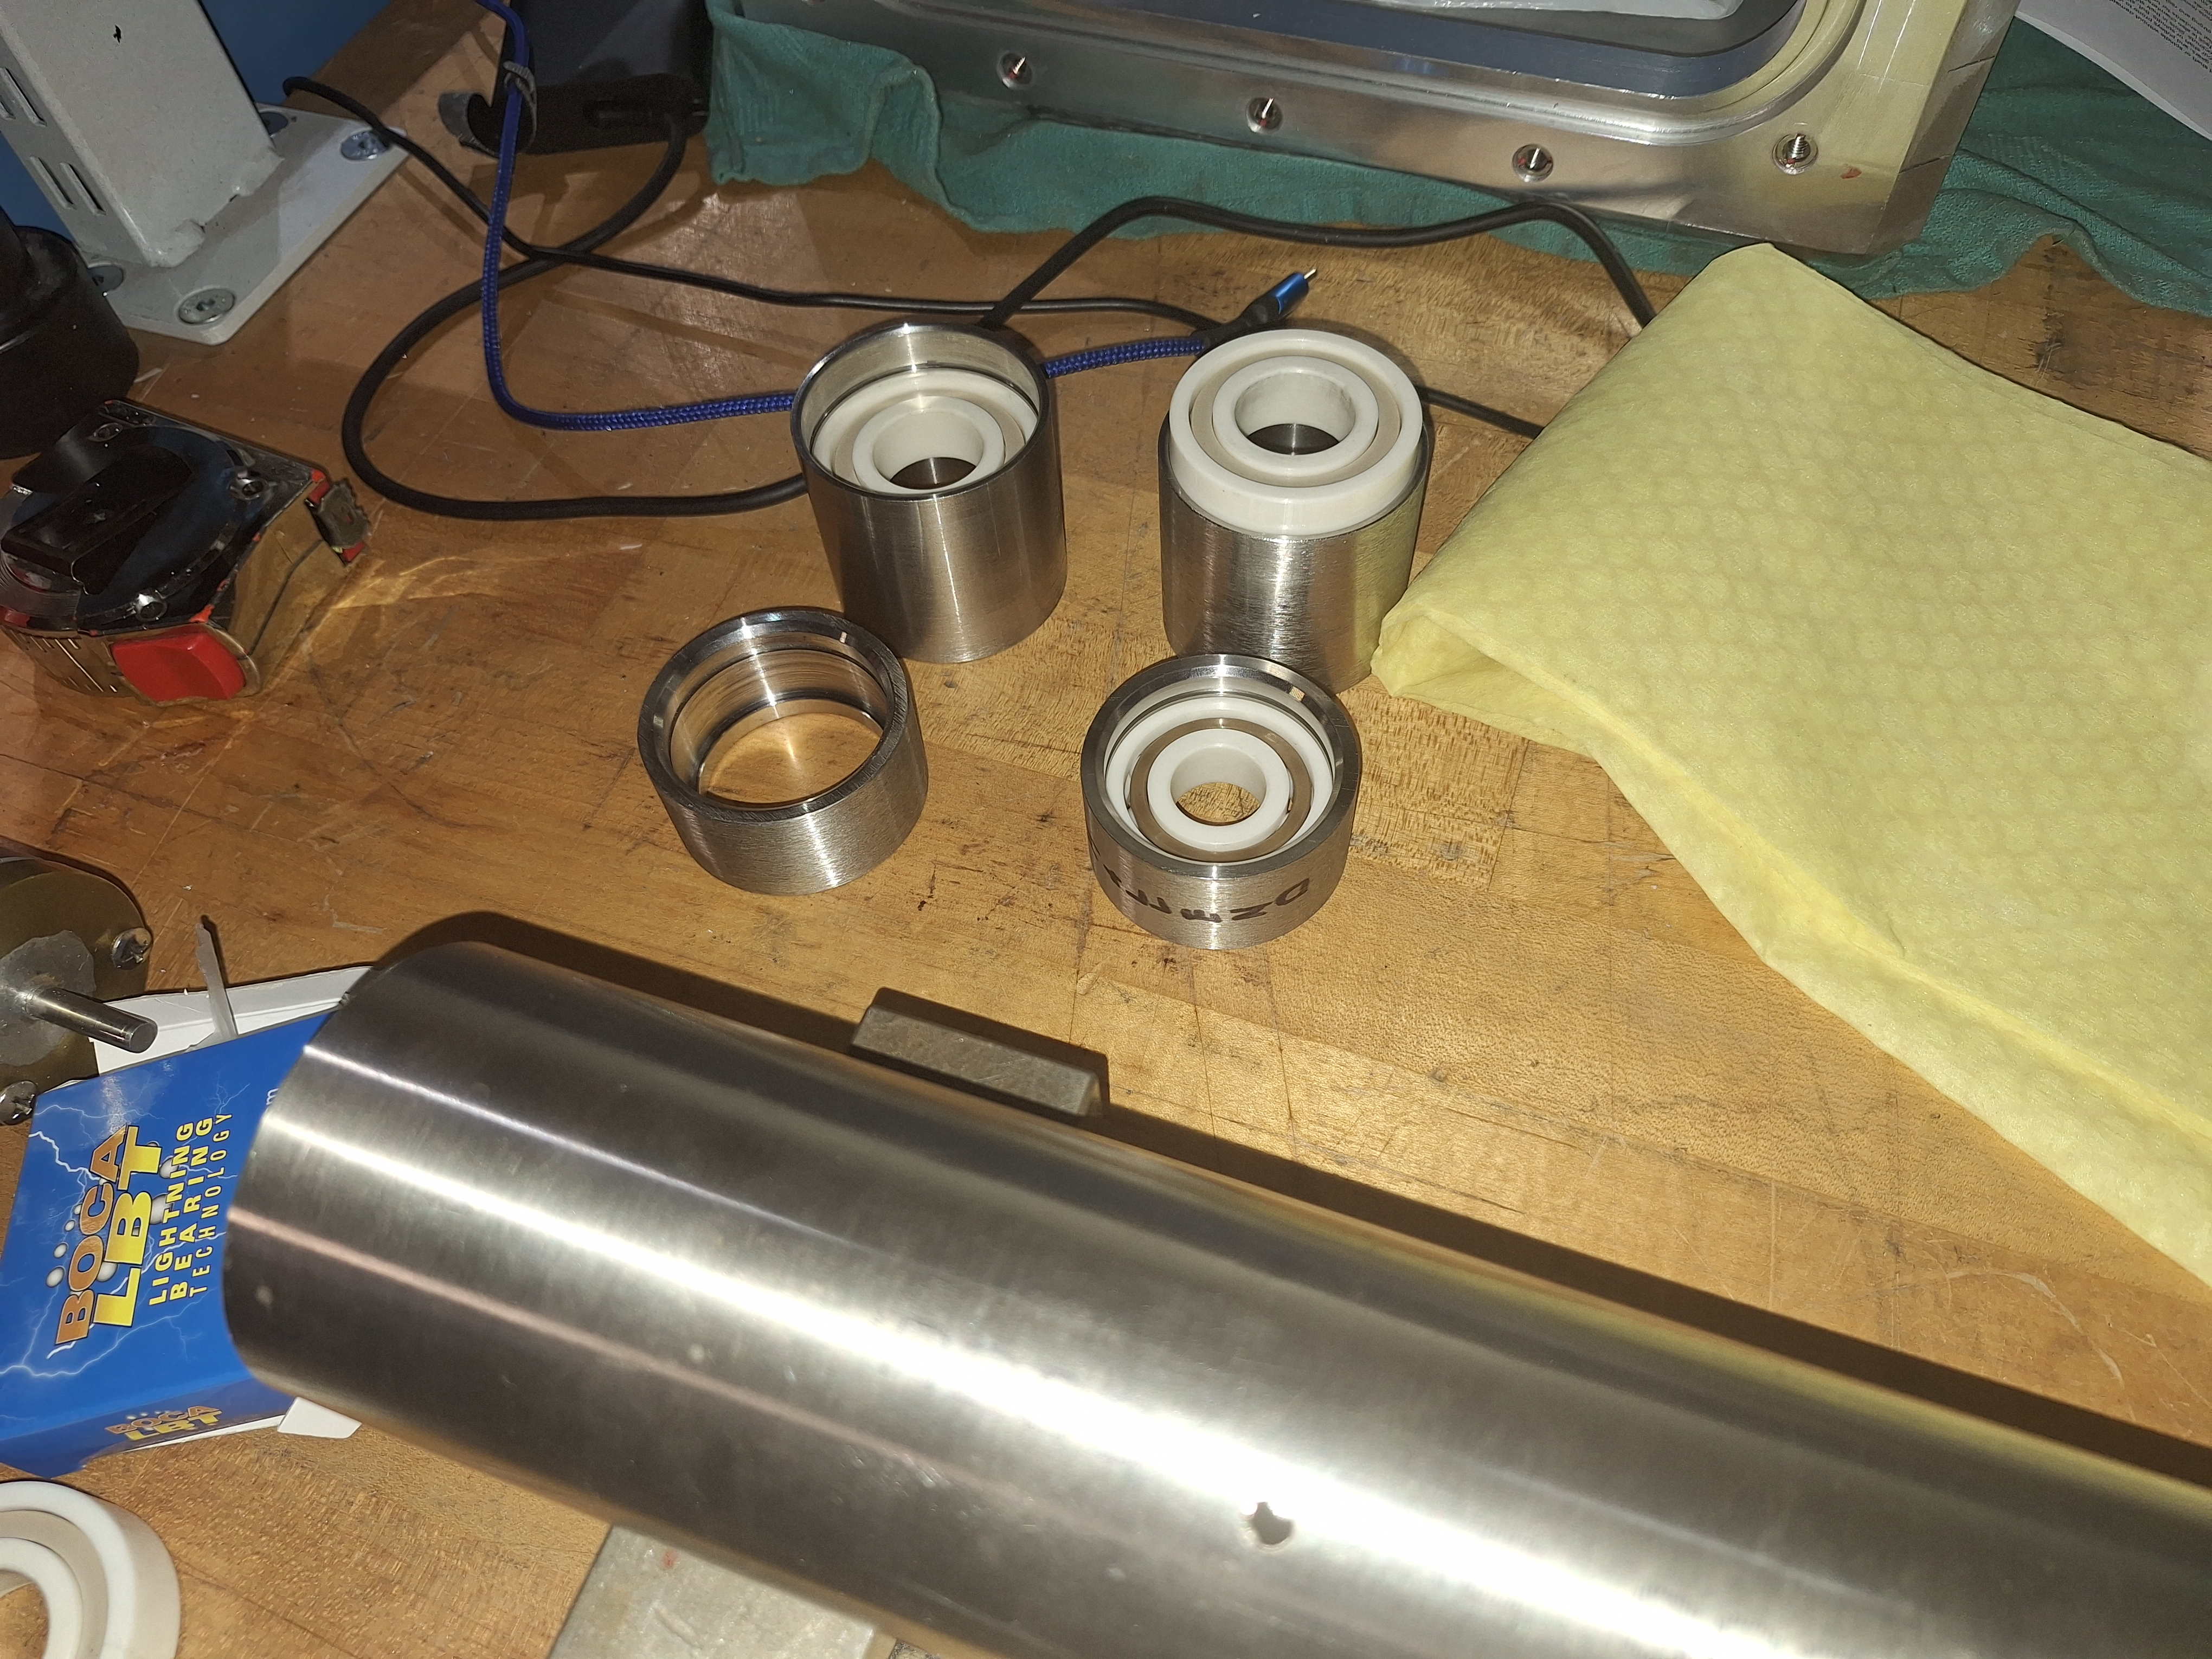
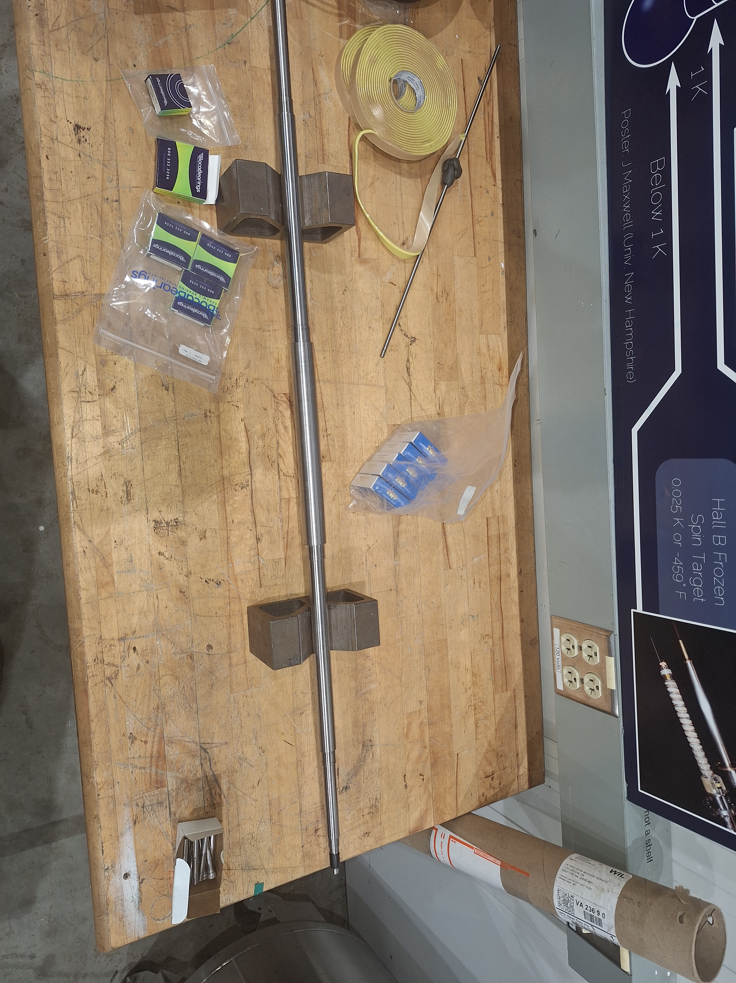
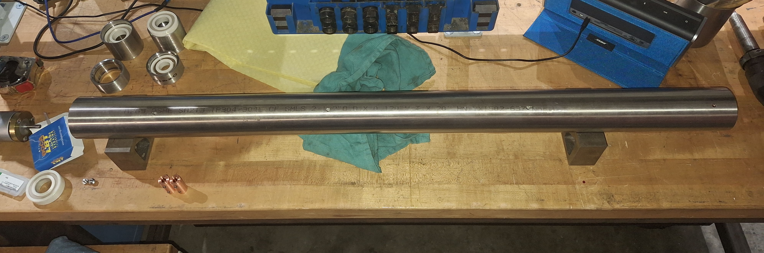
Pump Shaft Fit Up
Pump Shaft: Machined and balanced from solid SST
Bearing cups slide into outer shaft
Outer shaft

Slide 27
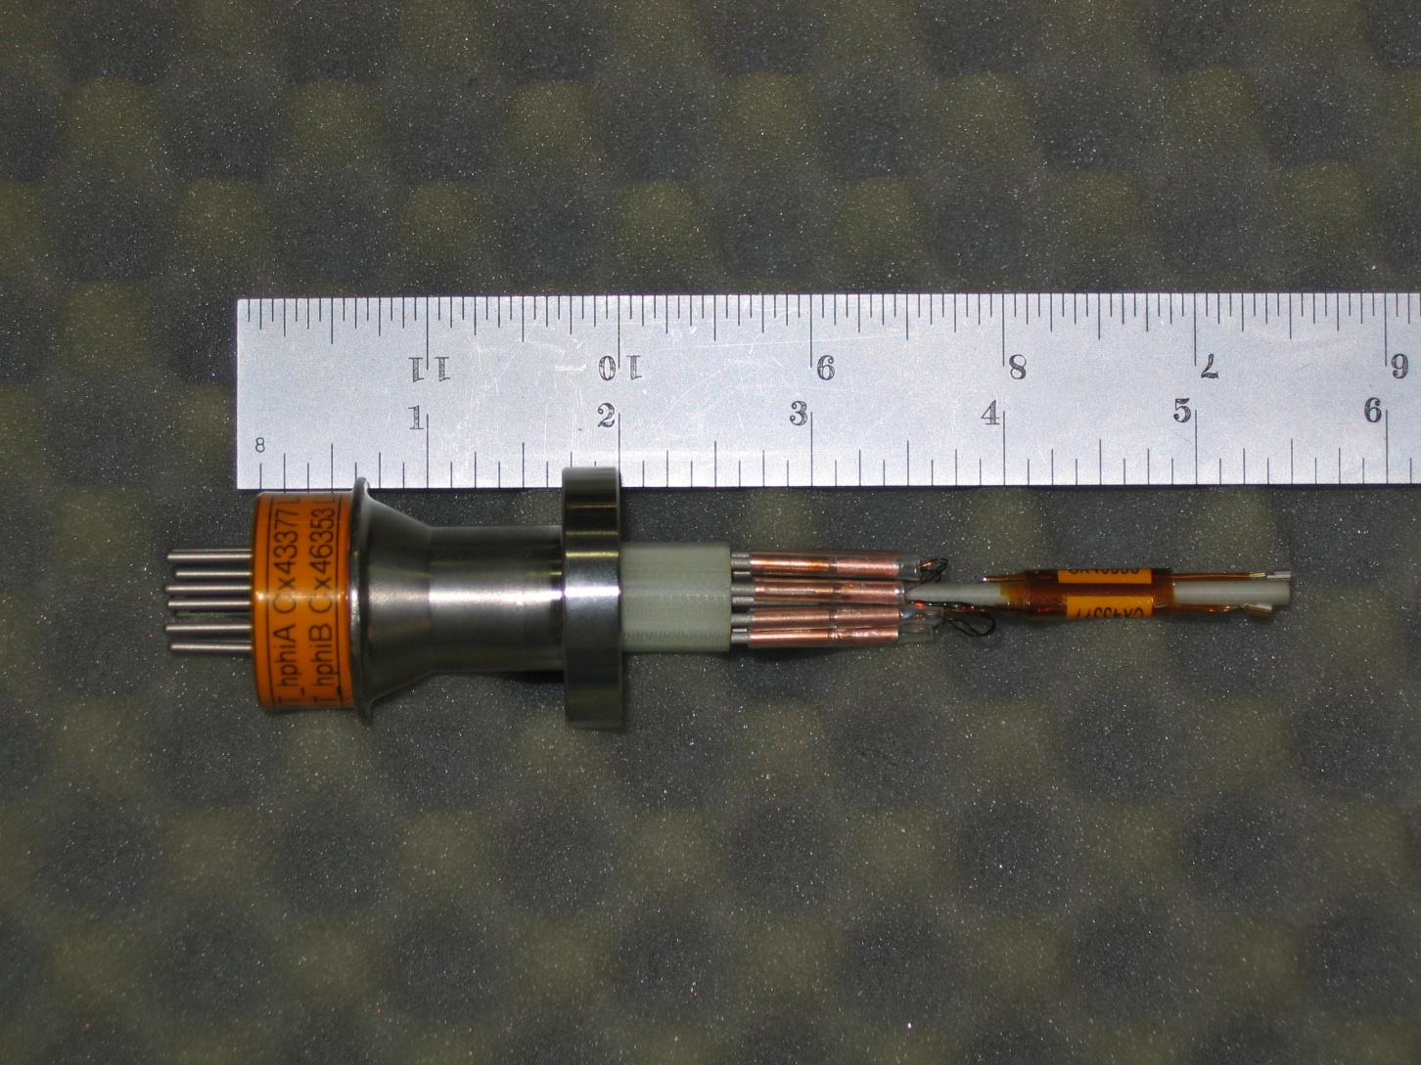
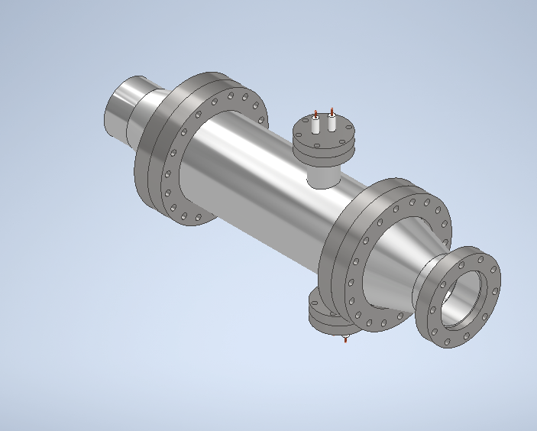
WBS 1.02.05 Target Loop
Heater and Instrumentation
Heater 5 kW
Supply 4 kW without inducing boiling
Thermometers
CeramaSeal 10 pin feed through
  Integrated with RTD mount
Dual CernOx RTD on each feedthrough

Slide 28
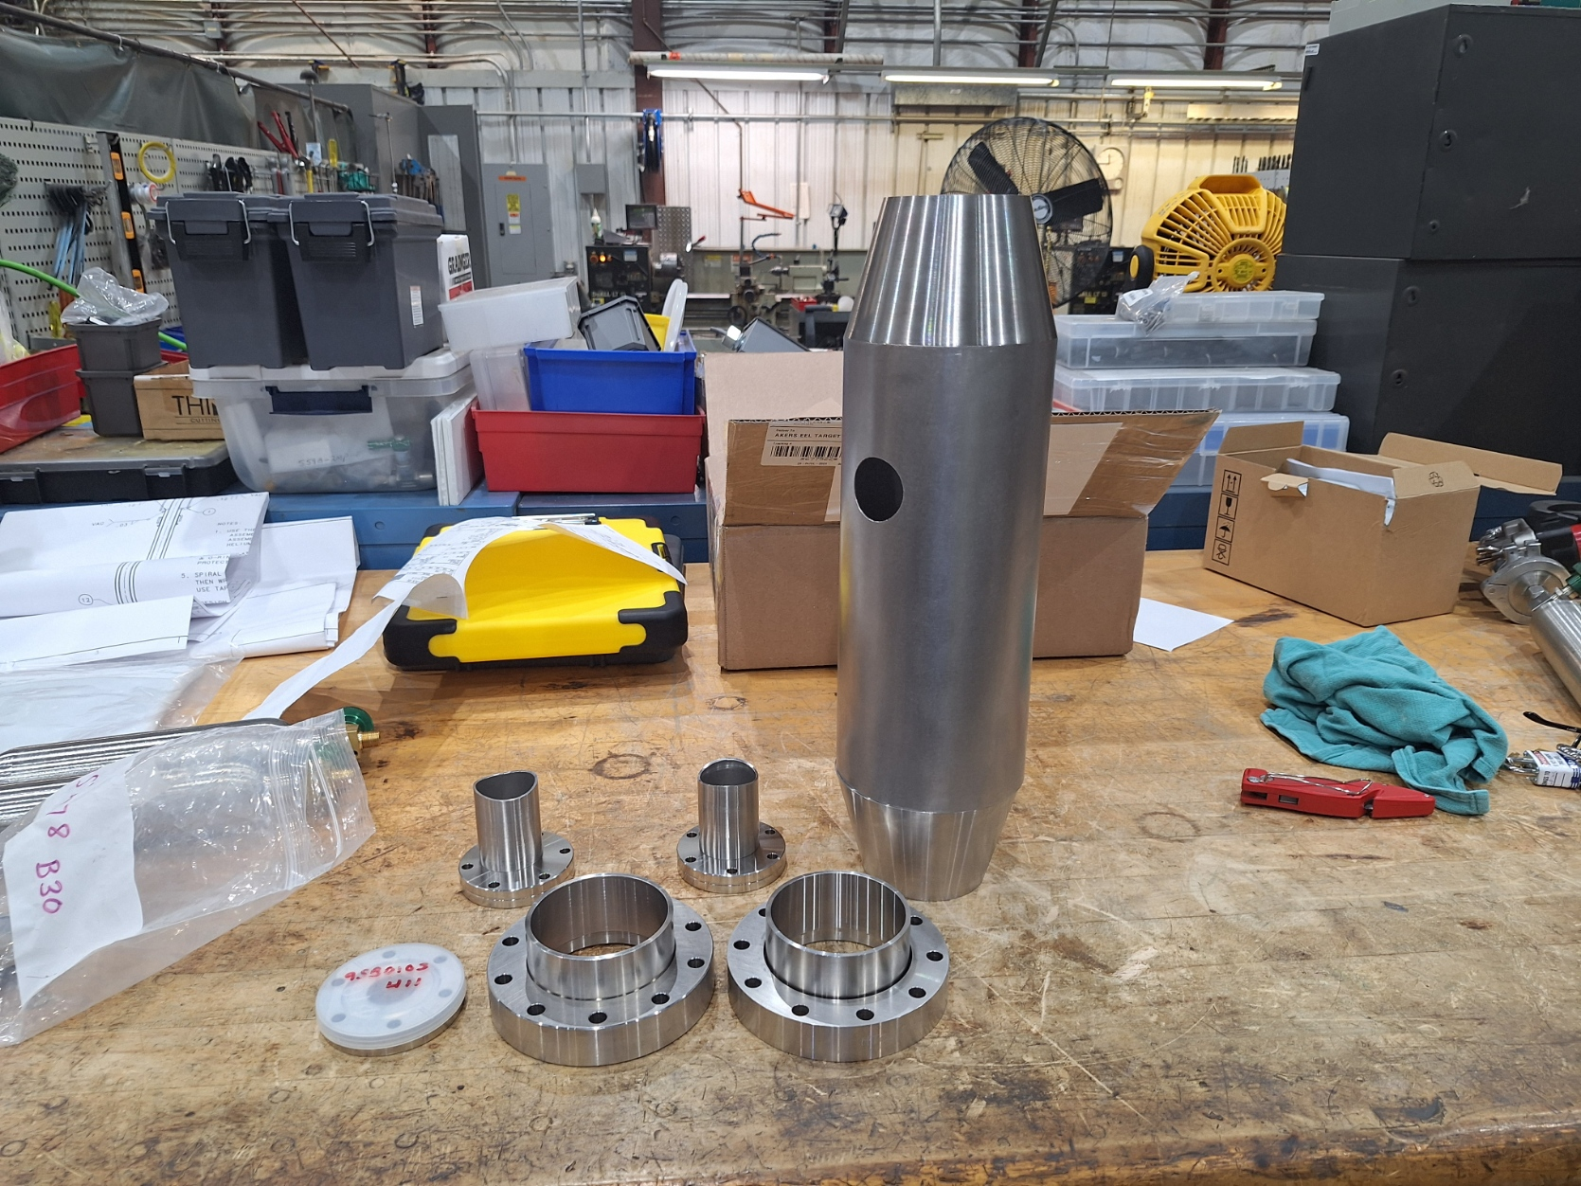
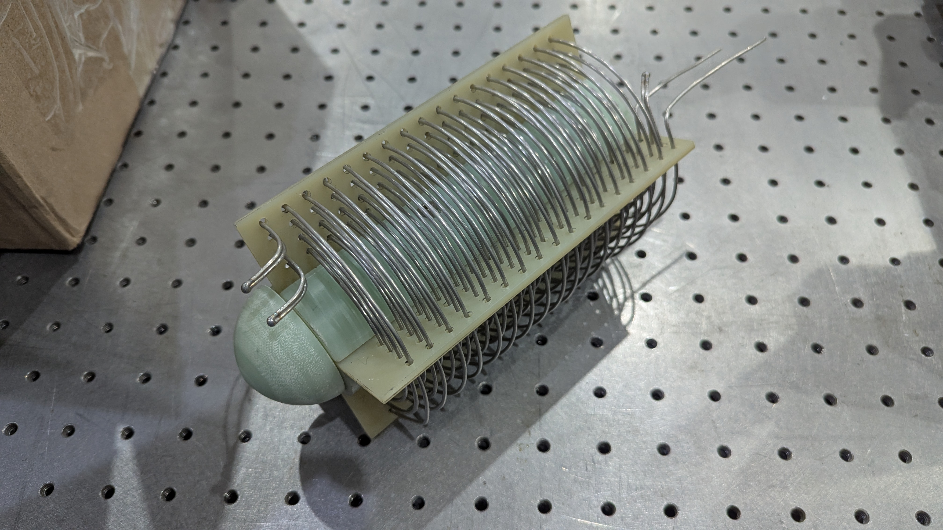
Heater Components
Shell components are complete
Winding of heater core is complete
Assembly/weld heater
Leak test
This assembly should be completed and tested by end of March (waiting on flanges)

Slide 29
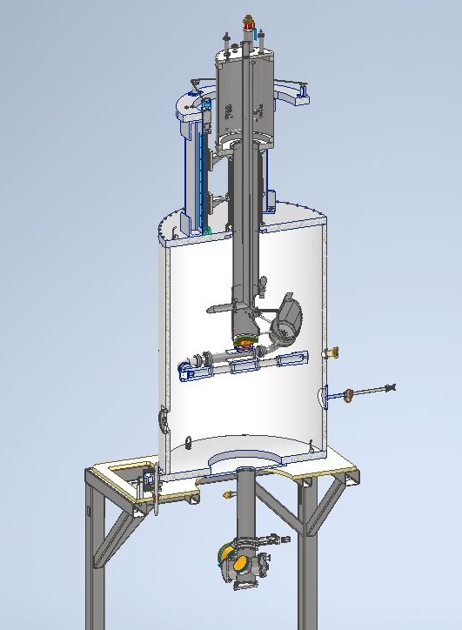
WBS 1.02.06 Motion Systems
Three subsystems
Vertical motion system
  Provides remote operation of target selection by operator
  Fabrication and testing is complete
Cell alignment fixture
  Positions cell during alignment process
  All components have been completed and test assembled
Chamber alignment system
  Positions chamber during alignment process.
  Test fit complete
Three separate alignment processes all take place in Hall A during assembly
  Stand positioning (gross alignment)
  Chamber positioning
  Cell - final alignment
Vertical Lifter
Cell Alignment
Chamber Positioning

Slide 30
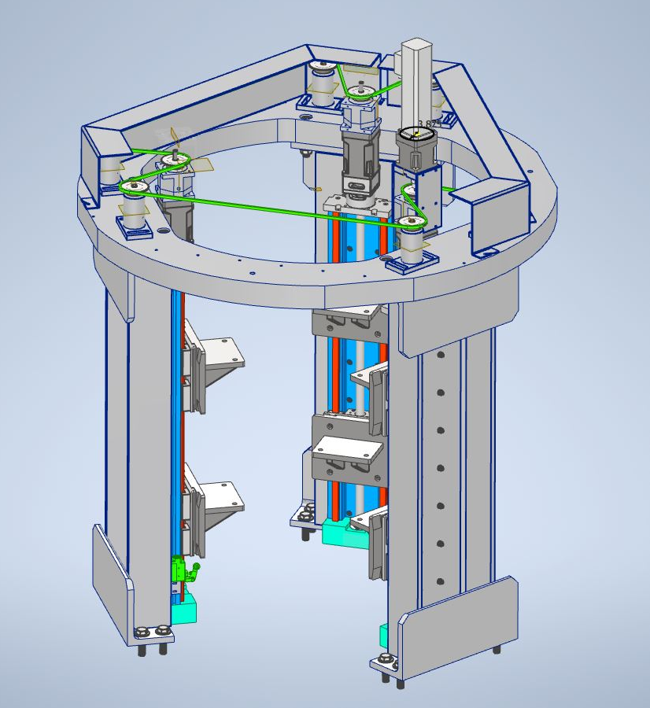
WBS 1.02.06 Motion Systems
Vertical Motion System
Remotely operated by target operator
Positions targets vertically to select target for physics
  18 inches of total motion
  Repeatable to better than 0.05 mm
System is capable of lifting 12000 lbf
  Need 4000 lbf
Chain drive cover has been removed for clarity in the CAD model

Slide 31
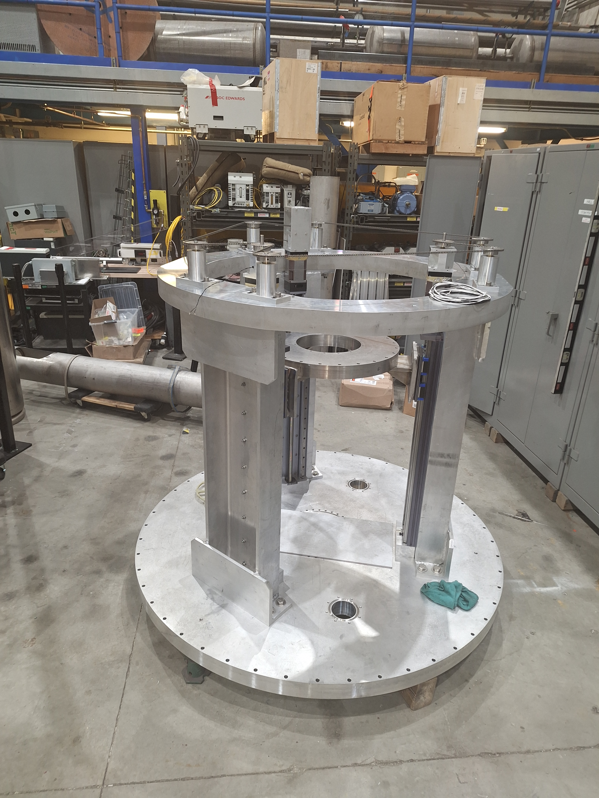
Lifter positioning system
Lifting system fabrication is complete
  Rebuild of linear actuators is complete
  Fabrication/welding of leg assemblies is complete
  Idler fabrication and assembly is complete.
  Brake assembly complete.
  Gearbox rebuild is complete
Final assembly and testing completed in Mid Feb.
Lifter assembly to the right without chain cover and motor.

Slide 32
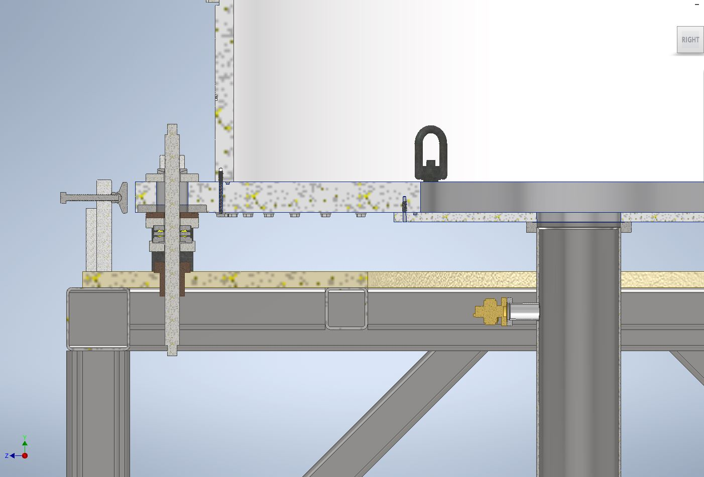
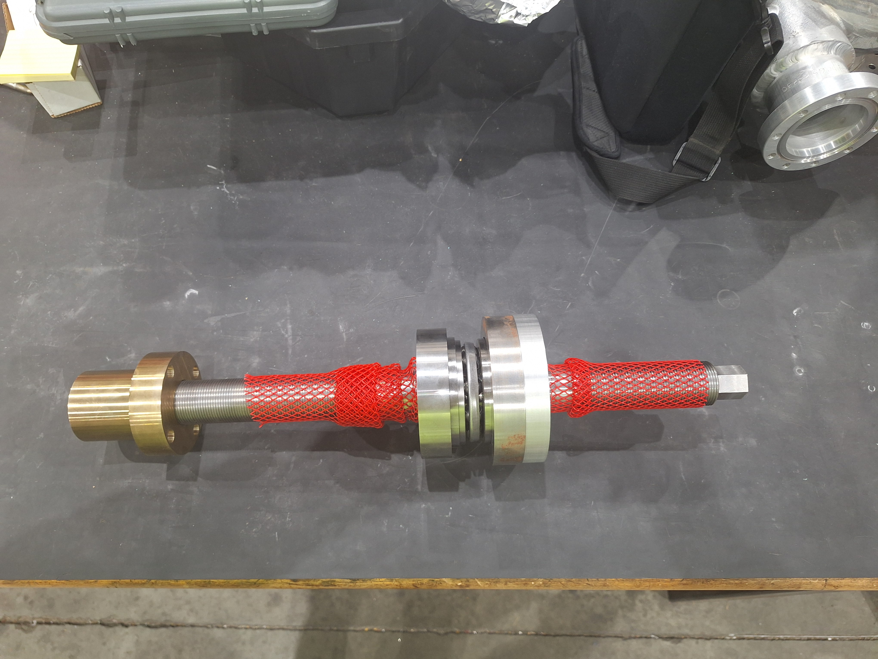
WBS 1.02.06 Motion Systems
Chamber motion system
Manual operation for correcting small installation misalignments
Can be accessed after shielding is stacked to adjust position from floor loading
All components are complete with the exception of bronze skid plates
Final assembly in Hall is required
Cell positioning system
Position cell to 0.1 mm (x,y,z)
Angles 0.01 mrad (pitch, yaw, roll)
All components are complete and test fitup has been performed.

Slide 33
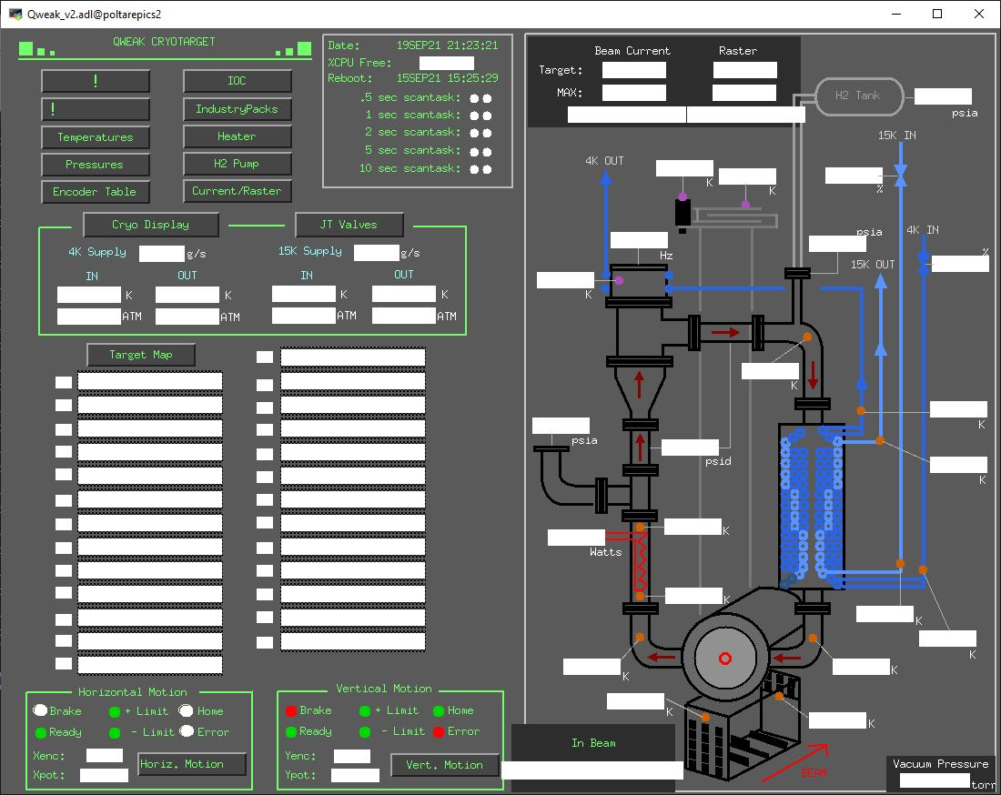
WBS 1.02.07 Controls and Instrumentation
Slow Controls
Control system design is > 90% complete
EPICS shall be used for target slow controls
  DB runs on single board computer (IOC)
EDM shall be used for the User Interface
  Similar to other cryotargets
All components have been selected/specified
Safety Systems are Integrated
Logic for FSDs defined in Statement Of Work (SOW)
  Drawing: TGT-1060-4001-0001
Logic for instrument shutdowns is defined in SOW
  Drawing: TGT-1060-4001-0002
Integration with fire protection

Slide 34
Controls and Instrumentation
Outstanding fabrications and procurements
Heater control chassis
  Custom control chassis needed for beam operations
VESDA H2 gas detector
  To be integrated with existing VESDA system in Hall A
Other custom chassis components
  Plan to reuse existing Hall A target chassis
Cables and Connectors
  Plan to reuse existing Hall A target components
  Heater power connections substantially larger than existing components are required and in process of specification

Slide 35
WBS 1.02.07 Controls and Instrumentation
Instrument | Function | Status
(8) Cernox RTD | LH2 temperatures at four key locations | Delivered
(4) Cernox RTD | Helium coolant temperatures at supply & return | Delivered
(4) Platinum RTD | Solid target temperatures | Delivered
Tachometer | Shaft speed on pump | Delivered
(2) Cold cathode gauge | Chamber high vacuum | Delivered
Convectron gauge | Chamber coarse vacuum | Delivered
(4) Pressure transducers | H2 gas pressure at key locations on gas panel and in the relief line | Delivered
Heater power supply | Voltage/Current to heater | Delivered
Motion PLC | Lifter position and status | Delivered
Pump motor controller | Shaft speed and status of controller | Delivered
Input/Output Controller | Single Board Computer serving as EPICS host | Delivered

Slide 36
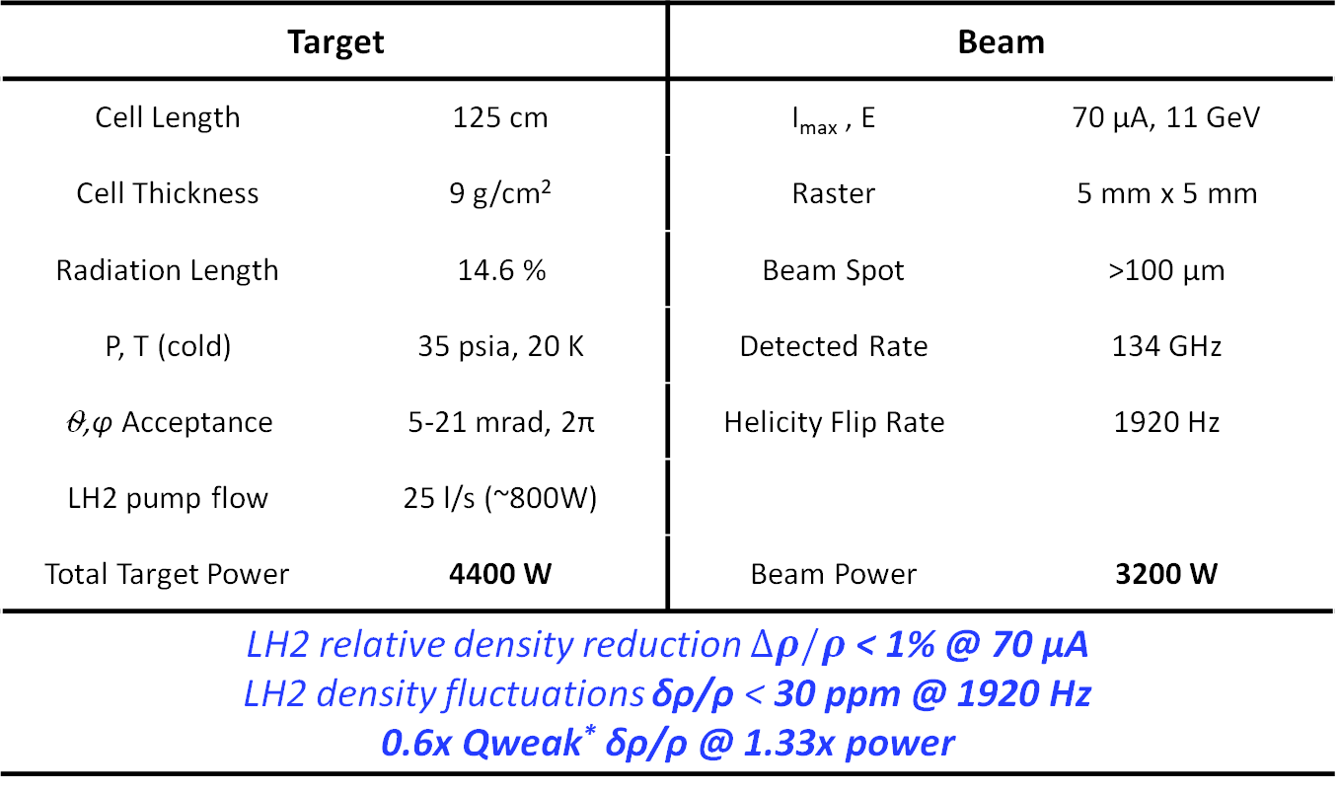
Target System Physics Requirements
Target |  | Beam
Cell Length | 125 cm | I_{max} , E | 70 μA, 11 GeV
Cell Thickness | 9 g/cm² | Raster | 5 mm x 5 mm
Radiation Length | 14.6 % | Beam Spot | >100 μm
P, T (cold) | 35 psia, 20 K | Detected Rate | 134 GHz
⍬,φ Acceptance | 5-21 mrad, 2π | Helicity Flip Rate | 1920 Hz
LH2 pump flow | 25 l/s (~800W)
Total Target Power | 4400 W | Beam Power | 3200 W
LH2 relative density reduction $∆ρ/ρ$ < 1% @ 70 µA LH2 density fluctuations δρ/ρ < 30 ppm @ 1920 Hz 0.6x Qweak* δρ/ρ @ 1.33x power
*The Qweak LH2 target was 35 cm long and 3 kW total power, measured LH2 density reduction 0.8% @ 180 µA and LH2 density fluctuations 50 ppm@480 Hz

Slide 37
FMEA For Performance Subsystems
Brief introduction to the formalism used in the analysis
Drive our car home without accident over 10 years
One failure mode is that we lose control of the car- One potential cause is that we get a flat tire
If we do nothing to maintain the car, what is the probability (occurrence) that the tire goes flat--- assign a value between 1 and 10 (very likely to fail 10)
What is the severity --- assign a value between 1 and 10 (10 fatal)
What is the chance that this failure mode would be detected before it causes the failure. (9 unlikely)
Risk Priority Number = Severity*Occur*Detect
  (RPN) is 900 in this case 10*10*9. This is above 200 which is a somewhat arbitrary threshold triggering action.
What can we do to mitigate this failure mode
  Lower the probability
    Regular alignment, regular check of tire pressure and condition, replace defective tires, driver training (4)
  Lower consequence
    Not much we can do here accept train the driver (9)
  Increase detection
    Install sensors on tire pressure, pre-trip inspection, driver training
    Go from 9 to 3
  New RPN=108 so we are happy(er)

Slide 38
FMEA for Target Performance
Performance:
  Reliability/uptime, pump capacity, beam heating in cell, vacuum integrity, motion, controls, etc.
  Not Safety
Analysis is working document filed in the pressure system folder.
  Criteria is somewhat arbitrary
Highest pre-mitigated RPN
  640 for pump failure
  648 for vacuum system/cell failure
Implementing steps:
  Full ceramic bearings, vibration analysis, testing, Code compliance, etc.
  Reduces RPN to below 100.
Detection/Severity Values
Value | Level | Description
1 | Very High | Certain detection
2 | Very High | 90%
3 | High | 80%
4 | Moderate High | 70%
5 | Moderate | 60%
6 | Moderate | 50%
7 | Low | 40%
8 | Low | 30%
9 | Very Low | 20%
10 | Very Low | Detection unlikely
Value | Level | Description
1 | Very Low | Down less than 1 day/no physics impact
2 | Low | Down ~ 1 day/no physics impact
3 | Low | Down ~ 2-3 day/no physics impact
4 | Low | Down ~ 4-7 days/no physics impact
5 | Low | Down ~ 1-2 weeks/no physics impact
6 | Low | Down ~ 3-4 weeks/slight physics impact
7 | High | Down ~ 1-2 mon/physics impact
8 | High | Down ~2-3 mon/physics impact
9 | Very High | Down 3-6 mon/strong physics impact
10 | Very High | Down >6 mon/Severe physics impact

Slide 39
Hydrogen Purity
H2 gas is supplied by JLAB standard gas contract or other specialized vendors.
  115 thousand STP liters of H2
  This amounts to 1.5*10^9 J of stored energy
  The supplied gas purity is 99.999% H2
Gas Panel
  System fill and blowdown, process relief, gauging, purification, etc.
  This panel is fairly simple and was used in the past for Qweak.
  Detailed procedures are developed and followed to ensure proper operation
Fluid purity
  Gas panel is used to clean out the system. First with He and then with H2.
  H2 will be sampled and analyzed in house (RGA) and sent to testing lab for analysis
  Gas assays are filed in the pressure system folder and e-logs
During the run:
  Repeat the sampling during the run on maintenance days
    This will require dedicated RGA system for light gasses

Slide 40
Target Heat Loads and Cooling
Heat loads in the target 4400 W
  Beam load at 70 microA = 3200 W
  Viscous load ~800 W
  Heater overhead and other loads ~10% more = 400W
Tests have shown that we can operate the ESRII at @ 79 g/s
  Supply: 17.3 atm, 11K Return: 3 atm, 19K
  Available enthalpy = 120 W/g
    Need ~ 80 g/s
  ESRII can supply the necessary enthalpy for the MOLLER Target to operate at the required beam current assuming reasonable losses.
Target has been optimized for performance and reliability over efficiency.

Slide 41
Heat Exchanger Adequacy Calculation
We are reusing the Qweak HX
  Successfully provided 3 kW of heat removal for the Qweak target using the CHL and ESR in combination of 4.5K and 15K coolant.
TGT-CALC-20-010
  Analysis of the Qweak HX using ESR 2
  Assuming a heat load of ~ 4.3 kW and
    ESR supply temp 11.7K at 15 atm
    ESR return temp 19K at 3.8 atm
    LH2 temperature of 20K at 35 psia.
  The UA per path (there are three sets of coils)
    ~ 982 W/K
  Total heat removal
    25 kW
To provide this power ~ 82 g/s would be required from the ESR 2.
ESRII has demonstrated slightly better performance than expected.

Slide 42
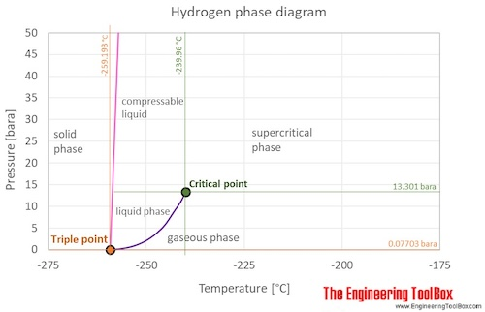
Capacities and Fluctuations in Cooling Power
The target will be operated several degrees subcooled and 20 psi above the vapor pressure
  Makes it more difficult to boil
  More stable
Forced convection also makes the target more stable to operate (T,P,ρ)
Small deviations is temperature and pressure of the He coolant will not be an issue for target operations as they are absorbed by the heater PID control
Should the supply temperature rise 1K the available target power for beam operations would start to fall.
  Reduce beam current
  Operate slightly higher loop temperature
  Reduce pump speed
Ambient temperature swing of 22K would lead to a 0.05% change in target density
Operational point for target

Slide 43
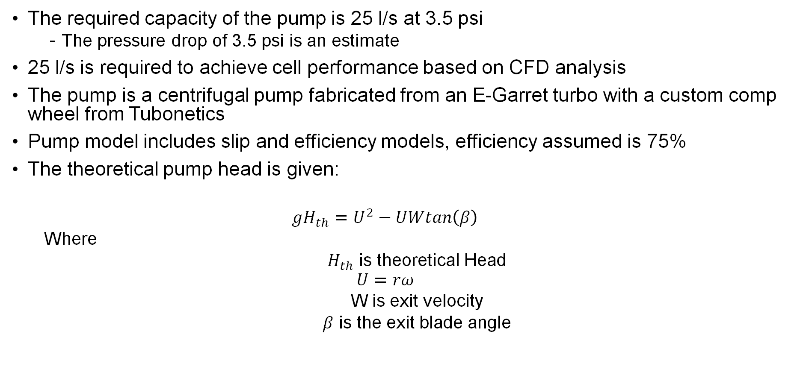
Pump Capacity
The required capacity of the pump is 25 l/s at 3.5 psi
  The pressure drop of 3.5 psi is an estimate
25 l/s is required to achieve cell performance based on CFD analysis
The pump is a centrifugal pump fabricated from an E-Garret turbo with a custom comp wheel from Tubonetics
Pump model includes slip and efficiency models, efficiency assumed is 75%
The theoretical pump head is given:
  $${gH}_{th}=U^{2}−UWtan\left(β\right)$$
  Where
  $H_{th}$ is theoretical Head
  $$U=rω$$
  W is exit velocity
  $β$ is the exit blade angle

Slide 44

Pump Capacity
To include slip
  $${gH}_{th}=U^{2}σ−UWtan\left(β\right)$$
$$σ=\frac{1−\sqrt{sin⁡(90−β)}}{Z^{0.7}}$$
Where Z is the number of blades.
Model was accurate to within a few percent for Qweak operations including predicting the measured efficiency of the pump to be 73%

Slide 45
Projected Pump Performance
Requirements:
  25 l/s with 3.5 psi head
2 HP motor is outside vacuum space
  Removes heat load from e-drive
Long shaft requires proper bearing choice and location.
Vibration analysis is complete.
Prototyping of shaft system is complete
A shaft speed of ~50 Hz should be sufficient to operate the target
  A shaft speed of 60 Hz is easily possible with a likely increase in heat load from the pump.
Final assembly is in process.
Modeled Head vs Speed for 25 l/s Flow

Slide 46
Performance of Cell/CFD Analysis
Requirements for the cell:
  Cell length = 125 cm, Flow rate 25 l/s (1.7 kg/s)
  Max current is 70 microA
  Max density change < 1%
  Raster 5x5 mm^2
  Density flux < 30 ppm @ 1920 Hz flip rate
Computational Fluid Dynamics (CFD) was used to model the cell H2 flow space
  All the CFD was performed by Silviu Covrig-Dusa
  Several designed were considered. Only the final one is presented here.

Slide 47
How CFD Works - Oversimplified
Scalar equations are discretized, linearized and solved iteratively
Original equation
Discretized equation
Linearized equation
Solve the system of linear equations iteratively to “convergence”
Post-process, refine, redo until some criteria are met

Slide 48


MOLLER Cell Model 21 Flow Space
LH2 flow bypass 20 K, 30 g/s, 12 mm diameter
Bypass jet at beam in window, 6 mm diameter
LH2 flow inlet manifold at 20 K and 35 psia
LH2 flow direction
Beam-in cell Al window, 2 cm
diameter, 0.125
mm thick
Internal flow
LH2 flow aperture into the cell
diverter to jet
LH2 flow direction
at beam out nipple
LH2 flow outlet manifold
Beam direction
Beam-out cell Al window, 7.6 cm diameter, 0.25 mm thickness with a 12 mm diameter beam nipple
0.125 mm thick

Slide 49
ANSYS-Fluent Parameters
CFD “nominal” simulations conditions:
  LH2 at inlet to the cell: 20 K / 35 psia / 1.5 kg/s (or which 30 g/s for Flow bypass)
  75 µA beam current with 4x4 mm² raster or ~3300 W into LH2 and ~5.5 W into one Al window
Material properties have been adjusted for temperature dependence using MPDB for metals and NIST for fluids
The geometries have been developed in ANSYS-Design Modeler and meshed with ANSYS Mesh21R2, a typical cell volume of 6 liters was meshed with 20-30M volume cells, the mesh min orthogonality quality was ~0.1
The 2-phase flow Mixture model from Fluent was used with evaporation-condensation as interaction between the two phases, the saturation temperature was set at 23.705 K (from NIST)
The Fluent k-ωShear-Stress-Transport (SST) with viscosity heating was used to model fluid turbulence, the model uses two equations to calculate the turbulent kinetic energy and the turbulent dissipation rate of eddies
The beam power is sourced uniformly in both LH2 and the Al windows, as a constant volume density in Al and a constant mass density in LH2 (accounts for density variations in the mesh cells)
The second order interpolation scheme was used for all relevant variables and double precision for calculations

Slide 50
CFD Cell 21: Temperature at Windows

Slide 51
LH2 Window Jetting

Slide 52
Cell 21: Flow profile and nucleate boiling transport

Slide 53
Summary
Presented an introduction to high power cryogenic hydrogen targets for electron physics
Failure mode analysis for performance parameters was discussed
The target requirements were presented
Expected/modeled performance of the HX, ESR (data), Pump, and Cell were shown
Addressed the following charge bullet points:
  1.1) What is the expected cooling power consumption, and is it optimized for efficiency?
  1.2) Are there any risks of cooling power fluctuations that could affect stability?
  1.3) How is heat dissipated, and does the cooling system have adequate capacity for sustained operation?
  1.4) What are the temperature thresholds at which shutdown becomes necessary?
  1.5) Have the nominal operating parameters (temperature and pressure) been established, and how much headroom is available to achieve the measurement goals?
  1.6) How frequently are pressure sensors calibrated and tested?
  2.3) Have potential failure modes for pressure and temperature stability been thoroughly analyzed?
  3.4) What are the collaboration’s plans to ensure that the hydrogen meets the required purity standards and that its purity is maintained during operation?

