Slide 1
Ferrous materials in the Main Detector Support Structure
L. Bartoszek
BARTOSZEK ENGINEERING
9/26/24

Slide 2
How to read the pictures
Every item in the following pictures that is colored red is either steel or stainless steel.
If it is metal colored, transparent, or not red but some other color, that material is aluminum or other nonferrous materials
I made much of the structure transparent to expose some hidden stainless dowel pins
The gear box, motor (not shown at all,) drive shafts, chains, and sprockets can all be removed after the detector is aligned if necessary
The bearings holding up the ring rollers would be extremely difficult to remove

Slide 3
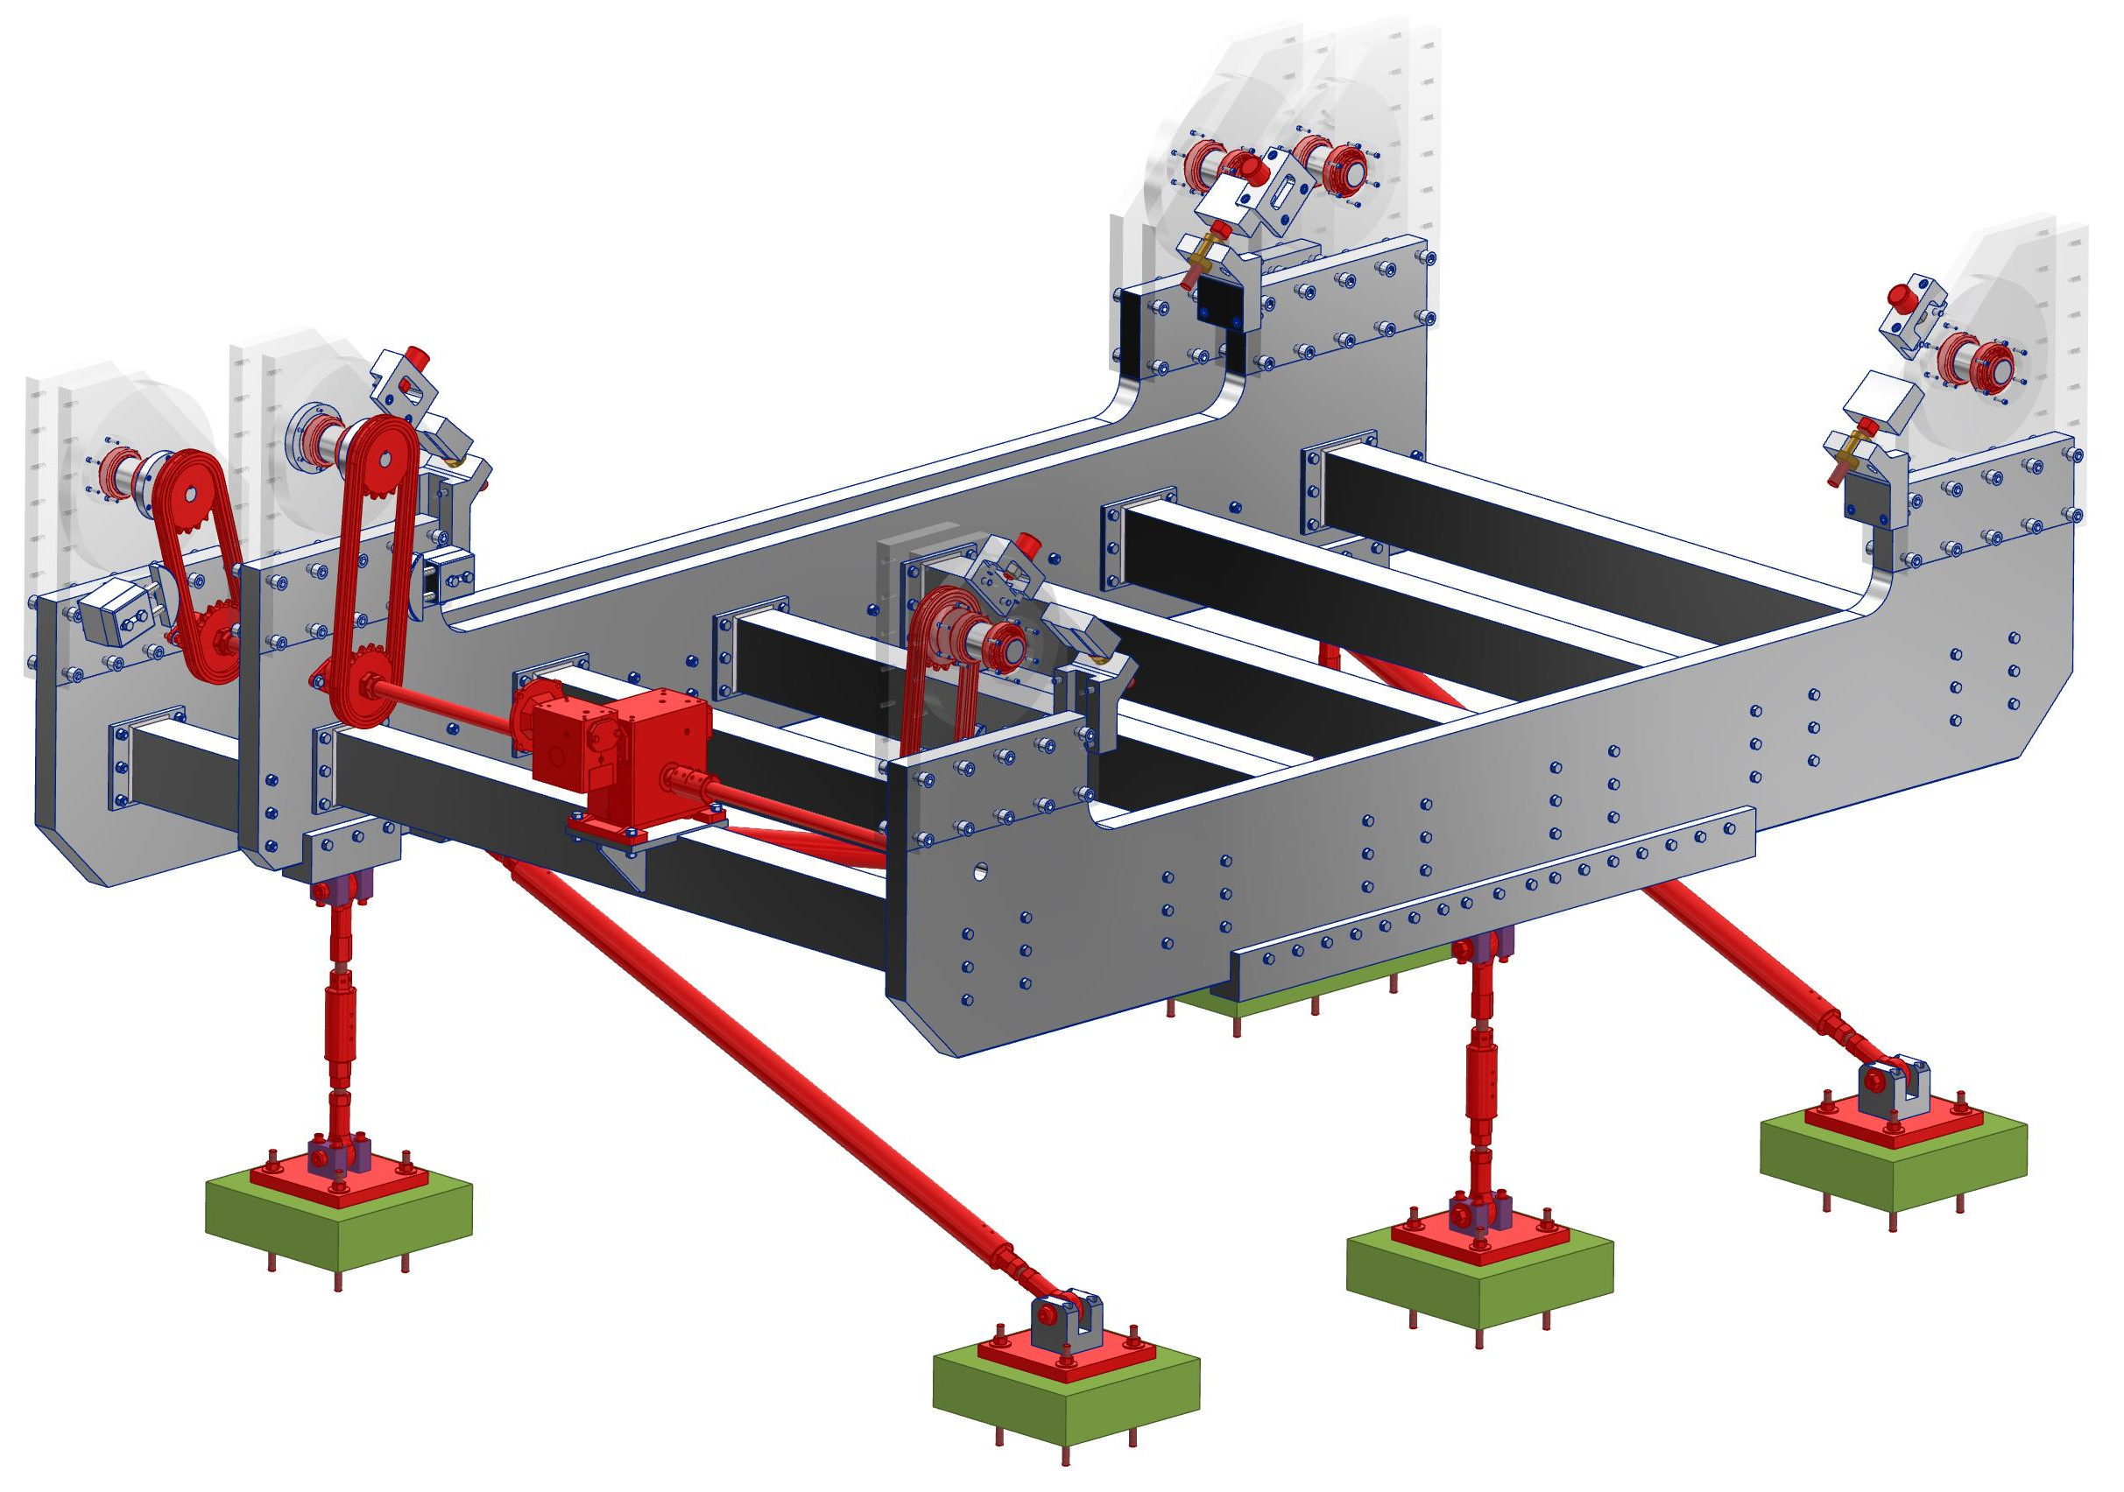
Steel materials in the lower support structure
Roller support bearings
Chain and sprockets
Gearbox, motor not shown

Slide 4
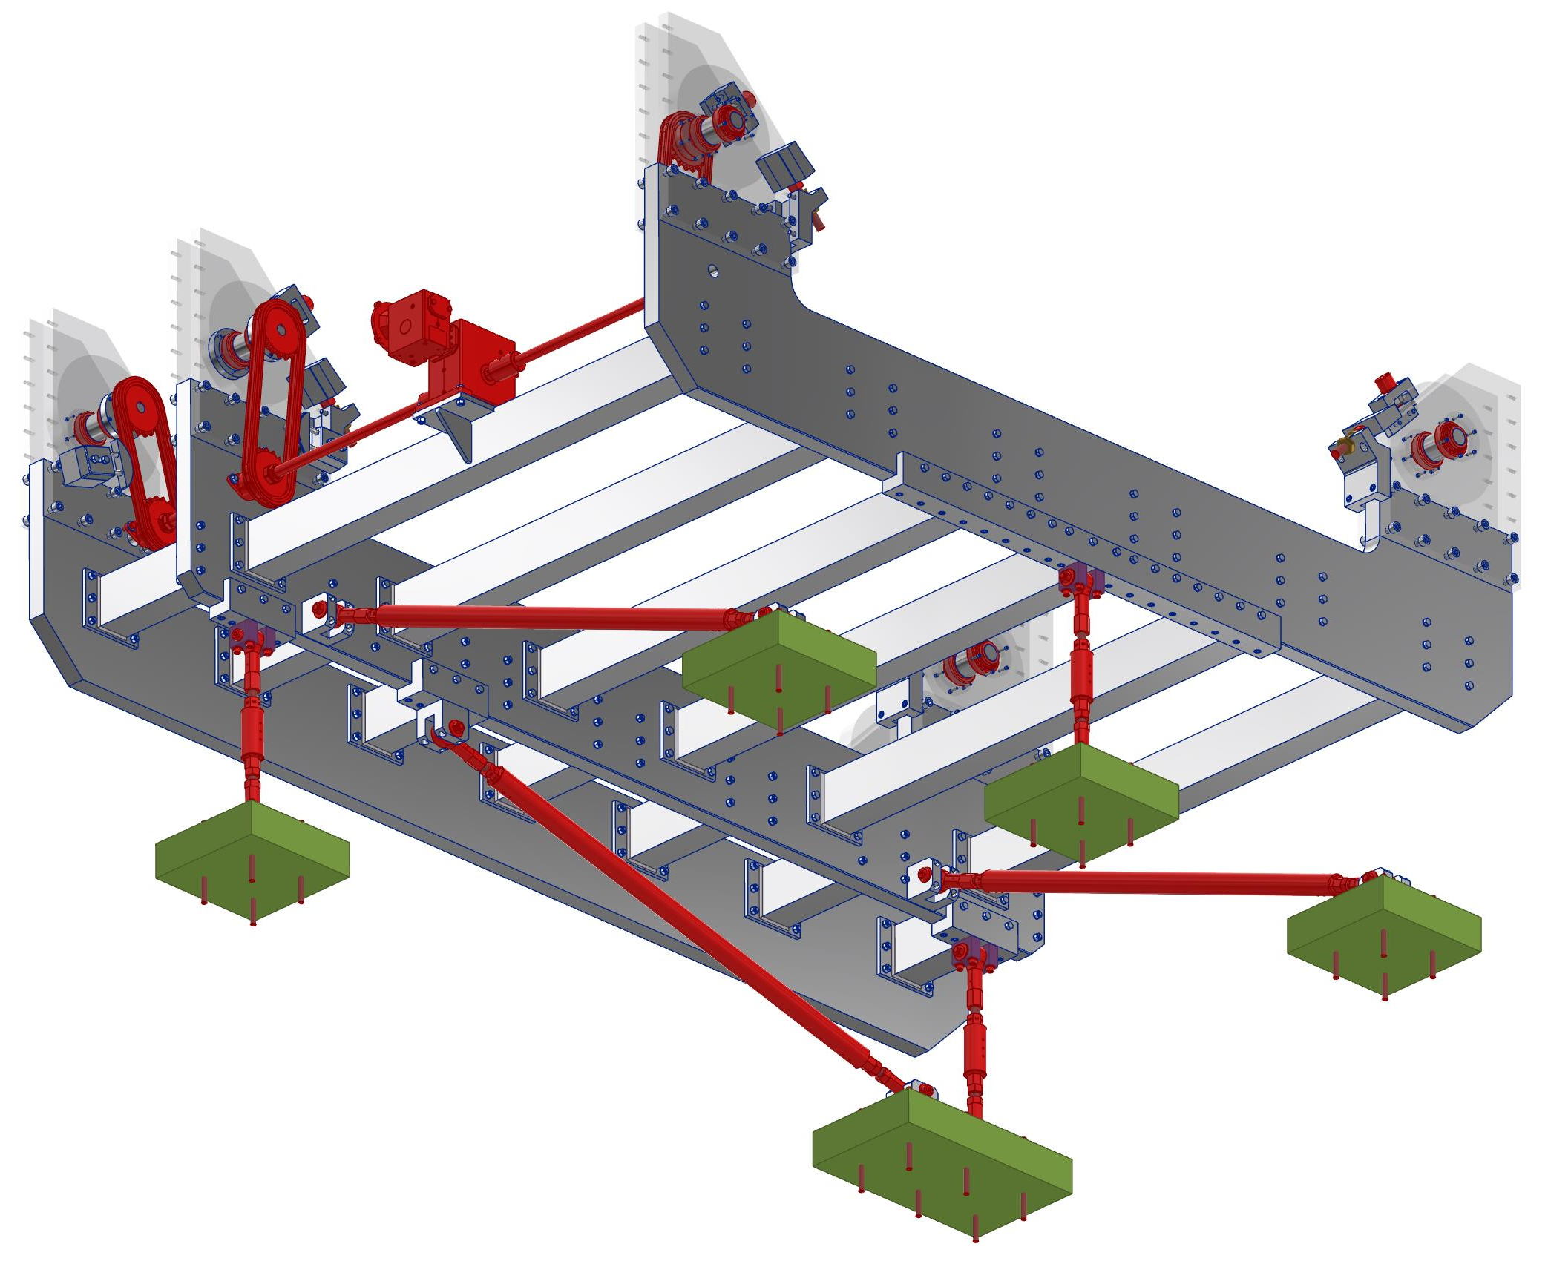
View looking at the lower structure from below

Slide 5
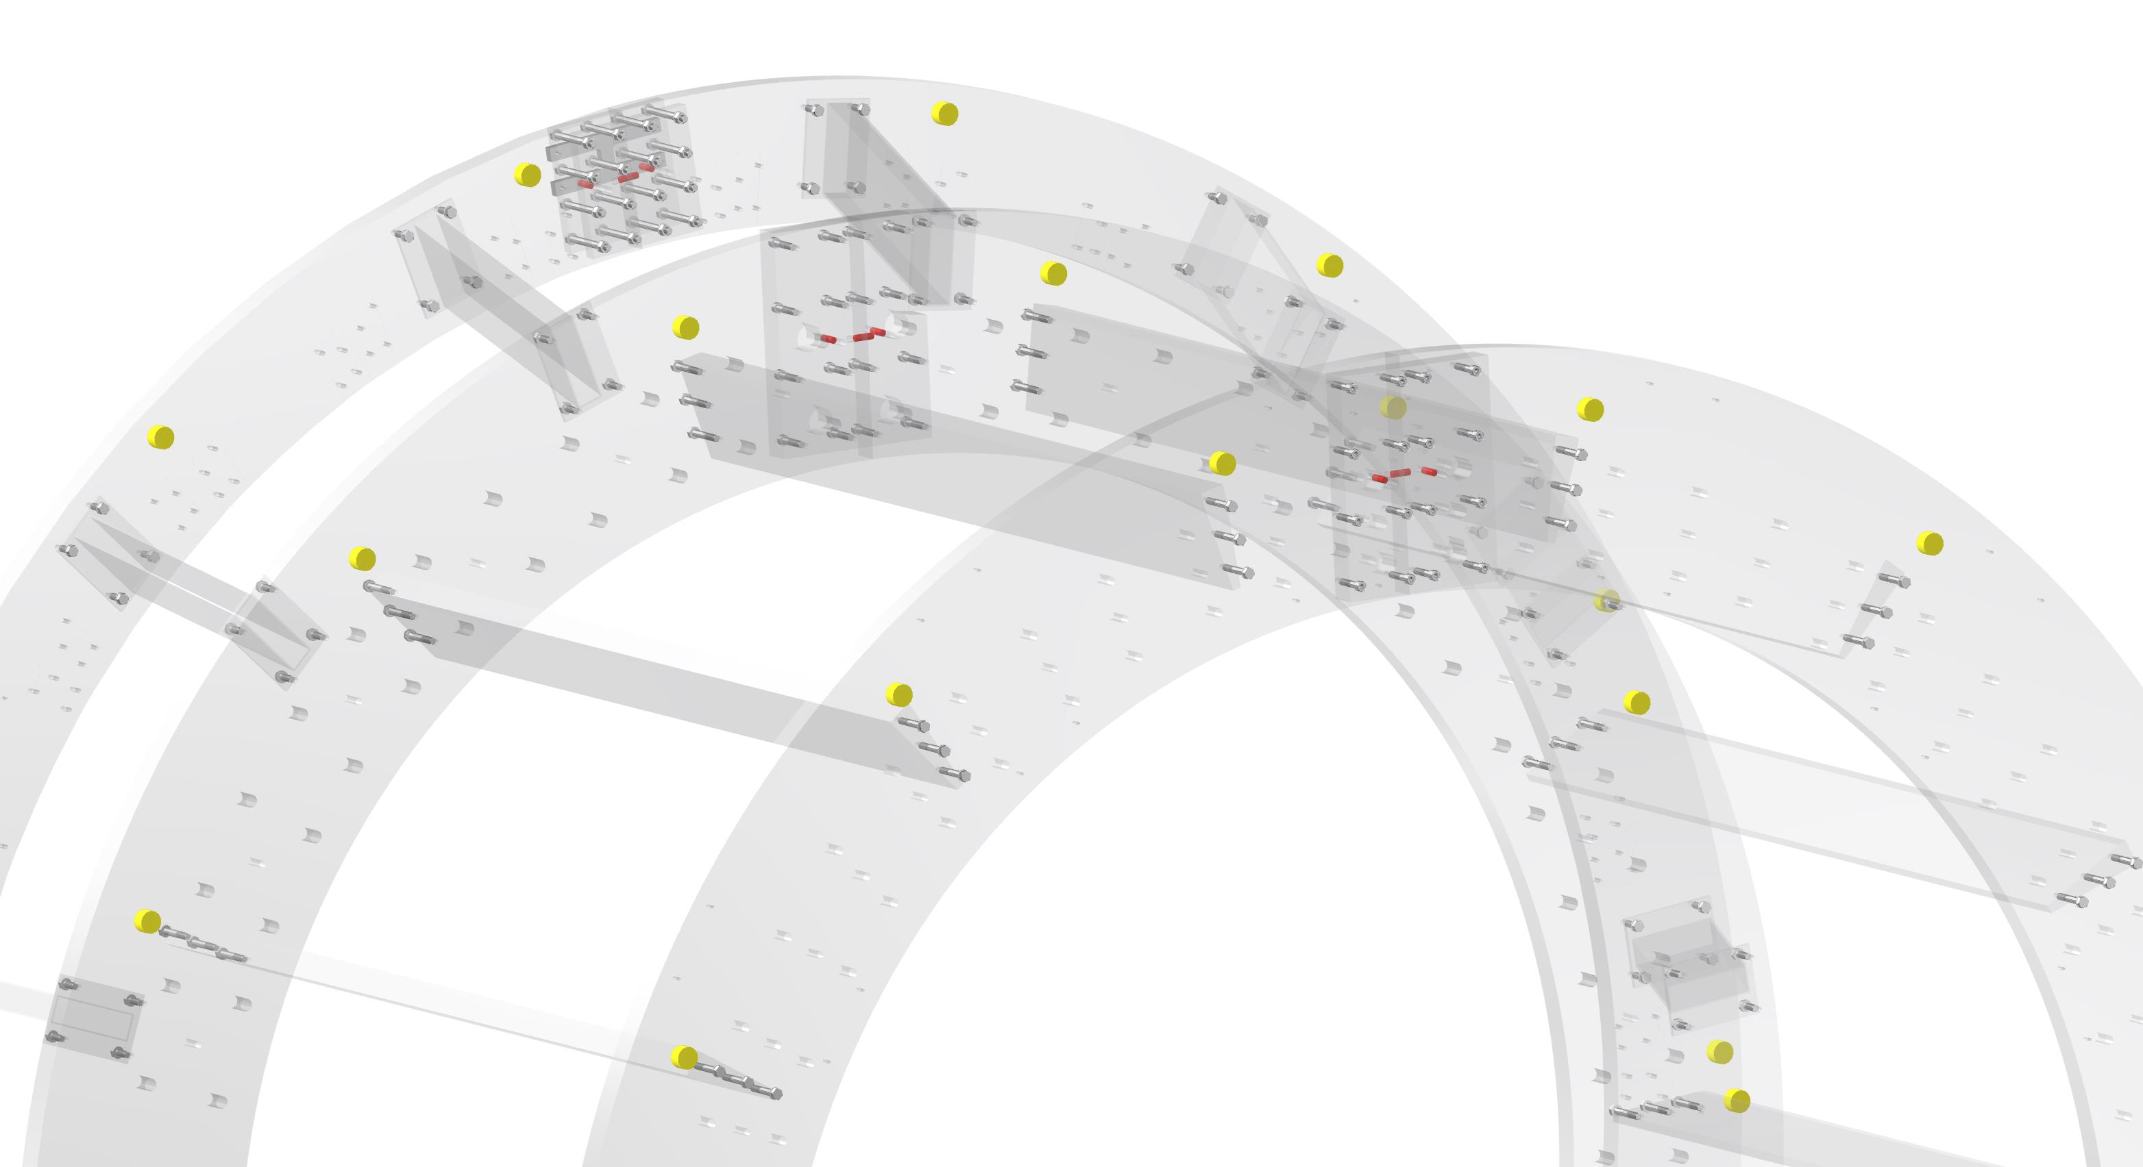
Stainless steel dowel pins aligning the support rings
There are three dowels in each half-interface of each ring. (Six dowels per ring total, three rings.) Only half of the total number of dowels is shown in this picture. Each dowel pin inside the aluminum rings weighs .084 lb (.038 kg) of stainless steel.
73 in (1,854.2 mm)
Radius from beamline
62.5 in (1,587.5 mm)
Radius from beamline
Shower max ring dowels are at larger radius than main detector ring dowels.

Slide 6
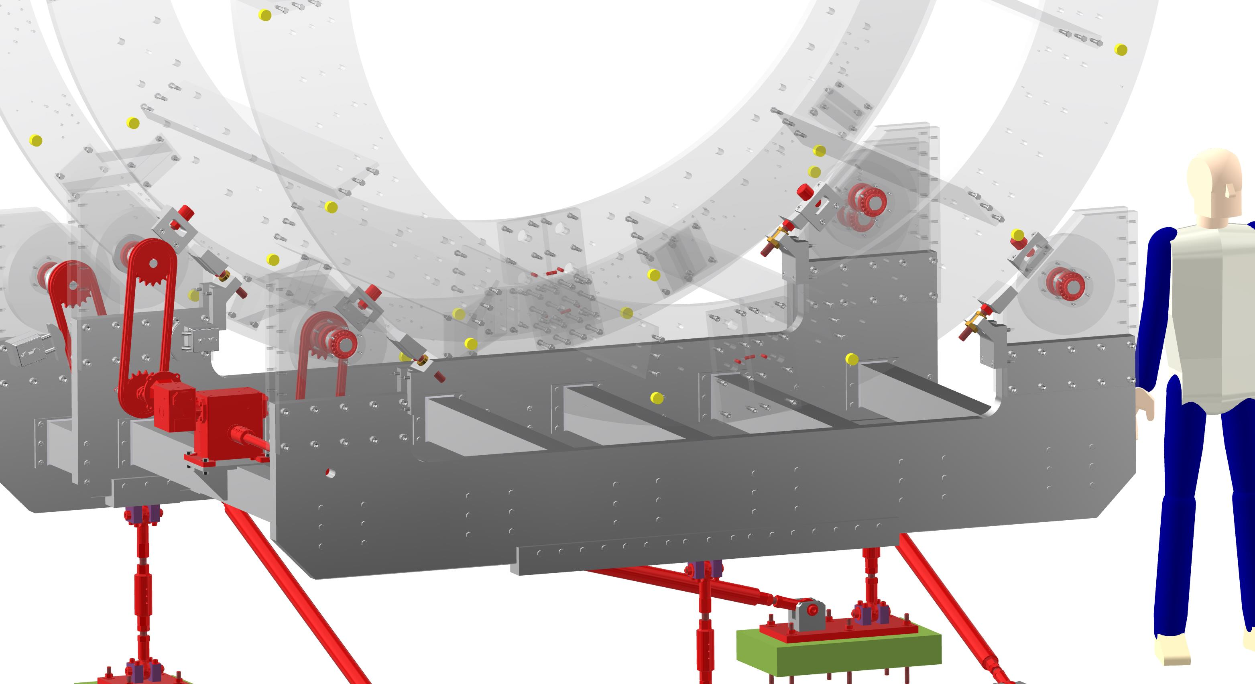
A view of the lower stainless steel pins in the support rings
More ring dowels
Brake threaded rod

Slide 7
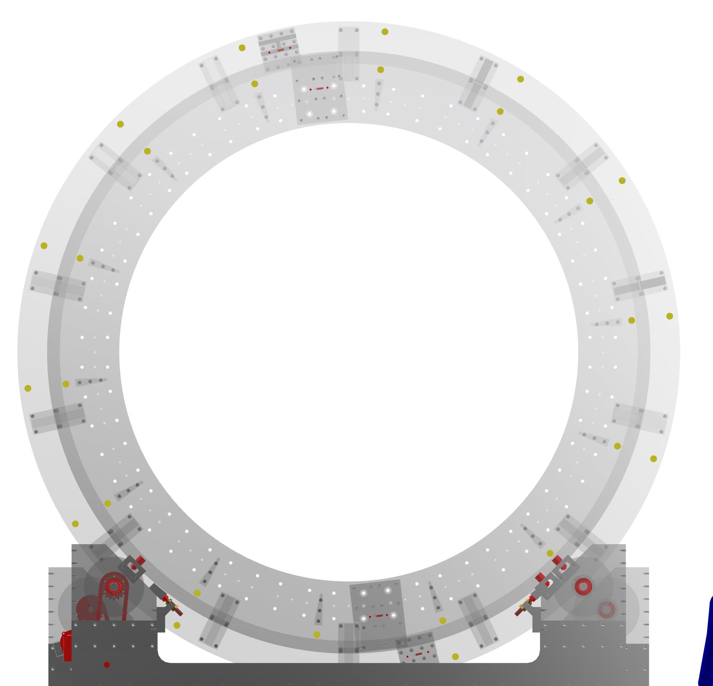
View looking straight downstream through transparent rings
78.1 in (1,983.74 mm)
Radius from beamline to center of sprocket
68.5 in (1,740.0 mm)
Radius from beamline to McM track roller

Slide 8
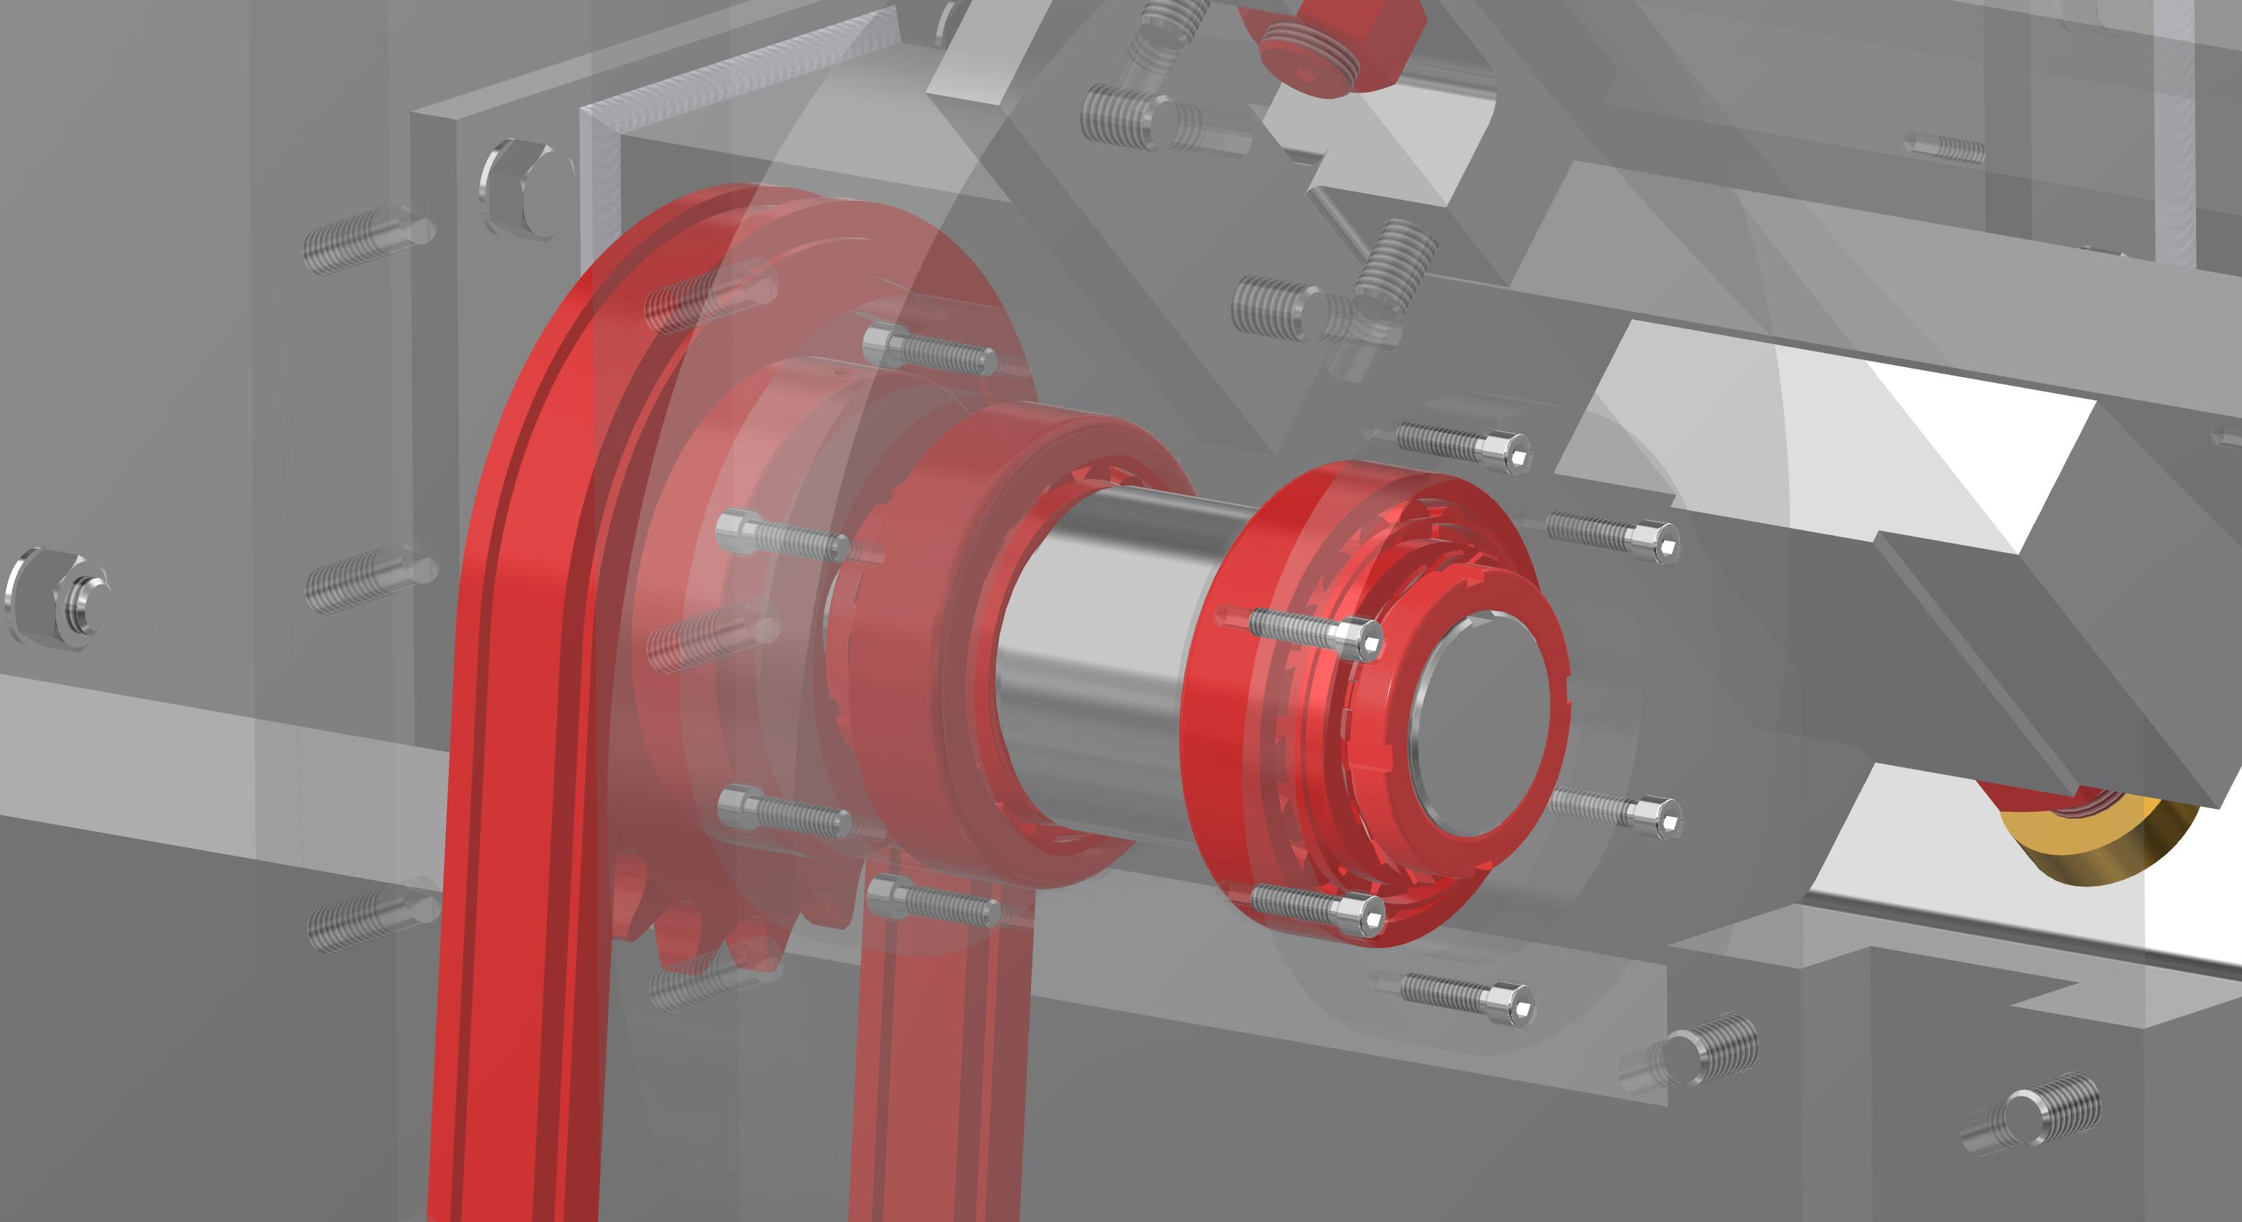
Close-up of chain, sprocket, and tapered roller bearings and hardware

Slide 9
Conclusion
Let me know what other information is needed.
Included is a spreadsheet of the material and masses of every part
The best outcome is for all the steel to be acceptable because it is outside of a given radius from beam center
If the tapered roller bearings supporting the rollers are too much steel too close the beam line, then a redesign will have to happen.

