Slide 1
Update on Moller polarimetry for MOLLER
May 22, 2024
Don Jones

Slide 2
Moller polarimeter in Hall A
Measure the parity conserving Moller scattering asymmetry from an iron foil target (polarized along beam direction) with a required coincidence between the left and right detectors.
Four quadrupoles select the events of interest focusing them through left/right slits in the dipole onto a calorimeter.
Dipole is critical in removing background and helping to reduce the Levchuk effect (correction for electron Fermi motion in target)
Aiming for 0.40% uncertainty: Note that Compton has already demonstrated this level during CREX but we are at the level where a small oversight or mis-estimation of a systematic error can have a significant effect so it is critical to demonstrate agreement between 2 or more polarimeters with similar magnitude but uncorrelated uncertainties
Moller polarimetry is invasive and must be taken at low current during dedicated period of running: added difficulty of trying to assess effects from any changes in beam properties between the measurement and the experiment production data

Slide 3
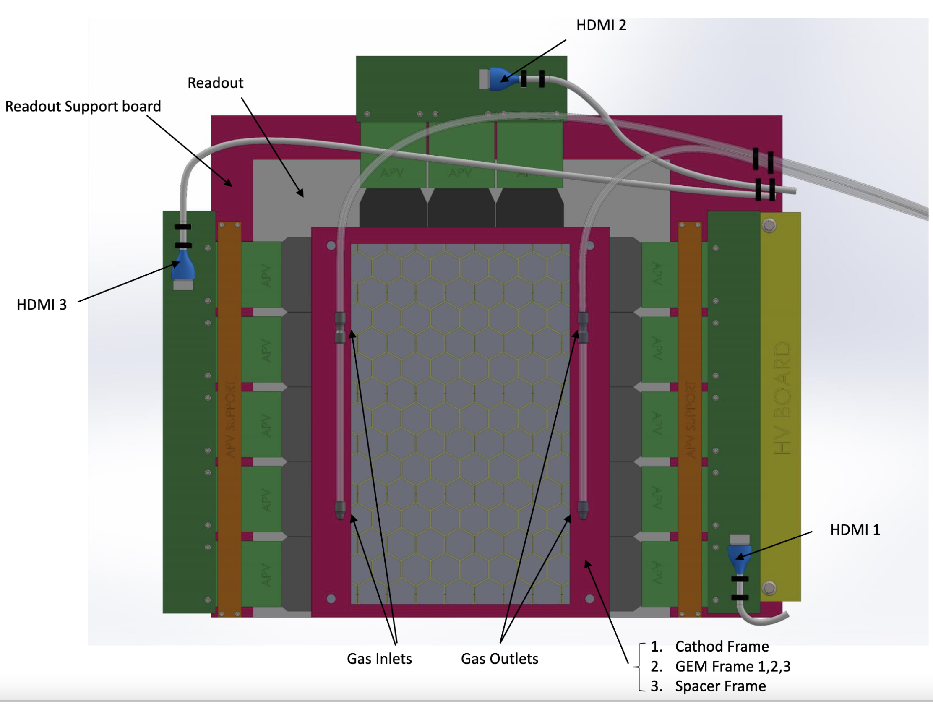
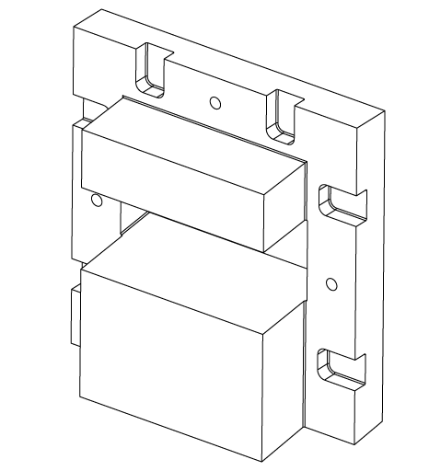
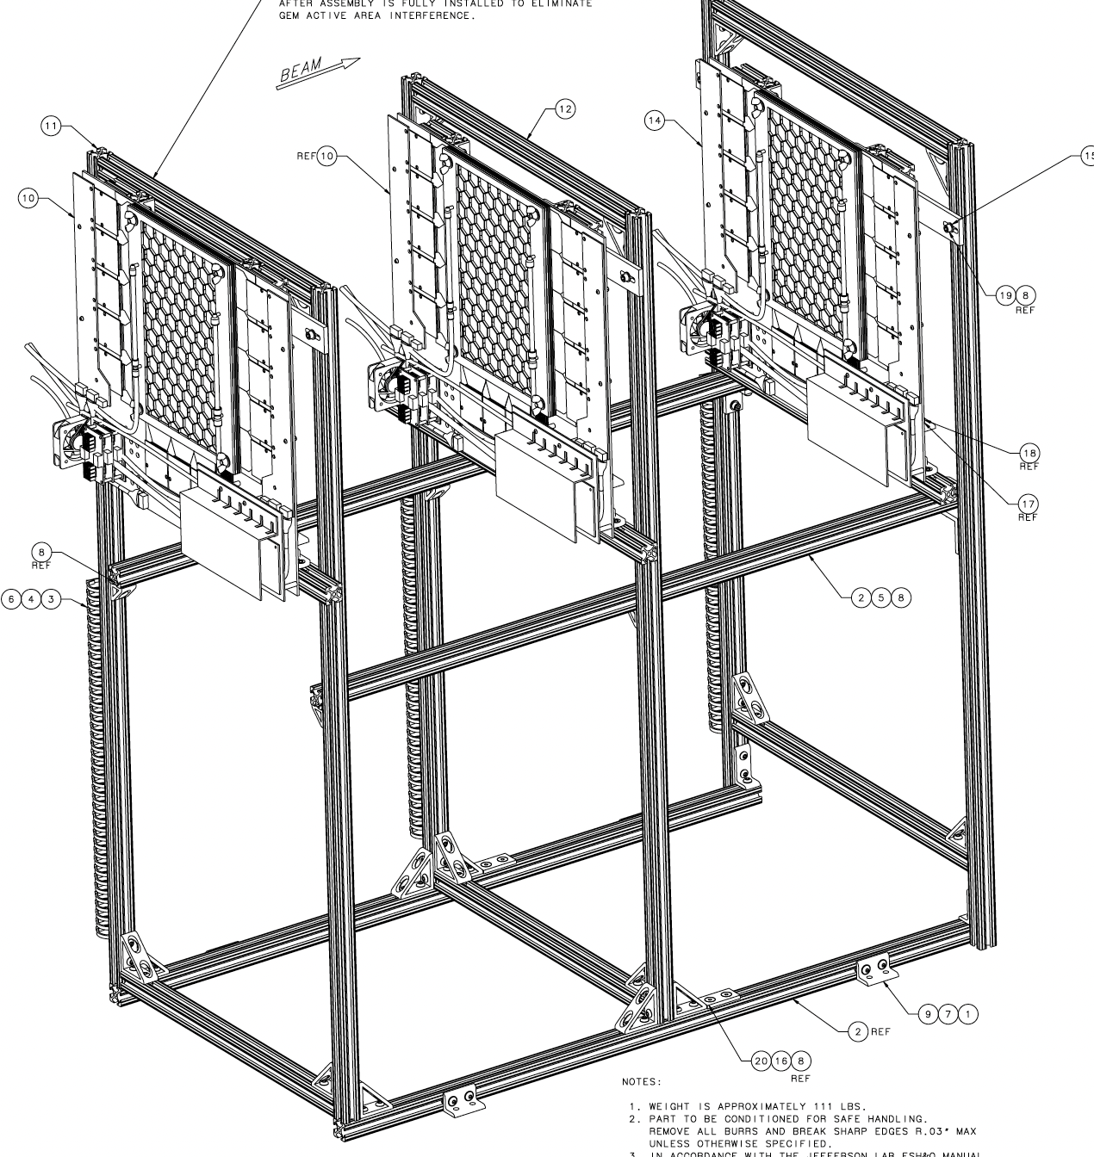
Hardware overview: changes included in the project
GEMs
Design complete including stand
Foils and frames ordered Dec. 2023: foils in queue at CERN and frames in hand
Takes 3 months to build at UVA after foils arrive
Tungsten Collimator
Limits vertical acceptance (momentum) on detector to reduce Levchuk uncertainty
Already manufactured and onsite
Syracuse spearheading installation and readout for GEMs
Moving Moller target upstream
Moving SC target magnet upstream 30cm gives more favorable optics and allows near elimination of Levchuk correction
Part of upstream beamline upgrade planned for MOLLER Summer 2025

Slide 4
Hardware overview: improvements outside the project
DAQ
Old NIM/CAMAC-based DAQ working fine, but is now obsolete
Swap-in replacements for most parts in hand.
Trusted and decently understood
New FADC-based system under development by Bob Michaels
Hope to be able to implement this DAQ in parallel during MOLLER
Verify its performance and results against old DAQ
Power supplies
Lots of power supply issues during SBS relating to quads and dipole
3 of 4 quad power supplies will be replaced this summer. 4th next year perhaps?
Plan is to purchase and replace dipole power supply during 2025
Plan for MOLLER
3 new quad power supplies in hand and will be installed this summer. 4th next year perhaps?
Plan is to purchase and replace dipole power supply during 2025 subject to availability of funds.

Slide 5
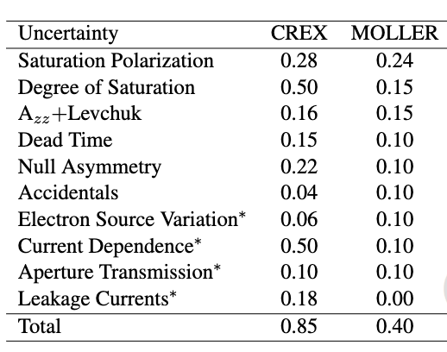
Systematic Error Estimates
Knowledge of the target polarization
Methodology under investigation
Dedicated studies consisting of several shifts
Measured with each Moller measurement

Slide 6
Progress dealing with systematics
Uncertainty | CREX(%) | MOLLER (%)
Saturation Polarization | 0.28 | 0.24
Null Asymmetry | 0.22 | 0.10
Leakage Current | 0.18 | 0.00
Electron Source Variation | 0.06 | 0.10
Azz + Levchuk | 0.16 | 0.15
Dead Time | 0.15 | 0.10
Accidentals | 0.04 | 0.10
Degree of Saturation | 0.50 | 0.15
Current Dependence | 0.50 | 0.10
Aperture Transmission | 0.10 | 0.10
TOTAL | 0.85 | 0.40
Complete
Mature understanding and techniques but still learning
Small improvements from verifying radiative+Levchuk corr
Ongoing efforts on these fronts
Top priority measurements during beam

Slide 7
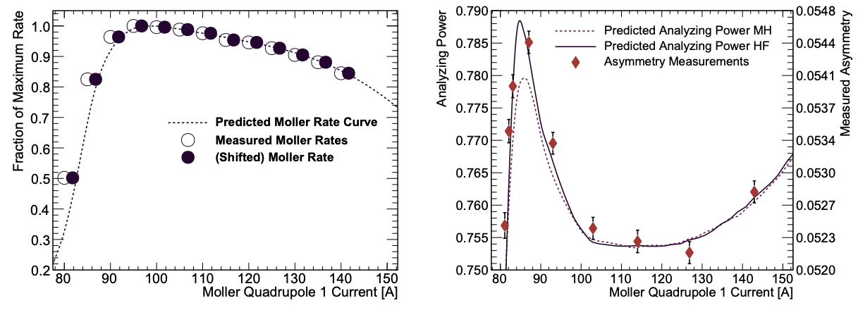
Azz + Levchuk
arXiv 2207.02150
CREX asymmetry scan
CREX rate scan
Simulation nicely follows data for rate scan
New model for electron momenta in Fe improved Levchuk correction
Provided confidence in our model
Still we always seek to minimize systematic corrections even if we can do these corrections accurately

Slide 8
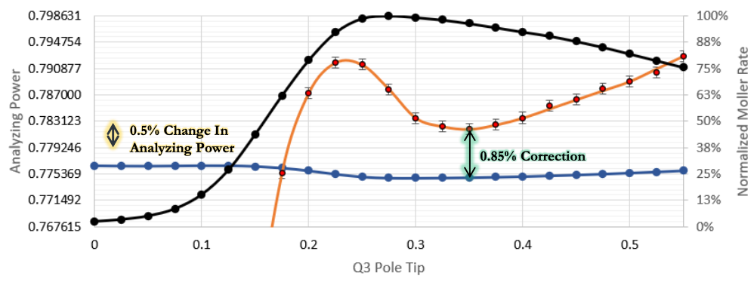
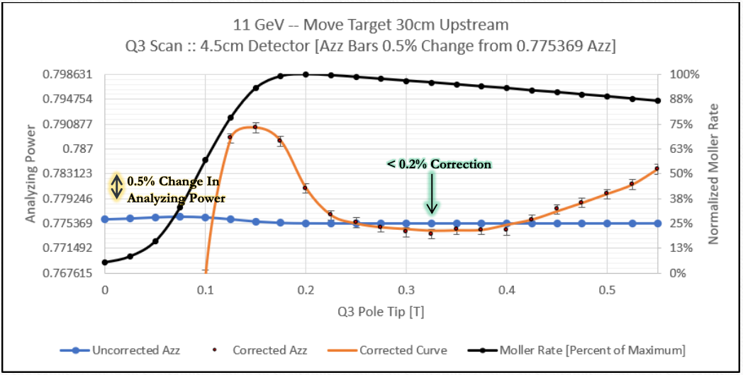
Minimizing Levchuk correction
11 GeV Target in Current Position
At 11 GeV current spectrometer had insufficient strength to focus desired Moller events through dipole (high sensitivity to optical setting and 1% level correction)
Moving target upstream 30cm and limiting vertical acceptance on detector nearly eliminates Levchuk and reduces sensitivity.
We will map this out like we did in CREX to prove the model gets Levchuk right
11 GeV Target 30cm Upstream and Detector 4.5cm

Slide 9
Unresolved discrepancy seen in SBS 4-pass data
SBS requires 3% precision so we didn’t take a long time optimizing the optics.
Possible that we ended up in a particularly sensitive configuration where small uncertainties in beam angle, upstream collimator or positions of dipole apertures had a large effect

Slide 10
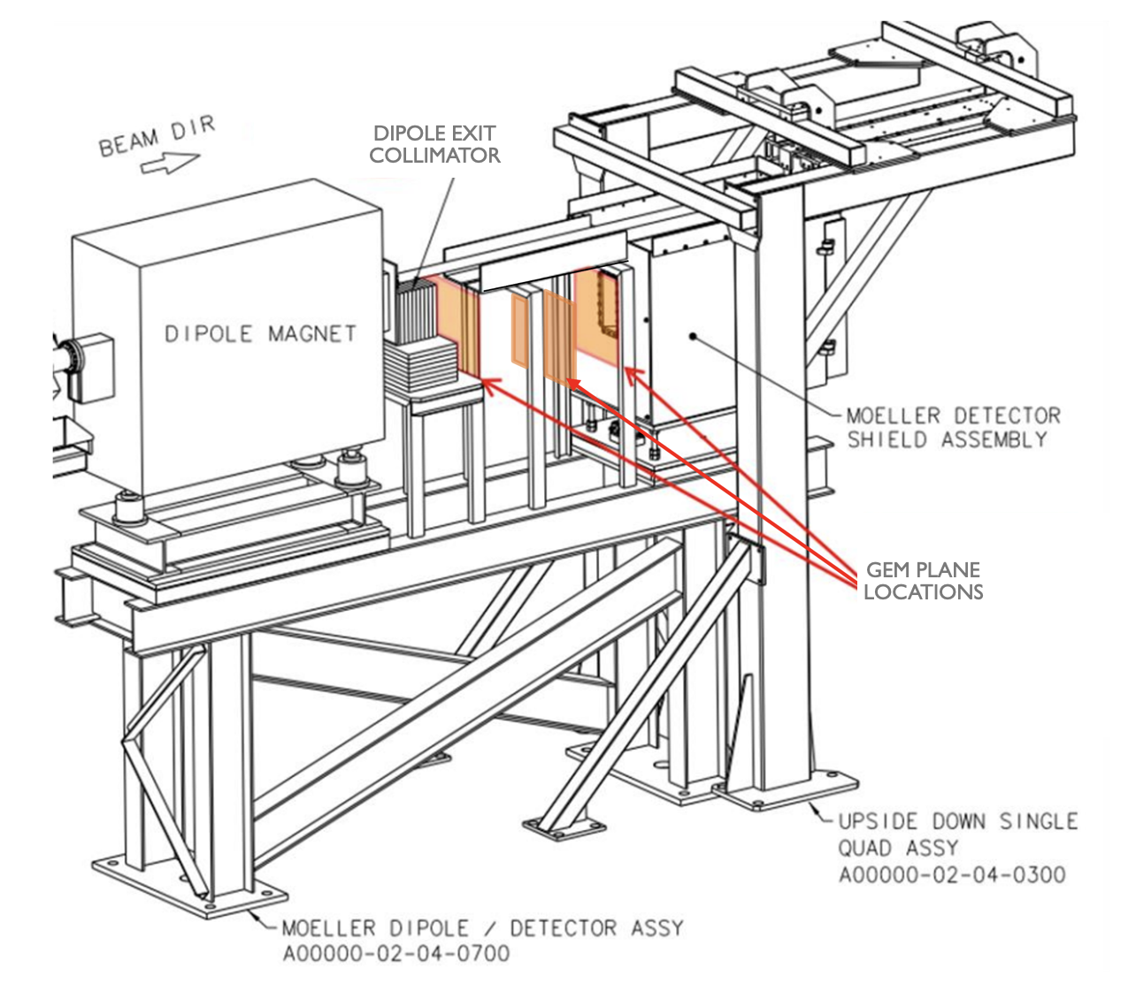
Addition of GEMs
We expect the new GEMs will help us discover some of the subtle differences between our G4 model and reality
Hope to further validate Levchuk and benchmark radiative corrections (small but currently unverified)

Slide 11
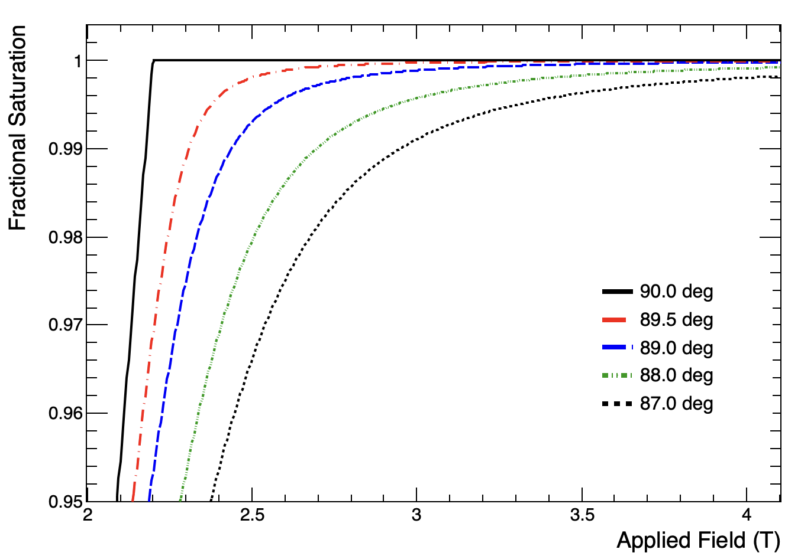
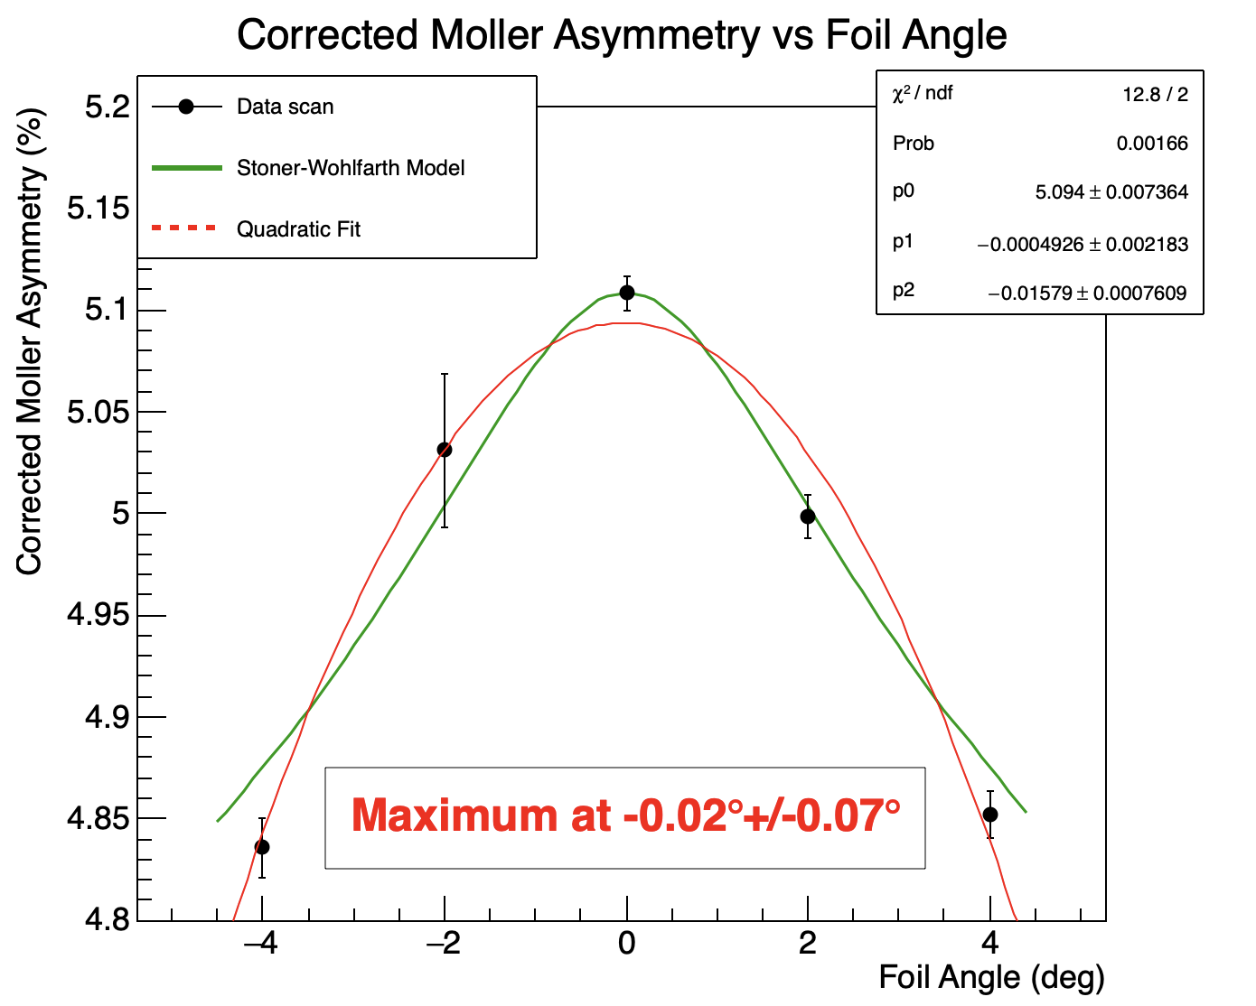
Results from SBS: foil alignment
Survey showed ladder aligned very close to normal: $<0.04°$ in yaw and $<0.11°$ in pitch
Stoner-Wohlfarth shows negligible difference between perfectly normal and $0.5°$ off normal down to 3T
Stoner-Wohlfarth Model
Asymmetry vs foil angle data taken during Gen at 2.5 T also showed good alignment in yaw
Stoner-Wohlfarth model (after correction to remove transverse asymmetry component) gives decent agreement with SW model
Demonstrated we can easily and quickly measure foil angle (short runs sufficient due to large change @2.5T)

Slide 12
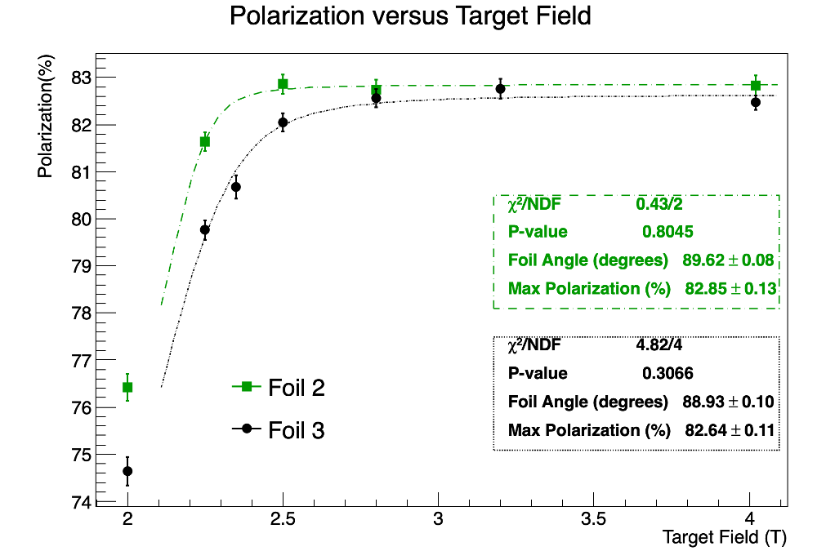
Saturation scan
Two 10 micron foils during GEn
Foil 2 gives slightly lower polarization (0.21+/-0.17%) and roll-off is consistent with slightly worse alignment (likely not mounted perfectly tight and flat)
Foil 3 appears to be almost perfectly aligned and saturated all the way down to 2.5T (2.2T is theoretical saturation point for perfectly aligned flawless monocrystalline foil)
Conclusions
A well aligned, taut foil is saturated at 3T
Takes 15.5 minutes to ramp from 3T to 4T, so save ~0.5hr per measurement.
A poorly aligned or loose foil can easily lead to a 0.3% level systematic error
Comments
Suspicion is an imperfectly taut foil leads to inconclusive results like we have seen eg. lower polarization at higher field
Need agreement from >1 foil to convince ourselves we have reliable results.
Need at least 1 saturation curve with 0.1% per point errors

Slide 13
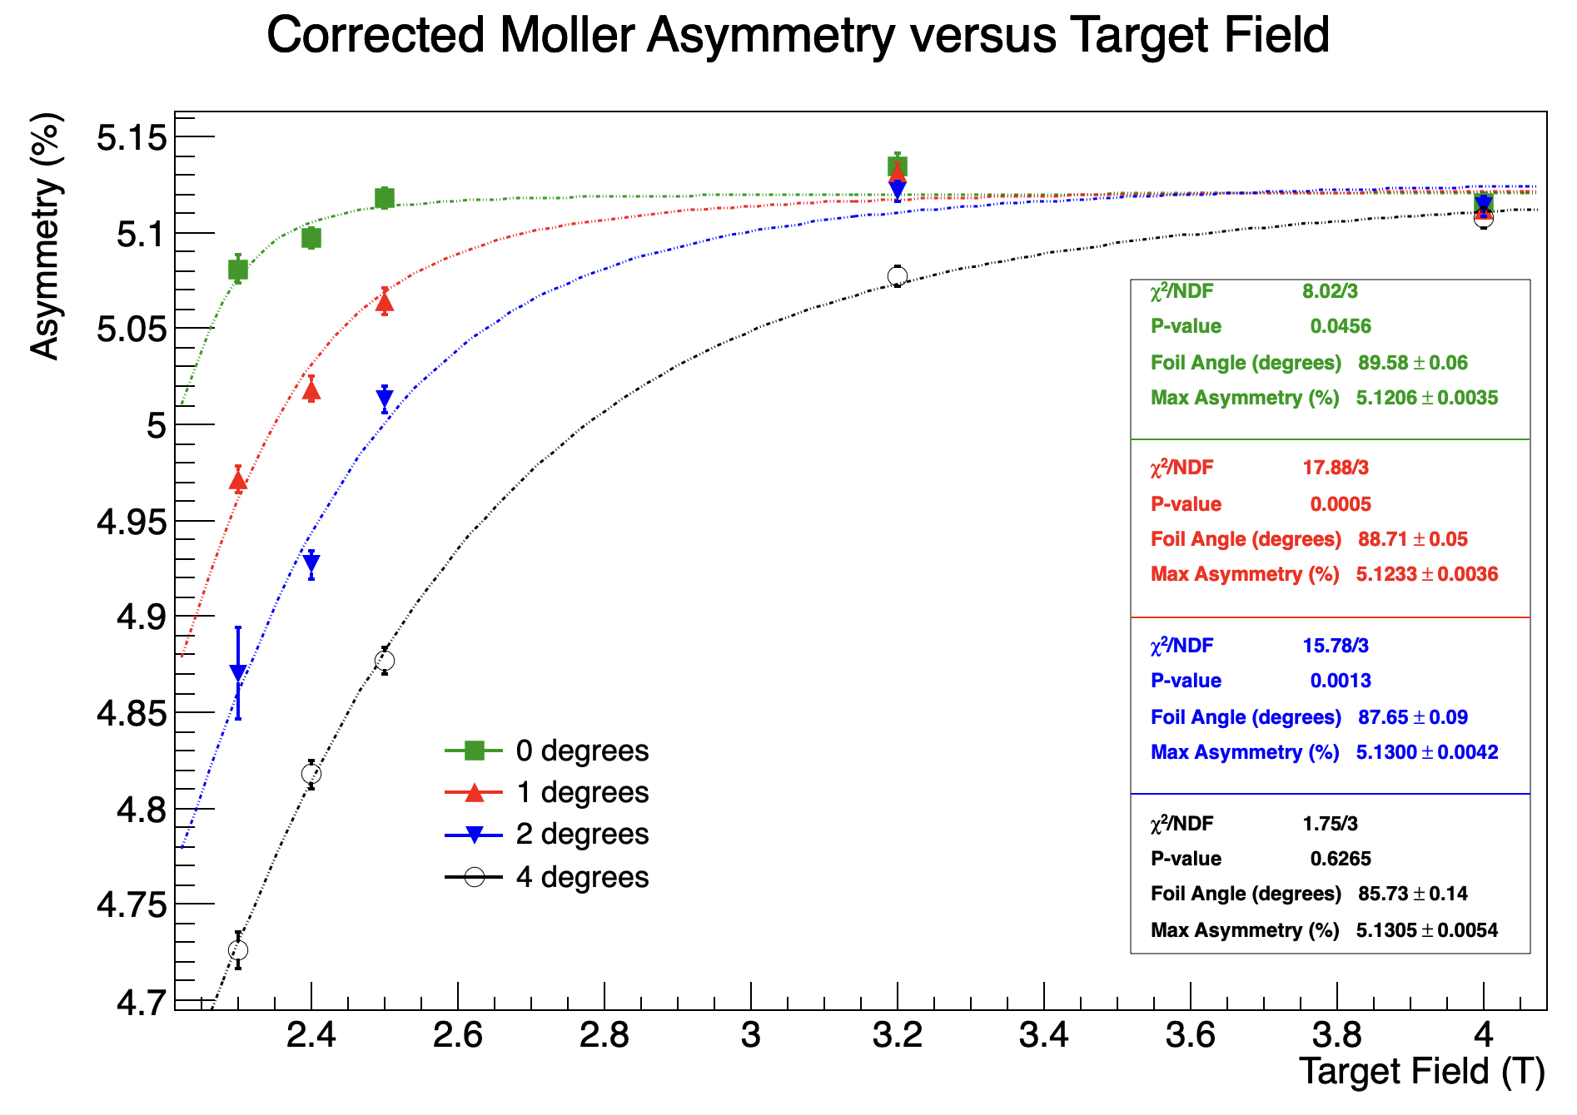
Saturation scan with foil rotation during SBS
Took Azz and Saturation scans
Precise (0.1-0.15% per point) but poor setup
At 4-pass and 17 degrees off longitudinal highly sensitive to precession drift
Large point-to-point changes believed to arise from changing beam conditions rendering precise interpretation difficult
Overall take-aways valuable
Fit to SW model gets foil angle to within $0.5°$
SW model provides good estimate of alignment error
Need to be set up in region where insensitive to changes in beam energy/precession if hope to get interpretable curves with indisputable saturation
Unaccounted for point-to-point changes remain an issue for us. New DAQ will provide additional diagnostic power.

Slide 14
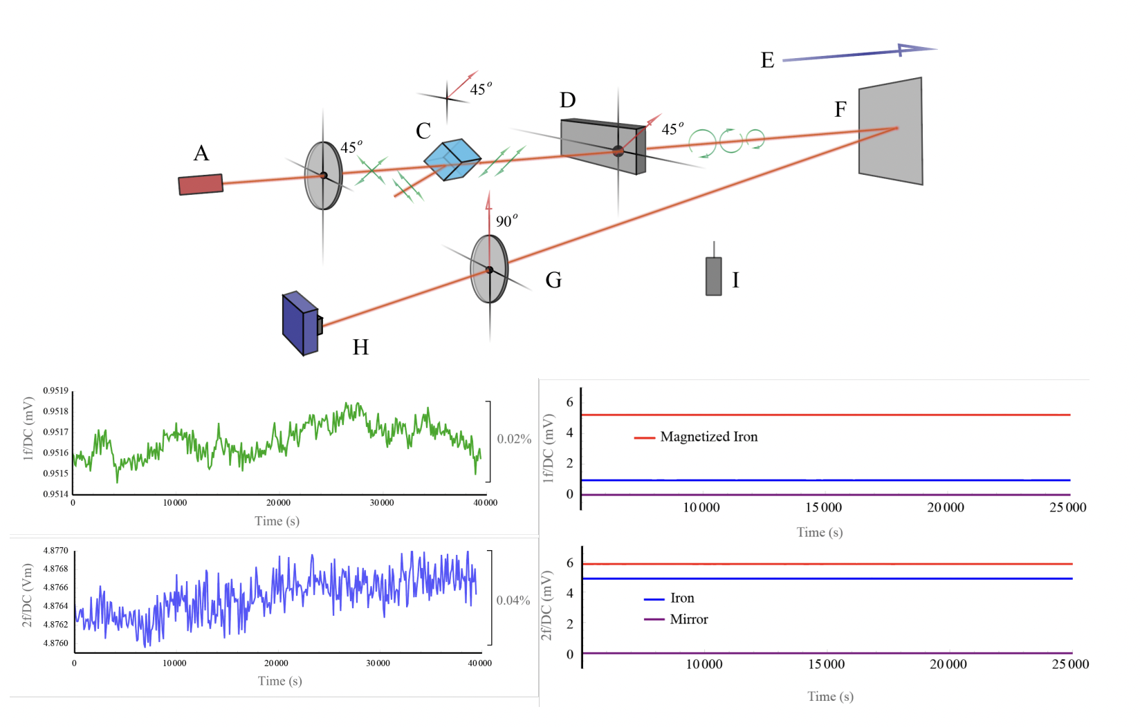
RMCD apparatus studies continued by Temple Group
Reflectance magnetic circular dichroism (RMCD) effect exploited to measured polarization with laser
Encouraging initial results provide stable signal and significant difference between signals reflected from magnetized and non-magnetic foils
Since we have no high field magnet available, Jim N. submitted proposal to MagLab at Florida State to used high field magnet→approval for 1 week Aug 2024
Possibility to save a lot of beam time if we can demonstrate saturation (at what field?) and sensitivity to angle

Slide 15
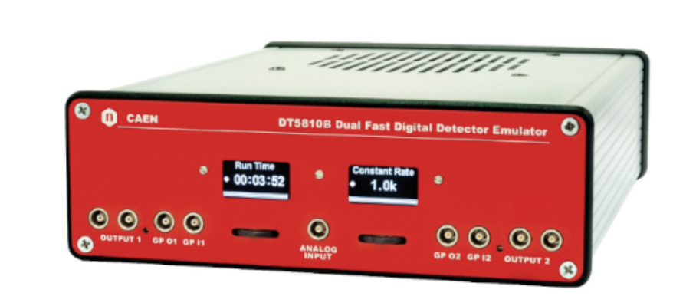
Dead time and accidentals
Dead time determined using 5kHz pulser during regular data taking with beam and seeing how many pulses are missing.
Ongoing effort to confirm with new flexible detector emulator that provides Poisson-distributed pulses at a user-selected rates on two independent channels with coincidences and singles following a given energy distribution.
Results from these studies also helped us recognize deficiencies in our accidental correction which we are working to modify.
Accidental rate measured using delayed signal (~120ns)

Slide 16
High current extrapolation
Large uncertainty due to the fact that production data is taken at 70uA where the Moller measurements are taken at 1uA. Is there any evolution of polarization with current?
We can in principle repeat a “beat frequency” study from 2006 where the laser frequency is tweaked off the 499 MHz frequency of the chopper such that only every Nth pulse goes through the main aperture and the remaining pulses drop on the aperture face. Keeps current off photocathode high while current in the hall remains low. $N=\frac{F_{laser}}{\left|F_{laser}−F_{chopper}\right|}$
Example: Take a Moller measurement at 4uA under usual injector setup. Set up the laser frequency such that every 16th pulse goes through the A-aperture in the master slit (469.6471 MHz). Take another measurement at 4uA in the Hall corresponding to 64uA off the photocathode. Revert to usual 499 MHz laser and take final measurement at 4uA. Compare.
Collaboration will have to decide on the relative value of such systematic studies but they are the only way we can reach our goals.

Slide 17
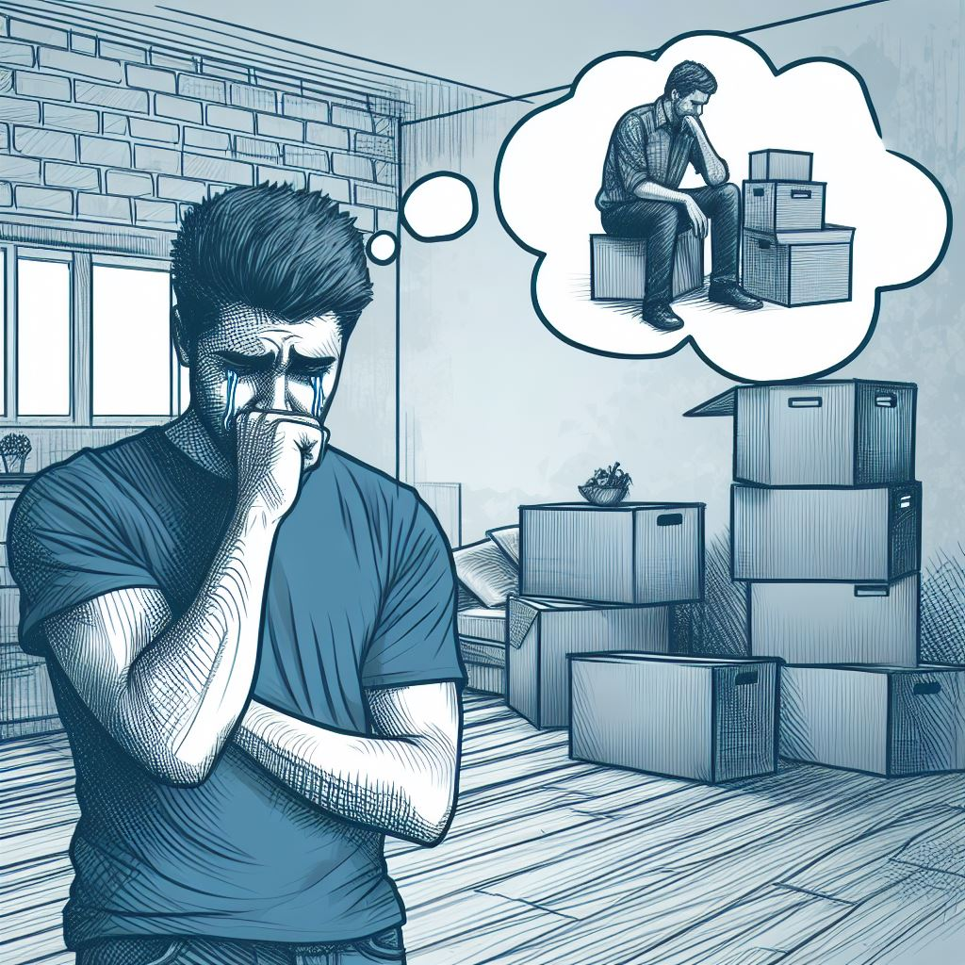
Here I am worrying because I have no room full of boxes to demonstrate progress

Slide 18
Summary
Steady improvements on understanding the systematic errors and the apparatus and we are going through the process of reducing each one
New hardware improvements will increase accuracy and reliability
Optimistic that we can reach the vicinity of 0.40% but it will depend somewhat on what the collaboration deems appropriate to give in terms of systematic studies with beam time.

