Slide 1
Spectrometer physics
Fields and particle tracks
Juliette Mammei

Slide 2
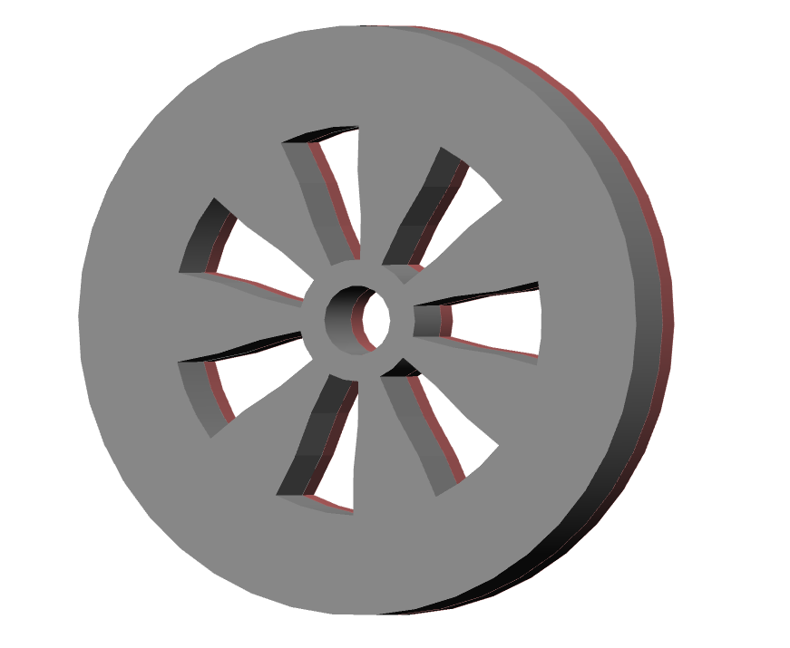
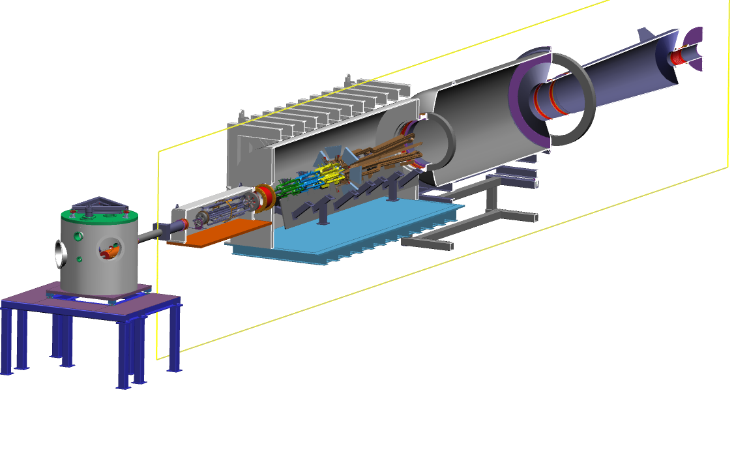
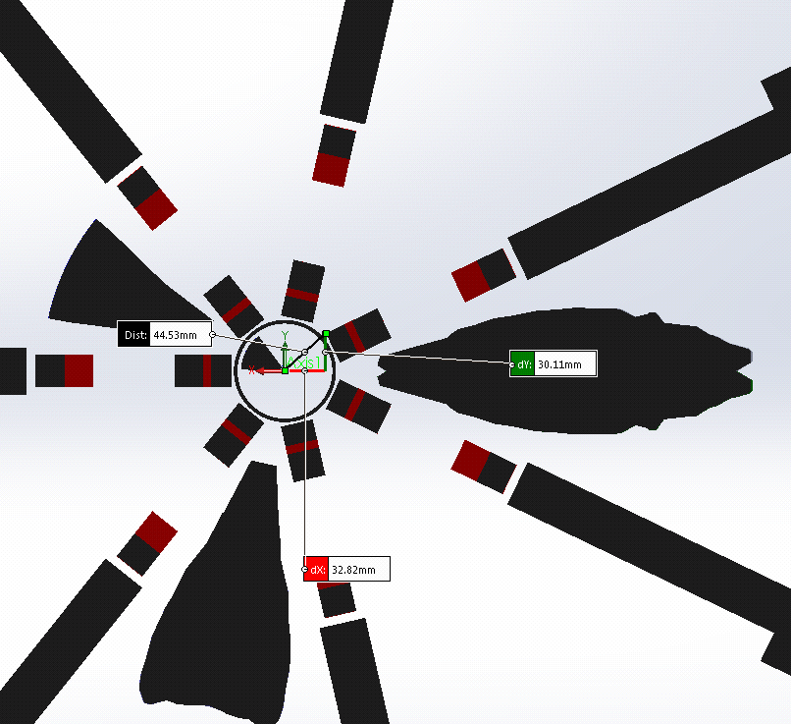
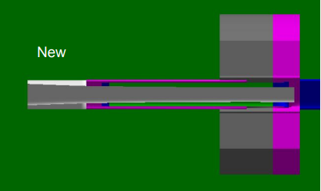
Open Spectrometer system separates signal from backgrounds
cleanup collimator – coll 4
Full azimuthal acceptance for mollers from
6 < $θ_{lab}$ < 20 mrads
Collimators 5 and 6a, b provide add’l clearance to coils
Photon scraper provides clearance to the photon envelopes
particle envelopes defined along beamline
Acceptance defining collimator(s) – coll1+2
Wedges and “2-bounce” tube to shield epoxy
lintels and collars throughout to provide shielding for detectors
Coils in one septant

Slide 3
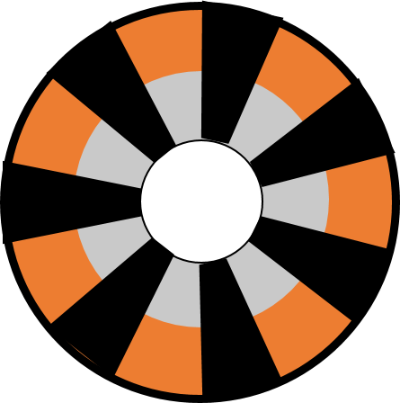
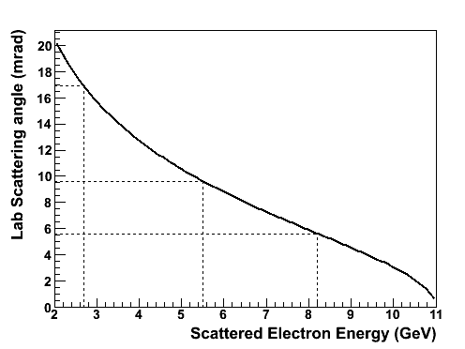
100% Azimuthal Acceptance Possible
Appendix
Energy and scattering angle strongly correlated for mollers (eps are all ~11 GeV)
Maximize azimuthal acceptance
identical particle scattering
accept COM angles around 90◦
Large energy and angle range to focus
21 mrad
9.5 mrad
6 mrad
Acceptance defining collimator
Lab Frame
Detectors in open sectors
e-
2 < E’ < 8 GeV
e-
6 < θ < 21 mrads
e-
e-
e-
Forward and backward (in COM) scattered electrons from two events (line type links electrons from same event)
e-
Coils in closed sectors
Any odd number of coils will allow for 100% $φ$acceptance

Slide 4
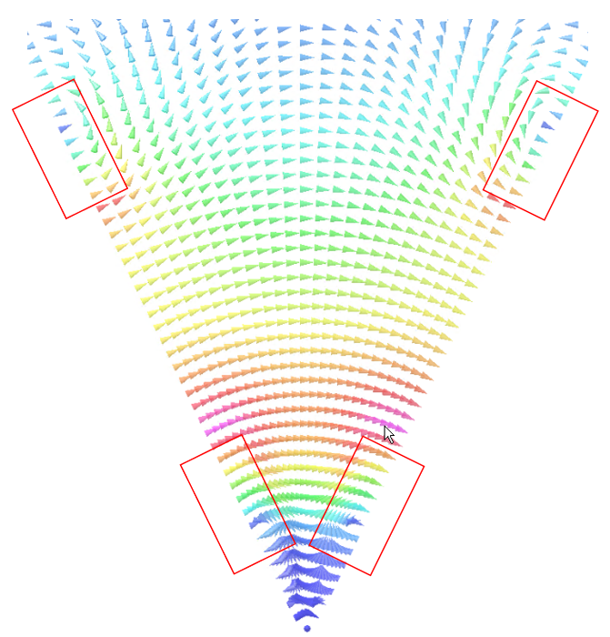
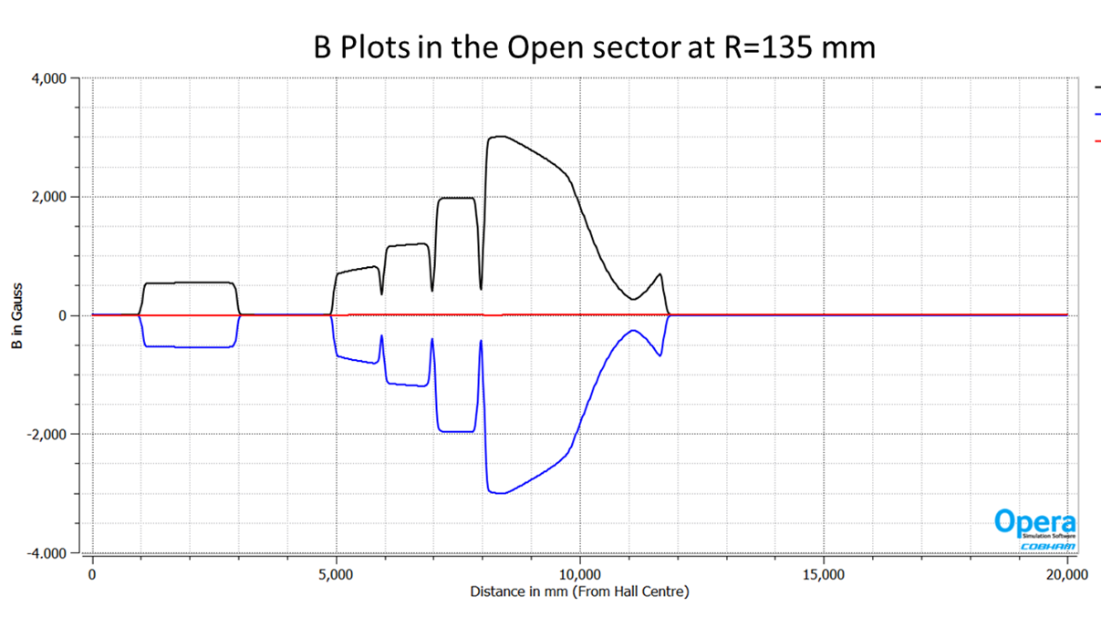
Shape of Field in a Septant – varies along z, and also along r and $φ$
Appendix
z=9500mm
Vector map colors show relative total field strength in a septant
Radial components of field cause azimuthal (de-)focussing near the conductor at the (outer) inner radius of the conductor
Provides required inelastic electron separation
Causes mid-angle mollers to fill full azimuth at detector
Field varies along z to separate the low E moller and high E eps
azimuthal de-focusing
BMOD
B_{φ}
B_{z}
azimuthal focusing
R=135mm
B (Gauss)
z=9500mm
$B_{ideal}=\frac{μNI}{2πr}$ in the $φ$ direction
Notes:
This contour plot shows the relative strength of the total field in different locations within a septant. The approximate locations of the adjacent coil cross-sections are shown in orange. Illustrative field vectors indicate the direction of the field at different places. The radially focussing part of the field is the phi component; at the center of the septant the field is all in the phi direction. Near the coils, however, you have components in the radial direction. In between the inner radius parts of the coil, this results in azimuthal focussing of electrons; in between the outer radius parts of the coils we get phi defocussing. We make use of the focussing in phi to study the different parts of the acceptance.

Slide 5
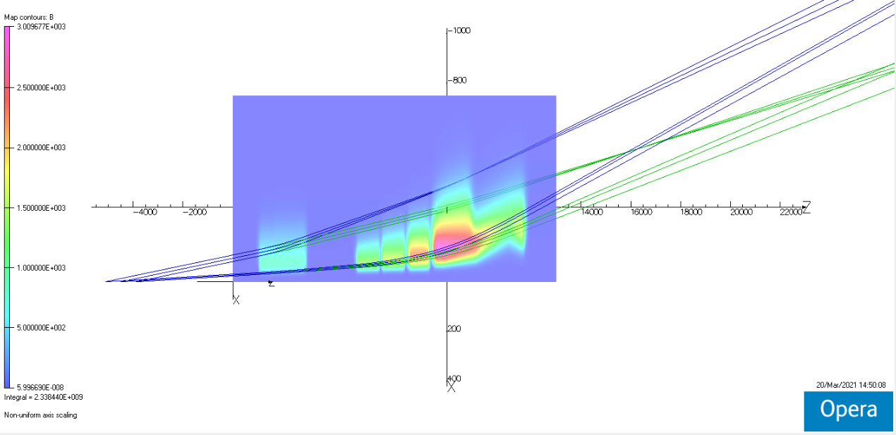
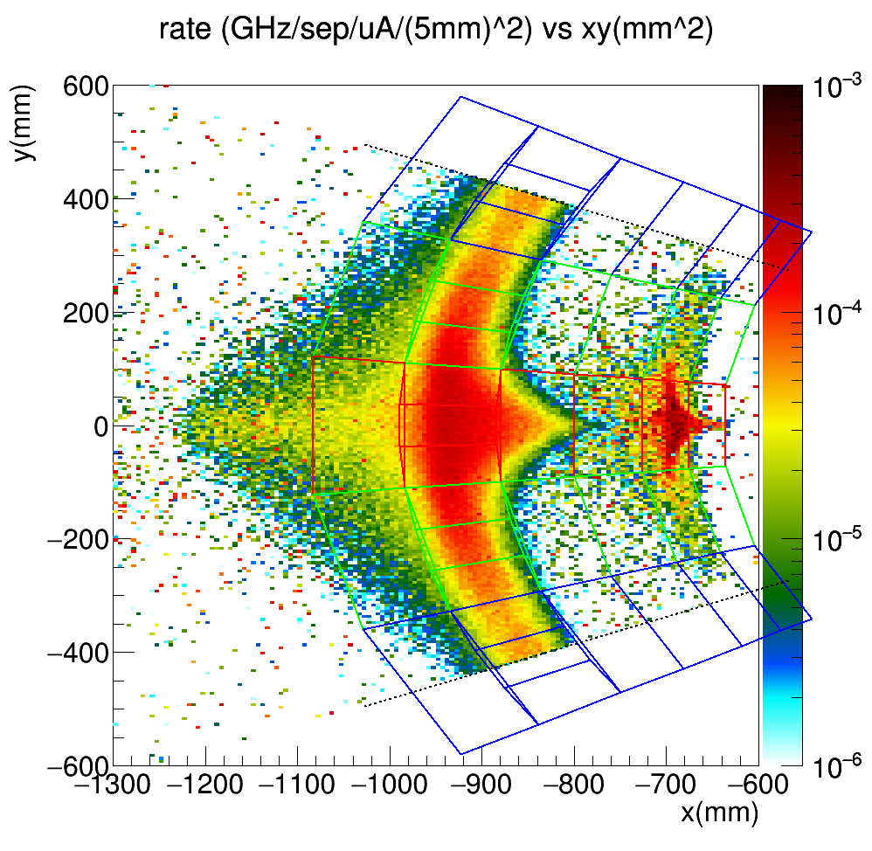
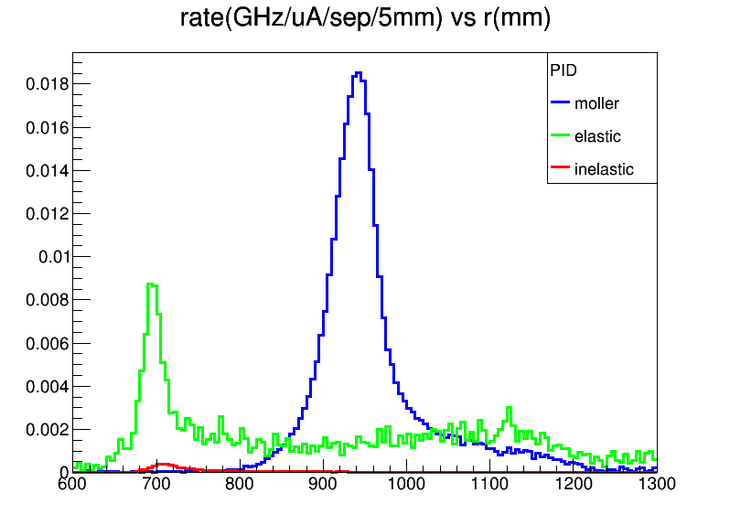
Fields produce desired particle tracks
Side view of $φ$=0 field and tracks (center of open septant)
Tracks are 6 and 21 mrads for both ep and mollers, from 3 different parts of the target
Tracks have energy/angle correlation, but not the radiative effects in the target
detector plane z=2650cm
Dashed lines indicate the extent of a single septant
Transport through the magnets causes the moller “envelope” to be azimuthally defocussed; allows for
monitoring of systematics
deconvolution of the asymmetries
Require ± 10% current for background determination
2D rate
ep
moller
1D radial dist., all $φ$
includes rad. eff.
Red – “open” sector
Blue – closed sector
Green – transition sector
Notes:
This slide shows another contour plot showing the relative total field at the center of an open sector in a plane parallel to the beamline. Superimposed are two sets of particle tracks produced in TOSCA; one for the electrons from elastic ep scattering and the moller electrons. In the lower right is a 1D distribution of these events from the GEANT simulation which includes all the radiative effects in the target. You see the long radiative tail from the elastic events underneath the MOLLER peak is approximately flat; to minimize this and the inelastic background we want as tight a focus in the moller peak as we can get.

Slide 6
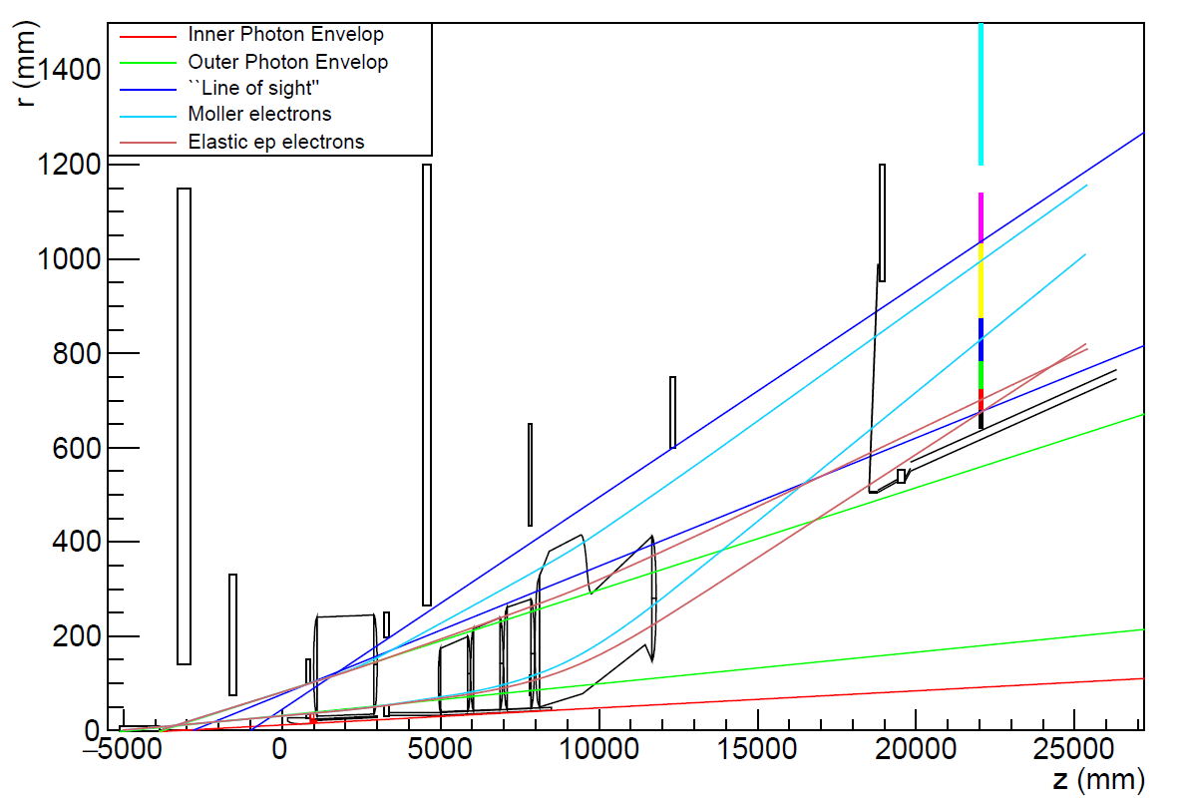
Blocking backgrounds (and not signal!) – ray drawing
Ray traces with apertures
Coils shown for position reference (actually in closed sector)
Detector plane
Moller/ep
Line of sight
moller
Collars
ep
Lintels
DS beampipe between OPE and ep envelopes
Collimators
1+2 4
Outer Photon Envelope
Target
Inner Photon Envelope

Slide 7
Beam particles with various energies and scattering angle of 2.4 mrad
Ray traces with apertures
Coils shown for position reference (actually in closed sector)
Detector plane
Moller/ep
Line of sight
Rays for “primary beam” particles of different energies for a relatively large angle
moller
Collars
ep
Lintels
DS beampipe between OPE and ep envelopes
Collimators
1+2 4
Outer Photon Envelope
Target
Inner Photon Envelope

Slide 8
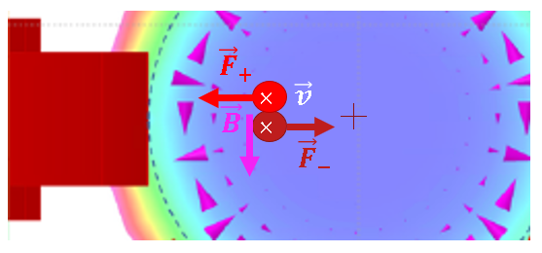
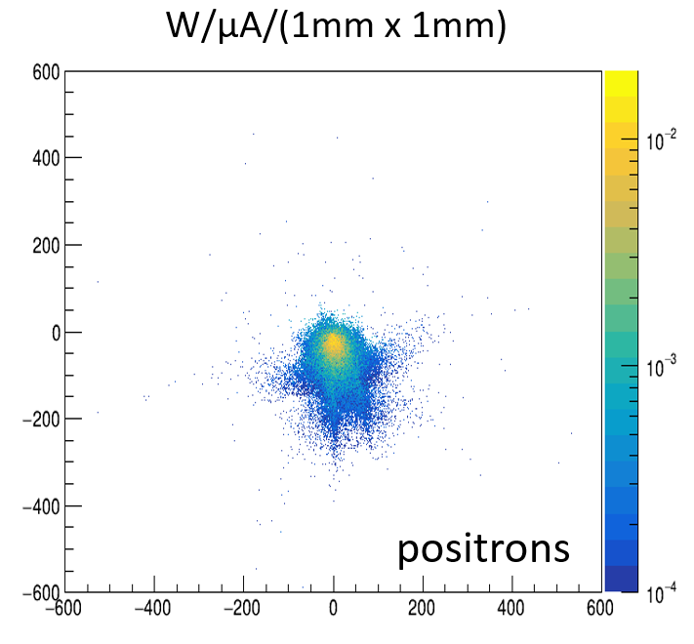
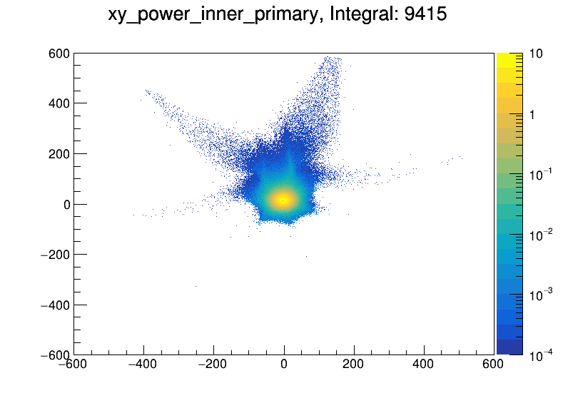
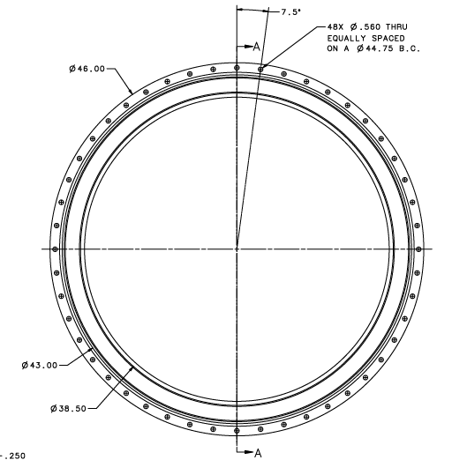
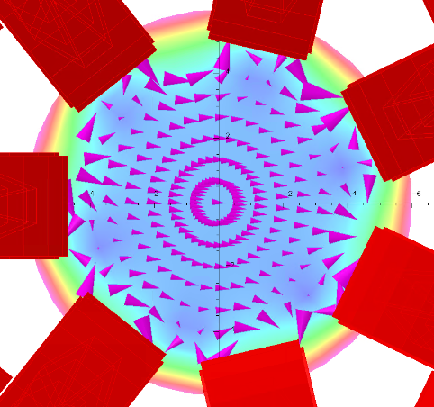
Fields in the beamline – symmetric and asymmetric cases
e⁺ will be bent to the left (onto the coil)
e⁻ will be bent to the right (into the open sector)
End of Hall
dump entrance
flange (r = 483 mm)
Consider the horizontal coil, in the perfectly symmetric case
all velocity in the z-direction
field is vertical along the x axis, (mid-plane of coil)
just off the axis,
e± would feel both horizontal and vertical components of force
the field direction is dramatically different
dispersed
limiting aperture in dump tunnel (r=300mm)
(~0.5 m downstream)
Worst case scenario
dipole field
electrons
(within tolerances)

Slide 9
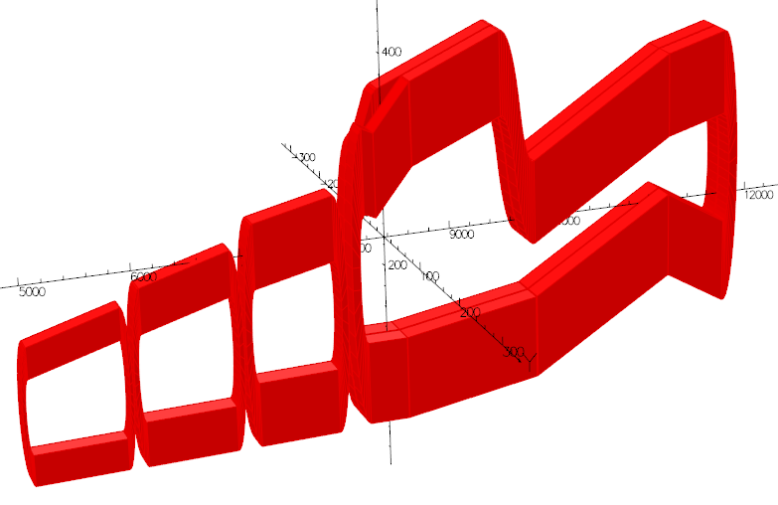
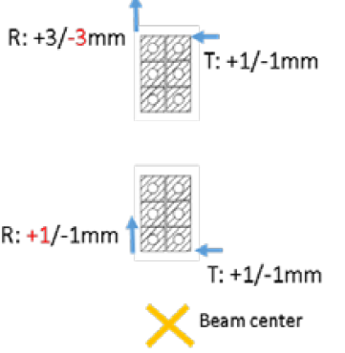
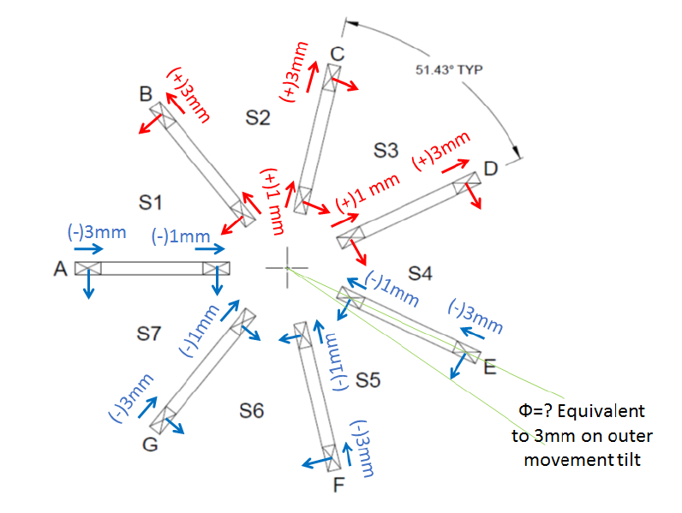
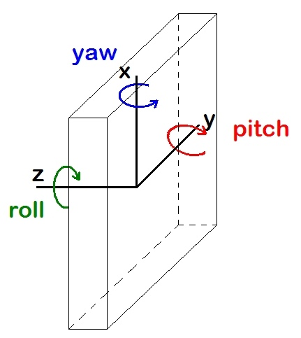
Alignment tolerances determined first by physics and clearance of signal
Tolerances determined by single coil/single offset studies have been verified with “worst-case” multiple coil/multiple offsets within the specified tolerances
Considerations
physics optics (ability to “deconvolute” the asymmetries with desired uncertainty)
signal electron focal plane distributions
backgrounds
clearance with the scattered particle envelopes
clean transport to the dump
doses on coils (epoxy, especially at inner radius)
single coil/ single offset tolerances
along z
azimuthally
radially
BEAM worst cases tested
coils aligned in a “conspiratorial” way within tolerances
→ induces dipole along beamline
worst (to left)
more likely - only ±0.5 mm
most likely ±0.5 mm and random for different subcoils
Physics worst case
All coils offset in same direction (without us knowing)
Least likely (survey, tracking)
Relatively insensitive

Slide 10
Summary
Many spectrometer items are actually here, at the lab (see engineers talks)
Many things are being tested for quality control and as-built dimensions for entry into the simulations
Eventually as-built coil maps will be produced
The optics group is looking into the effects of offset coils and the ability to verify coil locations using tracking data (see optics talks)
People should be aware of the effects of the field on electrons (and positrons) in both the acceptance region and the beamline
When simulating you should consider using the symmetric map and also asymmetric maps, especially if considering beamline backgrounds

Slide 11
Appendix

Slide 12
Shape of Field in a Septant – varies along z, and also along r and $φ$
Appendix
z=9500mm
Vector map colors show relative total field strength in a septant
Radial components of field cause azimuthal (de-)focussing near the conductor at the (outer) inner radius of the conductor
Provides required inelastic electron separation
Causes mid-angle mollers to fill full azimuth at detector
Field varies along z to separate the low E moller and high E eps
azimuthal de-focusing
BMOD
B_{φ}
B_{z}
azimuthal focusing
R=135mm
B (Gauss)
z=9500mm
$B_{ideal}=\frac{μNI}{2πr}$ in the $φ$ direction
Notes:
This contour plot shows the relative strength of the total field in different locations within a septant. The approximate locations of the adjacent coil cross-sections are shown in orange. Illustrative field vectors indicate the direction of the field at different places. The radially focussing part of the field is the phi component; at the center of the septant the field is all in the phi direction. Near the coils, however, you have components in the radial direction. In between the inner radius parts of the coil, this results in azimuthal focussing of electrons; in between the outer radius parts of the coils we get phi defocussing. We make use of the focussing in phi to study the different parts of the acceptance.

Slide 13
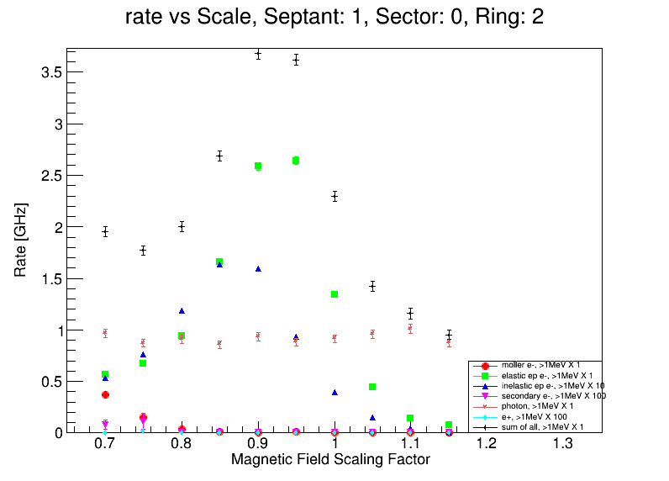
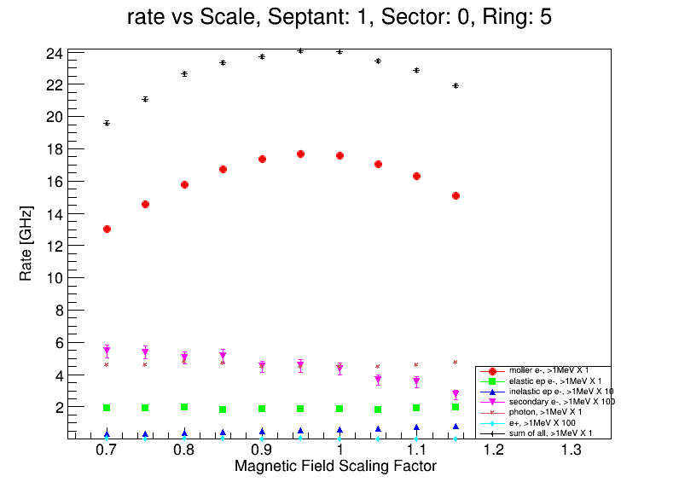
Using the whole detector array
Appendix
Although we call the rings moller or ep rings, we actually use more than one ring to determine the moller asymmetry
We will use the different contributions of the rate and asymmetry for each of the processes in each of the detector tiles to “deconvolute” the asymmetries for each process
Measurements to benchmark simulation with tracking system
low current runs - rate distribution on array
alternate beam energies
neutral dilution determination
high current - vary magnet currents to see how rates changes from quartz to quartz (20% less up to 10% higher current)
Notes:
we will also take measurements with the tracking system triggered on the main detectors (or even pulser triggered), where the GEMs and the trigger scintillators can then reject charged particles in software, and we can get at the pure neutral dilution directly

Slide 14
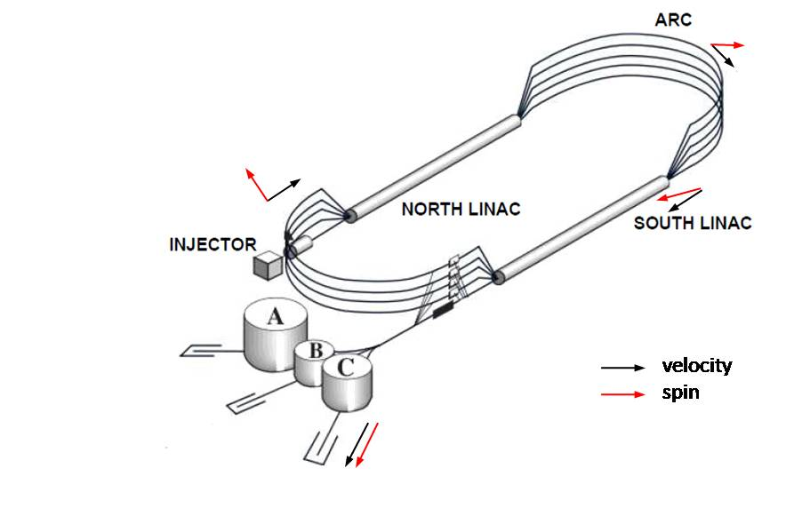
Sector Orientation
Appendix
Closed sector to beam left to shield synchrotron radiation from hall A arc
Horizontal coil

Slide 15
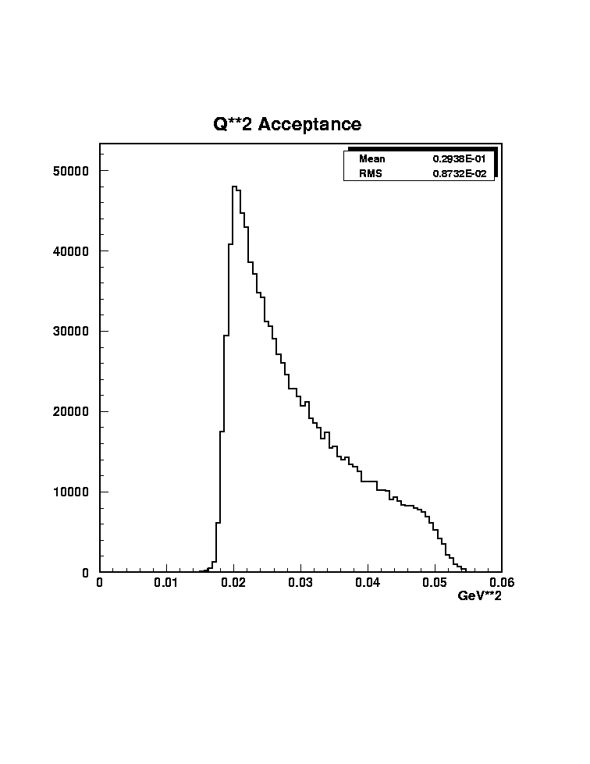
Finite Target Effects - Example
Appendix
The acceptance varies along the length of the target
Requires mapping with the tracking system
θ_{high,down}
Expected Q² distribution
R_{outer}
θ_{high,up}
θ_{low,down}
θ_{low,up}
R_{inner}
z_{targ,up}
z_{targ,center}
z_{targ,down}
z_{targ,up} = | -75 | cm
z_{targ,center} = | 0 | cm
z_{targ,down} = | 75 | cm
θ_{low,cen} = | 6.2 | mrads
θ_{high,cen} = | 19.2 | mrads
θ_{low} = | 5.5 | mrad
θ_{high} = | 17 | mrad
R_{inner} = | 3.658 | cm
R_{outer} = | 11.306 | cm
 | θ_{low,down} = | 7.1 | mrads
 | θ_{high,down} = | 21 | mrads
z_{coll} = | 590 | cm

Slide 16
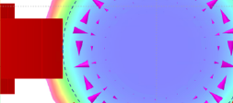
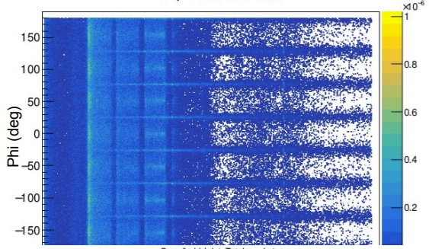
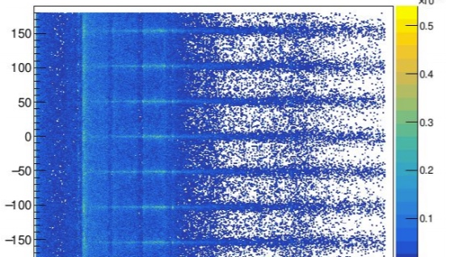
Stray fields in beampipe deflect e±
Appendix
10⁻⁶
e⁻
e⁺
$${\vec{F}}_{+}$$
$$×$$
$$\vec{v}$$
$$\vec{B}$$
$$×$$
$${\vec{F}}_{−}$$
Worst case scenario
Consider the horizontal coil, in the perfectly symmetric case
all velocity in the z-direction
field is vertical along the x axis, (mid-plane of coil)
just off the axis,
the field direction is dramatically different
e⁻ will be bent to the right
e⁺ will be bent to the left (onto the coil)
e± would feel both horizontal and vertical components of force
dispersed

Slide 17
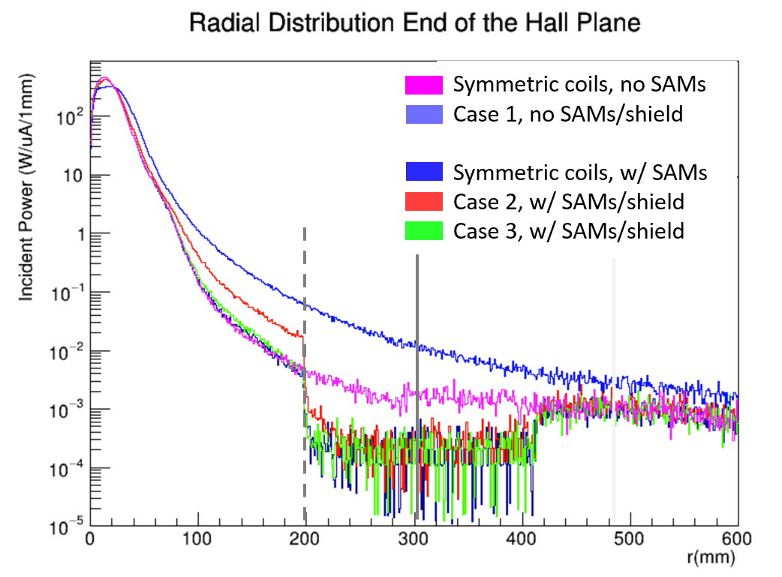
Clean transport to dump even in worst asymmetric coils*
SAM pipe
OD 400 mm
End of Hall
Worst case scenario
dump entrance
flange (r = 483 mm)
W/µA/(1mm x 1mm)
Total Beam Power 715 kW
Coil Configuration
Integrated Power from 200 mm < r < 600 mm
dipole field
Symmetric coils, no SAMs
Case 1, no SAMs/shield
Symmetric coils, w/ SAMs
Case 2, w/ SAMs/shield
Case 3, w/ SAMs/shield
38.1 W
260 W
13.4 W
17.8 W
14.2 W
worst-case* asymmetric coils
(within tolerances)
*case 1, slide 7
limiting aperture in dump tunnel (r=300mm)
(~0.5 m downstream)
electrons
(most likely configuration)

Slide 18
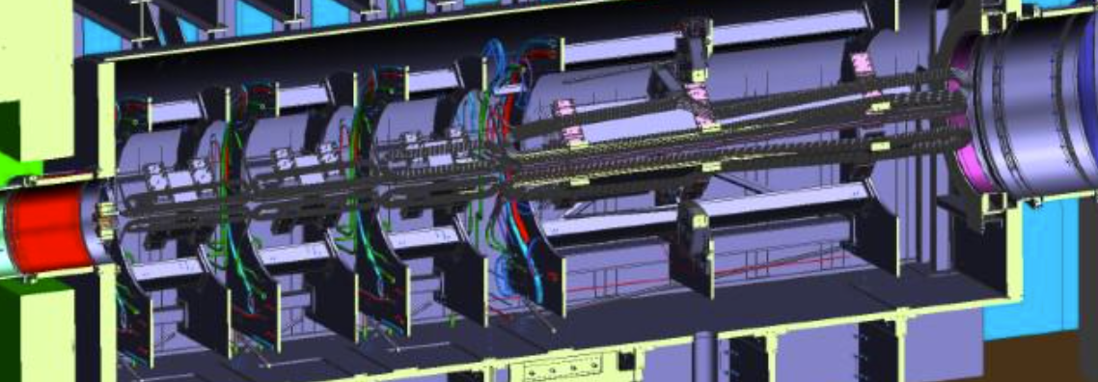
Collimators define acceptances and shielding protects equipment
Collimator 2 defines angular acceptance for signal
Downstream region
Upstream Region
Collimators 5 and 6a, b provide additional clearance to coils
Collimator 1 inserted into 2 to shield end
Wedges and “2-bounce” tube to shield US torus epoxy
Collimator 4 similar to 2 – “cleanup collimator” – at the end of the US enclosure
Photon scraper provides clearance to the photon envelopes
lintels and collars provide shielding for detectors

Slide 19
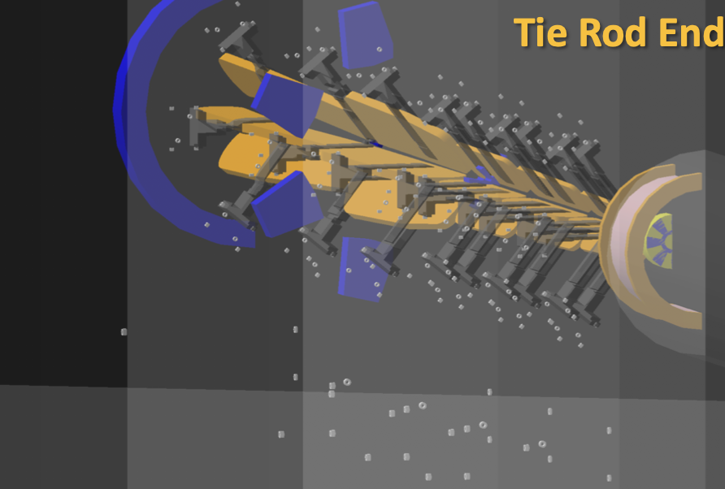
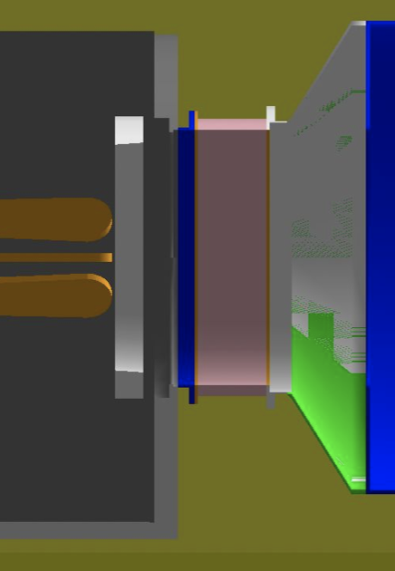
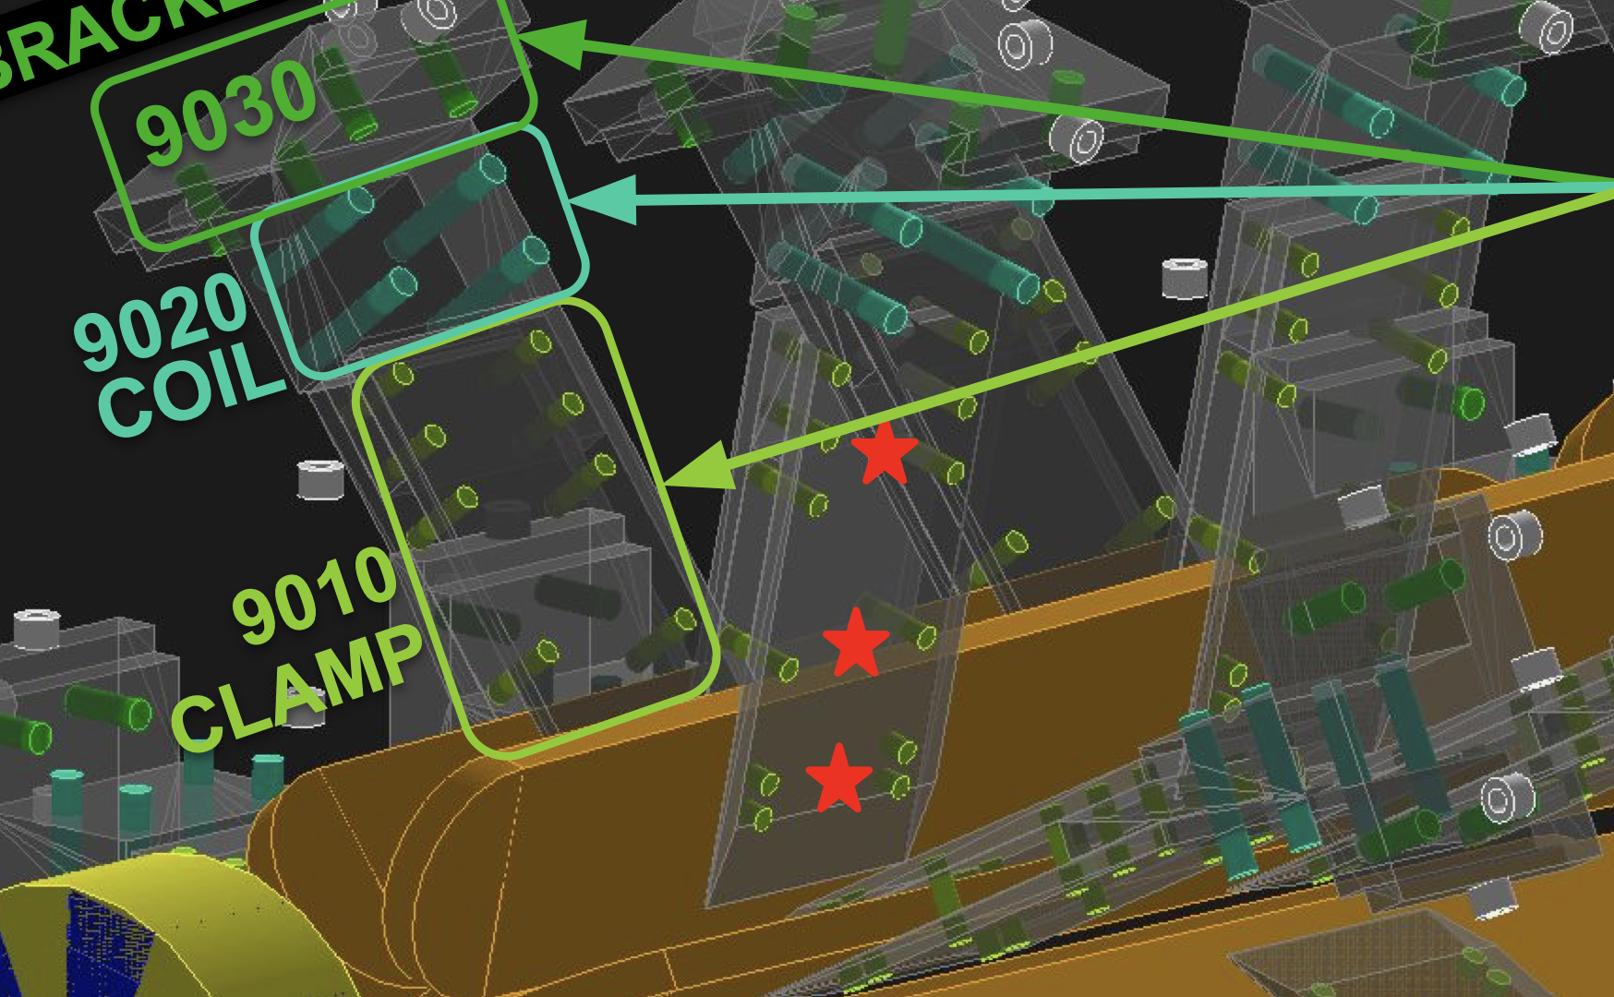
Ferrous Materials - Spectrometer
Double-spin ee or γe scattering from ferrous material can have large asymmetry.
Guidance for engineering, using conservative estimates of PeAn ~10⁻³
Simulations in G4, using ad hoc “biasing” for rare event estimation
Estimate false asymmetry
$$A_{f}=f_{r}P_{e}P_{s}A_{n}$$
Examples in spectrometer system:
Large diameter bellows 4 was specified to be built using SS 316 or 310, with 310 weld rods. Bellows 1-3 were allowed to be SS, Bellows 5 and 7 are Inconel. This controlled technical risk without excessive cost.
Tie rod ends for coil assembly support: large number of ferrous hardware were shown to be unacceptable - to be replaced by titanium
Demonstrated need for silicon bronze fastener hardware on coils mounts
Approved SS vacuum or water connections at edge of spectrometer
Demonstrated need for concrete walls downstream of US Torus and drift pipe due to floor-level ferrous steel
fr rate fraction of process
Pe incident electron polarization
Ps material electron polarization
An analyzing power
Goal: Af < 10⁻¹¹
In ~1G ambient field:
mild steel: Ps~10⁻²
Stainless steel: Ps~10⁻⁵ ~10⁻⁷
Inconel 625: Ps ~10⁻⁸
Aluminum (paramagnetic): Ps <10⁻⁹

Slide 20
Engineering designed to meet the physics requirements
The spectrometer system must
Achieve the physics optics (bend particles) by
defining the angular acceptance in a well-defined way
separating the moller and elastic ep electrons
providing 3 kinematic regions of the inelastic electrons (to deconvolve the asymmetries)
Shield the experiment by
minimizing the backgrounds at the detector
reducing the conductor epoxy/G10 filler dose from excessive radiation to acceptable levels
ensuring clean transport of the primary beam that has gone through the target to the dump
Operate for a long running time (344 PAC days)
The acceptance of the moller electrons is defined at collimator 2
The shape of the coils and the specified tolerances achieve the physics optics
Field stability requirements modest due to averaging over time and cancellation b/c measuring asymmetry
Collimator 1 defines the primary beam through experiment to the dump
Coils and supports obey >5x multiple scattering radius by design
The collimators, lintels and beam shields are all designed to minimize the backgrounds at the detector plane
The shielding is optimized to shield the coil epoxy/ G10 filler as well to maintain shear strength

