Slide 1
Triangle Wave RF scans
Caryn 2/12/24

Slide 2
Devi Analysis Screenshot

Slide 3
4 runs at 0.01Hz
Run14497 New gains -10.5dBm 86% AM
Run14499 New gains -20dBm 86% AM
Run12907 Old gains -20dBm 91% AM
Run14564 New? gains -25dBm 91% AM ??
Fit raw cav4cQ to fmod of CodaEventNumber, mod 9559.5 with quadratic, examine residuals, plot everything in units of Volts and events

Slide 4
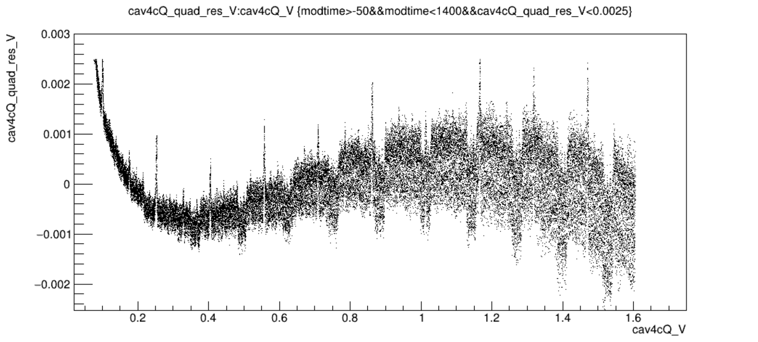
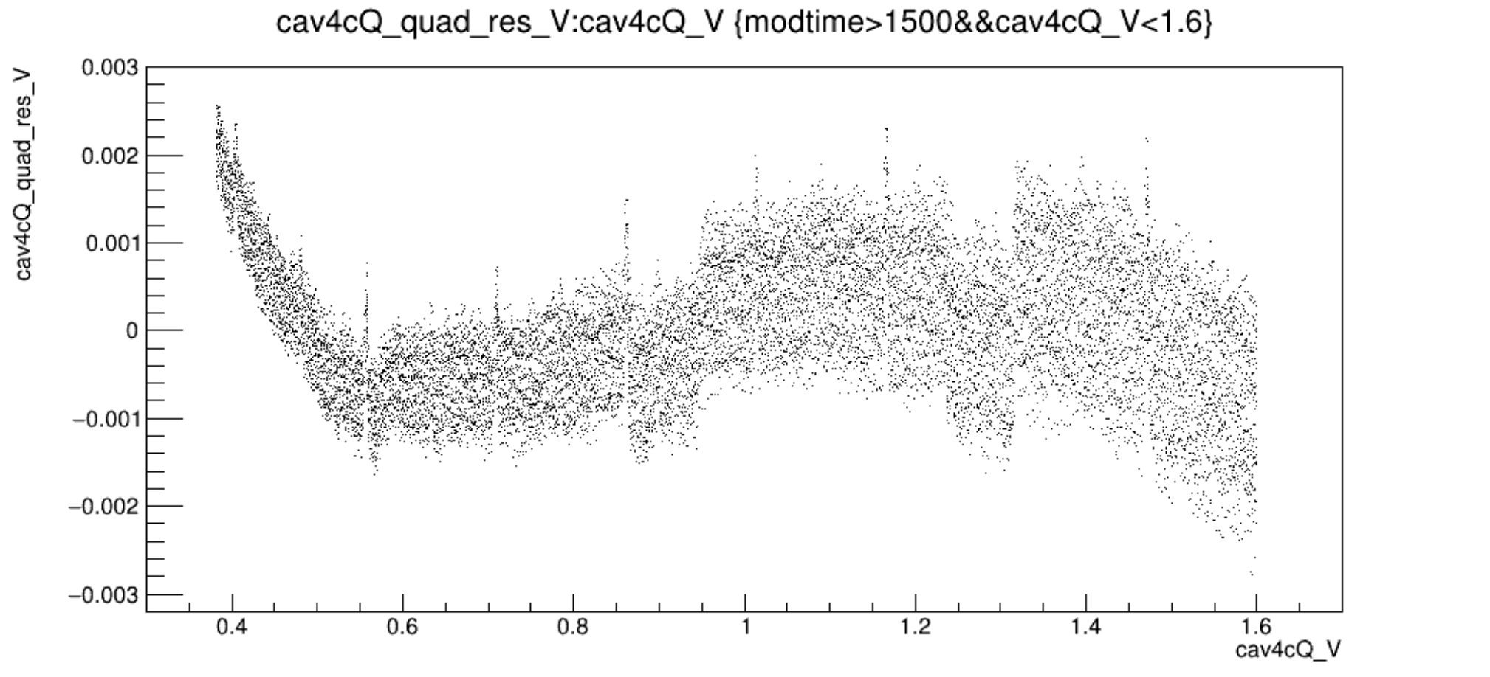
Run14499vsV_newgains_m20dBm_91percentAM.png
Run14497vsVzoom_newgains_m10p5dBm_86percentAM.png

Slide 5
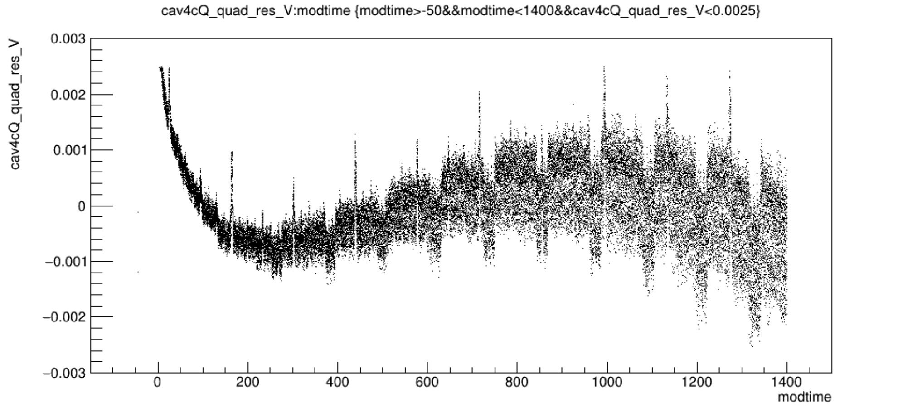
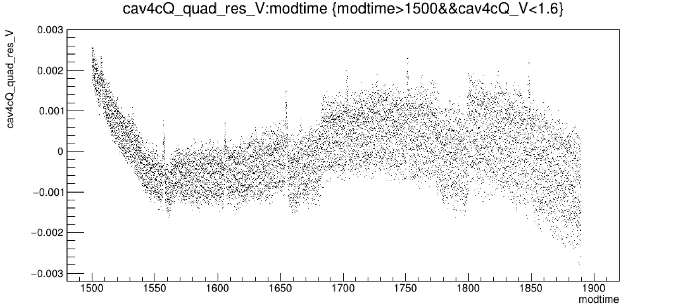
Run14499vsT_newgains_m20dBm_91percentAM.png
Run14497vsTzoom_newgains_m10p5dBm_86percentAM.png

Slide 6
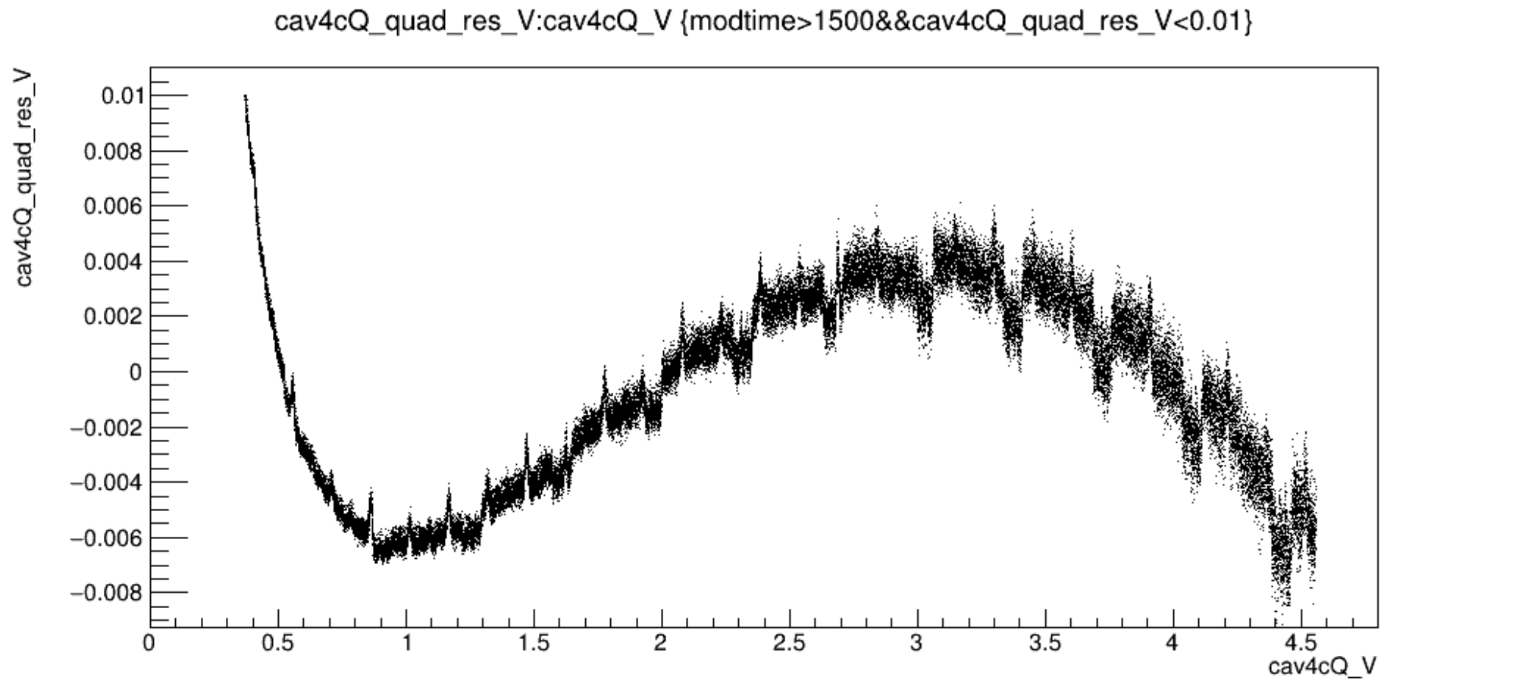
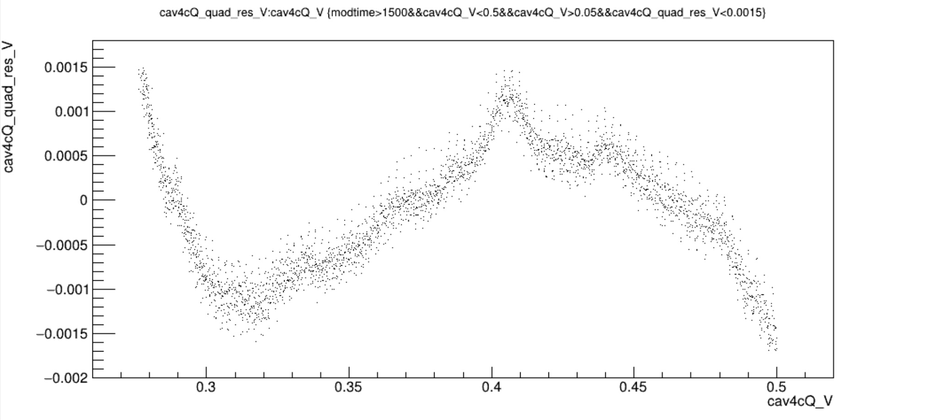
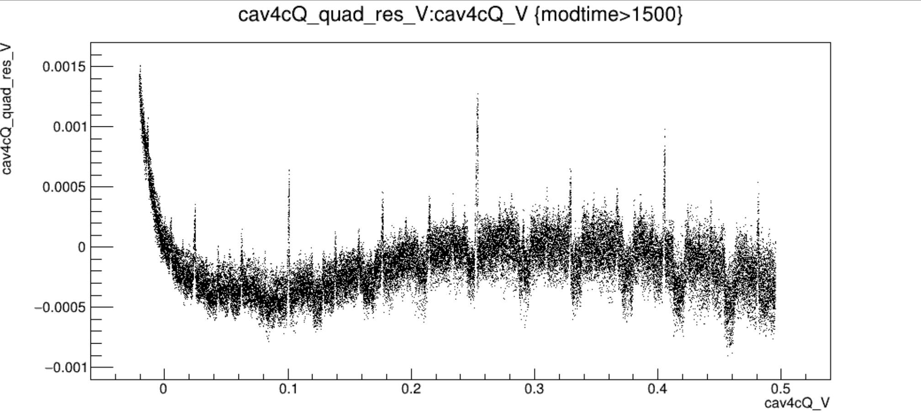
Run14564vsV_new?gains_m25dBm_91percentAM.png
Run14564vsVzoom_new?gains_m25dBm_91percentAM.png
?
?
Run12907vsV_oldgains_m20dBm_91percentAM.png

Slide 7
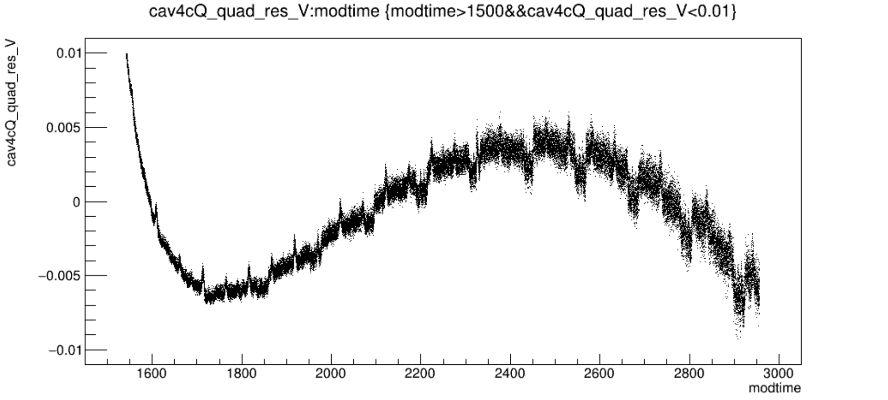
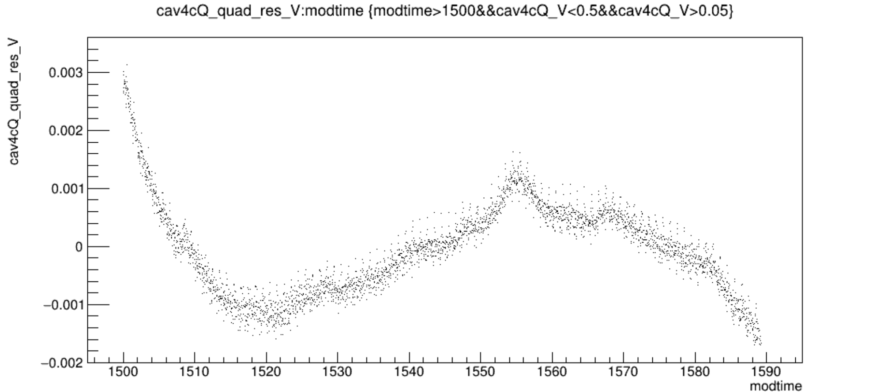
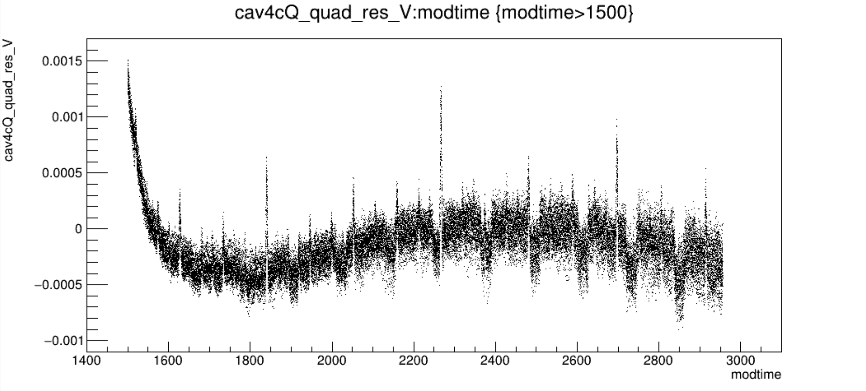
Run14564vsT_new?gains_m25dBm_91percentAM.png
Run14564vsTzoom_new?gains_m25dBm_91percentAM.png
?
?
Run12907vsT_oldgains_m20dBm_91percentAM.png

Slide 8
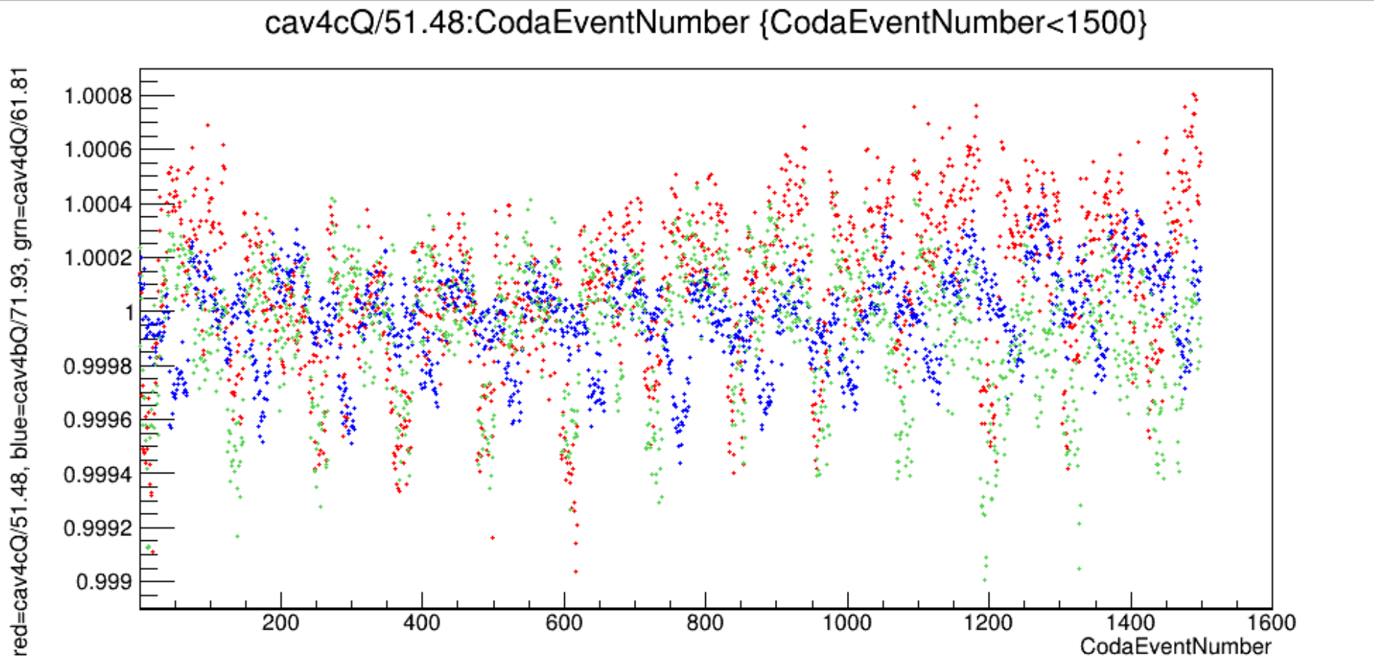
Constant -19dBm RF input, old gain setting
Run13365_m19dBm_oldgains_constantRF.png
Receiver outputs jump periodically in time, not at the same time, every ~100events(3sec)

Slide 9
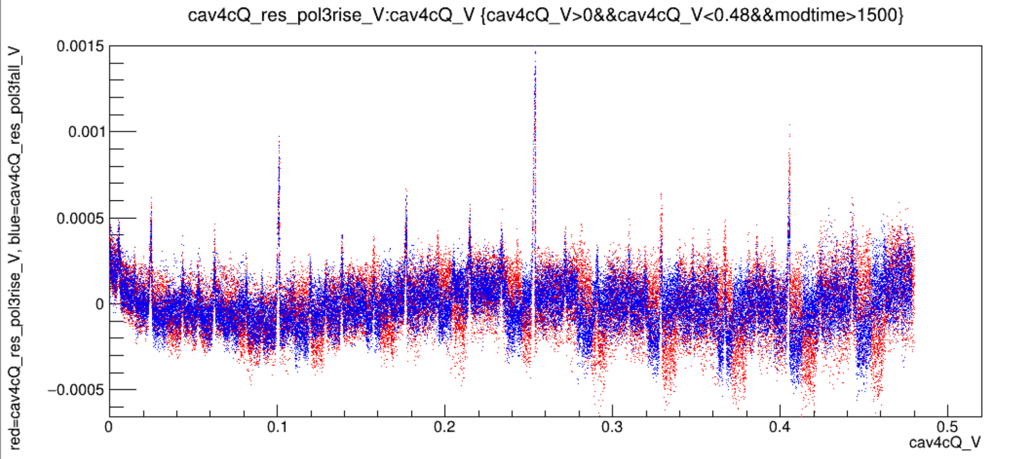
Rise and Fall fit and plotted
Run12907vsV_oldgains_m20dBm_91percentAM_riseandfall.png
Jumps in different places for rise and fall of triangle wave, spikes in same places…spikes in voltage, jumps in time.

Slide 10
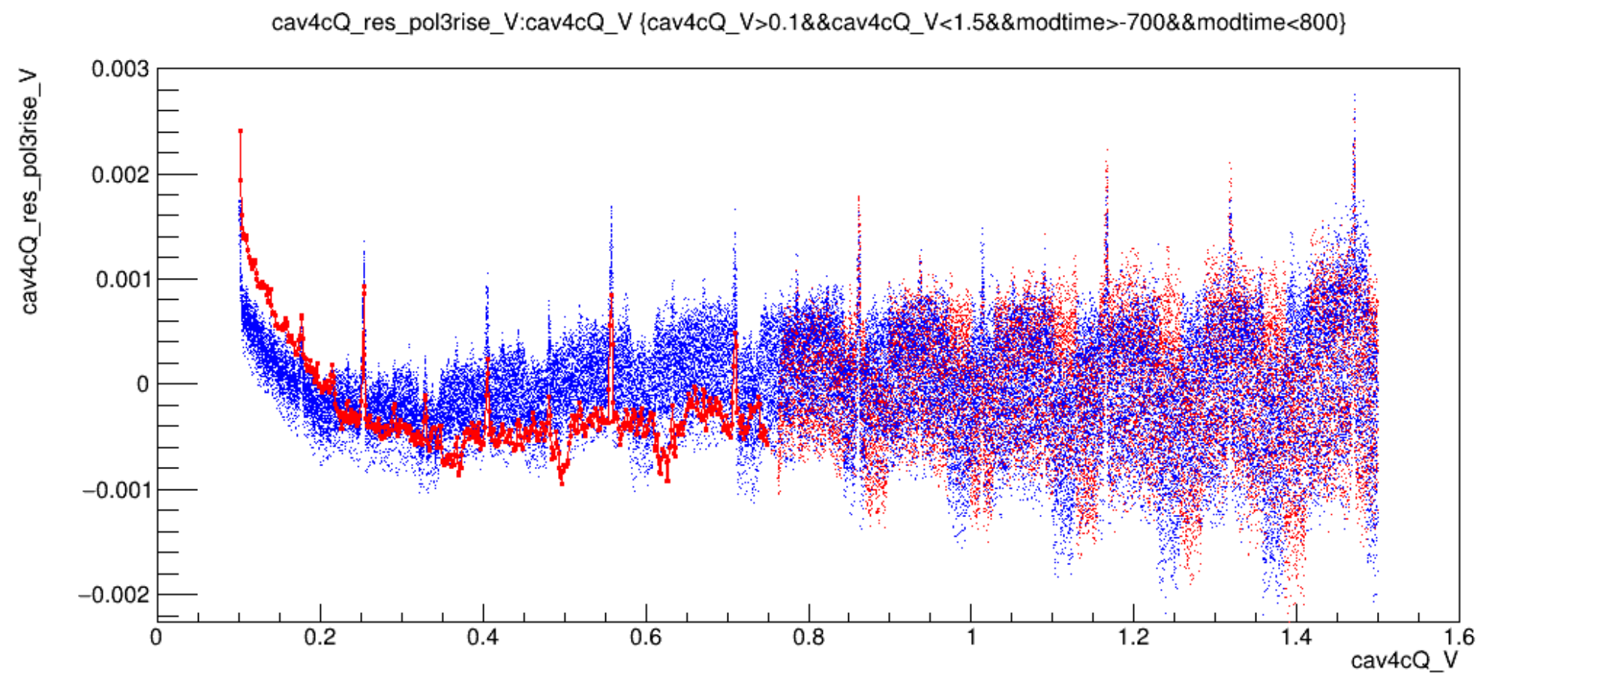
Run14499vsV_newgains_m20dBm_91percentAM_riseandfall.png

Slide 11
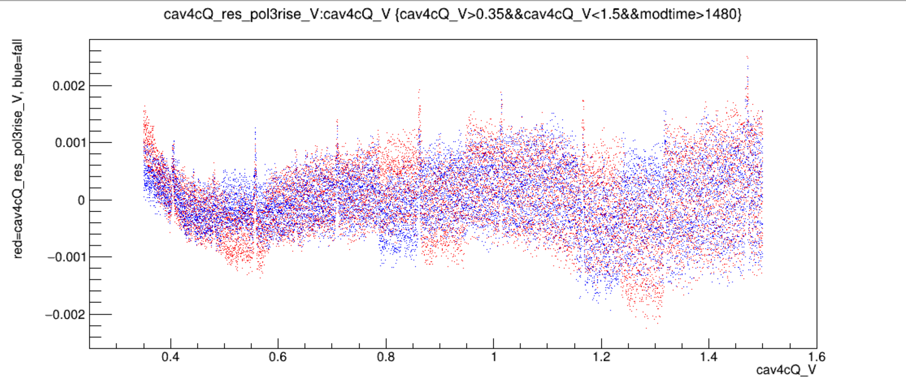
Run14497vsVzoom_newgains_m10p5dBm_86percentAM_riseandfall

Slide 12
Run14499vsV_newgains_m20dBm_91percentAM_riseandfall.png
Run14497vsVzoom_newgains_m10p5dBm_86percentAM_riseandfall

Slide 13
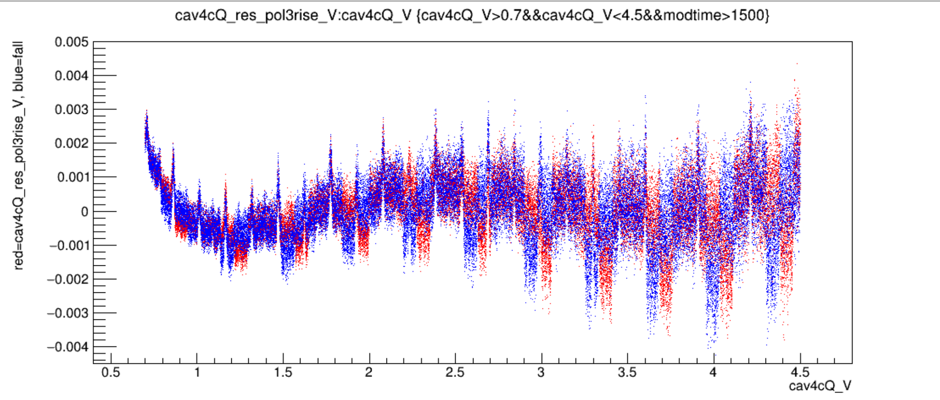
Run14564vsV_newnewgains_m25dBm_91percentAM_risefall.png

Slide 14
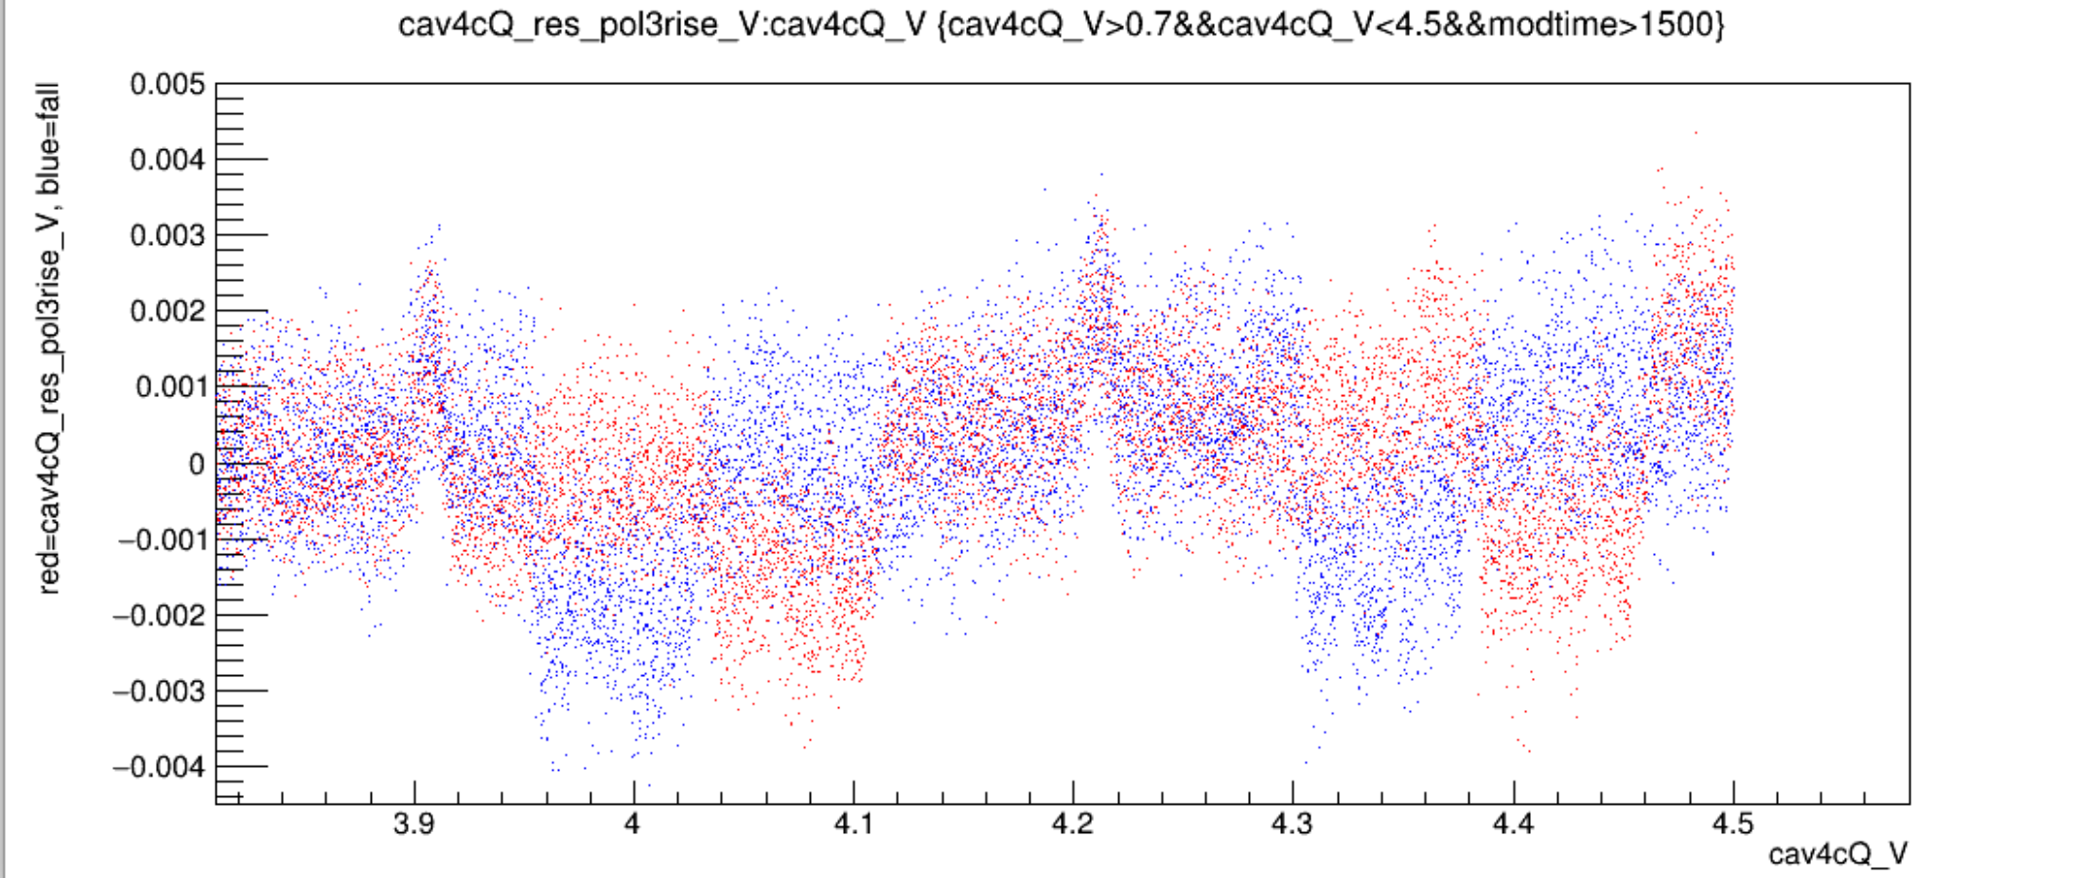
Run14564vsVzoom_newnewgains_m25dBm_91percentAM_risefall.png
0.0015V
2.5V=-25dBm
-19dBm~50uA
-25dBm~25uA
5V~50uA
Run12907vsV_oldgains_m20dBm_91percentAM_riseandfall.png
0.25V=-20dBm
-19dBm~>50uA
0.25V~>50uA
0.001V
Spike size appx same, signal size 10X bigger -> signal to spike ratio 10X better

Slide 15
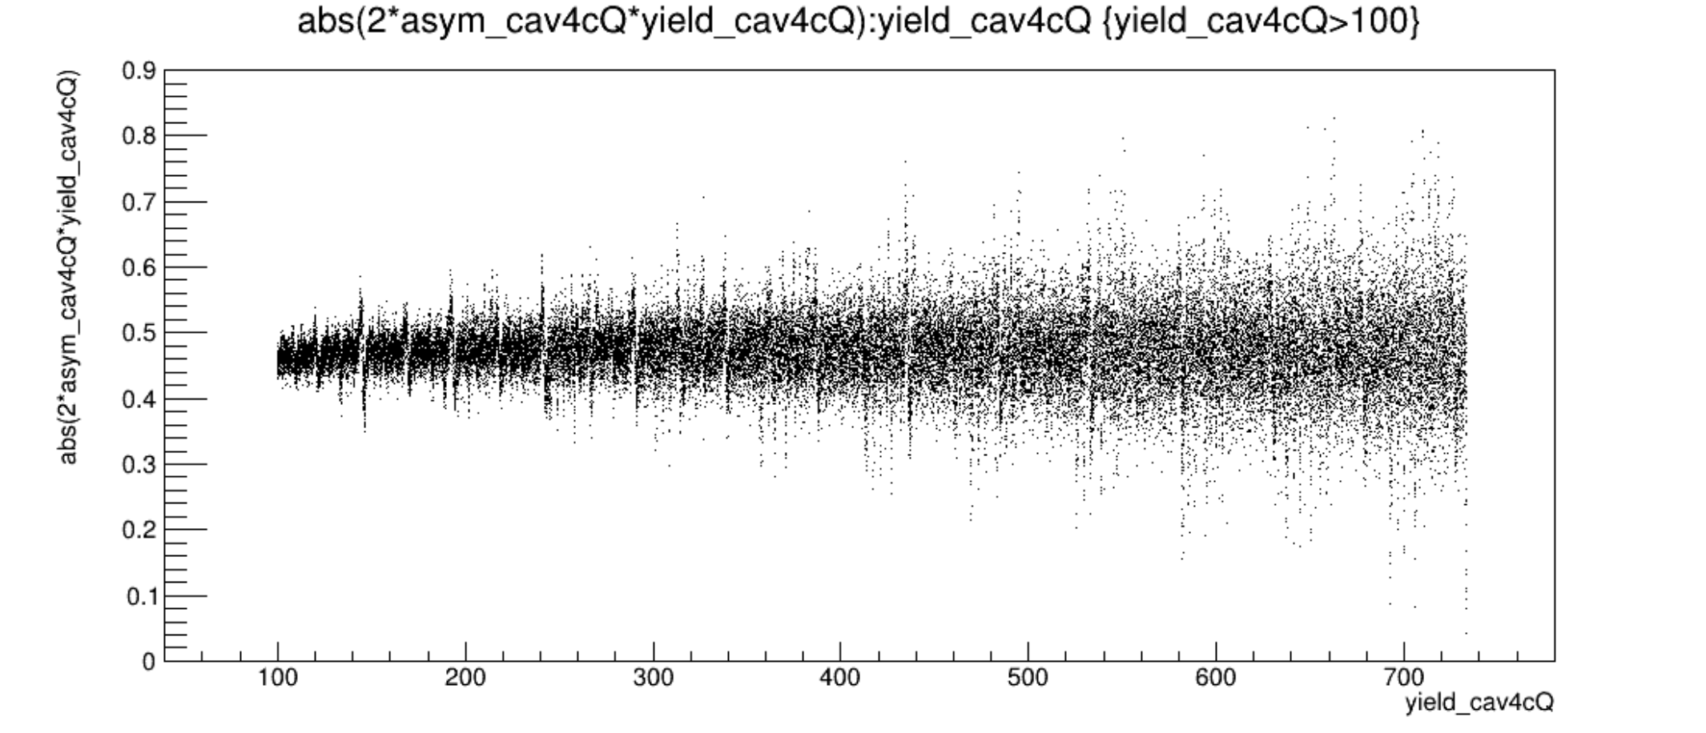
Run14564 newnewgains m25dBm 91percentAM pr tree

Slide 16
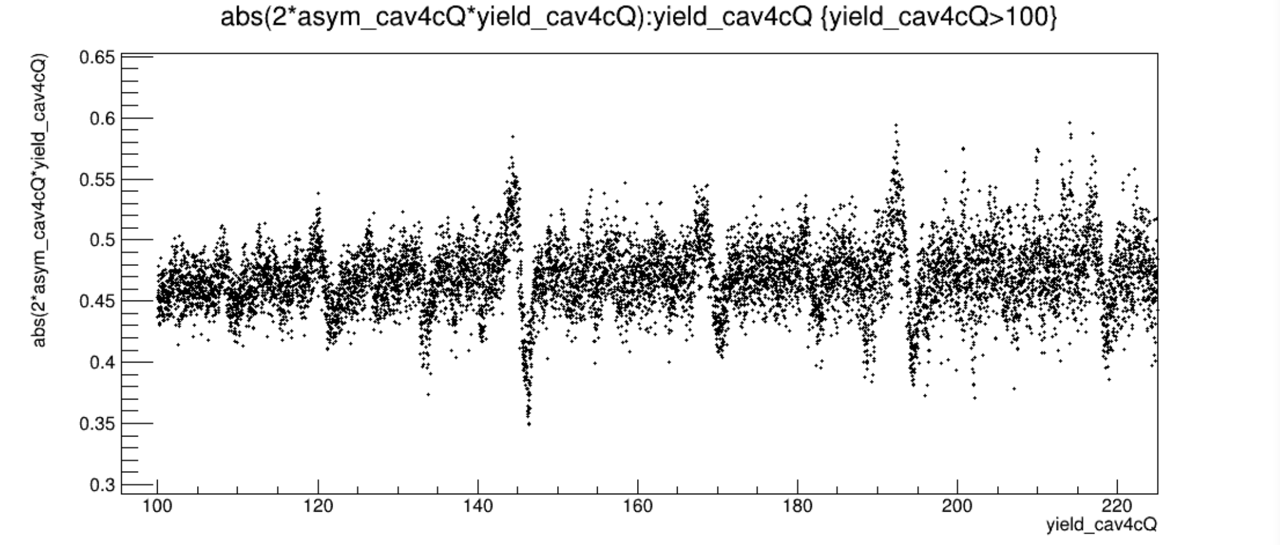
Run14564 newnewgains m25dBm 91percentAM pr tree

Slide 17
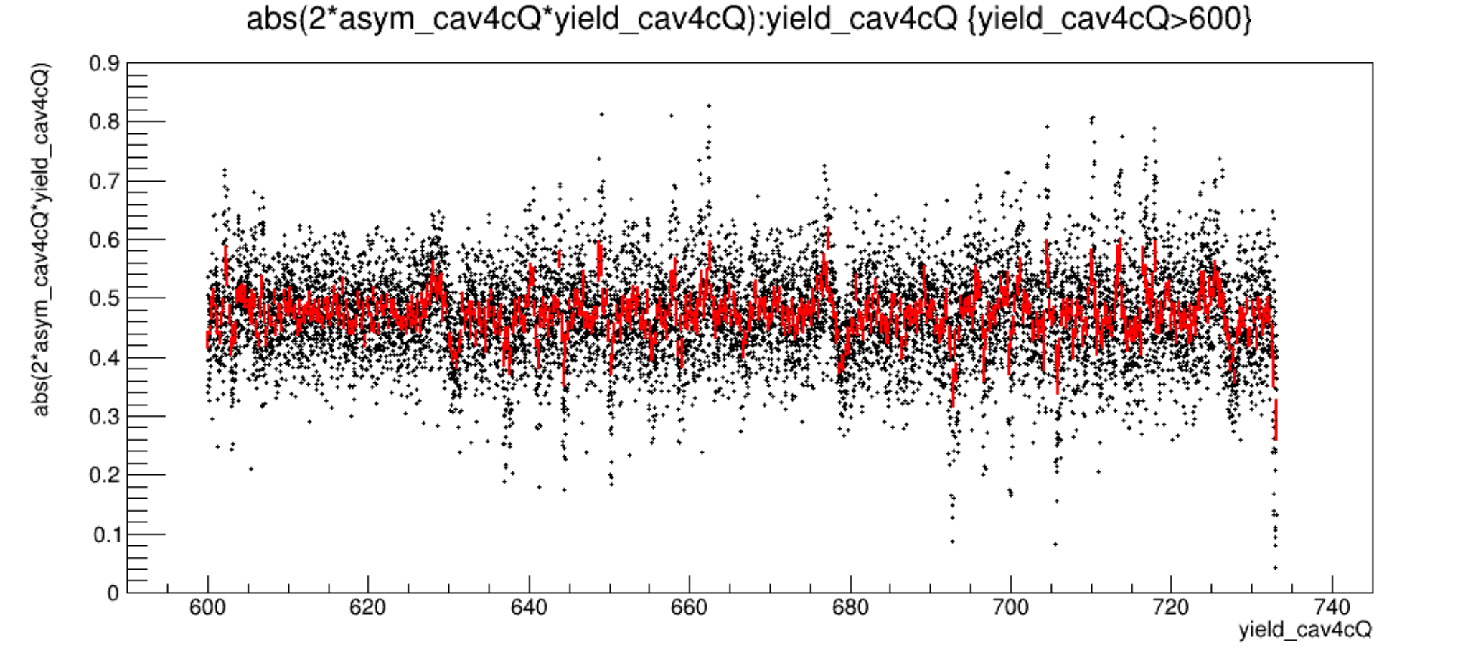
Run14564 newnewgains m25dBm 91percentAM pr tree

Slide 18
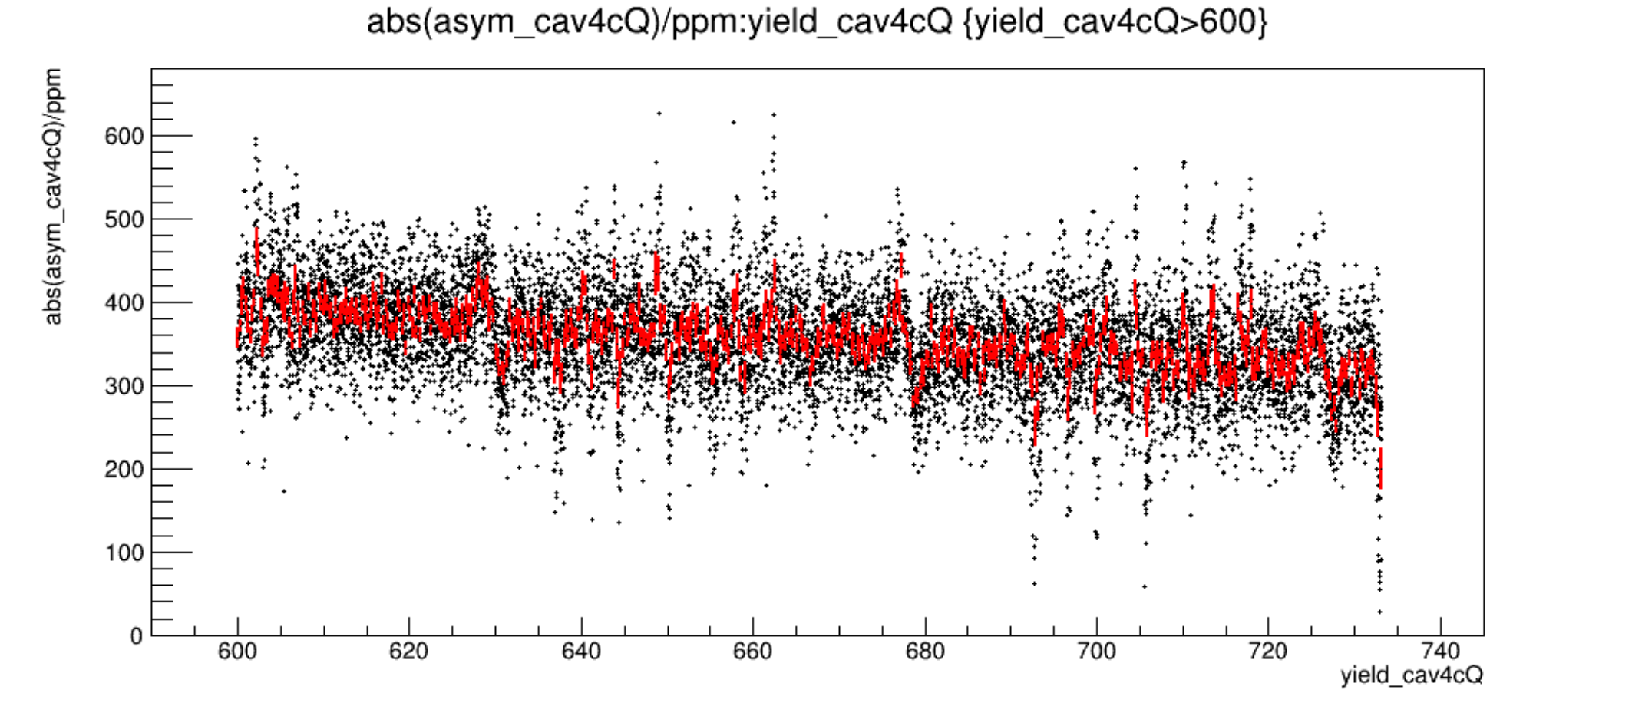
Run14564 newnewgains m25dBm 91percentAM pr tree

Slide 19
Run14564 newnewgains m25dBm 91percentAM pr tree

