Slide 1
Triangle Wave RF scans
Caryn 2/12/24

Slide 2
Devi Analysis Screenshot

Slide 3
4 runs at 0.01Hz
Run14497 New gains -10.5dBm 86% AM
Run14499 New gains -20dBm 86% AM
Run12907 Old gains -20dBm 91% AM
Run14564 New? gains -25dBm 91% AM ??
Fit raw cav4cQ to fmod of CodaEventNumber, mod 9559.5 with quadratic, examine residuals, plot everything in units of Volts and events

Slide 4
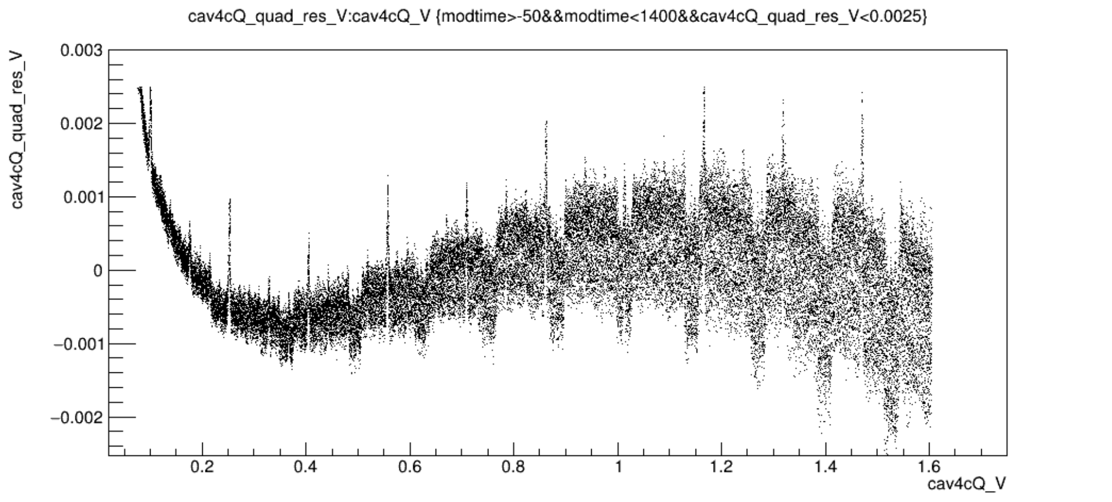
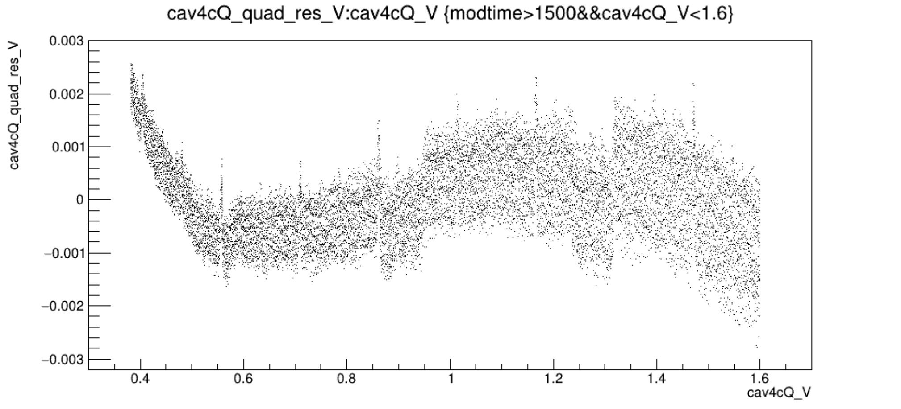
Run14499vsV_newgains_m20dBm_91percentAM.png
Run14497vsVzoom_newgains_m10p5dBm_86percentAM.png

Slide 5
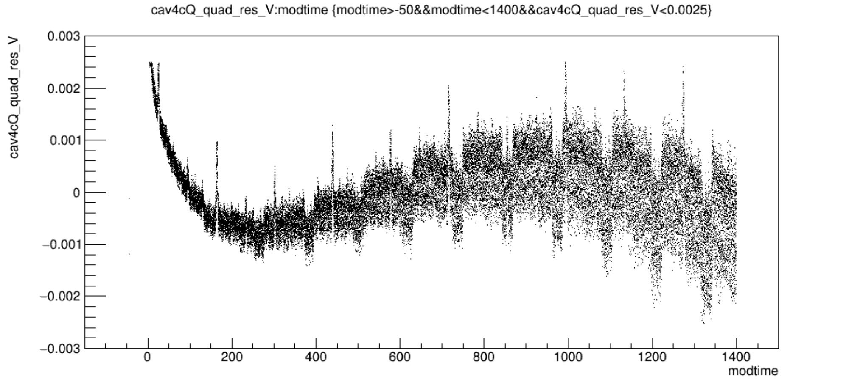
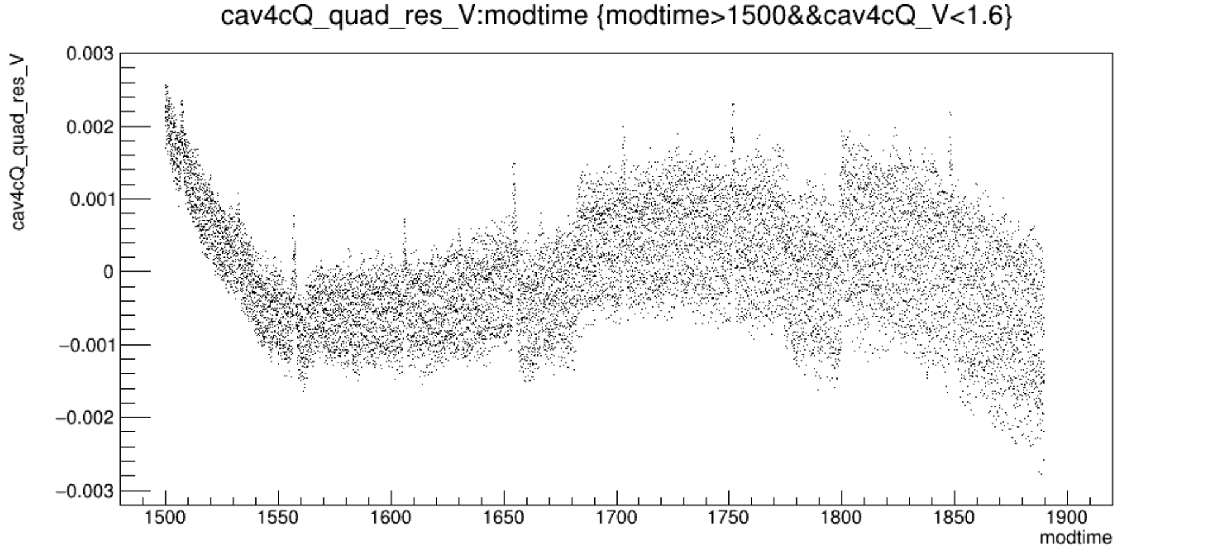
Run14499vsT_newgains_m20dBm_91percentAM.png
Run14497vsTzoom_newgains_m10p5dBm_86percentAM.png

Slide 6
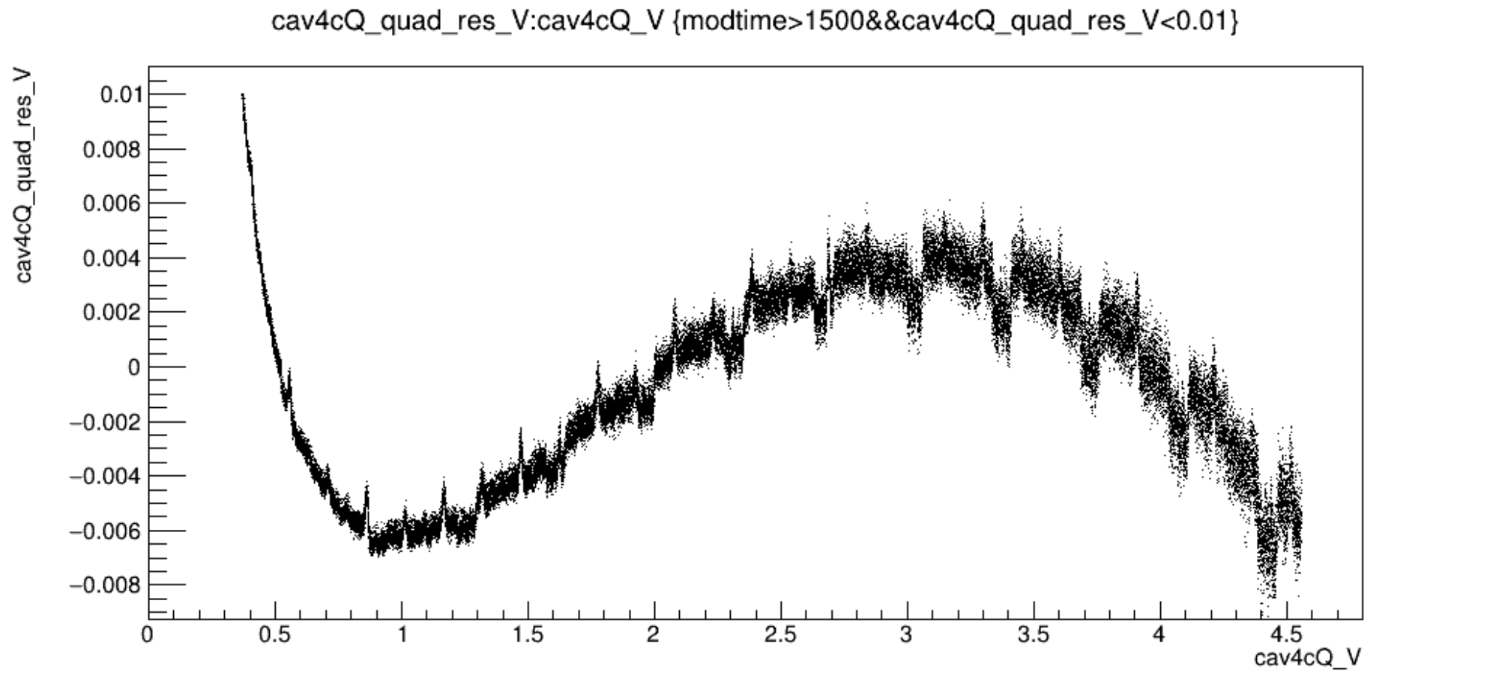
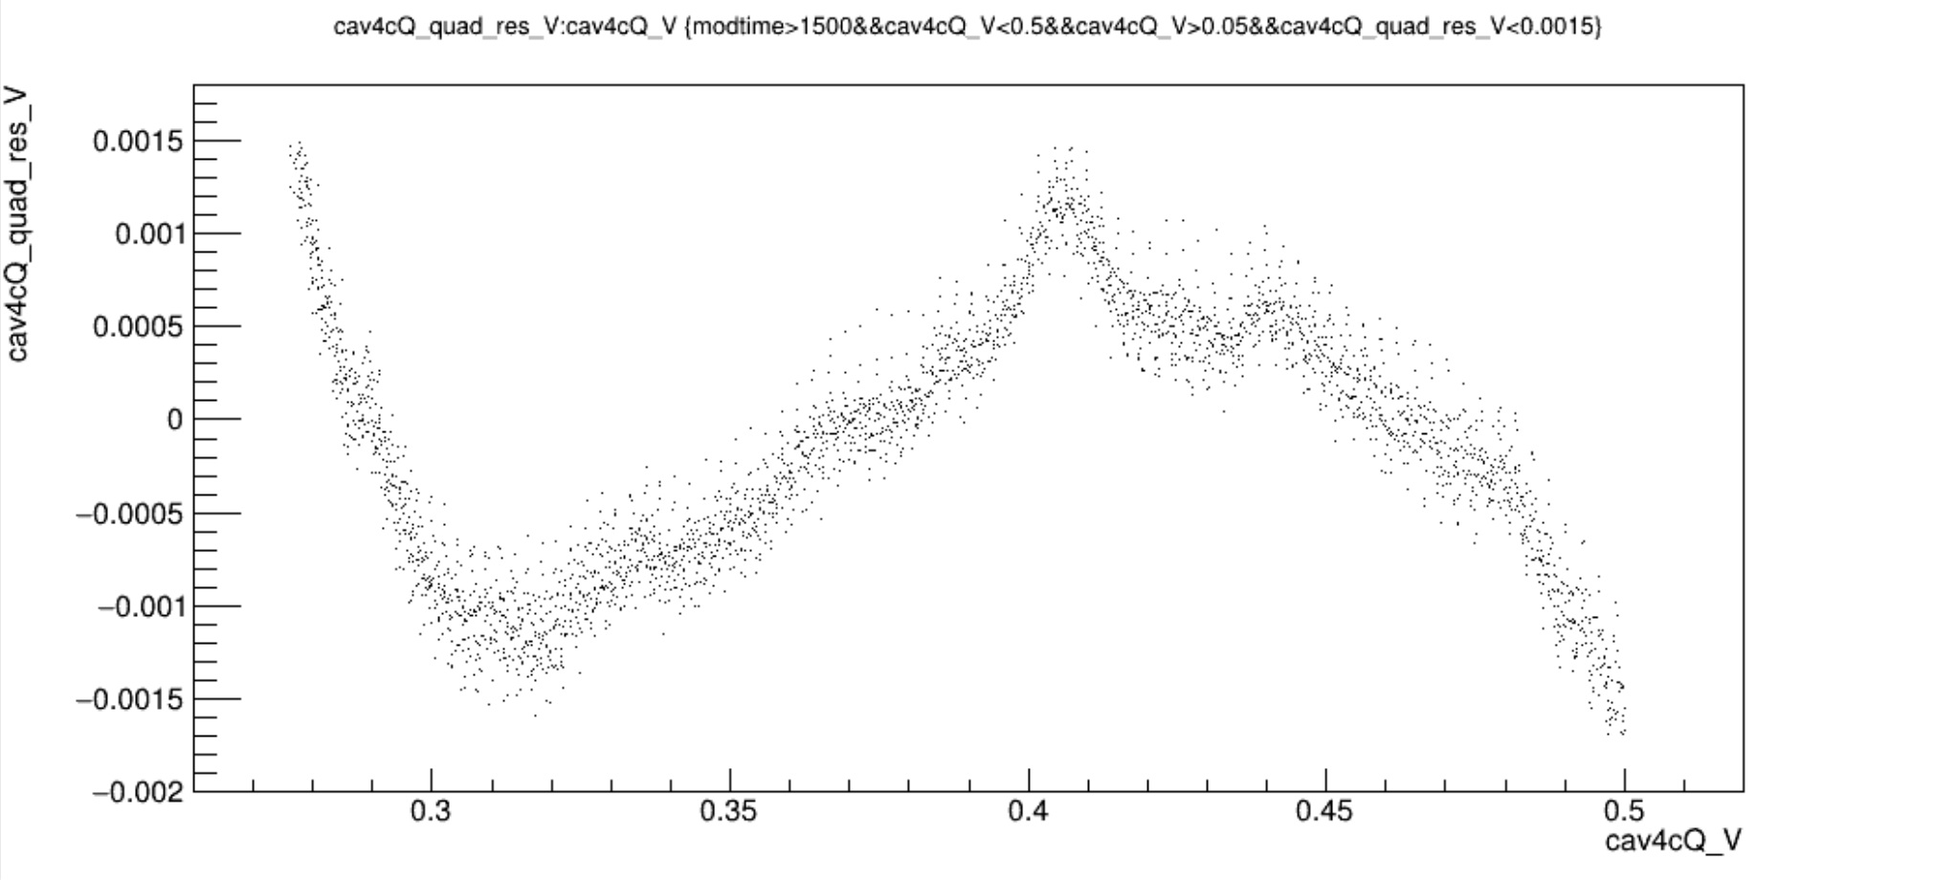
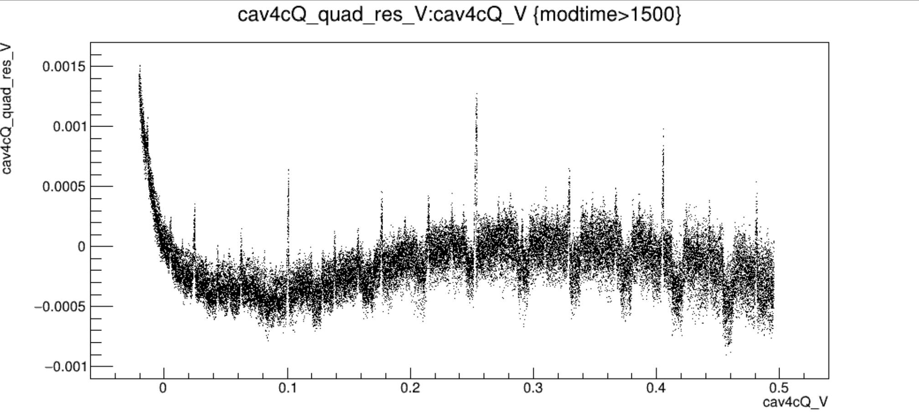
Run14564vsV_new?gains_m25dBm_91percentAM.png
Run14564vsVzoom_new?gains_m25dBm_91percentAM.png
?
?
Run12907vsV_oldgains_m20dBm_91percentAM.png

Slide 7
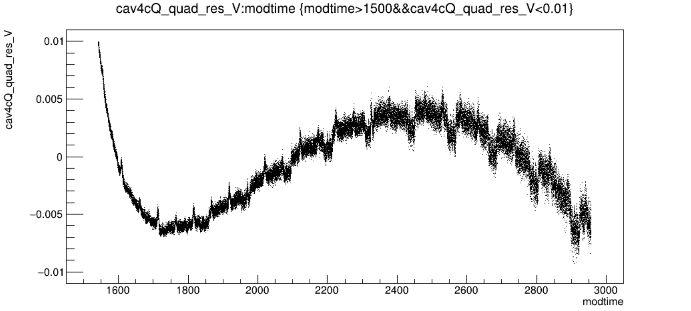
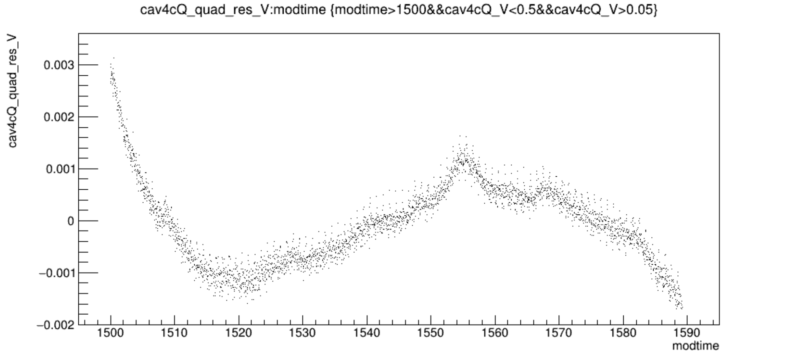
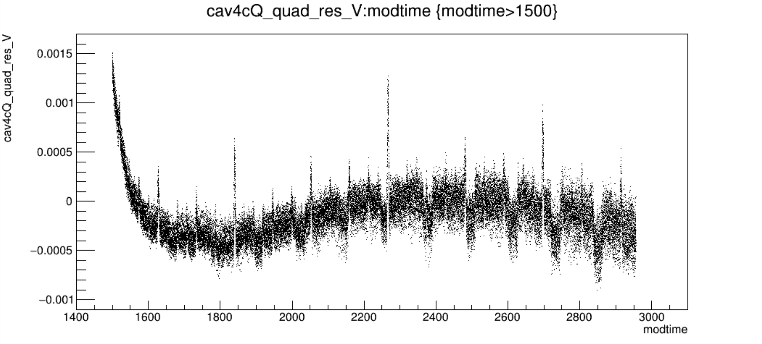
Run14564vsT_new?gains_m25dBm_91percentAM.png
Run14564vsTzoom_new?gains_m25dBm_91percentAM.png
?
?
Run12907vsT_oldgains_m20dBm_91percentAM.png

