Slide 1
HOW TO DO THINGS ON A SCOPE
Caryn
11/14/2023

Slide 2
Current Scan Analysis
Nominally this: I ~ 100 * 10^((#dBm-1)/20)
But in our case this: I ~ 100*9.8 * 10^((#dBm-1)/20)
For these runs 12907,12906: -20dBm, AM depth 91%, mod f 0.1Hz

Slide 3
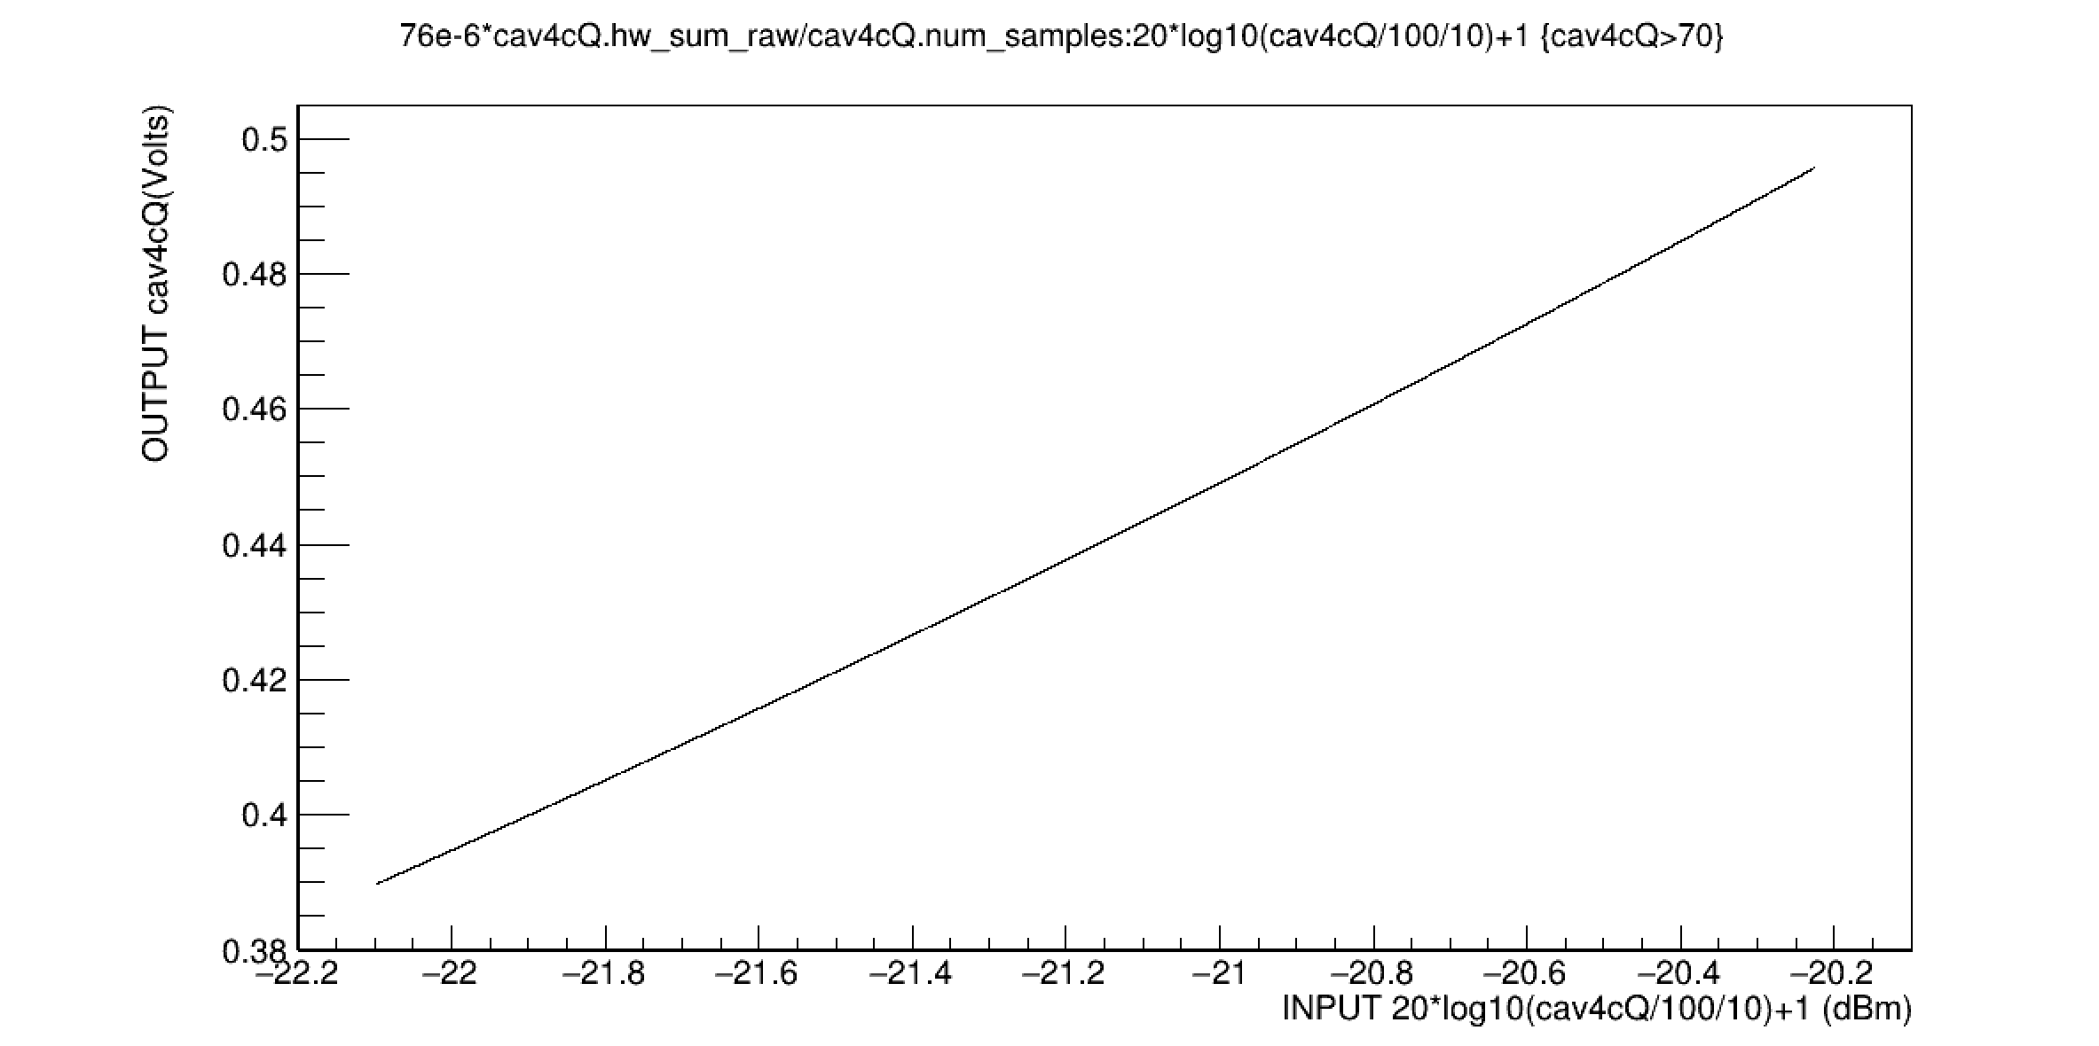
Voltage and dbm conversion: cav4c

Slide 4
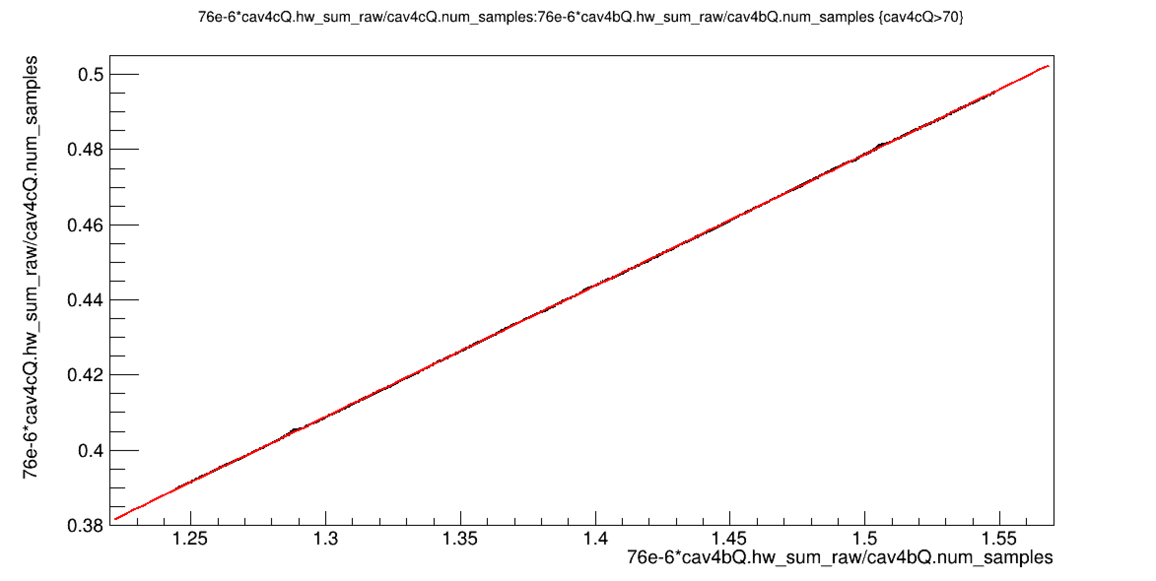
4cQ and 4bQ differ by 3X in output
japanOutput/sbs_CntHouse_12907.root
Minimizer is Linear / Migrad
Chi2 = 0.000714002
NDf = 21602
p0 = -0.0445769 +/- 1.97251e-05
p1 = 0.348842 +/- 1.40917e-05

Slide 5
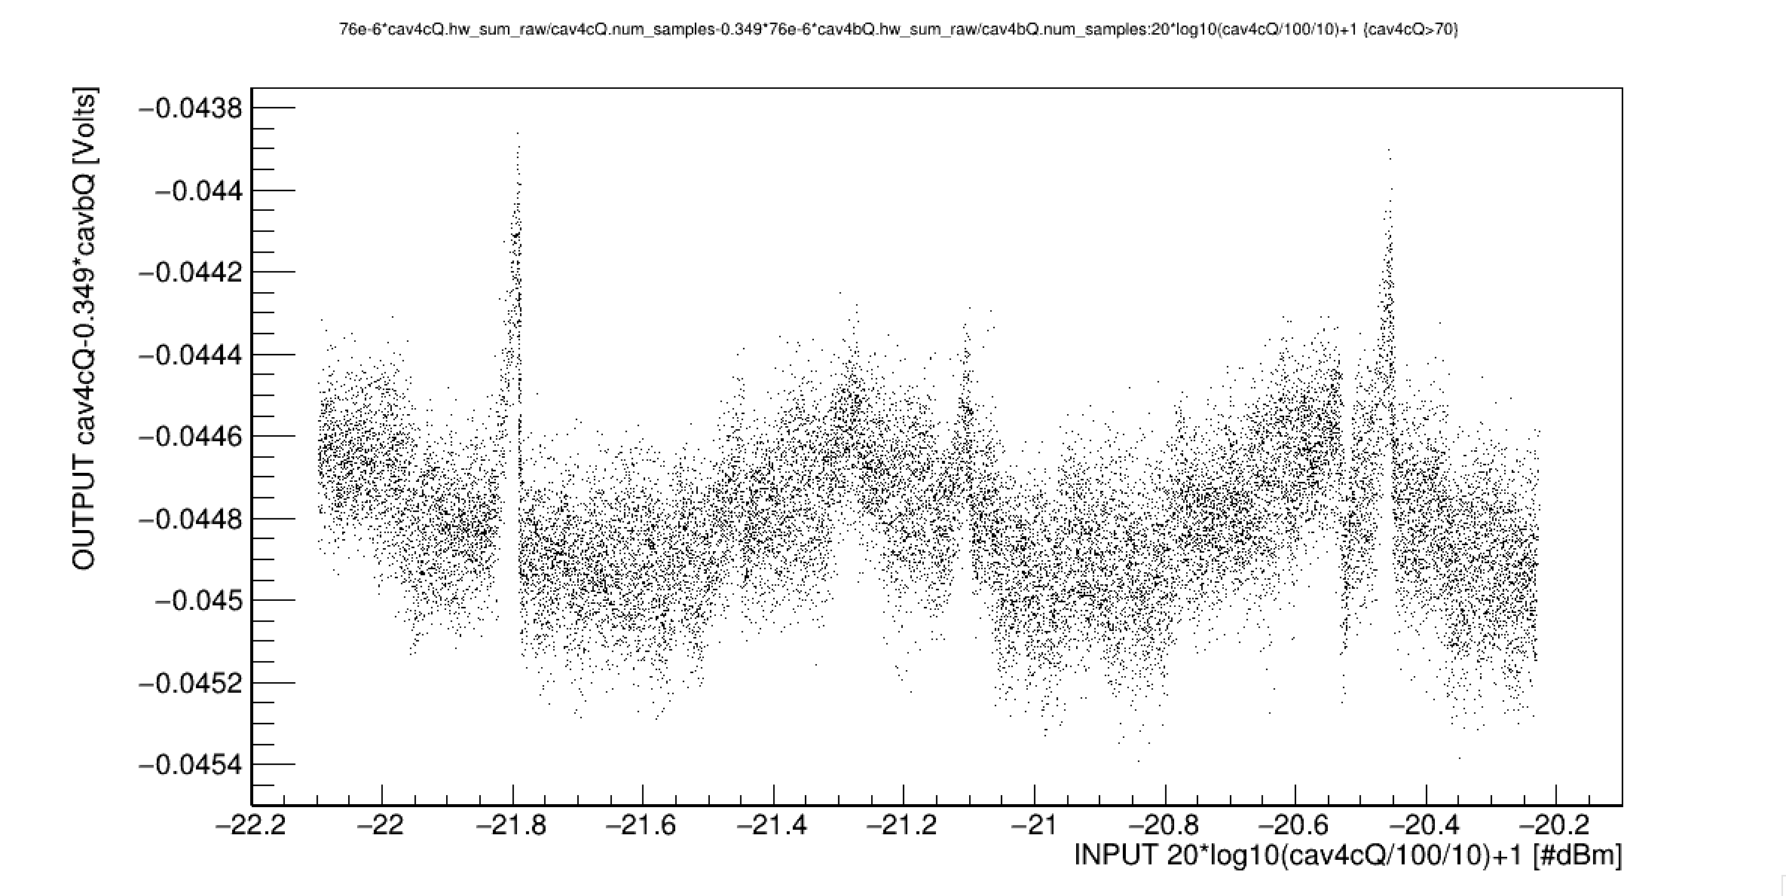
Double difference Voltage and dbm conversion
Method A: Scan 0.1dBm at a time. Measure 4cQ and 4bQ output to an accuracy of 0.1mV. Calculate scaled difference (outputs differ by 3X)

Slide 6
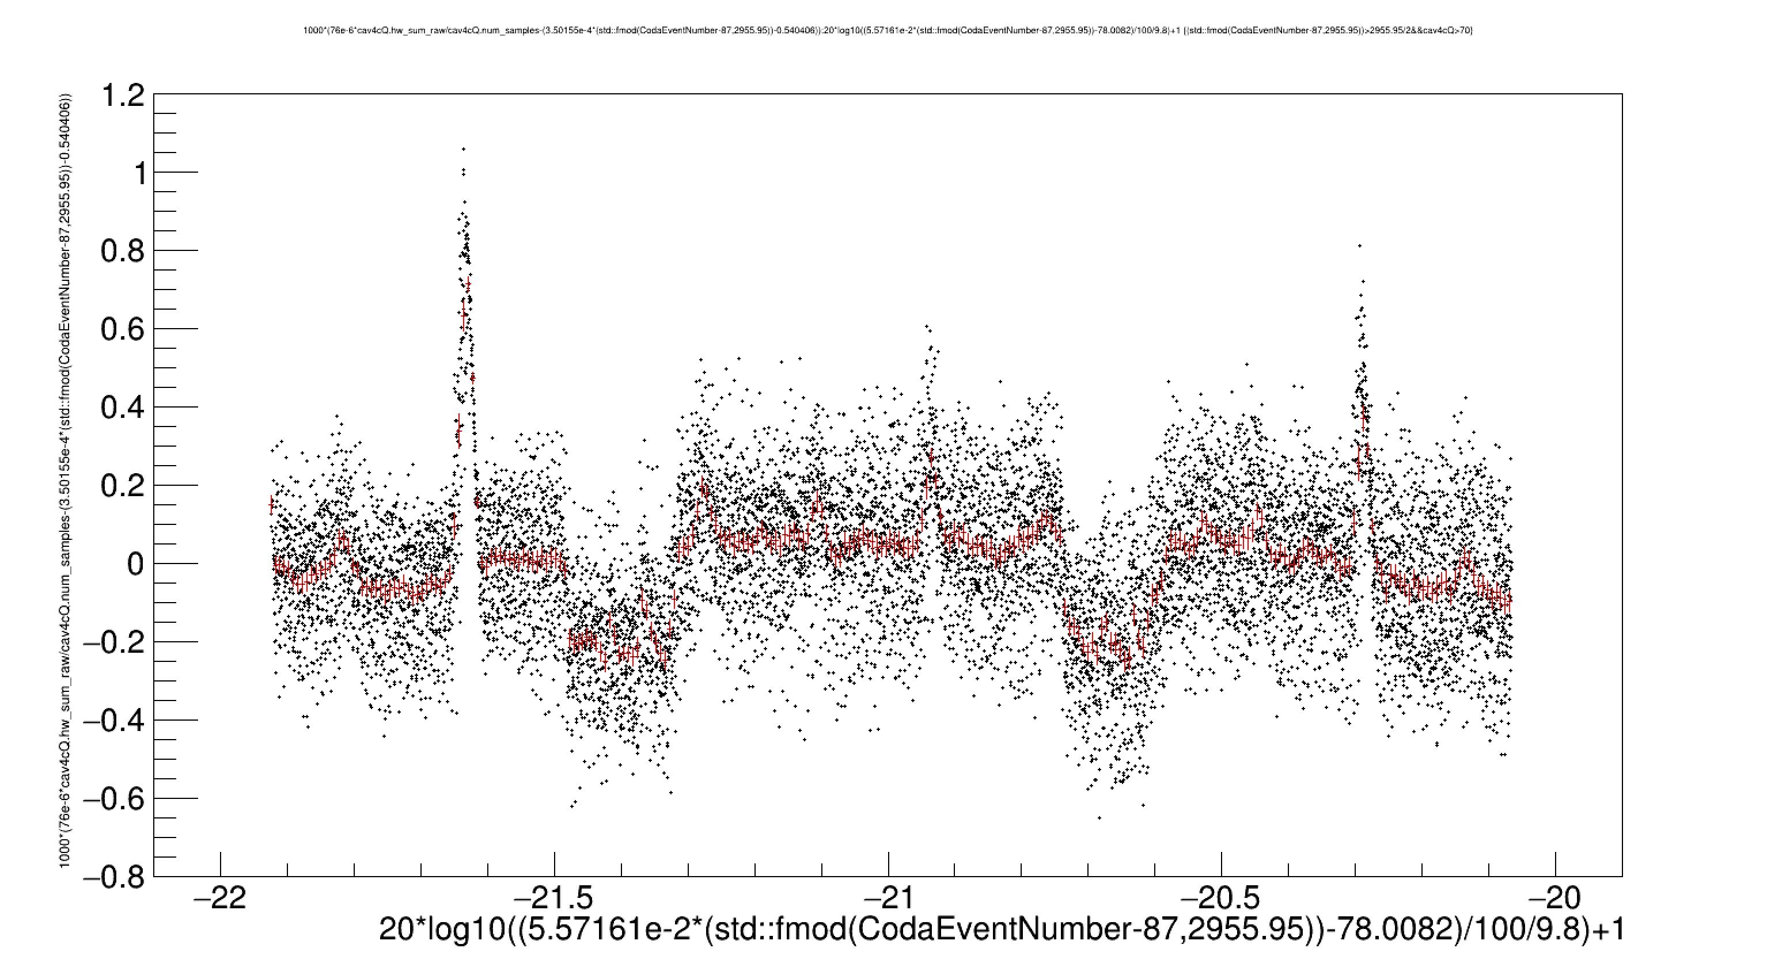
Method B: Scan 0.1dBm at a time. Measure 4cQ output to an accuracy of 0.05mV. Calculate deviation from linear.
OUTPUT cav4Q Deviation from linear (cav4c) [mV]
INPUT [dBm]

Slide 7
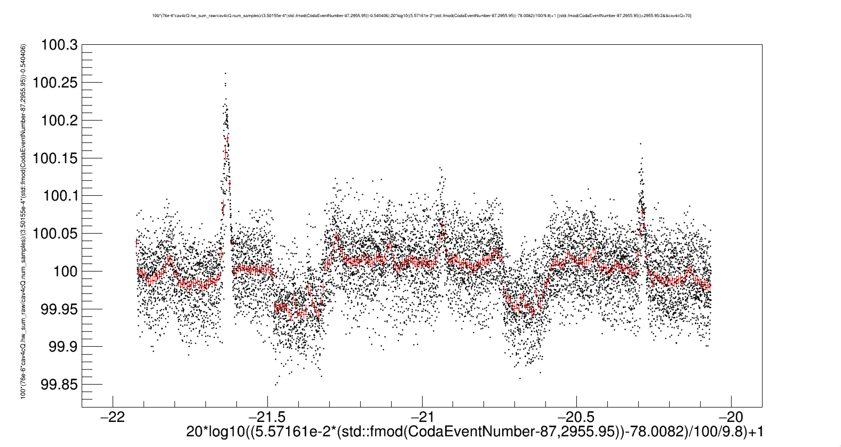
Method C: Sawtooth mod -22->-20dBm. Trigger on sawtooth edge on scope. Measure ratio cav4cQ/sawtooth to accuracy of 0.01% to see pattern on scope trace
OUTPUT cav4cQ/INPUT [%]
INPUT [dBm]

Slide 8
Other plots

Slide 9
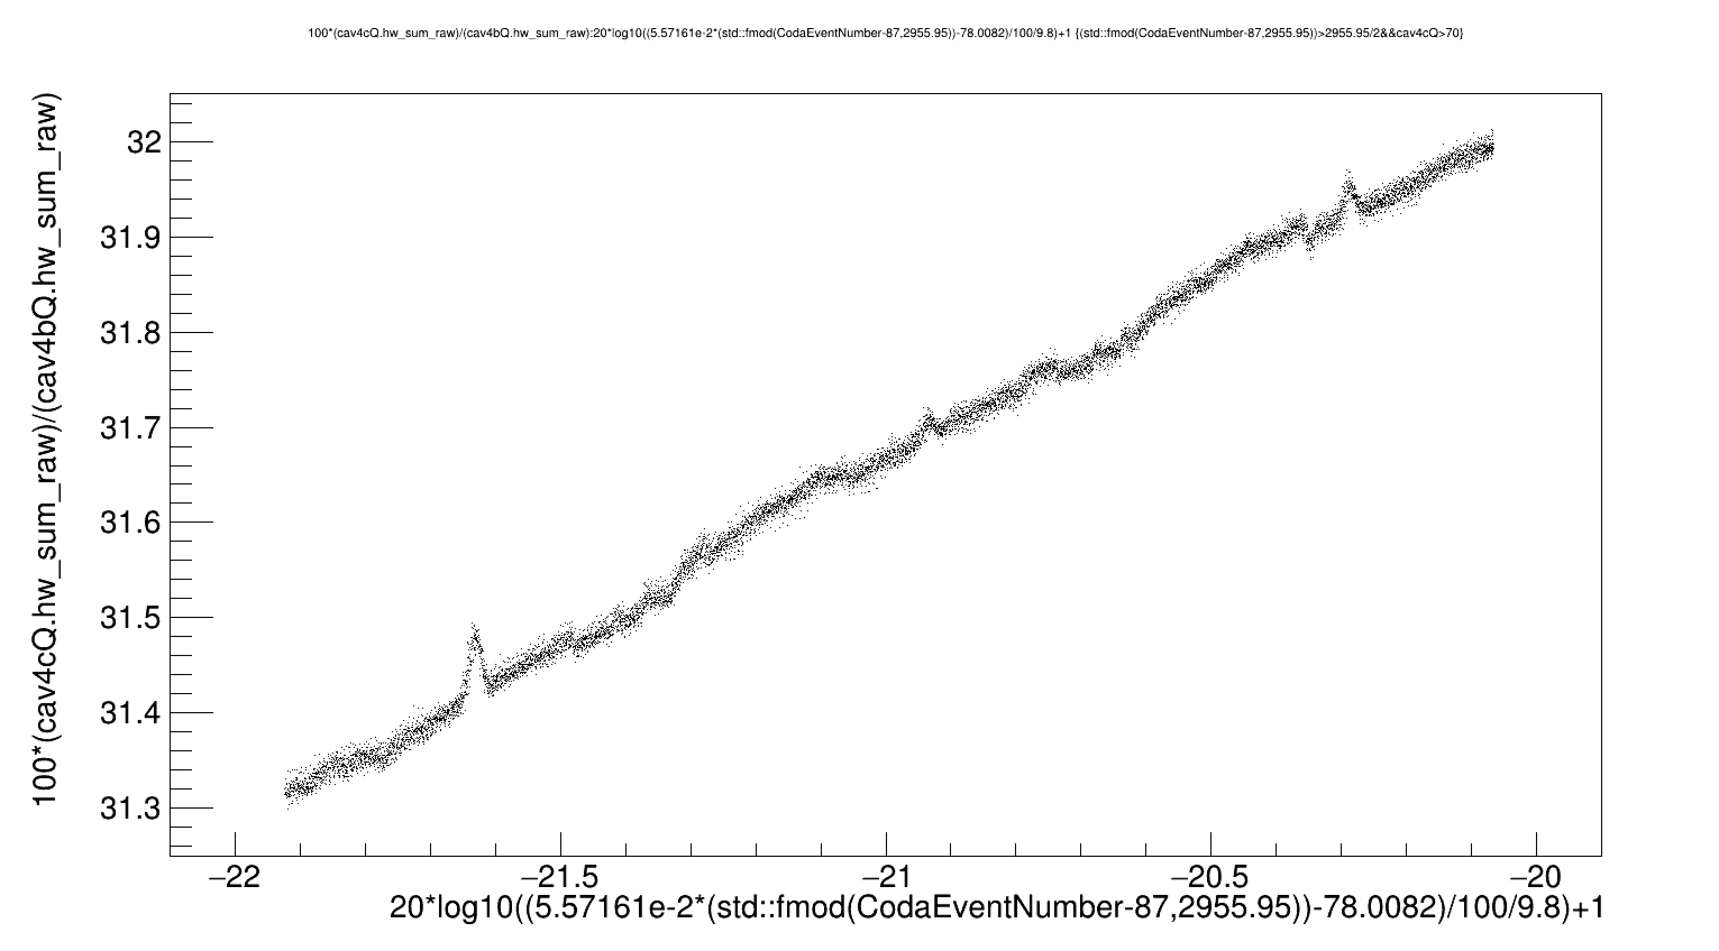

Slide 10
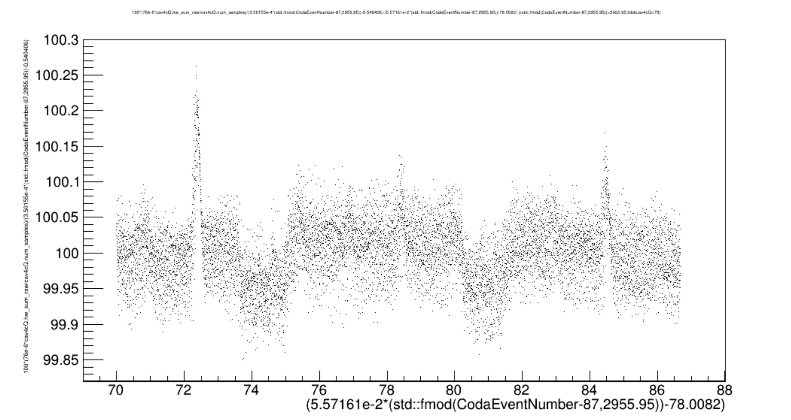
OUTPUT cav4cQ/INPUT [%]
INPUT [“current” from functiongen]

Slide 11
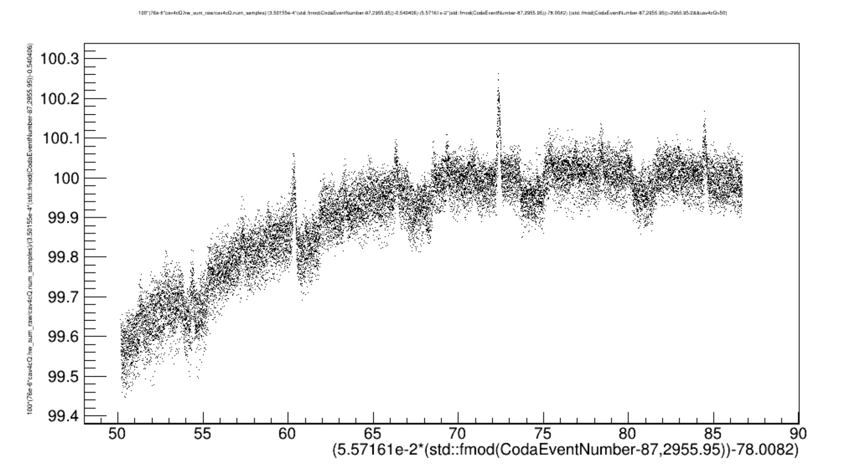
OUTPUT cav4cQ/INPUT [%]
INPUT [“current” from functiongen]

Slide 12
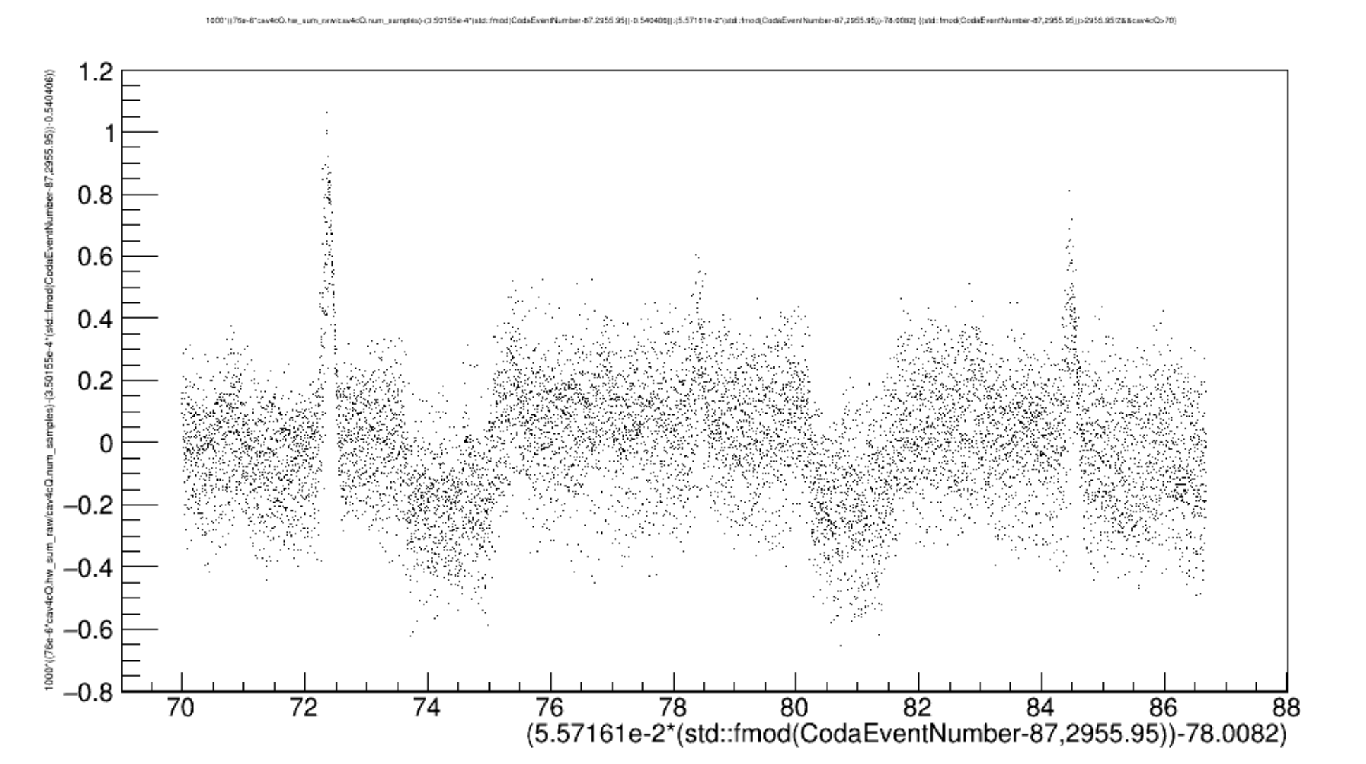
OUTPUT cav4Q Deviation from linear (cav4c) [mV]
INPUT [“current” from functiongen]

Slide 13
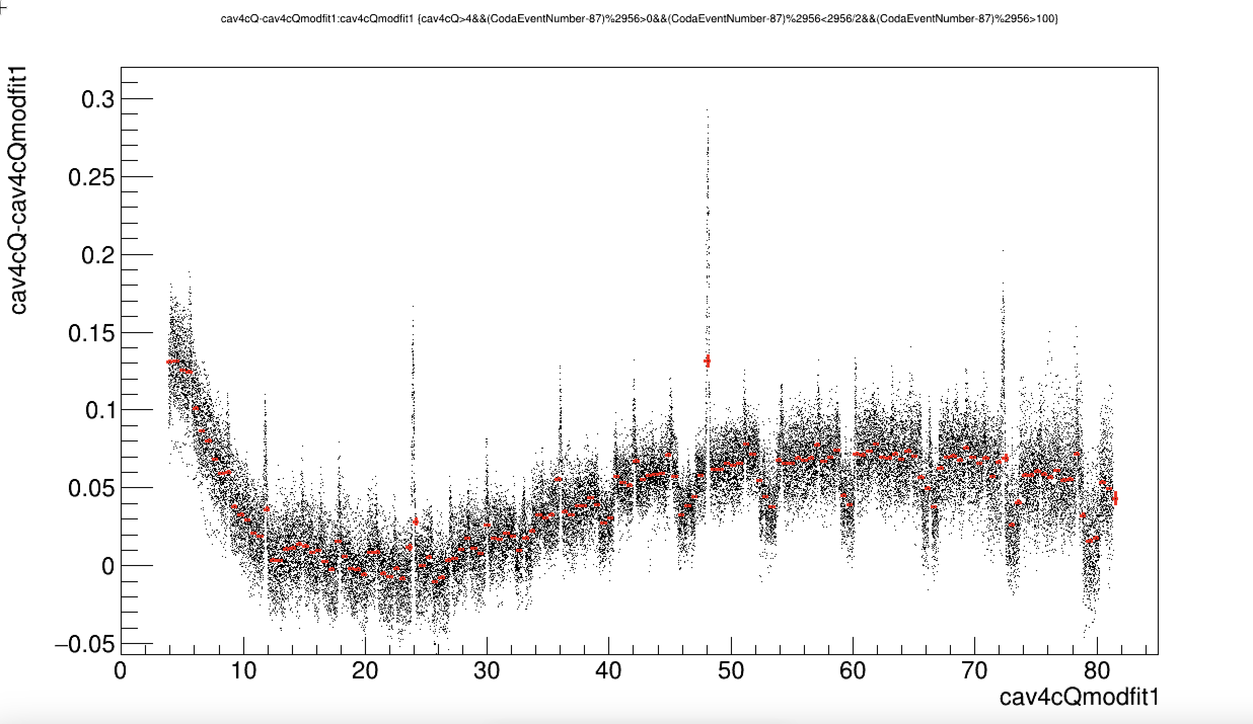
OUTPUT cav4cQ Deviation from quadratic fit (cav4c) [“uA”]
INPUT [“uA” from function generator]

Slide 14
Other plots of Devi’s runs

Slide 15
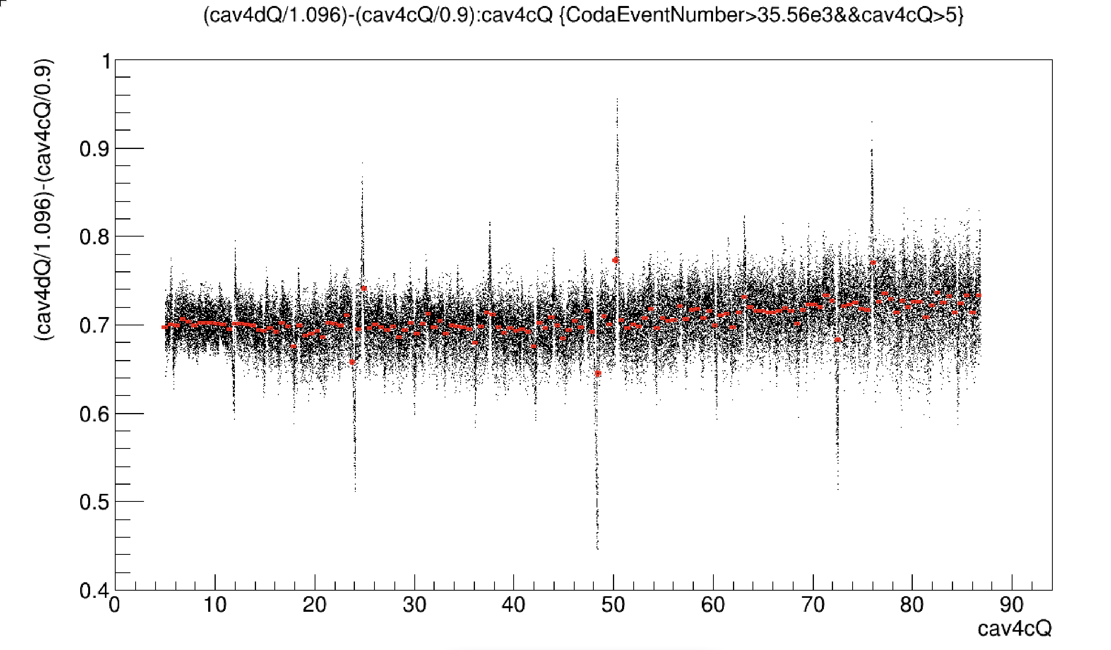

Slide 16
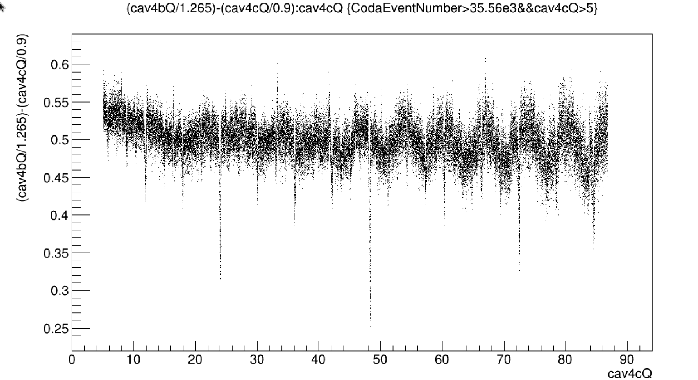

Slide 17
