Slide 1
Digital Receivers Theories
Caryn Palatchi
10/17/2023

Slide 2
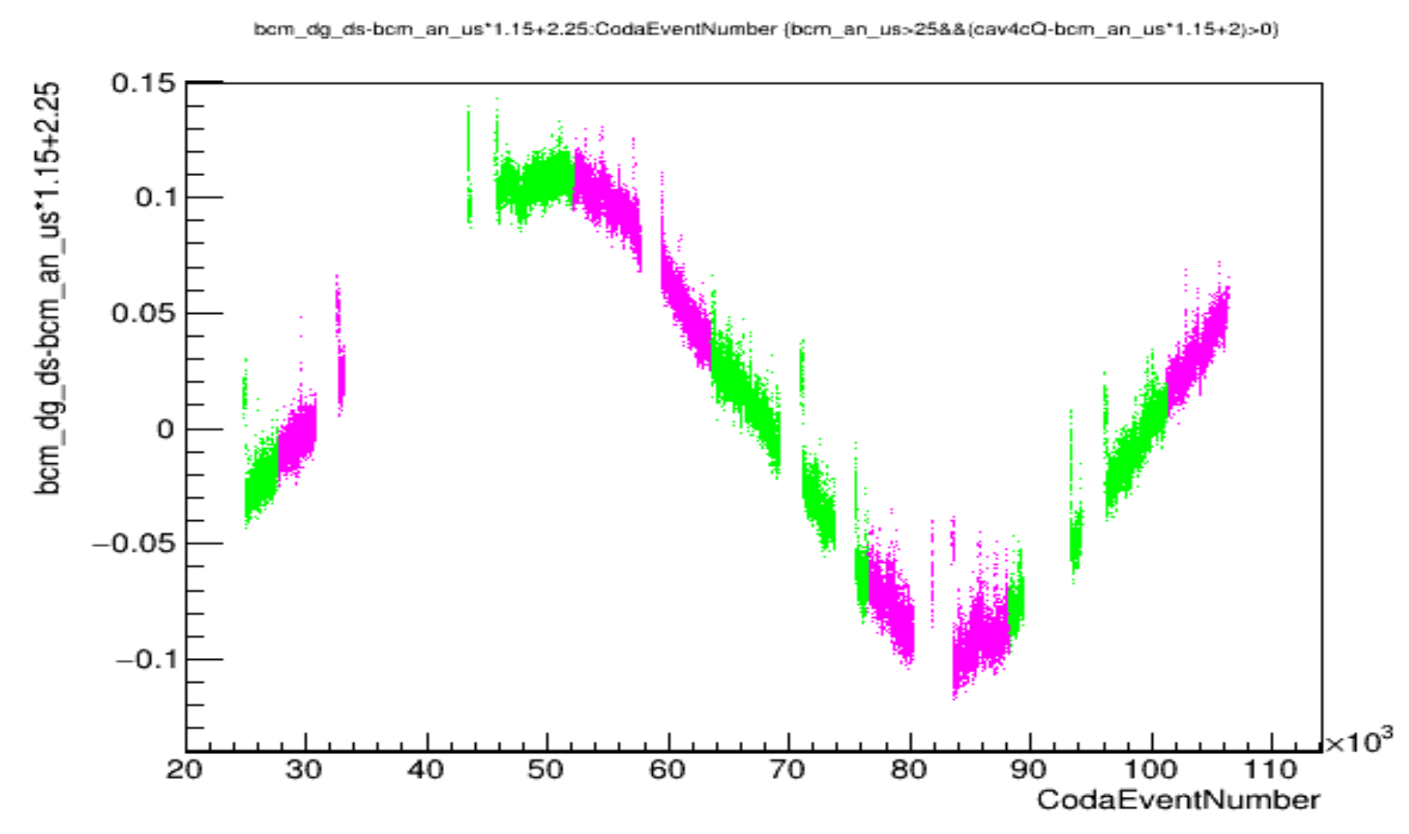
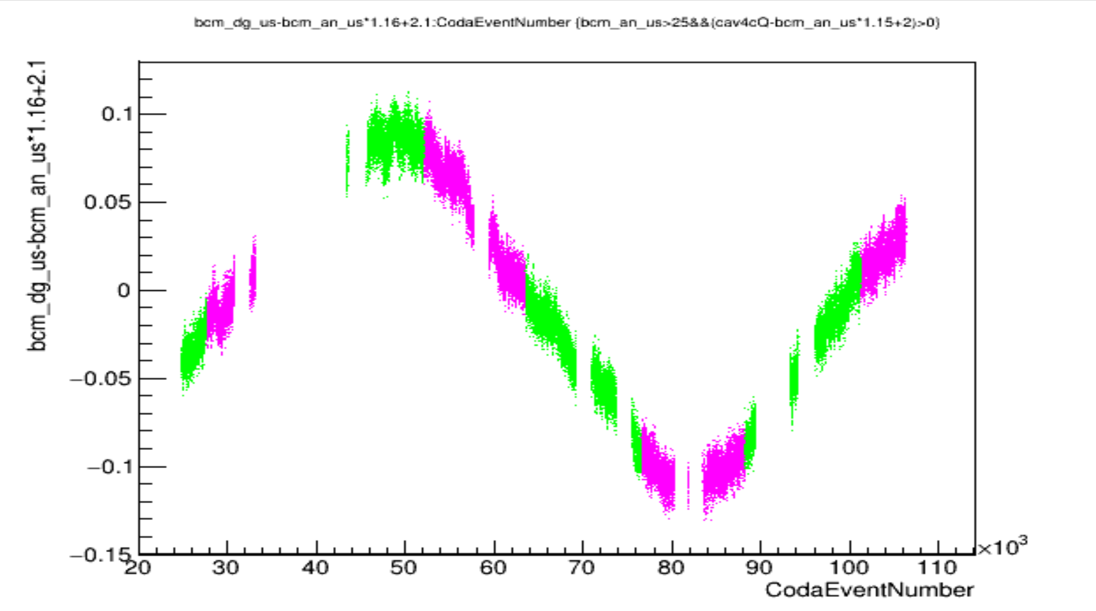
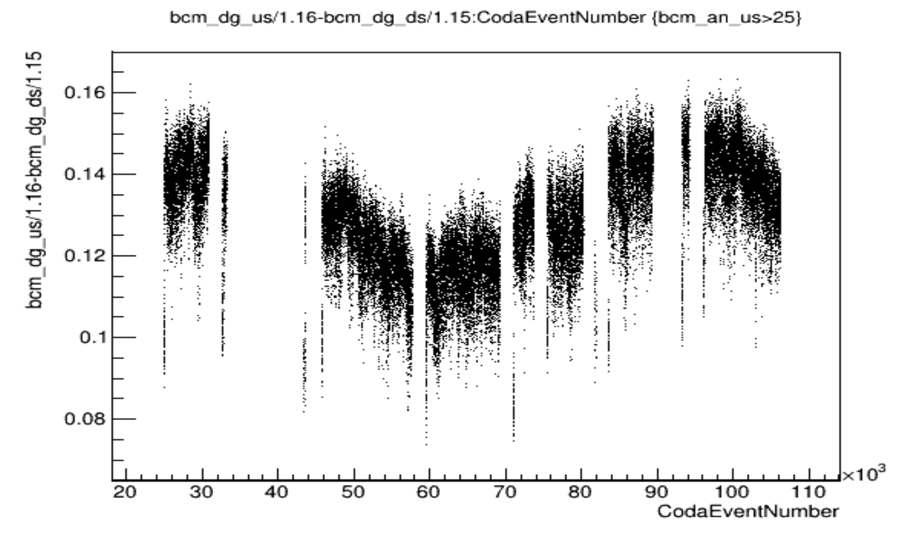
Devi’s Run12050 30uA 2023
I think the gain of the digital receivers are oscillating (together) with a period on the order of 1hr (I think these are the digitals not analogs because of oscillation in dgds-dgus)
I think this could be the result of a slippage of 10MHz ref to 499MHz ref /1497MHz the cans resonate at

Slide 3
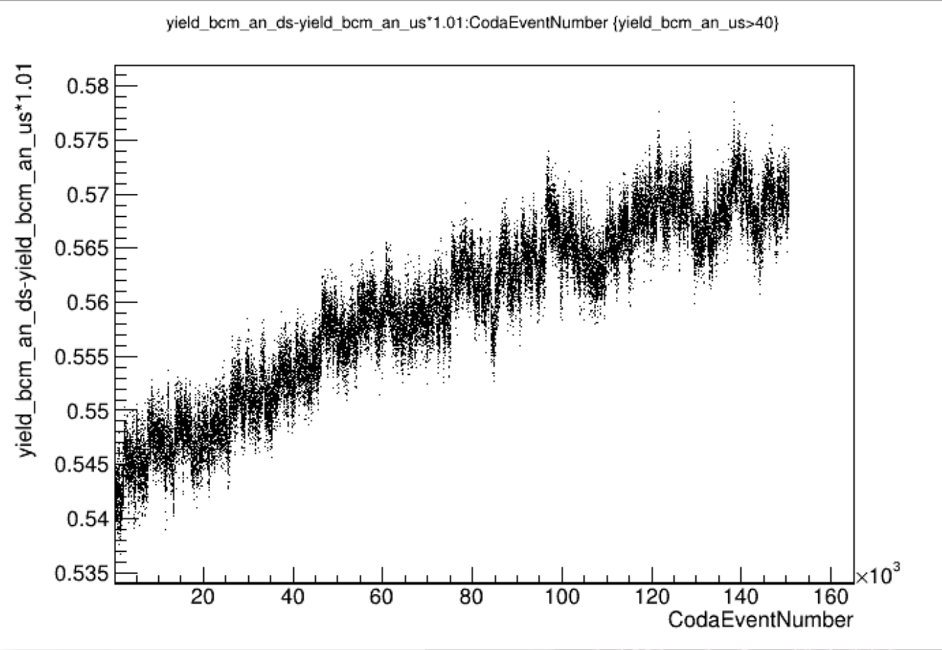
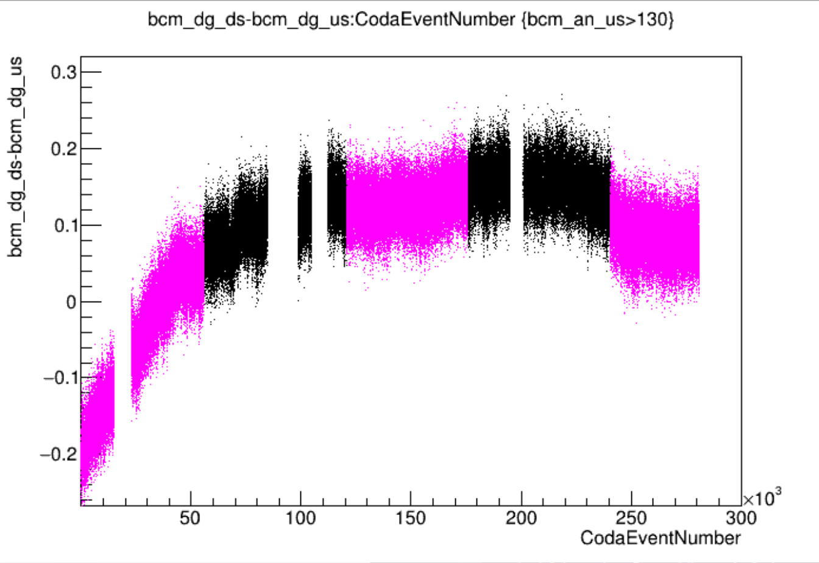
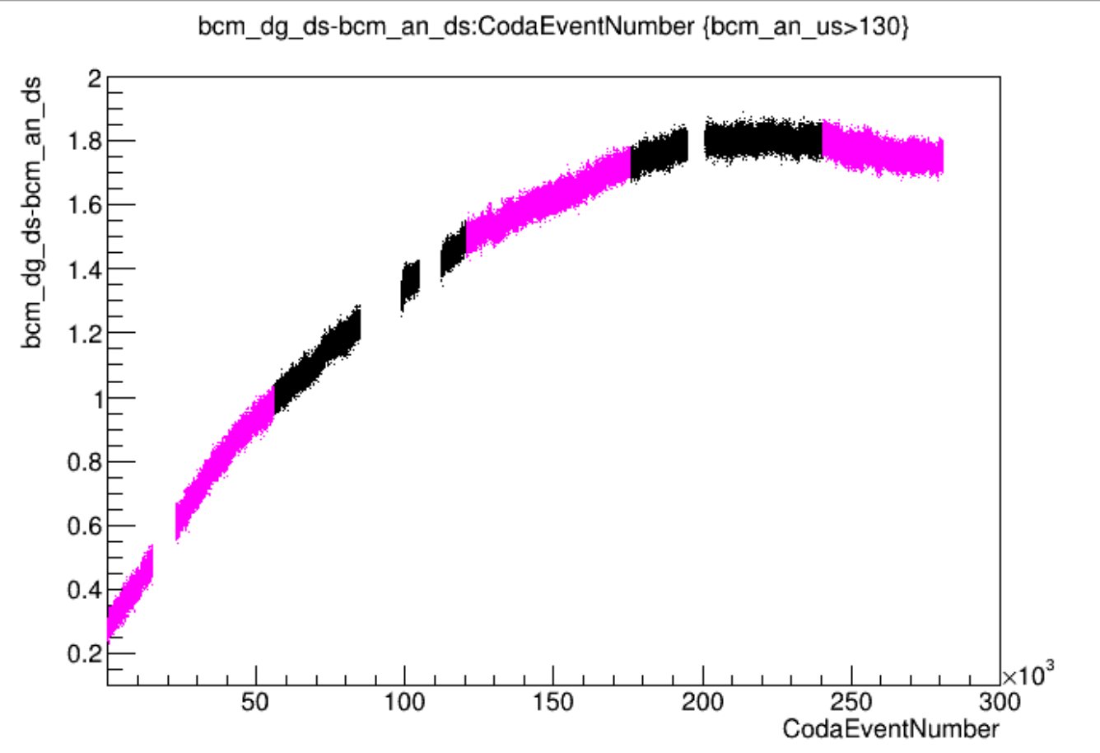
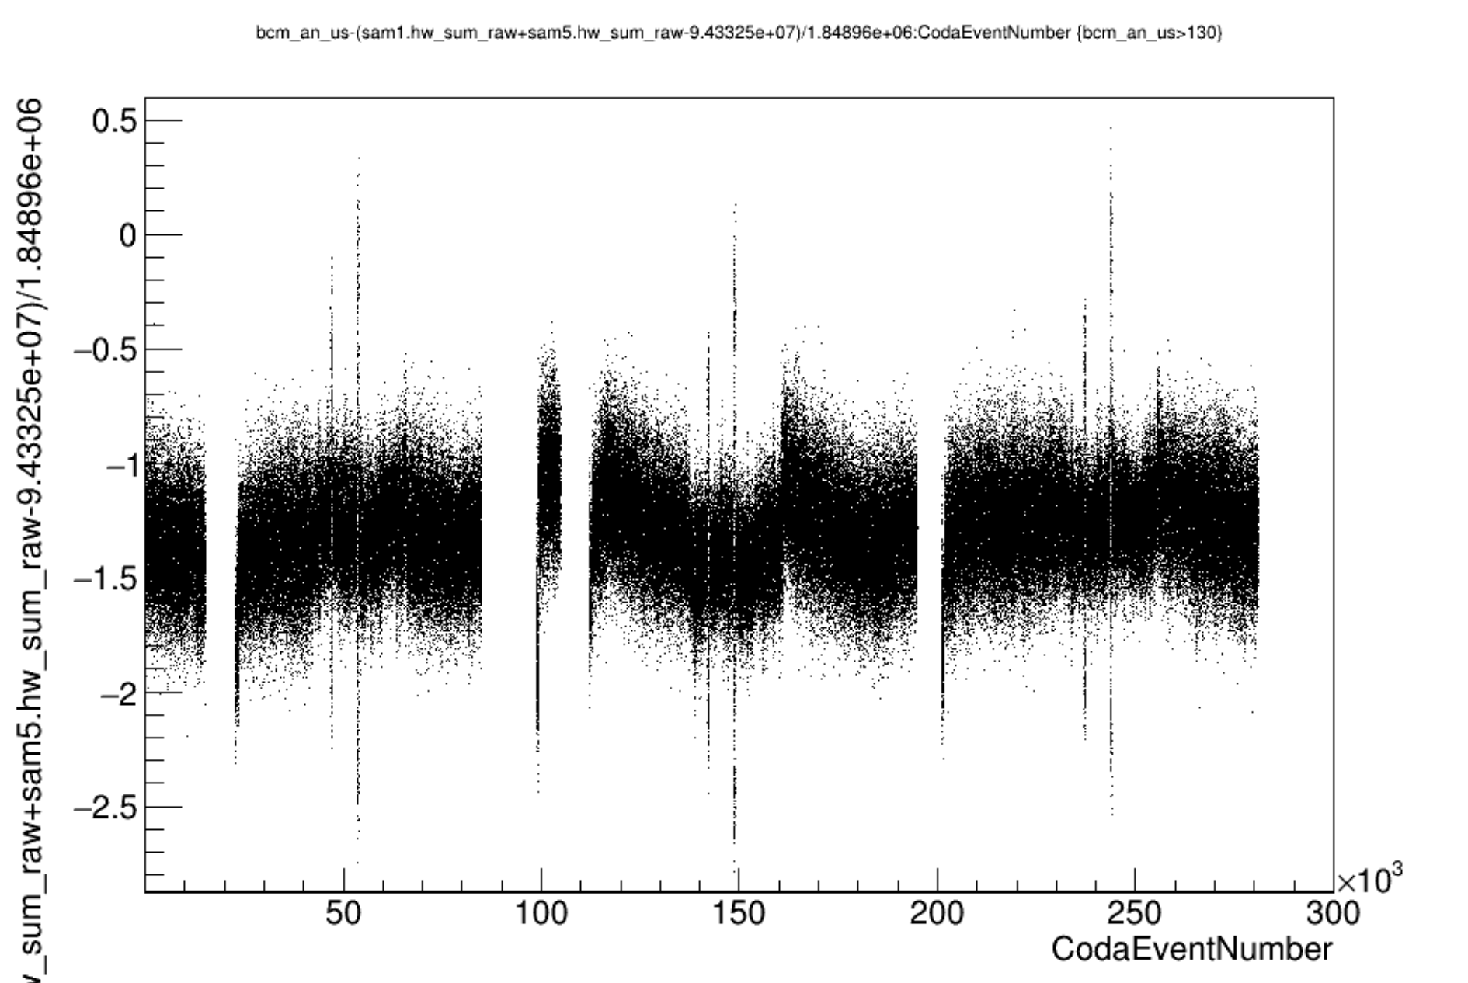
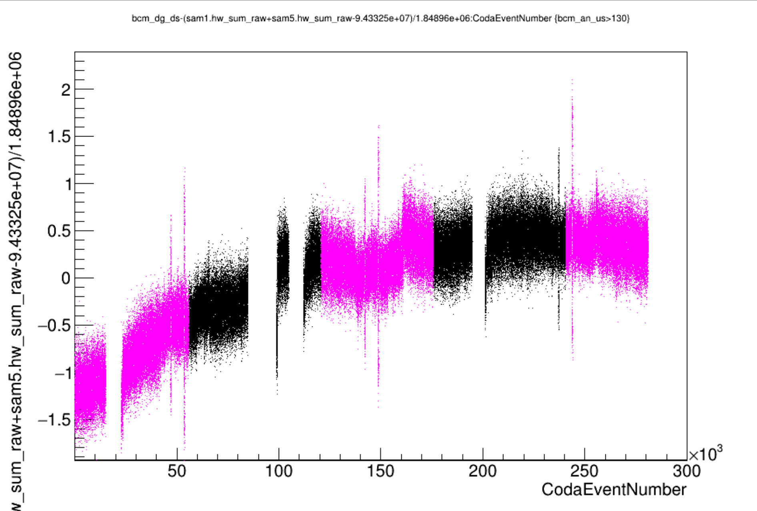
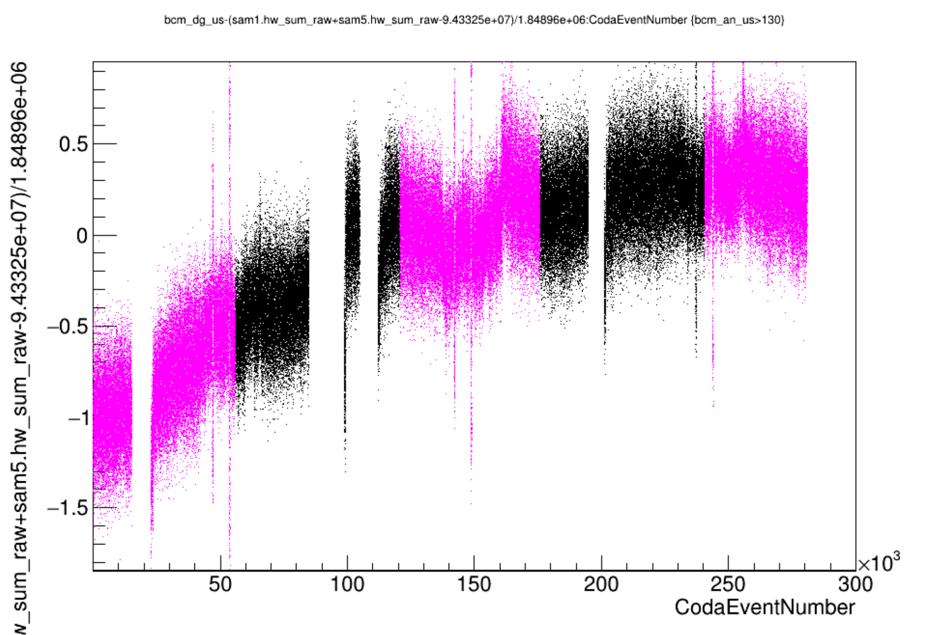
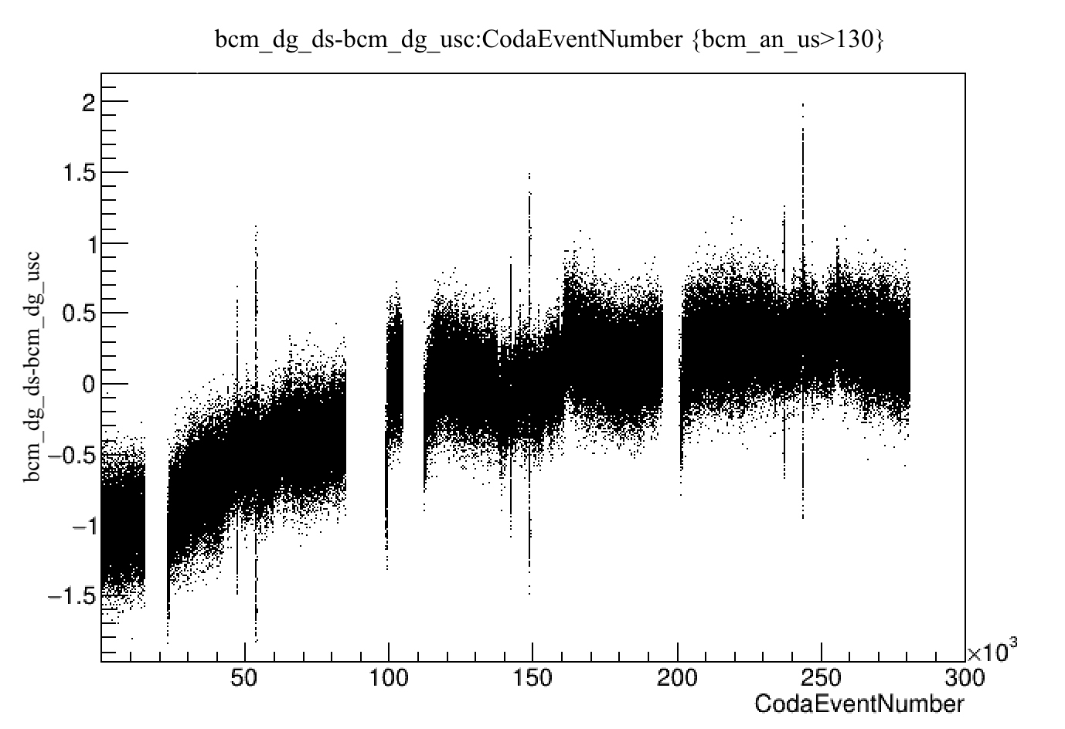
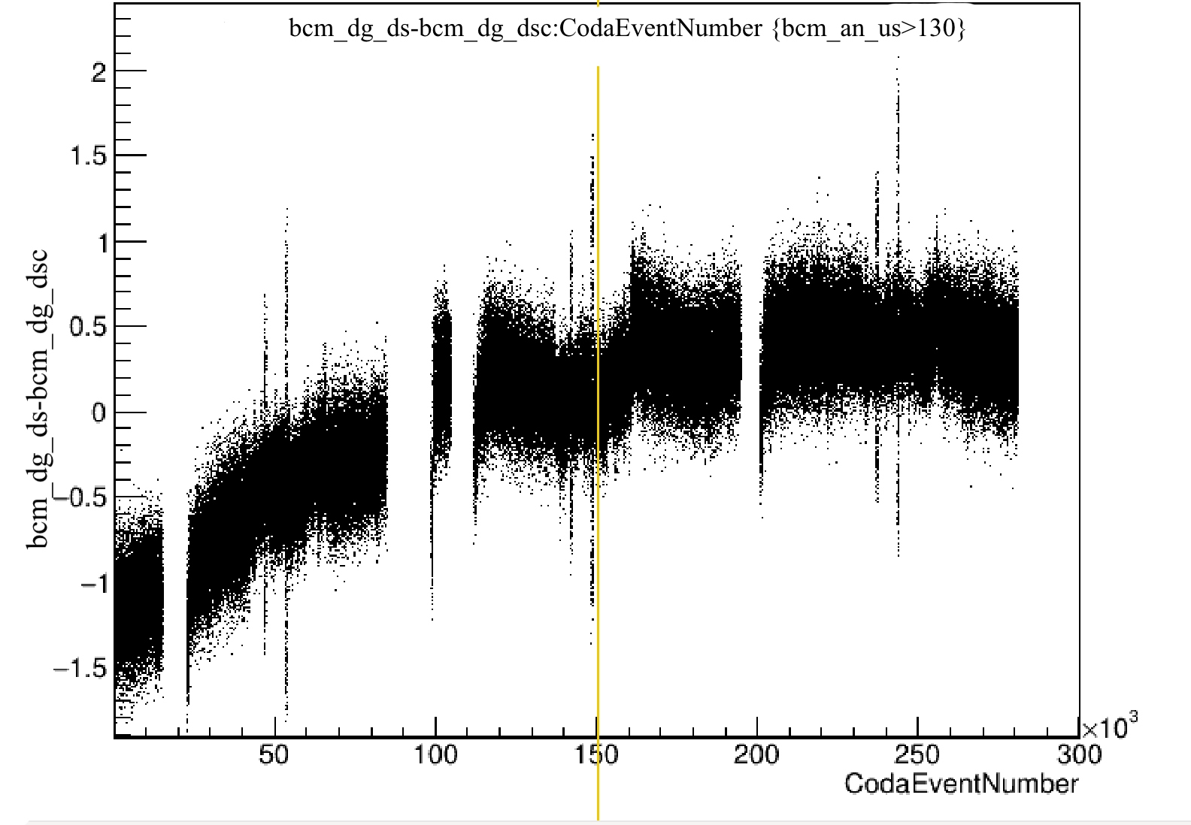
EXTRA proof
CREX Run1615 150uA: Digitals drift periodically, not Analogs (use SAMs)
anDS-anUS
dgDS-dgUS
dgDS-anDS
Δ0.3uA
Δ1.5uA
Δ0.03uA
dgDS-(sam1+5)
dgUS-(sam1+5)
anUS-(sam1+5)
Δ1.5uA
Δ1.2uA
<Δ0.2uA
dgDSc-(sam1+5)
dgUSc-(sam1+5)
~Δ1uA
~Δ1uA

Slide 4
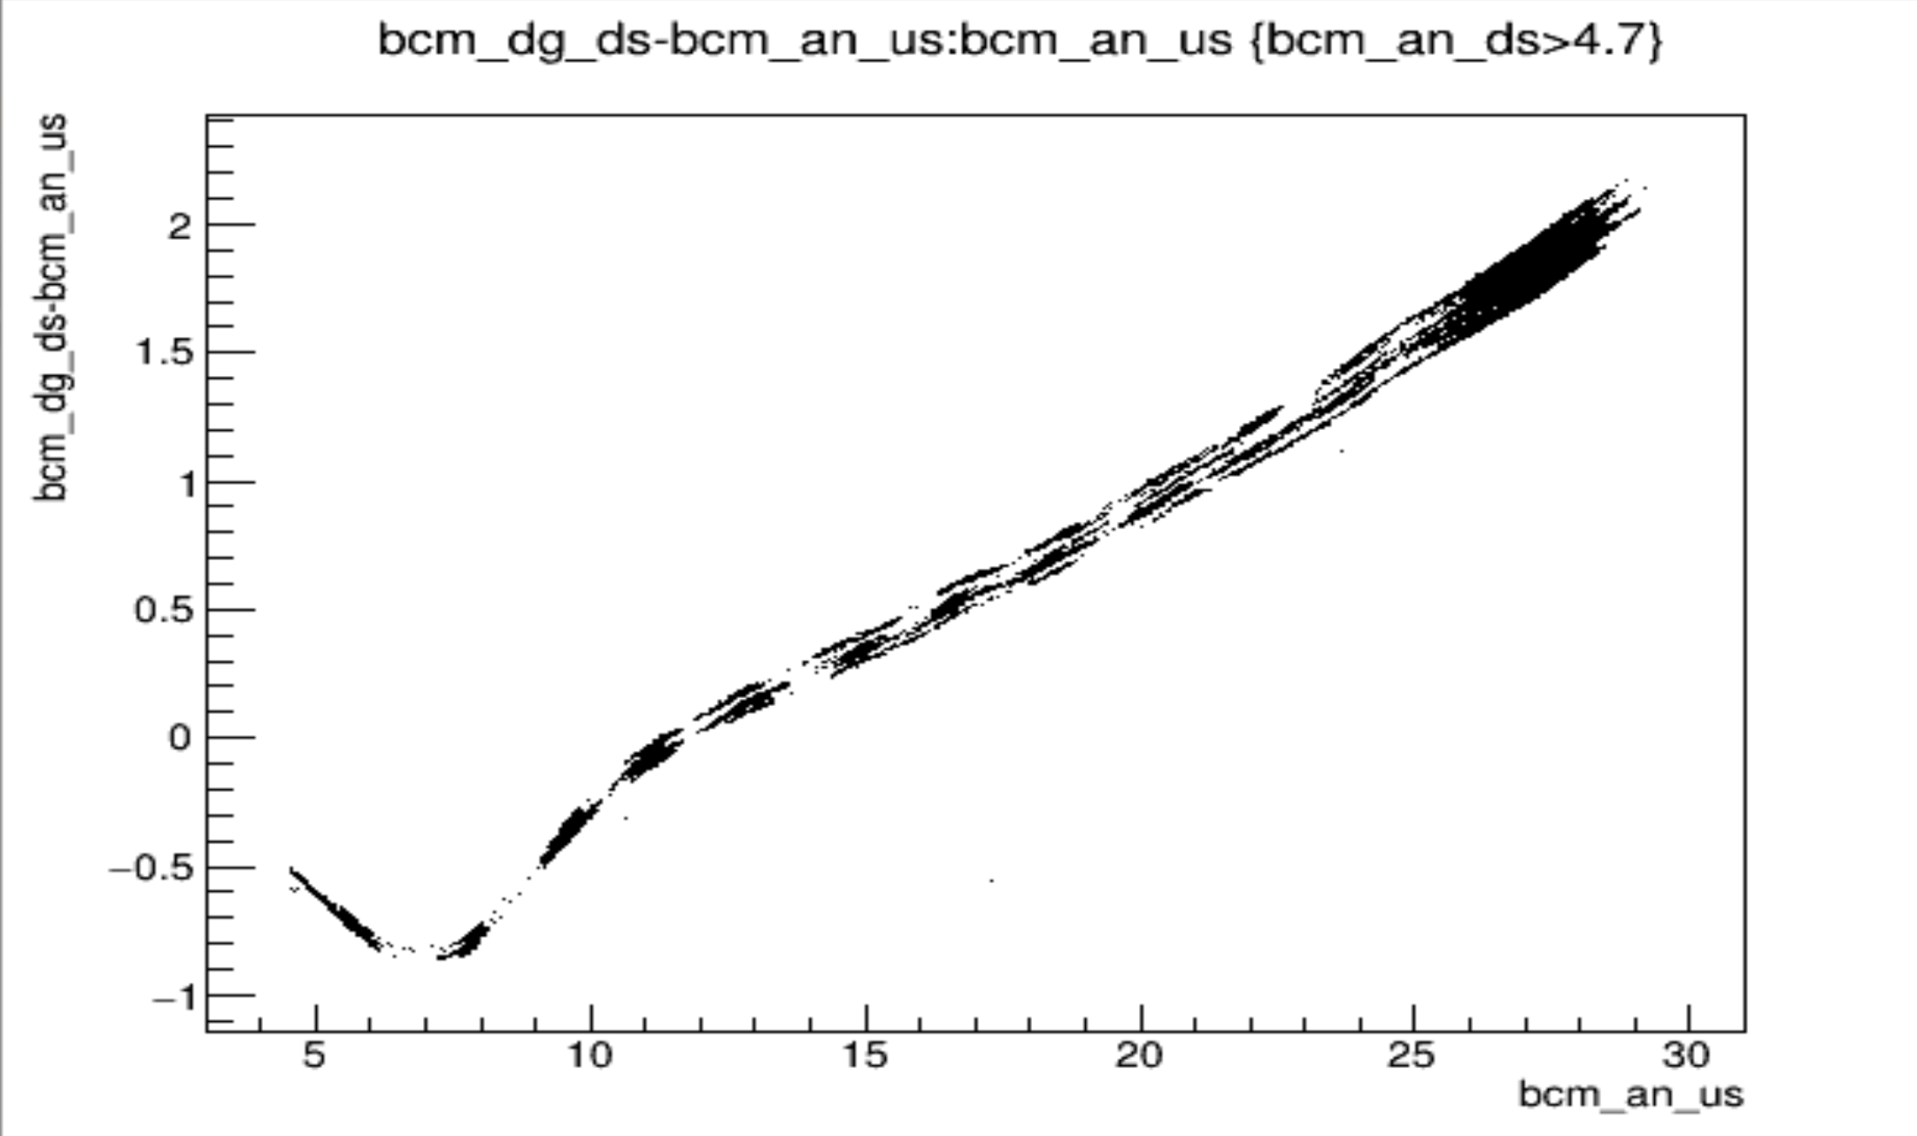
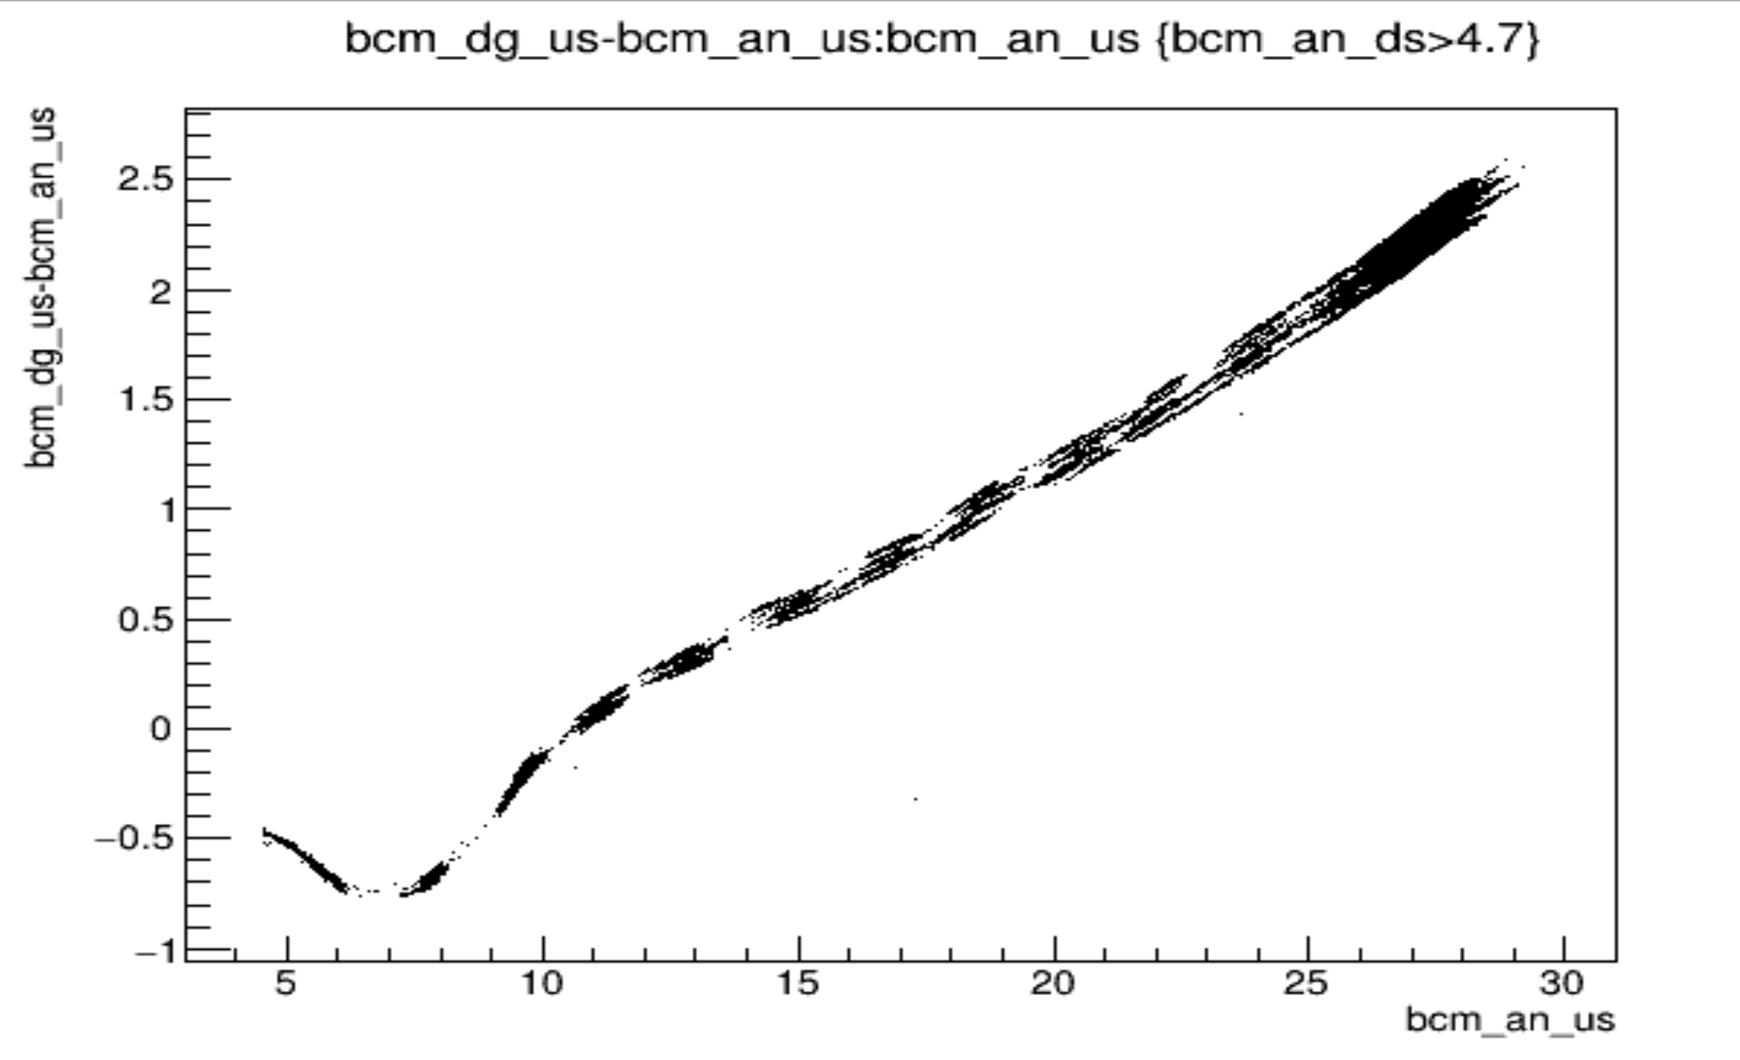
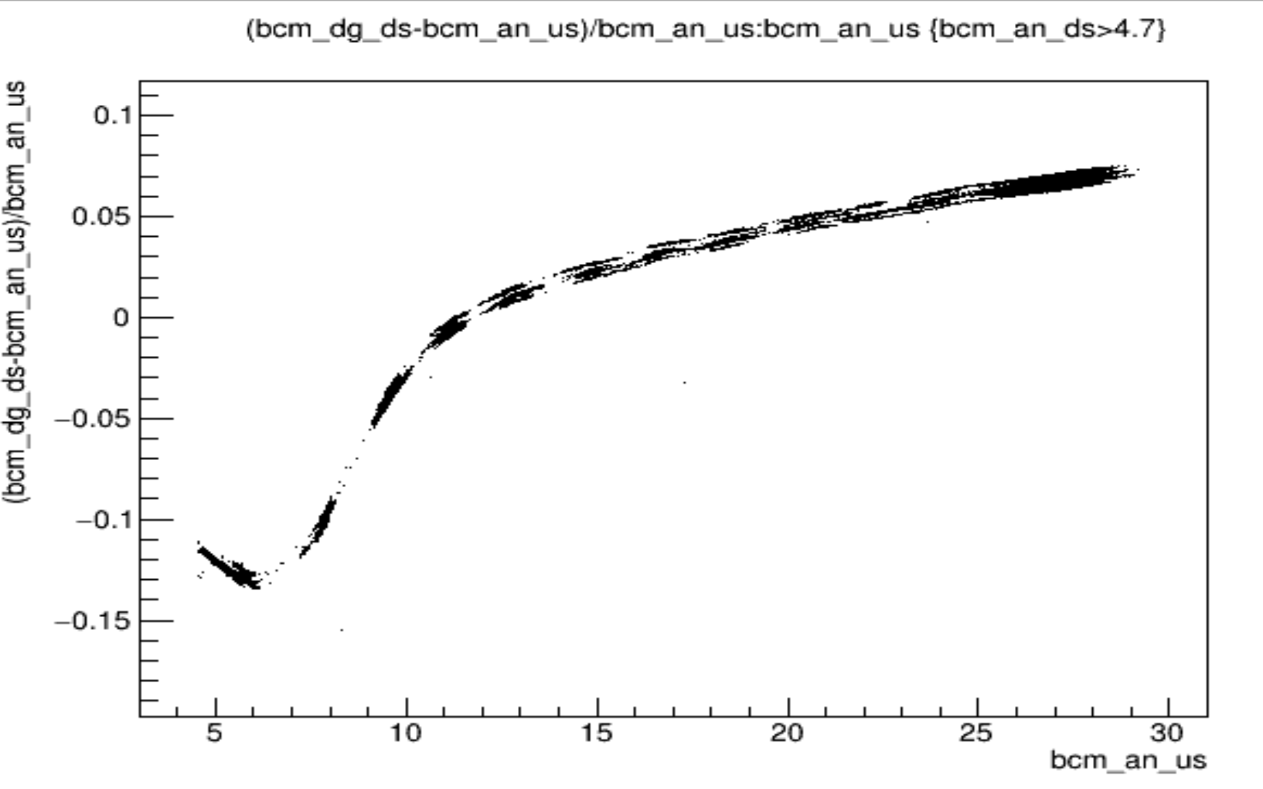
Devi’s Run12050 30uA 2023
The reason I think it’s the gain and not the pedestal of the receiver changing is the below graph where the “variations” are smaller in breadth for lower currents and seem normalized when divided by current.
Normalized
To current

Slide 5
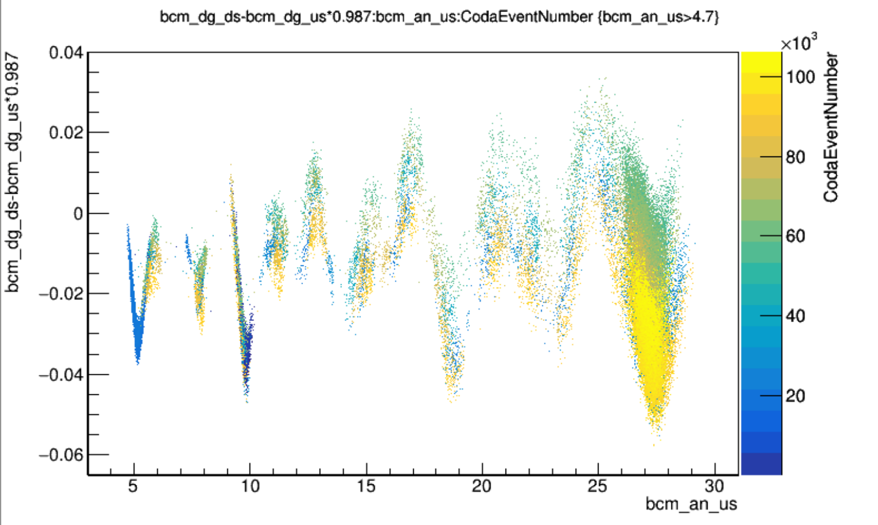
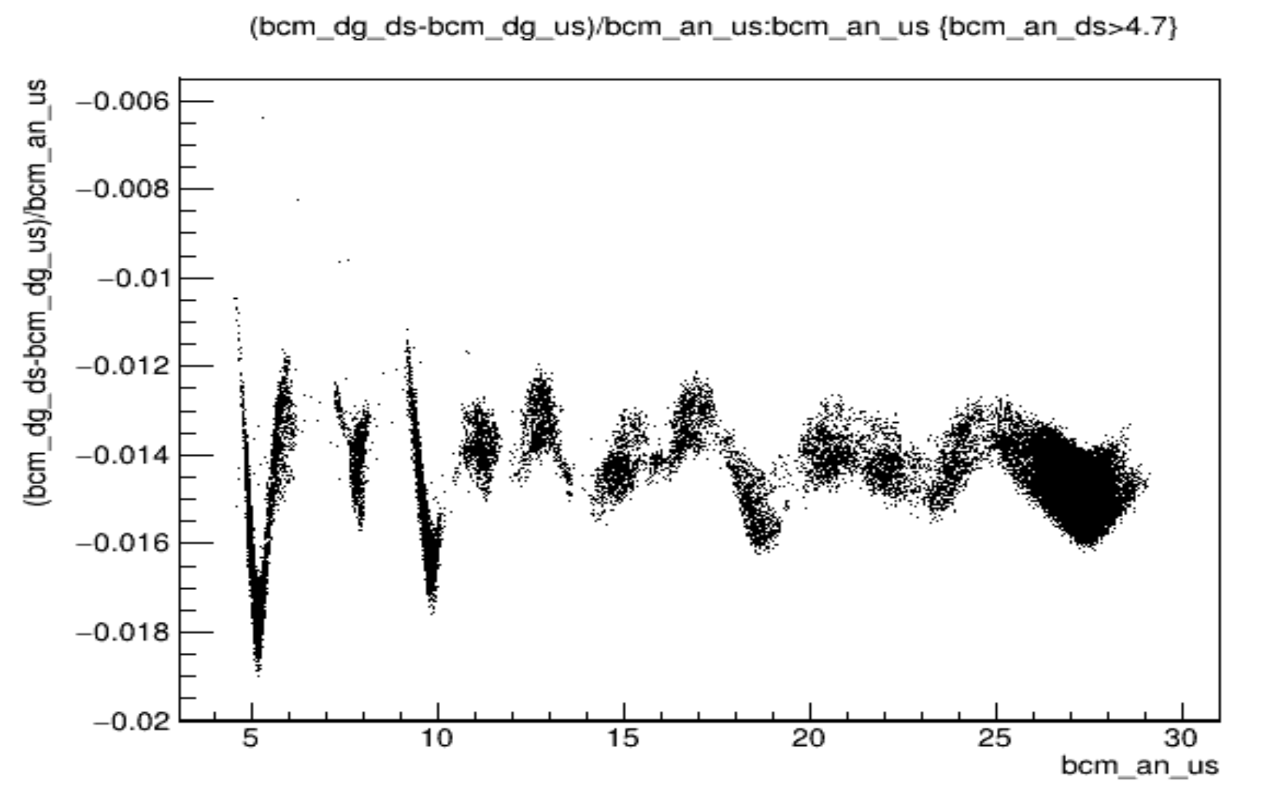
Devi’s Run12050 30uA 2023
Oscillatory signal response
When looking at dgds-dgus, can see a sinusoidal signal response to current. Maybe it’s actually sinusoidal S=I+a*sin(k*I) or the bit resolution is observable in signal output and this is actually like a sawtooth.
Note that for CREX, I think we wanted linearity at 150uA, so maybe 300uA Imax(??), 12bit dac gives 0.07uA/bit, 14bit dac git 0.017uA/bit…. If linear. But looks like period increasing with I so maybe logarithmic.

Slide 6
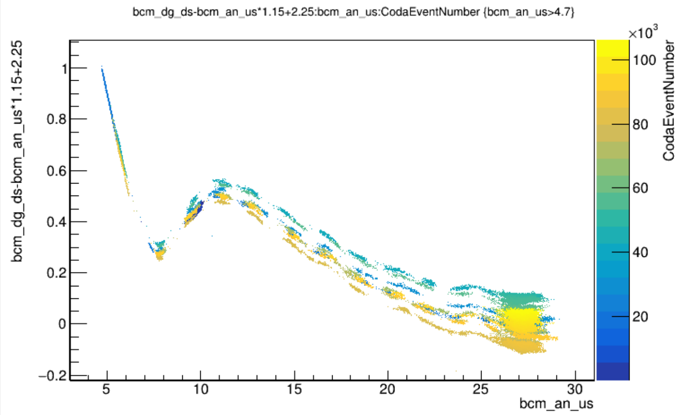
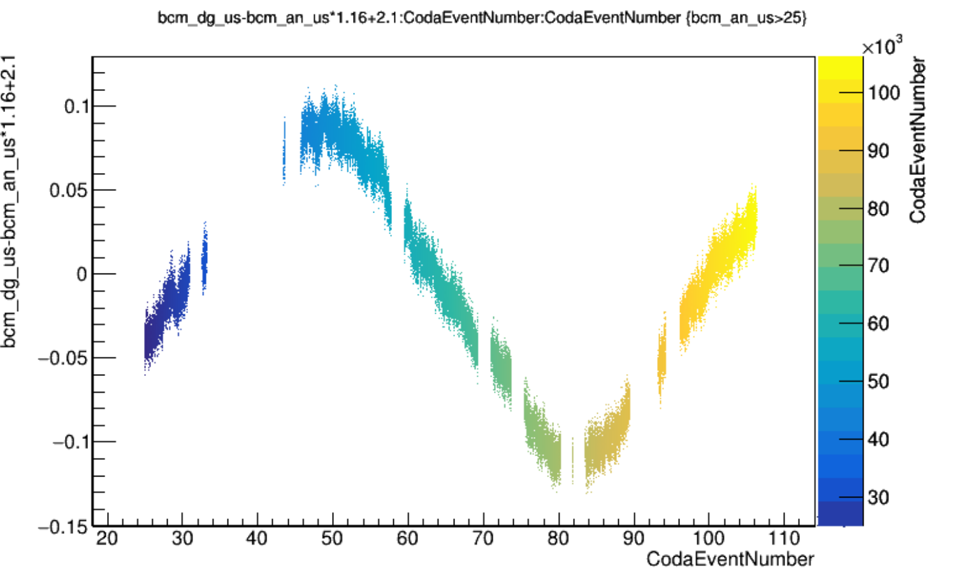
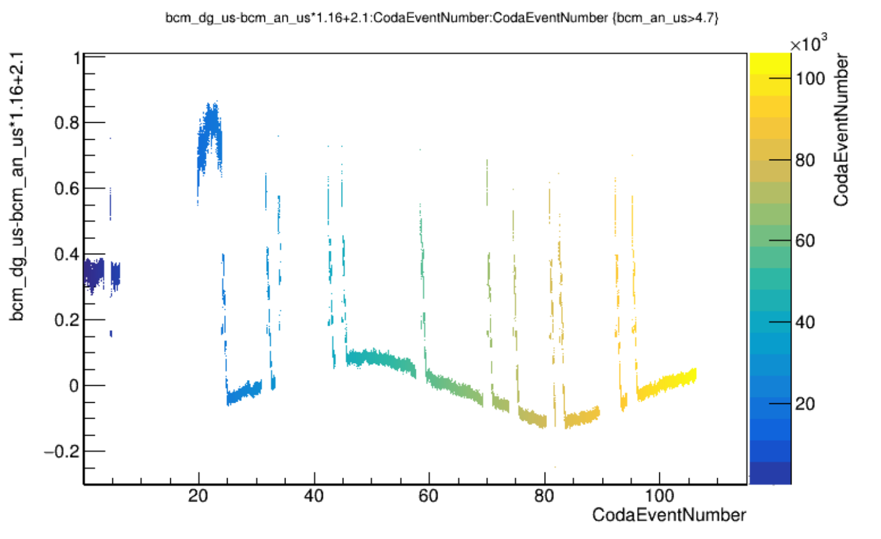
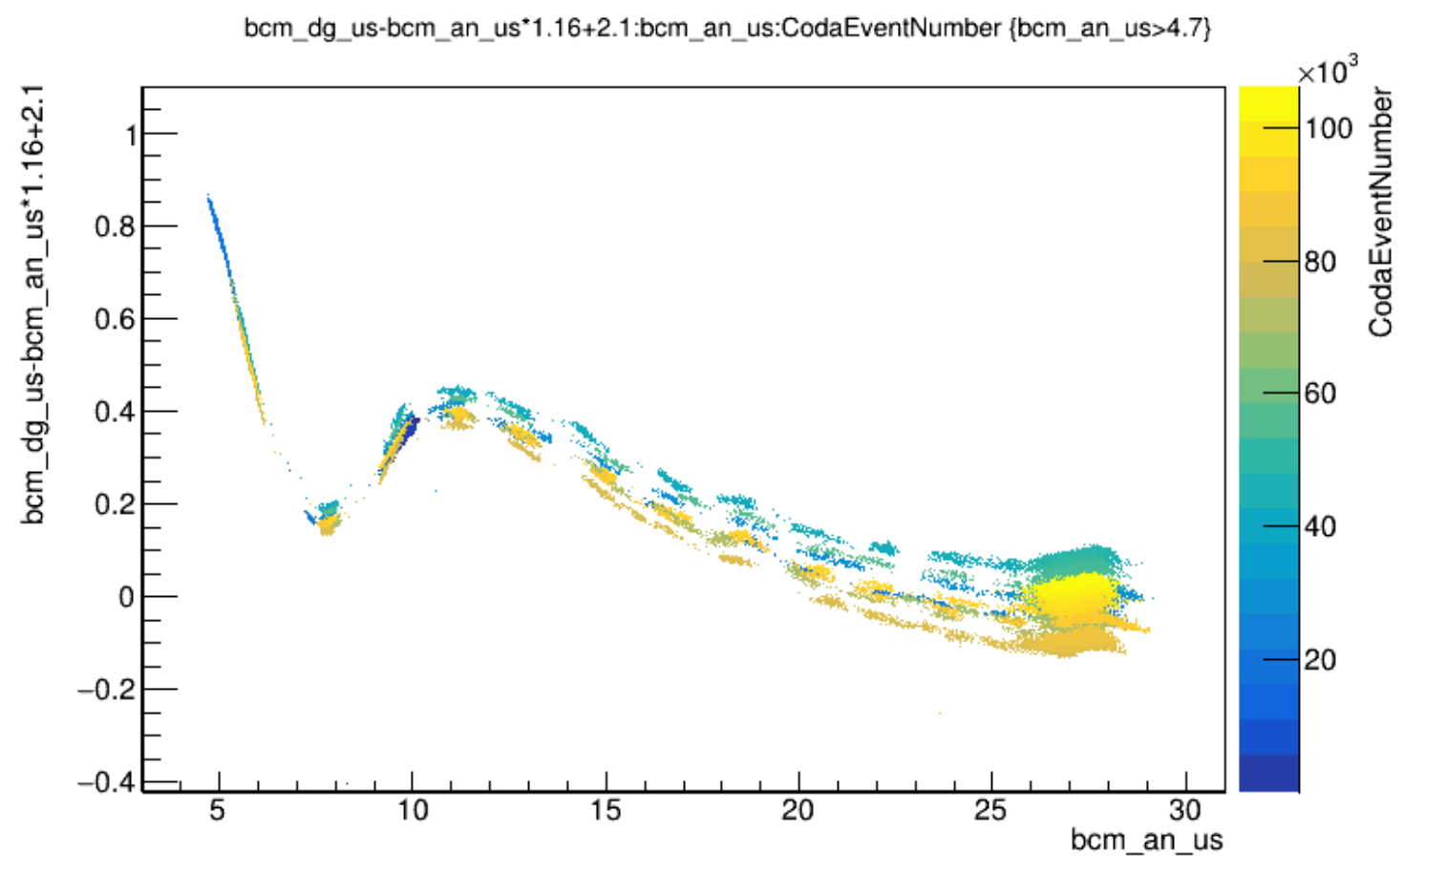
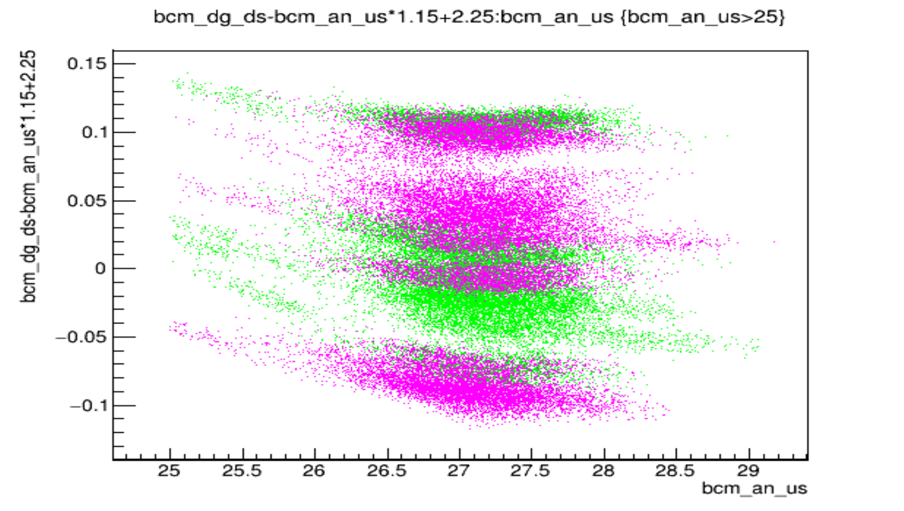
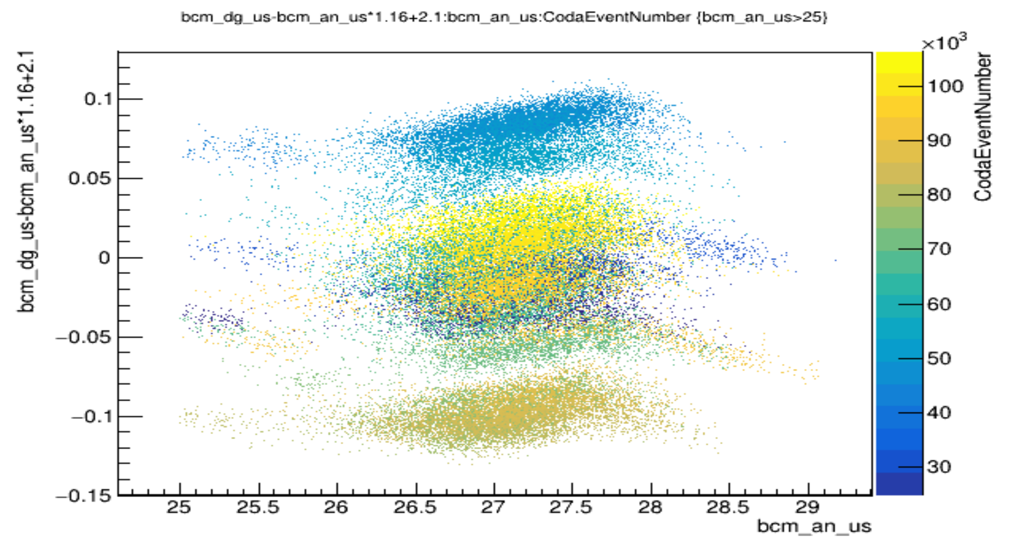
Devi’s Run12050 30uA 2023
Why are there stripes?
I think there’s two things: (1) the gain temporal oscillation + (2) beam trips at different times
+
=
=

Slide 7
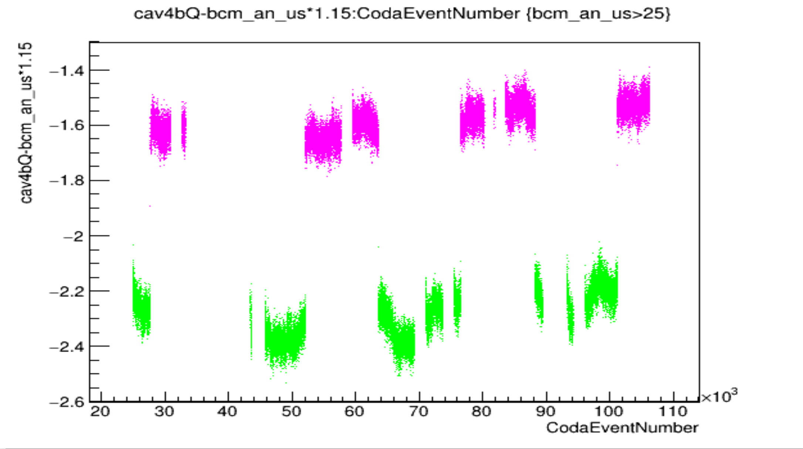
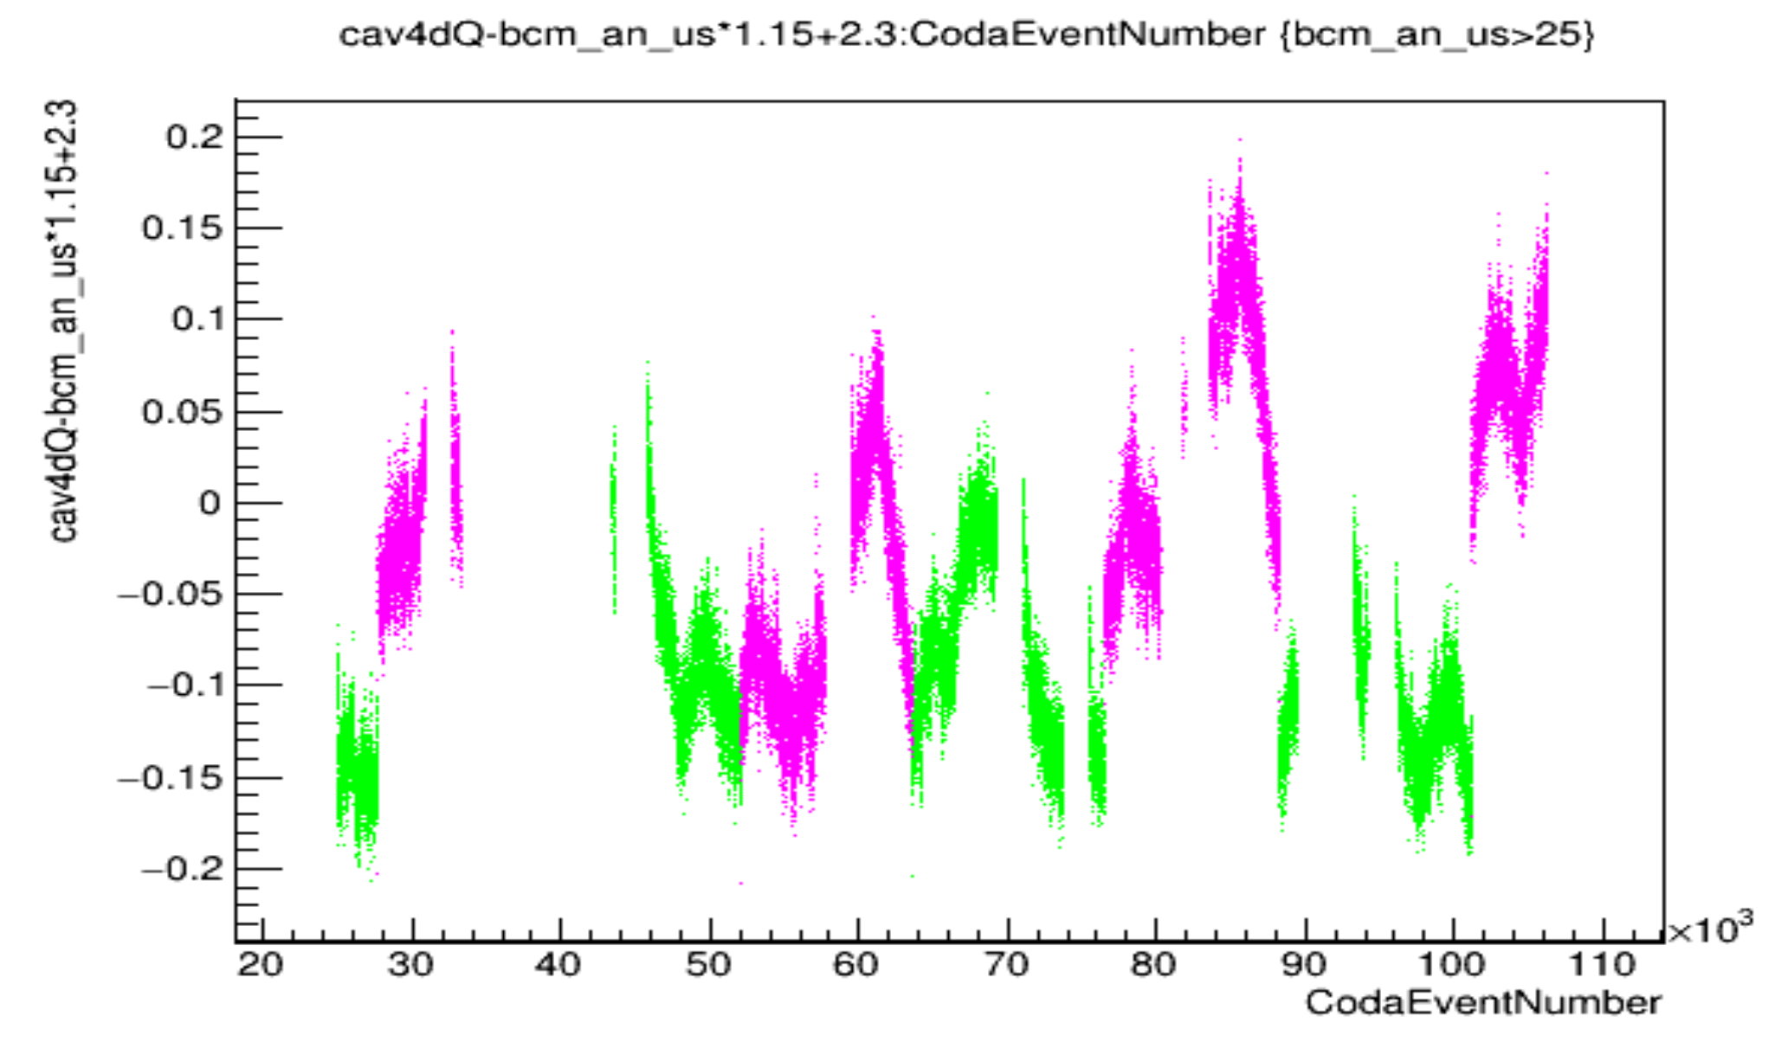
Devi’s Run12050 30uA 2023
What’s up with the cavities jumping? All 3 b,c,d jump at SAME times

Slide 8
Devi’s Run12050 30uA 2023
What’s up with the cavities jumping? All 3 b,c,d jump at SAME times
Note: look how this relates (maybe) to the temporal oscillation behavior. Doesn’t that look like when the oscillation reaches some threshold value, it switches over to green, then pink, then green, then pink. Like the cavity receiver “knows” what the bcm receiver knows too, and it’s another sort of bit / gain resolution on top of the smaller bit/gain resolution

Slide 9
Devi’s Run12050 30uA 2023
What’s up with the cavities jumping?
Note: look how this relates (maybe) to the temporal oscillation behavior. It could be a periodic behavior too that happens to coincide with the period of oscillation of the bcm digital oscillation

Slide 10
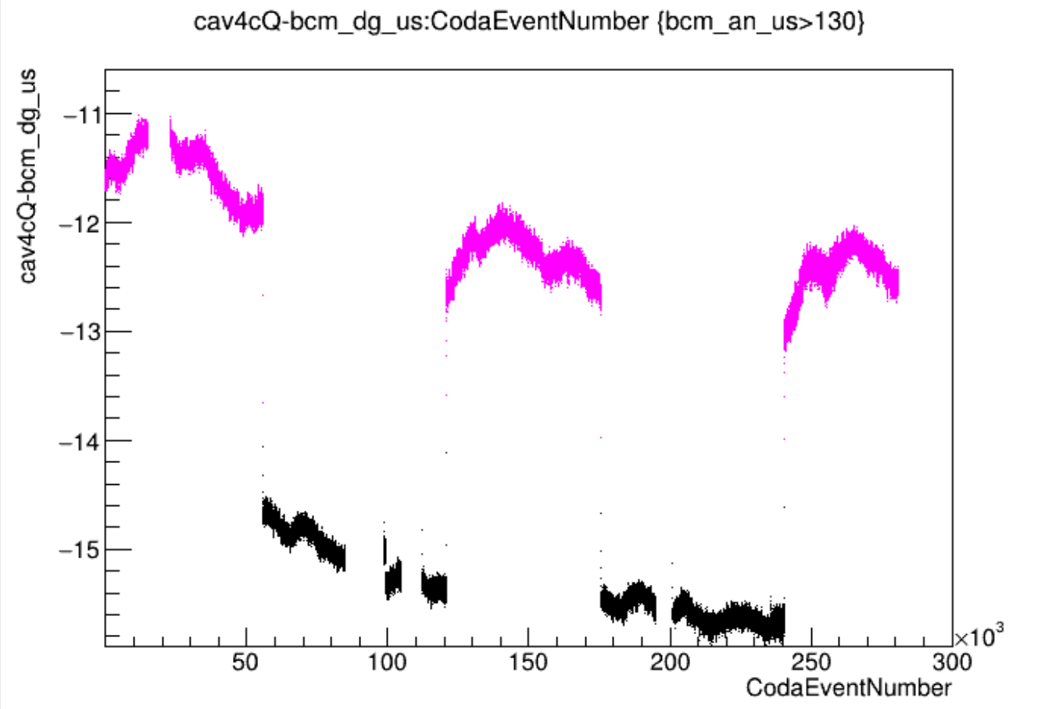
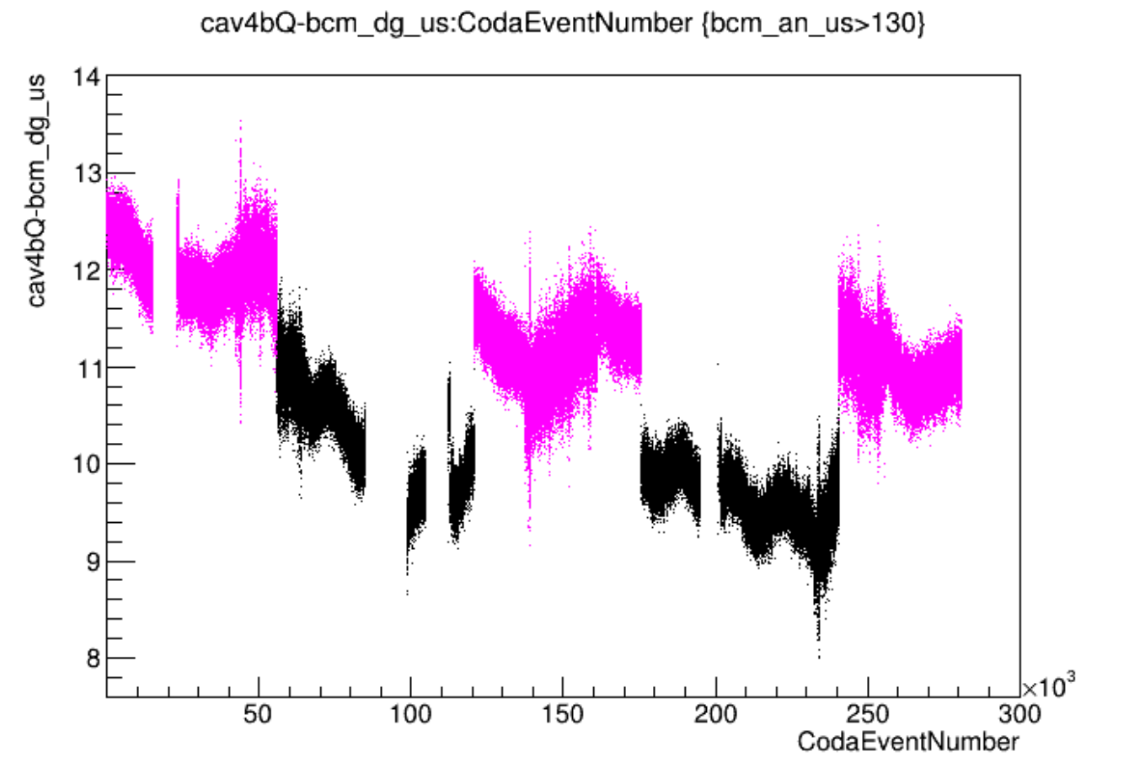
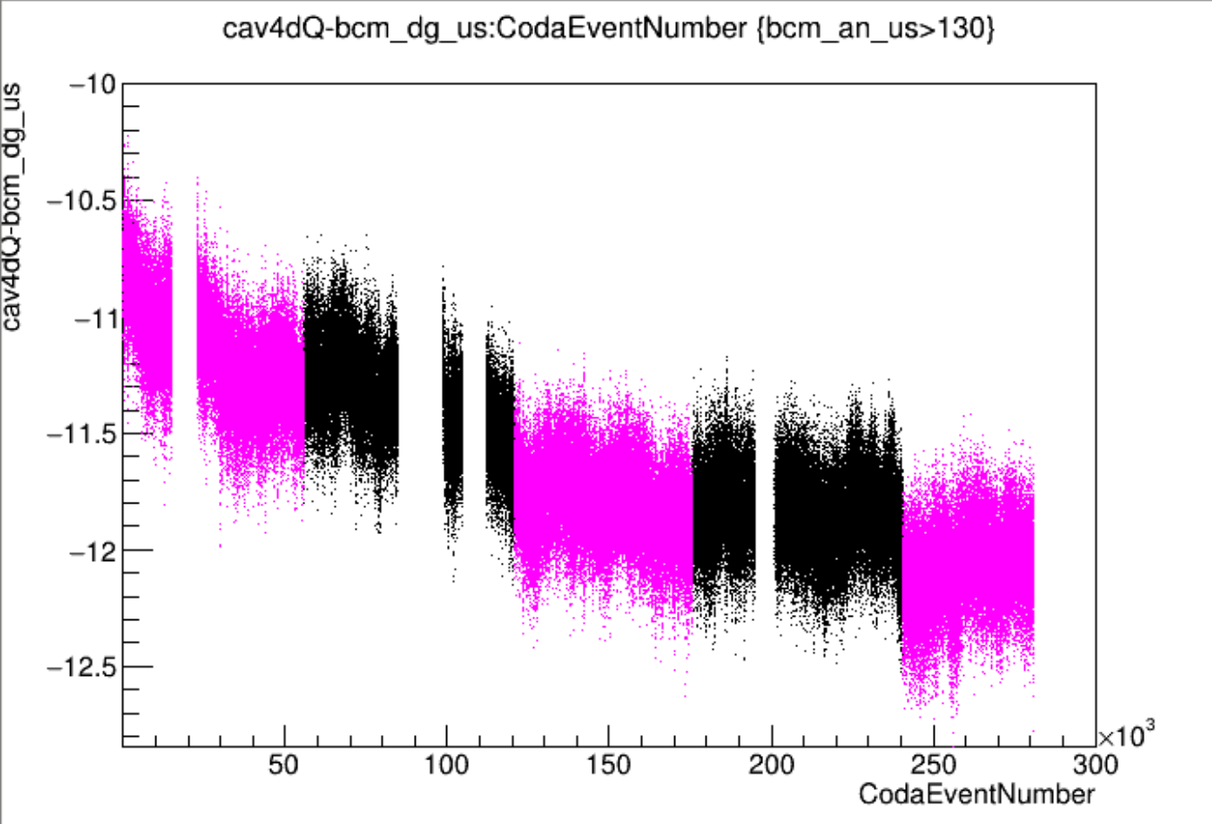
EXTRA proof
CREX Run1615 150uA: Digitals drift periodically, not Analogs (use SAMs)+Cavities Jump periodically
Δ2.5uA
Δ1uA
Δ0.2uA
4cQ-dgUS
4bQ-dgUS
4dQ-dgUS
anDS-anUS
dgDS-dgUS
dgDS-anDS
Δ0.03uA
Δ0.3uA
Δ1.5uA
anUS-(sam1+5)
dgDS-(sam1+5)
dgUS-(sam1+5)
Δ1.5uA
Δ1.2uA
<Δ0.2uA

Slide 11
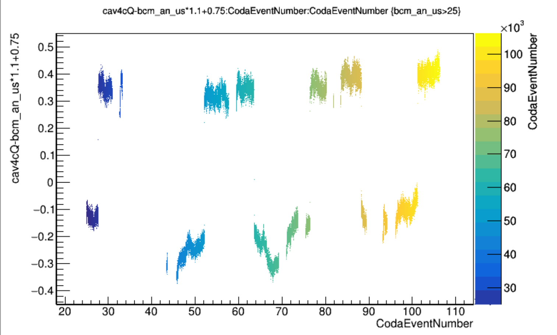
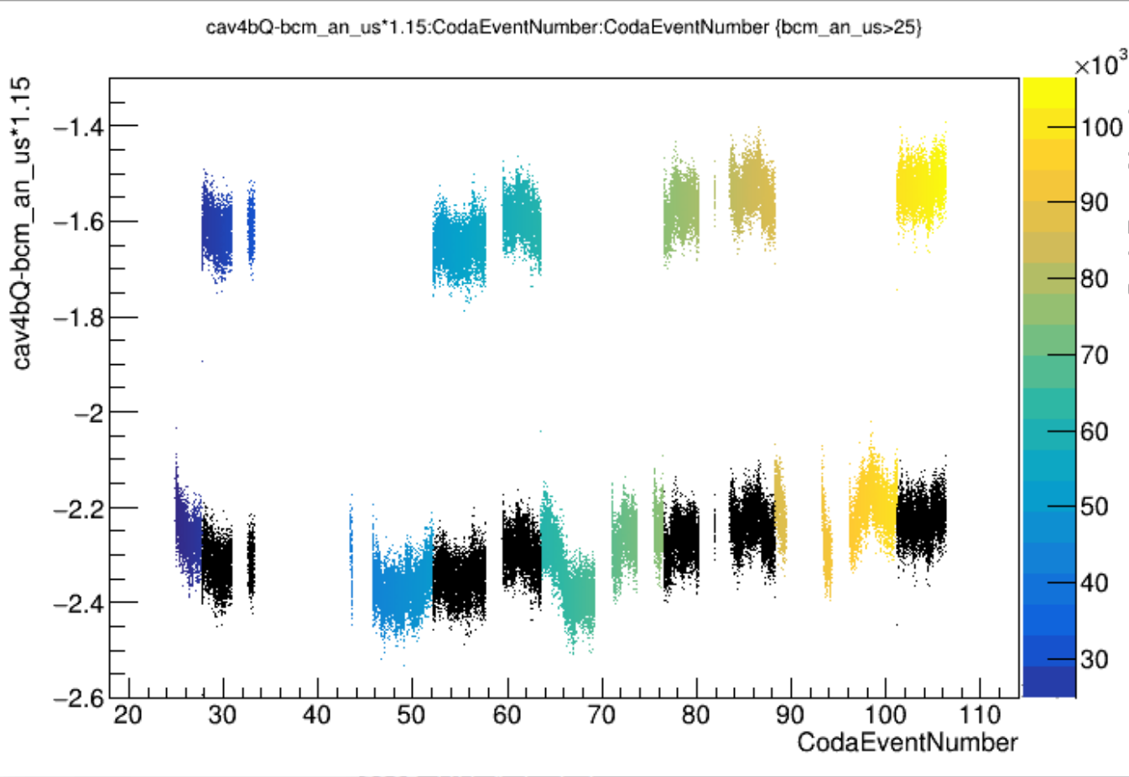
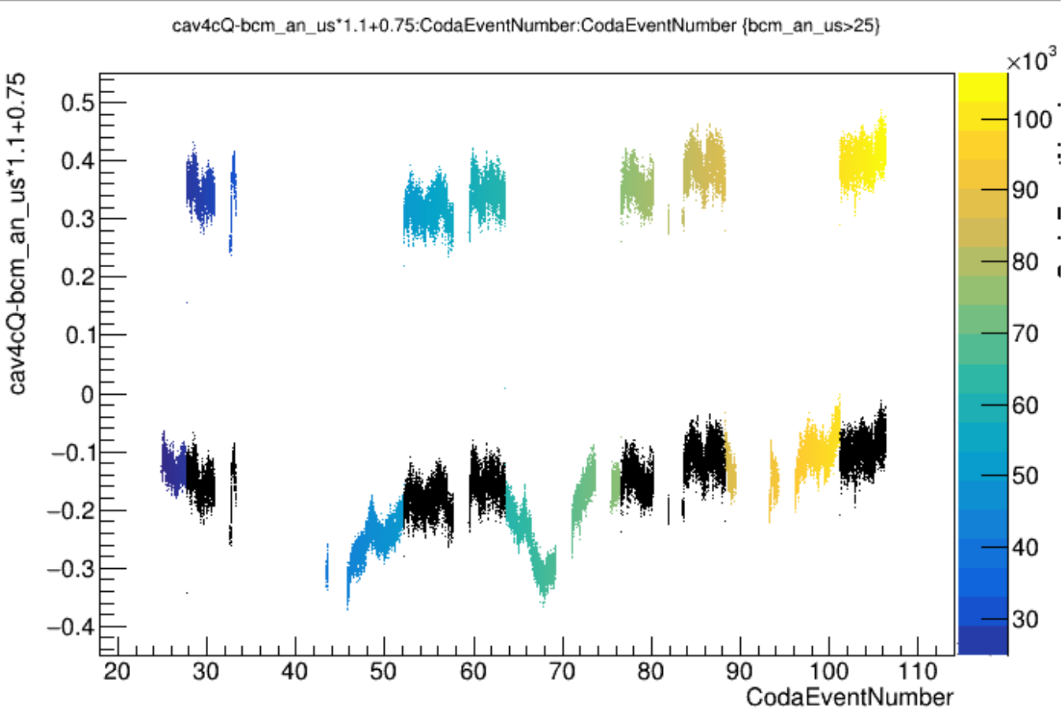
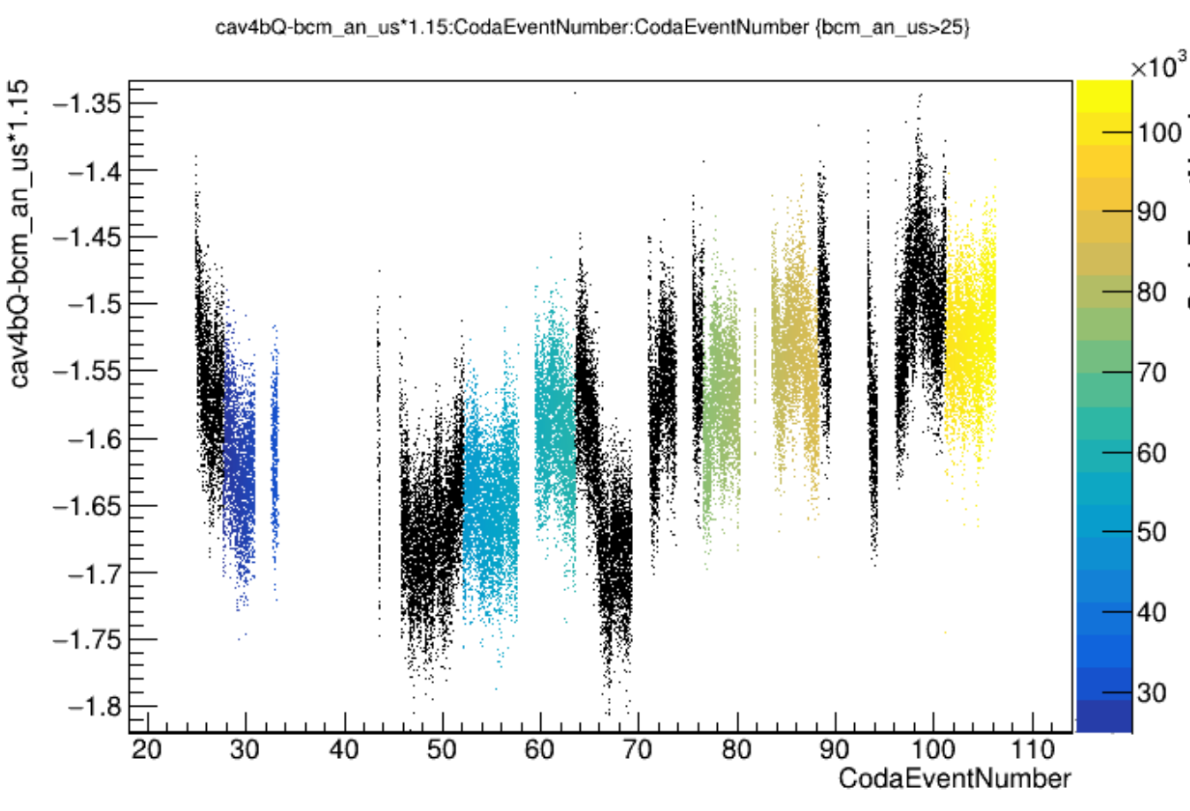
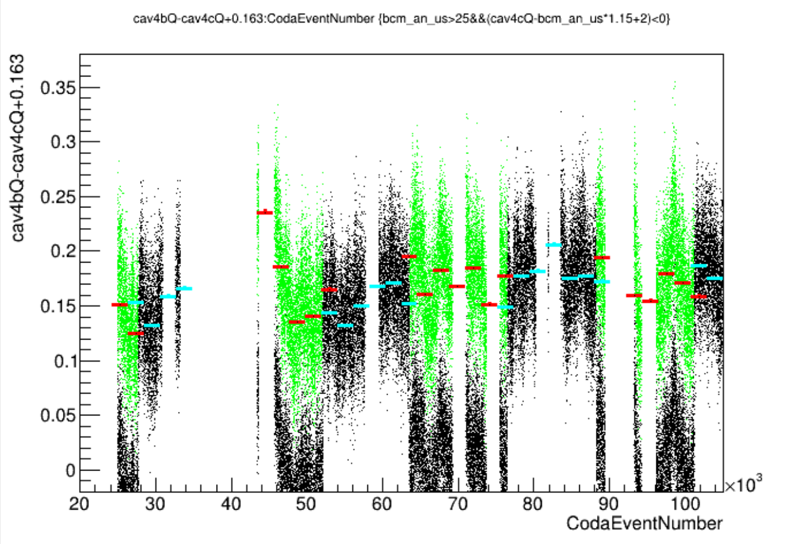
EXTRA:Another visualization looking for T-oscs in cavs

Slide 12
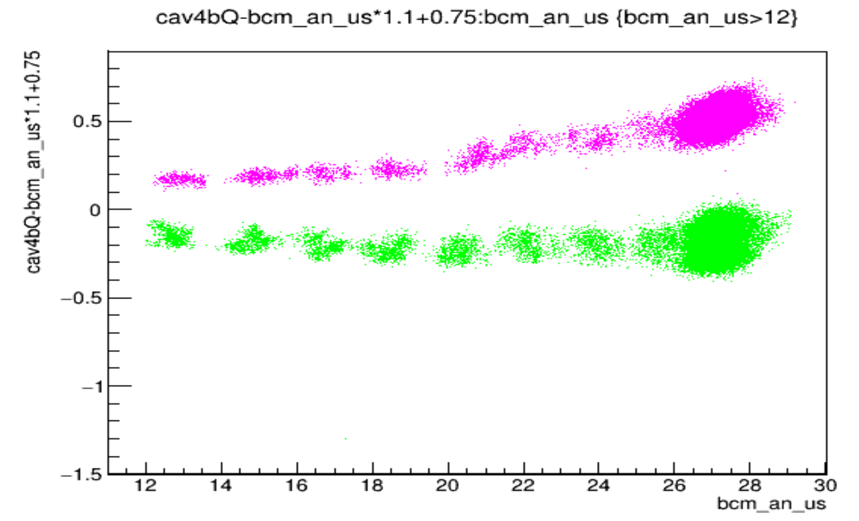
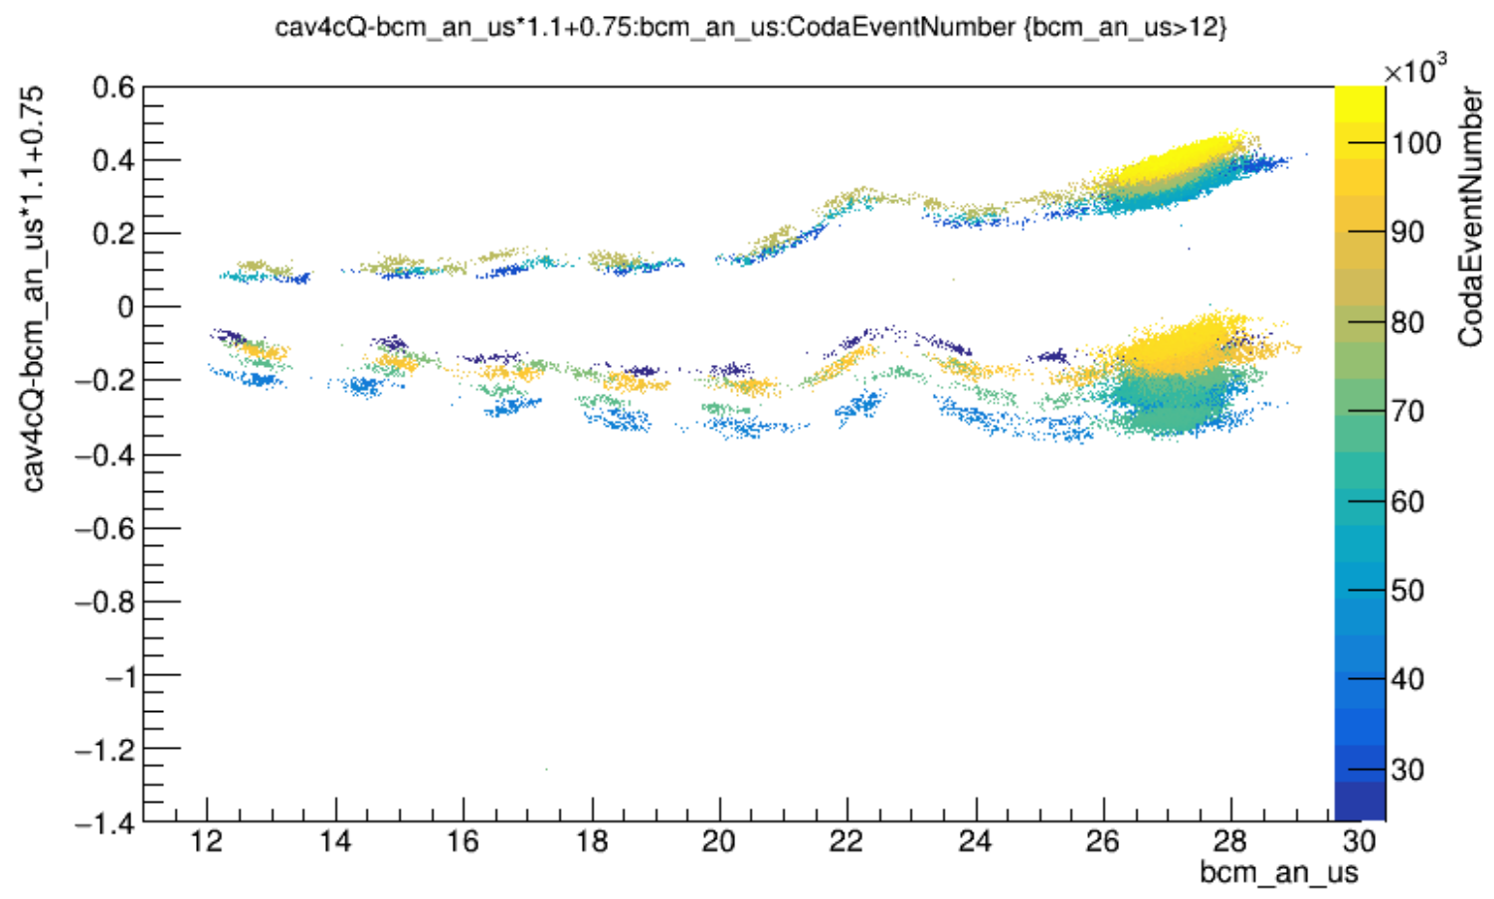
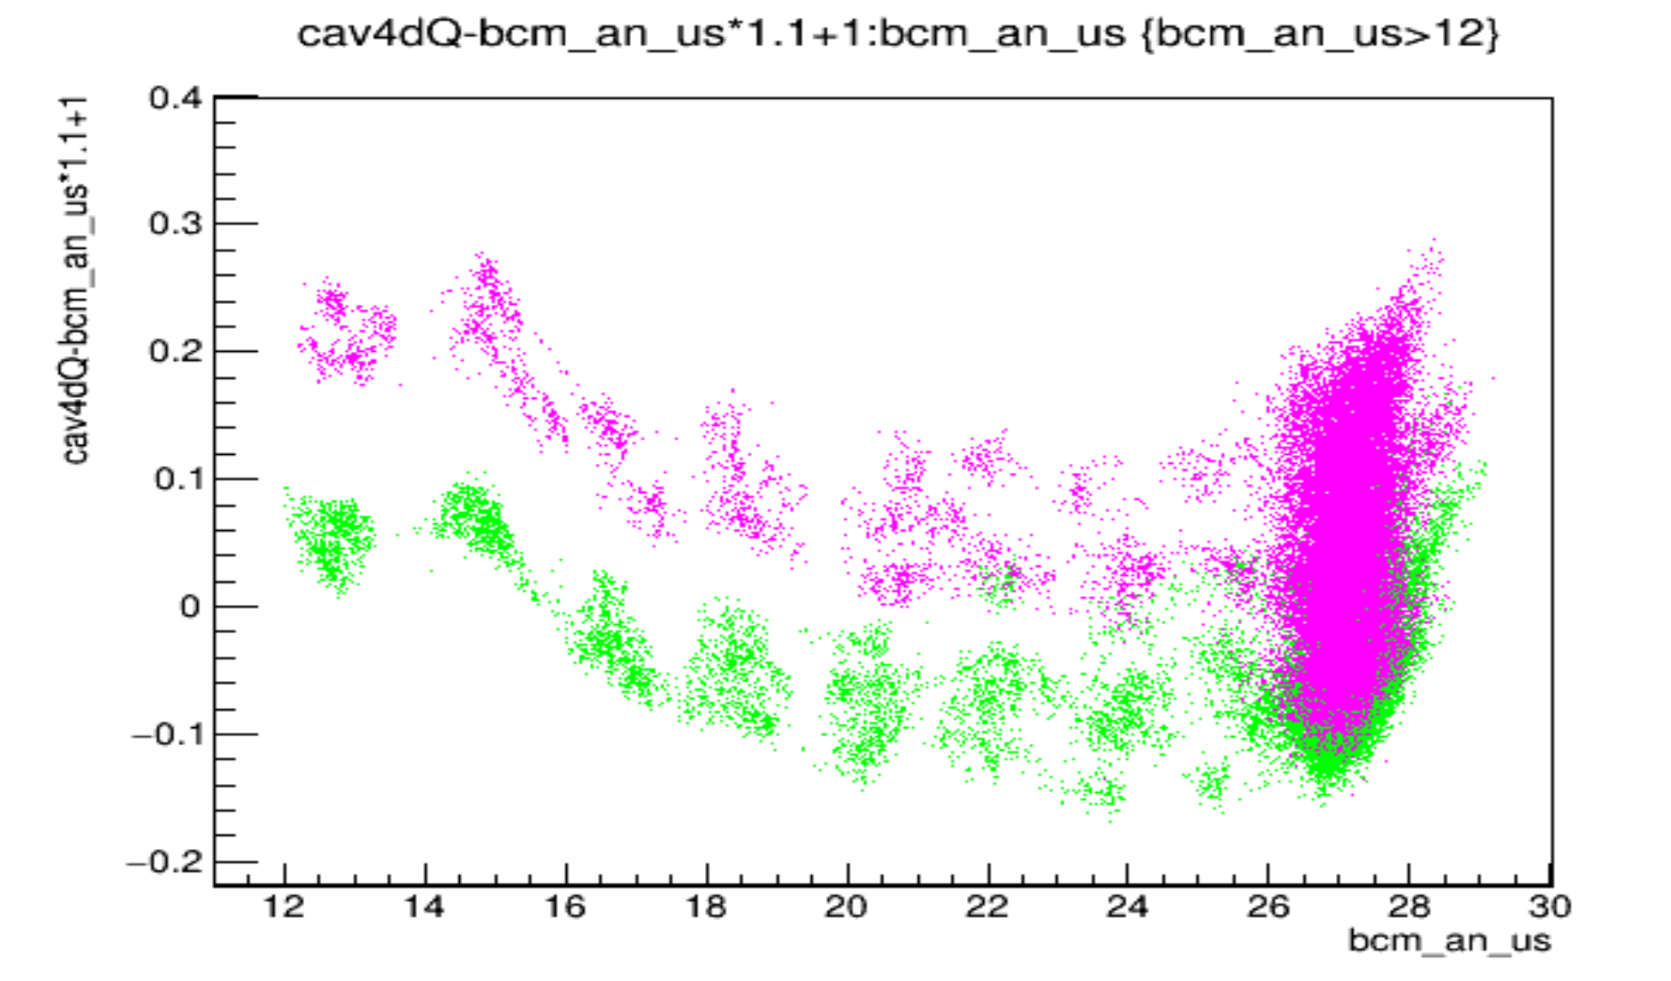
Devi’s Run12050 30uA 2023
3 things going on with the cavities:
1. Big jumps on slow time scale (all cavities at SAME time)
2. Small stripes like the bcm digitals (probably from similar temporal gain oscillation)
3. Oscillatory response to current, like the bcm digitals

Slide 13
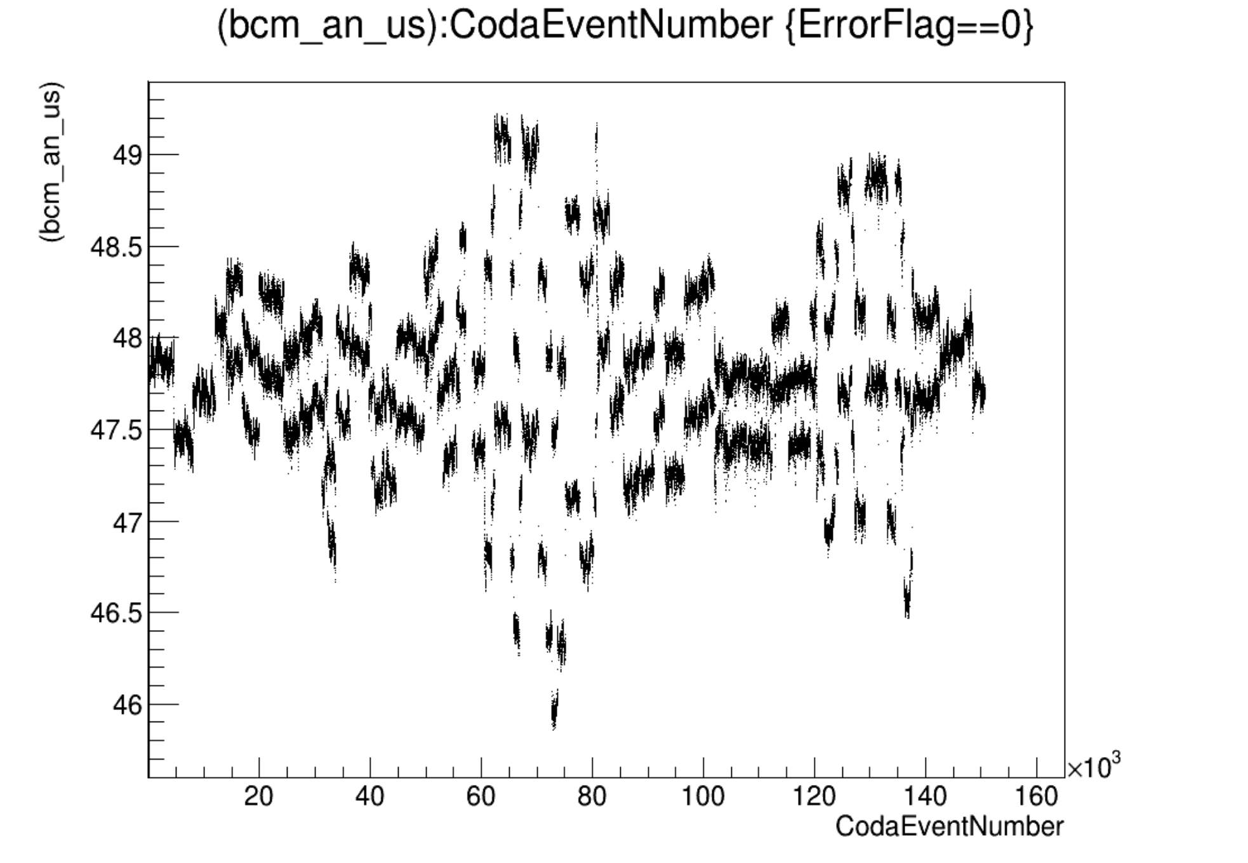
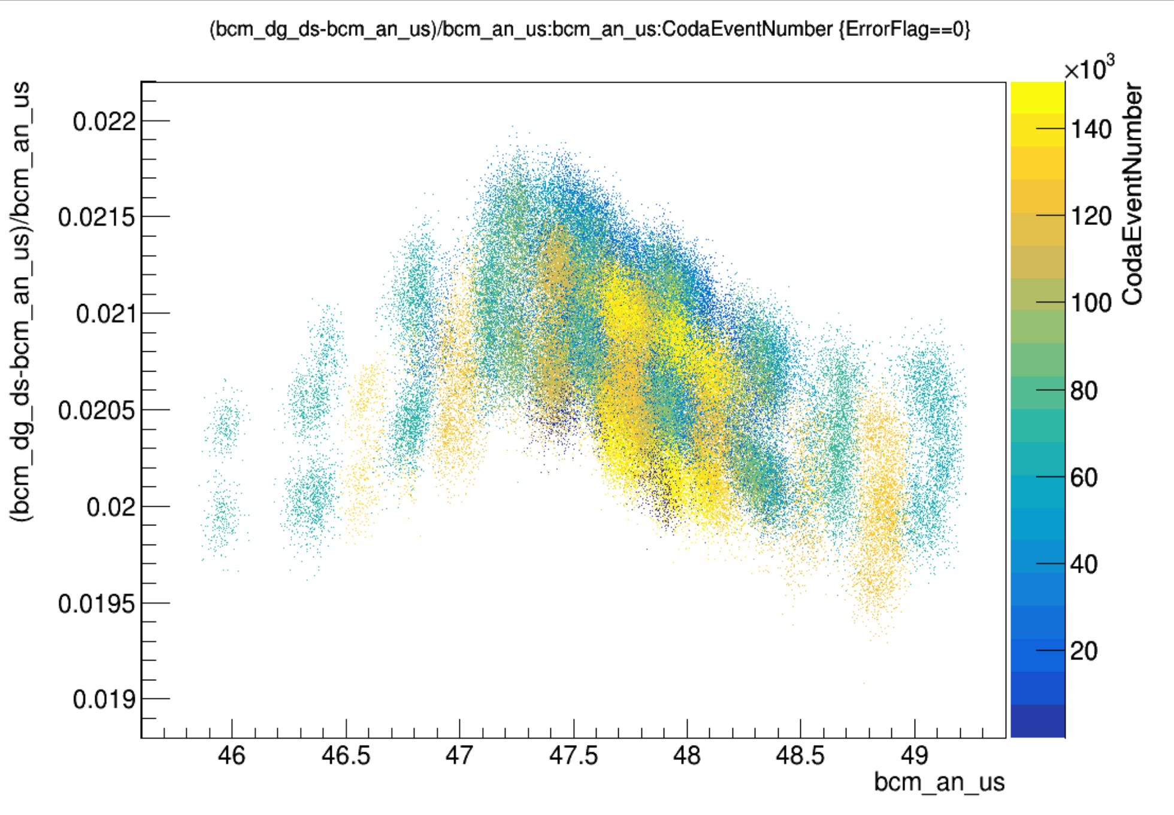
What’s this have to do with PITA scans?
PITA PREX Run3523 50uA
Current jumps (attenA lock?) probe Signal vs Current response
Signal vs Current response looks Osciillatory

Slide 14
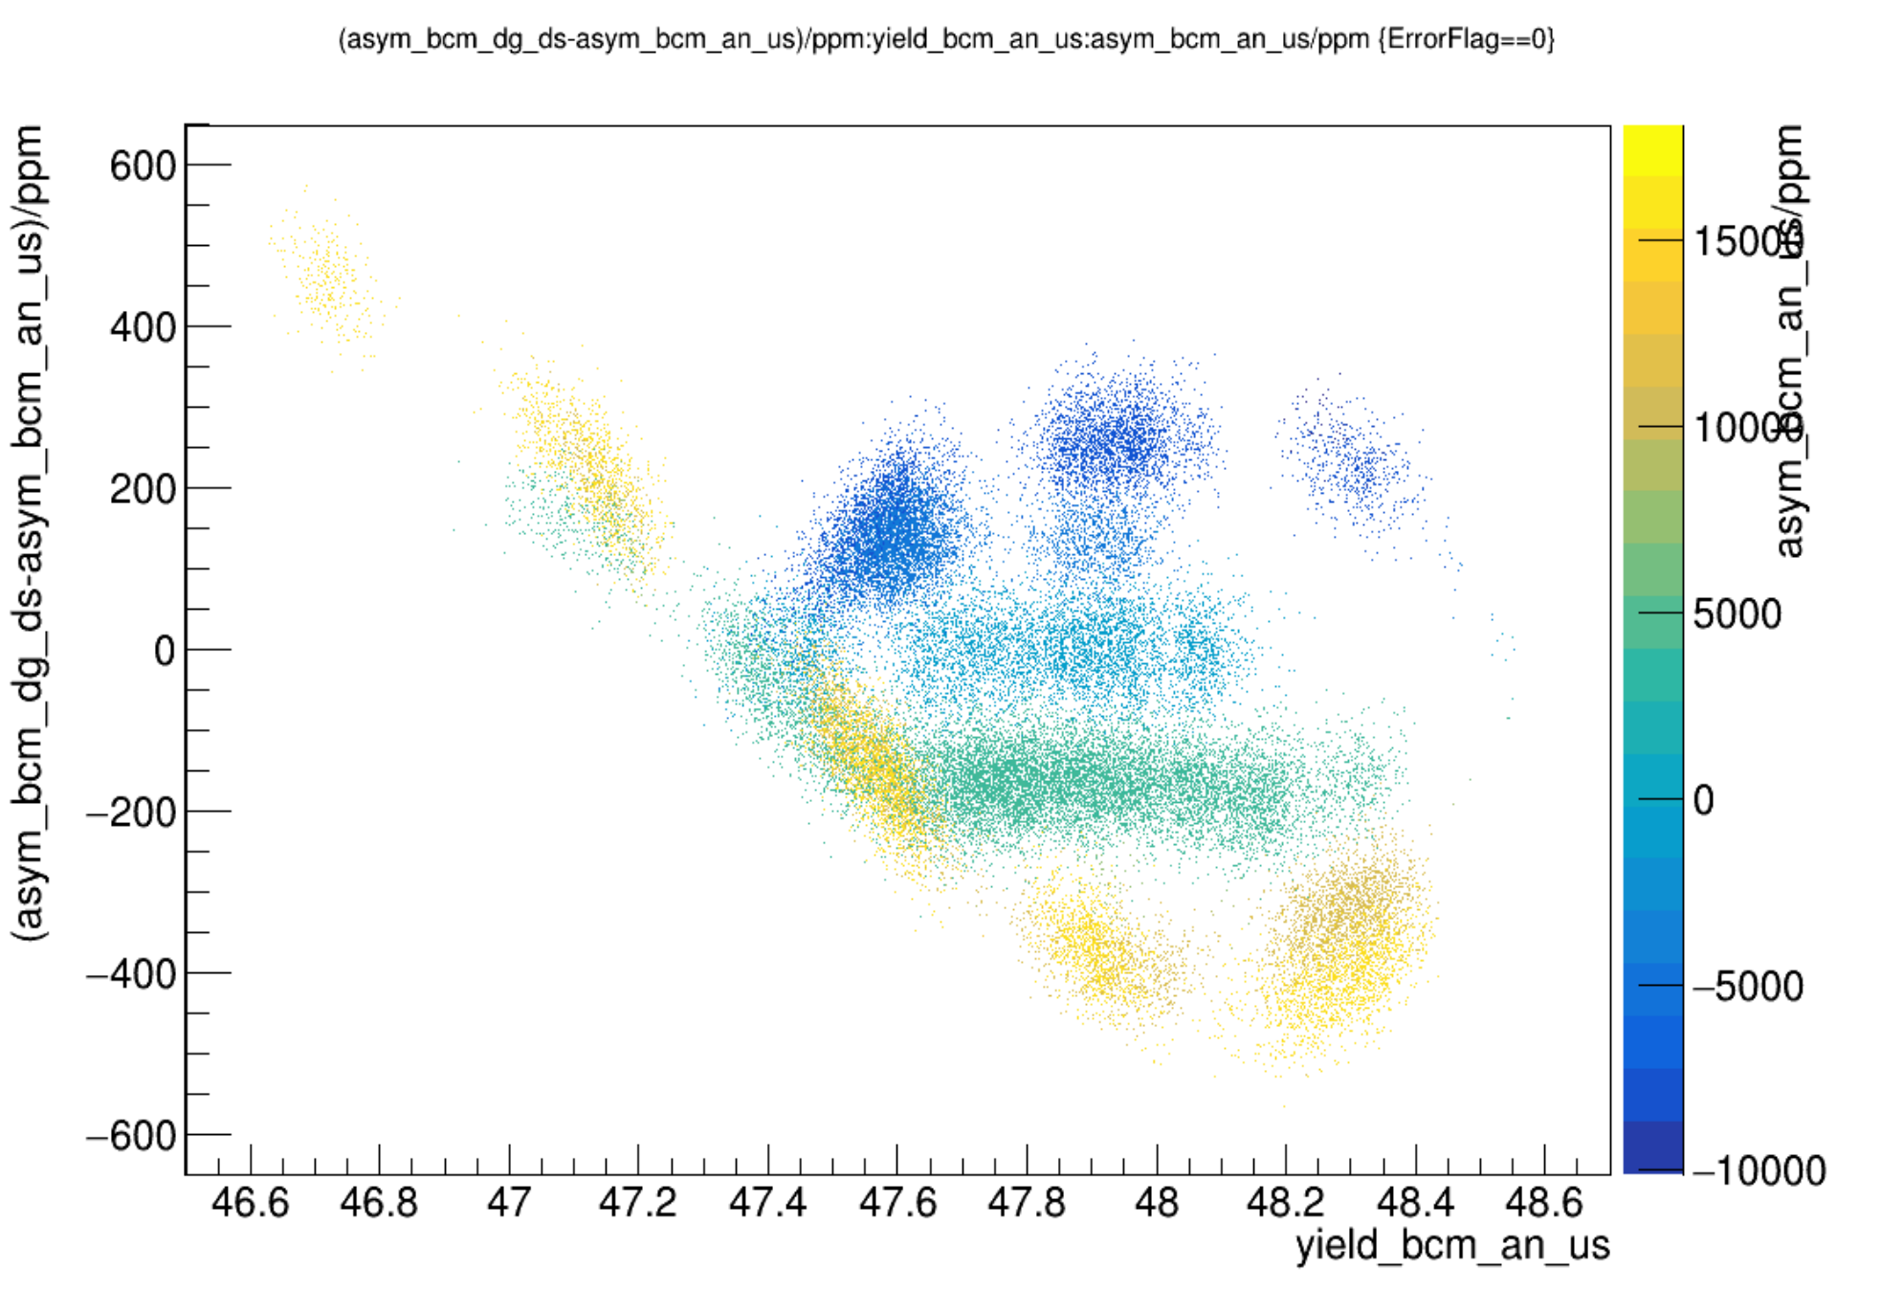
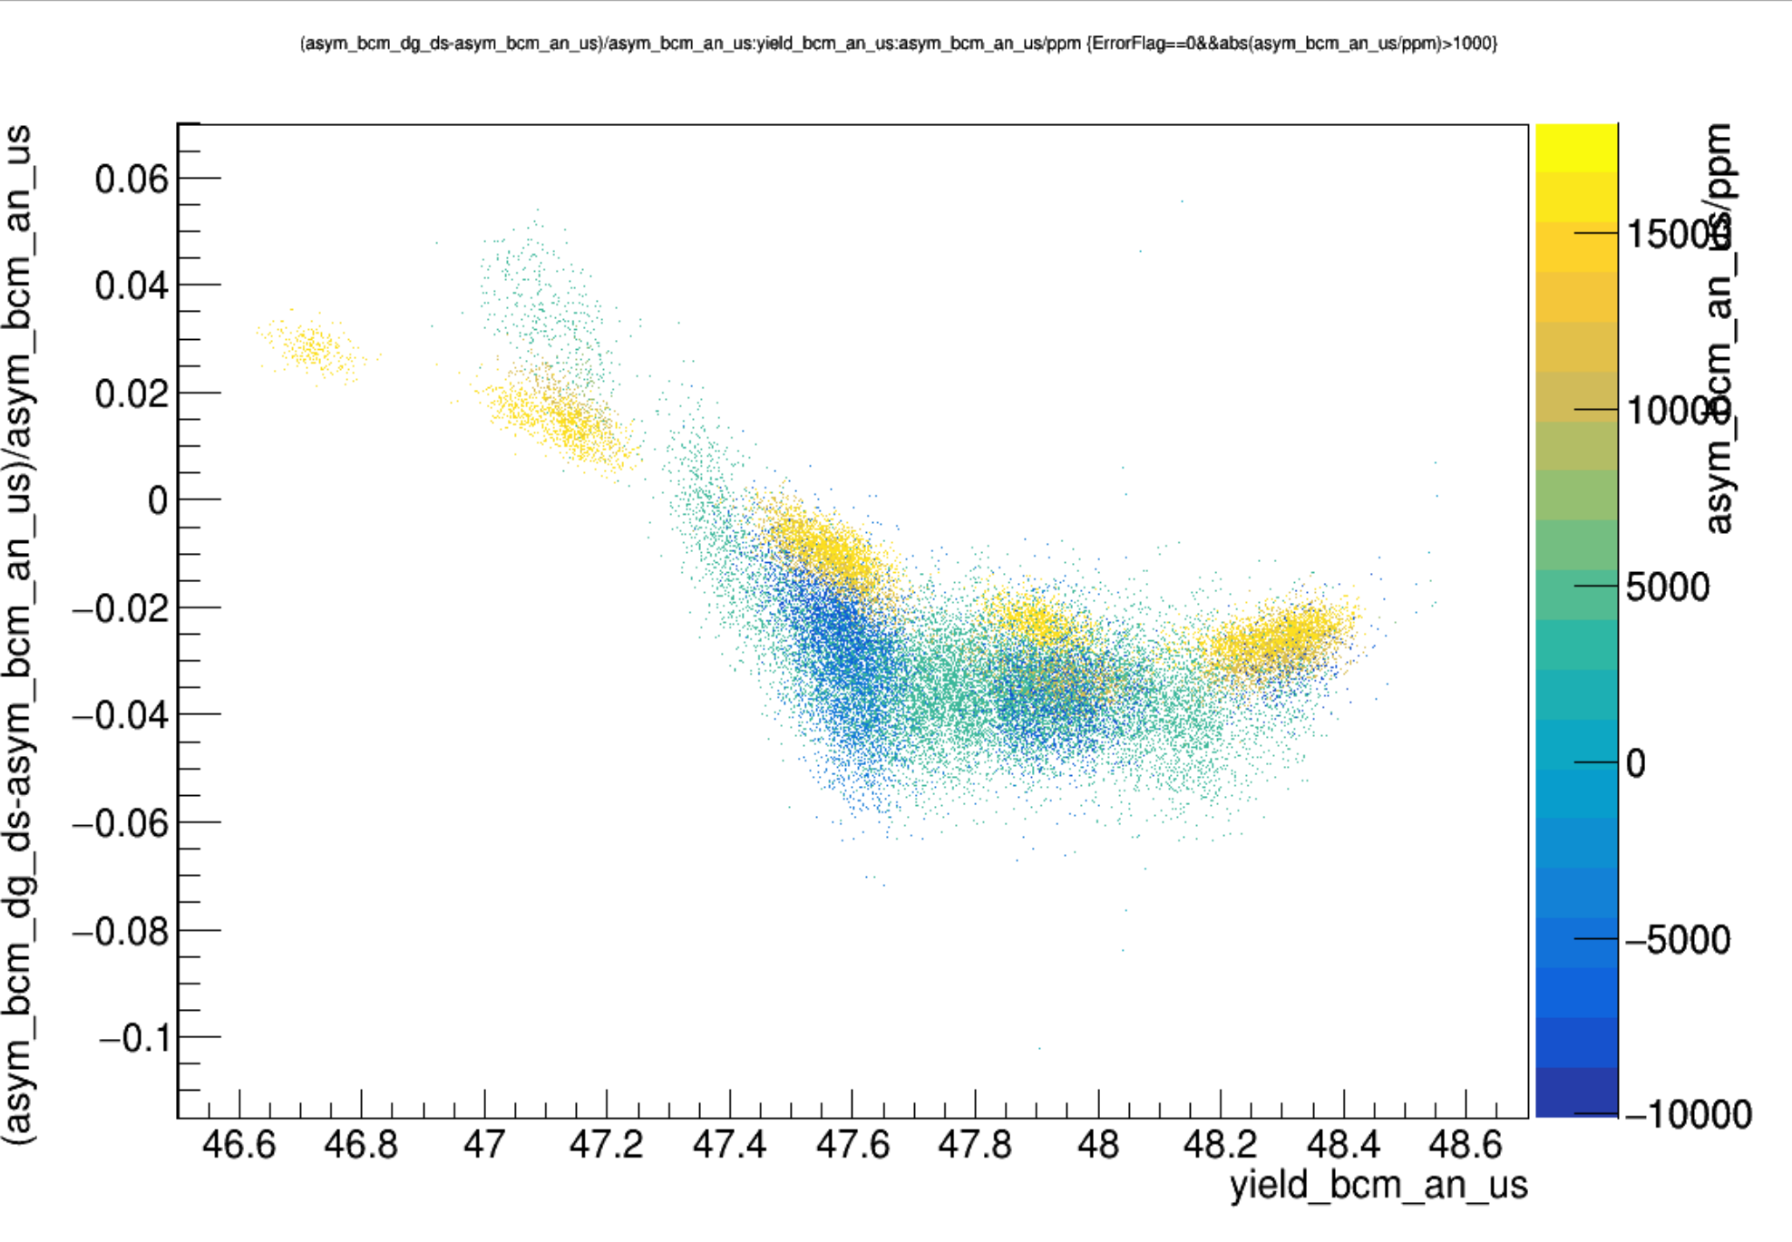
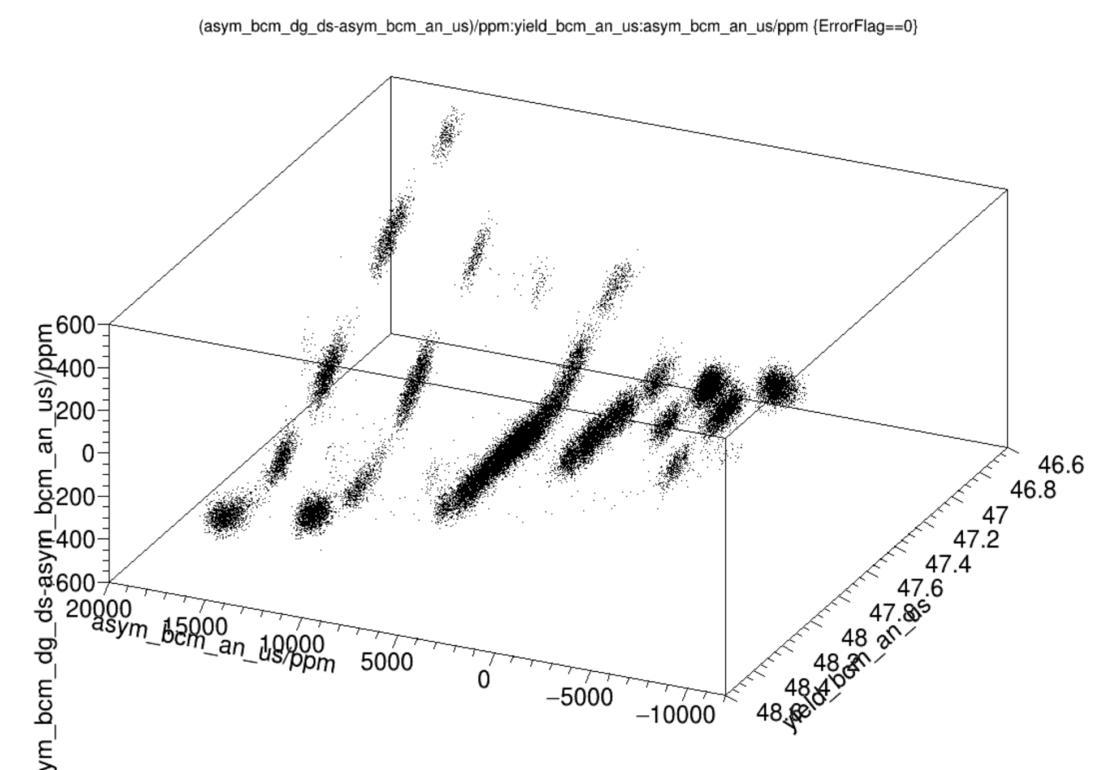
What’s this have to do with PITA scans?
PITA PREX Run3523 50uA
Weird Behavior Observed Before
Normalize by Aq to make sense of this, see same oscillation

Slide 15
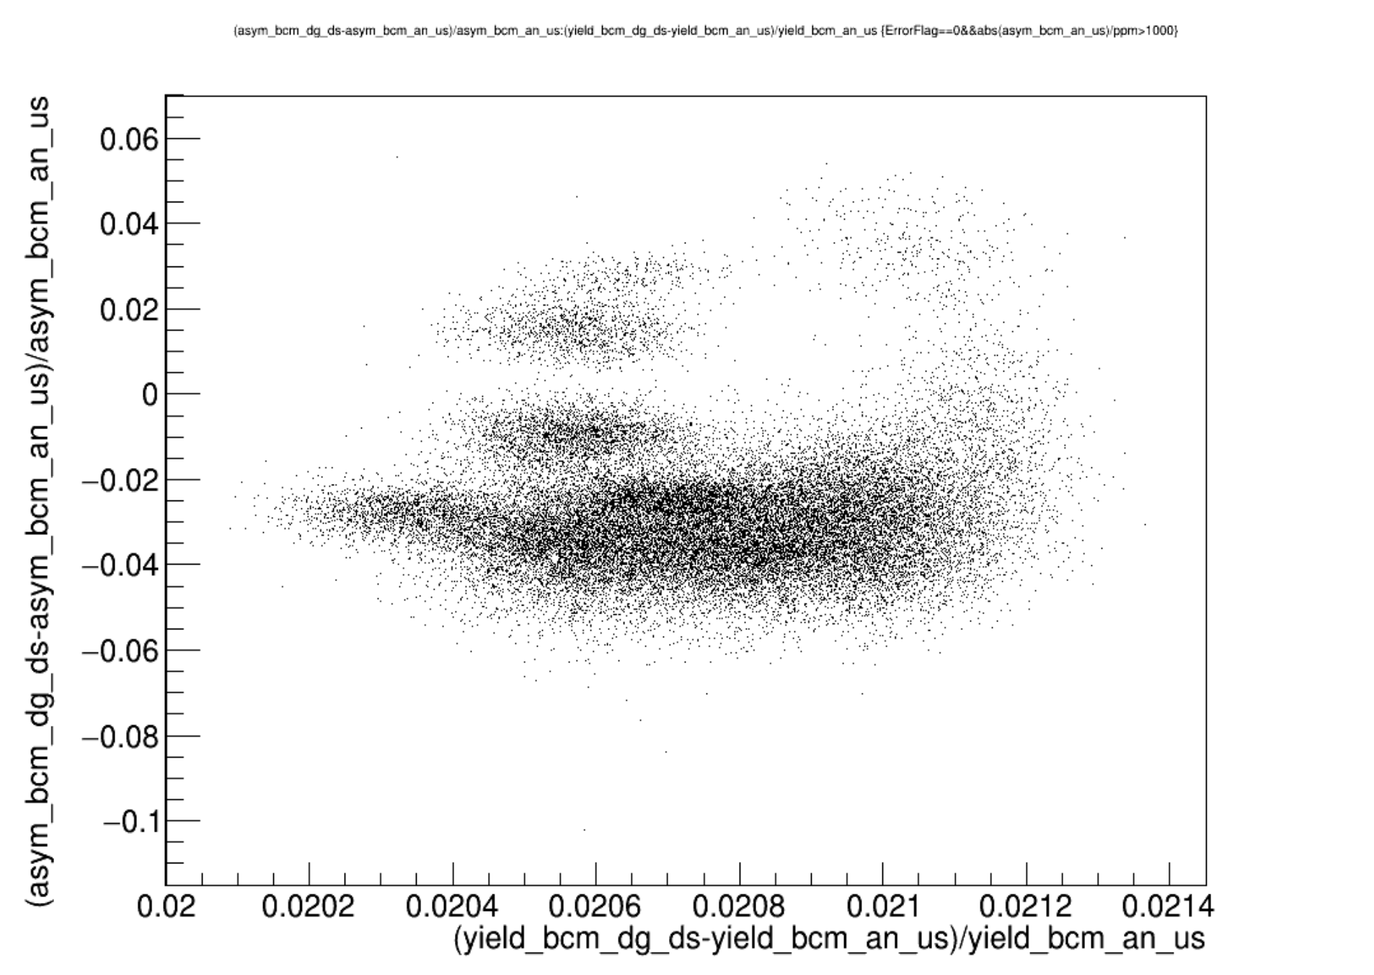
What’s this have to do with PITA scans?
PITA PREX Run3572 70uA
Ellipsoid?
Sinusoidal response curve S vs I
Cosine-like Aq vs I

Slide 16
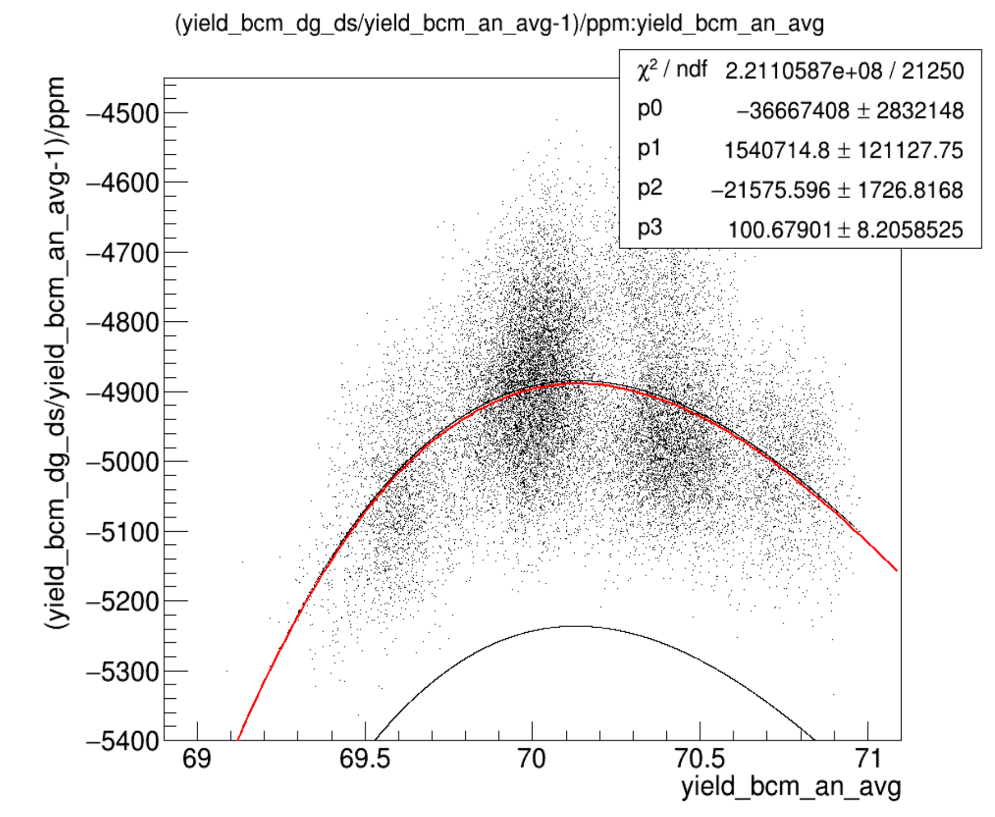
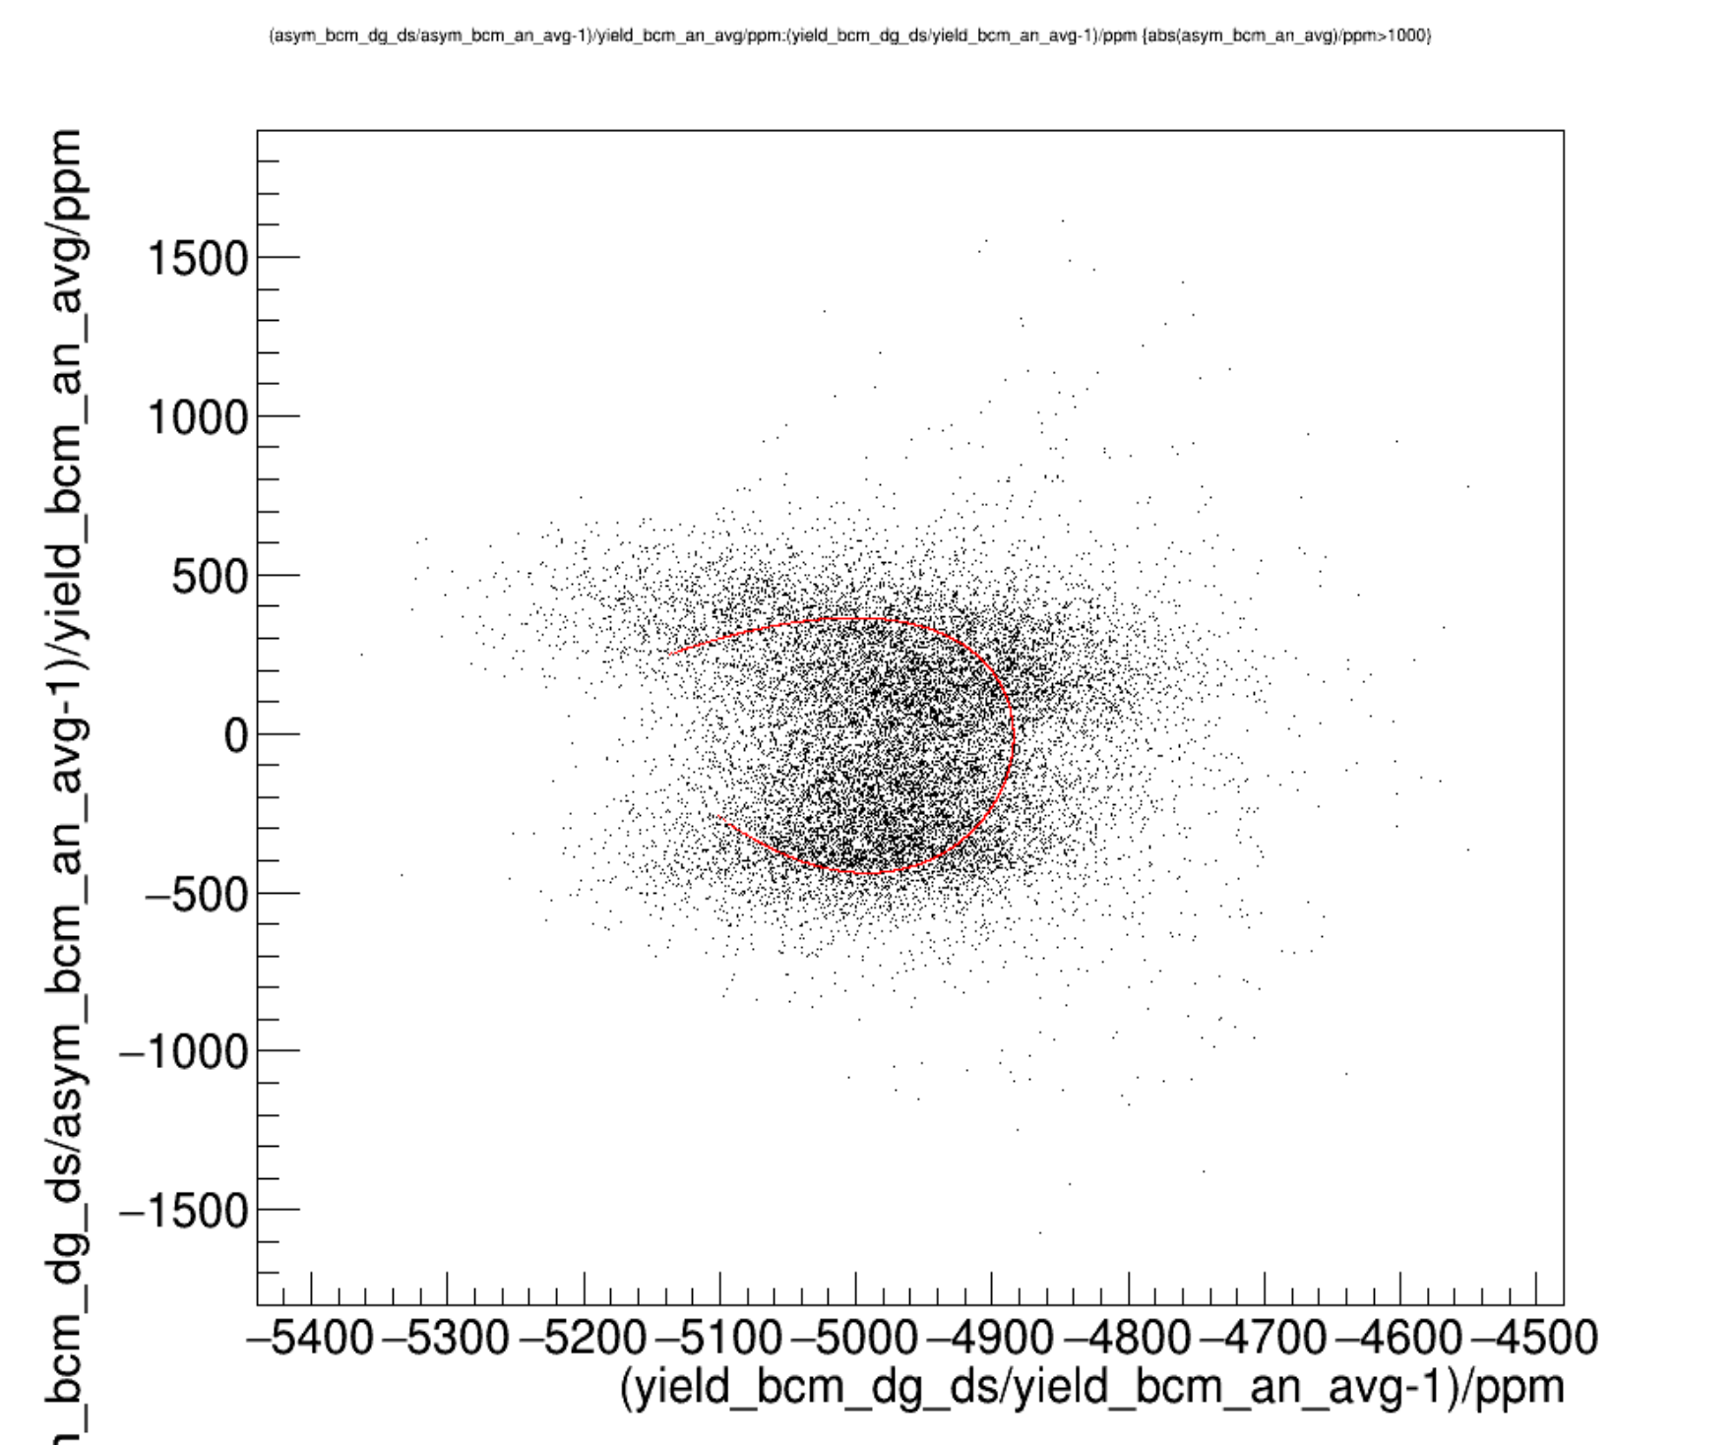
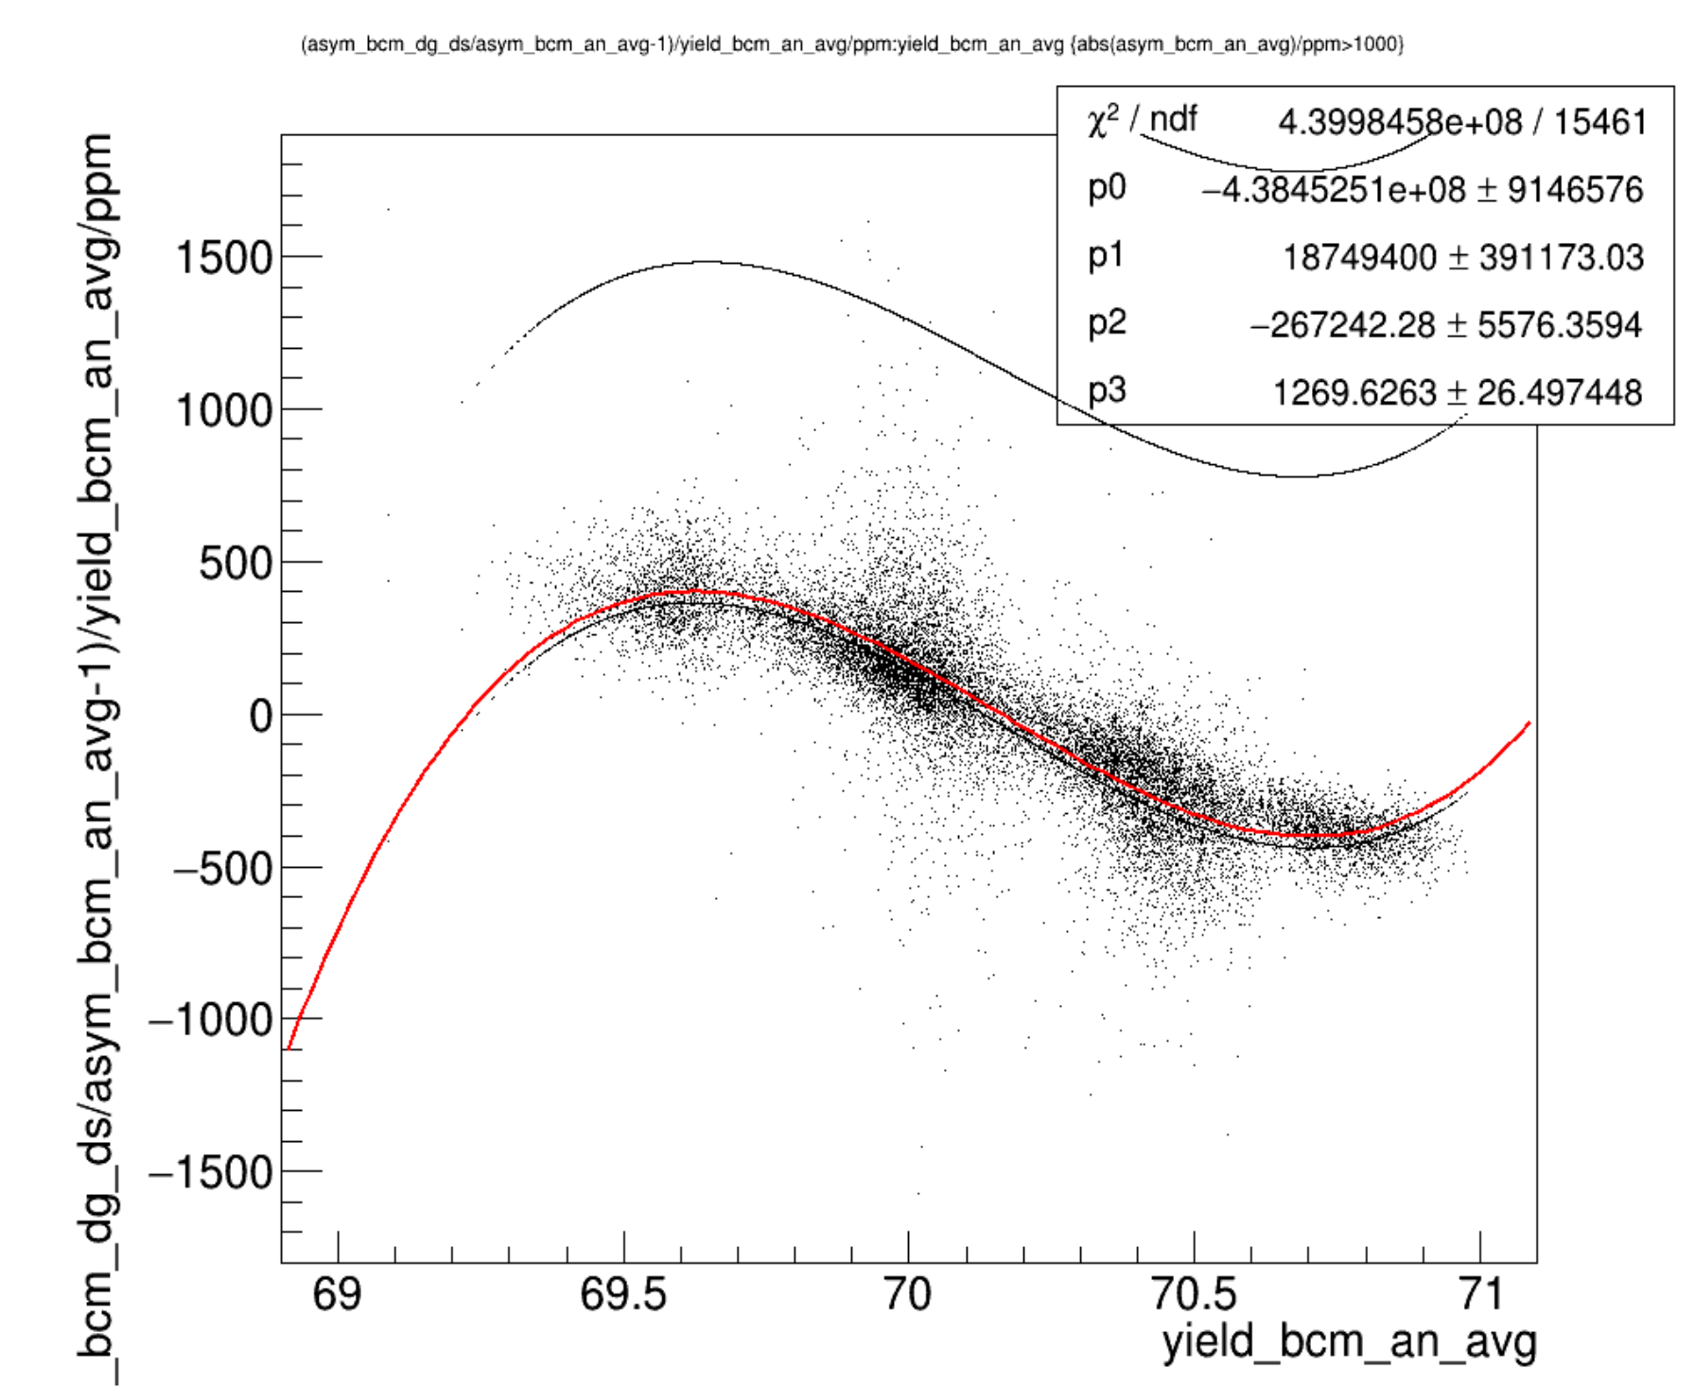
What’s this have to do with PITA scans?
PITA PREX Run3572 70uA
Parametrized Sine/Cosine -> Ellipsoid
OR BIT RESOLUTION!!!
Sinusoidal response curve S vs I
Cosine-like Aq vs I

Slide 17
What’s this have to do with PITA scans?
BIT RESOLUTION = sawtooth S-I vs I
Aq=(S0-S1)/(S0+S1)
<S>=(S0+S1)/2
S
S-I
S0-S1
I current
I
S0+S1

Slide 18
What’s this have to do with PITA scans?
PITA PREX Run3572 70uA
BIT RESOLUTION
= sawtooth S-I vs I
Parametrized Sawtooth-> Square
Sawtooth-like response curve <S> vs <I>
Sawtoothlike Aq vs I

Slide 19
What’s this have to do with PITA scans?
PITA PREX Run3572 70uA
BIT RESOLUTION
= sawtooth S-I vs I
Parametrized Sawtooth-> Square
Sawtooth response curve S vs I
Sawtooth-like Aq vs I

Slide 20
SUMMARY SLIDES

Slide 21
What’s wrong with BCM digitals
Oscillatory response in Signal vs Current at the 0.04uA,0.1-1% level(bit resolution?)
Temporal Oscillation in the gain ~1hr time scale (seen by both dgus&dgds, 0.1uA/40uA=0.25% amplitude (could be RF slip)
(Digital DS – I)
(Digital DS – Digital US)/I
(Digital DS – Digital US)
(Digital DS – I)
Analog Current (I)
Analog Current(I)
Analog Current(I)
(Digital US – I)
(Digital US – I)
(Digital US – I)
+
=
Time
Time
Time
Analog Current (I)

Slide 22
What’s wrong with cavity digitals
Jumps (2%) in signal on several minute time scale(which appear to occur at regular time intervals for all 3 cavities b,c,d and may relate to the ~1hr temporal oscillation in gain observed in the digital bcms)
Possible oscillatory response in Signal vs Current (a bit wobbly 0.1uA, 0.5%)
Possible Temporal Oscillation in the gain on the ~1hr time scale 0.1-0.2uA, 0.5-2%(see stripes in Signal vs Current for different beam trips at different times)
(Cav4cQ – I)
(Cav4bQ – I)
(Cav4dQ – I)
(Digital US – I)
4d
dgDS
4b
Time
Analog Current (I)
Analog Current (I)
Time

Slide 23
Propose 2 tests
1. Response curve measurement
  Function generator makes 1497MHz with Amplitude that varies as a triangle/sawtooth envelope, scanning from 5uA->100uA equivalent, recording with parity DAQ. bcm_dg_ds vs CodaEventNumber will reveal the Signal vs Current curve for the receiver. See if observe oscillations.
  Challenges: receivers are in the labyrinth, need Hall A in restricted access to do it and need to borrow nice function gen from Musson and carry it down there.
2. RF slip measurement
  Take 499MHz ref -> tripler -> digital bcm receiver input (with 10MHz ref plugged in). Check Amplitude of input signal is on the order of 10-100uA.
  Take parity daq data for a couple hours. See if observe slow temporal oscillation observed in the data.
  Challenges: 499MHz ref isn’t in HallA CH or in HallA labyrinth. It’s in the HallB CH. HallB has some digital receivers that might be patched to the HallA CH. But difficult in any case.
Alternatives since RF slip measurement is hard:
  RF slip sensitivity
    Generate 1497.00001MHz (or 1497.001MHz or 1497.01MHz) signal from the 10MHz ref. Plug into digital bcm receiver
    Check Amplitude of signal is on the order of 10-100uA.
    Change the frequency around a bit, record with parity daq and use greenmonster to write in frequ changes using scandata1. Then examine for oscillations in signal output for imperfect frequency, the period and the amplitude of the output oscillation. Look for changes which depend on frequency. This will tell you the sensitivity of the receiver to frequ changes and it’s behavior.
    Challenges: receivers are in the labyrinth, need Hall A in restricted access to do it and need to borrow nice function gen from Musson and carry it down there.
  Gain temporal oscillation hunt
    Generate 1497MHz signal from the 10MHz ref so we know it’s stable. Plug into digital bcm receiver
    Check Amplitude of signal is on the order of 10-100uA.
    See if observe oscillations on the same time scale (1hr)/size(0.25%) as seen in the run. If so, the culprit is not just RF slip, but lives within the receiver itself.
    Challenges: receivers are in the labyrinth, need Hall A in restricted access to do it and need to borrow nice function gen from Musson and carry it down there.

