Slide 1
Ring 6 simulation update
Modified reflectivity processing for MOLLEROpt
Jon Mott
May 11th, 2023

Slide 2
Outline:
Comparison of old simulations to beam and cosmic data
Discrepancy between simulations and beam/cosmic data for Ring 6
10mm R6 w/ Heraeus
20mm R6 w/ Tosoh
Possible solutions to this problem
Made changes to how MOLLEROpt simulations process reflectivity of the light guide
Changed how the angle dependent reflectivity is sorted into angular bins
Redefined the simulation’s reflectivity angles to be consistent with measurements
Comparison of new simulations to beam and cosmics
10mm R6 w/ Heraeus
20mm R6 w/ Tosoh
20mm R6 w/ Heraeus

Slide 3
Comparison of old simulation with cosmic and beam data
Module | Quartz tile | Data type | PE yield (Miro-silver) | PE yield (Mylar) | Sigma (PE) (Miro-silver) | Sigma (PE) (Mylar)
10 mm | Heraeus | cosmic | 3.78 (Langau) | 11.58 (Langau) | 2.52 (Langau) | 3.56 (Langau)
10 mm | Heraeus | beam | 4.68 (Langau) | - | 2.13 (Langau) | -
10 mm | Heraeus | simulation | 3.66 (Langau)​​ | 8.83 (Langau) | 1.71 (Langau)​​ | 2.47 (Langau)
Module | Quartz tile | Data type | PE yield (Miro-silver) | PE yield (Mylar) | Sigma (PE) (Miro-silver) | Sigma (PE) (Mylar)
20 mm​ | Tosoh​ | cosmic​ | 7.96​ (Langau)​ | 15.96​ (Langau)​ | 3.28​ (Langau)​ | 3.56​ (Langau)​
20 mm​ | Tosoh​ | beam​ | 9.16​ (Langau)​ | -​ | 3.02​ (Langau)​ | -​
20 mm​ | Tosoh​ | simulation​ | 5.72 (Langau)​​​ | 11.92 (Langau)​​​ | 2.30 (Langau)​​​ | 3.29 (Langau)​​​
Simulated PE yield is significantly lower than beam and cosmic results
To determine the cause, changes were made to how the simulations handle the reflectivity of the light guide

Slide 4
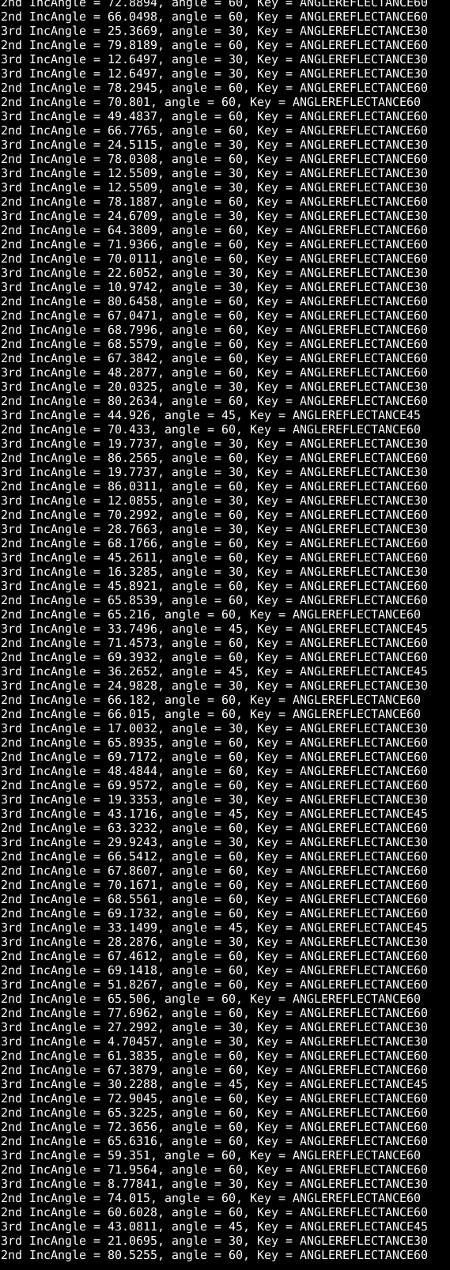
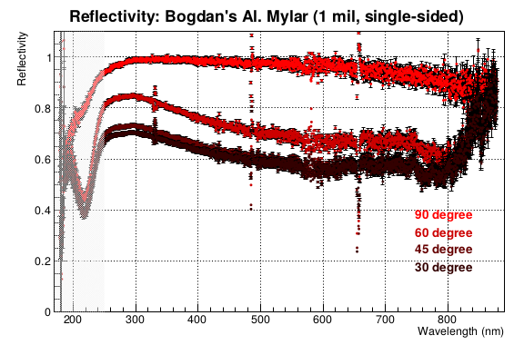
Old setup for handling light guide reflections
Data angle [°] | Simulation angle [°] | Simulation bin | Is it selected
30 | 60 | Θ > 45 | yes
45 | 45 | 45 >= Θ > 30 | yes
60 | 30 | 30 >= Θ > 0 | yes
90 | 0 | Θ = 0 | no
MOLLEROpt assumes that the reflectivity of the light guide can be sorted into angular bins, where each bin has an associated energy dep. reflectivity
Data angles were measured relative to the material plane (90 = normal)
The angle values in the simulation were flipped relative to the data
This setup was leading to PE values that disagreed with cosmic and beam test data

Slide 5
Adjusting the binning
Data angle [°] | Simulation angle [°] | Simulation bin | Is it selected
30 | 60 | 90 >= Θ > 52.5 | yes
45 | 45 | 52.5 >= Θ > 37.5 | yes
60 | 30 | 37.5 >= Θ > 15 | yes
90 | 0 | Θ <= 15 | yes
The binning was updated so that the sim would choose the reflectivity file with an angle closest to the actual reflection angle
This led to a slight increase in the PE yield, but not enough to explain the discrepancy with actual data, so further changes were made

Slide 6
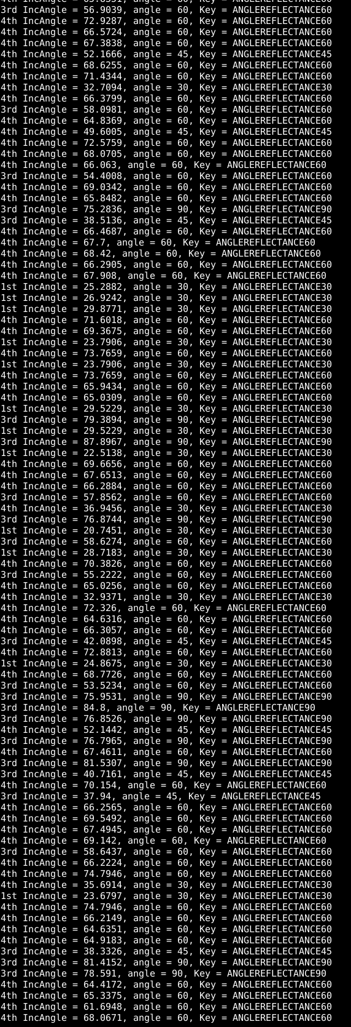
Changing the definition of the reflection angles
Data angle [°] | Simulation angle [°] | Simulation bin | Is it selected
30 | 30 | 37.5 > = Θ >= 0 | yes
45 | 45 | 52.5 >= Θ > 37.5 | yes
60 | 60 | 75 >= Θ > 52.5 | yes
90 | 90 | Θ > 75 | yes
Changed how the simulation chooses which reflectivity file to load. A 30° reflection on the LG will now load the 30° data file rather than the 60° file
Kept the new binning structure from the previous change
This configuration led to results that agree well with our cosmics

Slide 7
Comparison of new simulation with cosmic and beam data
Module | Quartz tile | Data type | PE yield (Miro-silver) | PE yield (Mylar) | Sigma (PE) (Miro-silver) | Sigma (PE) (Mylar)
10 mm | Heraeus | cosmic | 3.78 (Langau) | 11.58 (Langau) | 2.52 (Langau) | 3.56 (Langau)
10 mm | Heraeus | beam | 4.68 (Langau) | - | 2.13 (Langau) | -
10 mm | Heraeus | simulation | 3.66 -> 4.03 (Langau)​​ | 8.83 -> 11.4 (Langau) | 1.71 -> 1.76 (Langau)​​ | 2.47 -> 3.17 (Langau)
Module | Quartz tile | Data type | PE yield (Miro-silver) | PE yield (Mylar) | Sigma (PE) (Miro-silver) | Sigma (PE) (Mylar)
20 mm​ | Tosoh​ | cosmic​ | 7.96​ (Langau)​ | 15.96​ (Langau)​ | 3.28​ (Langau)​ | 3.56​ (Langau)​
20 mm​ | Tosoh​ | beam​ | 9.16​ (Langau)​ | -​ | 3.02​ (Langau)​ | -​
20 mm​ | Tosoh​ | simulation​ | 5.72 -> 6.24​ (Langau)​​​ | 11.92 -> 15.1​ (Langau)​​​ | 2.30 -> 2.37​ (Langau)​​​ | 3.29 -> 3.74​ (Langau)​​​
Simulations are in much better agreement than before, especially for the mylar
For the Tosoh quartz, we are currently investigating whether the remaining discrepancy is due to how Tosoh is implemented in the sims

Slide 8
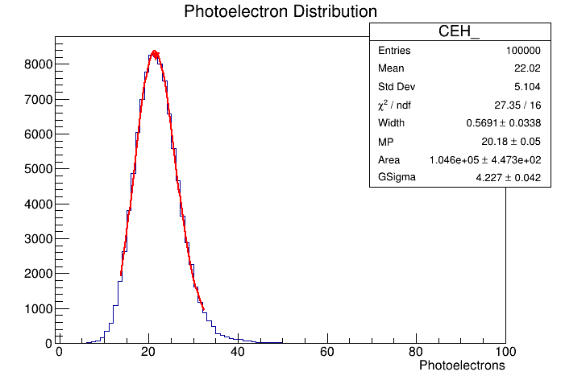
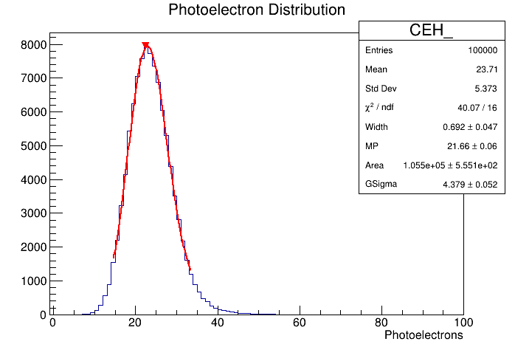
Simulations with Heraeus spectrosil 2000
Hits on center of quartz vs. evenly distributed
Module | LG material | PE yield (Langau) | Sigma (PE) (Langau) | Resolution (Langau)
10 mm​ | Miro-silver | 4.03 | 1.76 | 43.7%
10 mm​ | UVS | 7.71 | 2.62 | 34.0%
10 mm​ | Mylar | 11.4 | 3.17 | 27.8%
MP: 20.2 pes
Sigma: 4.23
Res: 20.9%
Module | LG material | PE yield (Langau) | Sigma (PE) (Langau) | Resolution (Langau)
20 mm​ | Miro-silver | - | - | -
20 mm​ | UVS | 13.7​ | 3.50 | 25.5%
20 mm​ | Mylar | 20.2 | 4.23 | 20.9%
MP: 21.7 pes
Sigma: 4.38
Res: 20.2%
Data above is for a beam striking the center of the quartz. Simulations for an even distribution give similar to slightly higher results

