Slide 1


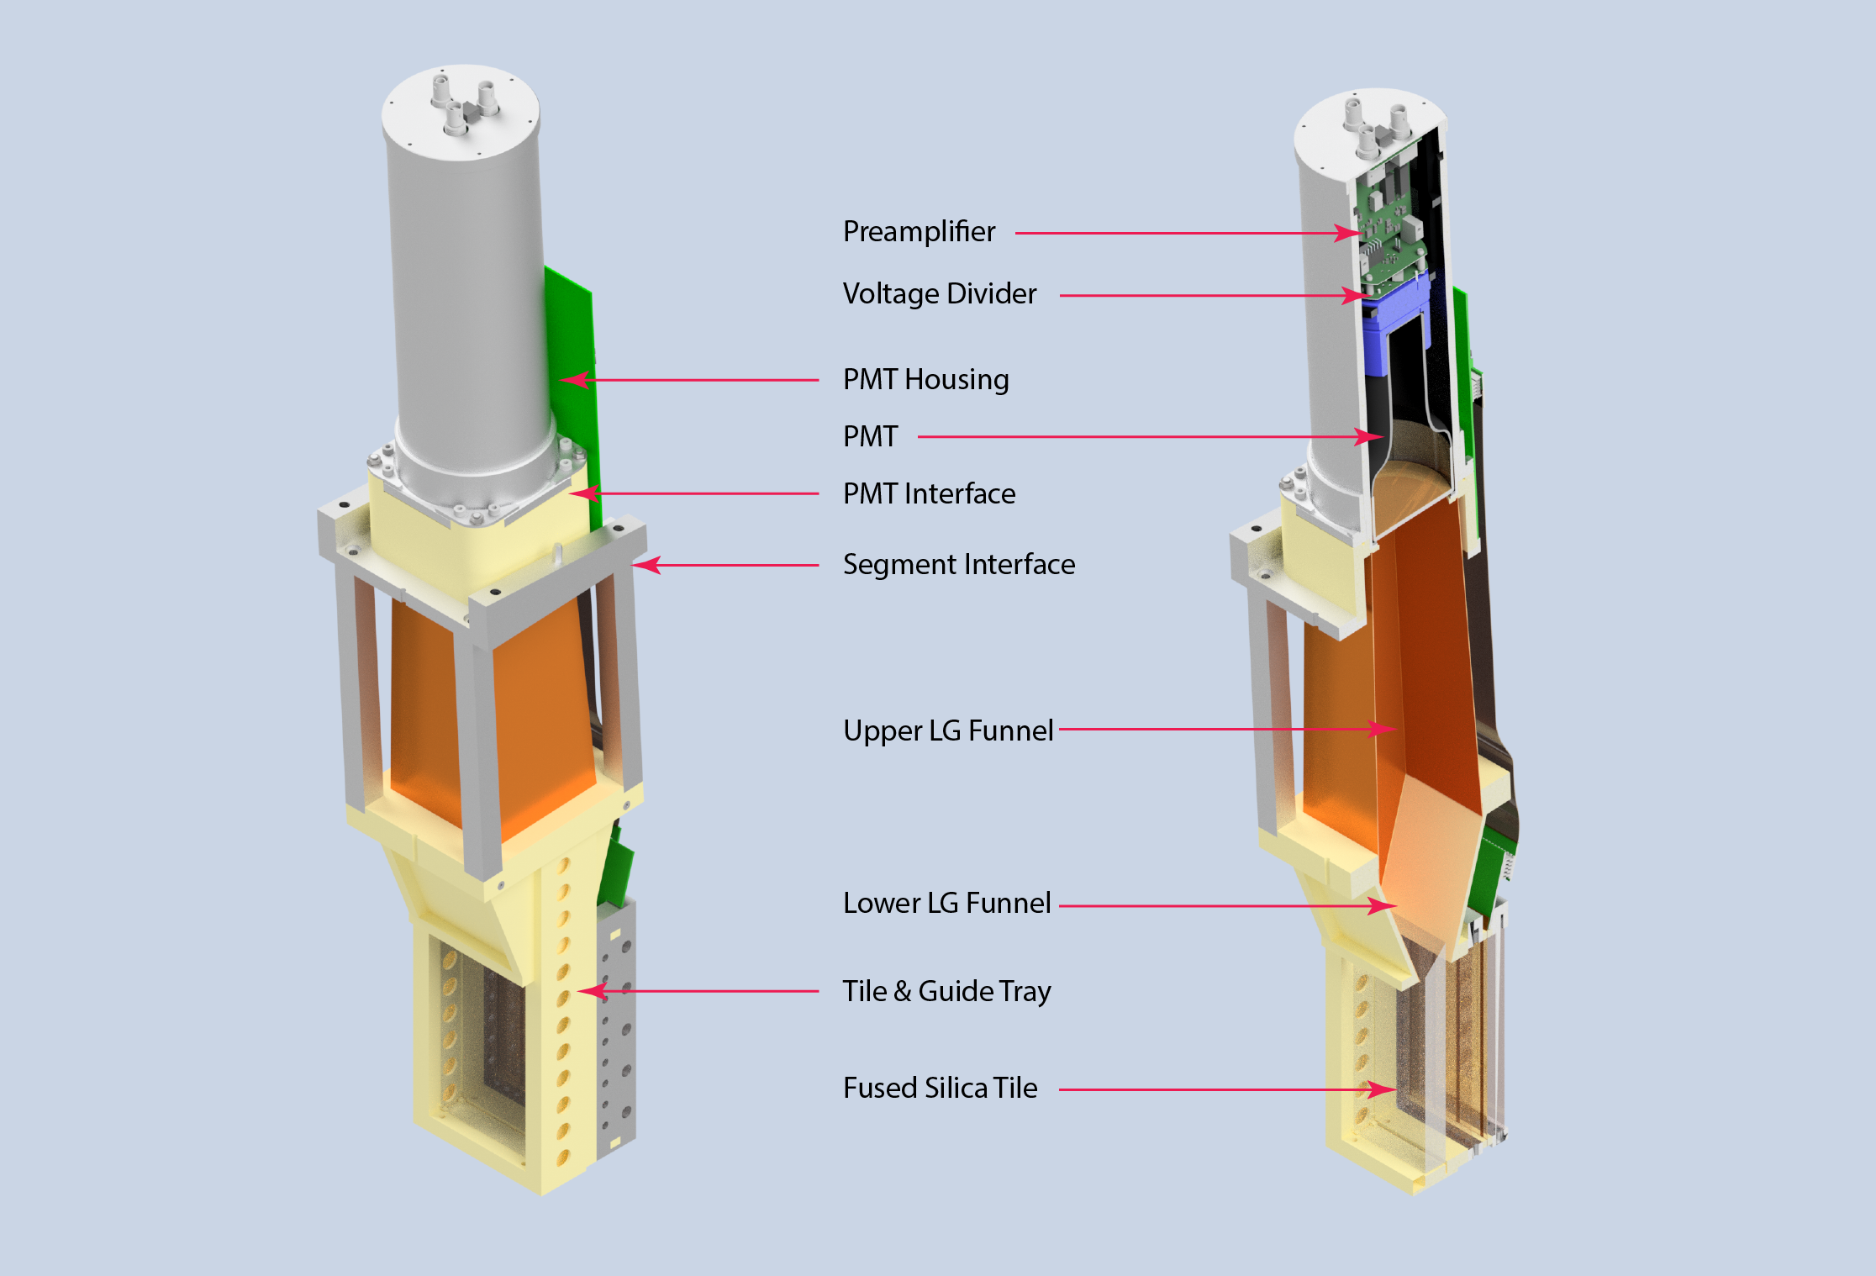
Ring 5 HVMAPS
MOLLER Collaboration Meeting
May 2023
Michael Gericke
  Motivation
  Operational principle
  Readout setup
  Cabling Plans
  Housing/Mounting/Cooling Kristofer Isaak

Slide 2
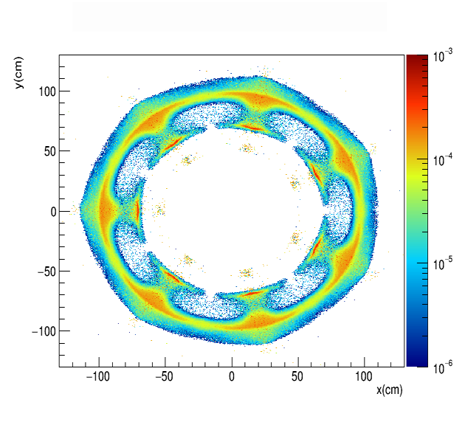
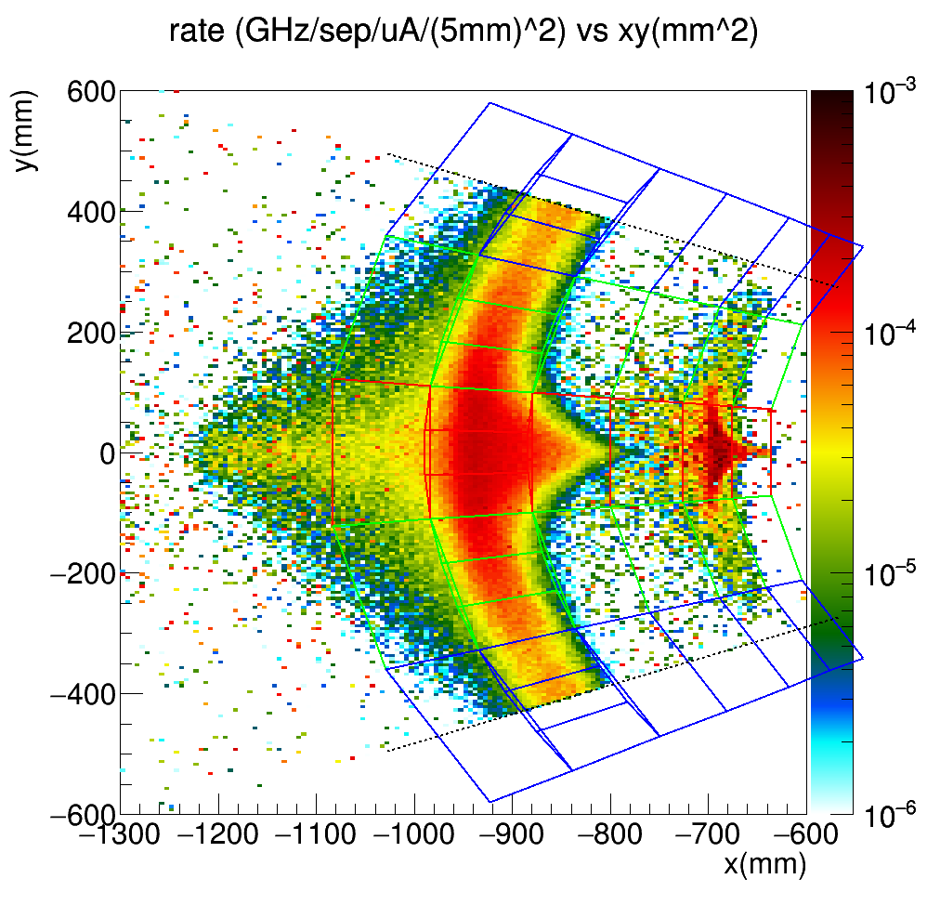
Motivation:
  The precise and correct measurement of the asymmetries depends on the correct event separation in the detector tiles, as indicated by the ideal event profile.
  Changes in beam properties and magnetic field non-uniformities lead to shifts in the event profile and change the measured event type share in a given tile.
  If these changes are helicity correlated this can lead to a false or incorrectly extracted asymmetry.
  Careful periodic tracking measurements with the GEM detectors event mode will verify the kinematics and the associated event profile at low current.
  The HVMAPS can be used as another tracking plane behind the ring 5 detectors at these lower currents, together with the GEM detectors.
  They could provide a measurement of background events created between the GEMS and ring 5.
  They can verify the profile at high beam currents due to their radiation hardness and high event processing speed (at fully beam current they have to be gated).

Slide 3
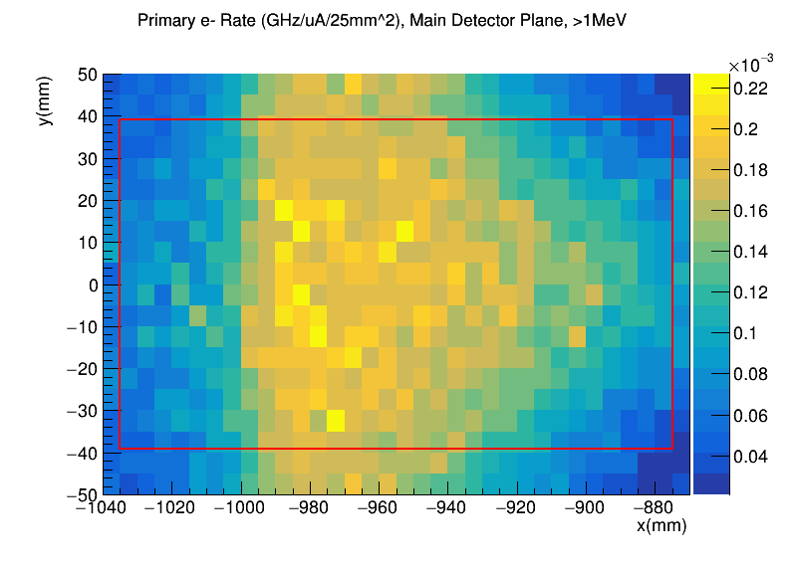
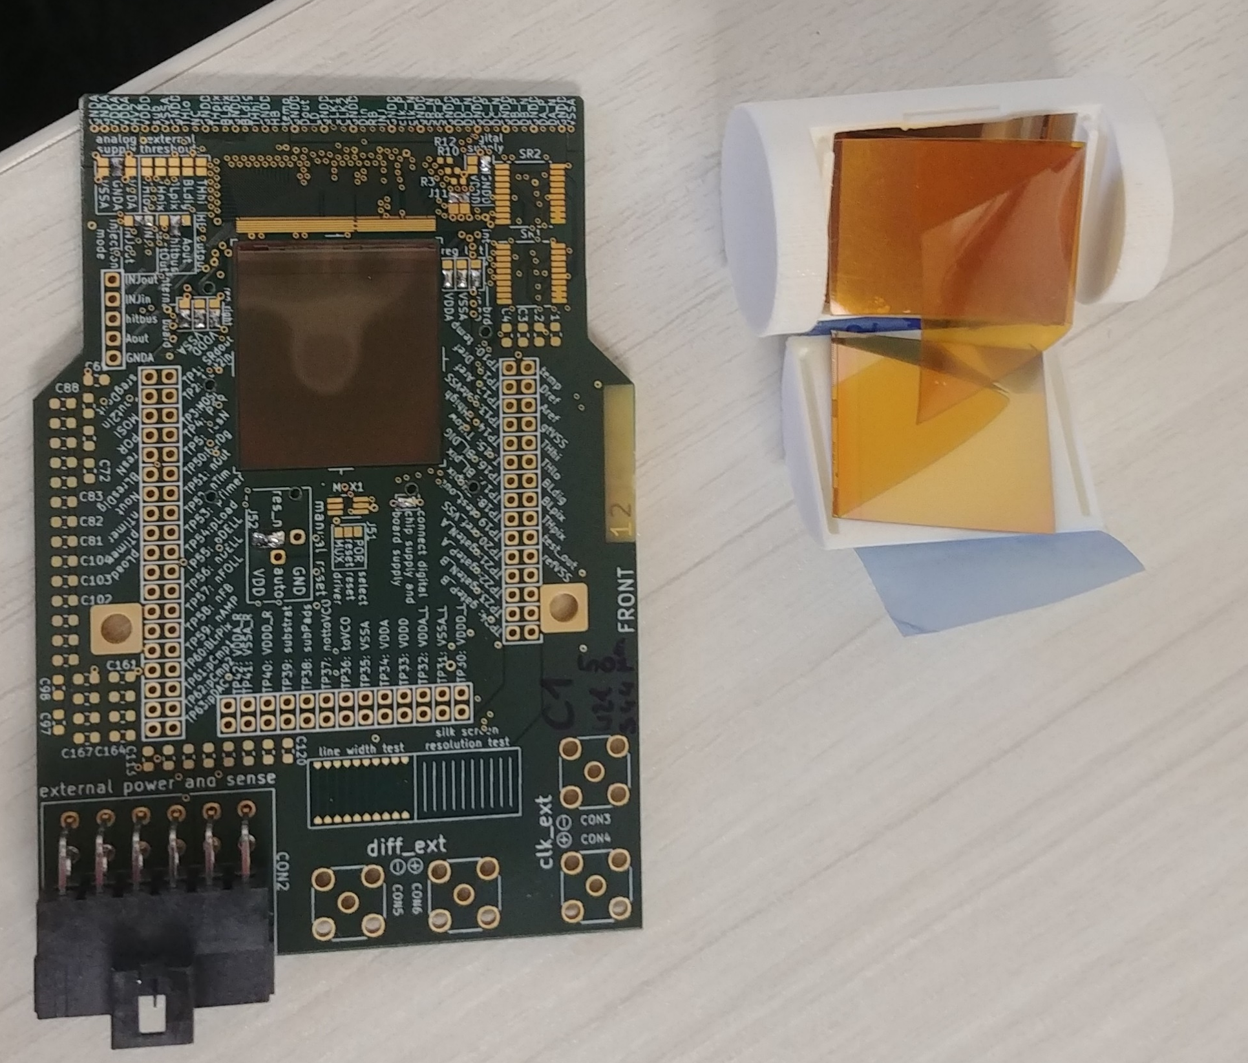
Motivation:
CFI funded parts
  2352 Pixel chips: 28 per ring 5 tile
  Mounting structure (including flex-print)
  Cooling equipment
  Front-end boards with lpGBT and VTRX+ (CERN)
  Cabling
  Power supplies
  FPGA boards

Slide 4
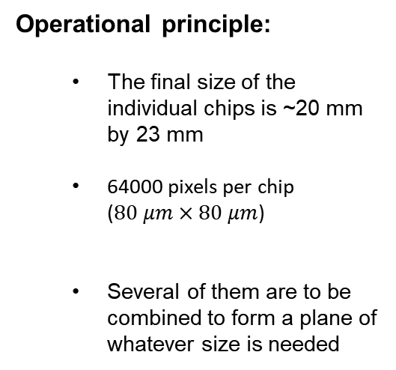


Operational principle:
  The final size of the individual chips is ~20 mm by 23 mm
  64000 pixels per chip
  ($80 μm×80 μm$)
  Several of them are to be combined to form a plane of whatever size is needed
$$20.66 mm$$
$$mm$$
$$23.18 mm$$
$$mm$$
$$mm$$
$$mm$$

Slide 5
Summary of HV-MAPS operation (with figures by Heiko Augustin, Alena Weber, and Andre’ Schoening – U. Heidelberg)
  There are three distinct areas of the chip:
    The pixel area, in which each of the 64000 pixels include an amplifier and a line driver to connect the pixel to the periphery
    The mirror pixel area at the chip periphery, which includes two tunable ToT comparators
    Three state machines at the chip periphery and a mux for data transfer

Slide 6
Summary of HV-MAPS operation
  Signal digitization and time stamp generation:
    Each pixel drives the amplified hit signal to a dedicated readout buffer at the chip periphery
    The two comparators for each pixel are part of the readout buffer circuitry
    The readout buffer generates two timestamps. The first one sets the hit latch. The second one establishes the ToT proportional to the collected charge and reduces time-walk effects.
    The buffer stores an 8b pixel row address and the two timestamps (TS1 = 11b and TS2 = 5b)

Slide 7
Summary of HV-MAPS operation
Chip event readout organization:
  The chip is readout in column-drain and row readout sequence. There are 250 rows and 256 columns
  Pixels buffers with hits are transferred to an EoC (End of Column) cell, selected by a priority logic.
  If a pixel buffer hit state is transferred to the corresponding EoC, the buffer is cleared and the pixel is sensitive to new hits again.
  The EOC contains an 8b column address and collects the full 32b hit information
  The priority chain within a column is based on pixel position and hit time
  The state machine generates signals to transfer the pixel hit information to the EoC and transfer the 32 bit EoC data to the serializer
  The 32b data words are byte serialized and 8b/10b encoded

Slide 8
Summary of HV-MAPS operation
Pixel area
Pixel buffer area
Readout logic

Slide 9
Summary of HV-MAPS operation
Pixel area
Pixel buffer area
Readout logic

Slide 10
Summary of HV-MAPS operation
Event Sequence:
Signal

Slide 11
Summary of HV-MAPS operation
Event Sequence:
Signal
Amplification

Slide 12
Summary of HV-MAPS operation
Event Sequence:
Signal
Amplification
Transmission to periphery

Slide 13
Summary of HV-MAPS operation
Event Sequence:
Signal
Amplification
Transmission to periphery
Storage in the buffer (pixel cleared for next event)

Slide 14
Summary of HV-MAPS operation
Event Sequence:
Signal
Amplification
Transmission to periphery
Storage in the buffer (pixel cleared for next event)
Digitization of the hit

Slide 15
Summary of HV-MAPS operation
Event Sequence:
Signal
Amplification
Transmission to periphery
Storage in the buffer (pixel cleared for next event)
Digitization of the hit

Slide 16
Summary of HV-MAPS operation
Event Sequence:
Signal
Amplification
Transmission to periphery
Storage in the buffer (pixel cleared for next event)
Digitization of the hit
Scalar generated from clk

Slide 17
Summary of HV-MAPS operation
Event Sequence:
Signal
Amplification
Transmission to periphery
Storage in the buffer (pixel cleared for next event)
Digitization of the hit
Scalar generated from clk
Timestamp generation

Slide 18
Summary of HV-MAPS operation
Event Sequence:
Signal
Amplification
Transmission to periphery
Storage in the buffer (pixel cleared for next event)
Digitization of the hit
Scalar generated from clk
Timestamp generation
Hit/pixel address and timestamp sent to serializer

Slide 19
Summary of HV-MAPS operation
Event Sequence:
Signal
Amplification
Transmission to periphery
Storage in the buffer (pixel cleared for next event)
Digitization of the hit
Scalar generated from clk
Timestamp generation
Hit/pixel address and timestamp sent to serializer
Data sent to readout board
Maximum readout rate is 33 MHz per link with a maximum of 3 links per chip.

Slide 20
Summary of HV-MAPS operation
Minor modifications to final chip:
Match the on-chip clk to the CERN readout chip frequency
A simple AND with a GATE link before each pixel buffer to turn on/off the readout – timed to choice to reduce pixel occupancy
These changes are relatively simple and underway.
Need to resubmit for one more engineering run
Then go to chip production – hopefully at the end of the year

Slide 21
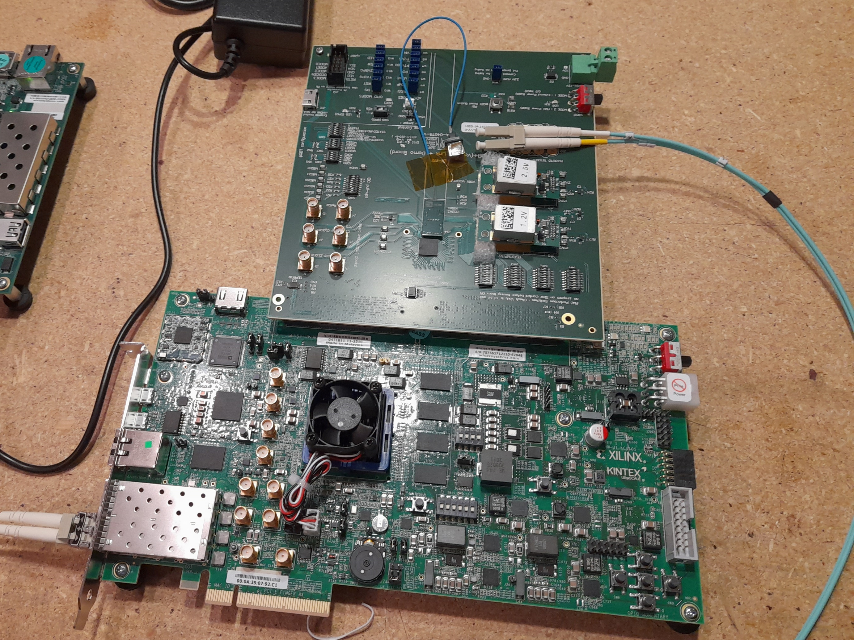
Readout Setup
We need to design and prototype a readout board that incorporates 4 lpGBT chips and 1 VTRx+, plus bias and LV power supply distribution.
Starting point: The bord schematics/design is available to us from CERN.
We can remove quite a few of the test/diagnostic components and want to make the board smaller for the ring 5 detectors, while incorporating 4 lpGBTs rather than 1.
Development is ongoing:
We have access to an engineer at Carleton Univ. through the Canadian SAP Major Resources Support network
To be mostly completed by end of June
VTRX+
lpGBT

Slide 22
Readout Setup:
  We want 3 lpGBTs in slave mode and 1 lpGBT as master
  Slow-Control the lpGBTs via the of the down/uplink data stream from the back-end FPGA . This field allows to read and write the internal registers if the chip operates as a Transceiver (master).
  The VTRX+ has 4 uplinks (10.24 Gb/s) and one downlink (2.56 Gb/s) so we can read out
  Need to determine if we need the FEASTMP DC/DC converters or can run via remote power control
  We can use the Samtec ASP-134486-01 FMC connector (female)
  Maximum board width 100 mm
  Maximum board length 200 mm
  Mounting holes can be relocated within the lower 50 mm of the board.
1.28 Gb/s Tx
Slave
lpGBT 1
VTRx+ Uplink 10.24 Gb/S
Downlink 2.56 Gb/s
1.28 Gb/s Tx
Slave
lpGBT 1
VTRX+
1.28 Gb/s Tx
Slave
lpGBT 1
1.28 Gb/s Tx
Master
lpGBT 1
lpGBT Uplink 10.24 Gb/s
80 Mb/s Rx
To all MAPS and
the other lpGBTs
lpGBT Downlink 2.56 Gb/s

Slide 23
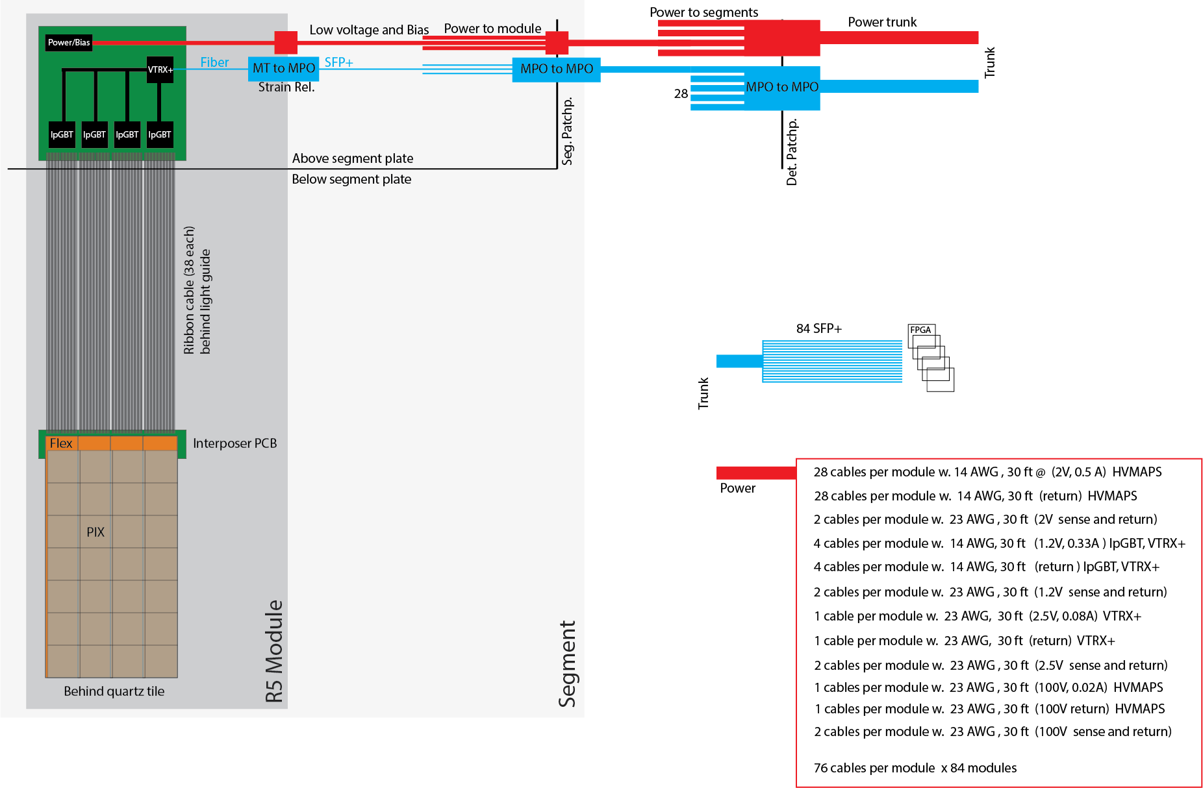
Readout Setup:
Conceptual schematic of the readout and control setup.
With 1.28Gb/s (TX) und 80 Mb/s (RX) we can read out 7 MAPS with one lpGBT.
Use 3 lpGBT as simplex transmitter and 1 lpGBT as transceiver (same mode as used by CMS).
Using this configuration we can use one VTRx+ to read out 28 MAPS
TX = Detector ➝ Counting Room,
RX = Counting Room ➝ Detector

Slide 24
Readout Setup:
Flexprint design (Jie Pan)
  Design Considerations:
  Maintain insolation and distance for HV bias
  Impedance control for differential pairs
  Minimize cross-talks
  Trace delay tuning for high-speed signal synchronization
  Edge overlap design to minimize gaps between strips
  Arrange high density connectors sideway to ease the assembly and installation
  Maximize widths of power and ground traces to allow large current flow at minimized low
  voltage drops
For each Ring 5 Quartz tile: TAB-bond 7 chips to a flex-print, have 4 such strips per detector
Simple FPC insertion
Flip-lock
Design is done, preparing for making prototypes

Slide 25
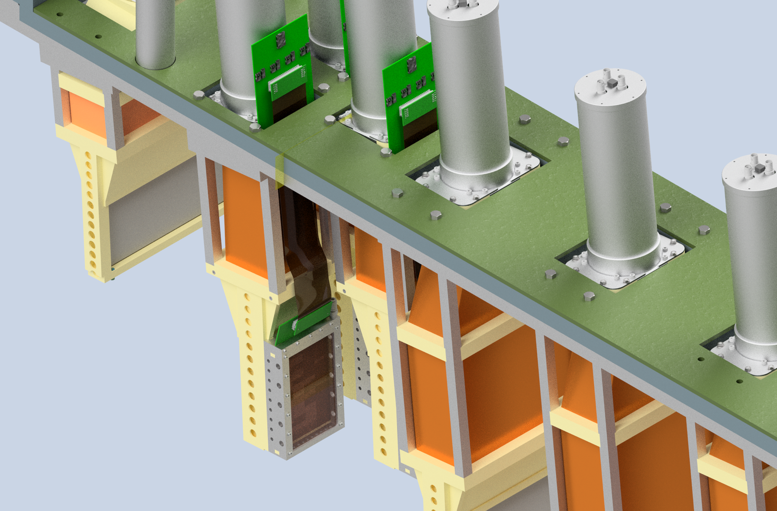
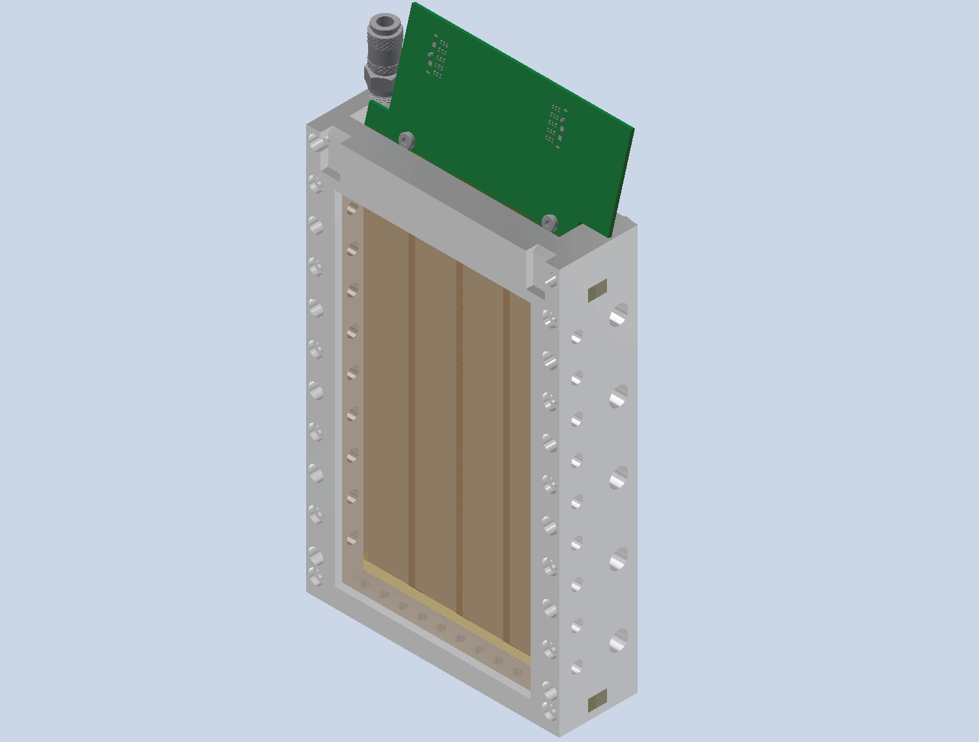
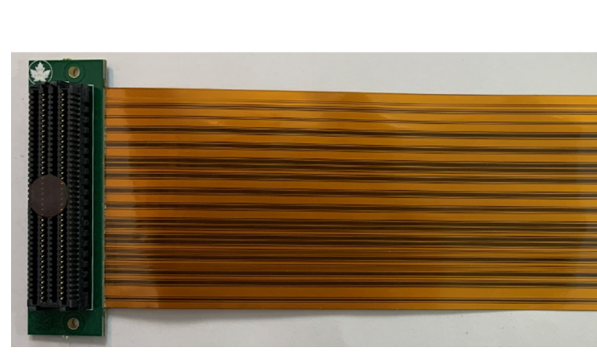
Mounting:
Ring 5 Quartz tile HVMAPS in the MD array:
More updated mounting
geometry in Kristofer’s talk

Slide 26
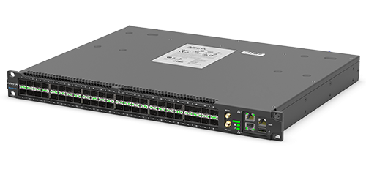
Back-end DAQ:
Need an array of commercial FPGA boards like the Xilinx kcu105
Or something like the Arista 48/96 LS fiber switch
From VTRX+ CERN Manual

Slide 27
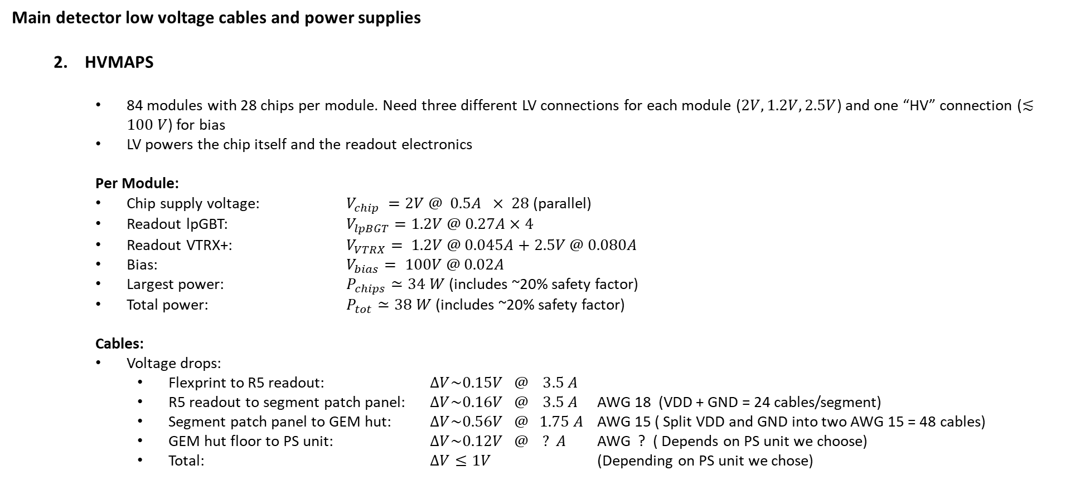
Main detector low voltage cables and power supplies
  HVMAPS
    84 modules with 28 chips per module. Need three different LV connections for each module ($2V, 1.2V, 2.5V$) and one “HV” connection ($≲100 V$) for bias
    LV powers the chip itself and the readout electronics
    Per Module:
    Chip supply voltage: $V_{chip} =2V @ 0.5A × 28$ (parallel)
    Readout lpGBT: $V_{lpBGT}=1.2V @ 0.27A×4$
    Readout VTRX+: $V_{VTRX}= 1.2V @ 0.045A+2.5V @ 0.080A$
    Bias: $V_{bias}= 100V @ 0.02A$
    Largest power: $P_{chips}≃34 W$ (includes ~20% safety factor)
    Total power: $P_{tot}≃38 W$ (includes ~20% safety factor)
    Cables:
    Voltage drops:
      Flexprint to R5 readout: $∆V\sim 0.15V @ 3.5 A$
      R5 readout to segment patch panel: $∆V\sim 0.16V @ 3.5 A$ AWG 18 (VDD + GND = 24 cables/segment)
      Segment patch panel to GEM hut: $∆V\sim 0.56V @ 1.75 A$ AWG 15 ( Split VDD and GND into two AWG 15 = 48 cables)
      GEM hut floor to PS unit: $∆V\sim 0.12V @ ? A$ AWG ? ( Depends on PS unit we choose)
      Total: $∆V≤1V$ (Depending on PS unit we chose)

Slide 28
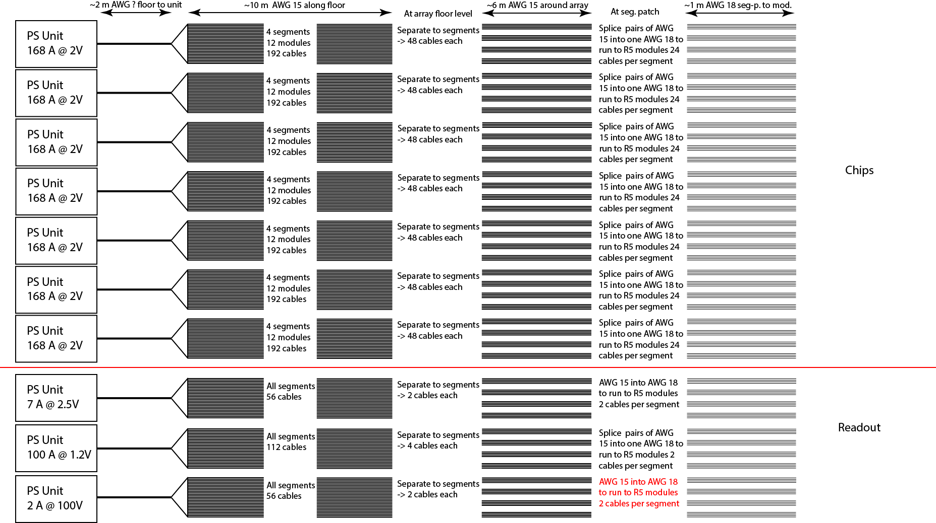

Slide 29
Main detector low voltage cables and power supplies
  HVMAPS
    PSU Series
    Single channel high current

Slide 30
Backups

Slide 31
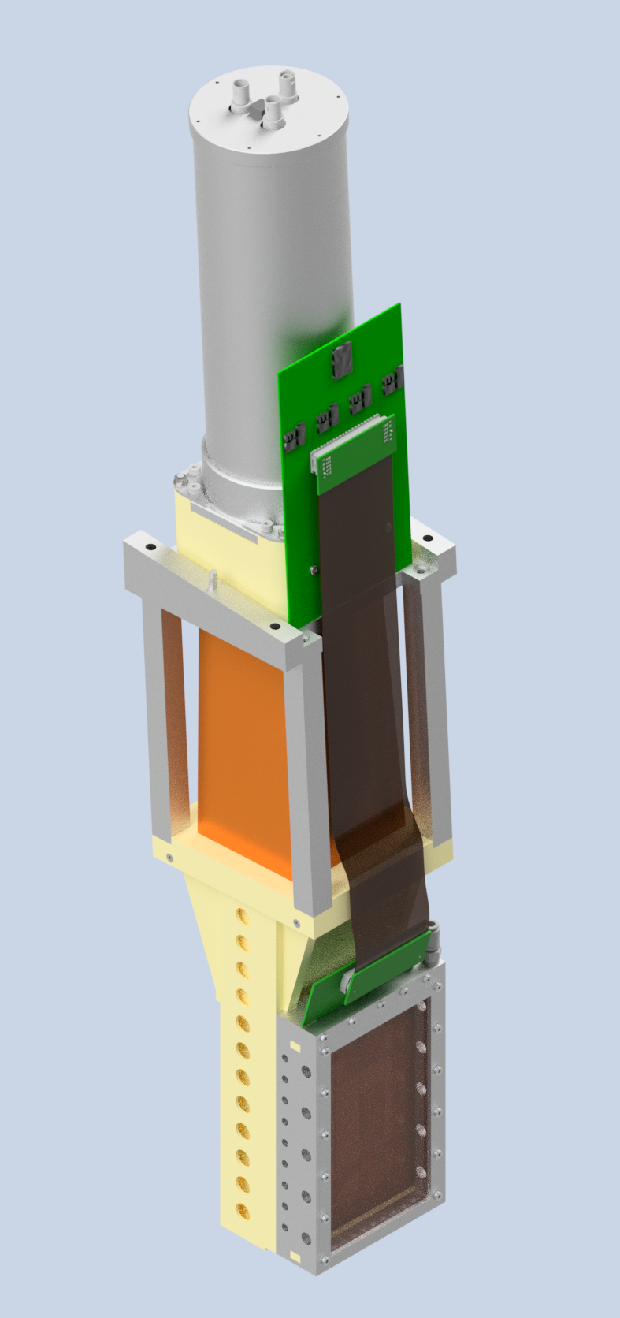
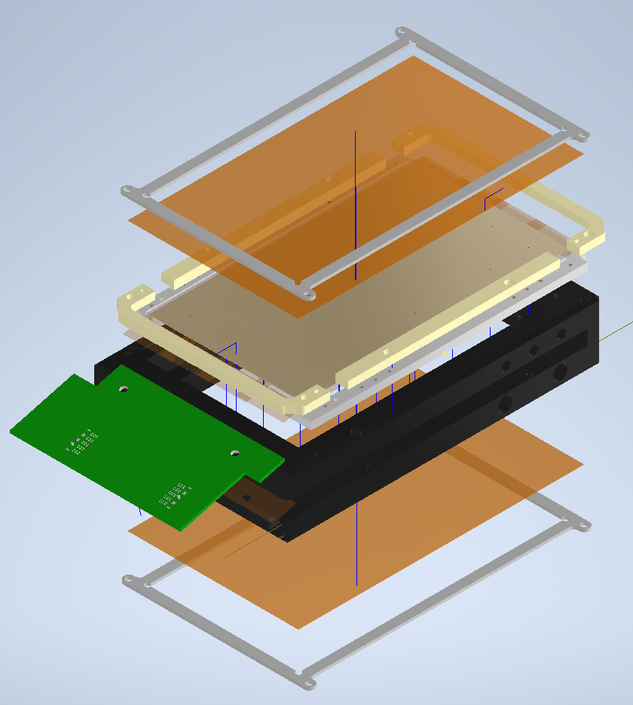
Work by Kristofer Isaak UManitoba
Sensor 1
Sensor 2
Sensor 3
Sensor 4
Sensor 5
Sensor 6
Sensor 7
CERN Developed readout test board. With FPGA backend.

Slide 32
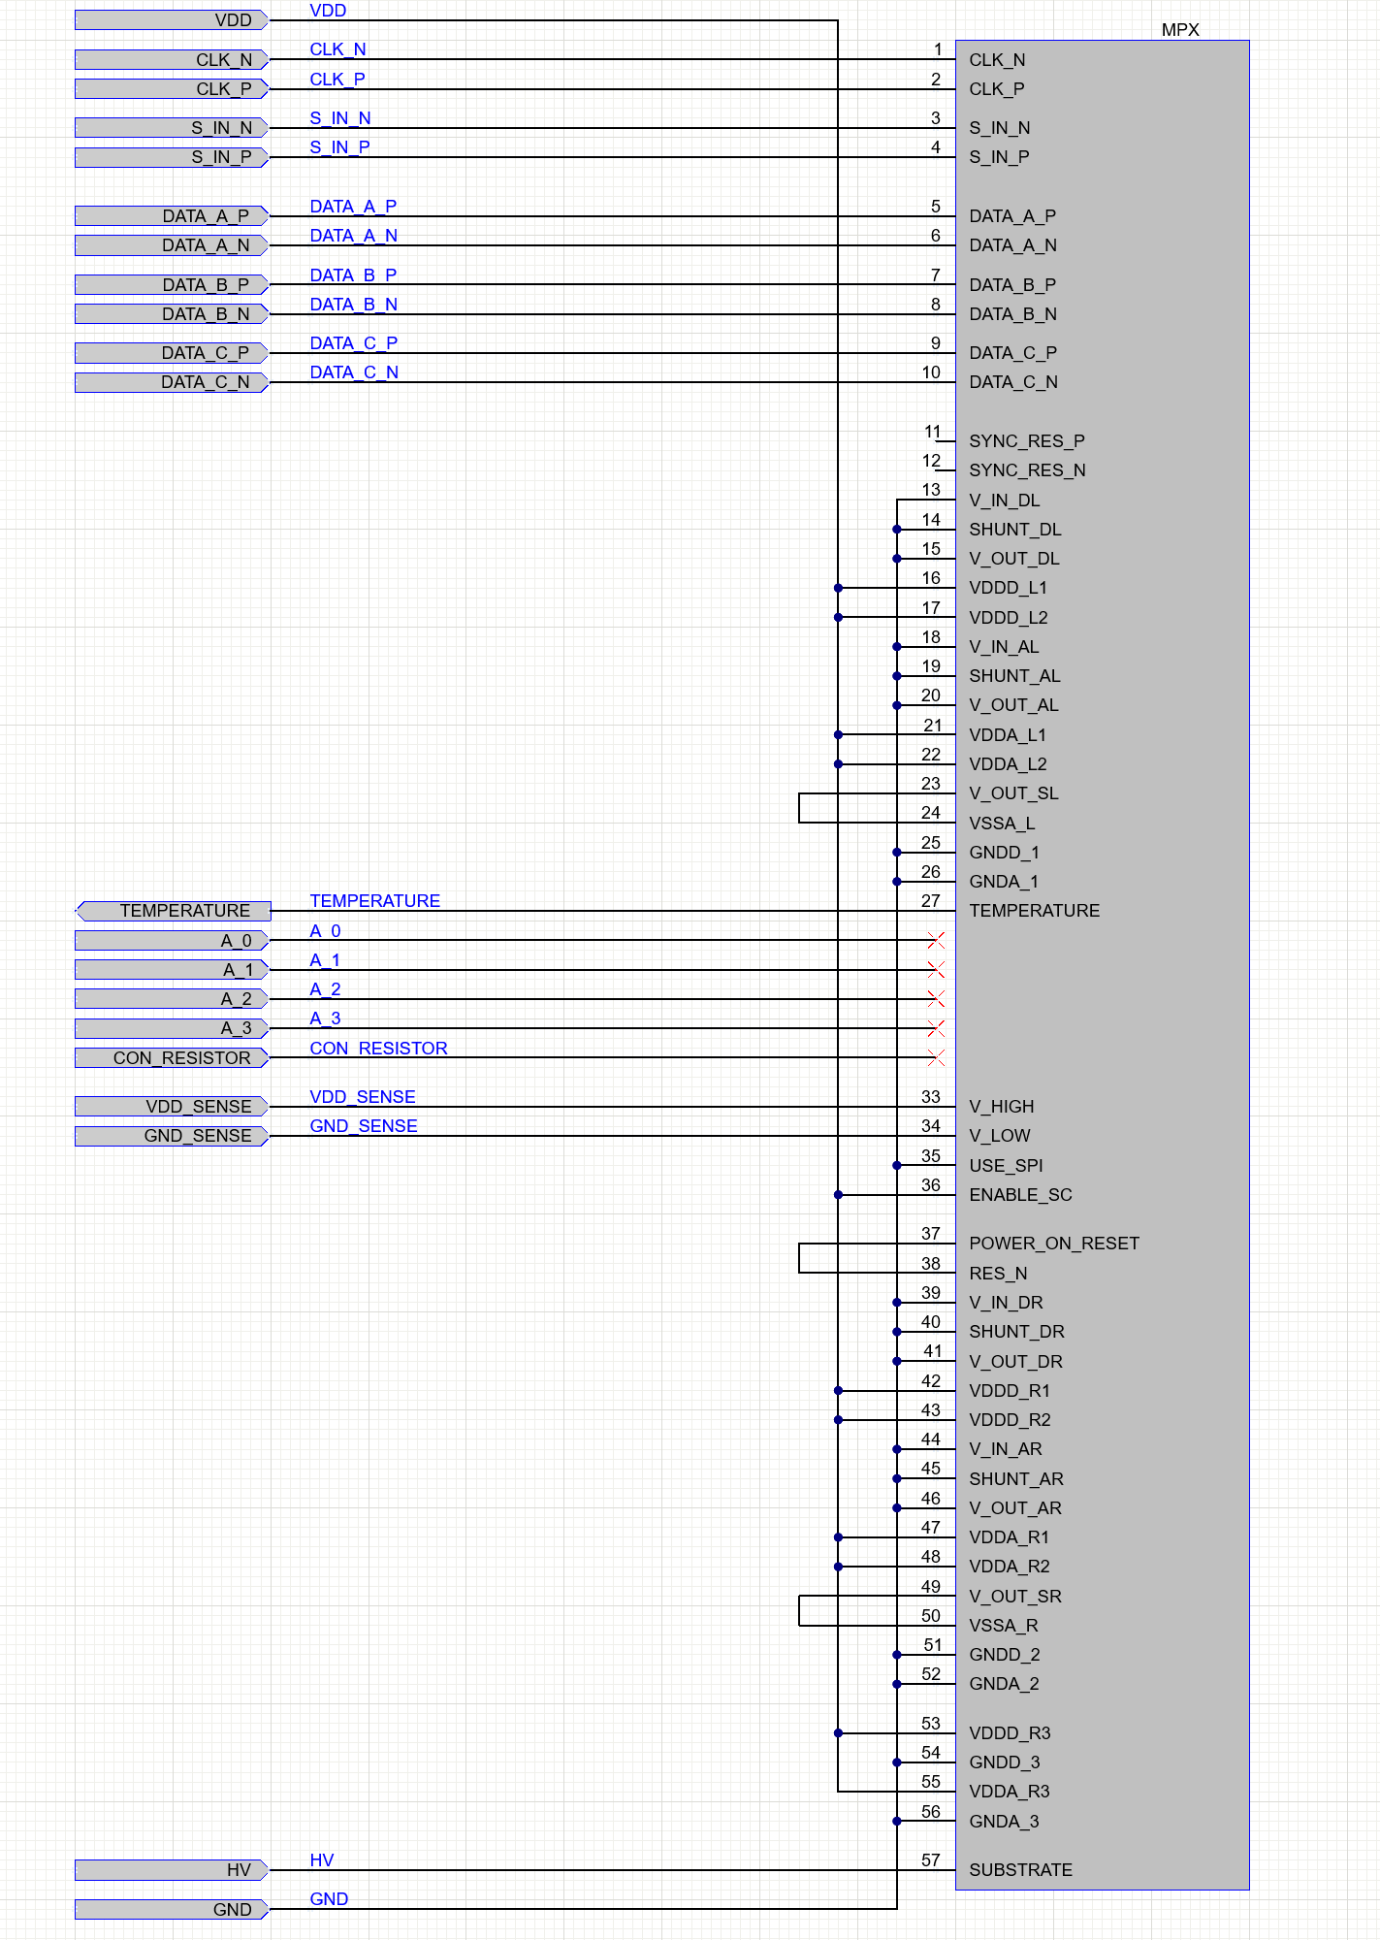
Readout Setup:
Chip-to-flexprint connections:
  Single LVDS pair readout per chip at ~180 Mbps
  7 chips ~ 1.28 Gbps
  14 lines per chip through flexprint and ribbon
  Clk_P/N from lpGBT
  S_In_P/N chip addressing through lpGBT slow control
  SYNC_RES_P/N chip gating (or similar) also through lpGBT
  Rest of the lines are voltage distribution
Reset/gate

Slide 33
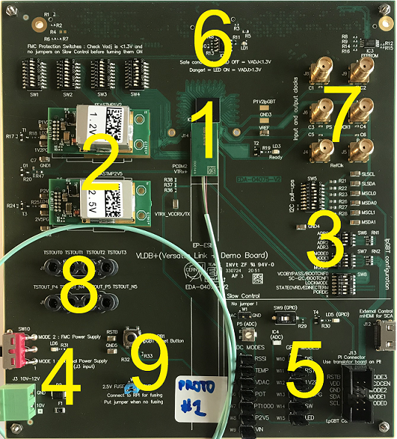
VLDB:
  Item 1: Core parts needed – 4 lpGBT, 1 VTRX+
  Item 2: FEASTMP may not be needed. Use remote power from PS unit (see slide 6) – need to implement a sense wire – maybe can use them though
  Item 3: Not needed - mode selection should take place via the downlink interface
  Item 4: Needs to be re-designed to supply power to the lpGBTs , the VTRX+, and to the HCMAPS chips
  Item 5: Not needed – startup configuration and operation mode need to be “hard wired” by pulling control pins high/low with resistors
  Item 6: Not needed
  Item 7: Not needed – reference clock should come through downlink, but the lower two connectors could be kept for benchtop testing/prototyping
  Item 8: Could be kept for prototype testing
  Item 9: Not needed but might be useful for testing

Slide 34
VTRX+ Info:
From VTRX+ CERN Manual
  Fiber optic transceiver
  4 upstream channels (sum = 10.24 Gb/s)
  1 downstream channel (2.56 Gb/s)
  20 cm pigtail with female MT terminator
  Needs to have MT-MPO (male) adapter or other to connect to standard fiber

Slide 35
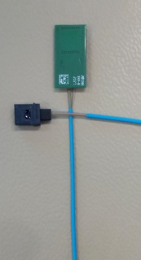
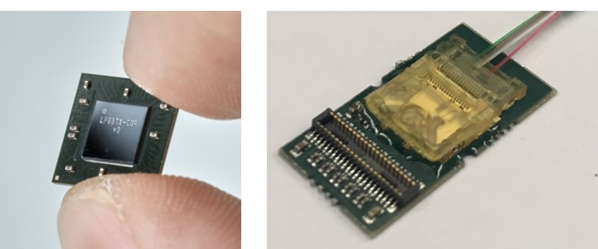
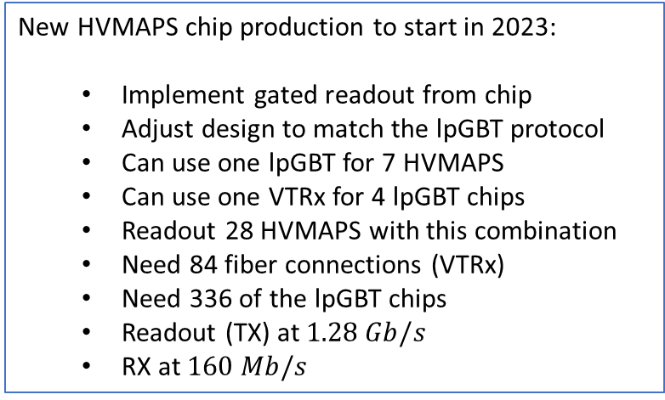
CERN Chips Details
New HVMAPS chip production to start in 2023:
  Implement gated readout from chip
  Adjust design to match the lpGBT protocol
  Can use one lpGBT for 7 HVMAPS
  Can use one VTRx for 4 lpGBT chips
  Readout 28 HVMAPS with this combination
  Need 84 fiber connections (VTRx)
  Need 336 of the lpGBT chips
  Readout (TX) at $1.28 Gb/s$
  RX at $160 Mb/s$
lpGBT
VTRx
New

Slide 36
Status:
  CERN shipped all of the lpGBT chips to Manitoba
  VTRX+ chips are coming in the next few months
  We have one of the CERN prototype readout boards. The VTRx+ can be used for prototype development
  Design of the MAPS module, flexprint, cooling, interposer is progressing well
  Commercial Xilinx FPGA backend solution is being identified and priced out
  Power supply and bias system (cabling and control) is currently based on direct remote control, but possible DC/DC conversion closer to the readout board is being considered.

Slide 37
Summary of HV-MAPS operation
  Chip connections:
    There will be 4 differential outputs (8 lines) per chip that are connected to the lpGBT:
      Clock (Clk_n/p)
      Data-out (DOut_n/p)
      Gate_n/p
      Addressing (Sin_n/p)
    There could be one more digital temperature signal from each chip to the lpGBT input (TBD)
    All signals except the temperature diode are LVDS
    Target TX speed is 1.28 Gbps (~180 Mbps per chip to lpGBT)
    Target RX speed is 80 Mbps (from lpGBT to chip)

Slide 38
Power and Bias
Remote LV control cable design for the HVMAPS tracking detector
We would need ~2 of these per segment
Shorter cable is definitely better …
We would need three fiber connections
per segment

Slide 39
Appendix:
CERN Prototype Board Schematics

Slide 40
Appendix:
CERN Prototype Board Schematics

Slide 41
Appendix:
CERN Prototype Board Schematics

Slide 42
Appendix:
CERN Prototype Board Schematics

Slide 43
Appendix:
CERN Prototype Board Schematics

Slide 44
Appendix:
CERN Prototype Board Schematics

Slide 45
Appendix:
CERN Prototype Board Schematics

Slide 46
Appendix:
CERN Prototype Board Schematics

Slide 47
Appendix:
CERN Prototype Board Schematics

Slide 48
Appendix:
CERN Prototype Board Schematics

Slide 49
Appendix:
CERN Prototype Board Schematics

