Slide 1

DAQ update
Integration and counting mode DAQ planning for MOLLER (WBS 1.07, 2.07, 3.07)
MOLLER Collaboration meeting, 5-6 May 2023
Paul M. King – Ohio University
MIE WBS1.07 Level 2 Technical Lead

Slide 2
DAQ development contributors
Common members in all groups
  R. Michaels, B. Moffit, C. Zorn; JLab
  B. Blaikie, M. Gericke, J. Pan; University of Manitoba
  D. McNulty; Idaho State University
  P. King; Ohio University
Integration mode
  D. Bishop, B. Shaw; TRIUMF
  C. Cuevas, W. Gu; JLab
Counting mode
  D. Armstrong; W&M
  S. Chatterjee, C. Ghosh, H. Liu; U. Mass.
Digital BCM
  J. Arrington, Y. Kolomensky, S. Li, Y. Mei, E. Sichtermann; LBNL
  W. Gu; JLab

Slide 3
Developments since June 2022
Completed the Final Design Review in December 2022
Continuing development and testing of integrating ADC
Tested the trigger distribution plan for synchronizing INJ and Hall readout
Identified location for GEM MPD crates
Planning for beamline readout
Developed plan for including HVMAPS in both integrating and counting DAQ
Reconsideration of data footprint
Not much progress on analysis → needs to shift to high priority

Slide 4
Recommendations from the PDR and actions taken
Continue plans for reviews of circuit board designs with Jefferson Lab staff before release of production versions.
  JLab staff have been actively involved in development of the integrating ADC module; W. Gu recently conducted a review for FEG of the DAQ plans
Update/verify existing electrical/grounding system drawings for Hall A to include new equipment for MOLLER detector and magnet apparatus.
  The collaboration has a Grounding task force that will complete its work soon, including updating the existing Hall A grounding system drawings.
Carefully review the requirements for new fiber optic cables from the Injector Service Building (ISB) to the Hall A electronics bunker locations and create an installation plan.
  Contract to install the ISB-CHA fiber has been put in place to be done in this SAD; CHA-Hall fiber installation planned for the MOLLER assembly period.
Make progress on the prototyping of the Integration/readout board a priority. The more time it can be tested and integrated into the CODA framework the easier it will be to flush out all potential DAQ and timing issues.
  Prototype ADC module delivered in November to B. Moffit to begin CODA installation

Slide 5
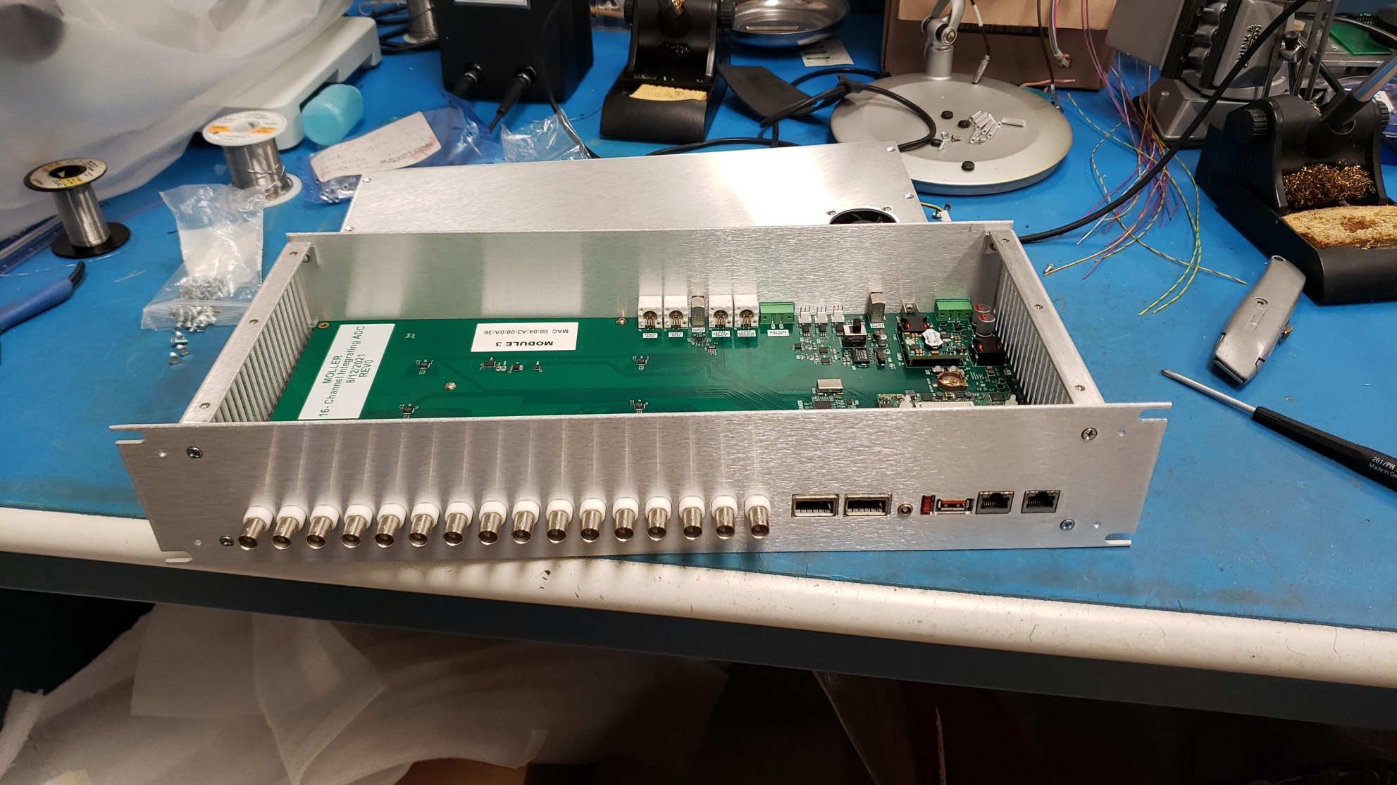
Integrating ADC development
Full 16-channel prototype tested with beam at Mainz
ADC board design has undergone preliminary review by JLab staff
Prototype chassis designed and constructed at JLab
One module is now with JLab DAQ group for installation of CODA
Power can be supplied through Power over Ethernet (PoE) or an external 48V supply. Prefer PoE, but to be checked with grounding working group

Slide 6
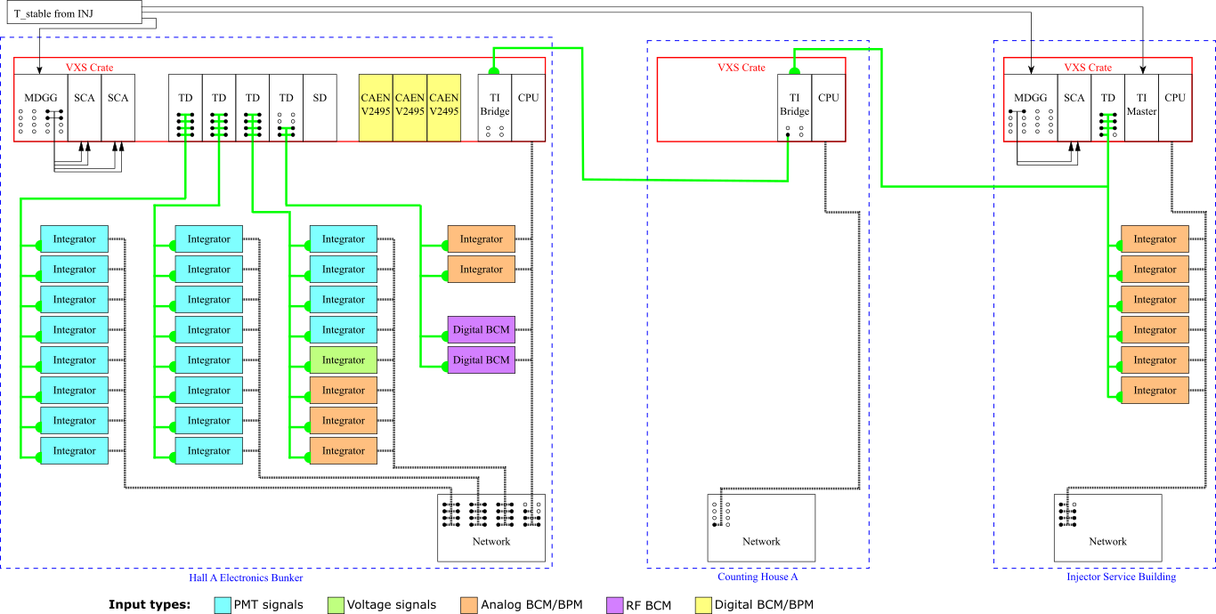
Integrating DAQ overview

Slide 7
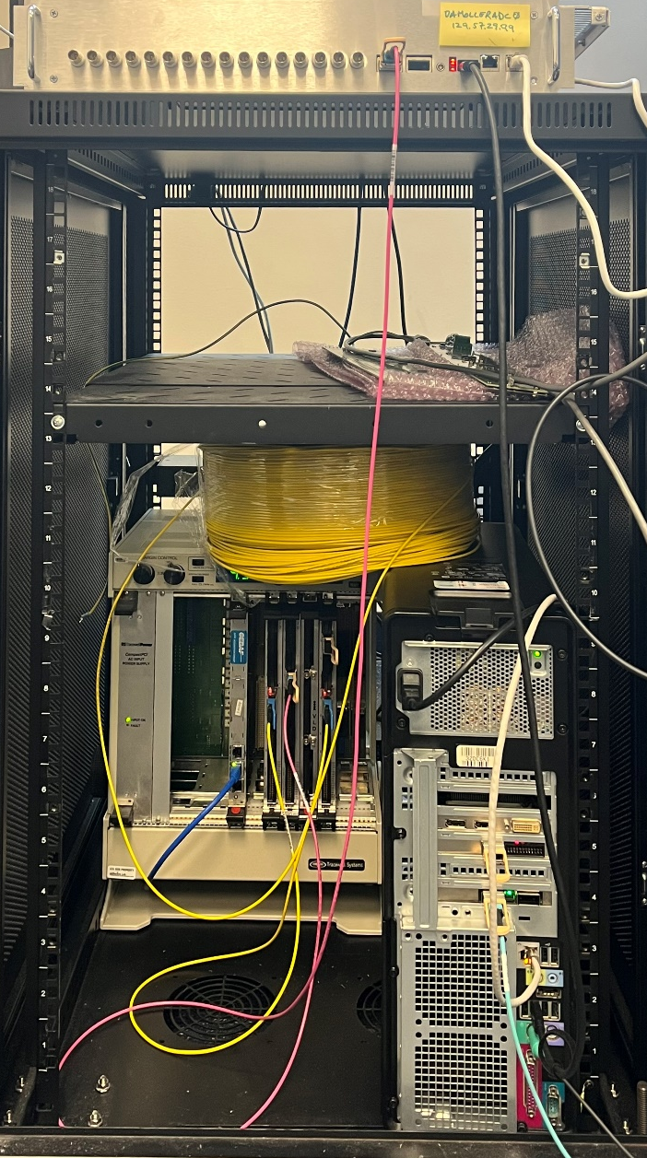
Bench testing of trigger distribution between ISB and Hall
TriggerGeneration (Timaster(slot#3) )
OpticFiber, SingleMode, 1500 ft
ADC
TriggerBridge (TI_bridge_supervisor (slot#6))
fake_SD backplane
TD (TD (slot#4))
Fiber, 1500 ft
SingleMode
OpticFiber, MultiMode, 6ft
Integrating ADC (TInode) in hallA
TD
Slot#4, ‘hallA’
fake_SD (slot#B)
Integrating ADC (TInode) in the Injector Building
(when the second ADC is available)
TI_bridge
Supervisor
Slot#6, ‘hallA’
Timaster
Slot#3,’Injector’
Picture and description, courtesy of W. Gu

Slide 8
Testing and development needed to complete the ADC
Testing of the TI interface on the ADC board with TIpice
  In progress
Installing Linux and porting CODA to the Ultrascale+ on an evaluation board
  Done
Install Linux/CODA on the SOC on the ADC
  Done
Decide if ground isolation using PoE++ is acceptable or should use independent isolated power supplies
FPGA firmware development to form the helicity window quantities
FPGA firmware development for streaming of all samples
Development of Linux driver to access the FPGA result registers
CODA ROLs
Testing

Slide 9
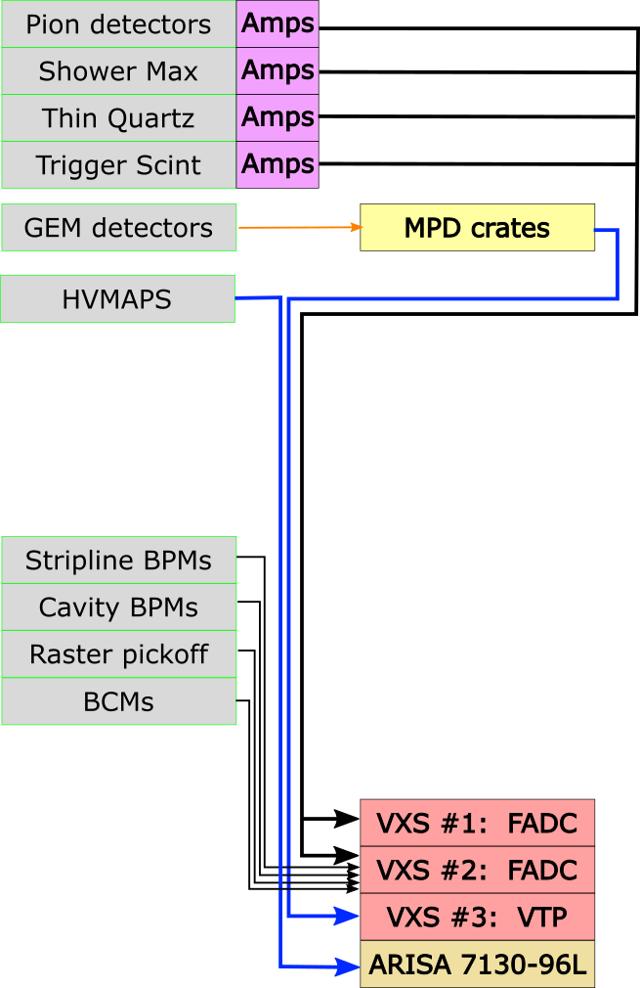
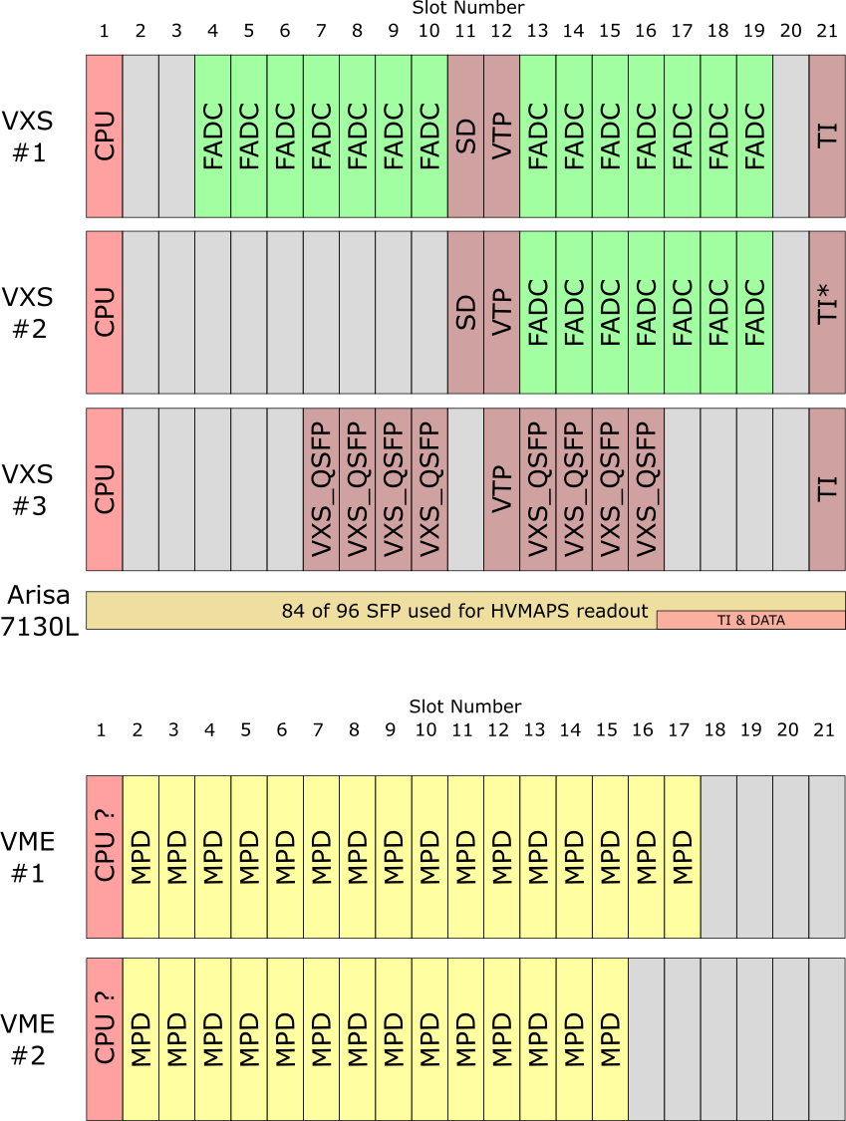
Subsystem overview: counting DAQ

Slide 10
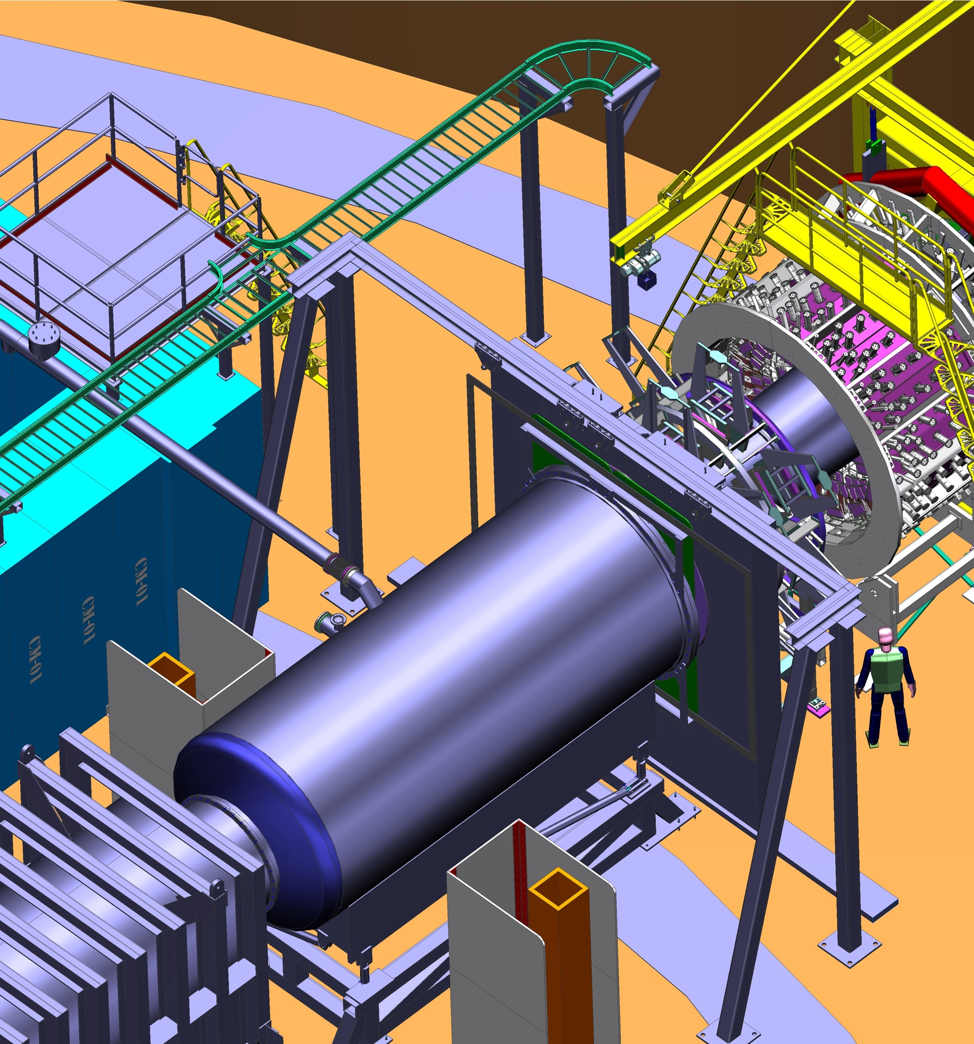
GEM Readout Planning
GEM modules will be instrumented by APV25 cards, which will be connected to MPD modules via HDMI cables
Data from MPD modules will be transferred over optical cable to a VTP module
  This is identical to the system currently in use by the SBS experiment
MPD modules will be in shielded area near the detectors
  Simulated total dose over the full experiment is a few krad
  We are in communication with SBS to understand their radiation experience with the MPDs
  To date, no APV or MPD failures have been attributed to radiation

Slide 11
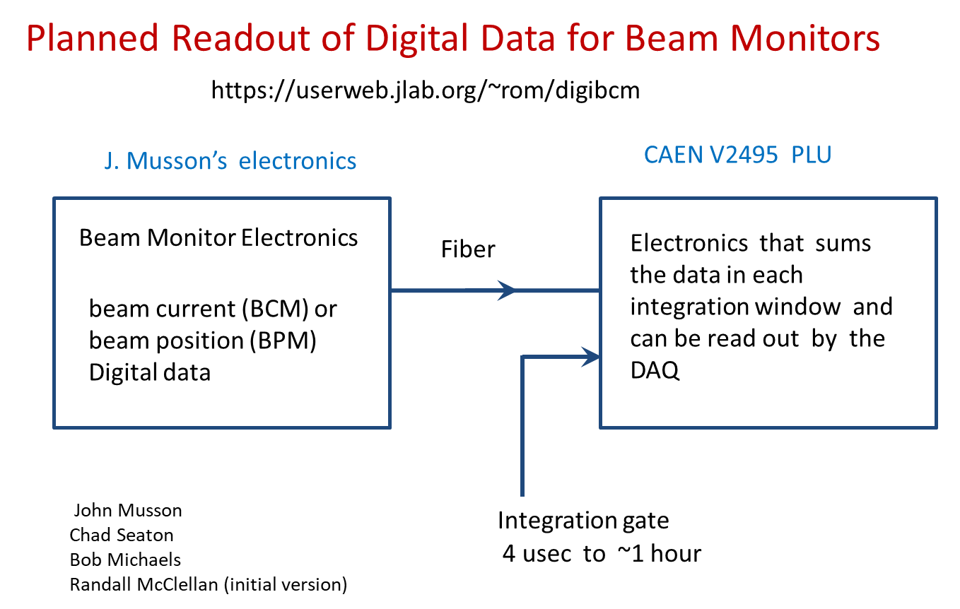
Beam monitor readouts
All JLab BCM and BPM receivers have analog outputs which can go to ADCs
Would prefer digital readout; development underway for Hall A/C experiments
UC Berkeley and LBNL are developing a digital BCM receiver
  The input bandwidth is closer to the integrated PMT channels
  Trigger Interface connection and readout would be done through QSFP as for the integrating ADCs

Slide 12
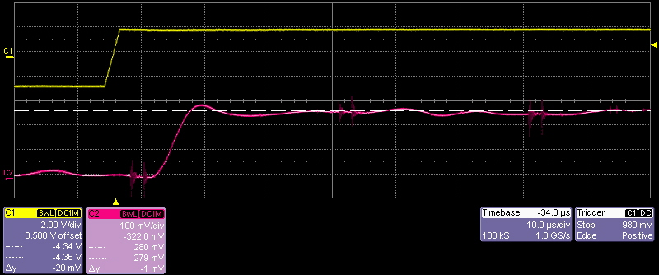
Bandwidth and latency considerations for beamline readout
We have sent a BPM and BCM requirements document to N. Rider
  Highlighted the bandwidth and timing requirements to match with the detector signals
JLab SEE electronics
  Bandwidth of analog output signals is ~30kHz
JLab digital receivers
  Digital sample rate is 1Msps, allowing a maximum bandwidth of 500 kHz
  Analog output (18-bit DAC) signals have a filter with effective bandwidth of 100-200 kHz
For both the JLab SEE and digital receivers, the analog outputs have a few µs latency compared to the inputs. We will allow for this by adjusting the integrating ADC gate timing.
Bench test of BCM digital receiver, showing latency.
Courtesy of J. Musson

Slide 13
HVMAPS
Each Ring-5 tile would have 28 HVMAPS chips
Readout from HVMAPS done via low
power gigabit transceiver (lpGBT) SER/DES chip and the VTRx optical transceiver
  One lpGBT supports 7 HVMAPS; four lpGBT supported by one VTRx
  VTRx output is SFP+ fiber
Data from HVMAPS collected in FPGA-based Arista switch (Arisa 7130 96L)
  This will also have a TI connection to allow CODA integration
HVMAPS will be part of counting mode DAQ; will be operated independently during integration mode running

Slide 14
HVMAPS Operation goals
Counting mode
Pixels are self triggered, and send their hit data and timestamp over the fiber connection
FPGA on Arisa switch uses timestamps to associate HVMAPS pixel hits to triggered event
Fairly loose requirement to match timestamps to trigger due to 25 ns time binning on GEMs
Pixel hit data is send to CODA data stream to allow combined analysis with GEM tracks
Integrating mode
Run as independent data stream to generate an occupancy map
HVMAPS are run in a triggered mode, to just record being hit within a narrow trigger window (~10 ns)
All hit pixels are read over the fiber and accumulated to form a 2D occupancy map

Slide 15
Data rate, file segment sizes, and data set size
The standard data rate for the integrating DAQ will be about 130 MB/s
  One hour of data would be about 470 GB
A convenient size for the data file segments might be 20 GB → ~150 seconds
  Hour-long runs would be split into about 23 segments
Many file segments makes it easy to run analysis jobs in parallel, but short file segments may make it harder to recognize and cut out beam trips or other instabilities
The total data footprint has been recalculated in DocDB#1027; total is 14PB
  Production + Compton raw data: 9.5PB (main production DAQ, 7TB; HVMAPS, 0.5PB; diagnostics mode, 0.5PB; Compton, 1.5PB)
  Production + Compton analysis results: 2PB
  Tracking raw data & analysis results: 1.5PB (raw data, 1.25PB; analysis results, 0.25 PB)
  Simulation: 1PB

Slide 16
Mock-data and analysis testing
Mock-data generator within “japan” creates realistic data files with time-dependent and randomized generation of beam parameters and detector signals, including correlations
First model of the integrating ADC data-structure has been added; should be updated as we become familiar with the actual data stream
Analysis of these data files allows testing of throughput and processing algorithms
  Processing time for initial mock-data (216 PMT channels and 50 beamline channels) is ~5µs per event; this is faster than we had expected from scaling arguments
We should restart the parity analysis group discussions
  Starting point is the japan framework as used in PREX/CREX; should revisit what worked well and what was missing
  Are there reasons to make major framework changes, or even start with new framework?
For tracking analysis, expect to look at what can be used from SBS analysis

Slide 17
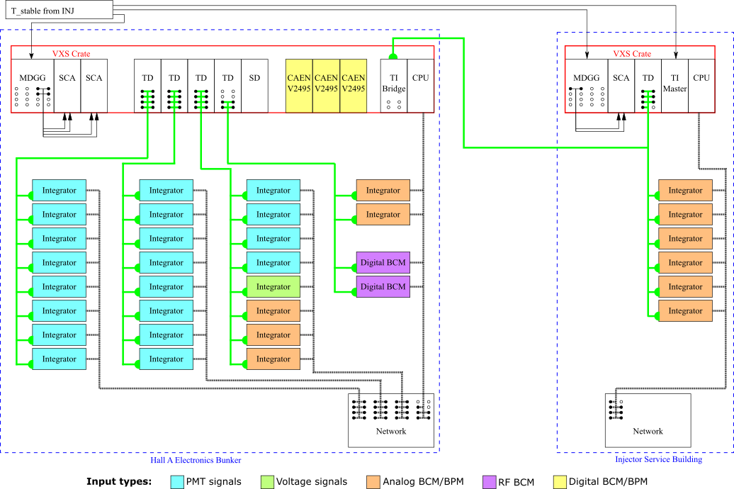
Summary
Paul King
pking@jlab.org
Integrating and counting DAQ working groups are preparing for procurements to begin shortly
CODA development for integrating ADC is continuing
Bench testing of JLab digital beam readout has started
Objective is to start “subsystem testing” this fall, and complete the bulk of “full system testing” by May 2024

Slide 18
Backup slides

Slide 19
Draft plans for integrating mode functionality
ADC sample clock will run at 14.7 MHz (250 MHz/17)
  If a lower sample rate is desired, we would keep the clock the same and discard samples within the FPGA
  Input bandwidth is ~1MHz, so need to keep effective sample rate > 2 MHz to avoid aliasing
Main mode: accumulate over the helicity window and four equal-length sub-blocks
  32-bit values of sum, sum-of-squares, min, max, and number of samples reported for each block. Data rate from 32 modules 130MB/s for full window + 4 subblocks
Waveform mode: all samples are reported
  For Fourier analysis, need to be able to get all samples from about 1 continuous second
  For evaluation of noise in helicity window, need samples within helicity window (and possibly also the T_settle period)
  The densest packing for waveform data would be ~34 MB/s/channel. This is presumed to be used infrequently and is not included in the data rate or data set calculations

Slide 20
Integration mode channels
Detector array (280 total)
  224 Main detectors, 28 shower-max detectors, 28 pion detectors
SAMs, LAMs, and beamline (233 channels)
  SAMs: 8
  LAMs and diffuse background monitors: 28 (14 LAM + 14 DBM)
  Injector beamline: 96
  Transport line and Hall beamline: 87 (PREX/CREX used 64; my count so far ~77 ch.)
    Channels needed for beamline may be lower due to LBNL & JLab digital recievers
Scanner (6+7 channels)
  X/Y scanner: 2 PMTs + 2 position voltages (positions might go into a FADC or VQWK?)
  Linear scanners: 4 PMTs + 4 position voltages
  Reference voltage for positions
Total: 512 channels → 32 16-channel modules
HVMAPS & Digital BCM expect to connect into CODA in same way as ADCs

Slide 21
Proposed plan to add the fiber connection
ISB to CHA
  1550 linear feet of armored fiber (48 fiber cable, single mode fiber)
  Ohio U would contract with an external vendor (selected and coordinated by C. Cuevas) to have the fiber installed during this SAD
CHA to Hall A DAQ shieldhouse
  500 linear feet of armored fiber (48 fiber cable, single mode fiber)
  Fiber and installation would be added as part of Infrastructure WBS, and would be done during MOLLER assembly period

Slide 22
Fiber path

Slide 23
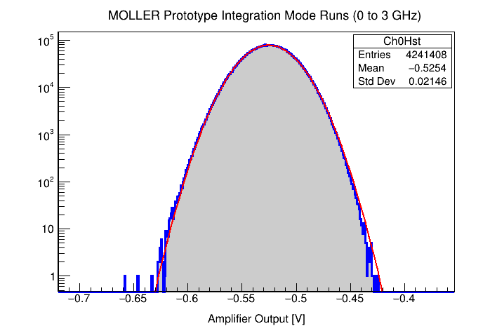
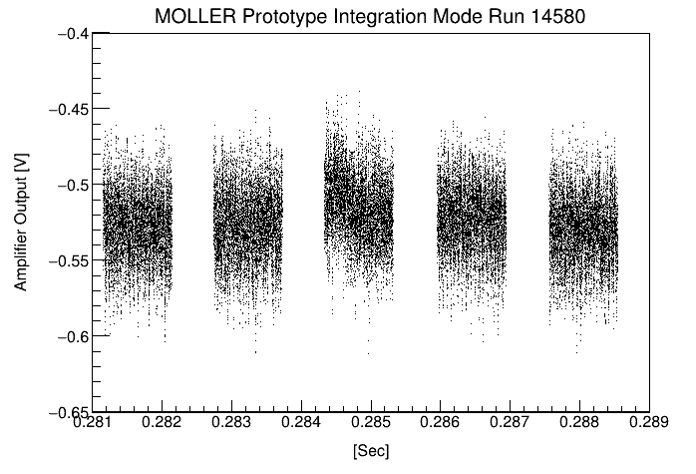
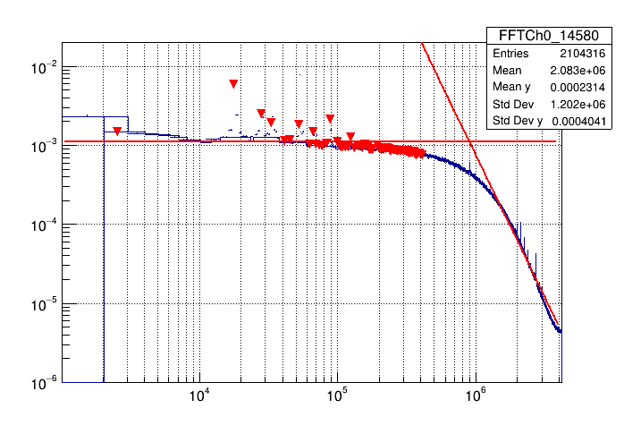
Results from the integrator ADC during 2021 Mainz tests
The integrating signal level is gaussian except for beam excursions
The beam test firmware gave 8191 samples over $≃0.983 ms$ with about $≃0.5 ms$ break between sample – next version goes up to full sampling rate at $≃15 Msps$
The high sampling rate we chose for the ADC is a good feature, as it allows us to run DFTs in diagnostic mode and identify potentially troubling noise sources and beam problems.
Figures from M. Gericke

Slide 24
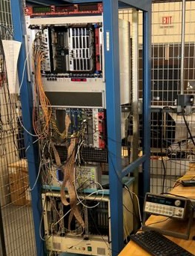
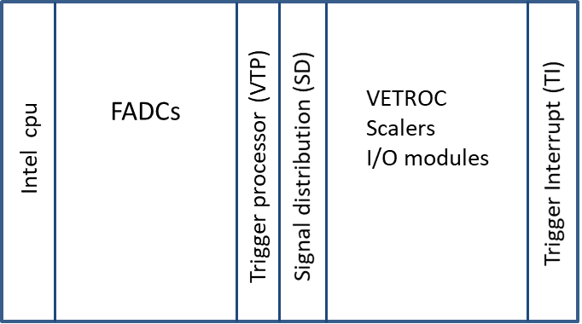
Counting Mode Test Stand
Test stand in TEDF used for common development of counting mode, Compton polarimeter, and Moller polarimeter DAQ systems
  DAQ designs share same concept: FPGA in VTP collects data from front-end (FADCs or VETROC) to form event triggers
Development objective for counting mode: VTP firmware to trigger on FADCs of single elements (quartz tiles) or two-channel coincidences (trigger scintillator)

Slide 25
Response to FDR committee about experience with GEMs in SBS
We want to make sure the DAQ talks tomorrow cover issues experienced in SBS with readout used for their GEM system.
SBS uses GEMs in both BB and SBS using the APV→MPD→VTP readout chain
A lot of the stability issues at the start of GMn were resolved with various firmware updates both to the VTP and MPDs.
The big limitation, as seen by SBS, is the transfer of data from MPDs to VTPs and from VTPs to network
Remaining instability issues now generally occur for various reasons when an APV misses a trigger.
  Bryan and Ben have added diagnostics to tell which APV or which MPD is causing the problem, and there are procedures to power cycle the MPD crates, VTP crates, or the low voltage to the APV card. This usually can fix any APV issue that is not a physical cabling or disconnect problem, and they continue to gain experience with this.
  They also have configurations in which problematic APVs can be disabled
The BB GEMs occasionally cause DAQ issues at the start of run in our current running (just needs a reset most of the time), and the SBS GEMs cause problems at about the same rate x2-3 or so due to the larger number of channels
  This is roughly 1 or 2 issues in 1-2 shift days for the BB GEMs
The INFN GEM layers are the only ones that are still having issues right now, but these have a different design than the other layers, and they think the problem has something to do with the low voltage configuration

Slide 26
Response to FDR committee about experience with GEMs in SBS, pt2
MPD data transfer links are 1.25 Gb/s and VTP output link is 10 Gb/s
MOLLER (280 APV, 28 MPD) is similar in size to BB (328 APV, 24 MPD) but expects lower data rates
  Most of SBS MPD cards readout 15 APV, but MOLLER will have 10 APV per MPD, so the data rate from a typical MPD will be 2/3 of SBS’s at the same rate and number of samples
  In order to saturate the VTP 10GbE link after zero suppression with 5kHz event rate, MOLLER would need to have GEM occupancies of ~58%; we expect 5-10% at 100nA, and can reduce beam current or prescale triggers if needed
MOLLER will benefit from the continuing development of the APV→MPD→VTP readout chain during SBS
MOLLER’s design already incorporates one lesson from SBS: using more MPDs than the minimum decreases transfer time by having more links

Slide 27
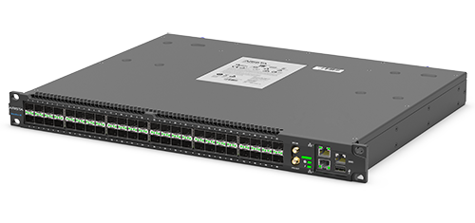
ARISA 7130 96LS
7130L is multiple devices in one; performing layer 1+ switching in only 5 ns, enabling unrestricted access to an onboard FPGA and containing an x86_64 server.
  84 SFP+ ports used by VTRx connections
  Remaining SFP+ ports can be used for TI connection
FPGA (UltraScale VU7P-2) plus quadcore x86 CPU
Development in parallel with Mainz HVMAPS effort

Slide 28
Rack space estimate for DAQ for 40U (70inch) racks
Integration mode: 71U in Hall, 31U in INJ
  Integrators, 1U rackmount units, assume +1U for airflow
    INJ: 6 modules → 12U: 0.3 rack
    Hall A: 26 modules → 52U: 1.3 racks
  VME/VXS: 11U height, front to back airflow
    Trigger distribution in Hall
    Trigger supervisor in INJ
  NIM crate: 7U +1U
    One each in Hall and INJ
  Don’t have space needs for HVMAPS or digital BCM receivers yet
  Doesn’t include integrator power supplies, or the HV and LV supplies
Counting mode: 44U in SBS bunker, 22U in downstream doghouses
  Three VXS crates: 11U each, front to back airflow → 44U
  Two VME crates in two “doghouses”: 11U each, front to back airflow
SBS bunker: 3+0.4? racks; Doghouses: 0.3+0.3 racks; INJ: 0.8+ rack

Slide 29
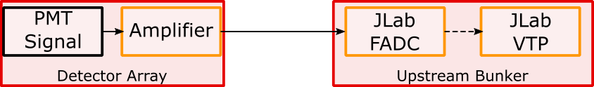
Counting Mode Data Acquisition and Trigger
Plan to include amplifier within the thin quartz PMT assembly; use NIM amps in US bunker if needed for others
Voltage and timing data: 320-336 ch. (20-21 FADC)
  Detector array PMTs: 280 total; 224 thin quartz, 28 shower-max, 28 pion detectors
  Trigger scintillators: 18; 2 each for 7 GEM sectors & 2 pion sectors
  Scanner PMTs: 6; 2 in X/Y scanner and 1 each in 4 linear scanners
  Alternate trigger signals: 16-32; SAM- or LAM- signals? Diffuse background PMTs? Halo PMTs?
Voltage data only: 23 ch. (2 FADC)
  Beamline: Two cavity triplets and two stripline BPMs: 14 ch.
  Raster readbacks: 2 ch.
  Scanner position: 7; 2 for X/Y, 4 for linear scanners, 1 voltage reference
GEM readout: APV25→MPD→VTP
We are considering if some channels may still go to a VETROC

Slide 30
Timing requirements for counting mode are met by the FADC250
The following are summarized from David’s https://dilbert.physics.wm.edu/Tracking/36
The charged particle flux through the scintillators will be completely dominated by the Moller and e-p electrons. Requiring both scintillators to fire will suppress the soft photon backgrounds even without a precise timing coincidence
The APV use 25 ns bins, and the time resolution of GEMs (in SBS) is about 10 ns. The only background in the GEMs should be clusters of strips hit caused by soft photons converting in a single GEM; these could be suppressed by timing, but given the 25 ns binning of the GEM signals, an additional smearing of the trigger timing by the 4 ns binning should not degrade our ability to do this.
Main detector and showerMax signals should be dominated by the "real" Moller + ep events. I can't see how higher resolution timing will improve our ability select hits in the quartz detectors that are true signal events.
"Random" coincidences are actually going to be dominated by two real Moller or ep electrons in the same sector in a given time window, so improved time resolution will not allow us to significantly suppress false events from randoms.
  FADC data should make it possible to recognize pile-up events

Slide 31
Conclusion: using FADC alone should be sufficient
Including amplifier within the PMT assembly is under consideration; otherwise use NIM amps in US bunker
Trigger timing resolution of 4 ns should be sufficient, and pileup should be identifiable in the FADC. Pulse timing in analysis should be better than 4 ns.
Removing the discriminator and VETROC allows a single cable from detector to the FADC input and simplifies the system
  Using the VETROC would require also adding a splitter (active or passive) in the bunker
Keeping the discriminator and VETROC would give somewhat better timing, and some redundancy. However, the key data for the quartz is amplitude, so VETROC alone insufficient.

Slide 32

Counting Mode Triggering
GEMs/trigger scintillators inserted
reduced beam current ($≈$100 pA) [100pA → Moller rate is ~30kHz/septant]
use of thin ¹²C targets, and the lH₂ target
some measurements with “sieve” collimator to select scattering angles
Primary Counting-Mode Trigger
  Trigger: “OR” of $i=1,7$of [${TSi}_{up}∙{TSi}_{down}]$
Quartz-triggered mode
  Triggers: possibility to select:
    OR of all thin quartz detectors in a given ring
    OR of all ShowerMax detectors
Pion-triggered modes
  Triggers: possibility to select from:
    OR of all 7 pion detectors (cosmics, setup)
    OR of the two $(i=1,2)$ANDs: [${πTSi}_{up}∙{πTSi}_{down}]$ (main pion dilution measurement)
    [OR of all 7 pion detectors] $∙[OR of all {TSi}_{up}∙{TSi}_{down}]$ (rate symmetry of pions; $πTS$efficiency; enhance pion signal)

Slide 33
Counting DAQ rates & data size
FADC trigger window range: 100ns (25 samples)
GEM samples: 3 25-ns samples
Total Moller rate: 135 GHz@65 uA → ~300 MHz/sector/uA
  At 100nA, ~30MHz/sector, 3 hits/sector/100ns
    Likely use a pulser trigger at this beam current and find scint. hits in analysis
  At 100pA, ~30kHz/sector
FADC raw mode data rate at 7kHz: 150 MB/s
  336 FADC channels * ( 25 samples * 2 bytes/sample + 4 bytes for channel) → 127 MB/s
  Estimate 8 particles with 5 detectors hit (2 scint, 1 quartz, 1 showermax, & 1 pion) in each sector per trigger; pulse parameter data would give ~23 MB/s

Slide 34
Beamline readout
Expect to use Berkley digital receivers for our primary BCMs
BPMs (and any BCMs we need to share with OPS) would (probably) go through JLab instrumentation
Discussion group: Yury, Kent, Mark P., Bob, Jim, Paul K., John Musson
PVES results published to date have relied on Switched Electrode Electronics for BPMs
  With the sample and hold cards, the linac SEE effective analog bandwidth is ~30kHz.
  SEE systems are gradually being replaced, but many likely to remain in use, such as in INJ
New BPMs in the hall would be instrumented by JLab digital recievers
  Normally, stripline wire-pairs are multiplexed like in SEE, but at 1 MHz switching
  16-bit 1 MHz analog outputs are available, with limiting bandwidth between 100-200 kHz.
  Digital output processing would allow ~21 bits at 1 MHz sampling
  New development work may allow removal of multiplexing and increase of sample frequency
Digital readout system development test stand is being set up
Plan to test new receivers in parallel with existing SEE systems on some devices

Slide 35
Planned Readout of Digital Data for Beam Monitors
https://userweb.jlab.org/~rom/digibcm
J. Musson’s electronics
CAEN V2495 PLU
Beam Monitor Electronics
Fiber
Electronics that sums the data in each integration window and can be read out by the DAQ
beam current (BCM) or
beam position (BPM)
Digital data
John Musson
Chad Seaton
Bob Michaels
Randall McClellan (initial version)
Integration gate
4 usec to ~1 hour
This development is supported by Hall Ops funds; would be needed for other experiments too
Slide courtesy of R. Michaels

Slide 36
Online Analysis
Needed Tasks
  Helicity correlated (HC) feedback
    Feedback cycle likely 10 s
  Monitor of data quality
    Some issues only appear at high statistics, needing hours or days
    Requires correction for HC beam properties
  Monitor of transverse beam polarization
    Requires corrections for HC beam properties
    Requires accumulating multiple hours of data
Hardware needs
  One workstation for helicity-correlated feedback
  10 workstations for full analysis to support #2 and #3 (~50 concurrent jobs)
  100 TB fileserver provides space for several days of raw data and analysis results (raw data rate is 450 GB/hr, outputs are similar in size)

Slide 37
Data reduction and visualization
The total raw data volume will be at the petabyte scale
Creating ROOT TTrees of all elements would also result in petabyte scale output files
Several parallel data reduction choices
  Average yields and asymmetries for all data elements over short period (~1 minute?) and store in a database
  Generate ROOT TTrees for only the key elements for all helicity patterns
  Keep the full ROOT TTrees for a small subset of data files
Anticipate needing a few hundred TB of disk space to work with the output files
We will also need robust ways to monitor system performance and present output results to analysis workers

