Slide 1
MOLLER Collaboration Meeting
(1.03) Spectrometer Overview
Organization
Spectrometer Scope
3A Review & Scope
Summary/Status
Michael Dion – Spectrometer CAM
May 5-6, 2023
dion@jlab.org

Slide 2
Organization
L2 Management, Control Account Manager (CAM)
  Mike Dion, Exp Nuclear Physics
L2 Technical Leads
  Juliette Mammei, U. Manitoba (Physics)
  Dave Kashy (Engineering)
  Technical Team
  JLab
      Josh Armstrong
      Joe Beck
      Ryan Biraben
      Chris Cleveland
      Brian Eng
      Probir Ghoshal (L3)
      Sandesh Gopinath (L3)
      Kaiyi Hall
      Keith Harding
      Jacob Hicks
      Chuck Hutton
      Onish Kumar
      Sarin Phillip
      Joe Lamont
      Andrew Lumanog
      Mark Lester
      Joseph Meyers
      Rachel Reese
      David Silvio
      Dan Spell
      Scot Spiegel
      Eric Sun (L3)
      Cameron Sutton
      Randy Wilson
      Daniel Young
    MIT-Bates
      Jim Kelsey (lead)
      Jason Bessuille
      Ernie Ihloff
      Danielle Petterson
      Tricia Smith

Slide 3
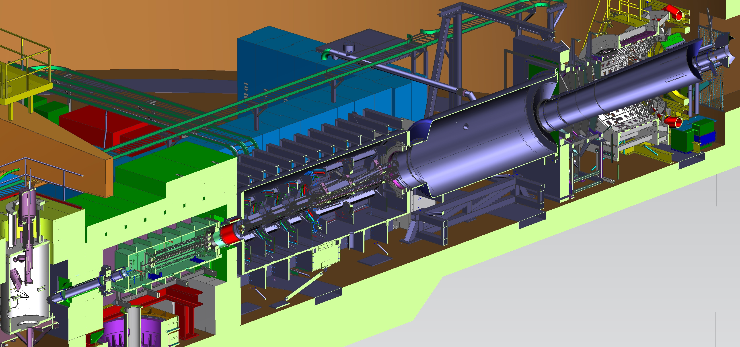
Spectrometer Scope
Instrumentation from after Target (upstream -z) to beam dump (downstream +z)
Detector Window
Collimators, Collars and Scrapers
7
Vacuum enclosures
Detector Pipe
100” OD
5
Drift Pipe
Target
TM-4
4
TM-2
TM-3
Pion donut and support
TM-1
3
TM-0
2
Bellows
1
Toroid magnets (TM)
Beampipes
HALL center

Slide 4
Spectrometer Scope (to L4)
1.03 Work Breakdown Structure (WBS)
  1.03.01 – Spectrometer Management – CAM
  1.03.02 – Downstream Toroid
    1.03.02.01 Downstream Toroid Coils
    1.03.02.02 Downstream Toroid Enclosure
    1.03.02.03 Downstream Toroid Collimator
  1.03.03 – Upstream Toroid
    1.03.03.01 Upstream Toroid Coils
    1.03.03.02 Upstream Toroid Enclosure
    1.03.03.03 Upstream Toroid Collimators
  1.03.04 – Magnet Power Supplies, Cooling and Controls
    1.03.04.01 Magnets Power Supplies
      1.03.04.01.01 Downstream Magnet Power Supplies
      1.03.04.01.02 Upstream Magnet Power Supplies
    1.03.04.02 Magnets I&C
      1.03.04.02.01 Downstream Magnet I&C
      1.03.04.02.02 Upstream Magnet I&C
    1.03.04.03 Magnets Water Chiller
    1.03.04.04 Field Measurement Equipment
    1.03.04.05 Shielding Supports
  1.03.05 – Beam Pipes and Windows
  1.03.06 – Spectrometer Assembly
MIT contract for US design
(TM-0 coils, 2 bounce, coll 1, 2, 4, and blocker and sieve)
3A Procurements ~$5.5M
Prototyping Efforts in Test Lab

Slide 5
Spectrometer 3A Review & Scope
Project Assessment for CD-3A and Status Jan 10-12, 2023
  Conducted by Office of Project Assessment
Successfully cleared 3A (with caveats) enabling procurement of expensive and long-lead items (a LOT of W, Cu and power supplies).
  New CAM…
Targeting CD-2/3 Q4 CY2023
So, what is the 3A scope…

Slide 6
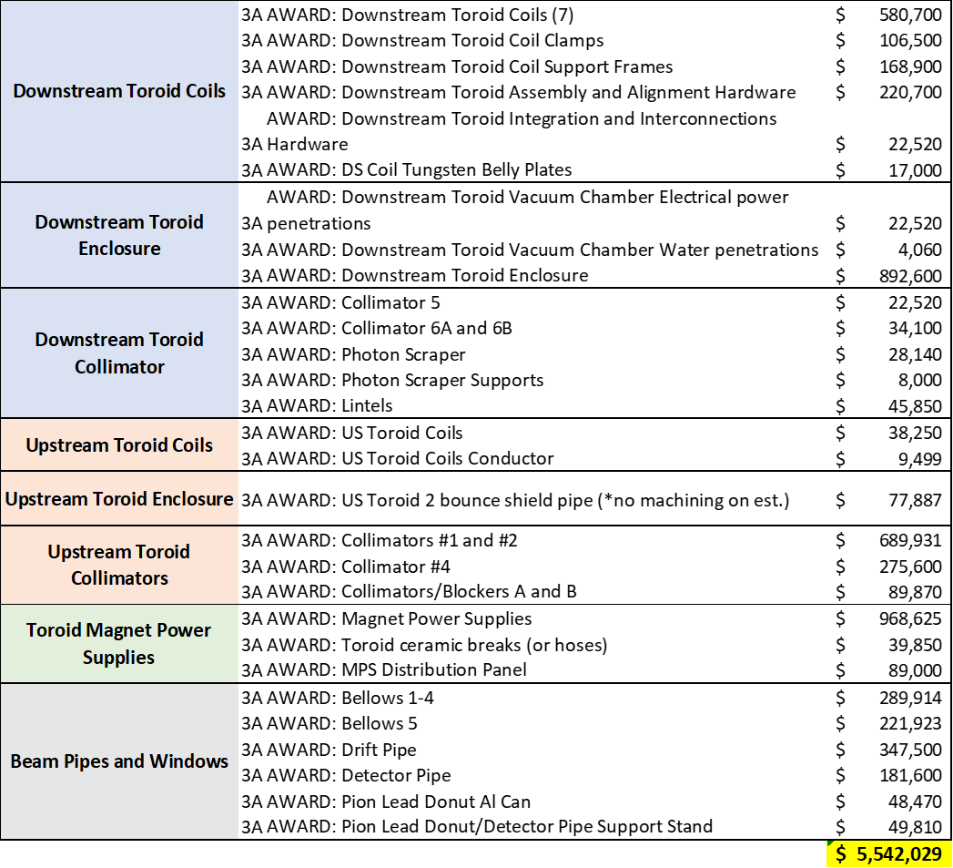
3A Scope: Procurements (1.03)
Long lead items

Slide 7
3A Scope: Procurements (1.03)
Long lead items
  W components

Slide 8
3A Scope: Procurements (1.03)
Long lead items
  W components
Production coils (35 total)
  Material to support production
  Assembly

Slide 9
3A Scope: Procurements (1.03)
Long lead items
  W components
Production coils (35 total)
  Material to support production
  Assembly
Power supplies

Slide 10
3A Scope: Procurements (1.03)
Long lead items
  W components
Production coils (35 total)
  Material to support production
  Assembly
Power supplies
Vacuum components
  Inconel bellows
  DS Enclosure

Slide 11
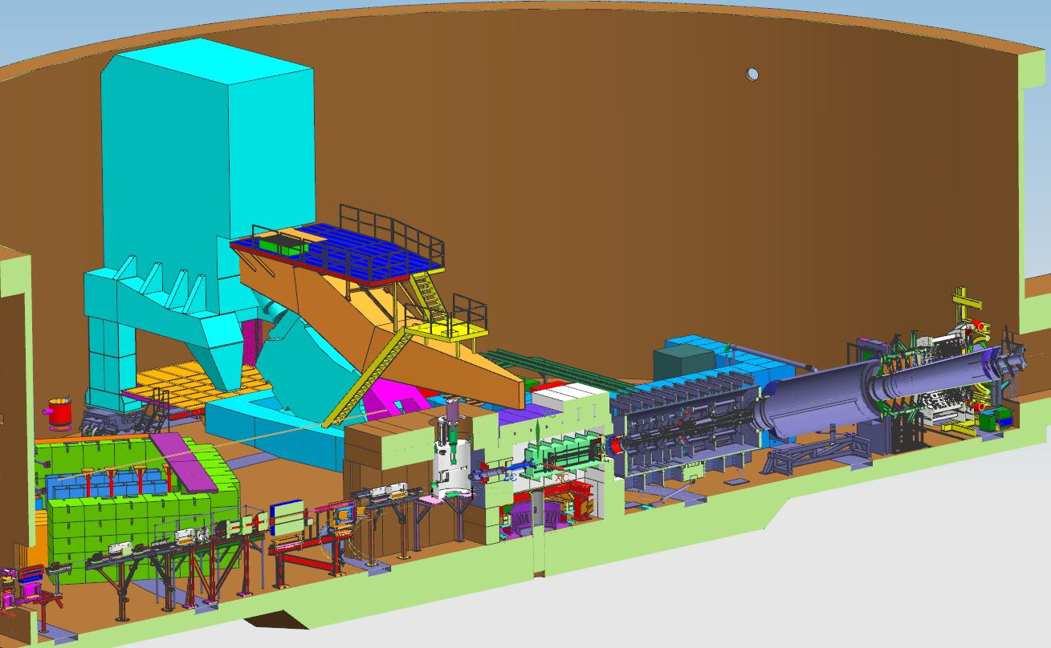
Summary/Status
3A Spectrometer Procurements:
  Most required design effort and technical writing
  DS Production coils in process (release ~5/15/2023)
  US conductor has been ordered (Oct 2023 del)
  DS Enclosure PR (submit this month)
  MPS Distribution panel buyer assigned (52 week lead)
  DS Coil Alignment Hardware PR
  Some delays w/ prototype MPS (FAT now mid/late July)
  Pion donut can: PR this week
  Bellows 1-5, Drift and Detector Pipe: PR this month
Planning/Prep for Director’s Review (week Aug 14th, 2023) and CD-2/3 (Oct 3-5, 2023)

Slide 12
BACKS

