Slide 1
MOLLER Collaboration
Spectrometer Engineering
Conductor Location Measurements
& DS Enclosure
May 5-6, 2023
Sandesh G & Team

Slide 2
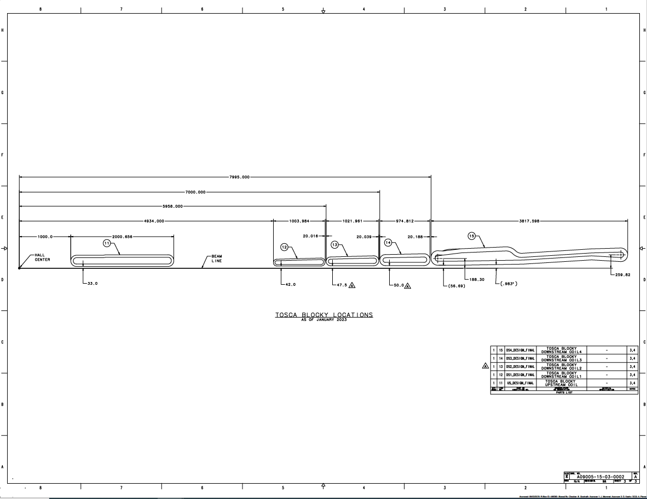
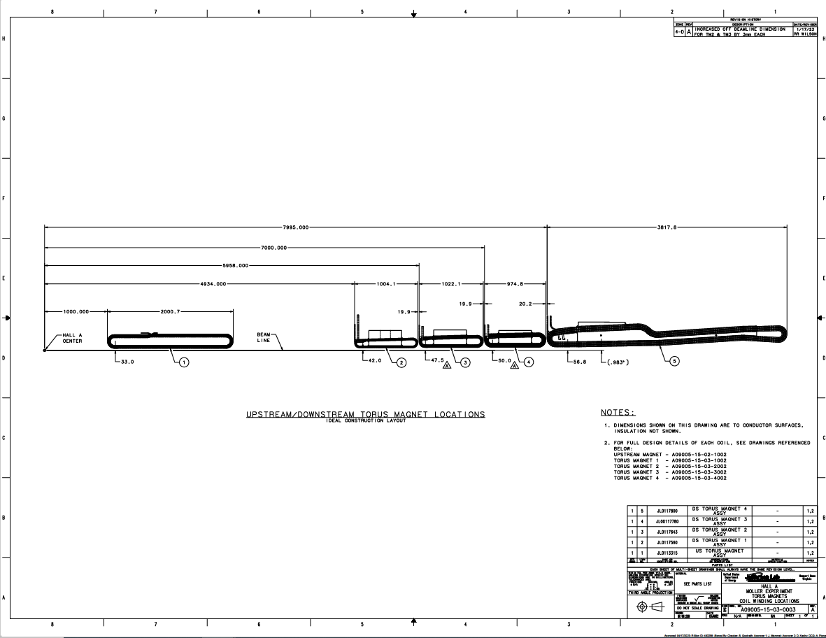
Final Coil (Copper) Locations
TOSCA Blocky Locations
A09005-15-03-0002 Rev A
Coil Winding Locations
A09005-15-03-0003 Rev A

Slide 3
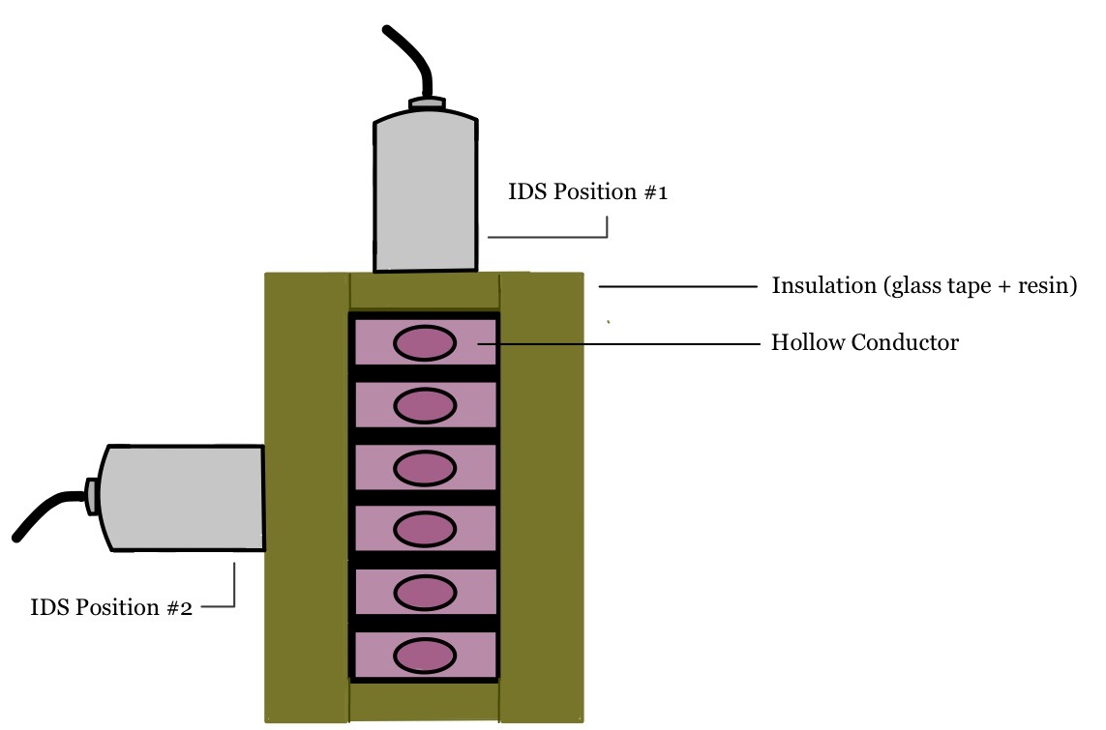
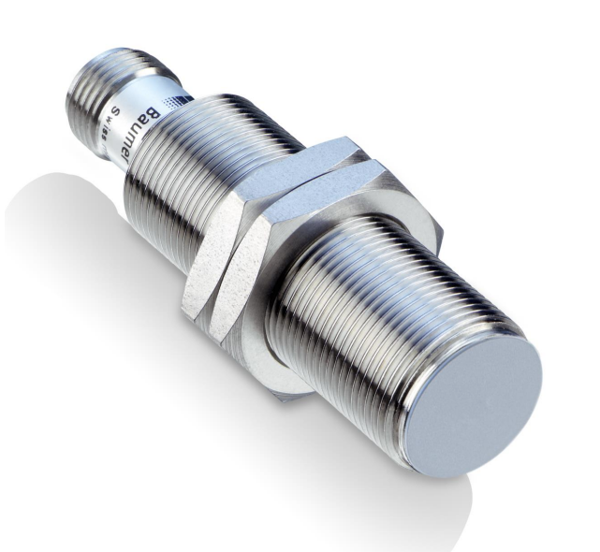
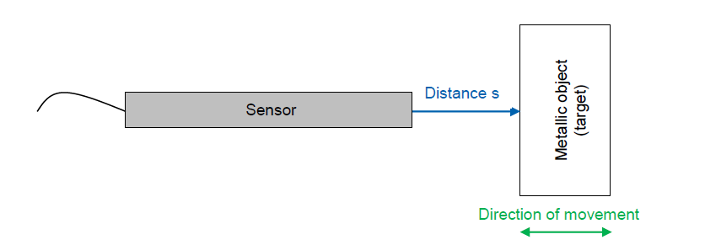
Conductor Location in Coils
Coil radial alignment requirement ± 0.5mm
Theoretical insulation build up around conductor 1.1mm
An inductive displacement sensor can measure the location of copper inside the insulation matrix
Table 1 Inductive Displacement Sensor Parameters
Name | Description
Range Resolution | 0-8 mm 20 µm static
Linearity/accuracy | ±70 µm
Min Target Thickness | 1 mm
Mini target size | 24 mm x 24 mm
Supply voltage | 12 – 36 VDC
Material Measured | Conductive Materials (i.e., metals)
Output signal | 0 – 10 VDC
Mount Type | Flush
Temperature Range | 23°C ±5°
Sensor Application in insulation measurement
Baumer Inductive displacement Sensor
Sensor Alignment

Slide 4
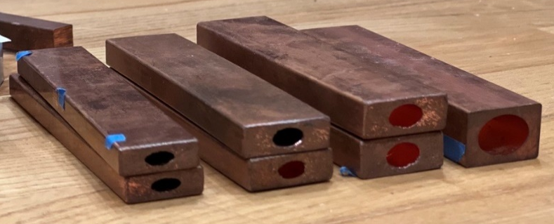
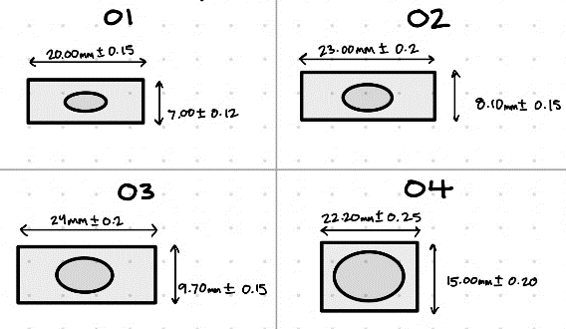
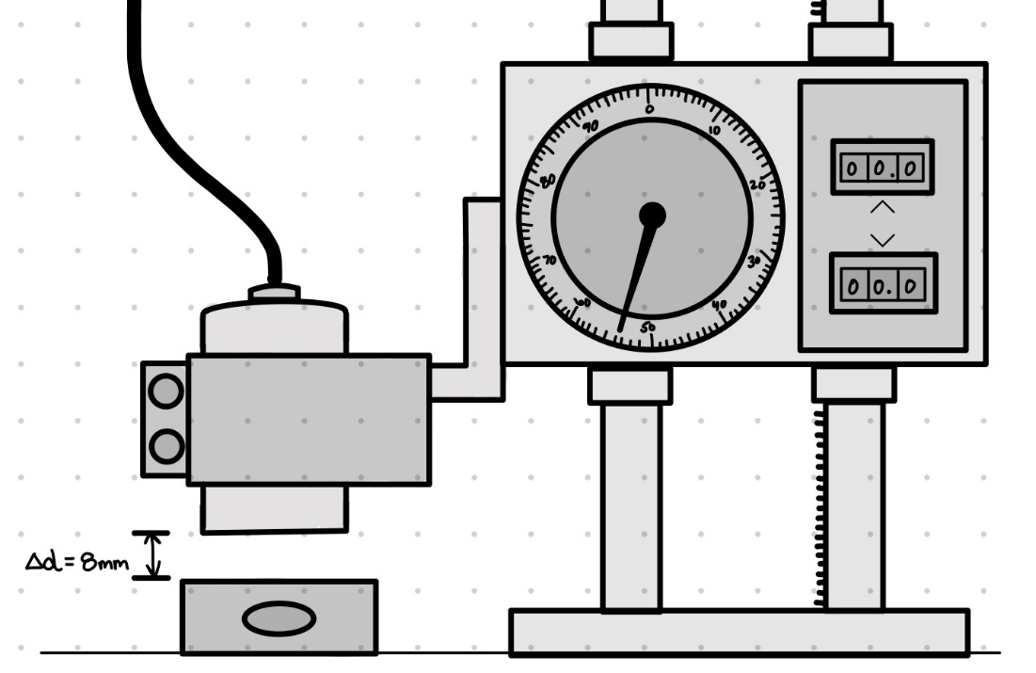
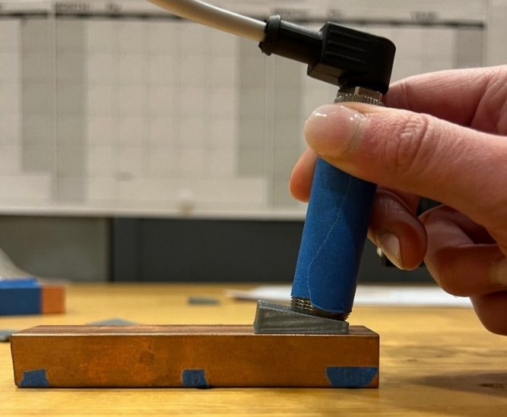
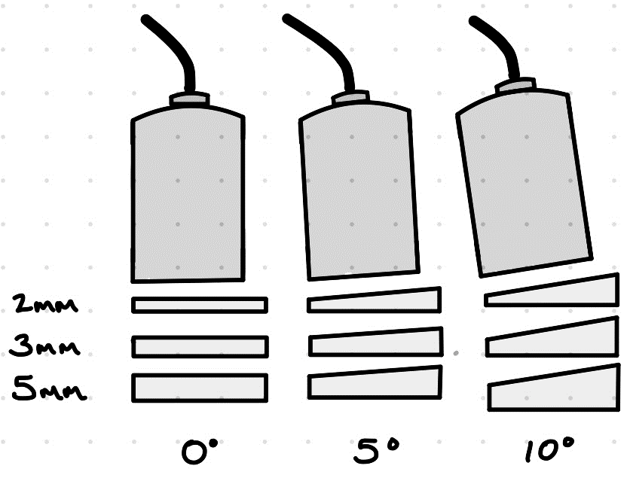
Sensor performance Characterization
Probe tested for accuracy based on target size variation, target surface angle variation and presence of multiple targets.
Conservative accuracy of -135 µm +70 µm expected which includes angle variation of up to 5°, surface finish, surface waviness and user error.
See ‘PMAG0000-0001-R0005 Use of an Inductive displacement sensor to measure coil insulation thickness’ for details
Conductor samples used for measurements
Probe mounted on a height gauge measuring distance to the conductor sample
Probe placed on a 3D printed wedge to simulate error due to angle variation

Slide 5
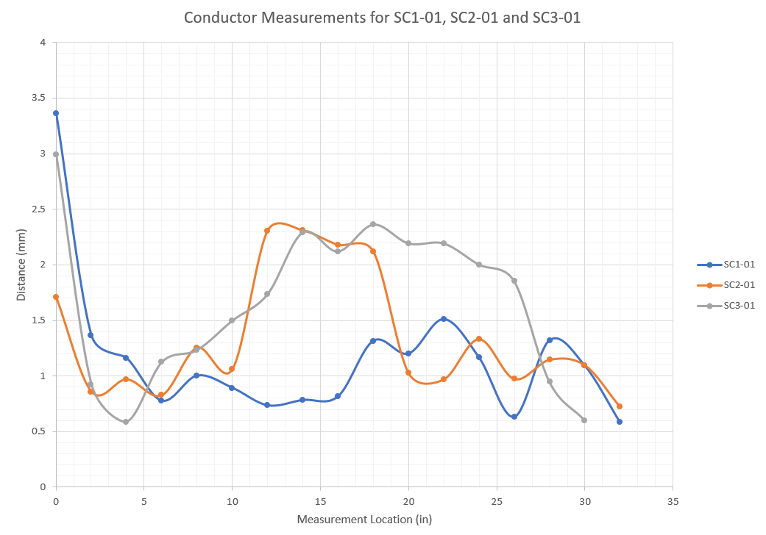
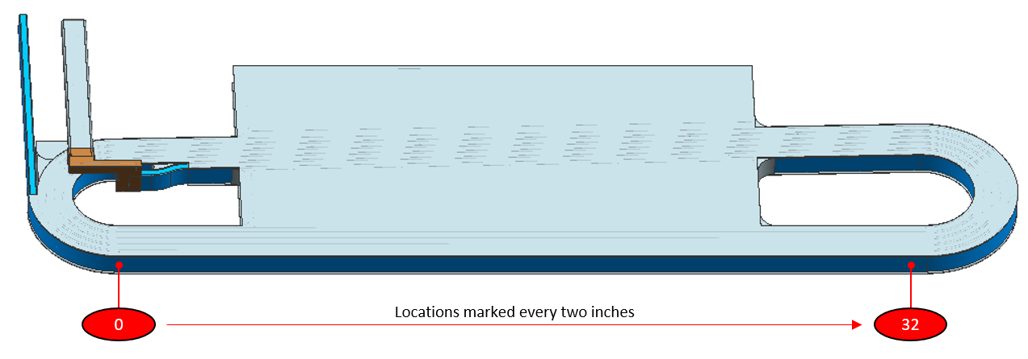
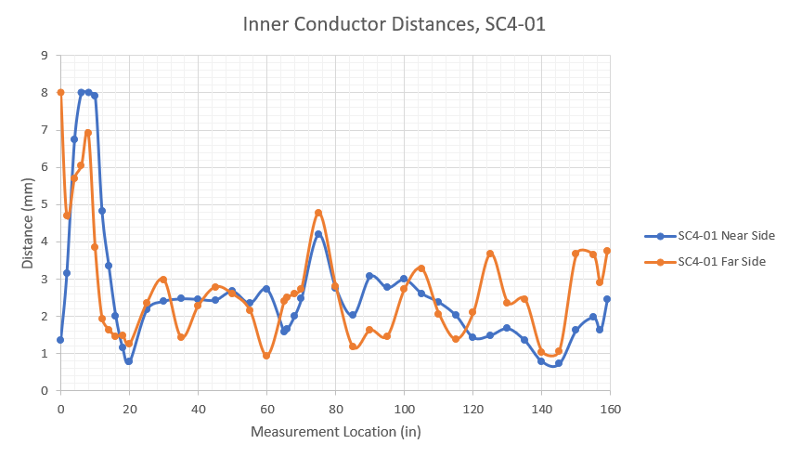
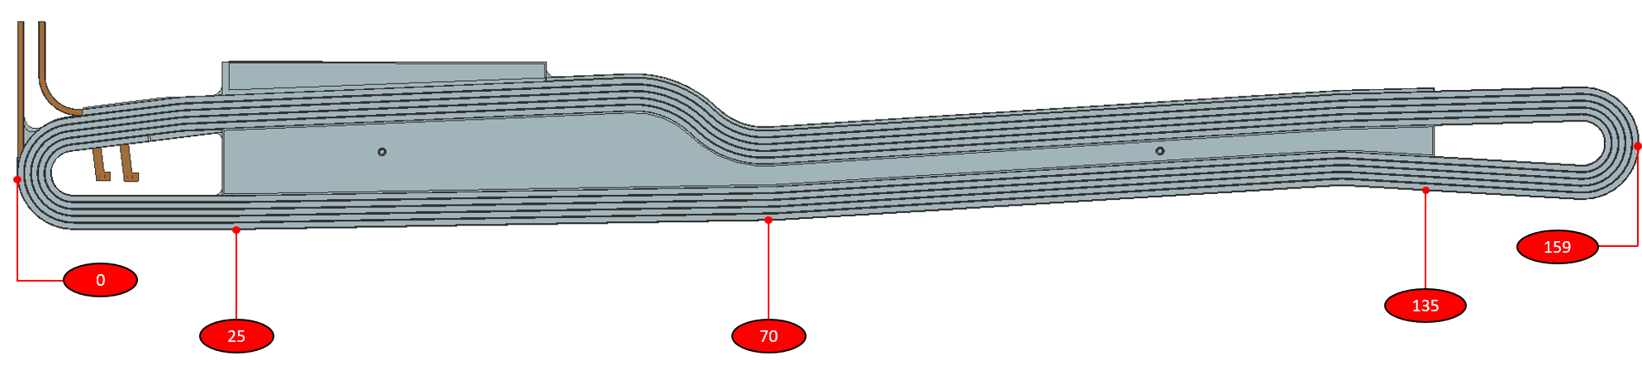
Conductor location Measurements in the Prototype Coils
0.6 mm – 2.4 mm insulation buildup
Inductive displacement sensor used to measure location of copper conductor relative to the outer epoxy surface in SC1 – SC4 prototypes.
Measurements taken on the coil ‘belly’.
0.8 mm – 4.8 mm insulation buildup
See ‘PMAG0000-0100-R0035 : MOLLER Spectrometer – Downstream Torus Magnet Prototype Coil Report on Fabrication and Testing’ for details

Slide 6
DS Enclosure : Design and Engineering Status
100% design and drawings complete, review ongoing
  57 total drawings
  21 Approved drawings
Ready for PR, in MAY 2023
High Level System Design Requirements
  10⁻² Torr Nominal vacuum
  Leak rate 10e-7 or better
  Minimize deflections of enclosure floor under TM 1-4 stand feet
  Limit vacuum motion to be within bellows range of motion
  Meet JLAB Pressure Systems - Vacuum Vessel requirements
QA Plan
  Use JLAB qualified vendors
  ASME/AWS qualified welders & WPS/PQR
  Leak test
  Full Survey to understand geometry with and without vacuum

Slide 7
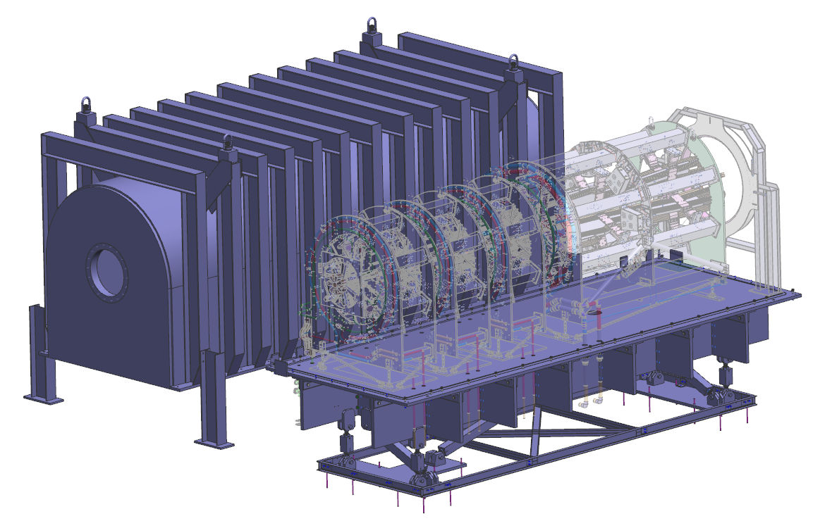
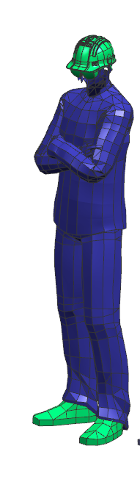
DS Enclosure : Overview
Top Hat Weldment Assy
A09005-15-03-7001
21,000 lbs
Base Plate Assy
A09005-15-03-7100
15,000 lbs
Beam Direction
Base Frame Assy
A09005-15-03-7200
7 Link Alignment & support system (2 inch Steel Rod ends )
2 – X links, 4 – Y links, 1 – Z link

Slide 8
DS Enclosure : Key Parameters
Material
  Top Hat : AL 6061 T6 weldment
  Base plate : Al 6061 T6 bolted structure
  Base Frame: Al6061 T6 welded and bolted structure with Steel rod ends and pins.
  14 sets of low carbon steel rod ends and pin exist underneath the enclosure near the Hall floor (up to 30” off the Hall floor). Each set is approx. 60 in³ volume.
  Silicon bronze and brass hardware
Physical Dimensions
  L 300 x B 140 x H 200 inches
Weight
  Enclosure 37,000 lbs
  Contents : 10,000 lbs
    Photon Scraper
    TM 1- 4
    Collimator 5, 6a, 6b
    Collar 1
Enclosure Vacuum motion limited to 1mm in the Z direction
Design alignment Range
  ±1” in X, Y, & Z

Slide 9
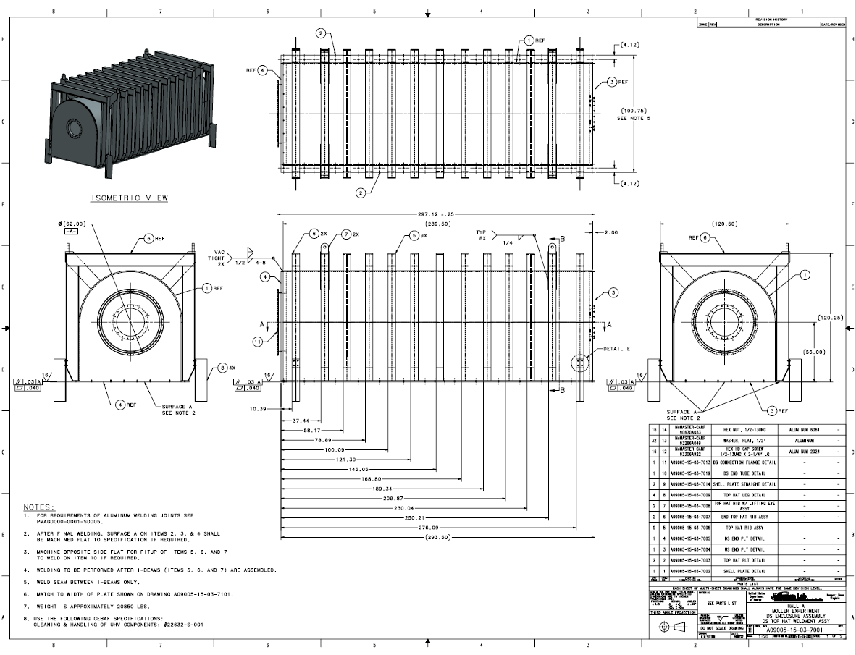
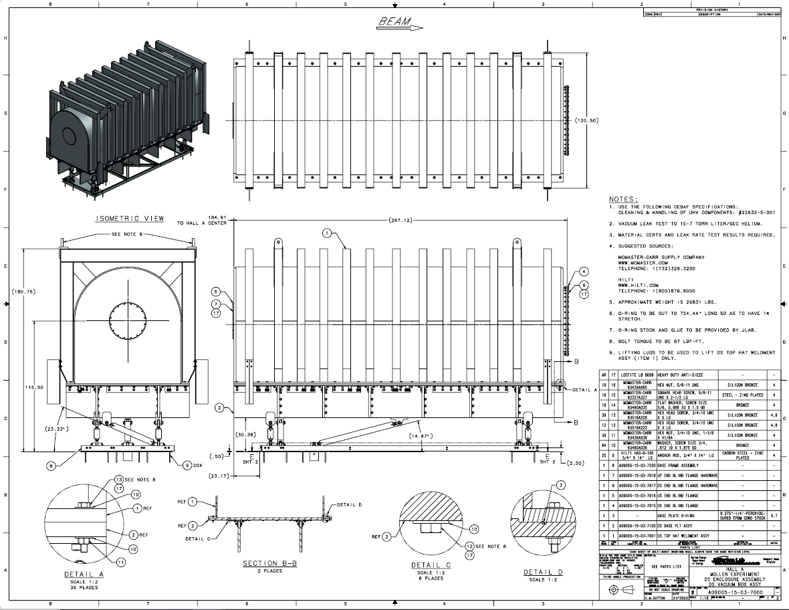
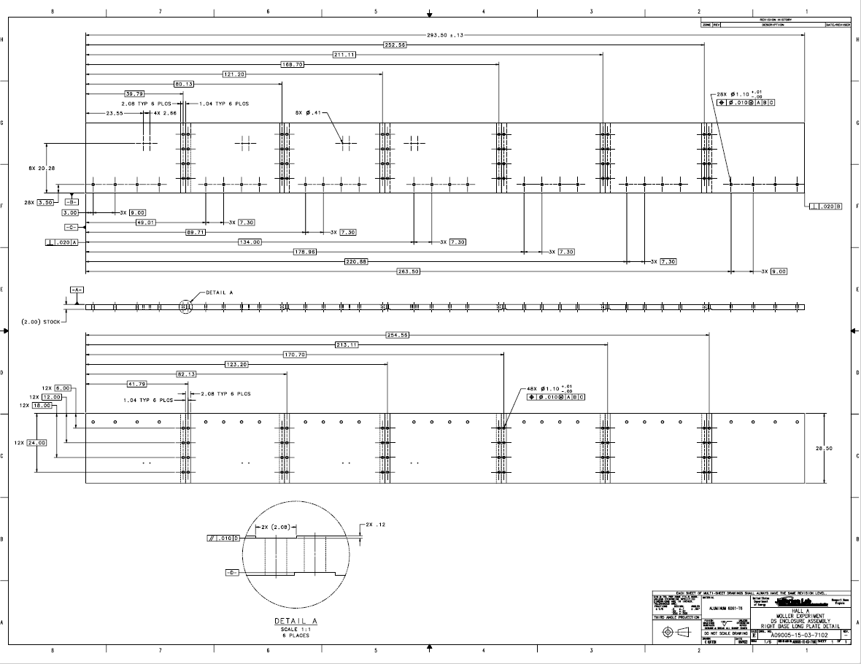
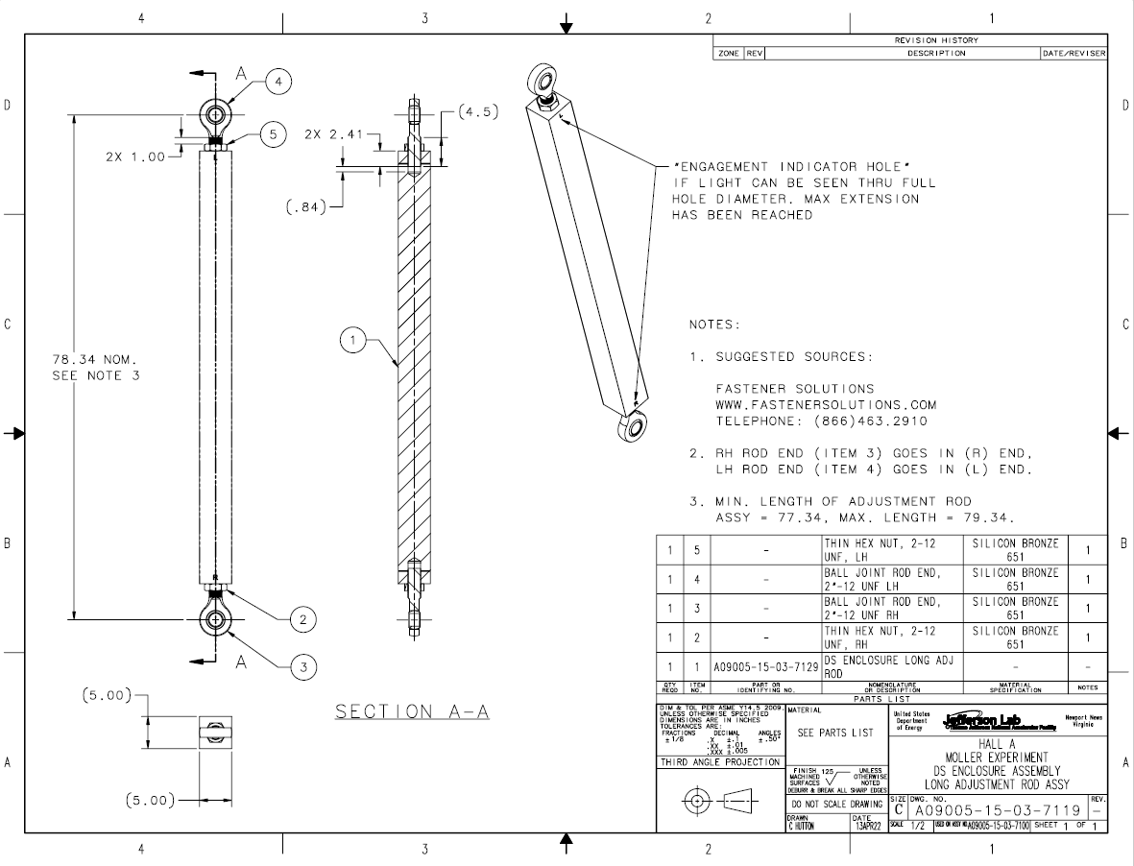
DS Enclosure : Drawing Samples
Top Hat Weldment Assy A09005-15-03-7000
Base Plate Assy A09005-15-03-7100
Long Adjustment Rod Assy A09005-15-03-7119
Right Base Long Plate Detail A09005-15-03-7102

Slide 10
Summary
An Inductive Displacement Sensor used to locate the conductor within the coil
  Measurements on prototype coils used to improve production coil fabrication method
  Future measurements will confirm coil belly plate location and performance
  Insulation thickness measurements in conjunction with coil physical survey data will give precise control over conductor placement relative to the beam
DS Enclosure Design, Analysis and Drawings complete
  21 out of 57 drawings approved, rest being reviewed
  SOW being reviewed
  PR to be submitted MAY 2023

Slide 11
BACKUP

Slide 12
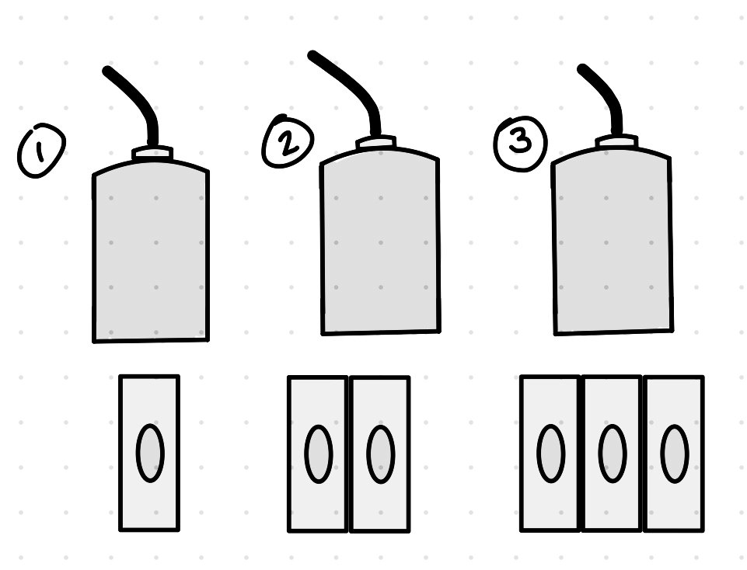
Sensor Performance Characterization
Table 8 Measured Conductors Against Each Other (V)
 |  | 01 (V) |  |  | 02 (V) |  |  |  | 03 (V) |  |  | 04 (V)
d (mm) | Step1 | Step2 | Step3 | Step1 | Step 2 | Step3 | Step1 |  | Step2 | Step 3 | Step 1 | Step 2 | Step3
0 | 0.35 | - | - | 0.15 | - | - | 0.01 |  | - | - | 0.005 | - | -
1.016 | 1.65 | 1.5 | 1.38 | 1.46 | 1.36 | 1.31 | 1.32 |  | 1.27 | 1.24 | 1.19 | 1.19 | -
2.032 | 3.03 | 2.86 | 2.6 | 2.83 | 2.67 | 2.56 | 2.65 |  | 2.57 | 2.54 | 2.49 | 2.497 | -
3.048 | 4.5 | 4.12 | 3.95 | 4.3 | 4.2 | 3.9 | 4.04 |  | 3.91 | 3.98 | 3.82 | 3.816 | -

