Slide 1
MOLLER Collaboration Meeting
Beamlines and Bellows
Eric Sun
On behalf of MOLLER Team
May 5-6, 2023

Slide 2
Outline
Overview
Status Summary
Beam Pipes and Supports
  Drift Pipe
  Detector Pipe and Support
Windows
  Prototype Window and Detector Window
Bellows
  Bellows 1, 2, 3, 4, 5, and 7
Conclusion

Slide 3
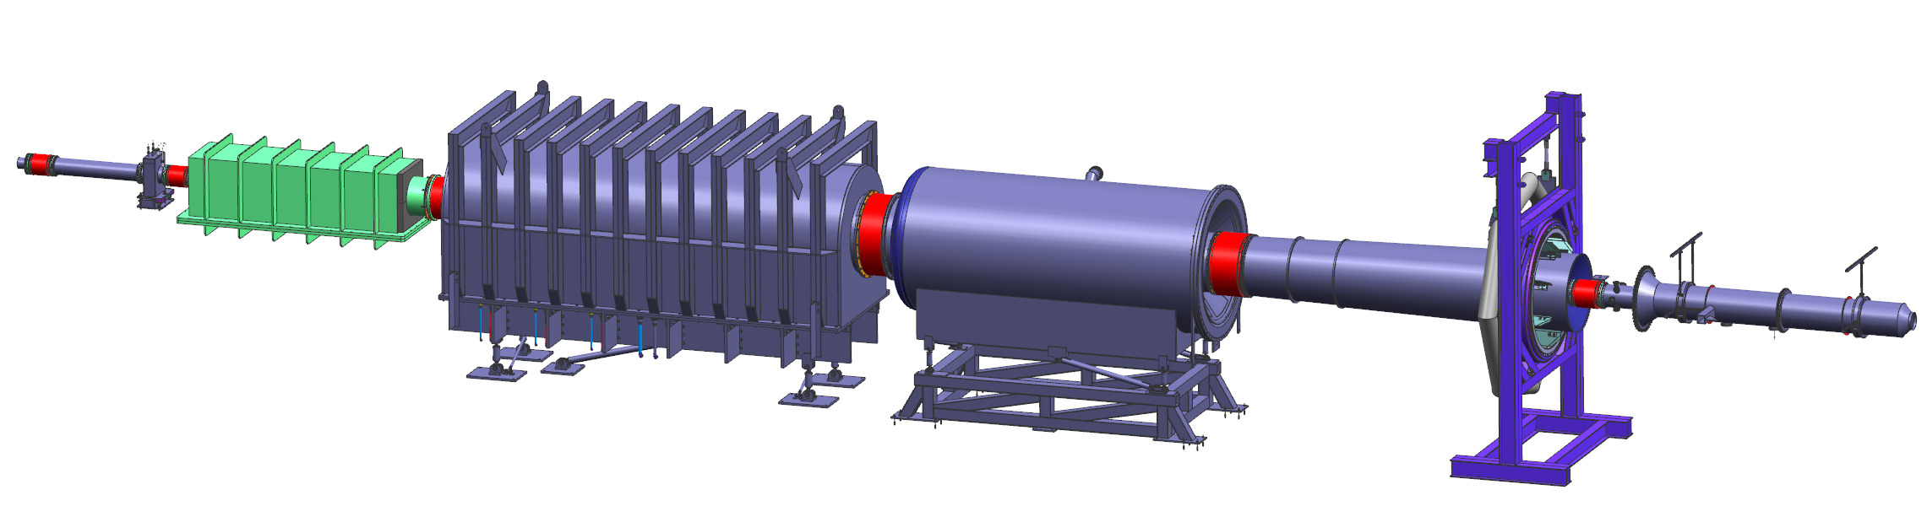
Overview
Collar 0
US enclosure
DS enclosure
Drift pipe
Detector pipe
SAM pipe
OD = 96.5’’
OD = 54.76’’
OD = 100’’
Support of dump entry pipe
12’’ beam pipe
Detector window
Neckdown window
12’’ bellows 1
12’’ bellows 2
26’’ bellows 3
54’’ bellows 4
41’’ bellows 5
16’’ bellows 7

Slide 4
Status Summary
Component | CD-3a | Drawings | RFI | SOW | Note
Drift Pipe | Yes | Approved | Yes | 75% done
Detector Pipe | Yes | Approved | Yes | 75% done
Neckdown Window | Yes | Approved | Yes | 75% done
Bellows 1-5 | Yes | Approved | Yes | 90% done
Bellows 7 | Yes | Approved | Yes | NA | Received, tested, accepted
Detector Pipe and pion donut Support | Yes | Draft drawings complete | Yes
Prototype Window | No | Approved | Complete | NA | Pressure-tested
Support of Beam Dump Entry Pipe | No | Approved | No
SAM Pipe | No | Reviewed and updated | No
Beam Pipe from Target to Collar 0 | No | Reviewed and updated | No
Detector Window | No | Ready for signatures | No
Shutter of Detector Window | No | Reviewed and updated | No

Slide 5
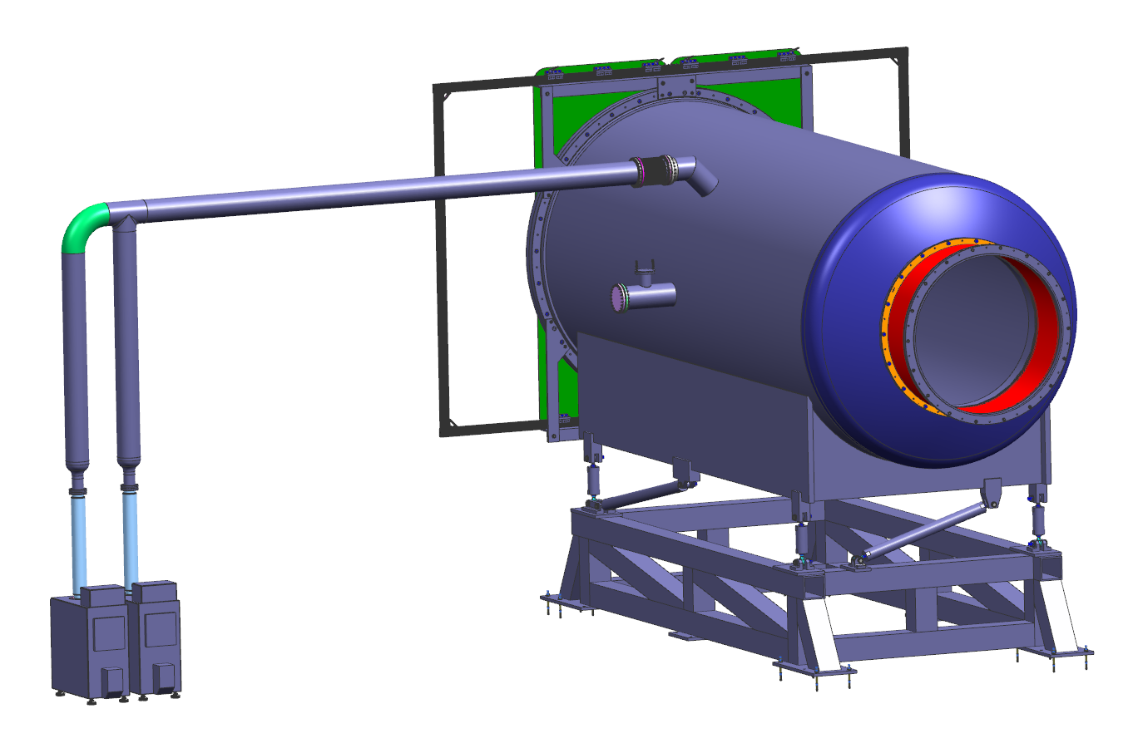
Drift Pipe
Drift pipe was designed per ASME Section VIII Division 1.
Division 2 was used to cross-check the results.
Thickness = 7/8’’
  P_{max_allow._ext (Div 1)} = 26.8 psi > 14.7 psi
  P_{max_allow._ext (Div 2)} = 29.5 psi
There are 4 vertical (Y) links, 2 X links and one Z link to support the drift pipe.
Under gravity and vacuum, motions are
  X of US, DS flange = 0.02 mm, 0.1 mm
  Y of US, DS flange = 0.09 mm, 0.6 mm
  Z of US, DS flange = 0.7 mm, 0.9 mm
Status
  All drawings (except drawings of bottom support) were approved.
Atmospheric pressure = 14.7 psi
Al 6061-T6
8’’ vacuum line
Shutter Frame
7/8’’ thick
OD = 100’’
Parallel plate
Drift pipe
Pump
Bellows 4
Drift pipe support
Y
X
Beam direction
Z

Slide 6
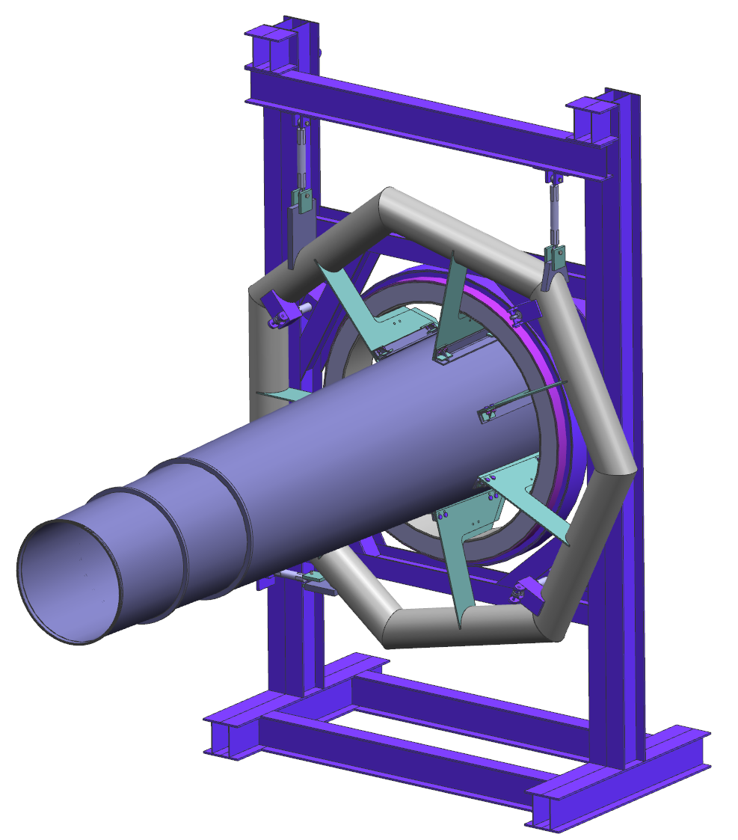
Detector Pipe and Pion Donut Support Assembly
Wall mount supports
Detector Pipe
Designed per ASME Section VIII Division 1. Division 2 was used to cross-check the result.
  P_{max_allow._ext (Div 1)} (0.75’’) = 53.7 psi >> 14.7 psi
  P_{max_allow._ext (Div 1)} (0.25’’) = 30.9 psi >> 14.7 psi
All drawings were approved.
Detector Pipe Support
Radial deflection at US end of detector pipe < 3 mm when vacuum is applied;
Draft drawings of the Pion Donut canning, the Frame, the Tube Assy, Fins, and Supports are complete;
All draft drawings will be reviewed as a package next week.
Vertical support
Vertical support
Tube assy
Axial support
Stiffening ring
Fins
Detector pipe
Pion donut
Thickness = 0.25’’
Thickness = 0.75’’

Slide 7
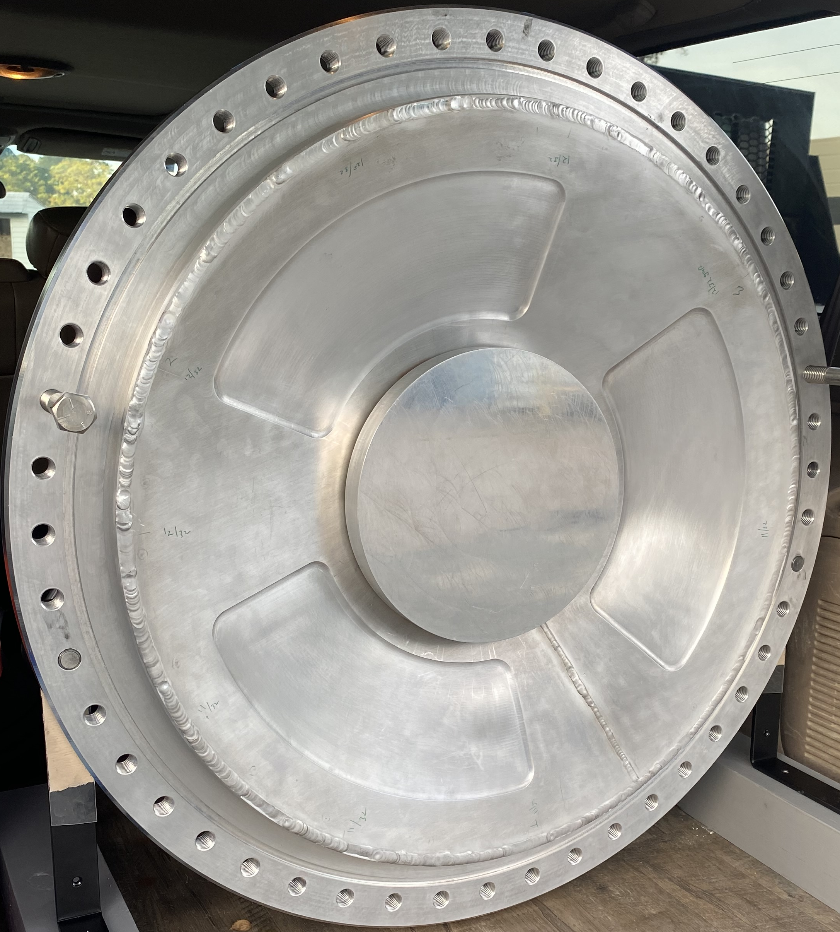
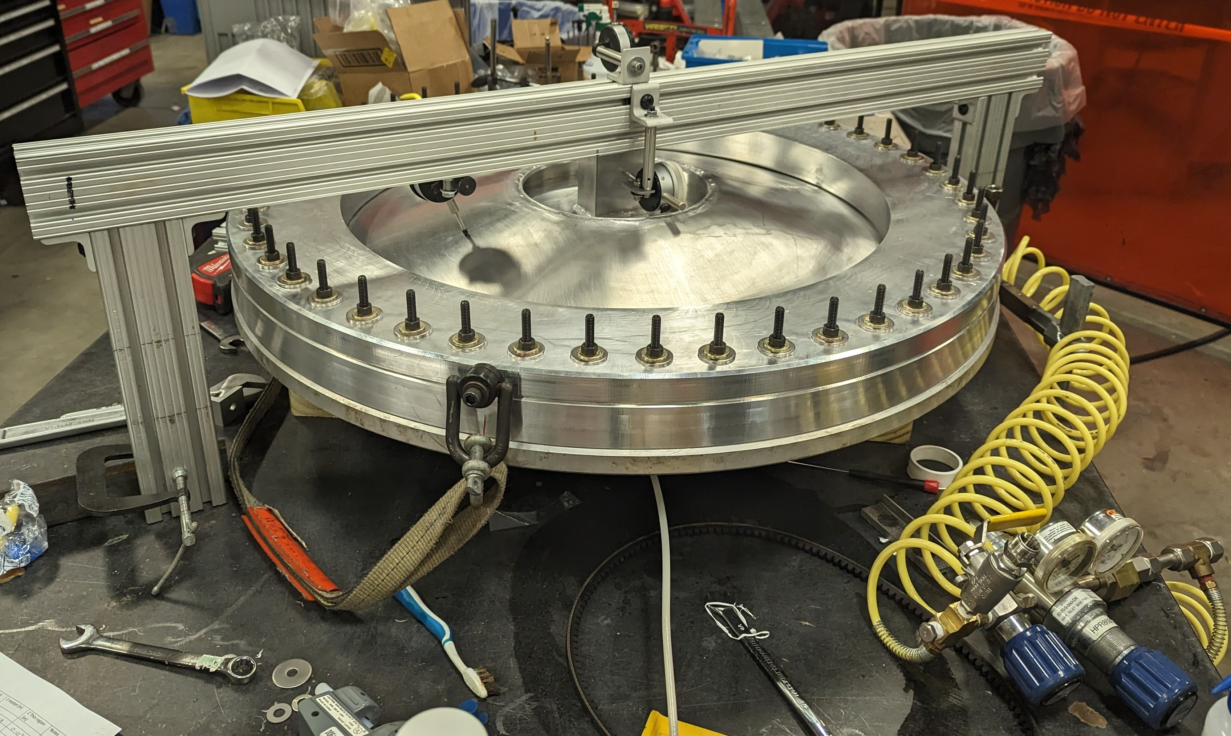
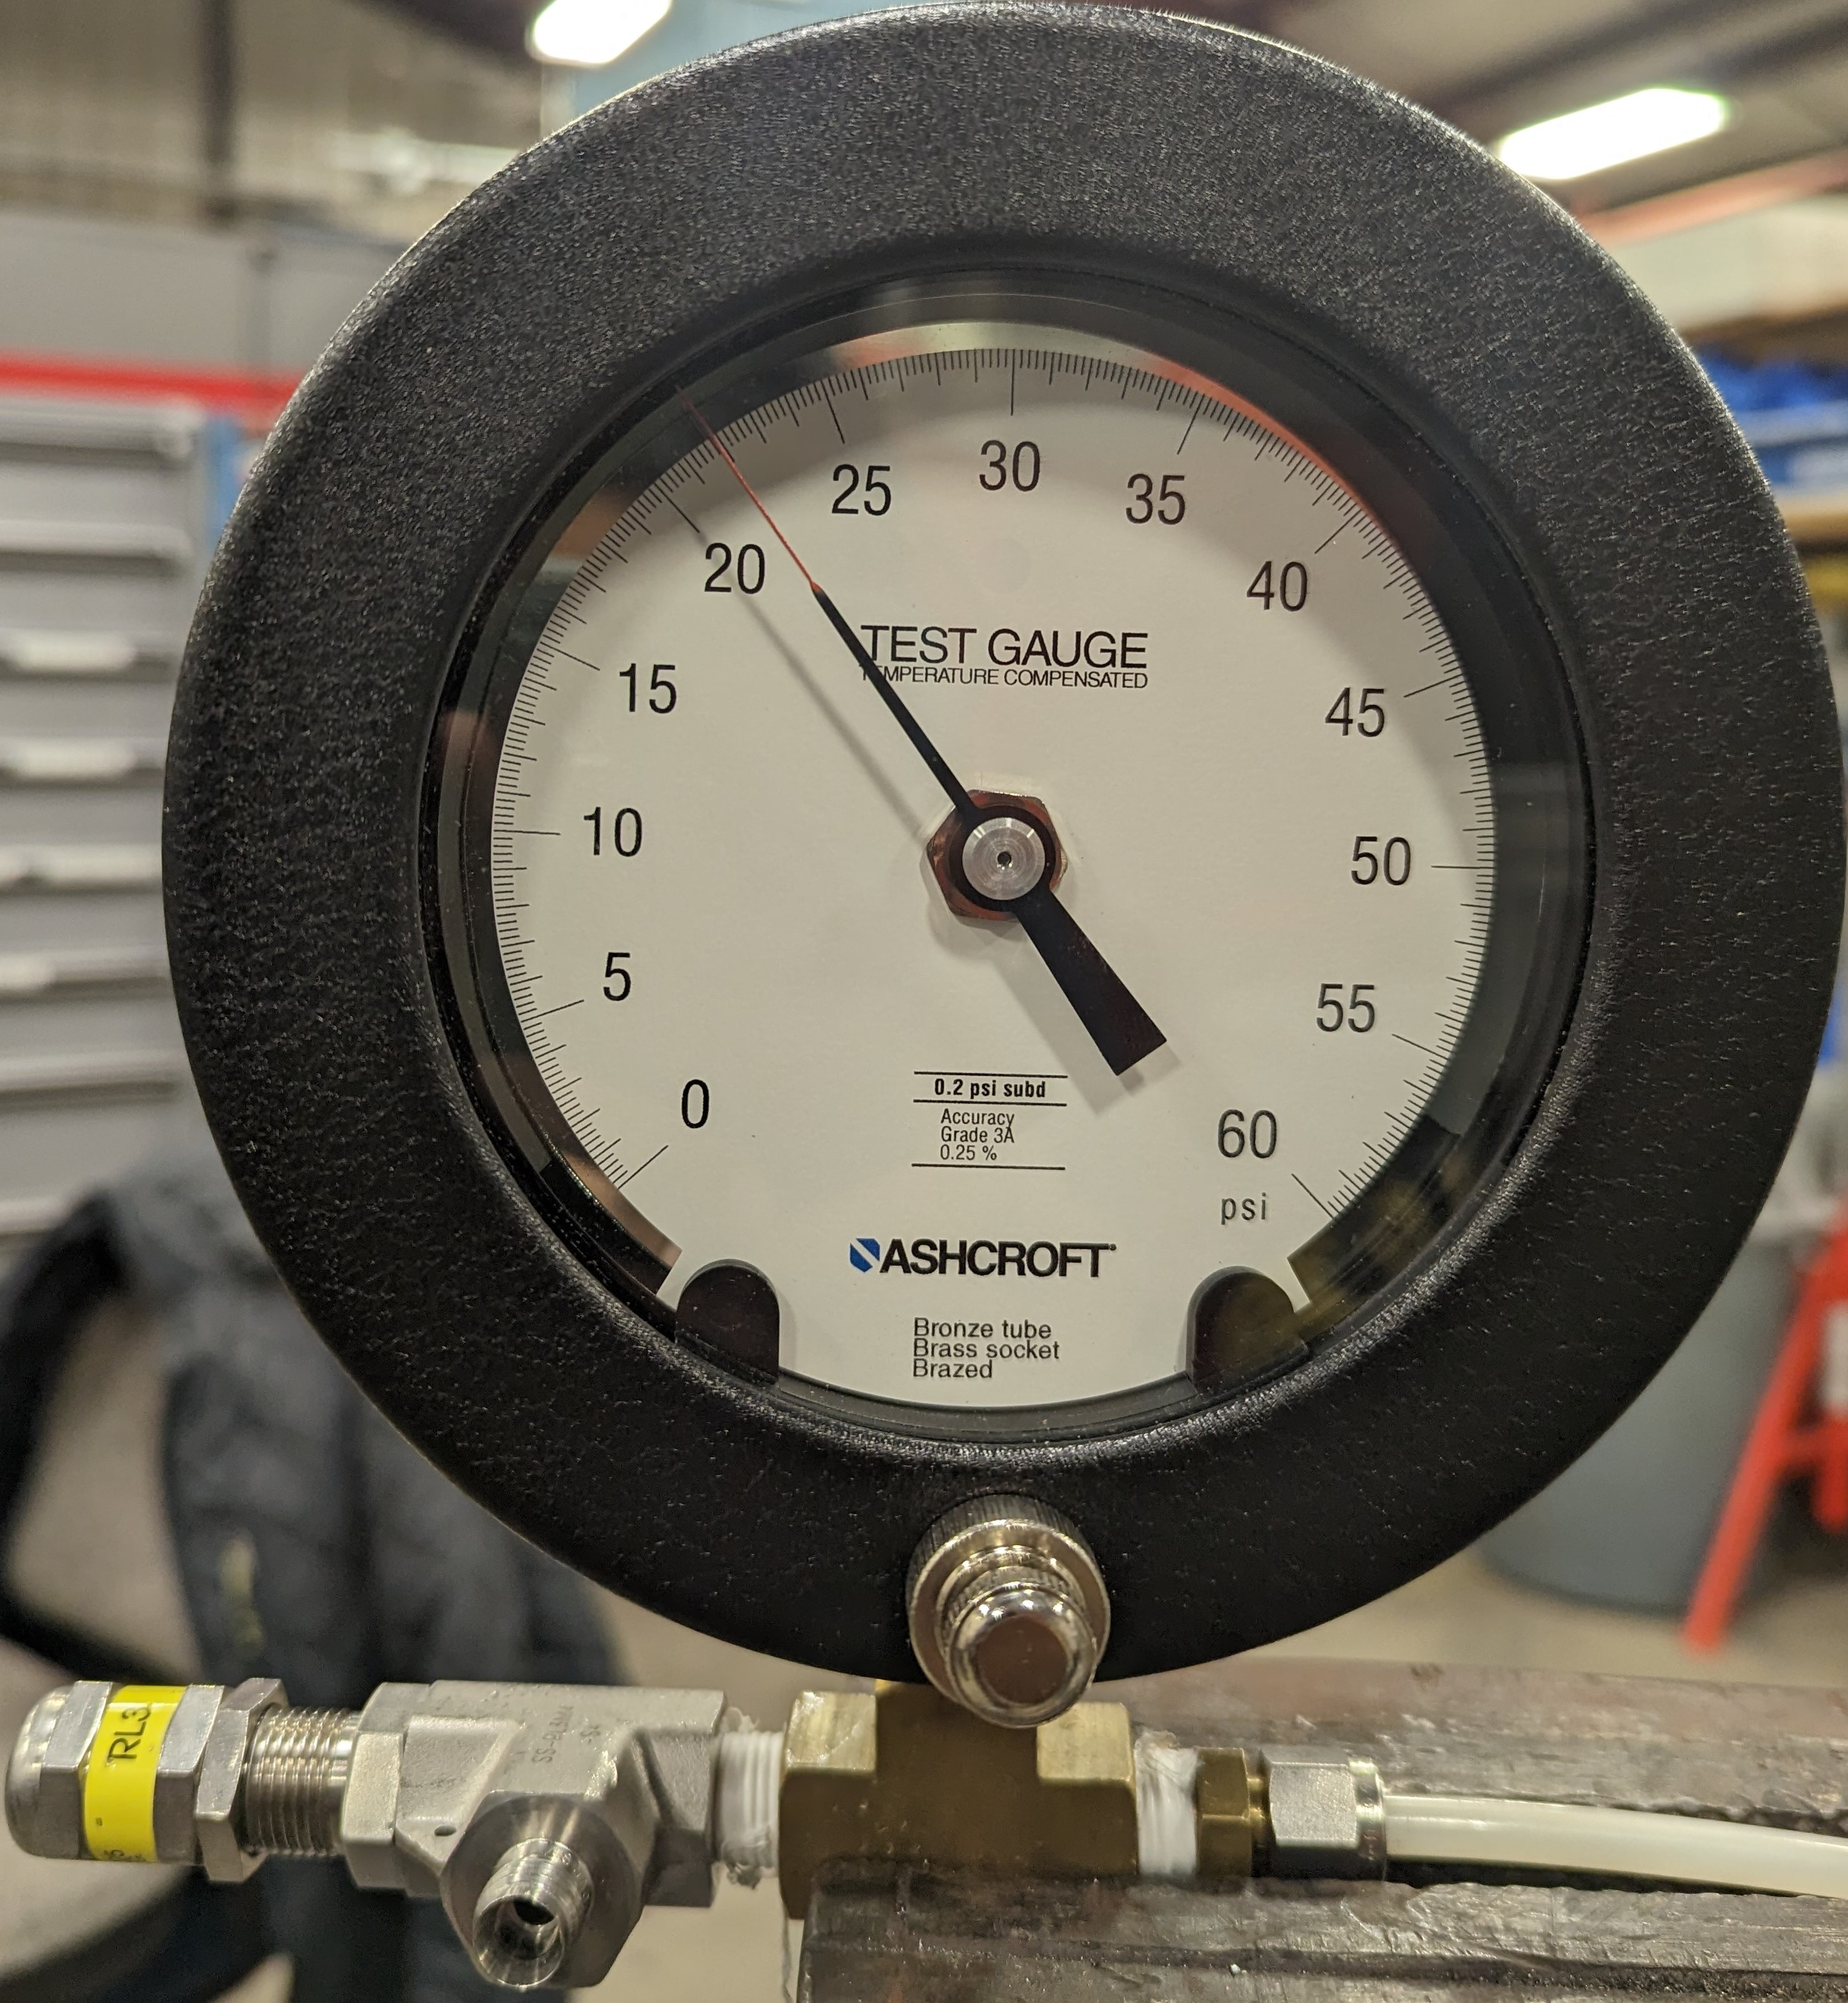
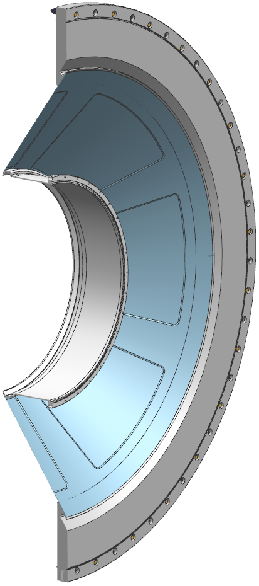
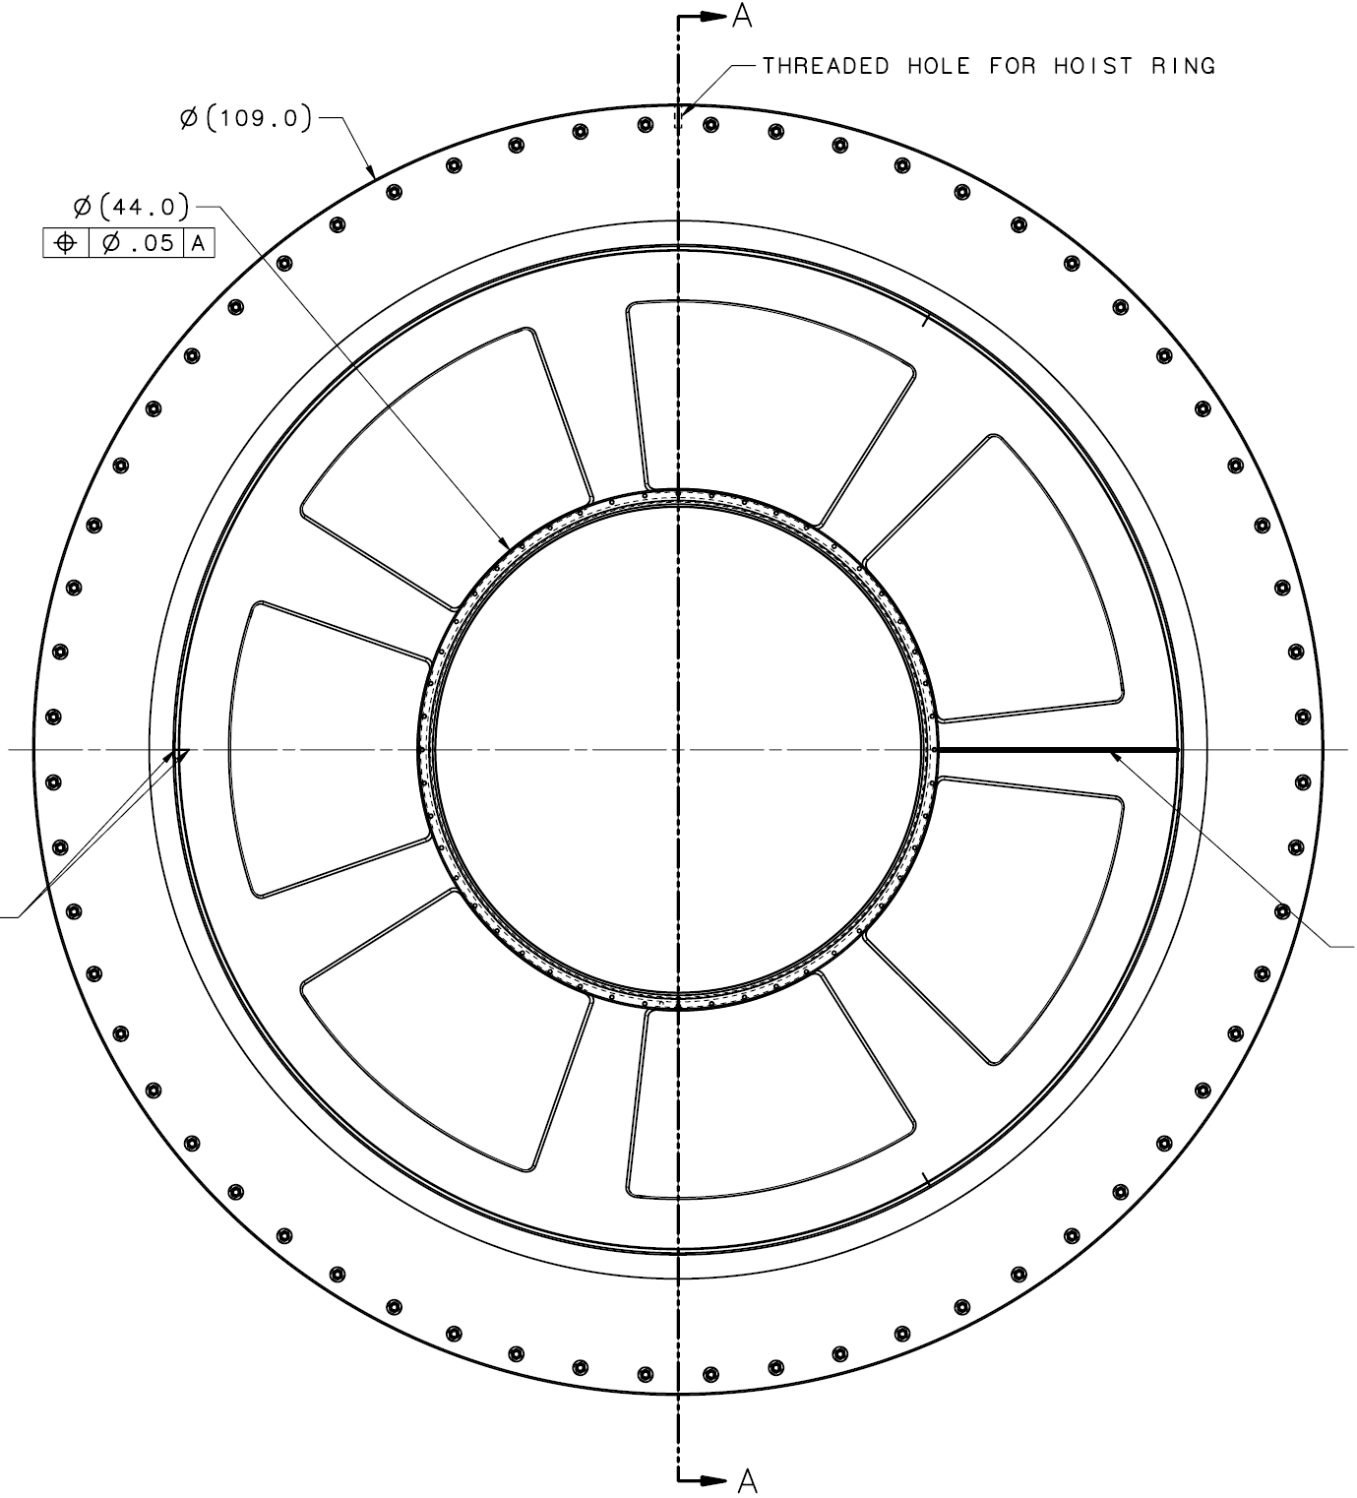
Prototype Window and Detector Window
Welded Prototype
Test Assembly of Prototype Window
Gauge at 22 psi
Detector window
Prototype Window
  Same material (Al 5083-H116) as Detector Window, same thickness in thinned regions to test machining;
  Pressure tested on 12-20-2022; test pressure = 0-5-0 psi (fixed a leak on a threaded fitting); 0-5-10-15-0 psi; 0-22-27.8-0 psi;
  Max z motion = 0.056 in (22 psi), 0.069 in (27.8 psi), 0.002 in (0 psi);
  No plastic deformation up to 27.8 psi;
  Plan to test to higher pressure in 2023.
Detector Window
  Drawings are reviewed and ready for signature
MOLLER Collaboration Meeting

Slide 8
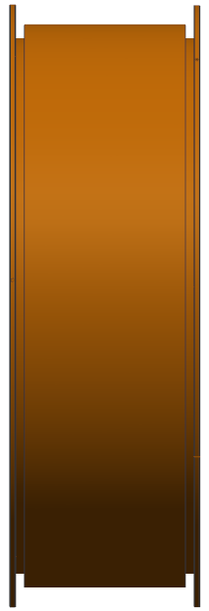
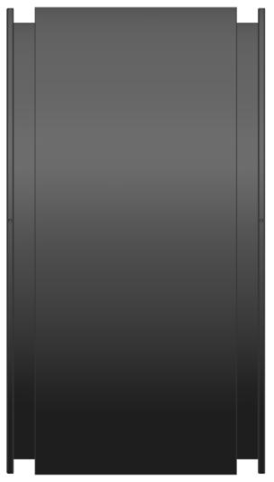
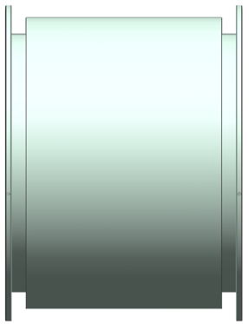
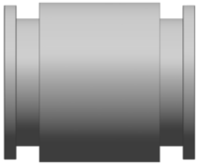
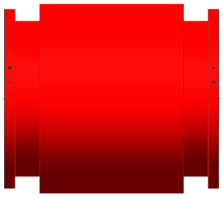
Bellows
12’’ SS Bellows 1
12’’ SS Bellows 2
26’’ SS Bellows 3
18’’ Inconel 625 Bellows 7
54’’ SS Bellows 4
41’’ Inconel 625 Bellows 5
Bellows | Material | Seal Type | Flange Thick (in) | Free Length (in) | Axial Spring Rate | Lateral Spring Rate | Angular Spring Rate | Axial Range (in) | Lateral offset (in) | Angular offset (°) | Required Cycles*
1&2 | SS 316L | CF - Al | 1.125 | 18 | 1250 | 5000 | 600 | ±1.5 | 0.5 | 3 | 20
3 | SS 316L | O-ring | 0.6 | 24 | 1000 | 5000 | 2000 | ±2.5 | 0.5 | 3 | 20
4 | SS 316L | O-ring | 0.6 | 15.75 | 1200 | 25000 | 8000 | ±1.25 | 0.3 | 3 | 20
5 | Inconel | O-ring | 0.6 | 24.5 | 800 | 4000 | 2500 | ±1.25 | 0.5 | 3 | 20
7 | Inconel | CF - Al | 1.12 | 20.56 (22.0) | 600 | 1000 | 250 | ±0.75 | 0.5 | 3 | 20
O-ring material is peroxide-cured EPDM; Al gasket is Al 1100-O.
Unit for axial spring rate and lateral spring rate is lbf/in; unit for angular spring rate: lbf-in/deg.
E310/ER310 welding rods will be used to weld bellows 1-4.
Status: All drawings were approved.
Bellows 7 procured and tested – ready to install!
* At max deflections (only needed during some installations).

Slide 9
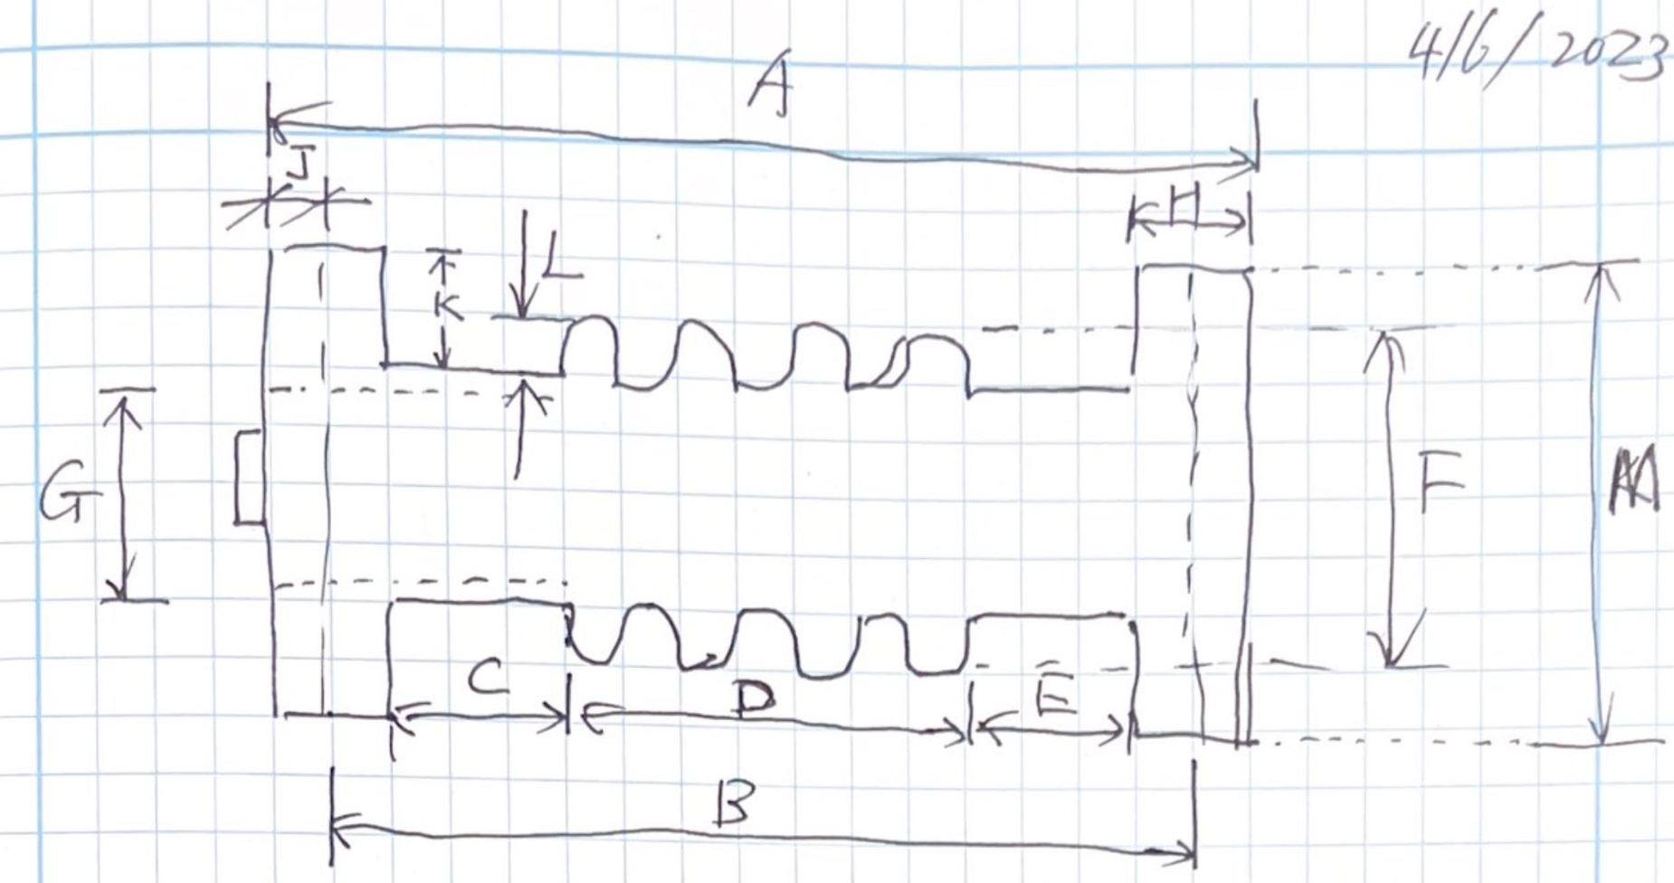
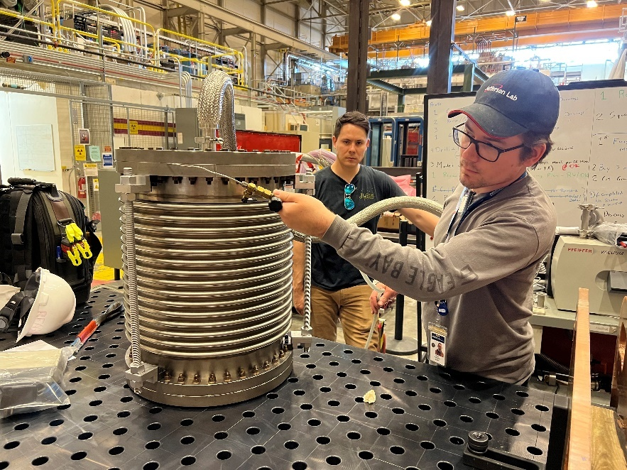
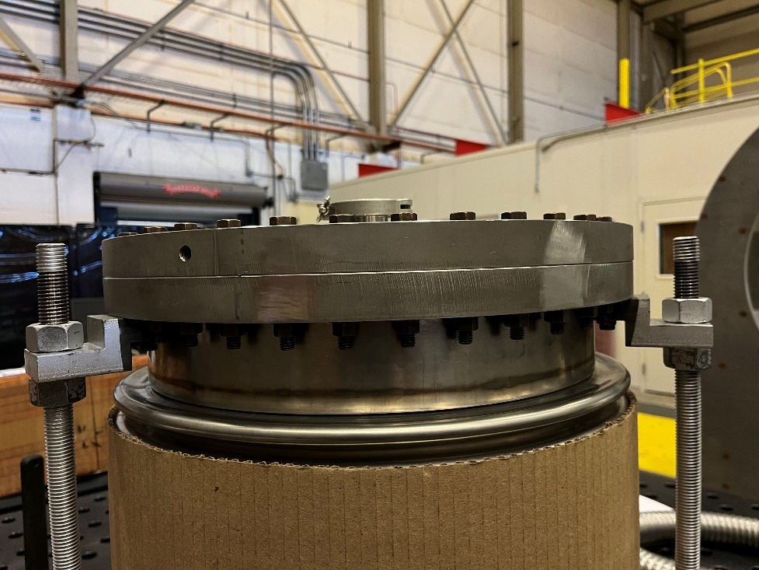
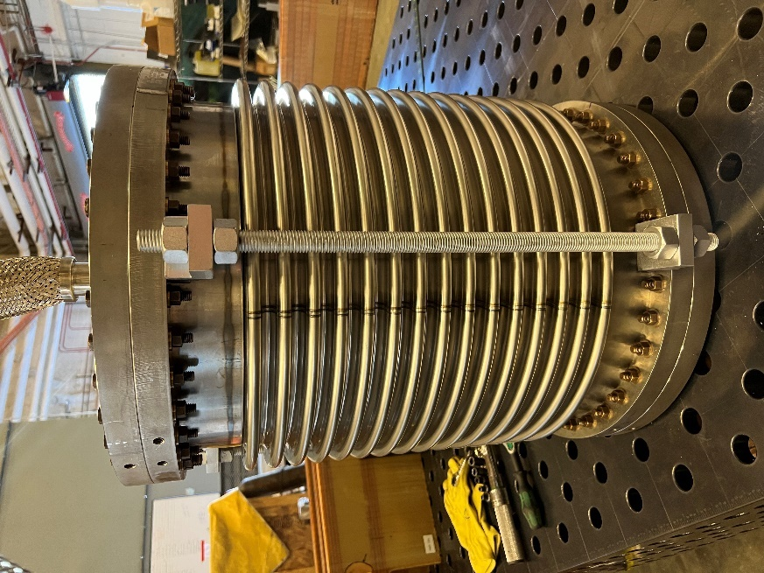
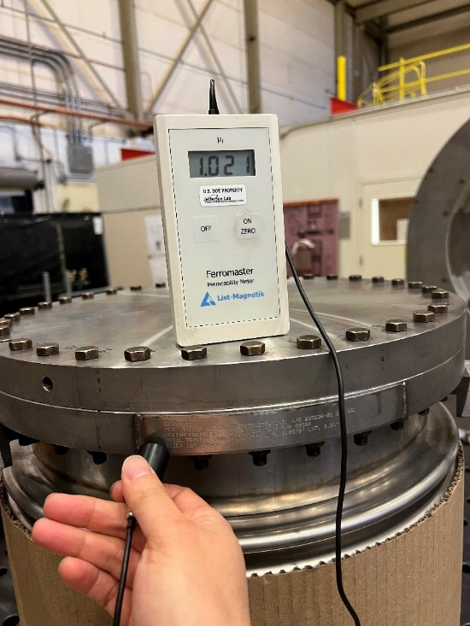
Acceptance Tests of Bellows 7
Welding quality is excellent.
Leak test confirms that Bellows 7 meets JLab’s specification.
Dimensional inspection indicates free length of Bellows 7 is 20.56’’ (B), short by 1.44’’. SAM pipe was extended 1.44’’.
Permeability measurements found that company name plate was not Inconel 625. Removed.
Measured axial spring rate = 516 lbf/in.

Slide 10
Conclusions
All drawings (except drawings of pion donut support assembly) of CD-3a items were approved.
Prototype window was successfully tested up to 27.8 psi (> 125% of 22 psi) without plastic deformation.
Use of stainless steel 316L or 316LN for Bellows 1-4 will reduce cost and lower the risk.
Prototype Bellows 7 are received, tested and accepted.
Request of length change of SAM pipe was presented to Technical Review Board and approved by TRB. NX model and relevant drawings were updated.
CD-3a beampipes and bellows are in procurement stage

Slide 11
Backup

Slide 12
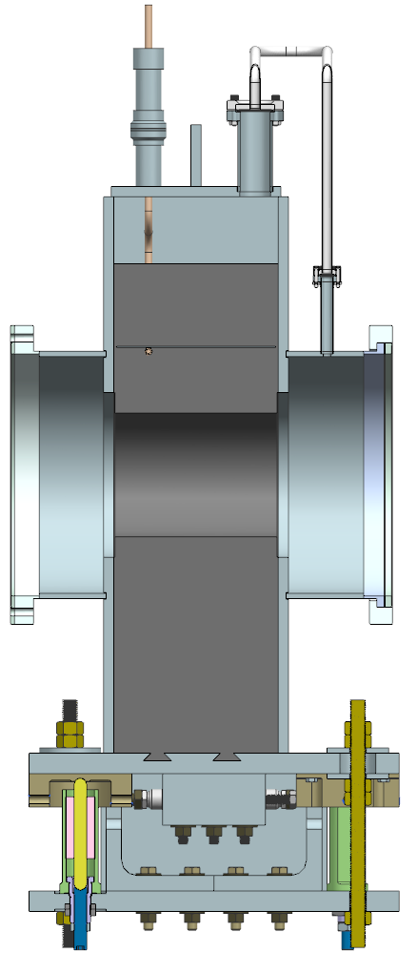
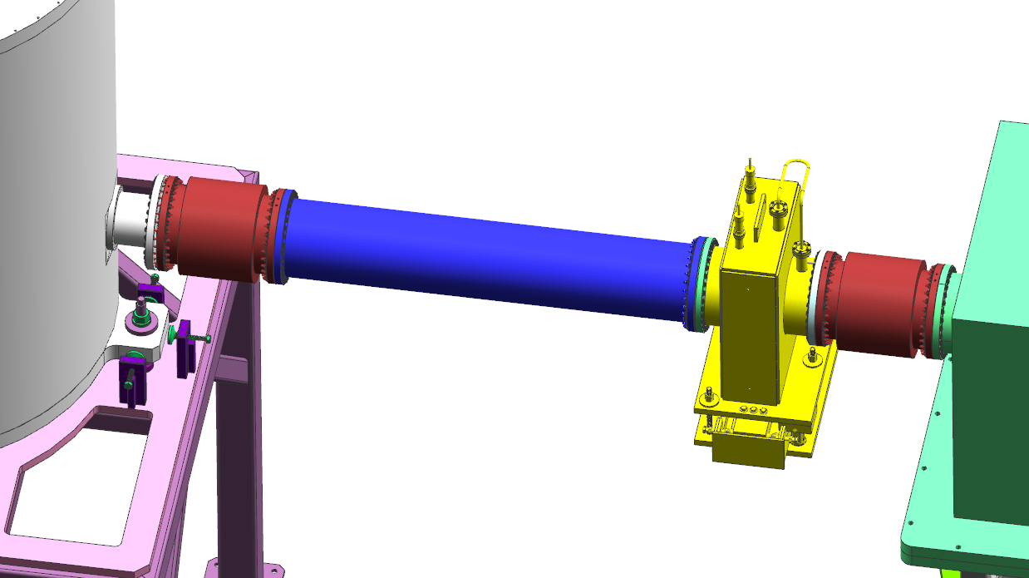
Beam Pipe from Target to Collar 0
12’’ Bellows 1
12’’ Bellows 2
Cooling Tube Exit Jacket (2X)
12’’ OD × 0.25’’ wall aluminum tube
Vacuum Equalization System
Cu Cooling Tube
Precision-Machined Bore
Lead Containment Vessel
0.55’’ gap - target flange to bellows 1
Beam Direction
Target
Collar 0
US enclosure
Collar 0
Lead Casting
Bellows 1 and 2 are identical.
Collar 0’s lead is cast into the containment vessel.
Bore in Collar 0 is precisely machined to be perpendicular and concentric with the upstream flange of the assembly.
Status: drawings were reviewed and updated.
Adjustment and Support System
Cross sectional View

Slide 13
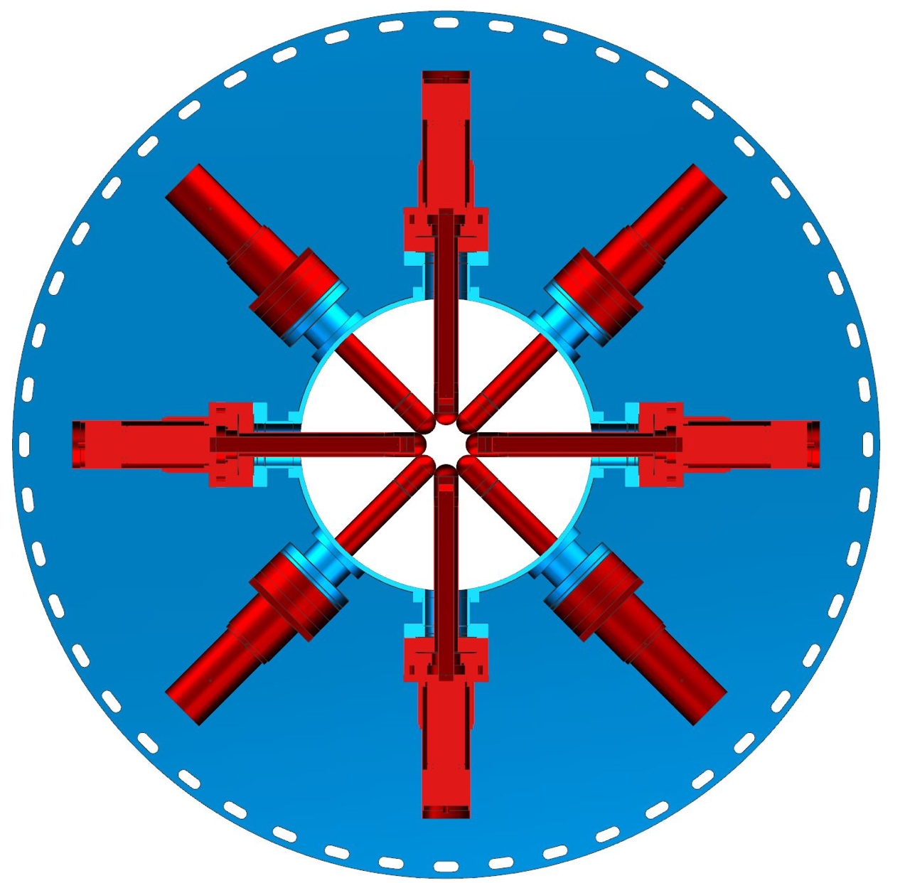
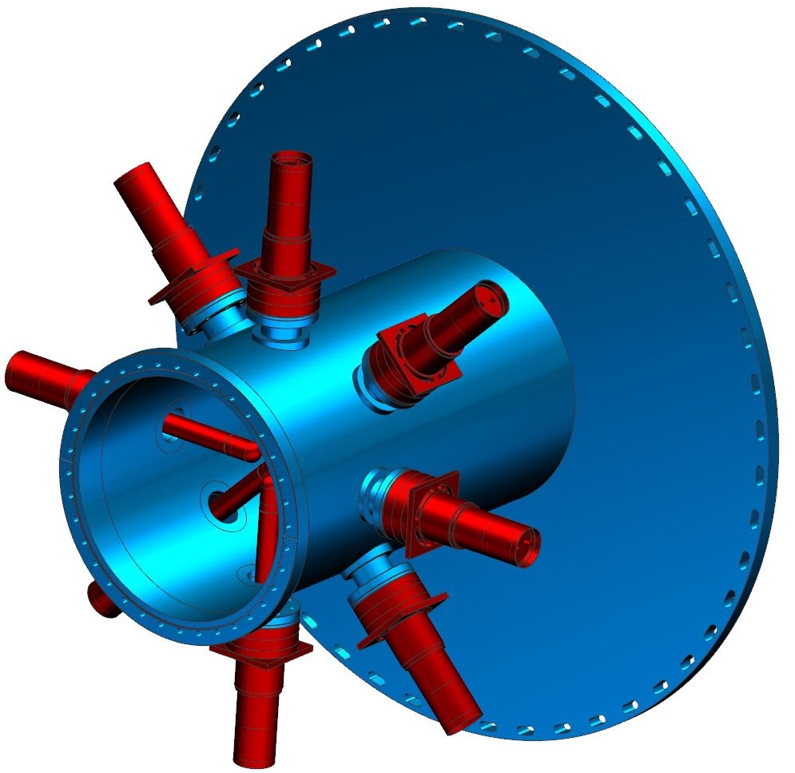
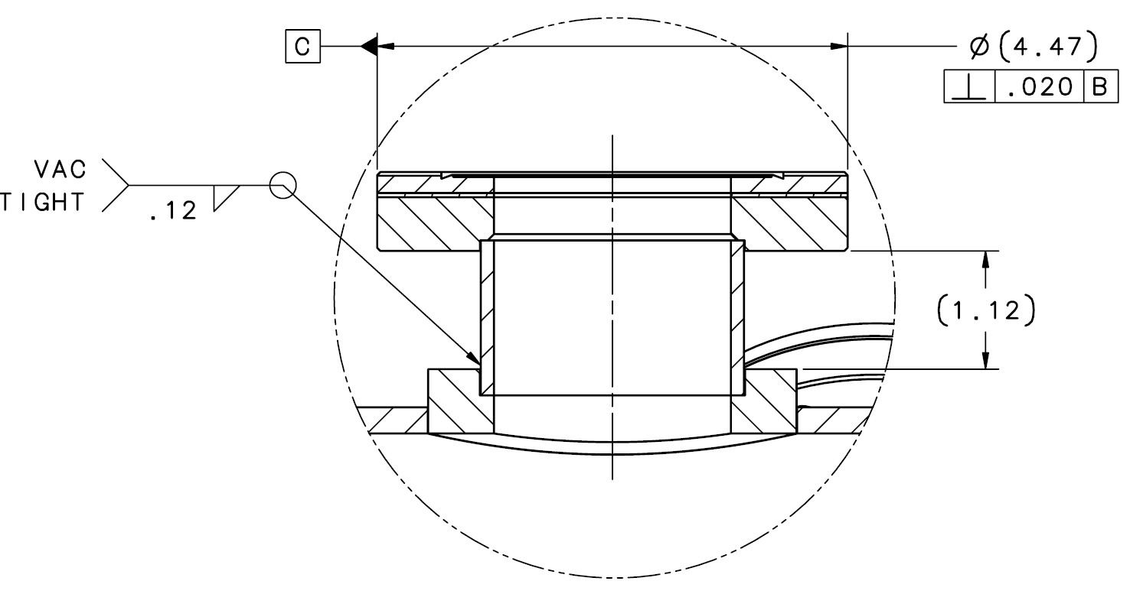
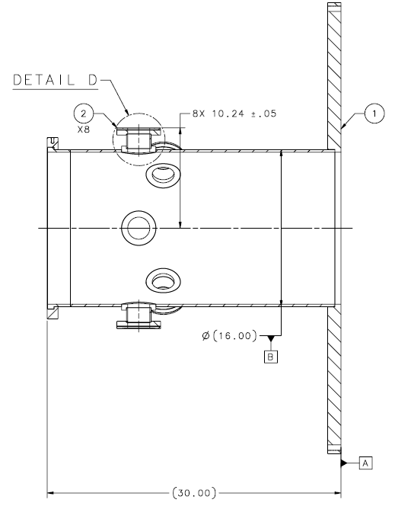
SAM Pipe
Thickness = 1.25’’
OD = 16’’
Thick = 0.25’’
16’’ pipe
Round support bar
Atlas 4.5’’ Ti-Al CF flange
Slots for rotational adjustment
2.5’’ OD Tube
P_{allowable (Div 2)}
= 168 psi >> 14.7 psi
SAM pipe is to precisely mount the SAM detectors.
  Roughly machine round support bars;
  Weld round support bars to the 16’’ pipe;
  After welding, machine round support bars according tolerances;
  Weld 2.5’’ tubes to round support bars;
  Weld 4.5’’ bi-metal flange to tubes.
Status
  Final drawings reviewed and updated.
Min code required thickness = 1.16’’
SAM detector
Drawing:
A09005-15-06-2000

Slide 14
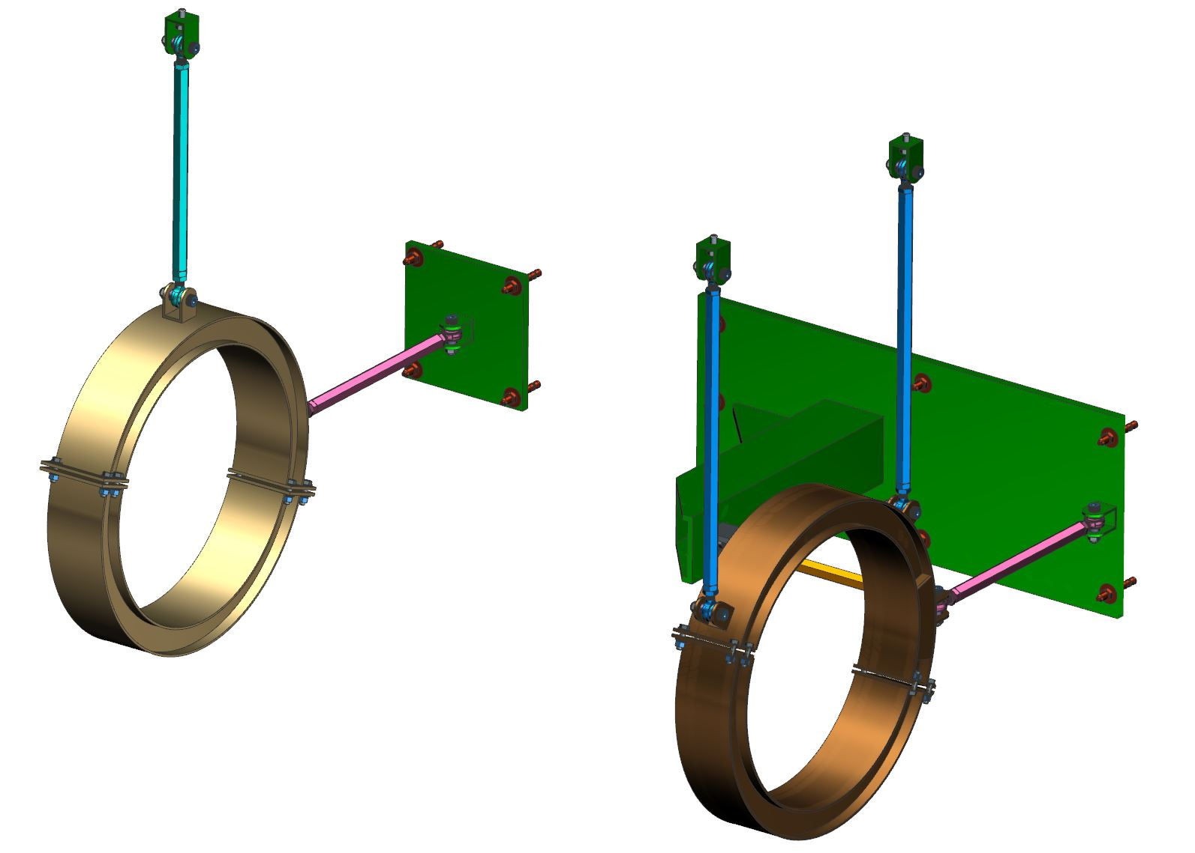
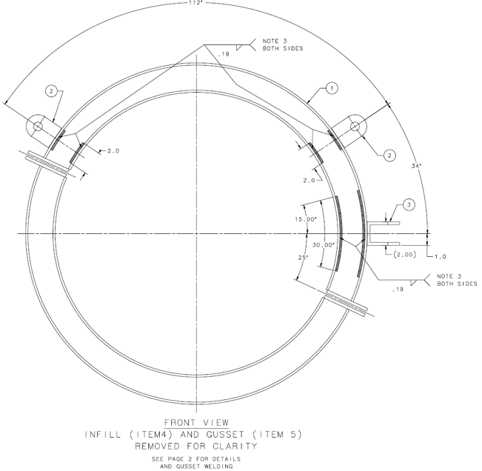
Support of Beam Dump Entry Pipe (OD = 24’’, thickness = 3/16’’)
Mount to existing ceiling unistruct
Beam dump entry pipe is floating and needs restraint in Z to resist vacuum load from Bellows 7.
There is a 3536 lbf (F_{z}) vacuum force pointing upstream.
One Z link, two X links and three Y links are used to support the pipe.
Links are made of aluminum HEX BAR.
F_{x1} = 428 lbf (compressive), critical buckling load of x link = 63,000 lbf.
F_{x2} = 428 lbf (tensile).
Total weight = 716 lbf.
Status
  Final drawings are approved.
Y link
Anchor to wall
0.75’’ thick
3/16’’ thick
X link
F_{x1}
F_{vacuum}= 3536 lbf
Y
Z link
X
Drawing:
A09005-15-09-1009
Z
F_{x2}

