Slide 1
Compton Polarimeter
Diamond Detectors
Jim Fast

Slide 2
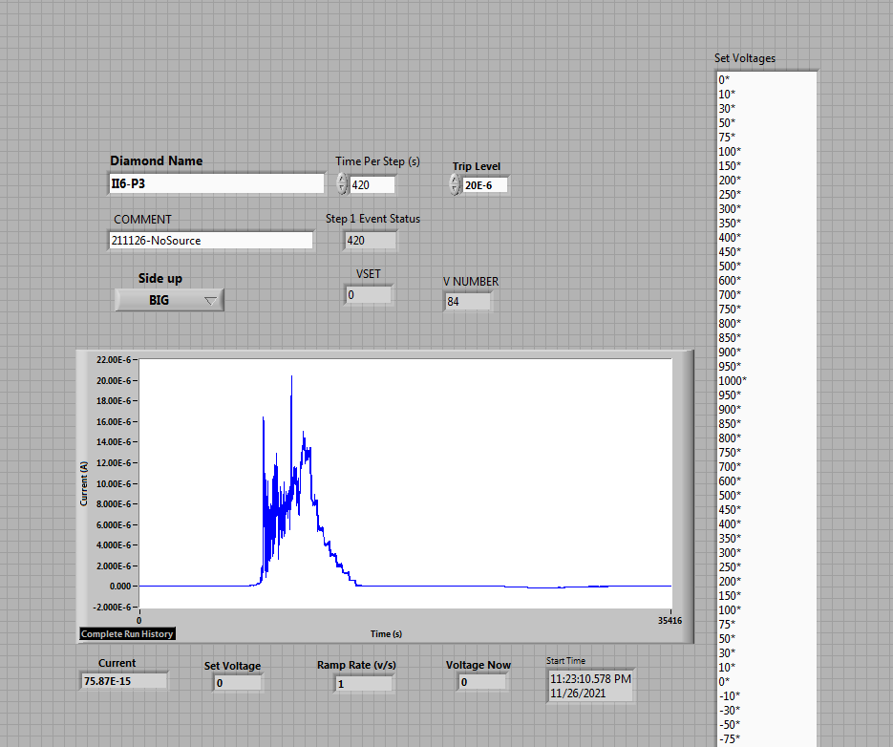
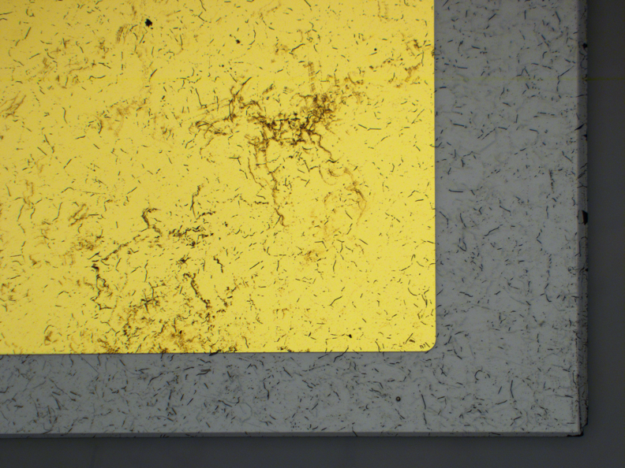
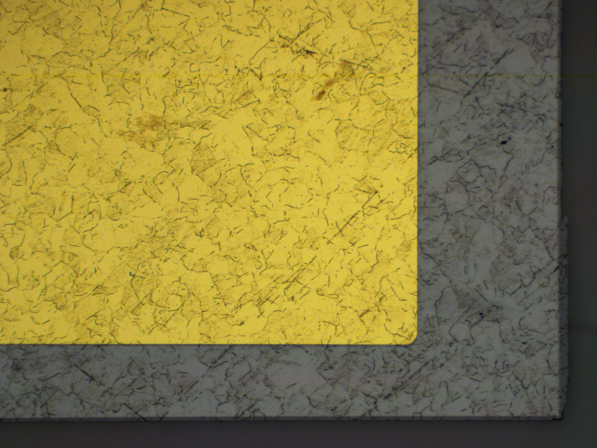
Status of Diamond Substrates/Sensors
Started working on this in May 2020
  Initial discussions with both ASU/Phynix, SenseICs/OSU and Nalu Scientific
  Exploration of many readout solutions (Nalu, IDEAS products, CALYPSO, SALT, SAMPA)
    SenseIC-designed CALYPSO board an JLab-designed SAMPA/SALT boards pursed
Only viable diamond substrate vendor identified as II-VI Semiconductor
  Initiated prototype substrate procurement in February 2021 (production order placed July 2022)
  November 2021 first substrates delivered to OSU for evaluation as “detector grade”
OSU identified material sent for JLab parts as originating from “old” substrates which had previously been known to be bad material by ATLAS – parts returned.

Slide 3
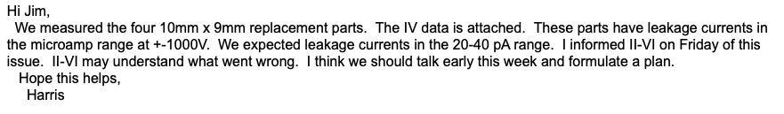
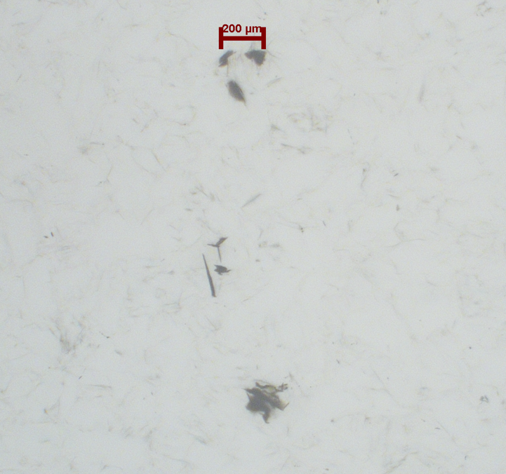
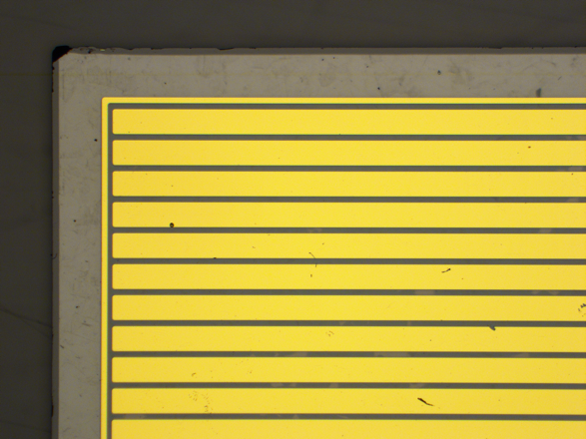
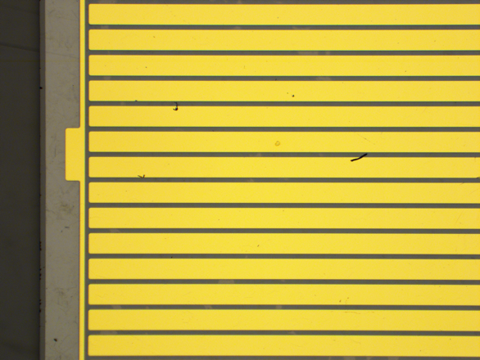
Substrate saga continued
Replacement parts tested at OSU in August 2022 (9 months later!)
Newly grown substrates, but II’VI “forgot” how to prepare surfaces (for ATLAS also)
Parts returned and surfaces redone – back to OSU 12/22
  Final got detector quality parts! 13 months after order….
  OSU rapidly turned in to strip sensors – Happy Holidays!!
245 micron strip pitch
50 micron guard ring
400 micron edge gap

Slide 4
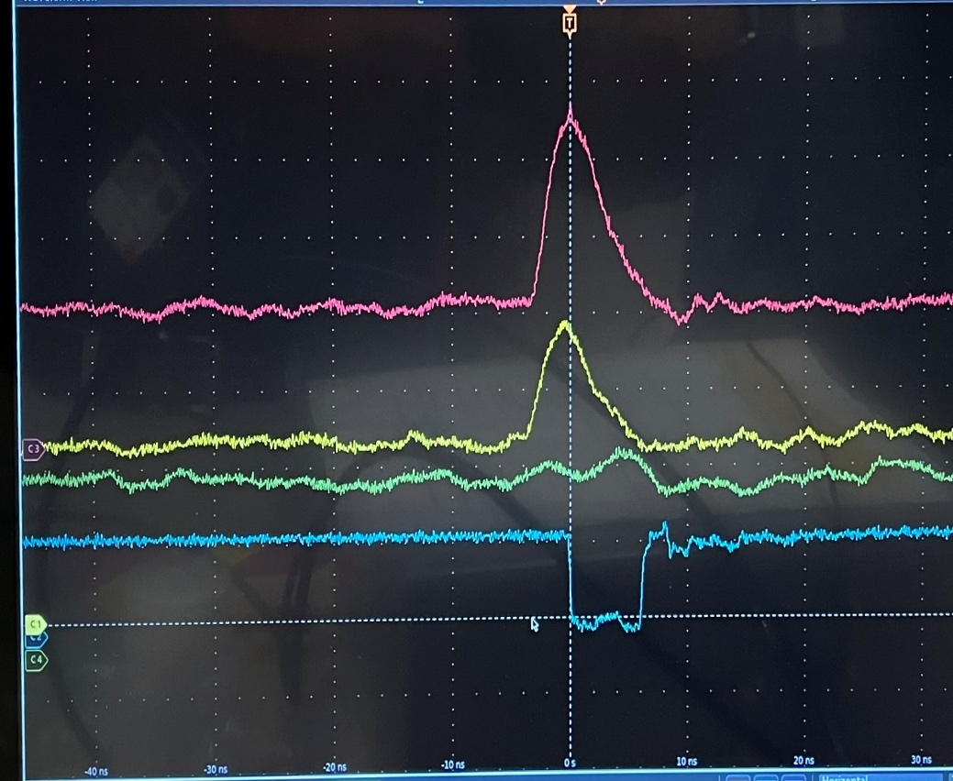
Early 2023
Diamonds mounted to two different PCBs (CALYPSO and SAMPA)
  Ultimately unable to acquire even a single SALT ASIC from LHCb for testing
Test boards delivered to JLab first week o February 2023
  Able to get CALYPSO test board operational at JLab in 2 days w/SenseIC

Slide 5
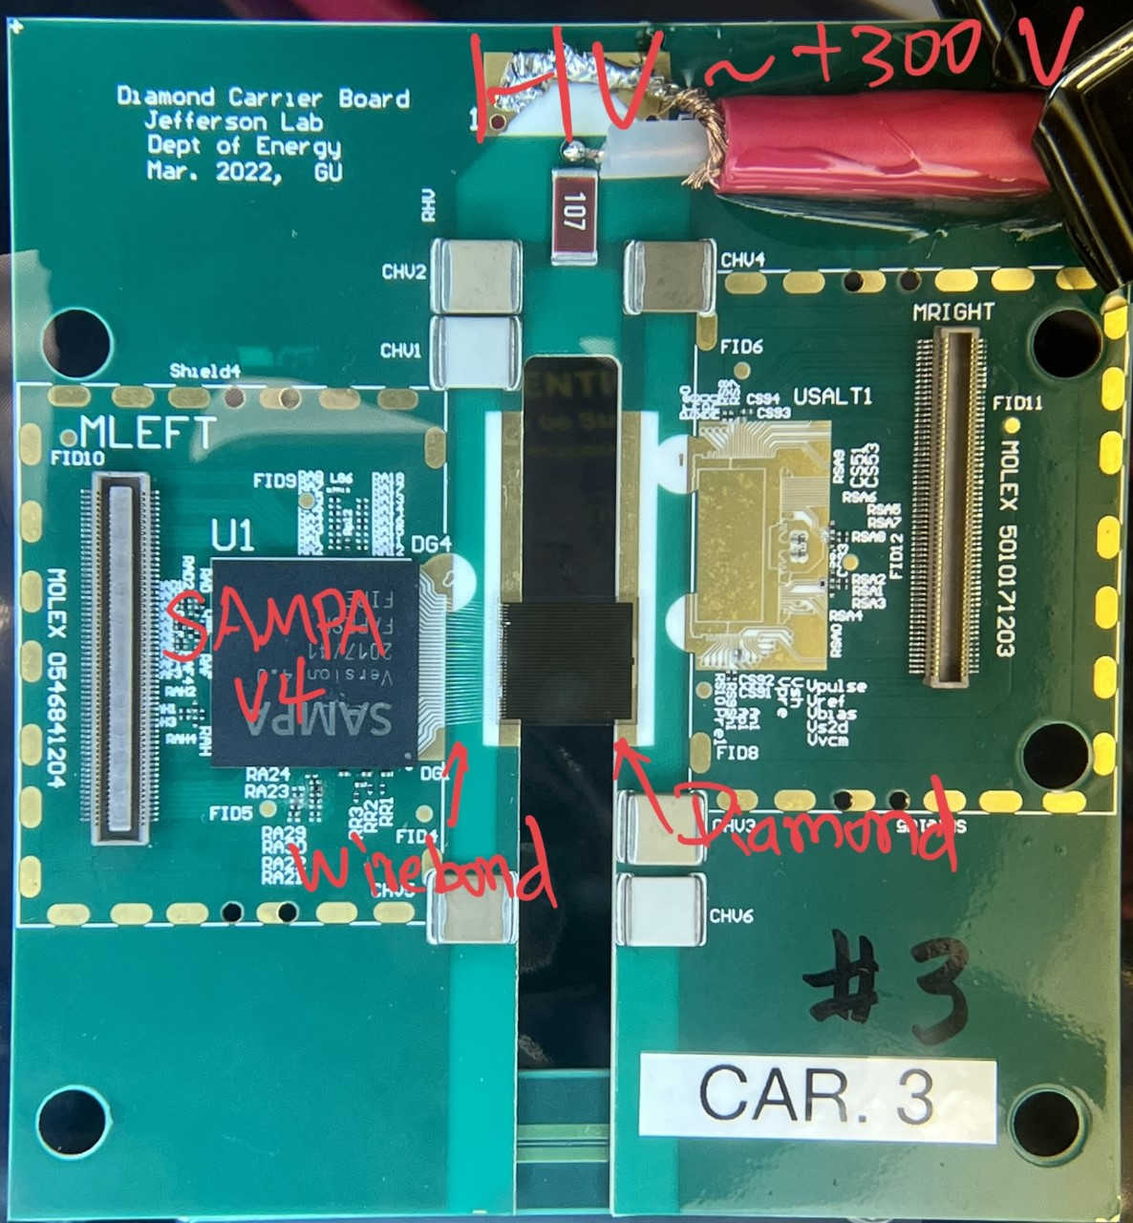
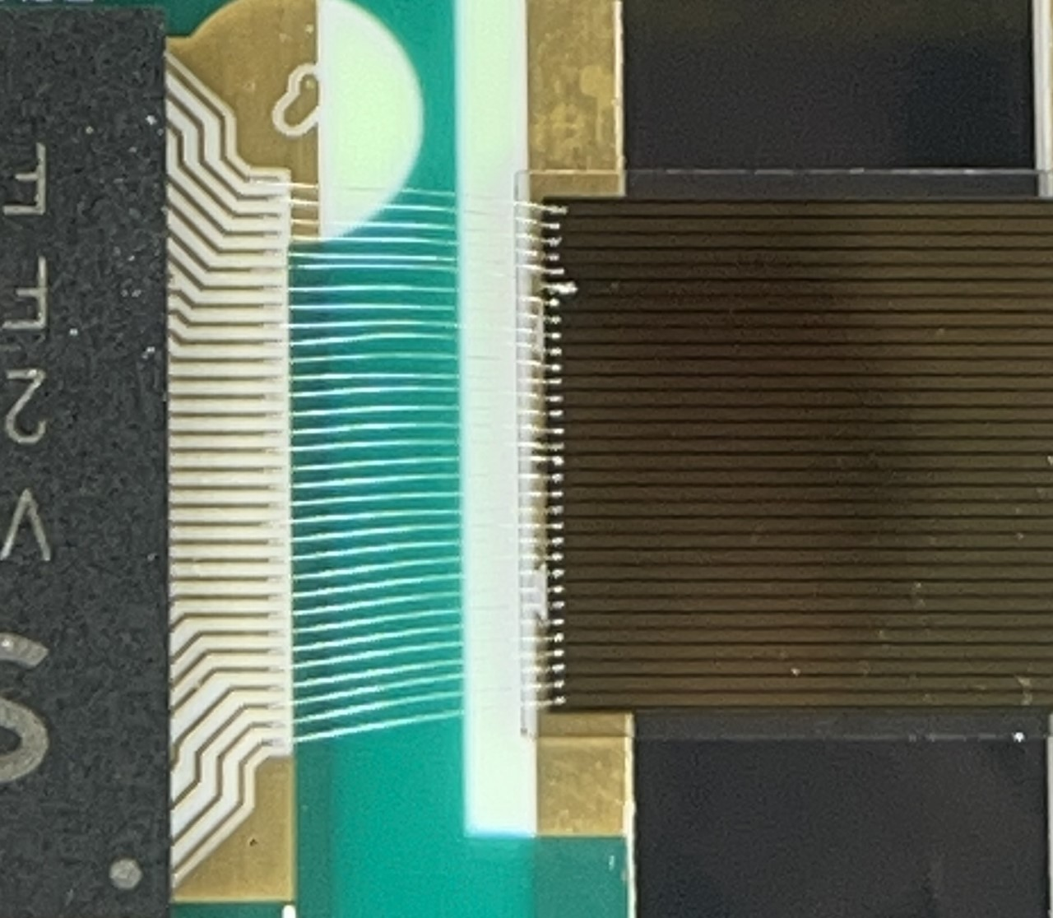
SAMPA test board
Diamond: ~10mmx10mm, 245 um pitch
Wirebonded to SAMPA
1.1 diamond CARRIER board
Two copper layers, alumina (Al2O3) base,
80mm x 85mm by 1mm thick

Slide 6
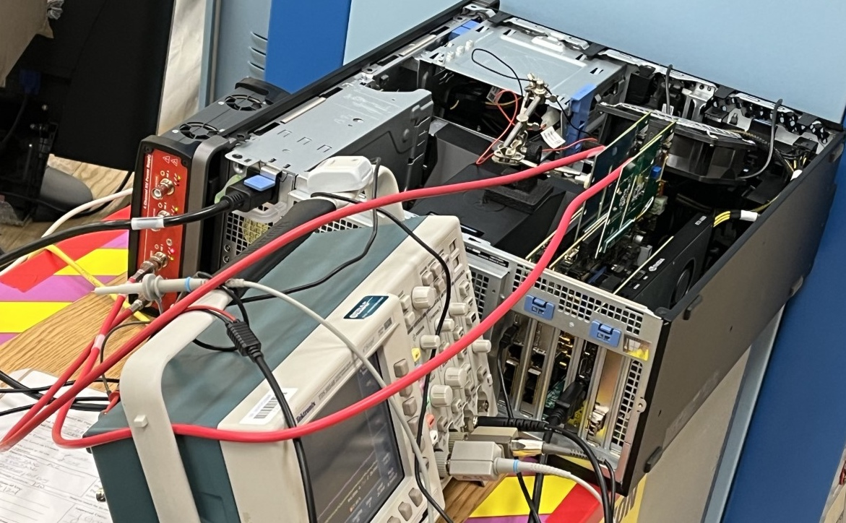
JLab Test Setup (William Gu leading effort)
1.2 Test setup, The CARRIER boards connect to the mezzanine board and the readout board directly
Carrier
(Diamond, SAMPA, CALYPSO)
Sr-90
MEZZ.
HV, 300V
KCU105
PCIe readout

Slide 7
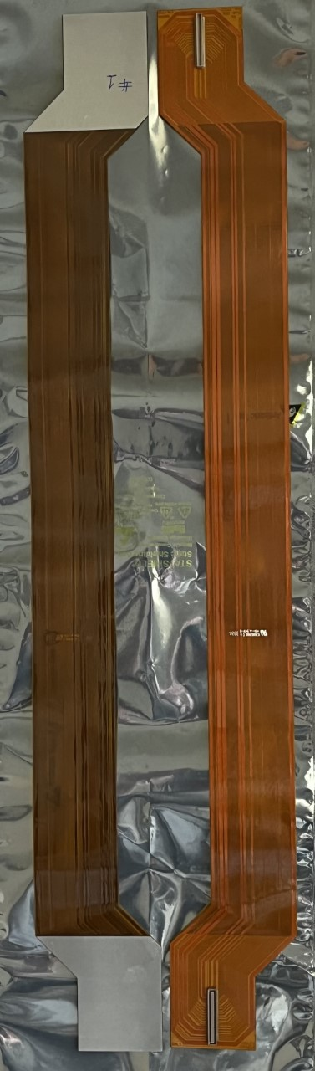
Flex cable (would carrier ASIC output to vacuum feedthroughs
One copper layer, Polyimide,
500 mm by 40/60mm wide.
Three Flex Cables populated
1.3 FlexCable: Carrying the signals and power for the carrier, interface to the FPGA readout
Molex 501017
To match with SAMPA on CARRIER
Or the right-side connector on MEZZ
Molex 054684
To match with SALT on CARRIER
Or the left-side connector on MEZZ
Metal stiffener

Slide 8
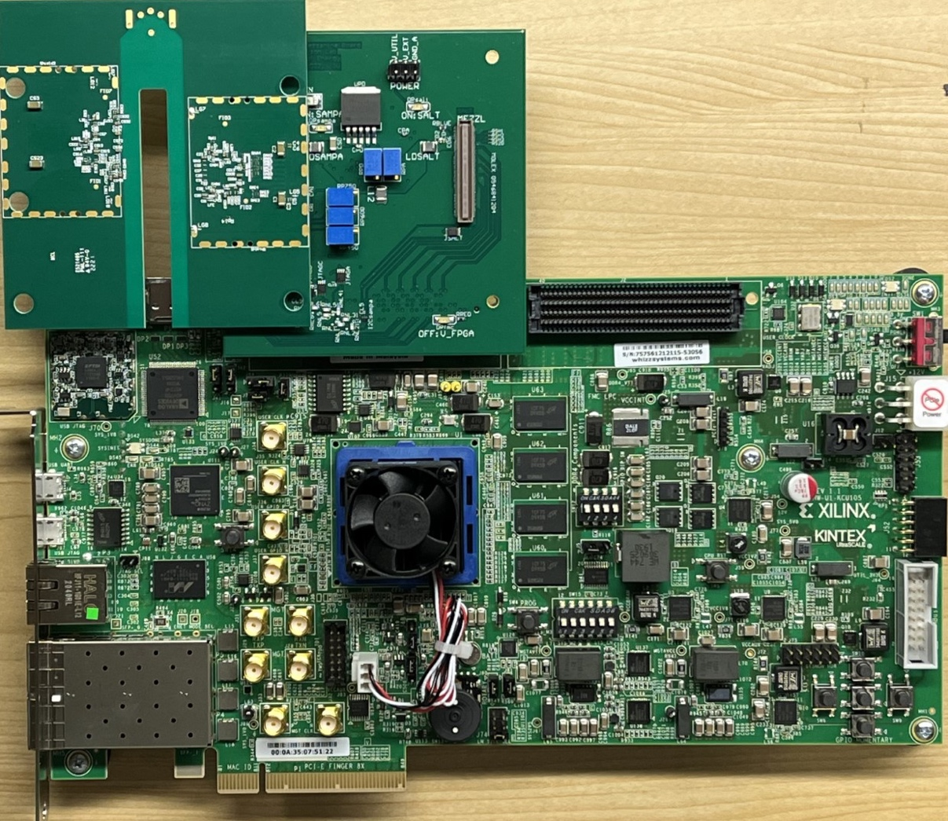
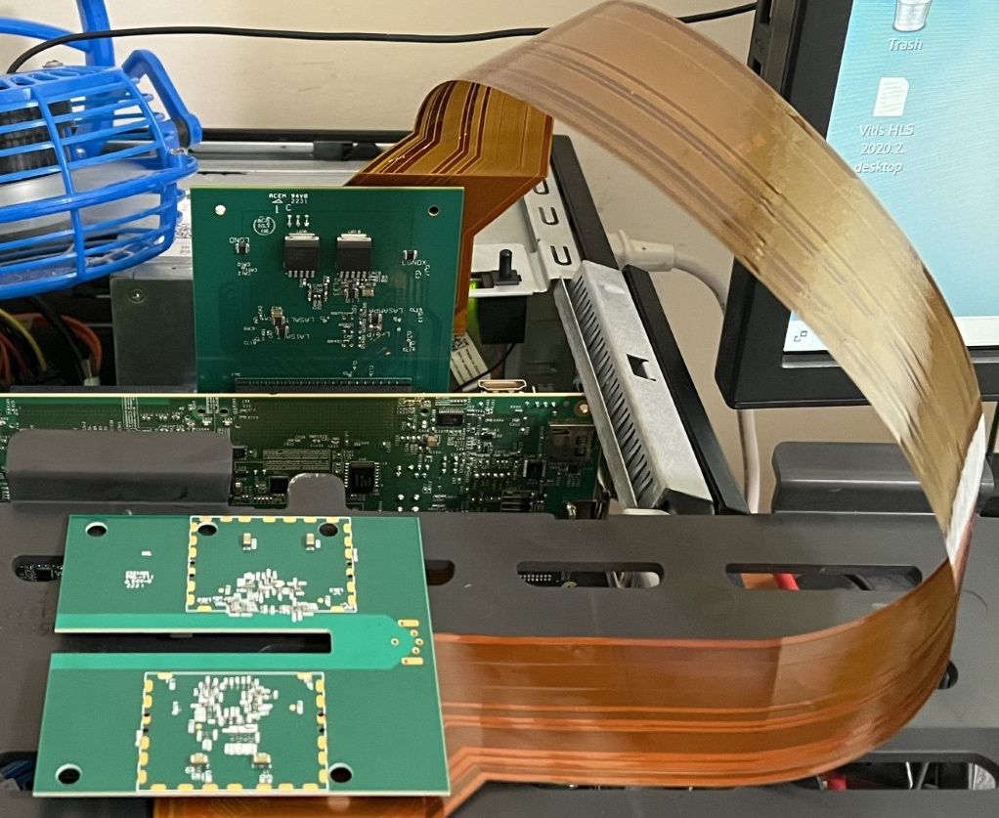
Test DAQ Signal Path
The CARRIER can mate with the MEZZ (through FMC to KCU105) directly,
or connect via the Flex Cable.
Lots of new firmware
1.4 KCU105 readout
KCU105
MEZZ
Flex Cable
CARRIER
MEZZ
KCU105
KCU105 in
GU-PC-HOME
KCU105: Xilinx eval board with UltraScale Kintex FPGA xcku040, PCIexpress x8 lanes.
CARRIER

Slide 9
SAMPA Noise – achieving design performance on test board
3.1 SAMPA pedestal and noise, All the 32 channels (pedestal Std_Dev = Noise_Level)
SAMPA raw readout pedestal noise level:
1.4 – 2.2 ADC_unit;
→ 630 – 1000 e⁻
After simple correction, noise level:
1.2 – 1.4 ADC_unit
→ 540 – 630 e⁻
SAMPA, Apr. 28, 2023, William Gu

Slide 10
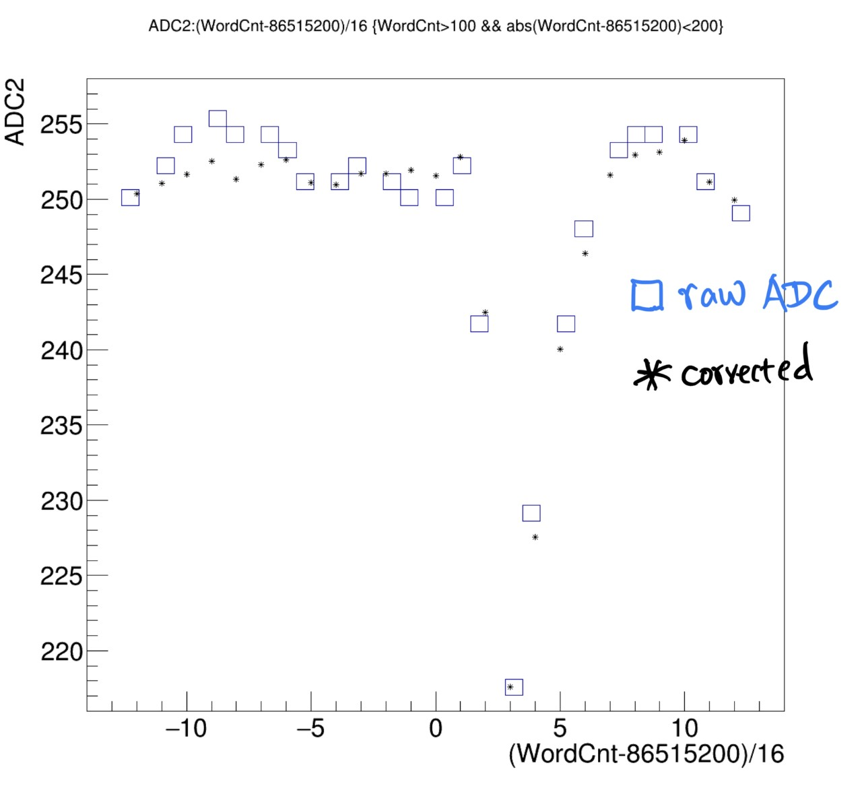
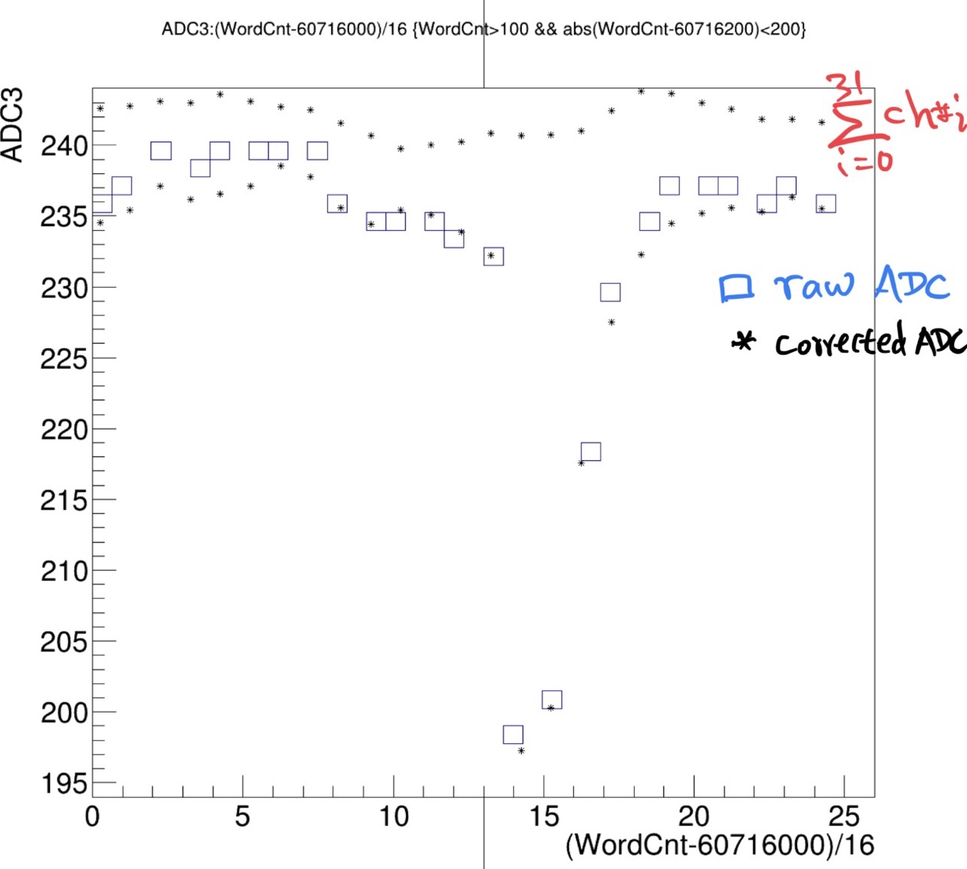
Two SAMPA pulses
3.2 SAMPA signals (two sample events), Pulse > 20
Ch#2 ADC pulse, X: time, 100ns/sample; Y: ADC
Ch#3 ADC pulse, X: time, 100ns/sample; Y: ADC
SAMPA, Apr. 28, 2023, William Gu

Slide 11
ASIC Decision
FLAT-32 (32-channel CALYPSO)
  Very radiation had (65 nm GF)
  Very low noise (~200 electrons)
    Signal-to-noise (S/N) ~ 50
  Very fast (<10 ns pulse length)
    <1 ns pulse timing
  Time-over-threshold to LVDS output
    Perfect match to replace QWADs
    Effective 7-bit pulse height (non-linear)
  Parallel 32-channel streaming output
SAMPA (32-channel)
  Reasonably rad hard (130 nm TSMC)
  Marginal noise/speed performance
    600 e- at 160 ns shaping time (S/N~15)
      Worse at 80 ns shaping time
    4 ns leading edge, long tail time
  Integrated 10-bit ADC (9.2-bit ENOB)
  Data streaming possible over 10 parallel serial links at 10 MSPS
  Integration with existing DAQ an analysis for JLab Compton is not as straight-forward
Highly desirable to design and build the FLAT-32 to support JLab polarimeters with intent that this chip may have other applications including EIC polarimeters/far forward detectors, fast GEMs for TDIS (with different front end).
Physics Division Capital Equipment is funding this development effort – thanks to Thia (previously Rolf)!!

Slide 12
Path forward
Expect to have all of the final diamond substrates at OSU for processing this FY
  QC testing (single diode) will be done as substrates arrive
  Detectorizing (strip sensors) will be done later
    Some R&D may be done to shrink dead area at ends of sensors below 400 microns
FLAT-32 design effort targeting October 2023 foundry MPW run
  Will produce ~100 die – usable die will depend on yield (expect this to b high)
    Hall A system requires 16 die
  Time is short, but an additional front end design (e.g. for GEMs) could be put in to the same MWP in October to reduce development costs for another application
  Development by SenseIC includes test system
    Test system and chips targeting April 2024 delivery
PCBs for detectors + ASICs will be developed in parallel
  Final system build-out of detector planes will only take a few weeks
If all goes to plan, we should have detector planes ready summer 2024

