Slide 1
MOLLER MIE Project Update
MOLLER Collaboration Meeting
May 2023
Jim Fast – MOLLER Project Manager

Slide 2
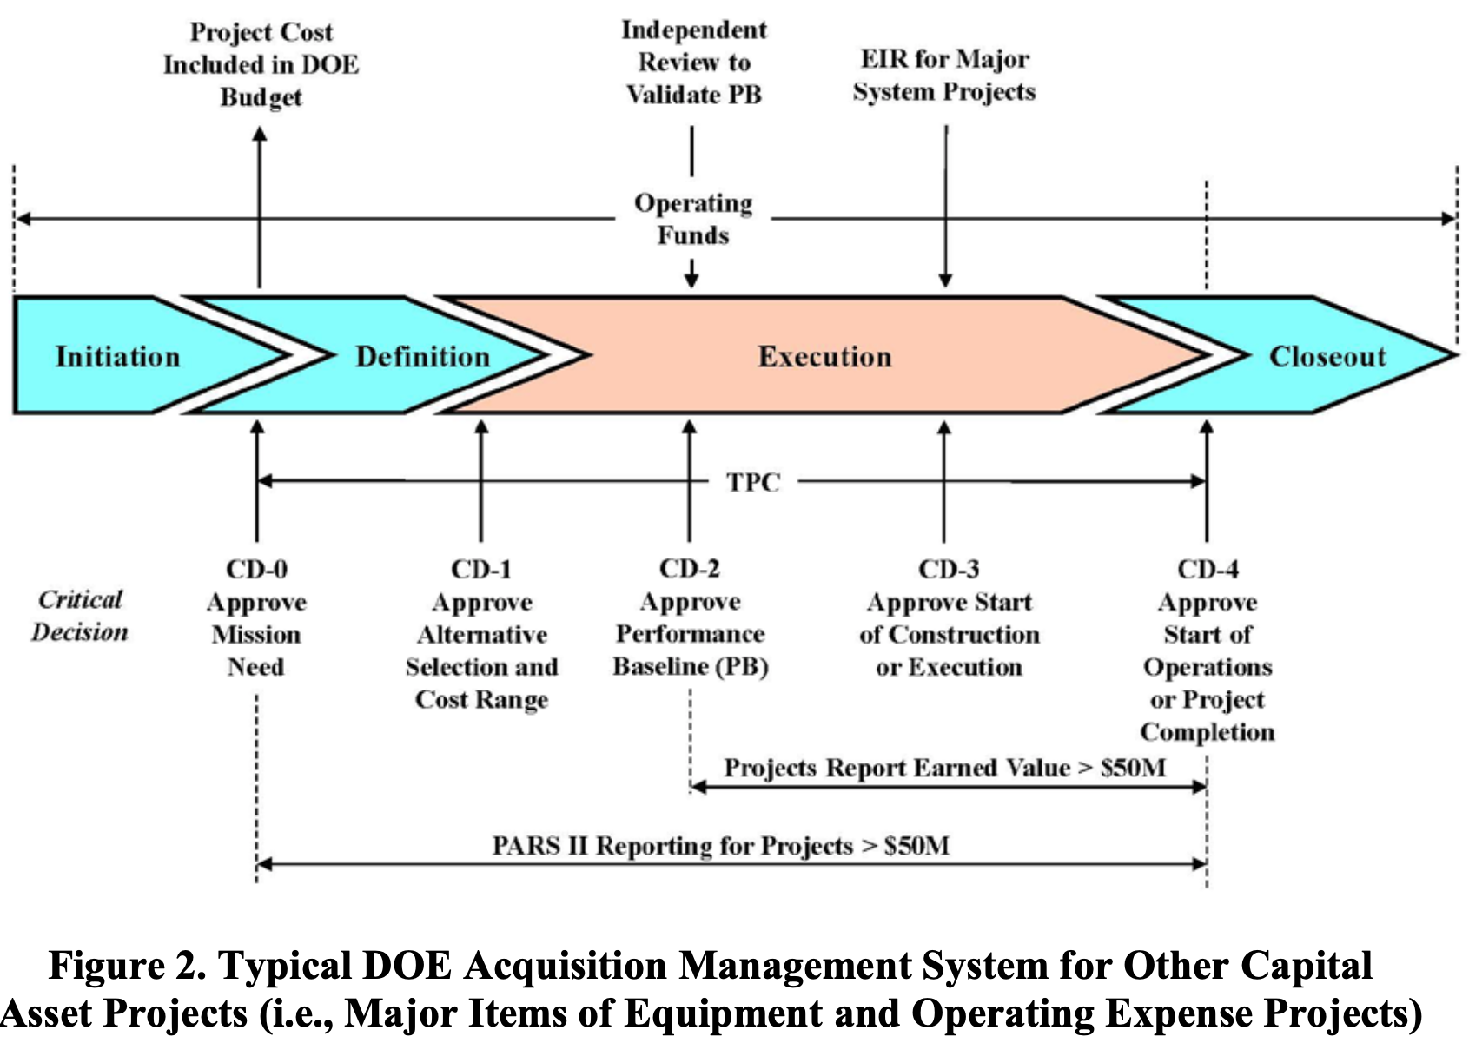
DOE Major Item of Equipment (MIE)
Falls under DOE-O-413.3B Change 5
CD-2/3 Independent Project (a.k.a OPA) Review is scheduled for October 3-5
Bill has replaced Ed as ES&H lead and Jacob has taken on the QA position
Inserted CD-3A
Long Lead Procurements
Mike and Cip joined the team, rounding out all the CAM roles

Slide 3
CD-3A Approved March 28
$9M authorized (~$7M scope + contingency)
  Three REQs with buyer
  Ten others submitted but not approved yet
Target Scope
  Chamber with heads
  Hydrogen storage tanks (buy & refurb existing)
  Cryostat
  Cryocan
Spectrometer
  US conductor and coil fab
  Collimators and blockers etc.
  All of DS toroid including W, Pb parts
  Magnet power supplies
  Bellows and beam pipes
Moller polarimeter collimator

Slide 4
Leadership changes
As of May 1 I took on role of EICPP (EIC Partner Project, i.e. JLab) Project Manager
  Candidate A has accepted position as new MOLLER PM July 17
  Until then, I will be managing both efforts
  EIC has a CD-3a Director’s Review the week after the MOLLER OPA review – busy time!
Lab has interviewed for Senior Scientist position – part of position is to serve as DPM
  Multiple excellent candidates; more to come as the hiring process plays out
We will ensure a smooth transition and successful CD-2/3 reviews

Slide 5
MOLLER schedule – CD-3a and beyond
Working on completing final procurement packages for CD-3a scope
  Intent is to have all requisitions in motion by July
Completing planning (Performance Measurement Baseline) for CD-2/3
  Data freeze in May – no changes until we set baseline at end of CY2023
Plan remains to complete fabrication/assembly/test outside Hall A by end of Q1 FY25
  Details beyond that depend on performance of CEBAF and delivery of luminosity to SBS program

Slide 6
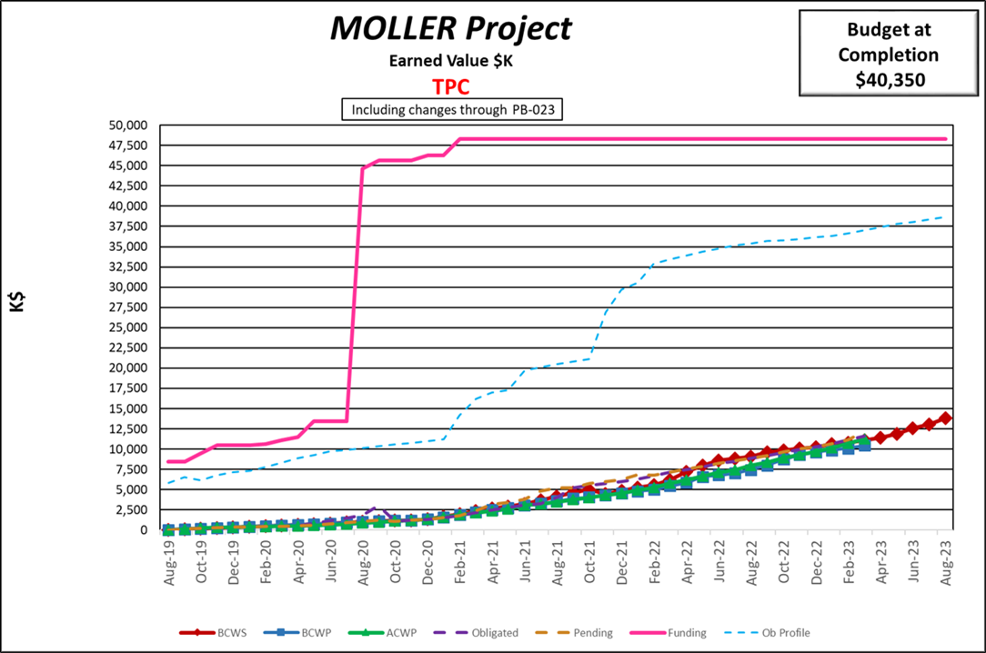
Funding is almost entirely in the can – just a couple $100k to go!
BAC has crept up considerable and must be brought back down to ~$38M for CD-2/3
We believe we have identified the required $2M reductions without impacting scope, but if need be we may cut some or all of the DOE-funded integrating detectors. We should understand this within 1-2 weeks.

Slide 7
Some lingering Project Review recommendations still need to get closed
Several recommendations closed out since last collaboration meeting
We will need to work to get the rest of these closed out in the next few months
  Vladimir is making good progress on 1st/3rd items

Slide 8
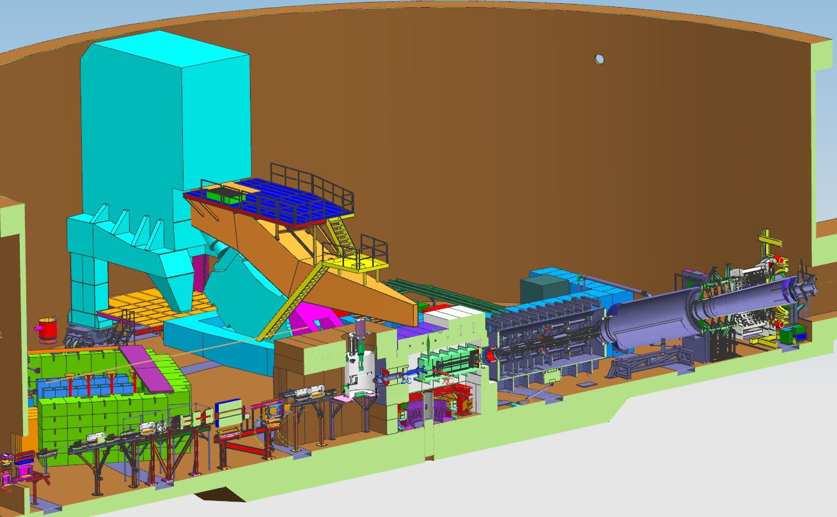
Summary
Project has nearly all of expected funding
CD-3a approved in March ($7M+ procurements)
CD-2/3 reviews scheduled – everything on track!
  Director’s Review week of August 14
  IPR (OPA) October 3-5
  TDR needs to get finalized by collaboration –
  this is a required document for CD-2
As of May 1 I officially started as EICPP PM
  Candidate A will take over as MOLLER PM July 17
  Interviews completed for Senior Scientist position including MOLLER DPM role

