Slide 1



Moller Polarimetry
MOLLER Collaboration Meeting – June 2022
Eric King (on behalf of the Moller Polarimetry Working Group)

Slide 2
The Polarimeter
Accurate Determination of Fe Foil Polarization
PREX-2 & CREX Moller Polarimetry

Slide 3
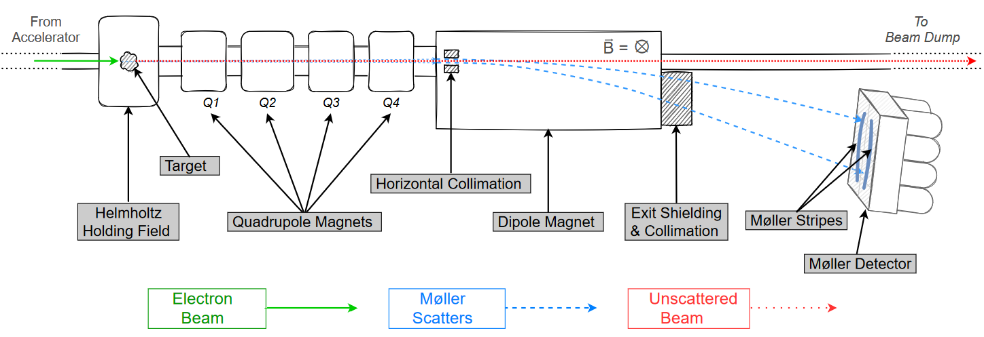
Basic Polarimeter Mock-up
Moller Polarimetry – Eric King – MOLLER Collaboration Meeting, June 2022

Slide 4
Publications
Accurate Determination of Fe Foil Polarization
PREX-2 & CREX Moller Polarimetry

Slide 5
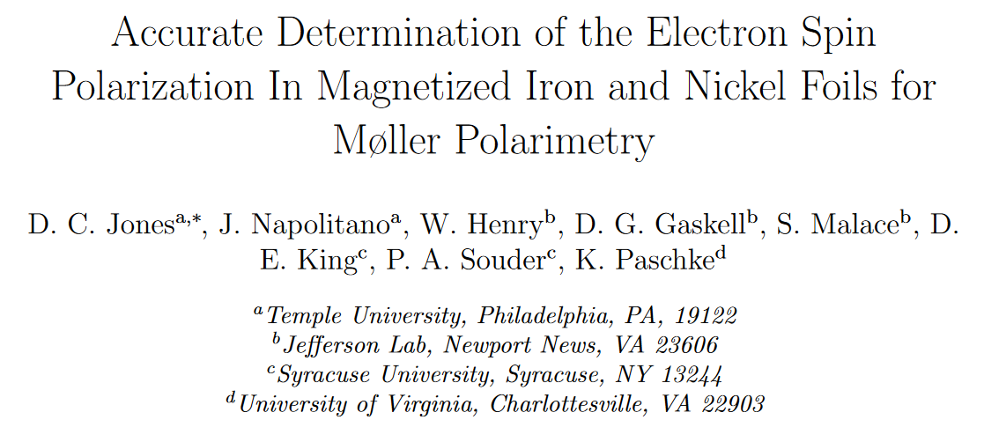
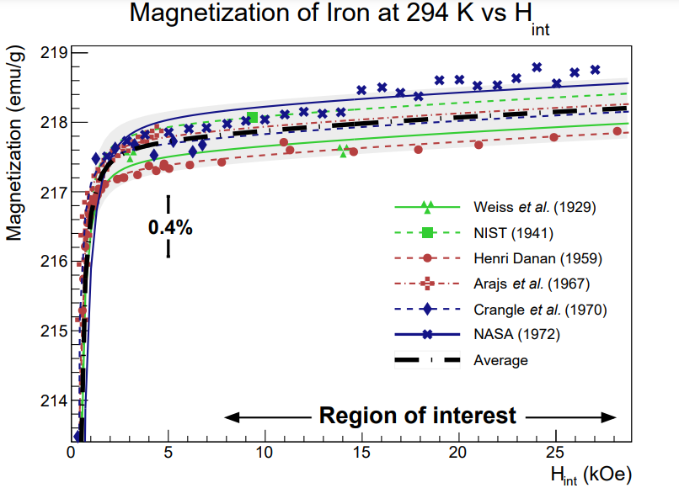
Publications – Fe Foil Magnetization
Moller Polarimetry – Eric King – MOLLER Collaboration Meeting, June 2022
Extensive literature review of world data on
Fe foil spin polarization.
Mean value for Fe foil electron spin
polarization from available world data
Peer review complete; making final edits.
Foil polarization known to ~0.24%
https://arxiv.org/abs/2203.11238

Slide 6
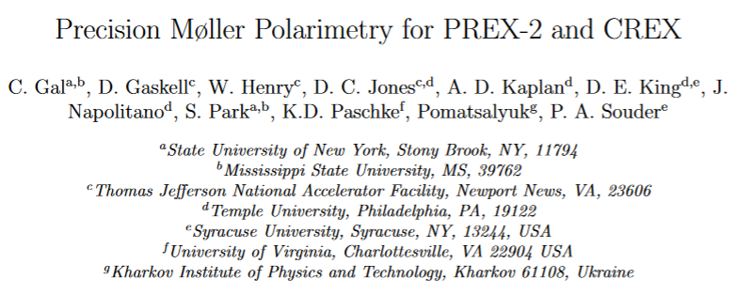
Publications – PREX-2 & CREX Moller Polarimetry
Reporting of PREX and
CREX polarimetry accomplishments.
Significantly improved Levchuk modeling
Moller Polarimetry – Eric King – MOLLER Collaboration Meeting, June 2022
Measurement and extrapolation uncertainties for PREX-2 and CREX.
Effectively ready to submit for review – final version going out to authors next week.

Slide 7
Moller Polarimetry Systematics
Key Systematics
Lessons and Improvements

Slide 8
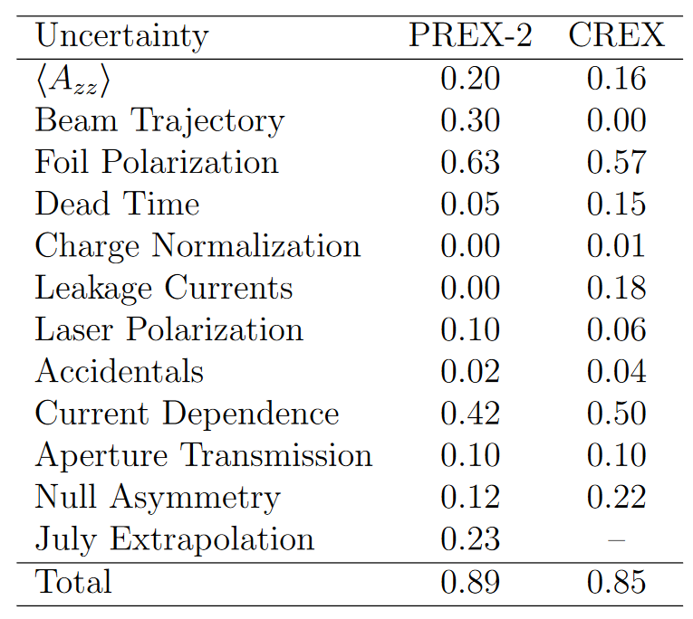
Moller Polarimetry Systematics
For PREX-2 & CREX we
achieved sub-1% Moller polarimetry measurements.
The polarimetry systematics goal for MOLLER is 0.45%
⇒ There’s work to be done.
Moller Polarimetry – Eric King – MOLLER Collaboration Meeting, June 2022

Slide 9
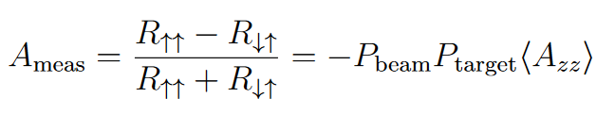
Key Systematic – Analyzing Power
First key systematic is understanding our mean analyzing power <A_{zz}>.
Marked improvement from PREX-2 to CREX.
Moller Polarimetry – Eric King – MOLLER Collaboration Meeting, June 2022
We measure this
We want this
We know this
We compute this

Slide 10
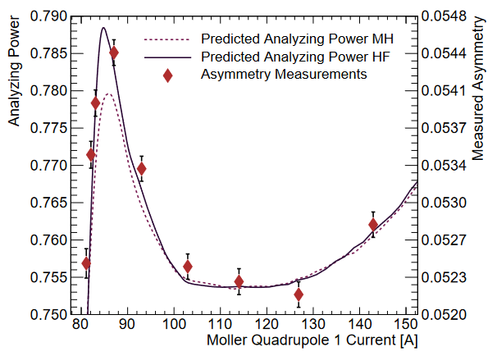
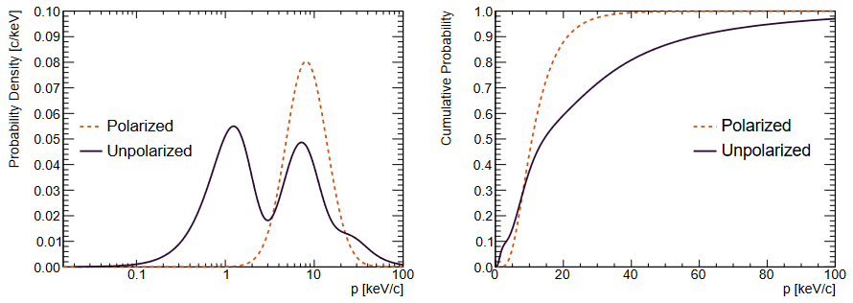
Key Systematic – Analyzing Power
Key lessons learned:
Developed a method which allowed us to be insensitive to absolute optics.
Incorporation of improved Hartree-Fock derived electron momentum distributions into our Levchuk model
  ~40% → ~10% model uncertainty
Moller Polarimetry – Eric King – MOLLER Collaboration Meeting, June 2022
Plot explanation:
MH: Modified-hydrogen Momentum Distributions
HF: Hartree-Fock Momentum Distributions
Hartree-Fock wavefunctions computed by Aaron Kaplan of Temple University
Hartree-Fock momentum wavefunction distributions

Slide 11
Lessons and Improvements – Measurement Setup
>>> Beam orbit control <<<
PREX: We identified a setup reproducibility issue.
  Required extensive measurement setup procedures.
Post-PREX: Installation of beamline harp.
CREX Measurement setup: Harp scans
  Calculate beam orbit angle going into polarimeter.
CREX: All Moller polarimeter setup calibrations after Jan 2020 harp calibration returned “identical” results.
Moller Polarimetry – Eric King – MOLLER Collaboration Meeting, June 2022

Slide 12
Key Systematic – Target Foil Polarization
Second key systematic is the polarization of our iron target foils
This is the topic of the second of the aforementioned publications.
Moller Polarimetry – Eric King – MOLLER Collaboration Meeting, June 2022
We measure this
We want this
We know this
We calculate this

Slide 13
Key Systematic – Target Foil Polarization
Target foil polarization is largely two components:
Magnetization (covered in upcoming publication):
8.005 ± 0.022% → 8.014 ± 0.018%
Foil alignment/saturation:
We’ve previously assigned a 0.5% uncertainty to this
⇒ Alignment study required.
(I’ll return to this)
Moller Polarimetry – Eric King – MOLLER Collaboration Meeting, June 2022

Slide 14
Remaining Systematics
Matter of minor systematics studies and statistics:
  Dead Time
  Leakage/Bleedthrough
  Aperture/Slit
  Null Asymmetry
Planned systematics study:
  Current Dependence
  (I’ll return to this)
Moller Polarimetry – Eric King – MOLLER Collaboration Meeting, June 2022

Slide 15
Additional Work
GEM Detectors:
Hardware
Data / Insights
Equipment:
Holding Field Move
Dipole Power Supply Upgrade
Systematics Study Plans:
Target Alignment
High-current Dependence

Slide 16
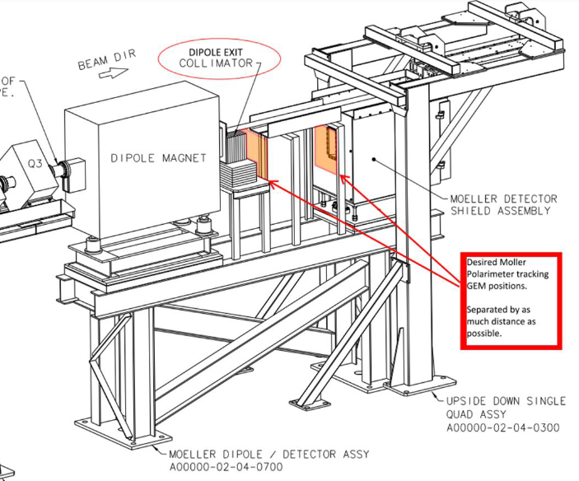
GEMS – Proposed
Budgeted for the construction of four (4) GEM detectors for the polarimeter.
Two (2) GEM detectors to be placed at moller dipole exit and prior to entrance of dipole.
In response to suggestions from last review, added third detector to be placed halfway in-between for track redundancy.
One (1) spare GEM
Moller Polarimetry – Eric King – MOLLER Collaboration Meeting, June 2022

Slide 17
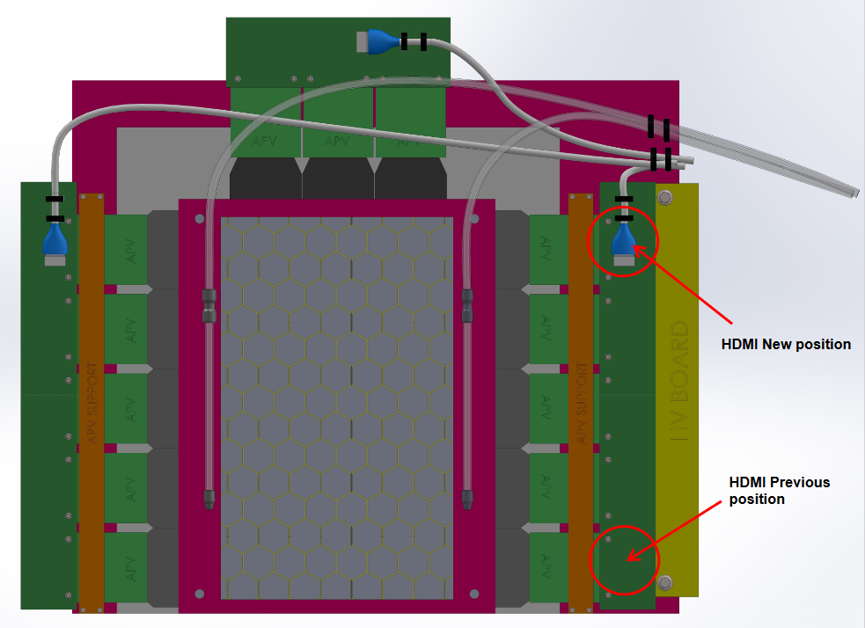
GEMS – Physical
Progress:
Nilanga’s lab has completed the GEM design.
Expected turnaround time is one year.
Work Remaining:
Support structure design.
Paul Souder’s post-doc to do the DAQ work.
Faraz Chahili and Paul Souder working on interpreting the data (ongoing).
Moller Polarimetry – Eric King – MOLLER Collaboration Meeting, June 2022

Slide 18
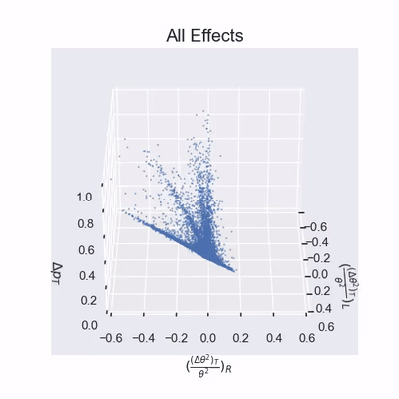
Extracting Physics from GEM Chamber Coordinates
Three GEM chamber coordinates are used to reconstruct kinematics:
Chamber Coordinates:
x₁: x-coordinate of GEM hit
y₁ & y₂: y-coordinate from two GEM
planes
From these:
Δy: Difference of y-coordinates
∝ bend angle ~ e- momentum
y: Average of y-coordinates
Values highlighted in orange are the preferred reconstruction variables.
Moller Polarimetry – Eric King – MOLLER Collaboration Meeting, June 2022
Animated GIF courtesy of Faraz Chahili

Slide 19
Extracting Physics from GEM Chamber Coordinates
𝝆: 1 / momentum
𝝓: plane of scatter
Δ𝛉: angular offset from moller stripe
𝛉: scattering angle
𝝆 = 𝑓(Δy,y)
𝝓 = 𝑓(Δy,y)
Δ𝛉 = 𝑓(Δy,y,x₁)
𝛉 = 𝑓(Δy,y)
Moller Polarimetry – Eric King – MOLLER Collaboration Meeting, June 2022
These are functions of the preferred set of values derived from chamber coordinates and various coefficients
m₁ , m₂ , b₁ , b₂ , A , B , C , D
derived from fitting functions
Δ𝝆 = 𝝆_{beam} – 𝝆_{L} – 𝝆_{R}
𝛉_{T}² = Δ𝛉² + 𝛉²
Animated GIF courtesy of Faraz Chahili

Slide 20
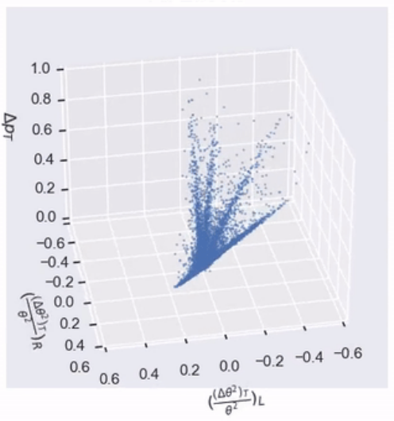
What was that rotating simulation data???
Radiative Corrections:
— Initial state beam
— Initial state target
— Final state radiation
(1 per moller e-)
— Levchuk Effect
Moller Polarimetry – Eric King – MOLLER Collaboration Meeting, June 2022

Slide 21
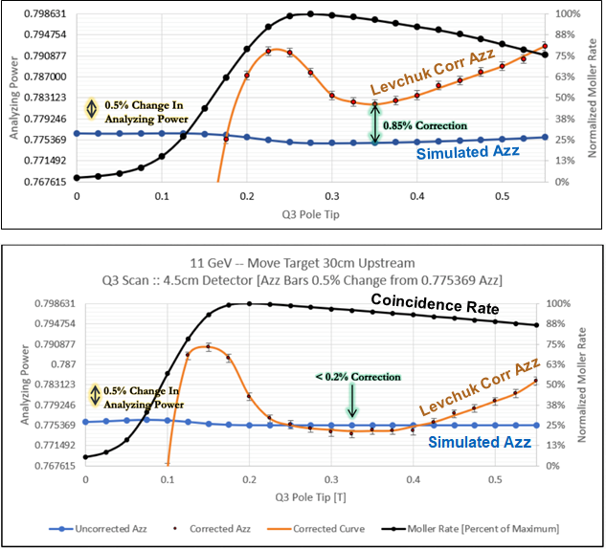
Target Move
30cm Upstream
(Top Image) Design as is. Minimally achievable Levchuk Correction is ~0.85%
(Bottom Image) Moving the target 30cm upstream.
  Allows for additional unaided separation of mollers from beamline center for better quad steering.
  Avoids running quadrupoles at maximum power rating.
Moller Polarimetry – Eric King – MOLLER Collaboration Meeting, June 2022

Slide 22
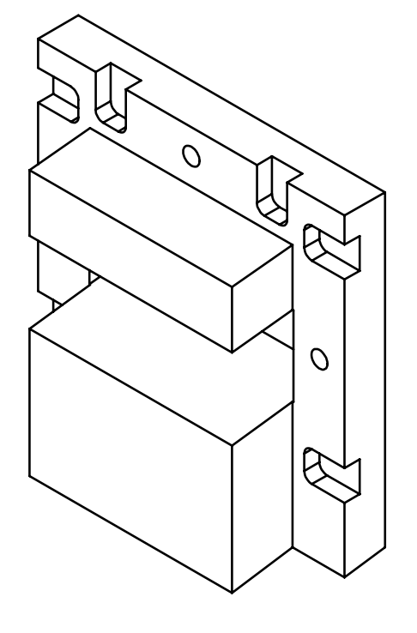
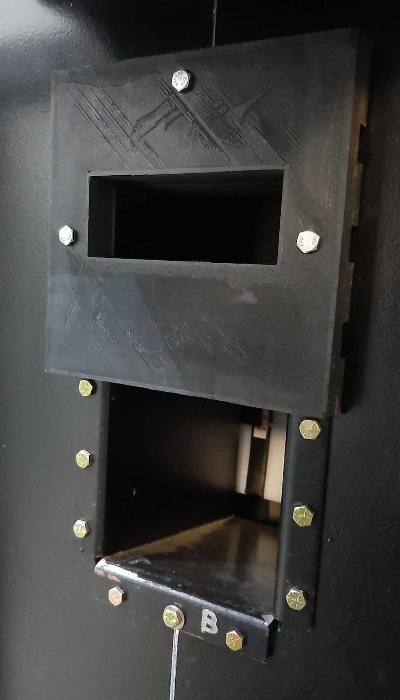
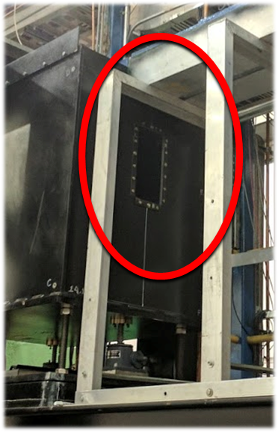
Detector Collimator – General
Will be milled from Tungsten (hevimet).
Is 2.5” Thick
3D printed prototype
Moller Polarimetry – Eric King – MOLLER Collaboration Meeting, June 2022
Resigned to be inserted
into detector window
and attached using existing
bolt locations.
Leaves 2” ~ 5cm vertical acceptance, which is ~±7°

Slide 23
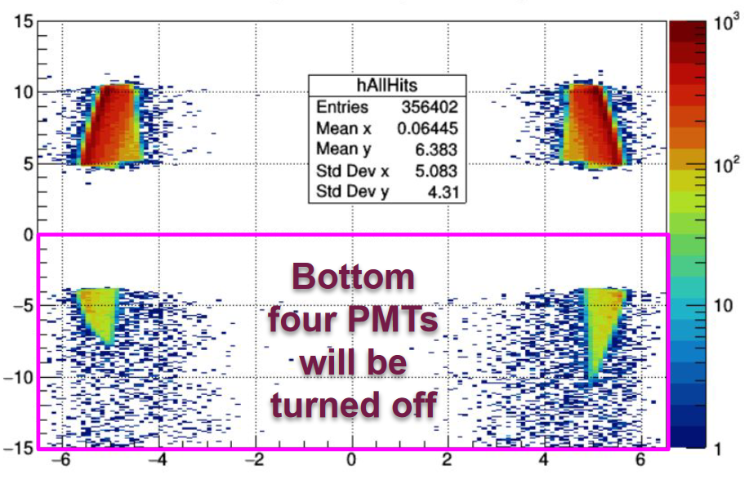
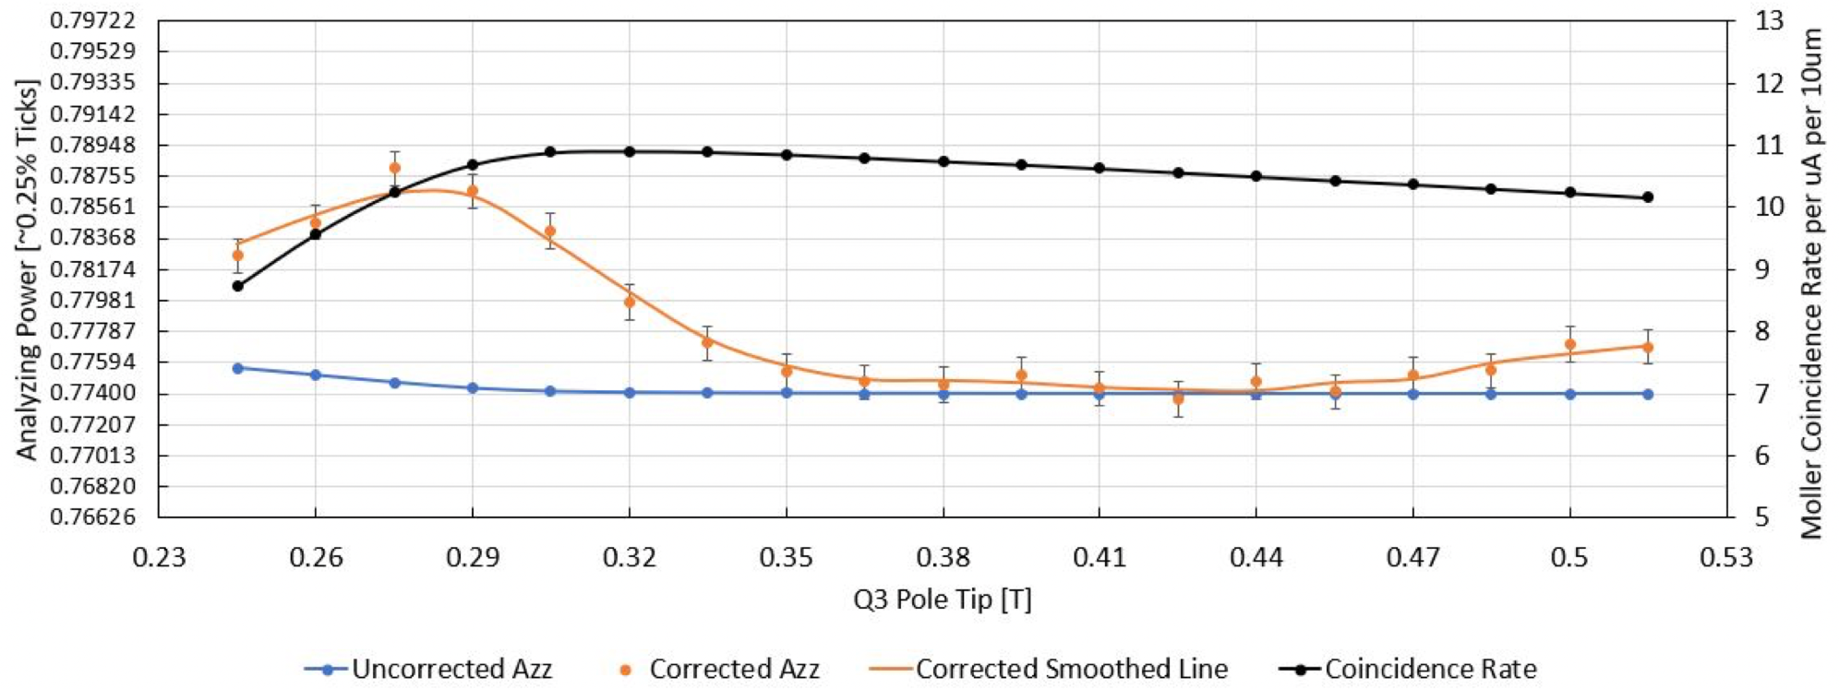
Detector Collimator – Simulation Results
Broad stokes review:
Image to the right shows all above-threshold detector hits for 11 GeV.
Top two PMT’s will be active and bottom four PMTs will be turned off
Collimator does an exceptional job at limiting acceptance.
on | on
on | on
off | off
off | off
Moller Polarimetry – Eric King – MOLLER Collaboration Meeting, June 2022
Azz and Rate with New Collimator

Slide 24
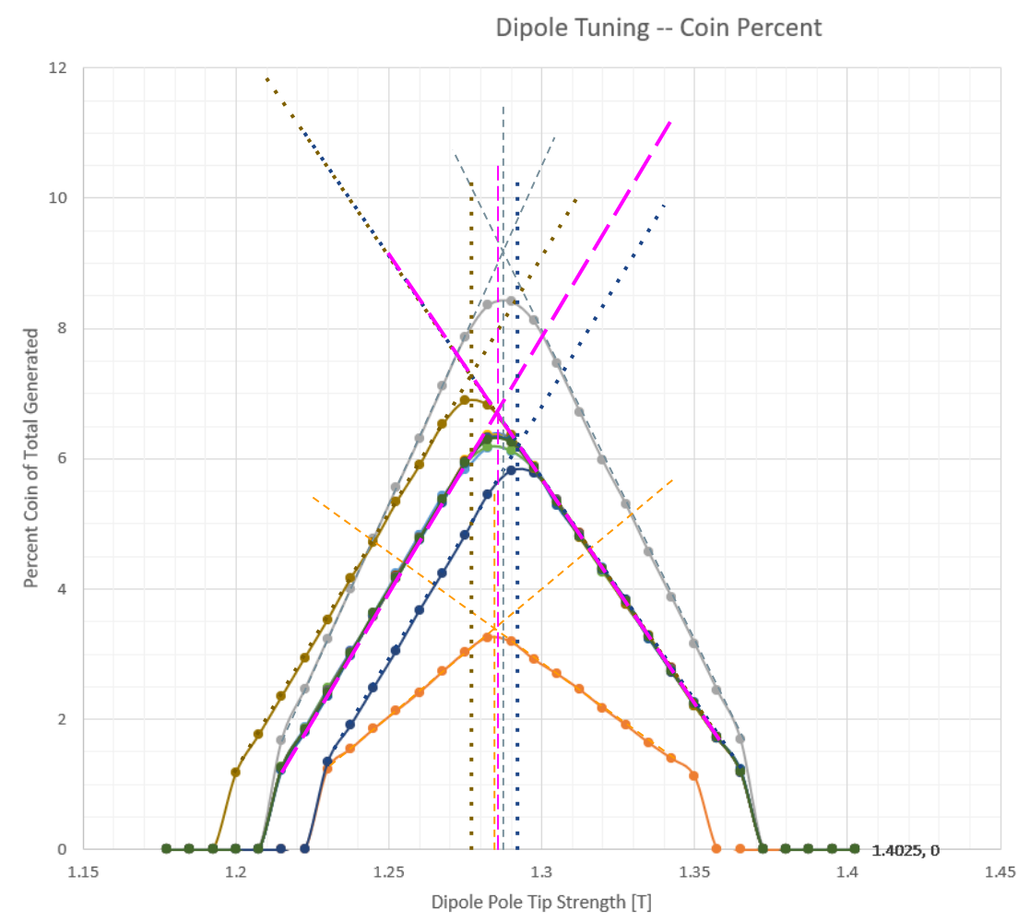
Dipole Power Supply Upgrade
Image of systematic studies of dipole tuning at 10.6 GeV
Current dipole power supply capable of <= 1.3T field
In order to center our acceptance into collimator window we need a field of
1.285T @ 10.6 GeV
This is above 1.3T for 11 GeV
We also need to be able to achieve higher fields for dipole tuning.
We need to upgrade the dipole supply to meet our needs.
Moller Polarimetry – Eric King – MOLLER Collaboration Meeting, June 2022

Slide 25
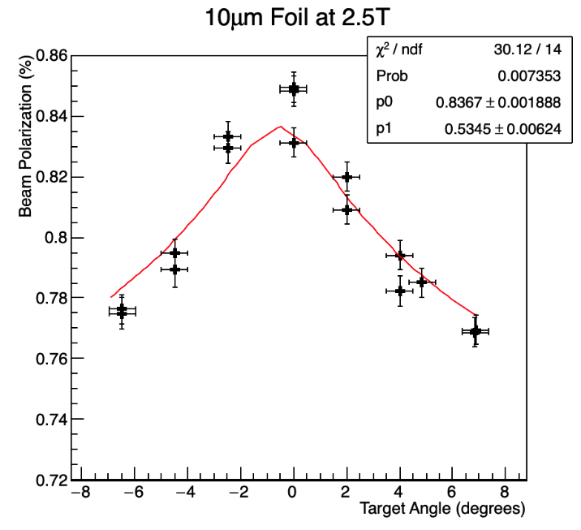
Target Alignment – Plan
Moller polarimeter target ladder has the ability to rotate.
Foil magnetization is maximized when the foil plane plane is perpendicular to B-field.
  Covered in Fe foil polarization publication.
Systematic studies will be need to be run in order to determine foil alignment.
Compare data to Stoner-Wolfarth model predictions.
Moller Polarimetry – Eric King – MOLLER Collaboration Meeting, June 2022
∝ Target Polarization
Data taken 3/18/2019
PREX-2 commissioning data – foil angle systematics study on 10um foil.
Note: The y-axis label is “improperly” labeled; however, since Pbeam is constant this axis is still proportional

Slide 26
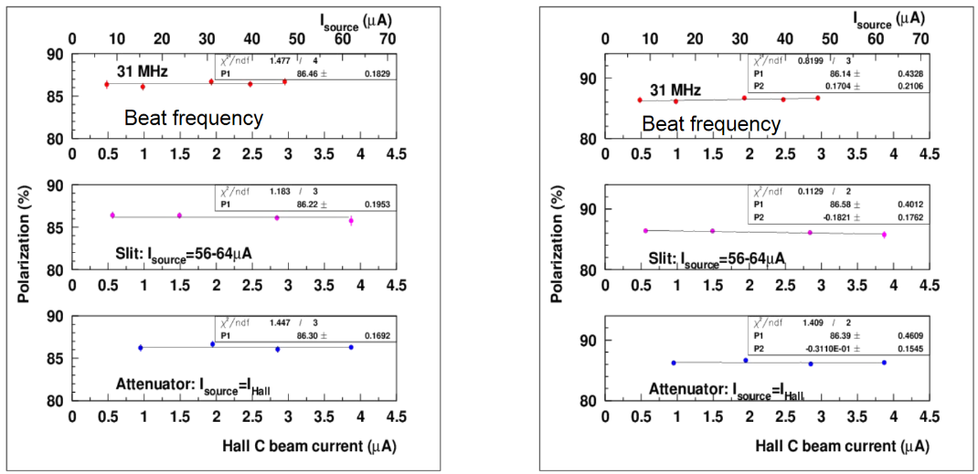
High-current Systematics Test
This is our main to-do item
Will require a detailed plan of action in order to complete.
Several methods available.
Moller Polarimetry – Eric King – MOLLER Collaboration Meeting, June 2022
Previous systematic studies performed in Hall-C in 2007 limit this systematic to 0.5%.

Slide 27
Miscellaneous Mentions
Bob Michaels is working on a new FADC DAQ which could be utilized to upgrade the existing decades old electronics
This was already covered in a talk by Paul King.
We [Temple] are looking at acquiring a detector emulator to test the DAQ
This was largely to convince ourselves that the deadtime measurement method utilized is correct
With a pending new DAQ this would be a vital piece of equipment.
Moller Polarimetry – Eric King – MOLLER Collaboration Meeting, June 2022

Slide 28
Summary
Working Group Members
Systematics Goal for MOLLER

Slide 29

Moller Polarimetry Active Personnel
⇒ Systematics Reduction ⇒ Continued review of design issues. | ⇒ GEM data insights ⇒ Paul’s post-doc will work on DAQ. | ⇒ Don Jones is now the heir to the polarimeter ⇒ Coordinate project deadlines ⇒ Technical operators. | ⇒ Insight ⇒ Advice

Slide 30
Systematics for MOLLER → How we get there…
Analyzing power systematic reduces with new Levchuk correction model.
Foil polarization systematic will require foil angle studies.
Dead time systematic was conservatively overestimated for PREX & CREX
Leakage / Bleedthrough
Current Dependence will require a systematic study to limit this to the
0.2% uncertainty level
MOLLER
0.14
0.30
0.05
0.01
0.00
0.06
0.04
0.20
0.00
0.05
0.41
Moller Polarimetry – Eric King – MOLLER Collaboration Meeting, June 2022

Slide 31


Questions / Comments
Hopefully, I have convinced everyone present that the polarimetry systematic uncertainty goal for MOLLER is achievable for the Moller Polarimeter.
Our goal hinges on:
High-current extrapolation
(a.k.a. current dependence)
Questions?
Moller Polarimetry – Eric King – MOLLER Collaboration Meeting, June 2022
Comments?

