Slide 1
Spectrometer Update
MOLLER Collaboration Meeting
21-22, June 2022
Juliette Mammei
Experimental Contact
University of Manitoba
[Supported by: the MOLLER collaboration, JLAB Magnet Group, MIT Magnet Group]

Slide 2
Team Acknowledgements
JLAB Magnet Group
  Mike Bevins (CAM)
  Probir Ghoshal (Magnet Group Leader)
  Dave Kashy (Principal Mechanical Engineer –
  Spectrometer Lead)
  Eric Sun (Senior Mechanical Engineer)
  Sandesh Gopinath (Mechanical Engineer)
  Randy Wilson (Mechanical Designer)
  Dan Young (Mechanical Designer)
Physics Collaboration
  Juliette Mammei (Experimental Contact)
  Krishna Kumar
  Chandan Ghosh
  Sakib Rahman
  Nazanin Roshanshah
  Ciprian Gal
  Kent Paschke
  and others…
MIT Bates REC
  James Kelsey (Associate Director Bates)
  Ernie Ihloff (Principle Research Scientist)
  Jason Bessuille (Senior Mechanical Engineer)
  Danielle Petterson (Mechanical Engineer)
  Designer/ Draftsperson TBD
Damon Spayde – massive effort in shielding studies
Notes:
Ruben sadly has left, he is now working on ITER at Princeton. I am happy to report he now thinks MOLLER is completely sane in comparison
We are very happy to announce that MIT is now finally back on board after settling contract issues; they will be taking over the upstream torus region, including the enclosure, supports and collimator 1+2 as well as the torus itself.

Slide 3
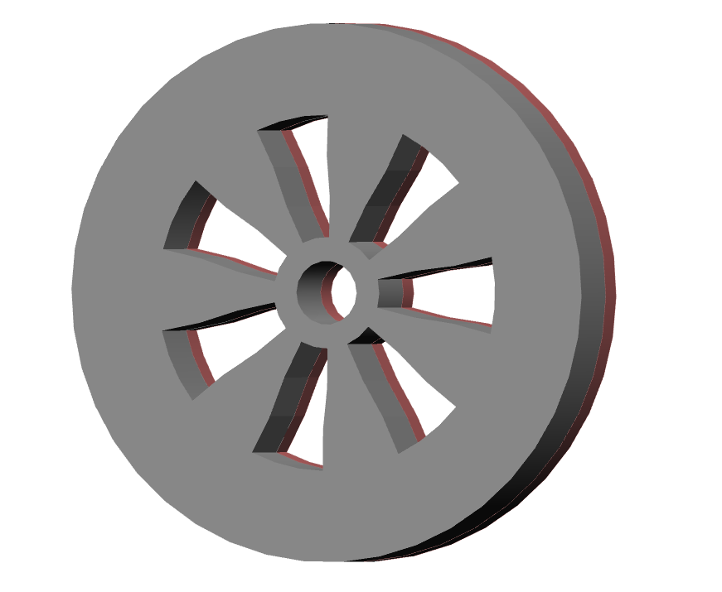
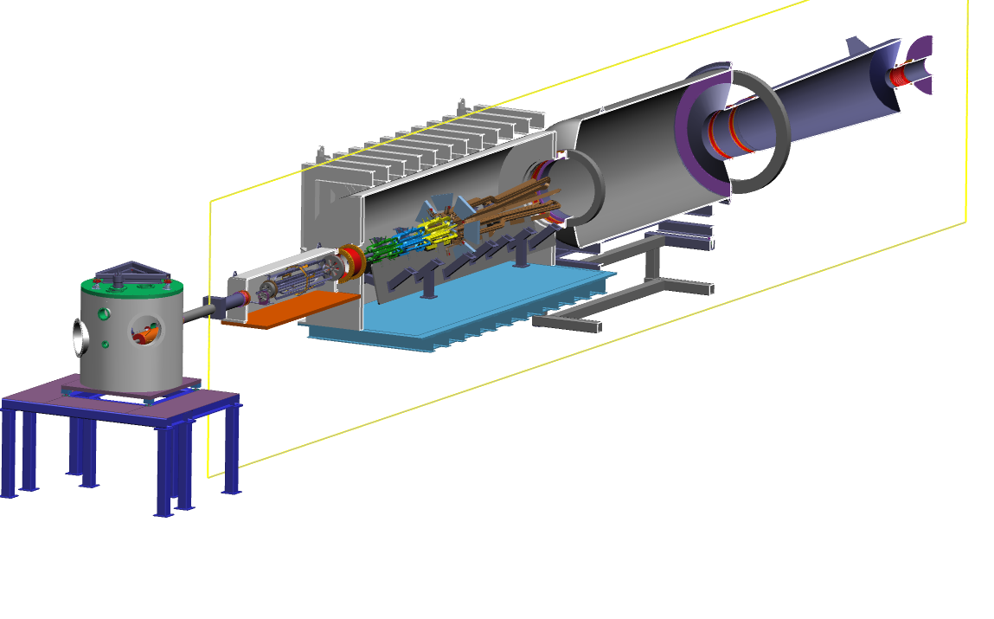
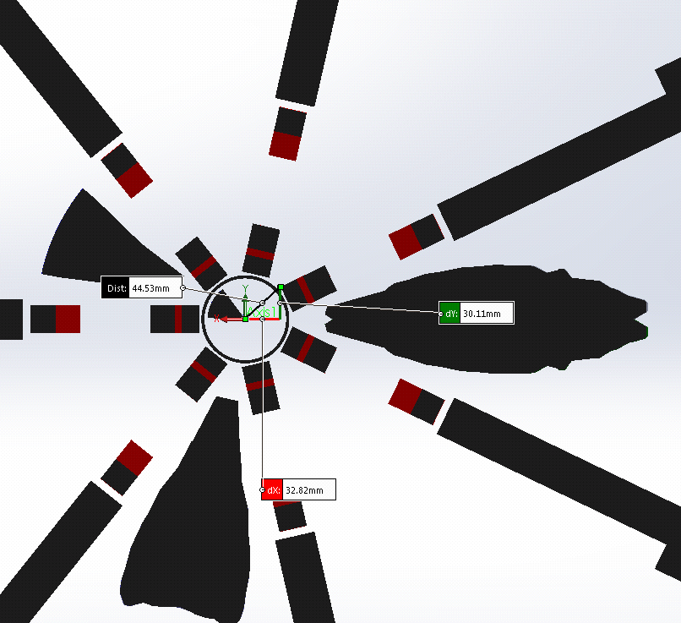
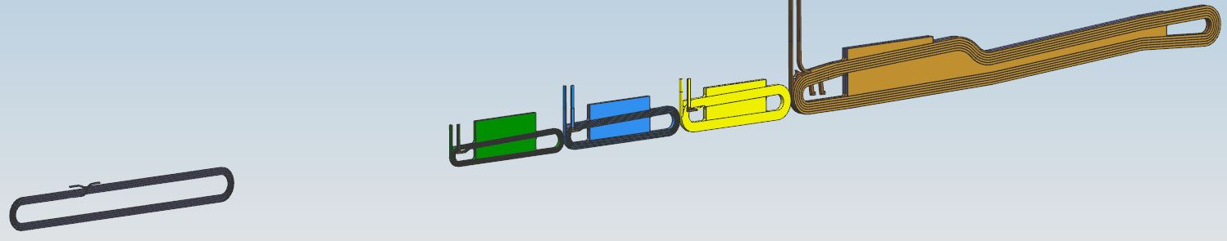

Open Spectrometer system separates signal from backgrounds
Spectrometer Elements
Set of resistive toroidal magnets (US and DS)
2 collimators to define the acceptance of the signal and that of the unscattered beam
Beam pipe and enclosures
Bellows and supports
collimators to control backgrounds
Blockers to study backgrounds
Lintels and “collars” to shield coils and detectors
Field measurement system
Instrumentation and controls
Acceptance defining collimator
US region $⟹$ MIT
Coils in one septant
particle envelopes
along beamline
Window separating target chamber from US enclosure $⟹$ target group

Slide 4
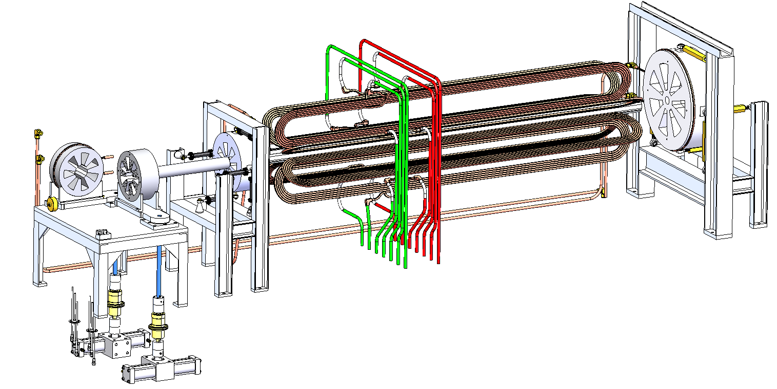
Upstream Region - MIT
Sieve Collimator
Array of high-aspect ratio holes 1mm-10mm
Collimator 4
500mm diameter, 500 kg
2-Bounce Shield
Long, self-supporting / structural piece
Collimator 1-2
Complex 4-piece brazement with internal cooling passages
Blocker Collimator
Cooled during operation
All collimators are pure W or WCu; no nickel is permitted.
All will be housed in a vacuum chamber at 1x10⁻² Pa
All except 2-bounce shield support own weight alone

Slide 5
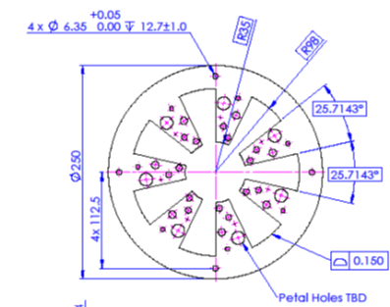
Sieve and Blocker
Blocker used to study backgrounds
  Leave one septant open to study cross-talk?
Sieve holes to be used in optics calibrations
Pattern or hole sizes used to identify holes
Asymmetric placement so we can determine the orientation
10 cm thickness along z, need to take care with aspect ratios of holes
Moveable into and out of the beamline
Needs to be positioned accurately
Optics group will specify the size, number and angle (if any) of holes

Slide 6
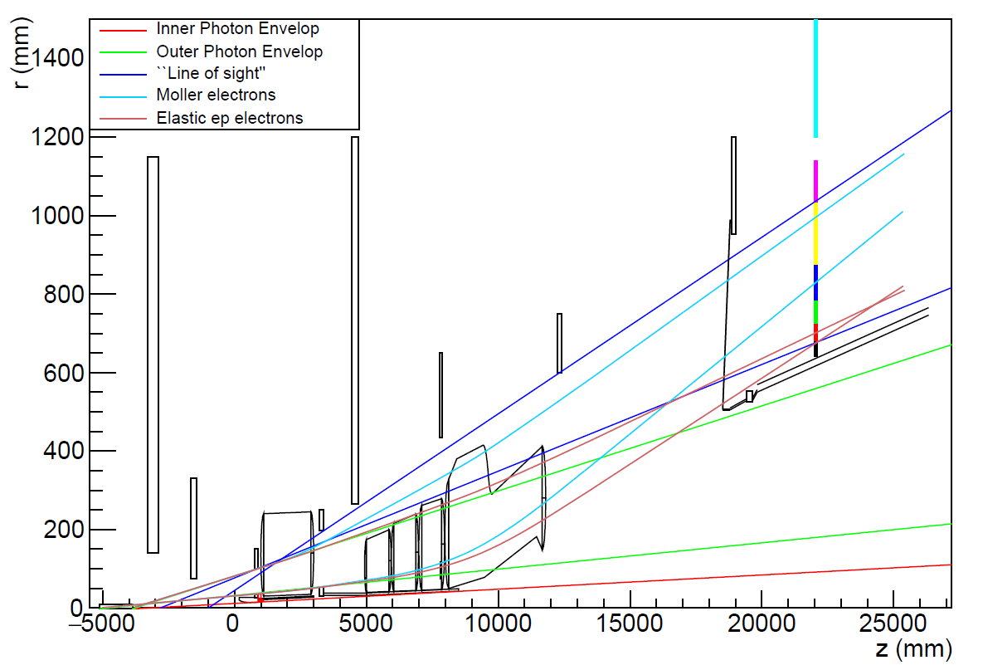
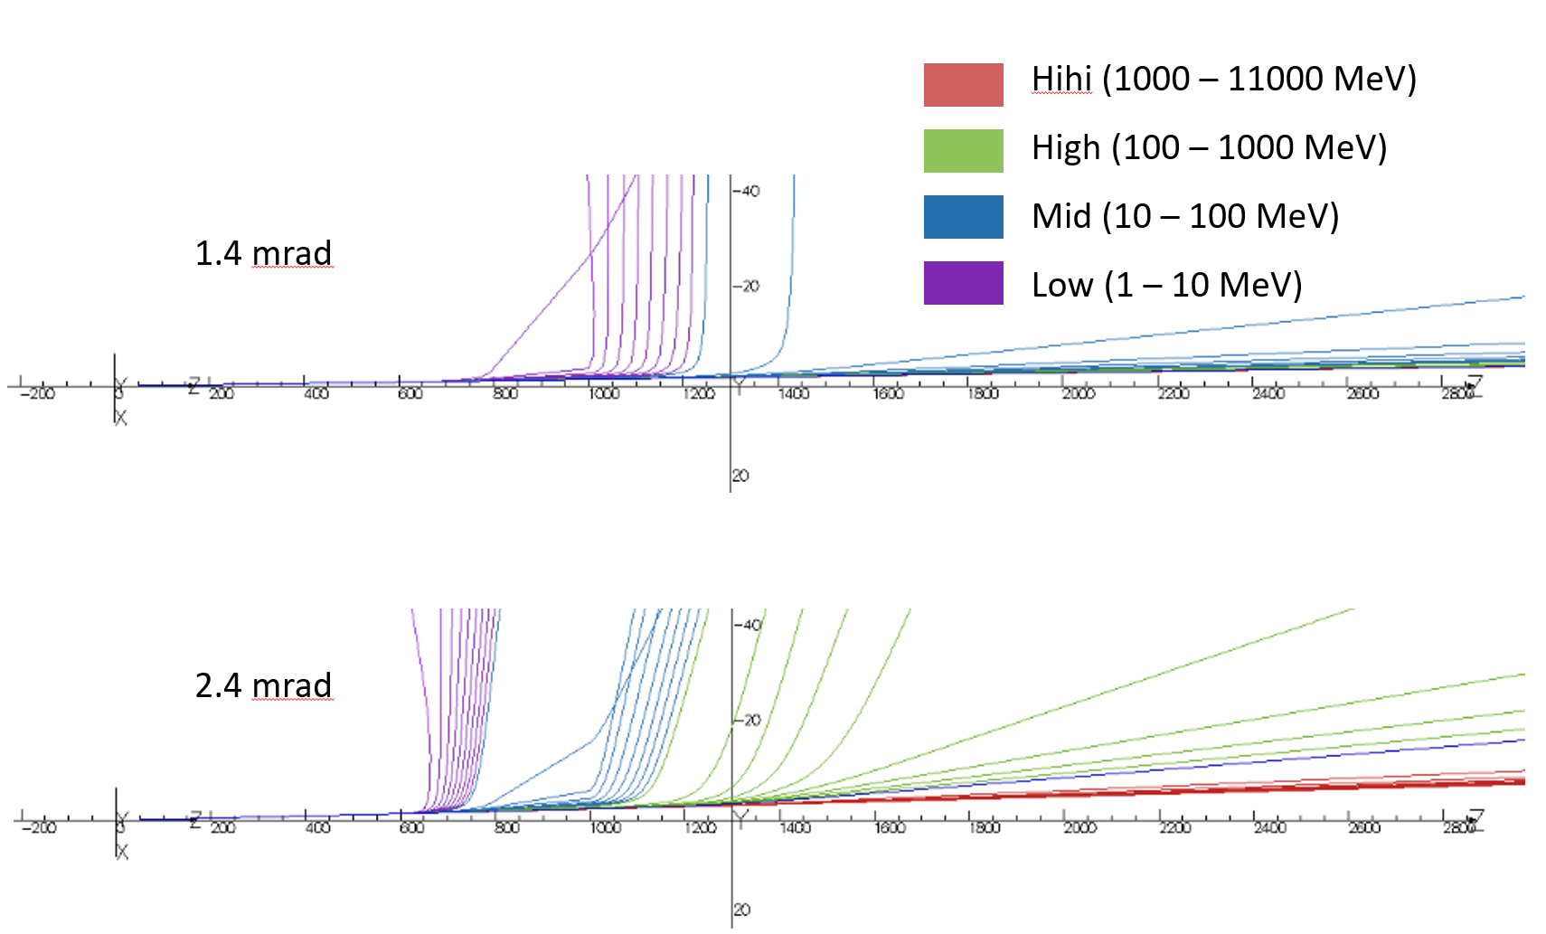
Conceptual ray drawing
Rays for “primary beam” particles of different energies and angles
Ray traces with apertures
All shown in one sector (coils are actually in closed sector)
Positions and sizes verified with simulations (taking into account radiative effects)
Detector plane
Vertical axis centered at ~subcoil 4 entrance
Moller/ep
Line of sight
moller
Collars
ep
Lintels
DS beampipe between OPE and ep envelopes
Collimators
1+2 4
Outer Photon Envelope
Target
Inner Photon Envelope

Slide 7
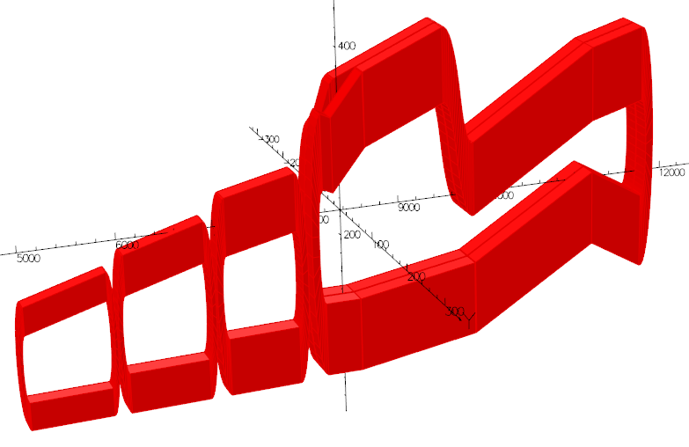
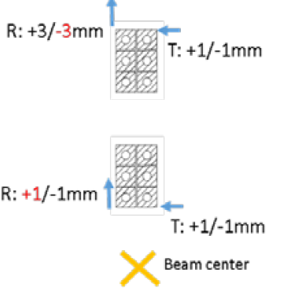
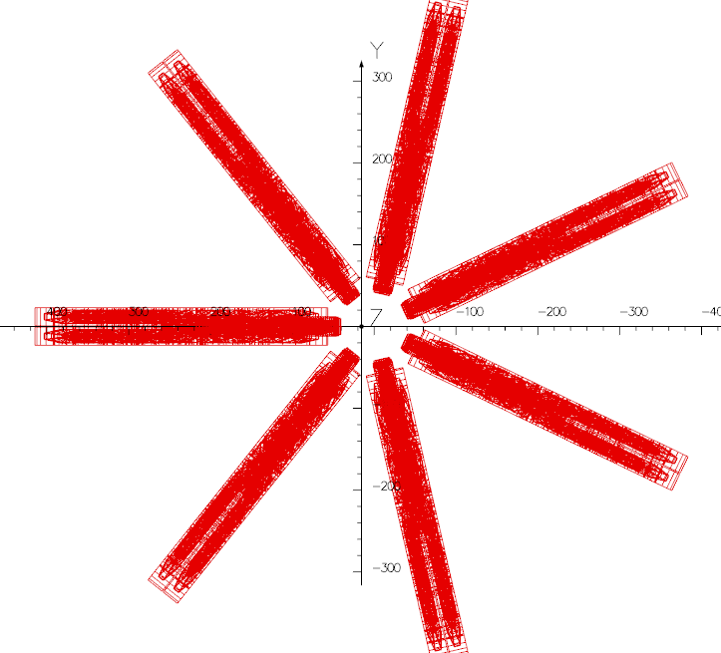
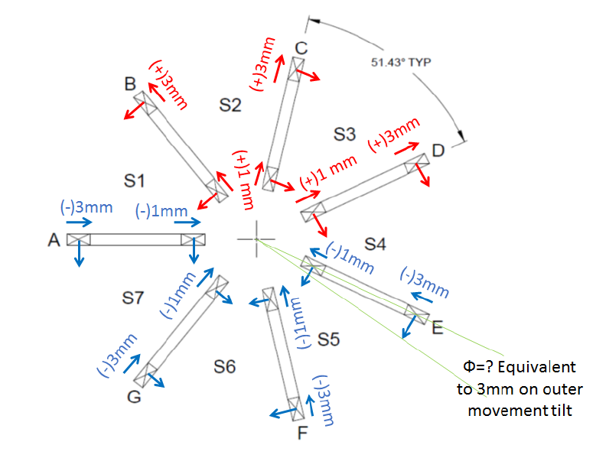
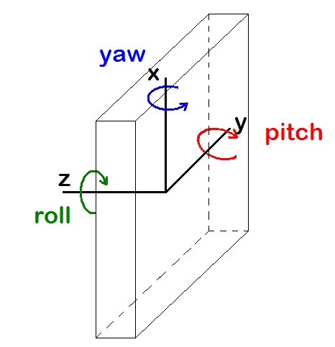
Alignment tolerances
Tolerances determined by single coil/single offset studies have been verified with “worst-case” multiple coil/multiple offsets within the specified tolerances
Considerations
  physics optics (ability to “deconvolute” the asymmetries with desired uncertainty)
    signal electron focal plane distributions
    backgrounds
  clearance with the scattered particle envelopes
  clean transport to the dump
  doses on coils (epoxy, especially at inner radius)
single coil/ single offset tolerances
along z
azimuthally
radially
BEAM worst cases tested
coils aligned in a “conspiratorial” way within tolerances
→ induces dipole along beamline
worst (to left)
more likely - only ±0.5 mm
most likely ±0.5 mm and random for different subcoils
Physics worst case
All coils offset in same direction (without us knowing)
Least likely (survey, tracking)
Relatively insensitive

Slide 8
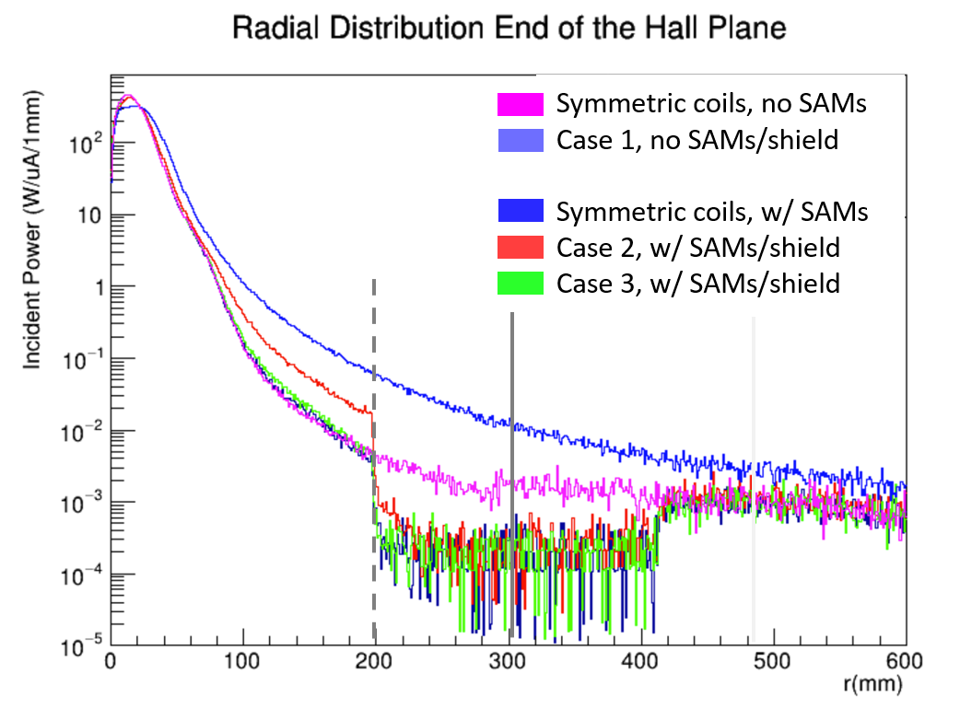
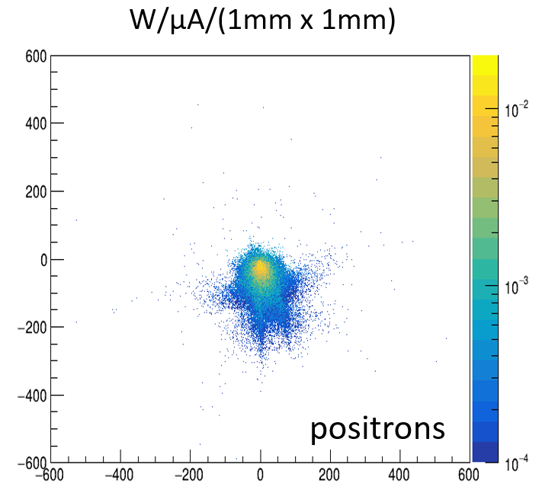
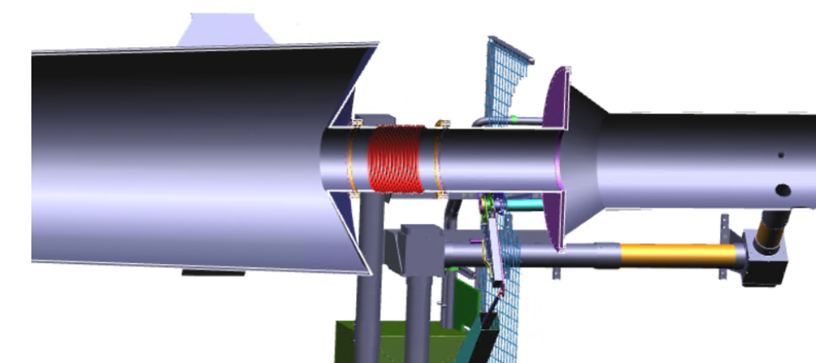
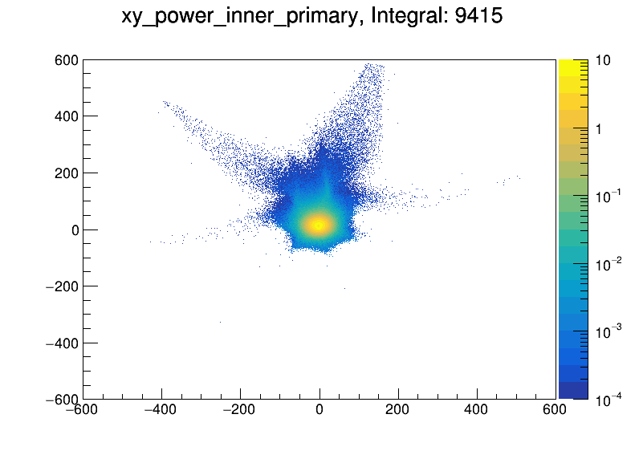
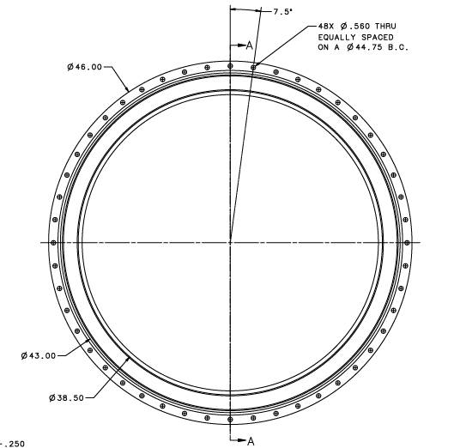
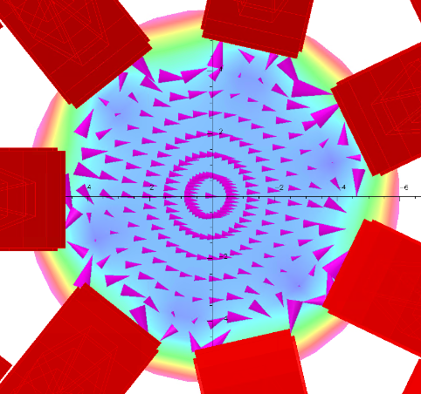
Clean transport to dump
Beampipe for SAMs
OD 400 mm
End of Hall
Worst case scenario
dump entrance
flange (r = 483 mm)
W/µA/(1mm x 1mm)
Total Beam Power 715 kW
Coil Configuration
Integrated Power from 200 mm < r < 600 mm
Symmetric coils, no SAMs
Case 1, no SAMs/shield
Symmetric coils, w/ SAMs
Case 2, w/ SAMs/shield
Case 3, w/ SAMs/shield
38.1 W
260 W
13.4 W
17.8 W
14.2 W
worst-case (within tolerances)
limiting aperture in dump tunnel (r=300mm)
(~0.5 m downstream)
electrons
(most likely configuration)

Slide 9
CTD Epoxy radiation tests
Goal stresses and doses (with factors of ~2)
Shielded doses ~50-100 MGy
Unsheilded doses > 300 MGy
*See Dave’s talk for details

Slide 10
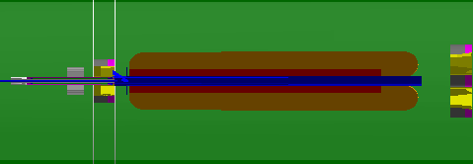
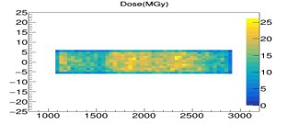
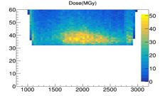
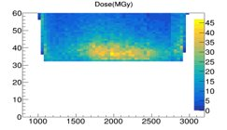
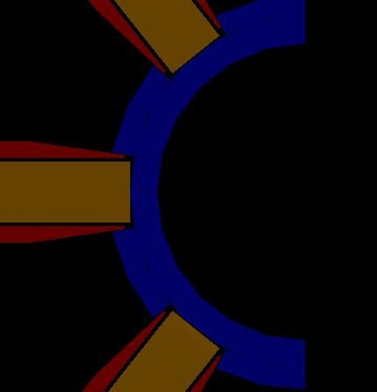
Epoxy shielding optimization (Upstream)
Inner Radial Layer
Left side
Cutaway view from side
Right Side
(Symmetric configuration shown)
Current Status:
Reducing the thickness of the 2-bounce shield tube without adversely affecting the spectrometer epoxy dose and photon backgrounds at the detector plane.
This will reduce the mass of the shielding tube and potentially also the power deposited in the tube itself.
Coil epoxy encasing the conductors
2-bounce shield with cutouts for coils
W wedges
View from downstream
Geo 4, Slide 10
https://moller.jlab.org/DocDB/0008/000892/001/PhotonBackgroundsUpdate%20%282%29.pdf

Slide 11
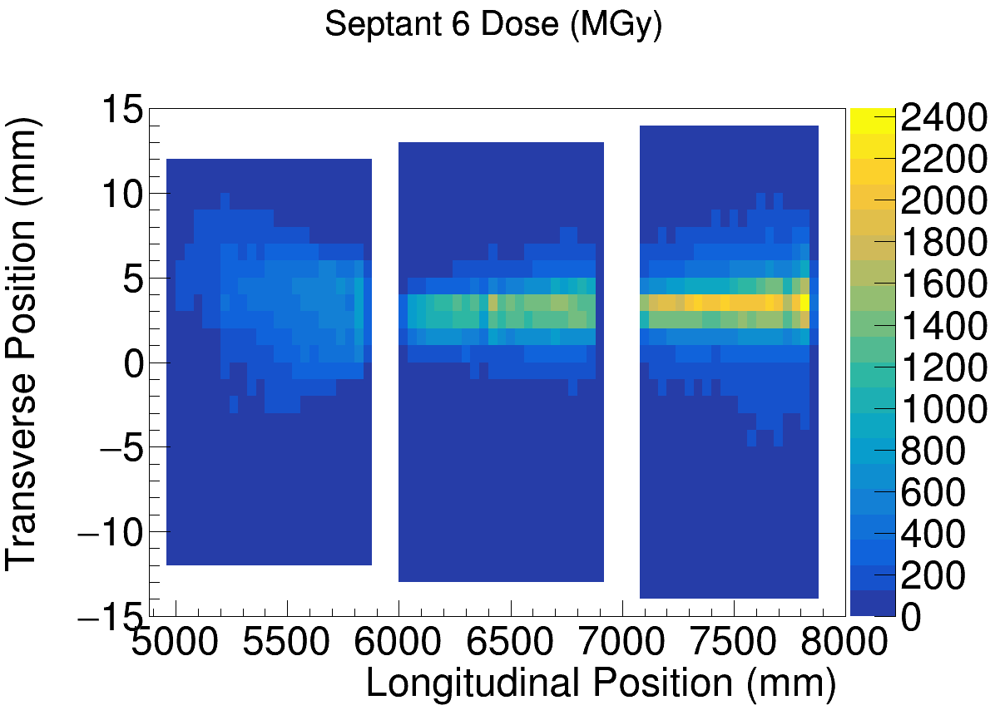
Epoxy dose in DS with worst-case asymmetric map
Yes, that is
2.4 Giga-Gray!!!
Whatever shielding is designed needs to be capable of shielding the coils in a misaligned or asymmetric case
Plates on underbelly reduce this to ~ 100 MGy

Slide 12
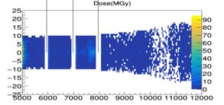
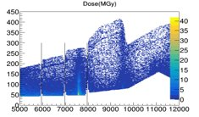
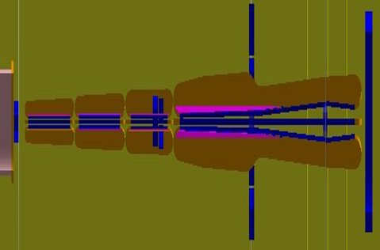
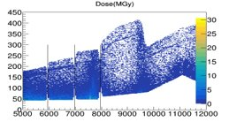
Epoxy shielding optimization (Downstream)
Geo 4, Slide 11
https://moller.jlab.org/DocDB/0008/000892/001/PhotonBackgroundsUpdate%20%282%29.pdf
Inner Radial Layer
Left side
DS 1
DS 2
DS 3
DS 4
Right Side
(Symmetric configuration, with bottom plates)
Current Status:
3 mm thick plates underneath coils in downstream (DS) 1, 2, 3 and 4
The plates are still being optimized for weight
Cutaway view from side
Bottom plates (3mm W) on every coil
w/o shielding, worst asymmetric map results in a dose of

Slide 13
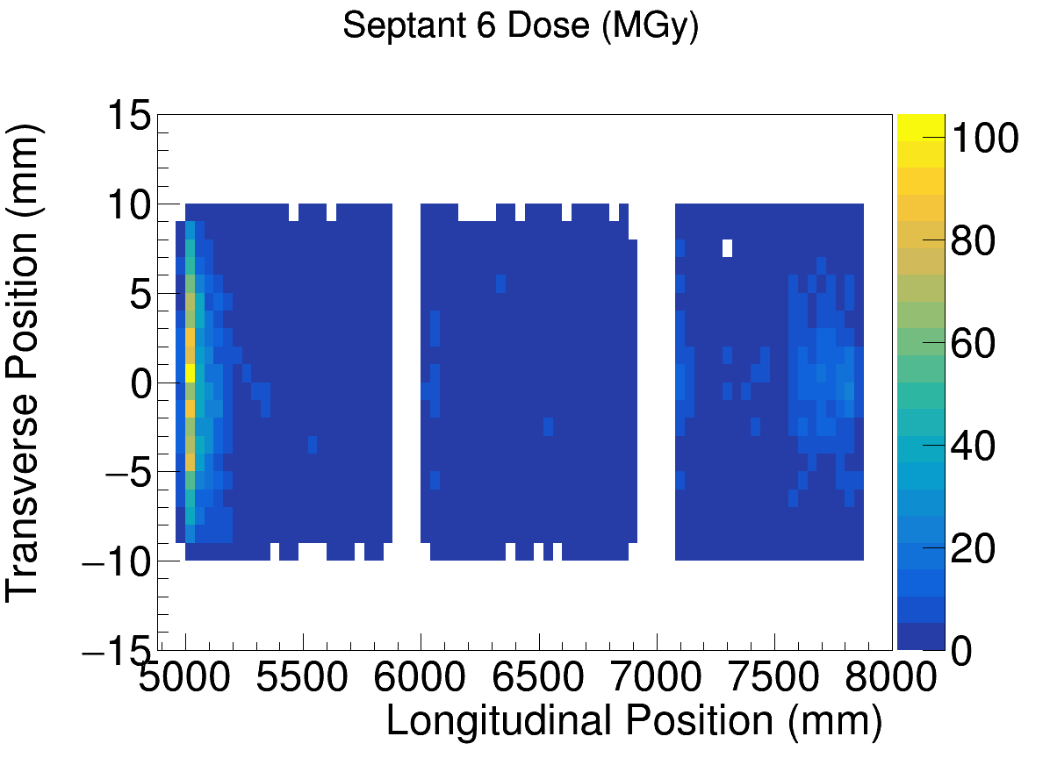
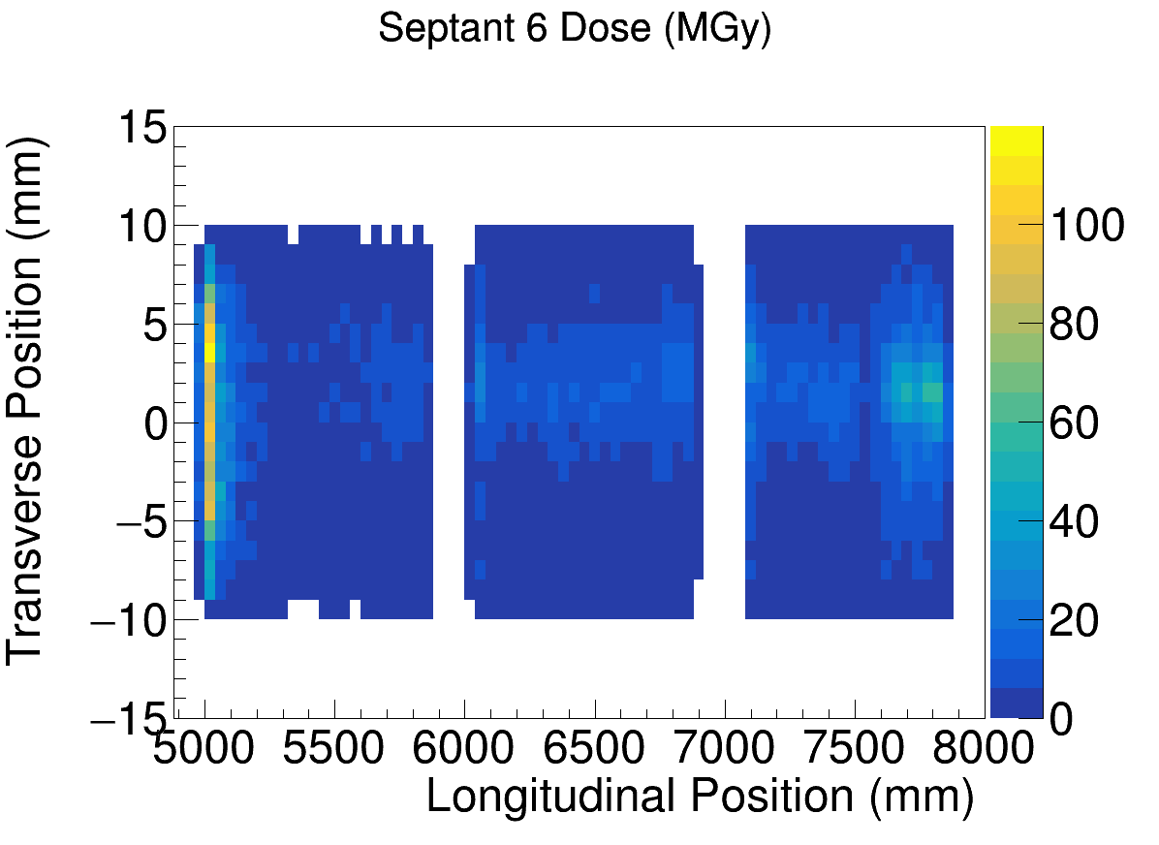
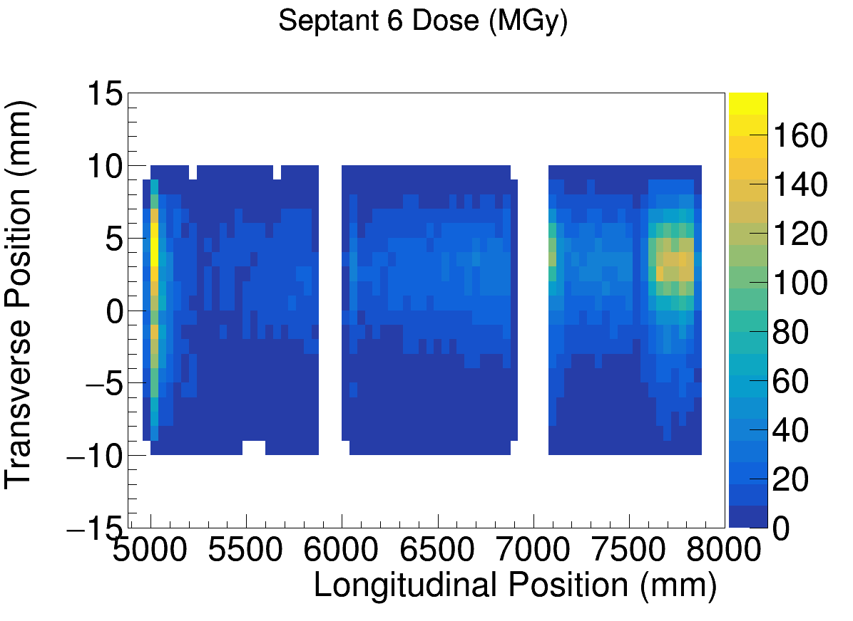
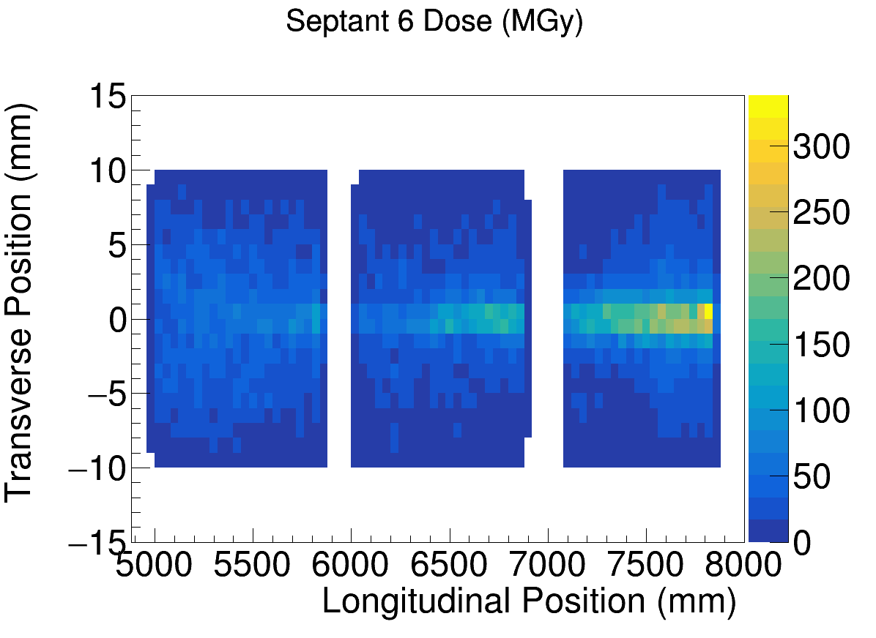
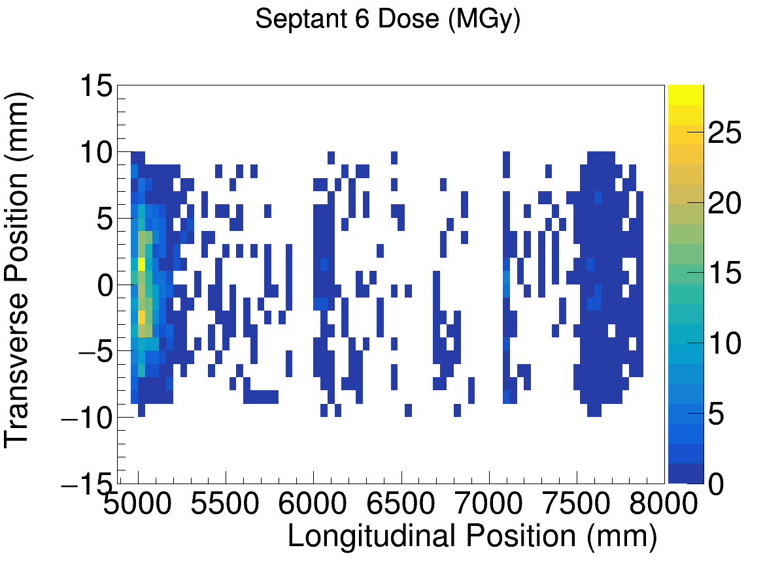
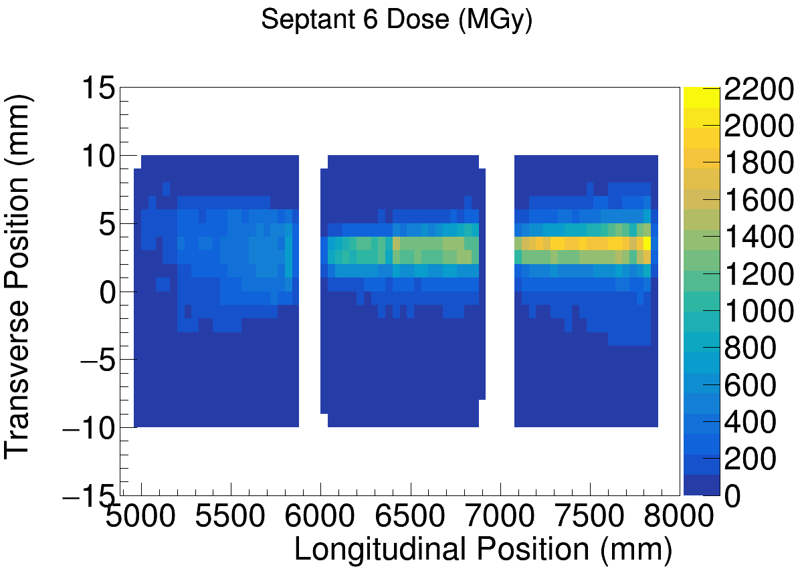
Dose on underbelly in DS
Are stresses high at same place where dose will reduce the strength?
* “Kryptonite” stops all tracks that hit it.
Symmetric, w/ shield
+/- 0.5 mm offset, w/ shield
+/- 1 or 3 mm offset, w/ shield
Symmetric, no shield
Symmetric, Kryptonite* shield
+/- 1 or 3 mm offset, no shield

Slide 14
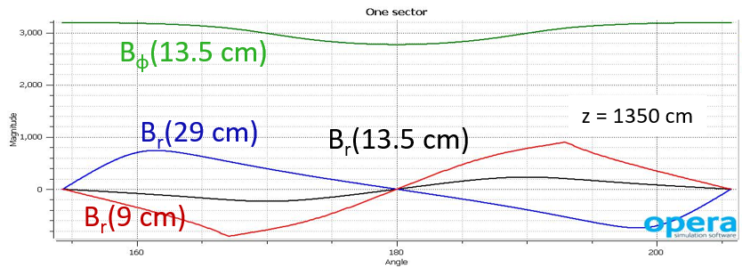
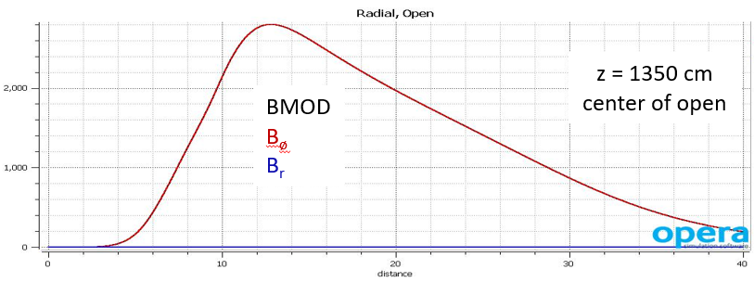
Modelling the as-built coils
Several ways to determine the positions of the conductor
Mechanical surveys
Tracking measurements
Field measurements – chance to adjust coils
Field measurements:
Perform the measurements during the magnet testing
Each individual magnet set (upstream, and DS 1-4)
Compare to calculations (TOSCA) for offset coils
Goal: minimize the dipole field in the bore
B (Gauss)
160 180 200
Azimuthal angle (degrees)
B (Gauss)
0 100 200 300 400
Radius (mm)

Slide 15
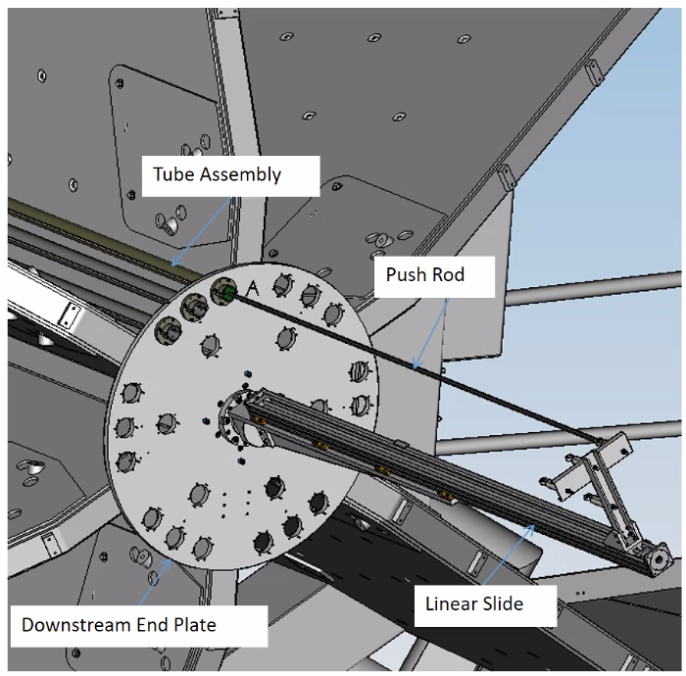
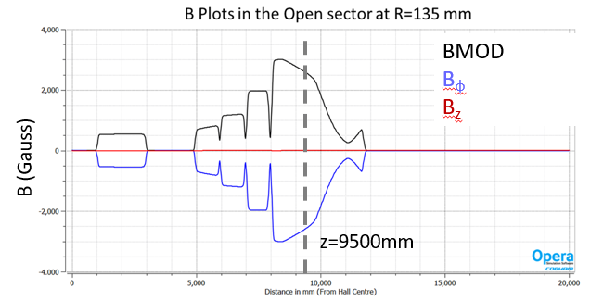
Magnetic Field Measurements
Existing apparatus with motion mechanism used to successfully measure the field in the CLAS12 magnet
Probe can be moved along z for a given radial/azimuthal position
Will need longer tubes for the DS4
Every 5 cm along 2 m in z takes ~ 2 hours, with 2.5 hours to change
Modified plate for our desired locations
0 5 10 15 20
Distance from target center (m)

Slide 16
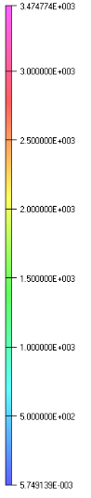
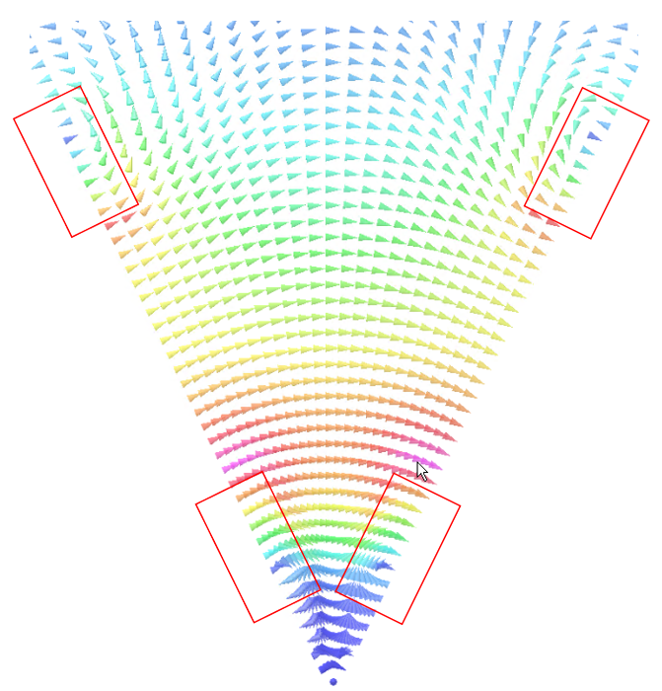
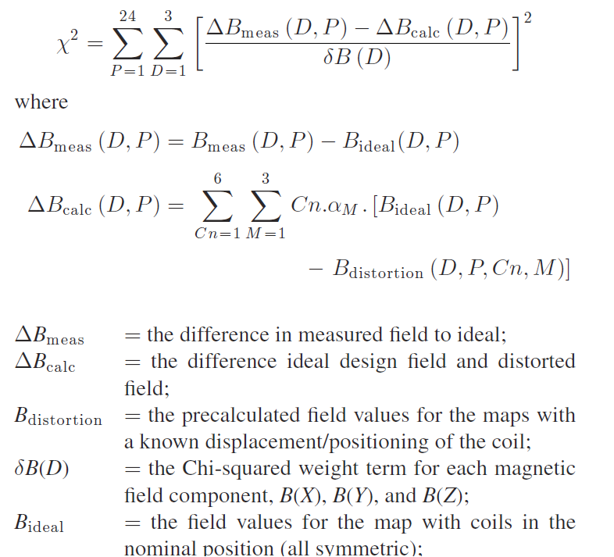
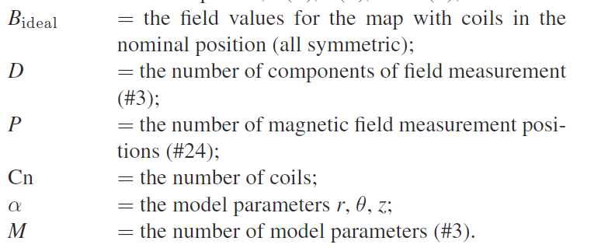
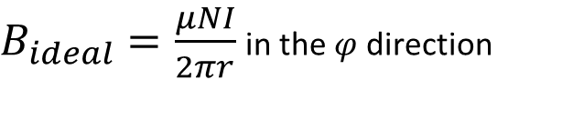
Optimization of the positions
z=9500mm
Vector map colors show relative total field strength in a septant
Radial components of field cause azimuthal (de-)focussing near the conductor at the (outer) inner radius of the conductor
  Provides required inelastic electron separation
  Causes mid-angle mollers to fill full azimuth at detector
Field varies along z to separate the low E moller and high E eps
azimuthal de-focusing
azimuthal focusing
R=135mm
Conductor and tube cross-sections approximately to scale
How many points along z do we need? How many $\left(r,φ\right)$?
$B_{ideal}=\frac{μNI}{2πr}$ in the $φ$ direction
Notes:
This contour plot shows the relative strength of the total field in different locations within a septant. The approximate locations of the adjacent coil cross-sections are shown in orange. Illustrative field vectors indicate the direction of the field at different places. The radially focussing part of the field is the phi component; at the center of the septant the field is all in the phi direction. Near the coils, however, you have components in the radial direction. In between the inner radius parts of the coil, this results in azimuthal focussing of electrons; in between the outer radius parts of the coils we get phi defocussing. We make use of the focussing in phi to study the different parts of the acceptance.

Slide 17
Ongoing work (on physics side)
Optimizing the epoxy shielding
  Reducing weight
  Shielding where stresses and doses highest
  Ensuring it will work even with worst-case offset coils
Checking the energy deposition in layers
Optimizing the field measurement procedure
Simulations of the prototype coil (changes due to manufacturing)
Defining the system requirements (SRD)
Preparing for the TRD

Slide 18
Appendix

Slide 19
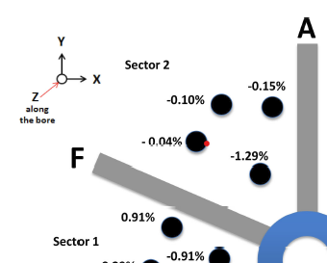
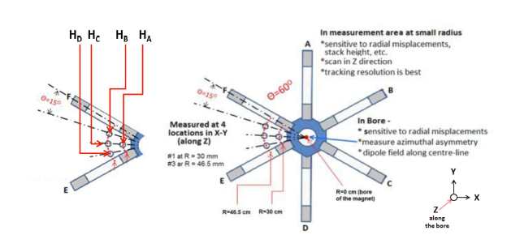
make a distortion using a shunt to compare to simulation

Slide 20
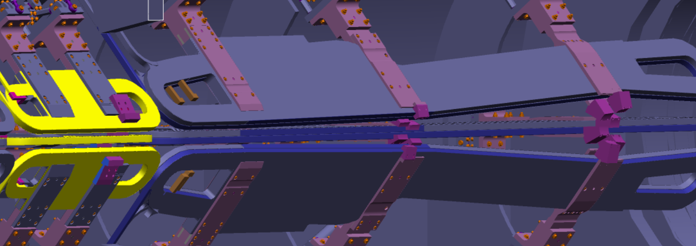
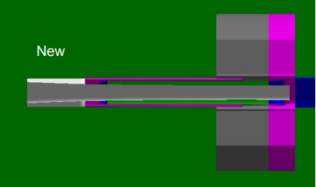
Collimator system
Upstream region
Collimator 2 defines angular acceptance for signal
Collimator 1 inserted into 2 to shield end
Wedges and “2-bounce” tube to shield US torus epoxy
Downstream region
Collimator 4 has a similar profile to 2 – “cleanup collimator”
Collimators 5 and 6a, b provide additional clearance to coils
lintels and collars provide shielding

Slide 21
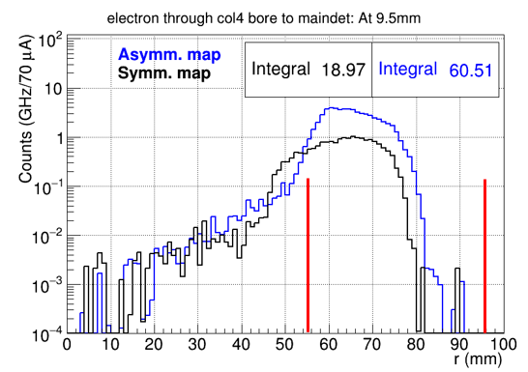
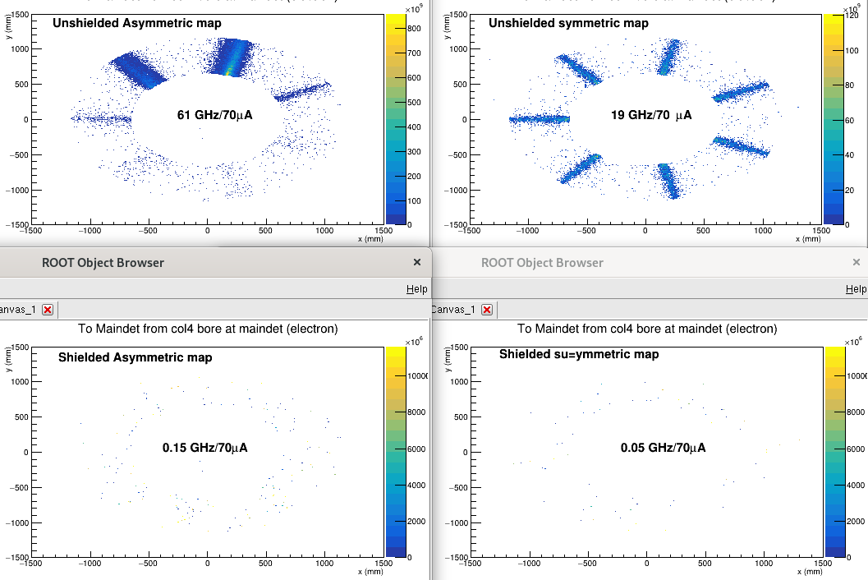




Collimators 5 and 6a,b
At the main detector
at 6a location
US z=7547.93mm
DS z=7647.93 mm
no Col 6a or b
Collimator 5
Shielded
at 6b location, with col 6a in place

Slide 22
Outstanding questions for physicists (from last meeting)
Field map and interpolation tests – our current maps are okay
  Extent – can/should it be smaller than 75 cm in the downstream?
  Coarseness of grid – probably okay; want to test the limits, optimize
  Interpolation – default is linear interpolation, investigating cubic as well
Dose reduction on epoxy
  Downstream – absolutely possible; just needs to be done
  Upstream – needs careful design
Effects of offset coils – needs to be considered in every study (still recommended)
Tolerable vacuum level determination – beamline backgrounds (Cip’s talk)
Dipole field specification – depends somewhat on some of the things above
Field measurement system needs
Continued iteration with JLAB and MIT engineers
Not started
Deprioritized
In progress
Done

Slide 23





Fields produce desired particle tracks
Side view of $φ$=0 field and tracks (center of open septant)
Tracks are 6 and 21 mrads for both ep and mollers, from 3 different parts of the target
Tracks have energy/angle correlation, but not the radiative effects in the target
detector plane z=2650cm
2D rate
Dashed lines indicate the extent of a single septant
Transport through the magnets causes the moller “envelope” to be azimuthally defocussed
The add’l segmentation in moller ring allows for monitoring of systematics
Require 20% less up to 10% higher current for background determination
ep
moller
1D radial dist., all $φ$
includes rad. eff.
Red – “open” sector
Blue – closed sector
Green – transition sector
Notes:
This slide shows another contour plot showing the relative total field at the center of an open sector in a plane parallel to the beamline. Superimposed are two sets of particle tracks produced in TOSCA; one for the electrons from elastic ep scattering and the moller electrons. In the lower right is a 1D distribution of these events from the GEANT simulation which includes all the radiative effects in the target. You see the long radiative tail from the elastic events underneath the MOLLER peak is approximately flat; to minimize this and the inelastic background we want as tight a focus in the moller peak as we can get.

Slide 24


Ultra-precise measurement of weak mixing angle $⇒$ Standard Model Test
The signal is an asymmetry
$$A=\frac{Y_{+}−Y_{−}}{Y_{+}+Y_{−}}$$
from e⁻e⁻ scattering
High precision yields a weak mixing angle measurement to test the Standard Model
  Need a high beam current, high polarization and a long target
  Maximize the acceptance while minimizing backgrounds
Identical particle scattering
  Achieve full acceptance by detecting the “other” electron in opposite septant
  Results in a large range of energies and angles in lab frame
Special considerations
  “No” iron in the magnet or collimators (parity experiment)
  Limited space to fit the conductor
  Understanding of backgrounds including the dilution (rate fraction) and asymmetry
Notes:
The high precision of the MOLLER experiment is key to testing the Standard Model. So we need a high current, highly polarized beam and a long target. In addition, we want to have the biggest acceptance we can have with tolerable backgrounds. We benefit from the fact that our signal is from single particle scattering (more on the next slide) to achieve full azimuthal acceptance around 90 degrees in the center of mass, which results in a large range of lab scattering angles and energies.
In addition, we want to exclude any magnetic materials and fit the experiment in the hall, because this is a parity experiment and our signal is an asymmetry; iron has a large analyzing power. We also need to minimize background rate fractions but also be able to determine their asymmetries.

Slide 25
Epoxy shielding is being optimized to reduce the weight of the shielding
Upstream torus
  shielding is sufficient – optimizing to reduce weight of 2-bounce shield
Downstream Torus
  shielding configuration works for the asymmetric coil configs
  expected stresses may be low enough for 100 MGy integrated dose
  only stresses present during operation matter wrt the dose
Check dose for G10 filler material density in the simulation

Slide 26
Engineering designed to meet the physics requirements
The spectrometer system must
  Achieve the physics optics (bend particles) by
    defining the angular acceptance in a well-defined way
    separating the moller and elastic ep electrons
    providing 3 kinematic regions of the inelastic electrons (to deconvolve the asymmetries)
  Shield the experiment by
    minimizing the backgrounds at the detector
    reducing the conductor epoxy and G10 filler dose from excessive radiation to acceptable levels
    ensuring clean transport of the primary beam to the dump
  Operate for a long running time (344 PAC days)
The acceptance of the moller electrons is defined at collimator 2
The shape of the coils and the specified tolerances achieve the physics optics
Field stability requirements modest due to averaging over time and cancellation b/c measuring asymmetry
Collimator 1 defines the primary beam through experiment to the dump
Coils and supports obey > 5x multiple scattering radius by design
The collimators, lintels and beam shields are all designed to minimize the backgrounds at the detector plane
The shielding is being optimized to shield the coil epoxy/ G10 filler as well to maintain shear strength

Slide 27


100% Azimuthal Acceptance Possible
Appendix
Need to shield conductors/ supports
Energy and scattering angle strongly correlated for mollers (eps are all ~11 GeV)
Maximize azimuthal acceptance
  identical particle scattering
  accept COM angles around 90◦
Large energy and angle range to focus
21 mrad
9.5 mrad
6 mrad
Acceptance defining collimator
Lab Frame
Detectors in open sectors
e-
2 < E’ < 8 GeV
e-
6 < θ < 21 mrads
e-
e-
e-
Forward and backward (in COM) scattered electrons from two events (line type links electrons from same event)
e-
Coils in closed sectors
Any odd number of coils will allow for 100% $φ$acceptance

Slide 28

Shape of Field in a Septant – varies along z, and also along r and $φ$
Appendix
z=9500mm
Vector map colors show relative total field strength in a septant
Radial components of field cause azimuthal (de-)focussing near the conductor at the (outer) inner radius of the conductor
  Provides required inelastic electron separation
  Causes mid-angle mollers to fill full azimuth at detector
Field varies along z to separate the low E moller and high E eps
azimuthal de-focusing
BMOD
B_{φ}
B_{z}
azimuthal focusing
R=135mm
B (Gauss)
z=9500mm
$B_{ideal}=\frac{μNI}{2πr}$ in the $φ$ direction
Notes:
This contour plot shows the relative strength of the total field in different locations within a septant. The approximate locations of the adjacent coil cross-sections are shown in orange. Illustrative field vectors indicate the direction of the field at different places. The radially focussing part of the field is the phi component; at the center of the septant the field is all in the phi direction. Near the coils, however, you have components in the radial direction. In between the inner radius parts of the coil, this results in azimuthal focussing of electrons; in between the outer radius parts of the coils we get phi defocussing. We make use of the focussing in phi to study the different parts of the acceptance.

Slide 29








Stray fields in beampipe deflect e±
Appendix
10⁻⁶
e⁻
e⁺
$${\vec{F}}_{+}$$
$$×$$
$$\vec{v}$$
$$\vec{B}$$
$$×$$
$${\vec{F}}_{−}$$
Worst case scenario
Consider the horizontal coil, in the perfectly symmetric case
all velocity in the z-direction
field is vertical along the x axis, (mid-plane of coil)
just off the axis,
  the field direction is dramatically different
e⁻ will be bent to the right
e⁺ will be bent to the left (onto the coil)
  e± would feel both horizontal and vertical components of force
  dispersed

Slide 30






Downstream Coil B Dose (MGy)
Appendix
* “Kryptonite” stops all tracks that hit it.
Symmetric, w/ shield
+/- 0.5 mm offset, w/ shield
+/- 1 or 3 mm offset, w/ shield
Symmetric, no shield
Symmetric, Kryptonite* shield
+/- 1 or 3 mm offset, no shield

Slide 31


Using the whole detector array
Appendix
Although we call the rings moller or ep rings, we actually use more than one ring to determine the moller asymmetry
We will use the different contributions of the rate and asymmetry for each of the processes in each of the detector tiles to “deconvolute” the asymmetries for each process
Measurements to benchmark simulation with tracking system
  low current runs - rate distribution on array
  alternate beam energies
  neutral dilution determination
high current - vary magnet currents to see how rates changes from quartz to quartz (20% less up to 10% higher current)
Notes:
we will also take measurements with
the tracking system triggered on the main detectors (or even pulser
triggered), where the GEMs and the trigger scintillators can then reject
charged particles in software, and we can get at the pure neutral
dilution directly

Slide 32


Sector Orientation
Appendix
Closed sector to beam left to shield synchrotron radiation from hall A arc
Horizontal coil

Slide 33

Finite Target Effects - Example
Appendix
The acceptance varies along the length of the target
Requires mapping with the tracking system
θ_{high,down}
Expected Q² distribution
R_{outer}
θ_{high,up}
θ_{low,down}
θ_{low,up}
R_{inner}
z_{targ,up}
z_{targ,center}
z_{targ,down}
z_{targ,up} = | -75 | cm
z_{targ,center} = | 0 | cm
z_{targ,down} = | 75 | cm
θ_{low,cen} = | 6.2 | mrads
θ_{high,cen} = | 19.2 | mrads
θ_{low} = | 5.5 | mrad
θ_{high} = | 17 | mrad
R_{inner} = | 3.658 | cm
R_{outer} = | 11.306 | cm
 | θ_{low,down} = | 7.1 | mrads
 | θ_{high,down} = | 21 | mrads
z_{coll} = | 590 | cm

Slide 34
Backups
Backups related to the SRD, things that are still TBD or TBR
Backups for the numbers that are solid if possible

Slide 35



Nominal (symmetric) case – clean transport to dump
Looking downstream
Looking upstream
Beampipe intrusion for the SAMs
(~0.5m upstream)
symmetric
Limiting aperture in dump tunnel
(~0.5 m downstream)
Dump entrance flange
(same z location as plots)
Rate distribution for a slice along radius
Symmetric coils, w/o SAMs
In the top left plot you see a picture of the ds coils at a particular z location with the magnetic field contours and vectors
Middle top plot is a 2D rate distribution at the entrance to the dump tunnel
To the right is a 1D distribution of the rate in horizontal septant (1); the vertical lines indicate the radius of various apertures
Notes:
Next steps are to look deeper into the dump to de

Slide 36

Worst case – clean transport to dump
Looking downstream
Looking upstream
Beampipe intrusion for the SAMs
(~0.5m upstream)
Worst case scenario
Limiting aperture in dump tunnel
(~0.5 m downstream)
Dump entrance flange
(same z location as plots)
Rate distribution for a slice along radius
Case 1, no SAMs/shield
In the top left plot in the worst case scenario there is an induced dipole field > 100 G over most of the area inside the coils
In this particular orientation, the electrons are bent upward into septant 2
To the right is a 1D distribution of the rate in the worst septant (2); even in the worst-case scenario the beam is mostly clearing
Notes:
Next steps are to look deeper into the dump to de

Slide 37



Comparison of cases – clean transport to the dump
Symmetric coils, no SAMs
Case 1, no SAMs/shield
Symmetric coils, w/ SAMs
Case 2, w/ SAMs/shield
Case 3, w/ SAMs/shield
Symmetric coils, w/ SAMs
Case 1
Total Beam Power 715 kW
Integrated Power from 200 mm < r < 600 mm
Case 3
Case 2
Symmetric coils, no SAMs
Case 1, no SAMs/shield
Symmetric coils, w/ SAMs
Case 2, w/ SAMs/shield
Case 3, w/ SAMs/shield
38.1 W
260 W
13.4 W
17.8 W
14.2 W
Most likely
worst case is 10⁻⁴ of total beam power
order of magnitude lower for most likely case

Slide 38

Fields along φ @ z=1350 cm for different r
Appendix
B_{φ}(13.5 cm)
B_{r}(29 cm)
B_{r}(13.5 cm)
z = 1350 cm
B_{r}(9 cm)

Slide 39


Fields along r @ z= 1350 cm
Appendix
z = 1350 cm
center of open
BMOD
B_{ø}
B_{r}
BMOD
B_{ø}
B_{r}
z = 1350 cm
edge of open

Slide 40


Fields along z @ r = 13.5 cm
Appendix
BMOD
B_{z}
r = 13.5 cm
center of open
B_{z} at edge
B_{z} center
r = 13.5 cm
edge of open
non-zero z components near current returns (included in field maps)

Slide 41


2 bounce code
Appendix
Python code
  Target, collar, collimators, beam shields, detector (600, 690-1300 mm)
  Uses straight lines to simulate an isotropic source (with random position, angle)
  Surfaces that “see” the target (red) become new sources
Tolerance study
  move the collimators and/or coils by +/- 1 mm w/o seeing green on the detectors
  sees the target
  sees 1-bounce from target
  1-bounce source
  Proper beam shield

Slide 42





0.4 mrad
Hihi (1000 – 11000 MeV)
High (100 – 1000 MeV)
Mid (10 – 100 MeV)
Low (1 – 10 MeV)
Stray fields only, no solenoid
Sol11 – 600 cm < z < 1700 cm, 10 A/mm²
Sol12 – 600 cm < z < 1700 cm, 10⁴ A/mm²

Slide 43



2.4 mrad
Hihi (1000 – 11000 MeV)
High (100 – 1000 MeV)
Mid (10 – 100 MeV)
Low (1 – 10 MeV)
Stray fields only, no solenoid
Sol11 – 600 cm < z < 1700 cm, 10 A/mm²
Sol12 – 600 cm < z < 1700 cm, 10⁴ A/mm²

Slide 44



3.4 mrad
Hihi (1000 – 11000 MeV)
High (100 – 1000 MeV)
Mid (10 – 100 MeV)
Low (1 – 10 MeV)
Stray fields only, no solenoid
Sol11 – 600 cm < z < 1700 cm, 10 A/mm²
Sol12 – 600 cm < z < 1700 cm, 10⁴ A/mm²

Slide 45







Segmented vs. Hybrid Downselect
$f_{i}A_{i}$ distributions at detector plane
segmented
blockyHybrid
V1U.2a_V1DSg.3
V1U.2a_V2DHy
V1U.2a_V2DSg.1b
V1U.2a_V2DSg.1b
moller
elastic
inelastic
See change control document

