Slide 1
MOLLER Spectrometer – WBS 1.03
MOLLER Collaboration Meeting
June 21-22, 2022
Prototype Coil Test, MPS, I&C and Mapping
Probir Ghoshal
Team - Magnet Group/ENP/Engineering
Jefferson Lab

Slide 2
Outline
Prototype Coil Test
Engineering requirements
Coil Fabrication
QA&QC checks
Measurements and factory test
JLAB Coil Acceptance Tests
Prototype coil test facility
Prototype coil test setup
MPS and I&C
Layout
Protection system layout
Magnet Mapping requirements
SUMMARY

Slide 3
Prototype Coil test
The key component of the prototype coil is the fabrication and testing of a full size pre-production coil (i.e. four sub-coils)
Physics Requirements translated into Engineering Requirements
Reference –
PMAG0000-0100-A0007 MOLLER - Upstream and Downstream Coil Functional Requirements
PMAG0000-0100-A0008 MOLLER - Spectrometer Functional Requirements
Measurements and tests planned as part coil fabrication
Vendor fabrication of coils – individual coils
Visual inspection
Dimensional checks
Leak test (pressure & He)
Coil Hi-pot
Resistance and Inductance check
Testing of coils on receipt at JLAB – individual coils (low current and high current)
The prototype coil allows us to verify and validate: our design and the vendor's manufacturing process
Flow, temperature gradient, pressure drop - validate JLAB design

Slide 4
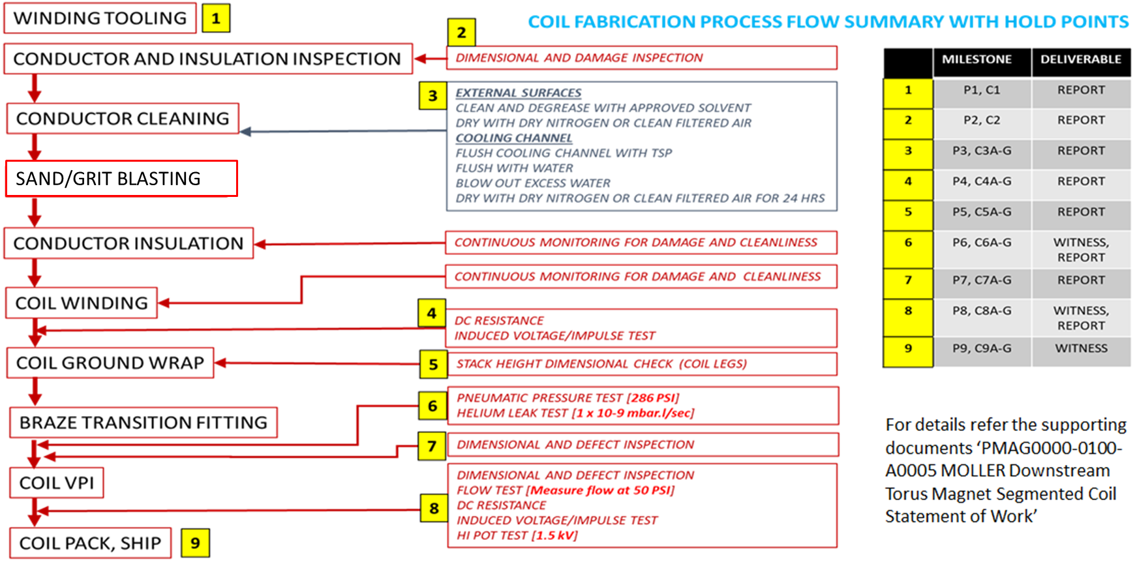
Vendor Coil Fabrication - individual coils

Slide 5
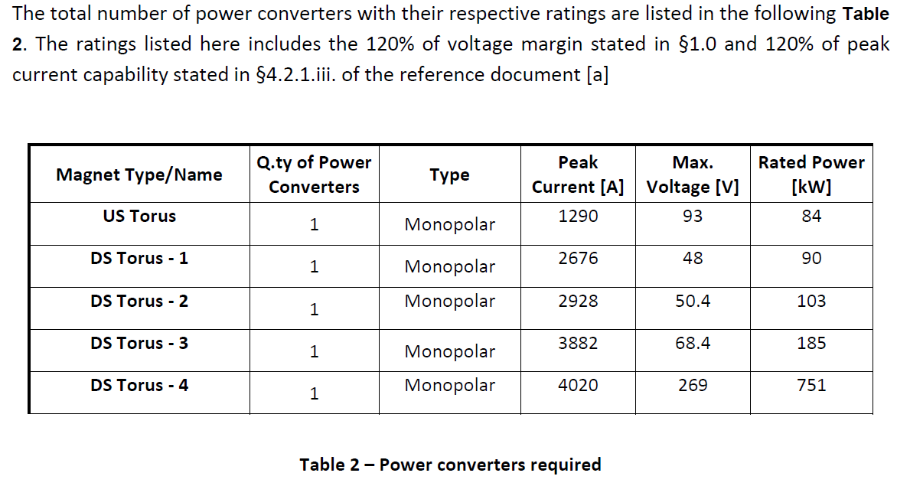
Acceptance Tests and Status of activities
Coil Testing - Mechanical & electrical inspections, and tests shall be performed on each (all individual coils)
Dimensional inspection - made to verify conformance to drawing and specification requirements.
Pressure leak check and helium leak check
DC Resistance and inductance measurement
DC Hi-pot tests (Line to GND) - establish an intimate Ground plane each circuit at 1.5 kV, e.g. at the clamping location(s).
Water Circuit Test – Flow, pressure drop and temperature tests (low current test @800 A)
establish and evaluate mechanical and thermal stability of the coil with reduced flow (per flow path)
Status of activities
Power Supplies Functional requirements - PMAG0000-0100-S0015 MOLLER (COMPLETE)
Physics and Engineering Requirements for Magnet Power Supplies (COMPLETE)
Magnet Power Supplies Specification Document both US & DS - PMAG0000-0100-A0014 (COMPLETE)
Prototype MPS (DS Torus3) – ORDER PLACED with OCEM, Italy.
Hall A – Location of PSUs and Lead Routing (COMPLETE)
Water-Cooled Leads, Air-Cooled Jumpers - Design (COMPLETE) and Interfaces (IN PROGRESS)
Control, Instrumentation (IN PROGRESS, ALONG WITH P&ID)
Environment Safety and Health (IDENTIFIED AND INCORPORATED AS REQUIRED)
Test Lab set-up and plan for the prototype coil (In Measurement Lab)
Challenges with MPS for test (Low current test and high current test)

Slide 6
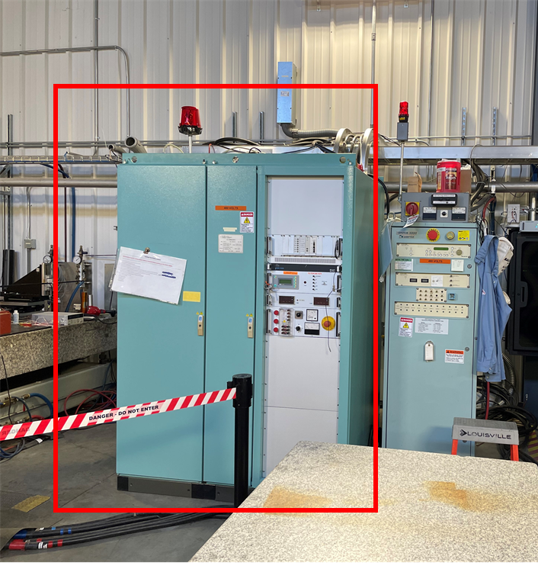
JLAB Coil Acceptance Tests - Prototype Coil Test Facility
Moller at Magnet Measurement Facility
Existing OCEM – MPS
166 kW PS, Vmax = 200V, Imax = 830A, connected to EPICS controls
DC Power is currently performing maintenance and certification testing on the PS in progress….
Facility
10T Overhead Crane
Surface plate up to 5m length
LCW connections (ΔP = 73 psi, Psupply = 110 psi, Tin = 35 deg C)
Safety beacons (Entrance Doors/Power Supply's) and red-white electrical Limited Approach Boundary
OSP’s available for testing
Test of Prototype coil in test lab (USING the basic control hardware from Dump solenoid in UITF)
Primary Control using PLC Based: Allen Bradley CompactLogix
Local Control only, network access only for archiving to JLAB OPS
Direct Interlock capability 5 or 24 VDC (e.g. voltage, temperature, field, flow, etc.)
Magnet is used to pretest the set up for the prototype coil inspection (HDIce Dump solenoid 320A)
All I&C and control and read back to EPICS with the MPS in the Magnet Measurement Lab
Address the operating parameters and requirements for testing - Flow, temperature, pressure, current, and voltage (available from operating manual max I=320A)

Slide 7
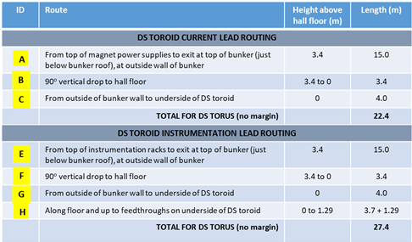
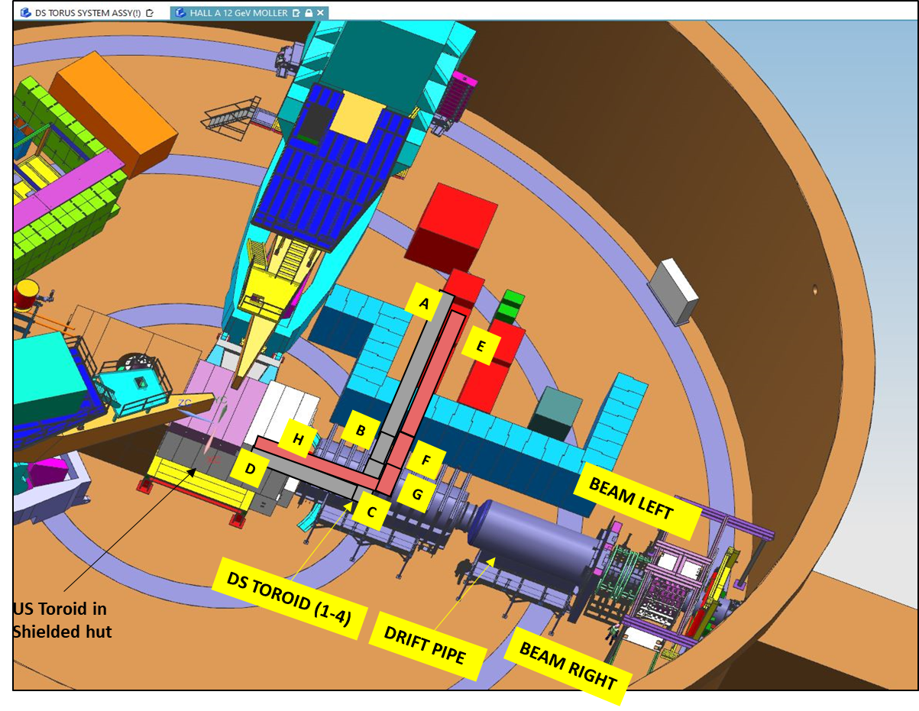
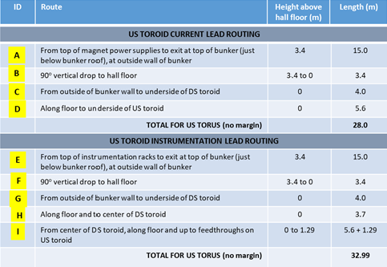
Magnet Power Supplies, I&C: Routing from MPS bunker to enclosure
The water cooled leads/bus design and specification - COMPLETE
Both PSU and Magnet end - Flexible copper air-cooled/in vacuum jumpers - COMPLETE
MOLLER Spectrometer - Spec and RFQ US_DS Magnet WCL & Jumper leads PMAG0000-0100-S0017 (Draft completed)

Slide 8
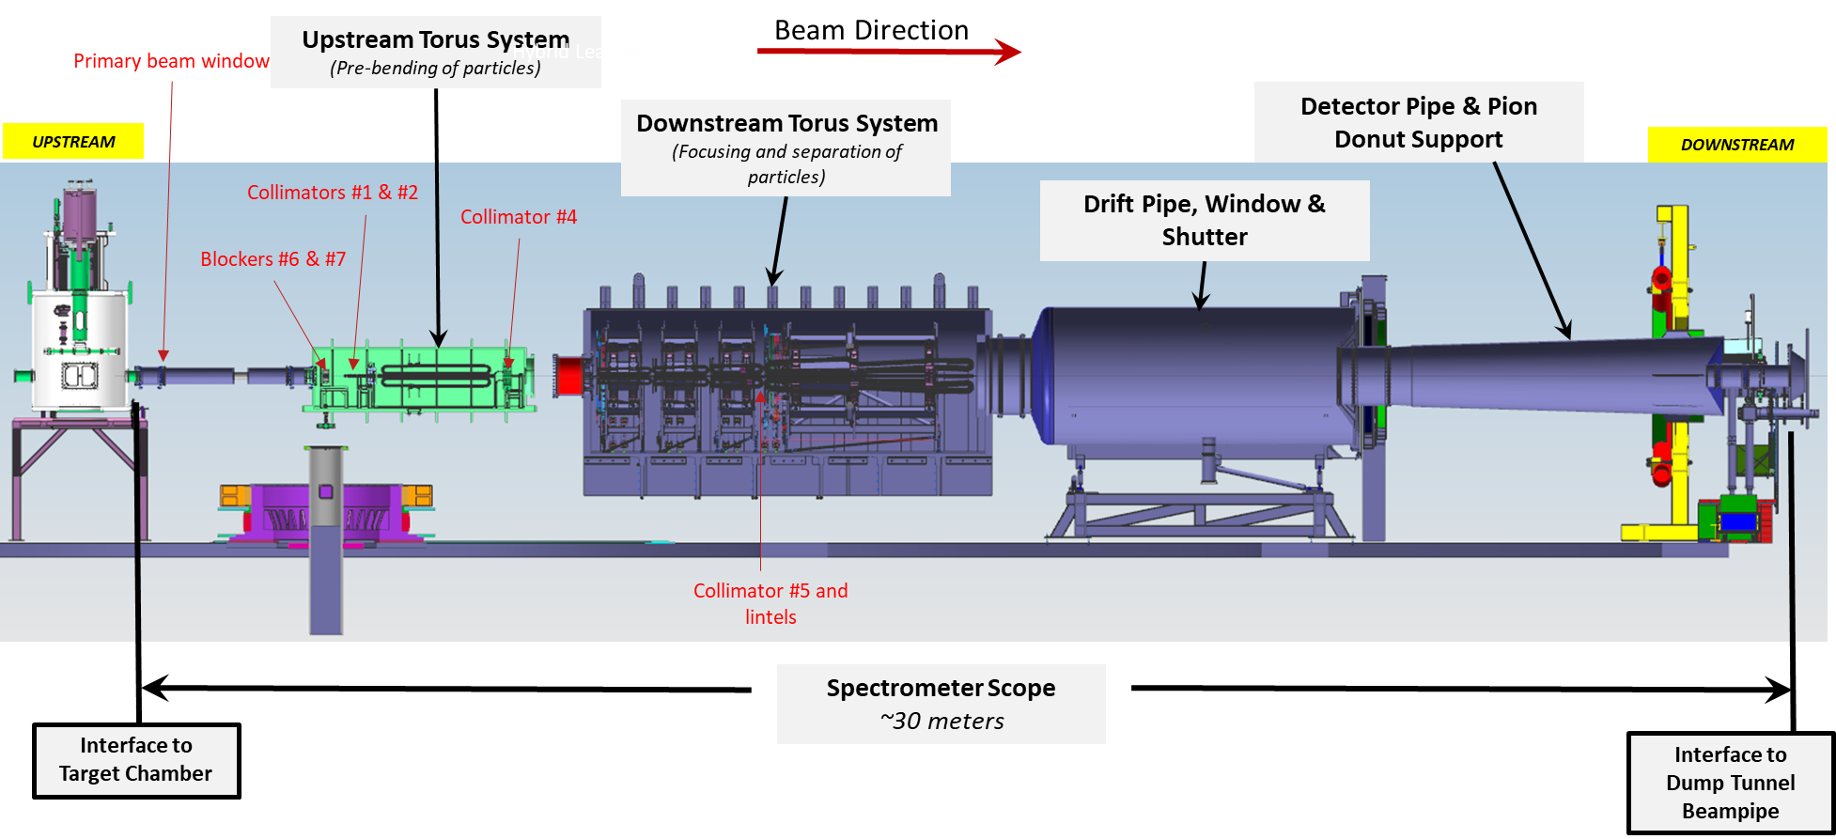
Engineering – Basic layout (Instrumentation and Control)

Slide 9
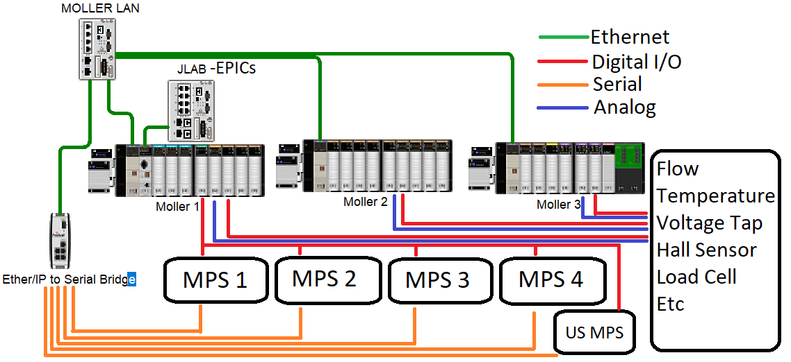
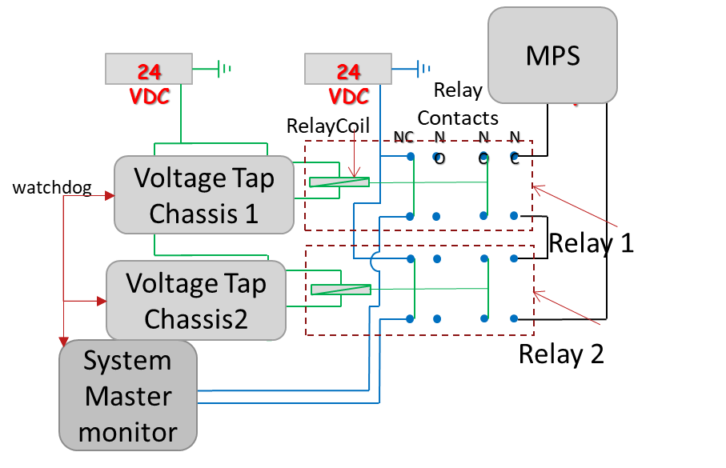
Magnet Power Supplies, I&C : Protection System layout
Sensor Node based controls
Primary Control provided by master processor with 1g/b Ethernet Interface
Dual Ethernet Interface
1 for JLAB: IOC/EPICS, remote programming, remote diagnostic
2 for Private Local Network for critical instruments
Direct Interlock capability 5 or 24 VDC (e.g. voltage, temperature, field, flow, etc.), each Chassis can independently safe out the system
Primary protection is accomplished using one hardwired multi-channel voltage tap readout chassis
A second multi-channel voltage tap readout runs through a PLC
Each chassis reads the same voltage taps and performs the comparator function in parallel
Chassis is JLAB designed FPGA system and targeting 100hz to 2.7khz sample rate. All hardwire interlocks shared with system master digital input for monitoring and diagnostics
Heartbeat messages are sent across nodes via Ethernet allowing automated response during communication outages
Secondary protection is on outlet temperature of each coil

Slide 10
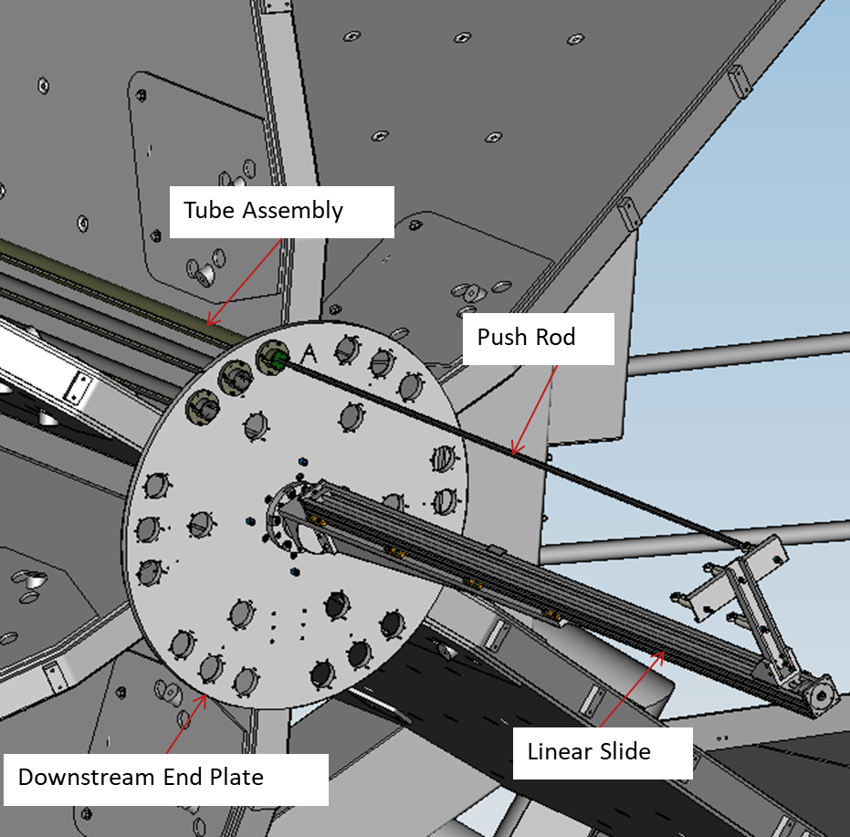
MOLLER – Mapping REQUIREMENTS
Mapping specification - definition wrt the accuracy and location requirements.
Mapping design tool for mapping all sector (TBD) plus the central bore.
Uncertainty in variation of field from sector to sector Things beyond measuring
modification(s) to match the coil geometry to produce field map…
Complete Magnet – after assembly of magnet
BMOD measurements (radially focusing component of field, BMOD) along Z in an open sector at r = 135 mm (TBR)
Determination of magnetic center, measurement of any dipole moment in the bore
Stray field measurements (location of 5 Gauss line)
Individual Coils - during fabrication and on receipt at JLab, Quality Assurance/Quality Check for each coil - Gauss/Amp, Polarity
Mapping Tool Operation-Mapping the Bore
The bore has a total of seven locations mapped
The center tube is offset from the collar center to take the 2.5cm radius measurement
The assembly is rotated for each angle while maintaining the required local coordinate system orientation
Mapping Tool used in HALL B Torus/Solenoid
Precisely machined upstream and downstream plates
The plates will be surveyed prior to install to know hole locations
Precise pins locate and orient the carbon fiber tubes
Pins assure locating/repeatability of carbon fiber tubes to 0.05mm
Linear slide/motor/controller accurate to 0.010mm

Slide 11
Summary
Engineering test requirements are defined
Conductor design → Coil design → Test requirements (Low current test)
Quality Assurance and Quality Control (QA/QC) process requirements at vendor and JLab
Verification and validation of the specifications (defined)
Vendor fabrication of coils and tests (defined)
OSP’s in place for the test in the Magnet Measurement Lab
Acceptance testing of coils on receipt at JLAB (defined)
Performance testing to evaluate JLAB Coil Acceptance for individual coils
MPS – Order in place for the prototype MPS (DS Torus-3)
The WCL and jumpers draft specifications are complete
P&ID’s are in place and list of instrumentation is been populated
Instrumentation and control philosophy is defined
Magnet Protection/Interlocks logics are defined
Hardware and software development required for the system are identified and the work is in progress
Moller mapping requirements are worked upon
Intent to use concept and tooling used in 12 GeV Hall B torus and solenoid mapping

