Slide 1
MOLLER Spectrometer – WBS 1.03
MOLLER Collaboration Meeting
June 21-22, 2022
Michael Bevins
Level 2 CAM (Interim)
Jefferson Lab

Slide 2
Outline
Spectrometer Team
Scope Overview
Technical Reviews
Schedule Snapshot
Status

Slide 3
Spectrometer Team
L2 Manager, Control Account Manager
Michael Bevins (Interim), ME Grp, Eng Division
L2 Technical Leads
Dave Kashy (Engineering), Magnet Group, Phy Division
Juliette Mammei (Physics), U. of Manitoba
Robin Wines (System Interfaces), Hall A Phy, Division
L3 Technical Leads
Coils, coil support system, Assembly, water chiller, vacuum pumping system
Dave Kashy, Magnet Group, Phy Division
Collimators, beam pipes,, magnet enclosures, windows
Sandesh Gopinath, Magnet Group, Phy Division
Eric Sun, Magnet Group, Phy Division
Power supplies, instrumentation and control, field measurement system
Probir Ghoshal, Magnet Group, Phy Division
JLab Key Support Team
Mike Beck – S&A, Eng Division
Ryan Biraben – Hall A Phy, Division
Kris Cleveland – ME Grp, Eng Division
Chuck Hutton – ME Grp, Eng Division
Onish Kumar - DC Power, Eng Division
Joe Lamont – ME Grp, Eng Division
Joe Meyer – S&A, Eng Division
Sarin Philip – DC Power, Eng Division
Nick Sandoval – Hall D, Phy Division
Scot Spiegel – Hall D, Phy Division
Cameron Sutton – ME Grp, Eng Division
Randy Wilson - Magnet Group, Phy Division
Dan Young – Magnet Group, Phy Division
MIT Upstream Torus Key Support Team
James Kelsey
Jason Bessuille
Ernie Ihloff
Danielle Petterson

Slide 4
Scope Overview
Beam Direction
Hybrid Lead Wall
Downstream Torus System
(Focusing and separation of particles)
Detector Pipe & Pion Donut Support
Upstream Torus System
(Pre-bending of particles)
Drift Pipe, Window & Shutter
Spectrometer Scope
~30 meters
Interface to Target Chamber
Interface to Dump Tunnel Beampipe

Slide 5
Technical Reviews Held
Sub-System Preliminary Design Reviews:
Downstream Toroid Coils – March 2021
Magnet Power Supplies, Current Leads and Jumpers – April 2021
Beam Pipes, Bellows and Windows – July 2021
Full Spectrometer System Preliminary Design Review – May 2022

Slide 6
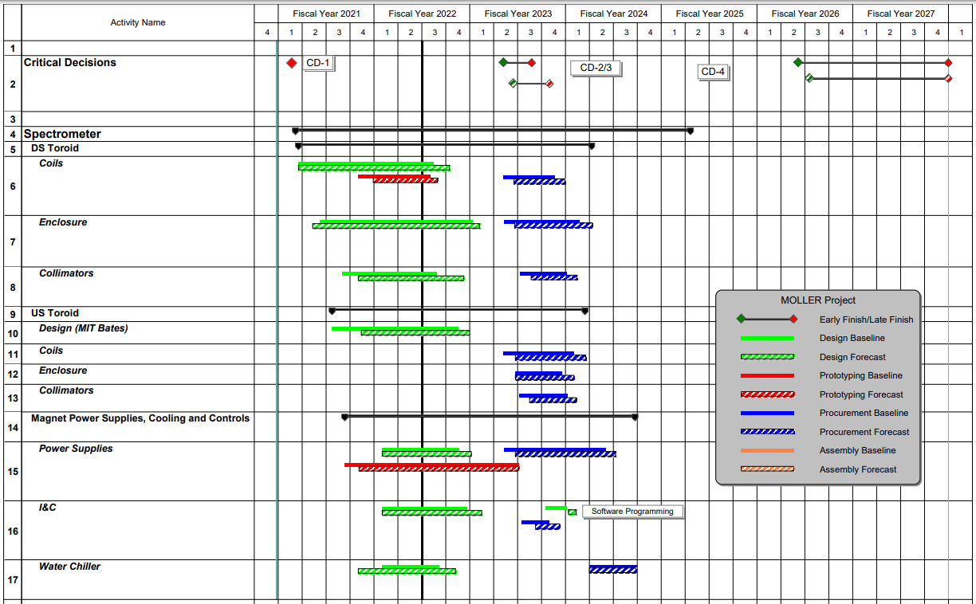
Schedule Snapshot
Key Dates: (L3 Milestones)
Spectrometer FDR 17-Nov-2022
CD2/3 IPR
16-Feb-2023

Slide 7
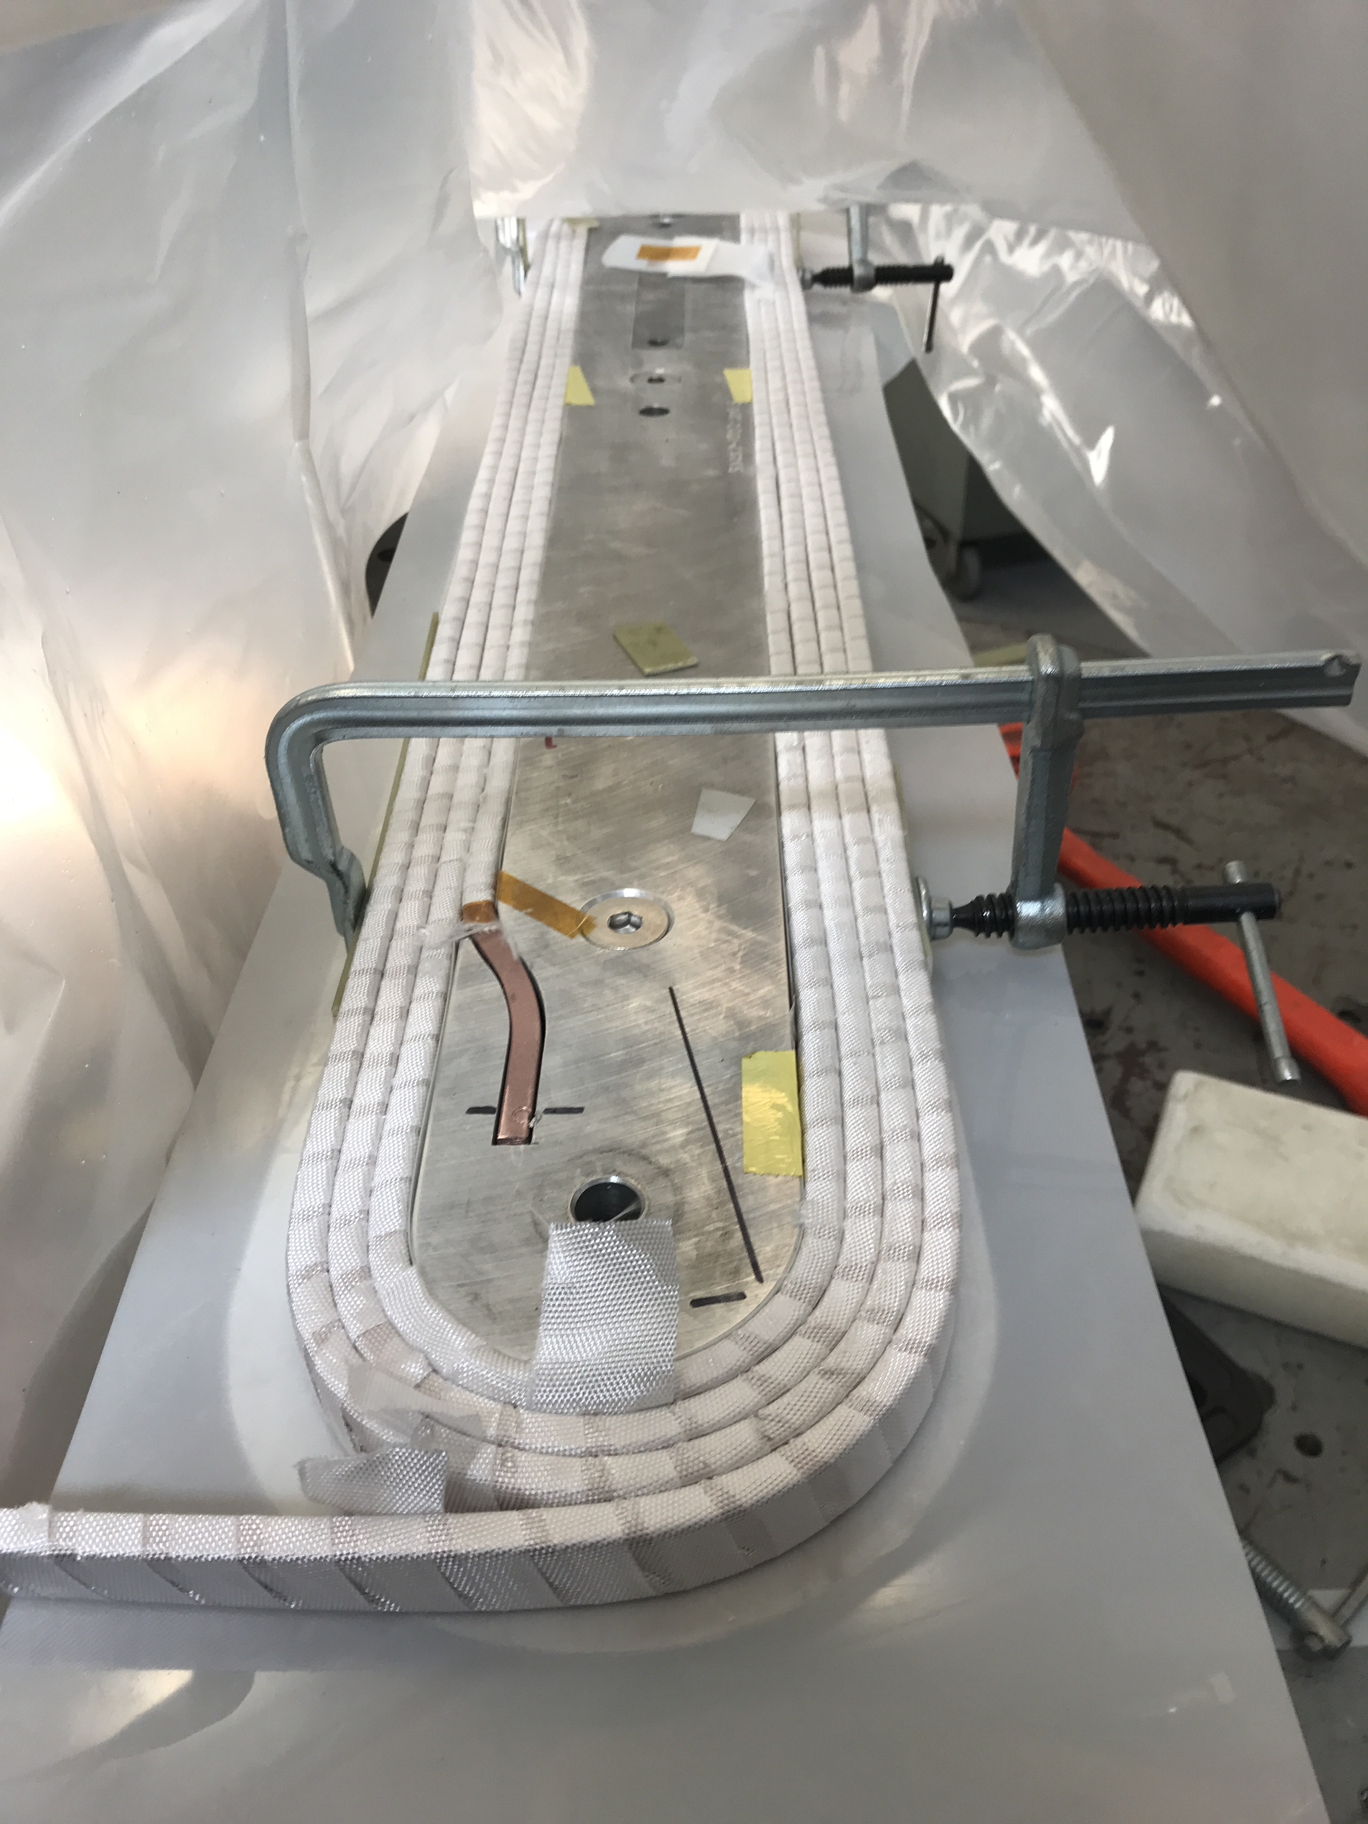
Status – Design & Prototyping
Upstream Torus
Good progress… particularly with the collimator 1 and enclosure design. Coil design in place. Still working coil supports
Downstream Torus
Coil support design well advanced and detail drawings produced for prototype support procurement
Enclosure
3D model and detailed engineering analysis complete
Prototype Coils
Conductor received, coil winding at vendor underway
Magnet Power Supplies & I&C
Prototype power supply contract awarded, vendor effort well underway
Magnet safety and interlocks identified
Beam Pipes, Bellows, & Window
Prototype window drawings complete. Vendor quote received – award imminent
Bellows specification developed. Vendor quote received for all bellows. Planning to prototype one bellows to qualify vendor
Pion Donut/Detector Pipe Support
Preliminary design and engineering analysis complete
Downstream Torus Prototype Coil Winding & Test Power Supply

