Slide 1
PQB Update
Injector Upgrade
MOLLER Accelerator Tasks
Riad Suleiman
MOLLER Collaboration Meeting
June 22, 2022

Slide 2
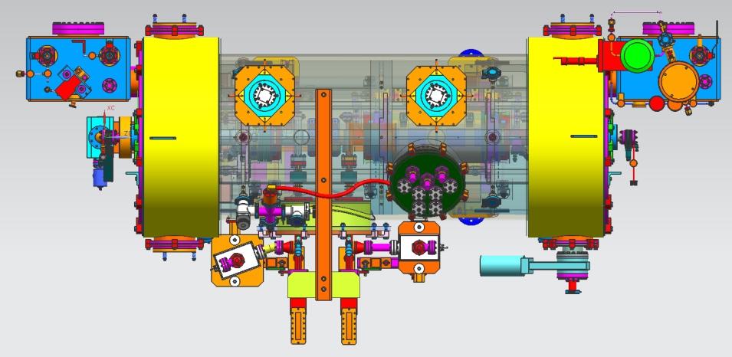
Injector Upgrade
200 kV
Increase gun voltage to 200 kV: to suppress space-charge effects and improve parity quality beam, and to be compatible with booster design.
Locate Wien filters (energy filters): upstream of pre-buncher cavity and install quadrupoles to better compensate astigmatism. Modified Wien Filters for 200 keV beam.
Increase aperture of chopper and beam line solenoids: to suppress existing astigmatism and improve parity quality beam
Install new SRF booster: that eliminates warm-rf capture cavity, RF deflection and x/y coupling. Commissioning at UITF was successfully completed.
Complete Phase-II in March-May 2023
New “booster”:
2 cell capture section + 7 cell cavity,
Provides up to 10 MeV beam and should introduce no x/y coupling, allow better matching, more adiabatic damping –
Will help achieve MOLLER beam requirements

Slide 3
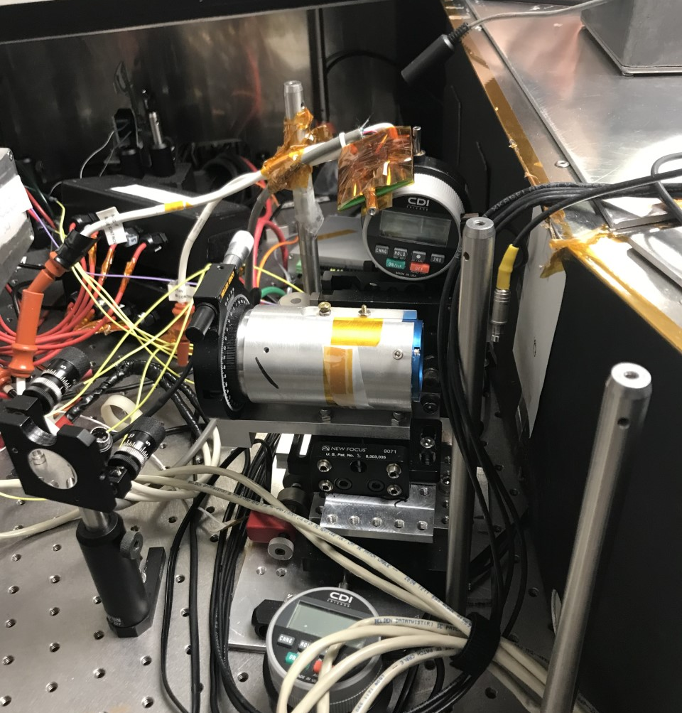
MOLLER Accelerator Tasks
Fast Helicity Reversal:
Ordered 6-8 Helicity new Generator Boards (to be ready by August)
Ownership will be transferred to Fast Electronics and DAQ Group
MOLLER Settings: Free Clock Mode, 1920 Hz, 510.85 µs T_Stable,10 µs T_Settle, three 64-window patterns, 128-window delay.
Request was sent to Engineering Division (EESICS) – new boards will come with new firmware
New RTP HV Driver:
Continue to use RTP
Spare: KD*P
Build new RTP HV Driver: coordinate effort with UVa (NSF funded) and implement Caryn’s comments
Helicity Decoder Boards:
Two protypes are under testing (UITF Mott and Hall B), 20 boards are on order
Re-visit firmware to ensure no possibility of real helicity decoding on board, only after event readout

Slide 4
MOLLER Accelerator Tasks … cont’d
Upgrade Helicity Magnets Control
MOLLER will use magnets to study sensitivities to position differences, position feedback (to suppress beam jitter), and check adiabatic damping
Request to upgrade was submitted to Engineering Division (EESICS)
Need to identify new owner from EESICS
MOLLER to provide a requirement document by end of summer (include quadruple magnets for beam size?)
Feedback on Horizontal Polarization Orientation
Choices: use H-Wien, new air-core short Wien in keV region, or new air-core long Wien in MeV region
MOLLER to provide a requirement document by end of summer
Develop/Test 20 Amp low-noise trim for Wien magnets
Wien magnets are not well matched to standalone 20 Amp SCE power supplies
DC Power Group to design/test 20 Amp low-noise trim card for 2023 March SAD

Slide 5
MOLLER Accelerator Tasks … cont’d
Planned beam studies in Injector before and after 2nd phase of injector upgrade
Phase-II will be completed in March-May 2023
Provide assessment of adiabatic damping and charge asymmetry for high current (less clipping, less x-y coupling)
Halo monitors in Hall A and beam studies at 11 GeV
On MOLLER collaboration to-do list
Possible conflict with MOLLER running? K_{L} secondary beam experiment in Hall D will run at 7.8 MHz, 5 µA average current, any issues?
IA system for Hall D laser: need 3 IA’s, but want to develop a 4 channel IA; need to test IA transition time (<10 µs)
Parity DAQ in Hall D for charge feedback – Quality of feedback depends on quality of Hall D bunch asymmetry (maybe feedback in Injector)
RF loading (?): explore beam loading of high bunch charge, i.e., 0.64 pC @ 7.8 MHz (128 ns) to Hall D at 5.5 pass (compared to 0.26 pC @ 249.5 MHz to MOLLER)
MOLLER to provide students and postdocs to support Injector activities and run parity DAQ

