Slide 1

DAQ update
Integration and counting mode DAQ planning for MOLLER (WBS 1.07, 2.07, 3.07)
MOLLER Collaboration meeting, 15-17 December 2021
Paul M. King – Ohio University
MIE WBS1.07 Level 2 Technical Lead

Slide 2
DAQ development contributors
Integration mode
  D. Bishop, B. Shaw; TRIUMF
  B. Blaikie, M. Gericke, J. Pan; University of Manitoba
  C. Cuevas, W. Gu; JLab
Counting mode
  D. Armstrong; William and Mary
  C. Ghosh, H. Liu; University of Massachusetts, Amherst
Digital BCM
  J. Arrington, Y. Kolomensky, S. Li, Y. Mei, E. Sichtermann; LBNL
  W. Gu; JLab
All three teams involve
  R. Michaels, B. Moffit; JLab
  P. King; Ohio University

Slide 3
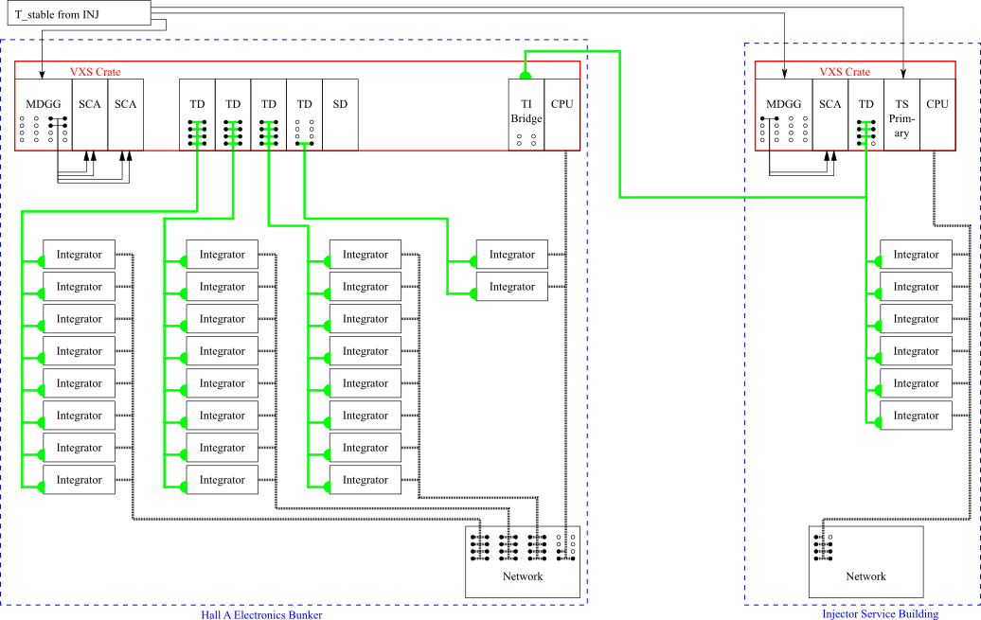
Integration DAQ layout
Helicity trigger is formed in ISB, so that INJ gate is formed promptly
Gate timing adjusted per module to account for ~20μs electron transit or other signal latencies; need ~0.1μs resolution
TI Bridge feeds SD/TDs to distribute gates/triggers
TI to Integrator connection use one QSFP connection
10Gb/s network on QSFP connections
HVMAPS and digital BCMs planned to connect like the integrators

Slide 4
Integration mode channels
Detector array (266 total)
  224 Main detectors, 28 shower-max detectors, 14 pion detectors (possibly 42?)
SAMs, LAMs, and beamline (233 channels)
  SAMs: 8
  LAMs and diffuse background monitors: 28 (14 LAM + 14 DBM)
  Injector beamline: 96
  Transport line and Hall beamline: 101 (PREX/CREX used 64; my count so far ~77 ch.)
Scanner (13 channels)
  X/Y scanner: 2 PMTs + 2 position voltages (positions might go into a FADC or VQWK?)
  Linear scanners: 4 PMTs + 4 position voltages
  Reference voltage for positions
Total: 512 channels → 32 16-channel modules (increase to 34, or reduce beam chan?)
HVMAPS & Digital BCM expect to connect into CODA in same way as ADCs

Slide 5
Integration ADC readout modes
Primary mode
  Samples are accumulated into 4 “subblocks” in each helicity window, as well as the full window accumulation
  Each subblock has the full window has: sum, sum of squares, minimum, maximum, and number of collected samples
Diagnostic modes are still being discussed. Some of the ideas we’ve mentioned.
  Streaming of all samples for a small number of channels for continuous ~1 second
    Purpose: to carry out FFT analysis over the range of Hz to MHz
  Reporting of all samples in a window; there may be deadtime, with windows non-consecutive
    Purpose: used with pulse mode beam to compare signal latency between different detector/monitor elements, and to adjust the gate timing
  Reporting of all samples for two or more consecutive windows; could be the same as #2 with a “special definition” of the window start
    Purpose: used to look at behavior of signals during the “settle” period

Slide 6
Signal levels in integration mode
The integrating ADC module base design uses a differential input with both pins accepting a -2V to +2V range, allowing a -4V to +4V signal range
PMT signals: the transimpedence preamplifiers are designed to match the ADC input.
Beam monitor signals from JLab instrumentation are available as single-ended signals. Alternate front-end panel for the ADC will take single-ended input on BNC with signal range of -4V to +4V.
  Stripline BPMs: The S&H cards output a nominal 3V signal (potentially chosen in either polarity), but the signal can go to 5V. Plan to add in-line attenuators
  BCMs: CREX saw nominal signal levels of ~1.3V from the analog BCM receivers
  Cavity BPMs: CREX saw <2V on the Q signals and a range of +/-1V on the position signals
  Raster pickoff: CREX saw triangle wave with <2V amplitude; the raster is being reworked & currents will be higher → Plan to add in-line attenuators

Slide 7
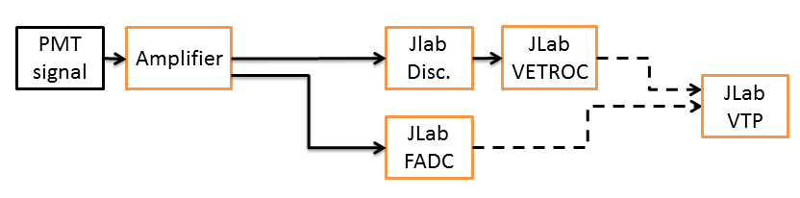
Why don’t we have the TDCs/VETROCs anymore?
In the counting mode DAQ in the CDR, we had discriminators and VETROC modules for timing. However, we think the FADC will give us sufficient timing resolution.
We need the timing to find coincidences between the scintillators, match to the quartz and GEMs, and have some gauge of accidentals
FADC250 waveform has 4ns time steps
  Fitting a peak in the waveform can get better precision; some report as low as ~60ps
  Considering only the 4 ns bins, a rough calculation gives accidental rate of 5% of coincidences at 100 nA (Moller rate ~30MHz/sector), so can likely do better by peak fitting
A more complete evaluation of the timing requirements is in progress.

Slide 8
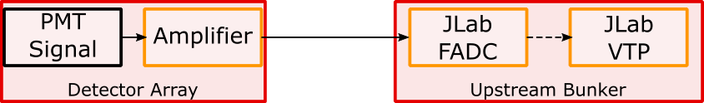
Counting Mode Data Acquisition and Trigger
Including amplifier within the PMT assembly is under consideration; otherwise use NIM amps in US bunker
Voltage and timing data: 304 ch. (19 FADC (or 21?))
  Detector array PMTs: 266 total; 224 thin quartz, 28 shower-max, 14 pion detectors (more?)
  Trigger scintillators: 18; 2 each for 7 GEM sectors & 2 pion sectors
  Scanner PMTs: 6; 2 in X/Y scanner and 1 each in 4 linear scanners
  Alternate trigger signals: 14; SAM- or LAM- signals? Diffuse background PMTs? Halo PMTs?
Voltage data only: 23 ch. (2 FADC)
  Beamline: Two cavity triplets and two stripline BPMs: 14 ch.
  Raster readbacks: 2 ch.
  Scanner position: 7; 2 for X/Y, 4 for linear scanners, 1 voltage reference
GEM readout: APV25→MPD→VTP

Slide 9
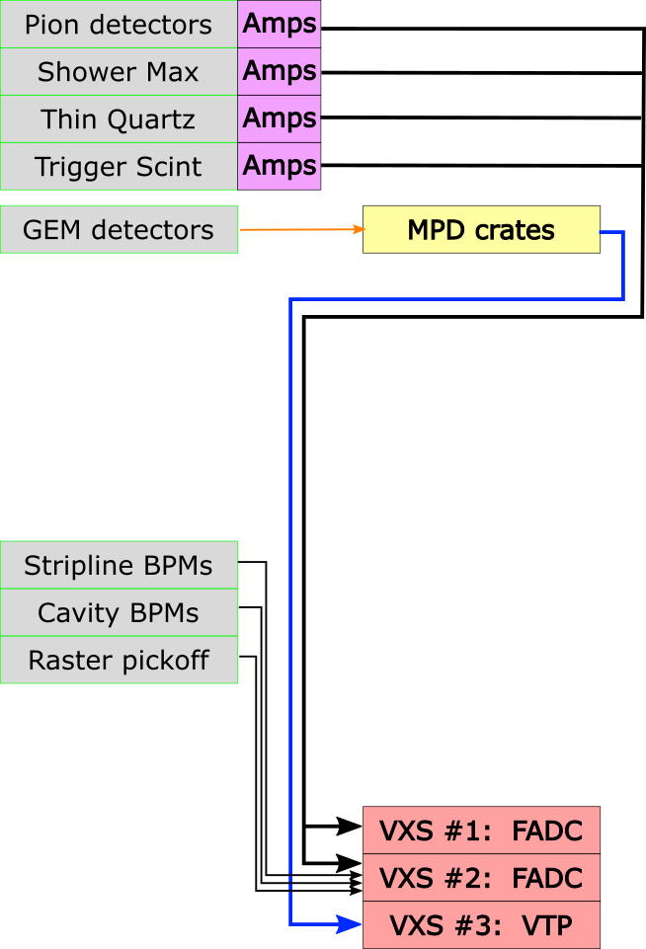
Counting mode cable and crate layout
PMT signals go through event-mode amplifiers built into the base, then through high density cables to a patch panel, then 320’ RG58 cables to main electronics hut patch panel
From main electronics hut patch panel, 600” RG58 cables connect to the FADCs
Beam monitor signals run on RG58 cables (length TBD) from the standard Hall A electronics racks to FADCs
GEM signals from 30 modules (28 tracking, 2 pion) go to the 30 MPDs in their doghouses, then to a VTP in the main electronics hut

Slide 10
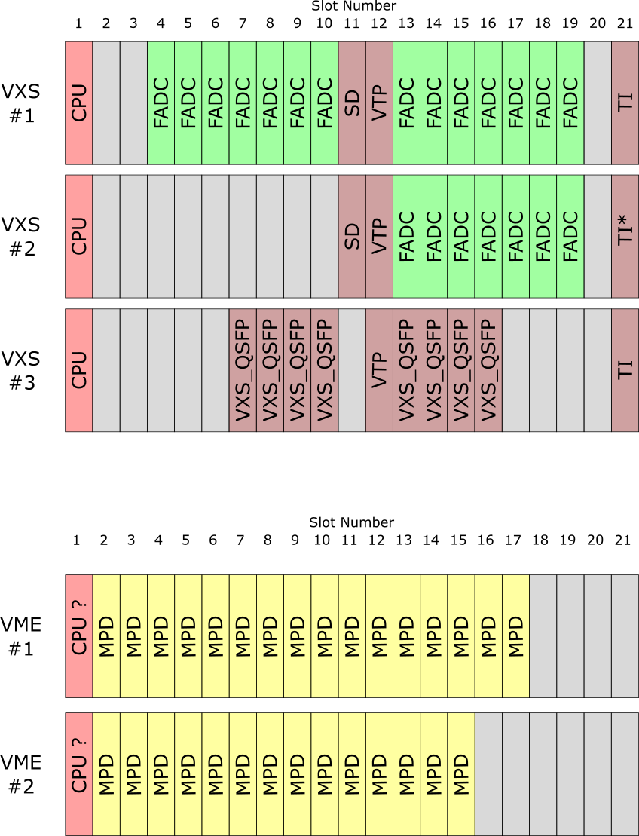
Counting mode crate layout
VXS #1: Rings 1 – 4, Ring 5 & 6
VXS #2: Shower max, Pion detectors, Trigger scintillators, Scanner, Alternates; Voltage-only signals
VXS #3: 30 MPDs readout through VTP
  Crates of 16 or 14 MPDs in two doghouses
Trigger formation
Trigger thresholds defined in FADCs
FADC trigger information sent to VTP for processing
VTPs in VXS #1 & #2 send triggers to TI-master
FADC readout may be done through VTP or VME

Slide 11
Signal levels in counting mode
The FADC can have a negative going range of 0V to -2V (or similar for positive) A DAC offset allows software adjustment of the baseline.
PMT signals: Signals should be within the input range
Beam monitors
  Stripline BPMs: The S&H cards output a nominal 3V signal (potentially chosen in either polarity), but the signal can go to 5V. Plan to use in-line attenuators and DAC offset
  BCMs: CREX saw nominal signal levels of ~1.3V from the analog BCM receivers
  Cavity BPMs: CREX saw <2V on the Q signals and a range of +/-1V on the position signals; Plan to use in-line attenuators and DAC offset
  Raster pickoff: CREX saw triangle wave with <2V amplitude; Plan to use in-line attenuators and DAC offset

Slide 12
Rack space estimate for DAQ for 40U (70inch) racks
Integration mode: 71U in Hall, 31U in INJ
  Integrators, 1U rackmount units, assume +1U for airflow
    INJ: 6 modules → 12U: 0.3 rack
    Hall A: 26 modules → 52U: 1.3 racks
  VME/VXS: 11U height, front to back airflow
    Trigger distribution in Hall
    Trigger supervisor in INJ
  NIM crate: 7U +1U
    One each in Hall and INJ
  Don’t have space needs for HVMAPS or digital BCM receivers yet
  Doesn’t include integrator power supplies, or the HV and LV supplies
Counting mode: 44U (+16U) in SBS bunker, 22U in downstream doghouses
  Three VXS crates: 11U each, front to back airflow → 44U
  Two VME crates in two “doghouses”: 11U each, front to back airflow
  Two NIM crates for amps in SBS bunker?: 7U+1U for airflow each → 16U
SBS bunker: 3+0.4? racks; Doghouses: 0.3+0.3 racks; INJ: 0.8+ rack

Slide 13
Milestones & Plans
Orders go out for test stand instrumentation modules: 21 July 2021
Verification of test system: Oct/Nov 2021 – Feb/Apr 2022
  Ohio just received the VXS crates and VME CPUs; ADC modules will be available later (Feb? March?) May push the test system verification into May?
90% design preparation and review: Apr 2022 – May 2022
  Trigger and DAQ FDR is proposed for June 9-10
Support of PQB studies
  Currently only using INJ crate with VQWKs, running CODA 2.6.2
  To run with hall beamline devices, we’d need to upgrade to CODA 3.10, with a new CPU in INJ crate
    There is also concern about isolating parity DAQ network traffic from SBS traffic due to very high data rates in SBS
    When are PQB studies (or parasitic tests) needed or planned (and what is needed)?
For the 90% review (or sooner), need to have the plan for certifying the electronics modules with the new guidance from Electrical Safety committee

Slide 14
Other things to think about before 90% review
Helicity readout options
  “Traditional” helicity readout using IO registers & scalers with some NIM signal handling
  A new helicity decoder board has been developed; a prototype is available but testing hasn’t started yet
Scalers
  Several scalers are in the budget, but we haven’t enumerated the signals we are inputting
  If we want to scale PMT-like signals, would also need discriminators
  Note that the FADCs have a mode in which they can provide counters of the pulses above threshold, so signals in FADCs could do without a scaler
Beam modulation
  The beam modulation system itself is hall infrastructure
  Modulation cycle start should be synchronized with DAQ; details may depend on modulation frequency, etc
What else?

Slide 15
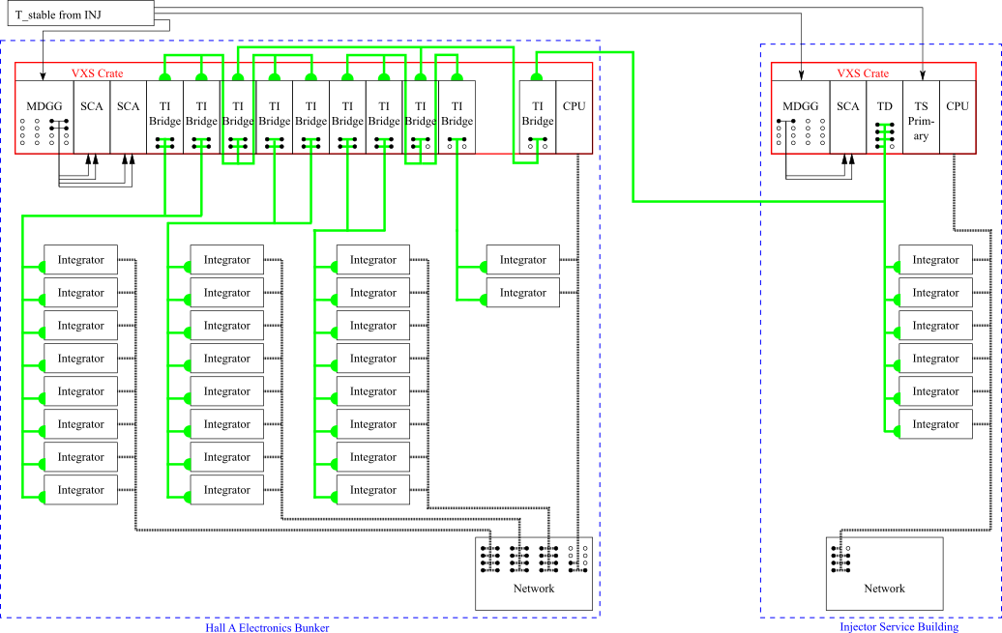
Summary
Paul King
pking@jlab.org
Integrating and counting DAQ working groups are continuing to refine the designs and prepare the design and interface documents
Digital BCM and HVMAPS plans are continuing to develop, but less advanced
Test stands and experience from SBS will help us get ready for 90% review next spring

Slide 17
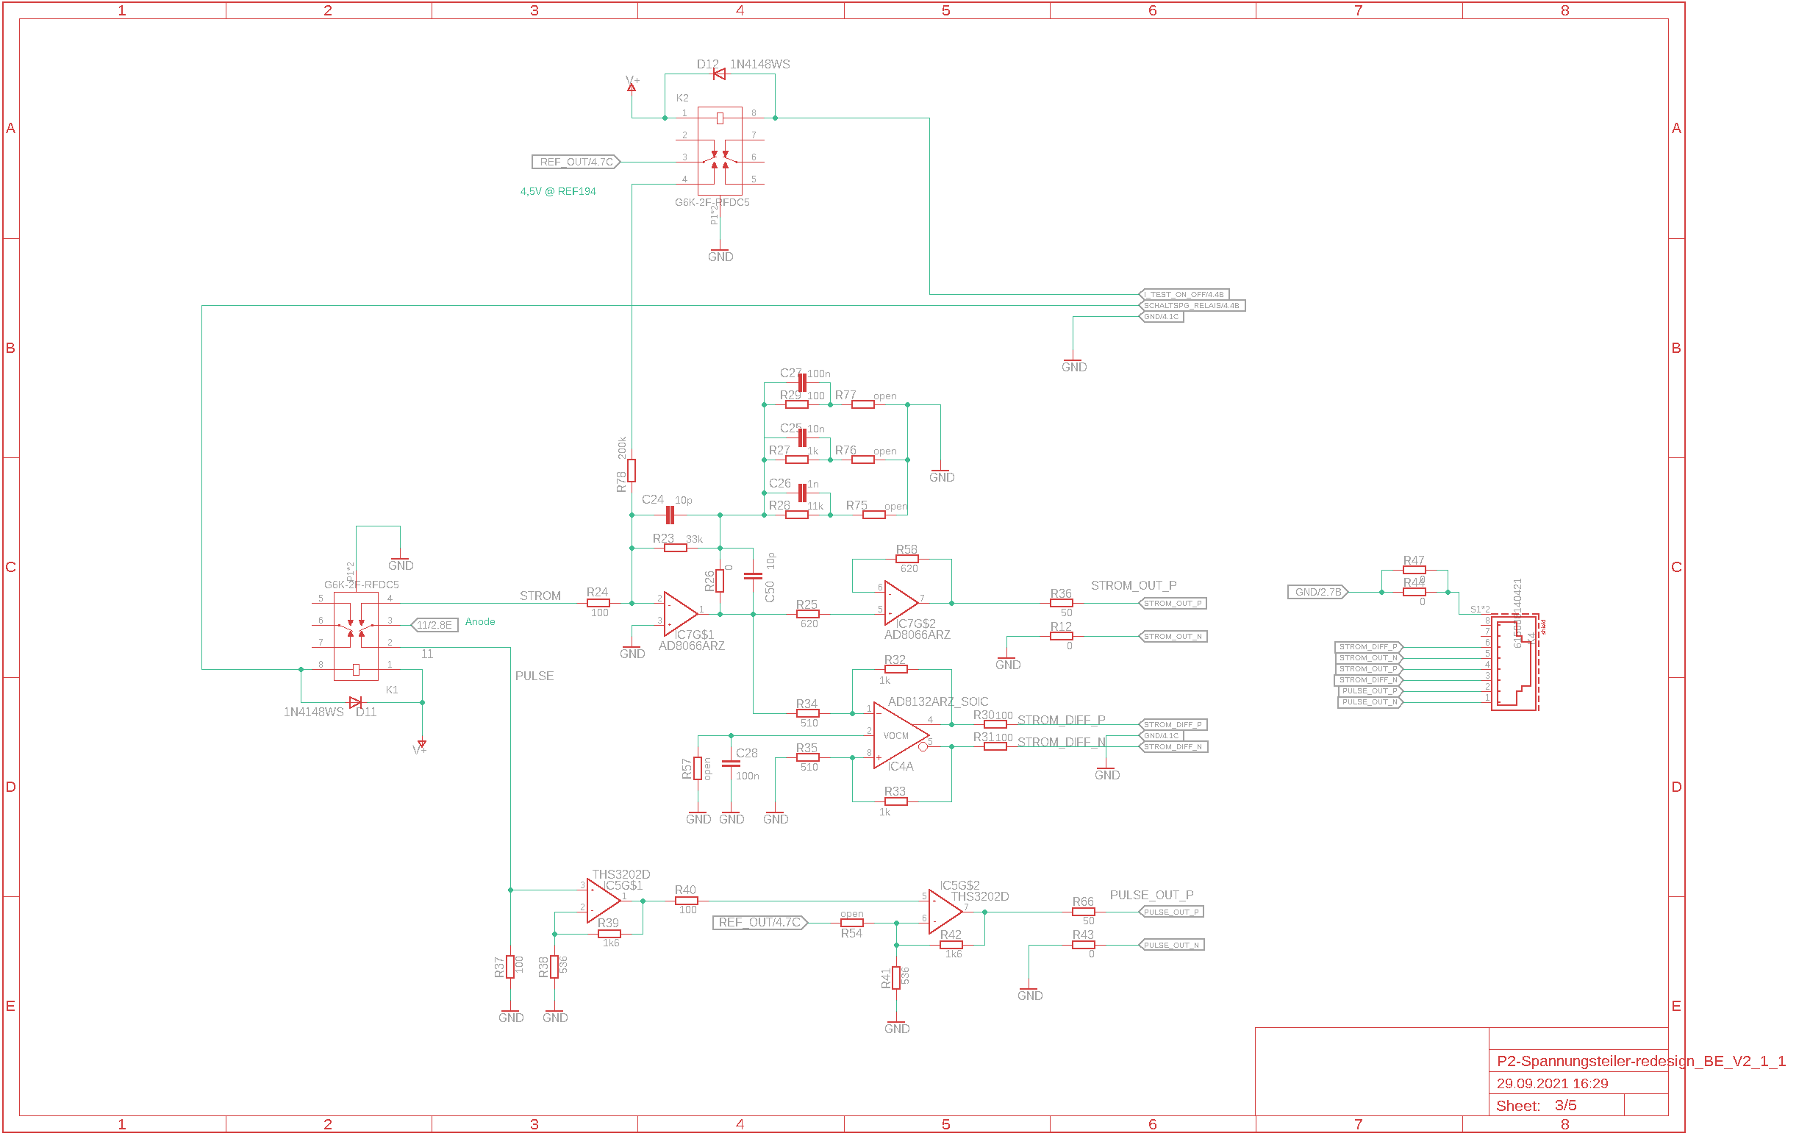
Dual-mode amplifier design from Mainz
This is the circuit diagram of the dual-mode amplifier designed by Mainz.
The counting mode amp performance was comparable (or better) than a commercial NIM amp.
Michael expects to include the counting mode amp in the next version of the base design
Would then check performance with ~100m cable
Integrating mode
Counting mode

Slide 18
CODA readout/control of custom modules
Integrating ADC modules, HVMAPS FPGA readout, and the digital BCMs should all act as independent CODA readout controllers with internal Trigger Interfaces
Trigger interface module functionality is being designed into the firmware for the integrating ADC, and TI connection will be made through QSFP on the main board
The HVMAPS readout is expected to use a similar FPGA/SOM as the integrating ADCs so will use the TI firmware development for the integrating ADCs. The QSFP connection likely through an FMC adapter board which has been designed by JLab
The digital BCM uses a different FPGA board and will not have a free FMC. LBNL is developing a special adapter board (similar to the JLab FMC TI) for the QSFP connection, and would incorporate the TI firmware in the design

Slide 19
Effect of gate time mismatch
If an integrator gate is not properly aligned with the spin flip then the measured asymmetry will be deceased by a percentage of about twice the fractional misalignment
  Electron beam transit through the machine is ~20μs
  Alignment within 200ns out of 500μs (0.04% misalignment) would bound this effect ~0.08% decrease in the asymmetry
  If the detector and beam current monitor integrals are not aligned with respect to each other, then a false asymmetry is introduced which is equal to the charge asymmetry times twice the timing mismatch percentage. This would appear as a detector non-linearity
Using a narrow beam pulse at 60 Hz (tune mode) and the diagnostic waveforms from the detector and beam current monitor modules, we expect to be able to adjust the relative gate timing to 2 or 3 of the 15 MHz samples, which would be about 0.1-0.2μs

Slide 20
Setting Board Programmable Delays
With 10 µs T_Settle time, travel time from photocathode to Hall target becomes relevant. At 5th pass, travel time is ~21 µs. Helicity signal propagation to the hall is ~2.5 µs.
How to set input time delays:
  Helicity Board: 60 Hz Line Sync
  Electron Beam: VL, 60 Hz Line Sync, 50 ns pulses
  Check VL Generator and Helicity signal on laser table
  Adjust gate timing to match
60 Hz Line Sync
Check relative timing
ISB
Helicity Decoder Board
Check relative timing
Delayed
Helicity
Fiber
Helicity Generator
VL
Generator
Real
Helicity
Fiber
Trigger
DAQ
Board Input Delay (0-30 µs)
HV Supply
RTP
Cell
Hall
CEBAF
Target
Slide courtesy of R. Suleiman

Slide 21
Integration mode data rate calculation
Production mode:
  Read out data for each helicity window separated into 4 blocks (4 data units)
  Each data unit consists of 4 items:
    The sum, sum of squares, minimum, maximum, and number of the collected samples
    (calculating these is done in the FPGA) → 4+8+4+4+2 = 22 bytes
  At 15 Msps ~7000 ADC samples per window from which to calculate these
  4 data units x 22 = 88 bytes / channel / window
  Add 8 bytes for one timestamp per helicity window -> 96 bytes / channel /window
  With 16 channels per board with one readout link that’s about ~ 2kB / helicity window per board or ~4 MB / sec per board
  Then 32 modules gives ~130 MB/s
For diagnostic purposes and during tracking readout every ADC sample for selected channels at ~34 MB/sec/channel
  One uses is to check gate timing with tune mode beam; helicity windows can be prescaled

Slide 22

Counting Mode Triggering
GEMs/trigger scintillators inserted
reduced beam current ($≈$100 pA) [100pA → Moller rate is ~30kHz/septant]
use of thin ¹²C targets, and the lH₂ target
some measurements with “sieve” collimator to select scattering angles
Primary Counting-Mode Trigger
  Trigger: “OR” of $i=1,7$of [${TSi}_{up}∙{TSi}_{down}]$
Quartz-triggered mode
  Triggers: possibility to select:
    OR of all thin quartz detectors in a given ring
    OR of all ShowerMax detectors
Pion-triggered modes
  Triggers: possibility to select from:
    OR of all 7 pion detectors (cosmics, setup)
    OR of the two $(i=1,2)$ANDs: [${πTSi}_{up}∙{πTSi}_{down}]$ (main pion dilution measurement)
    [OR of all 7 pion detectors] $∙[OR of all {TSi}_{up}∙{TSi}_{down}]$ (rate symmetry of pions; $πTS$efficiency; enhance pion signal)

Slide 23
Counting DAQ rates & data size
FADC trigger window range: 100ns (25 samples)
GEM samples: 3 25-ns samples
Total Moller rate: 135 GHz@65 uA → ~300 MHz/sector/uA
  At 100nA, ~30MHz/sector, 3 hits/sector/100ns
    Likely use a pulser trigger at this beam current and find scint. hits in analysis
  At 100pA, ~30kHz/sector
FADC raw mode data rate at 7kHz: 150 MB/s
  336 FADC channels * ( 25 samples * 2 bytes/sample + 4 bytes for channel) → 127 MB/s
  Estimate 8 particles with 5 detectors hit (2 scint, 1 quartz, 1 showermax, & 1 pion) in each sector per trigger; pulse parameter data would give ~23 MB/s

Slide 24
GEM data rate estimate
30 GEM modules (4 in each septant, plus 1 in each of two pion detectors)
1280 channels per module
Readout: 300 APVs to 20 MPDs
With 3 samples/chan & 16 bits/sample
  → 1.84Mb/event without data suppression
At 7kHz maximum APV rate with 3 samples
  → 12.9Gb/s; 0.645 Gb/s from each MPD
Occupancy (per 75ns window) expected due to Møllers at 100nA: ~2%
  3 e-e scatters per sector in 100 ns
  8 strips hit/module/track
  24 strips hit per event out of 1280
With zero suppression at the VTP, and a 5% occupancy at 7kHz
  → 80.6 MB/s to disk

Slide 25
Online Analysis
Needed Tasks
  Helicity correlated (HC) feedback
    Feedback cycle likely 10 s
  Monitor of data quality
    Some issues only appear at high statistics, needing hours or days
    Requires correction for HC beam properties
  Monitor of transverse beam polarization
    Requires corrections for HC beam properties
    Requires accumulating multiple hours of data
Hardware needs
  One workstation for helicity-correlated feedback
  10 workstations for full analysis to support #2 and #3 (~50 concurrent jobs)
  100 TB fileserver provides space for several days of raw data and analysis results (raw data rate is 450 GB/hr, outputs are similar in size)

Slide 26
Data reduction and visualization
The total raw data volume will be at the petabyte scale
Creating ROOT TTrees of all elements would also result in petabyte scale output files
Several parallel data reduction choices
  Average yields and asymmetries for all data elements over short period (~1 minute?) and store in a database
  Generate ROOT TTrees for only the key elements for all helicity patterns
  Keep the full ROOT TTrees for a small subset of data files
Anticipate needing a few hundred TB of disk space to work with the output files
We will also need robust ways to monitor system performance and present output results to analysis workers

