Slide 1


Møller Polarimetry Update
Don Jones
Temple University
December 2021 :: MOLLER Collaboration Meeting

Slide 2
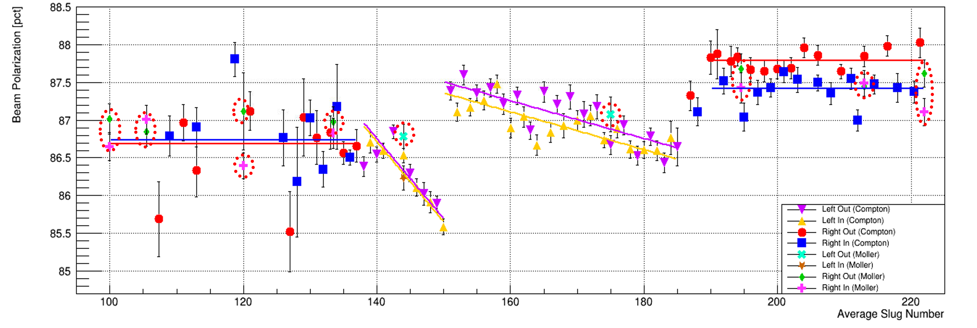

CREX Results
0.5%
Møller and Compton measurements during CREX
Agreement with Compton at ±0.02% level
0.2%

Slide 3
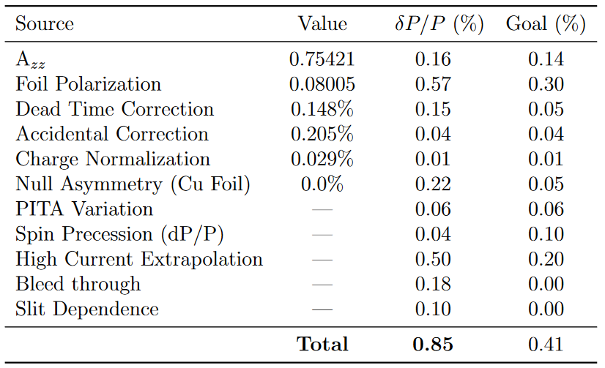
CREX Systematics Results
Record accuracy for JLab Møller polarimetry.
Significant progress has been made on A_{zz} systematic.
It looks like we will be able to reach 0.14% or better uncertainty for A_{zz} at 11 GeV.

Slide 4
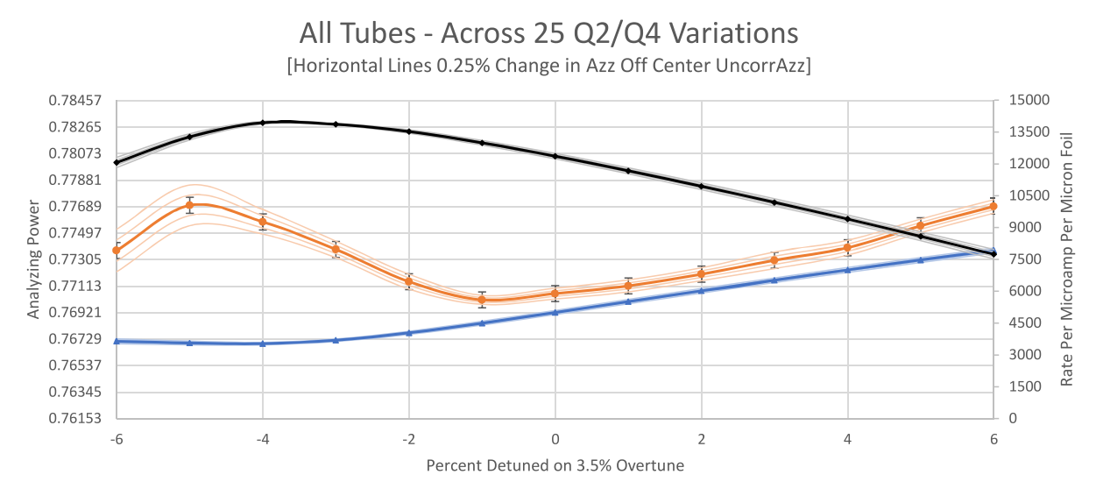
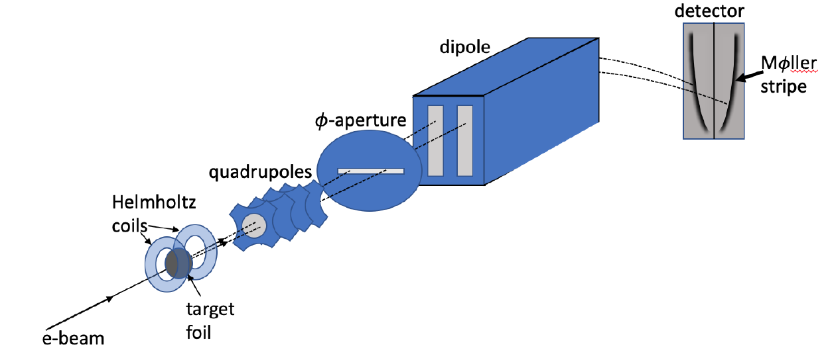
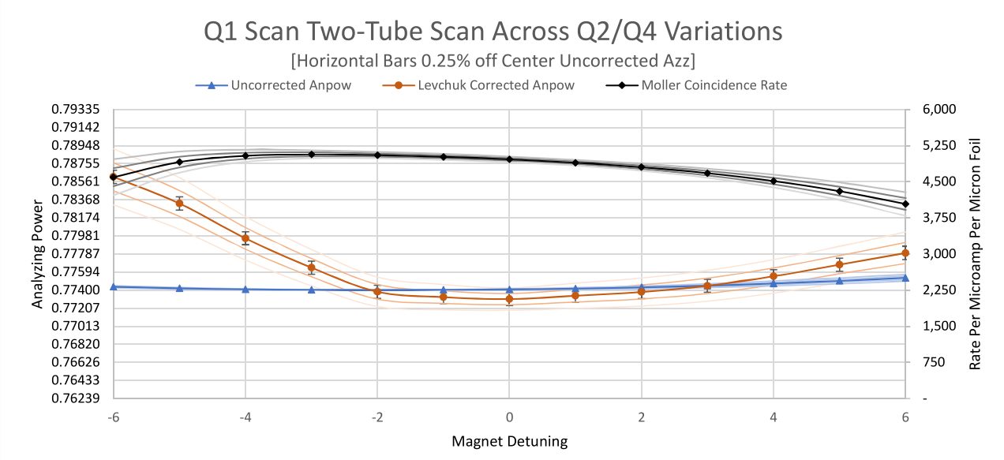
Moller A_{zz}: Two Recent Improvements
PREX 8 PMT Simulation
Active PMTs
(Red)
Our knowledge of spectrometer optics (field maps) is limited to several percent uncertainty, BUT simulation shows if we calibrate our settings relative to the rate maximum, we are highly insensitive to absolute knowledge of optics.
Coincidence Rate
Levchuk Corr A_{zz}
1.3%
Simulated Azz
Quadrupole 1 Detuning %
PREX 2 PMT Simulation
Active PMTs
(Red)
Coincidence Rate
Levchuk Corr Azz
Limiting the vertical detector acceptance allows AND over-tuning past rate peak to pull electrons off dipole walls allowed us to tune the Levchuk correction to nearly zero AND create a large flat region of Azz.
Simulated Azz
Relatively Flat A_{zz} Region
Quadrupole 1 Detuning %

Slide 5
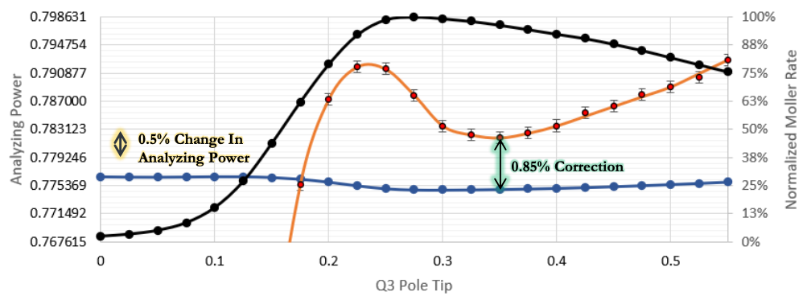
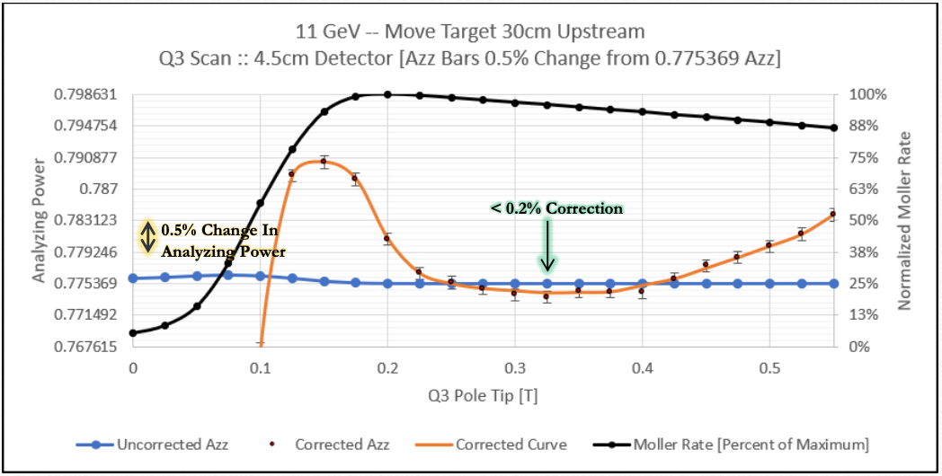
A_{zz} at 11 GeV optics
Coincidence Rate
At 11 GeV, with current beamline setup, we are unable to tune away large Levchuk correction nor create a flat region insensitive to accurate knowledge of the optical tune
Levchuk Corr Azz
Caveat: results for 4.5cm vertical detector acceptance.
May require detector redesign or collimator.
Simulated Azz
However, moving target 30 cm upstream accomplishes what we want by allowing Moller scatters to further separate before quadrupole steering.
Now officially implemented in beam line design.
Coincidence Rate
Levchuk Corr Azz
Simulated Azz

Slide 6
Beam Line Redesign Being Implemented
Moving Møller target coils upstream required some re-configuring of the beam line design: design changes now included in model
Plan in place to implement improved MOLLER beam line including Møller target move before MOLLER
  Could be as early as Spring 2022, although the probability for getting all parts in hand on time is low.
  Early implementation gives us time to study impact of redesign and benchmark simulation ahead of time.

Slide 7
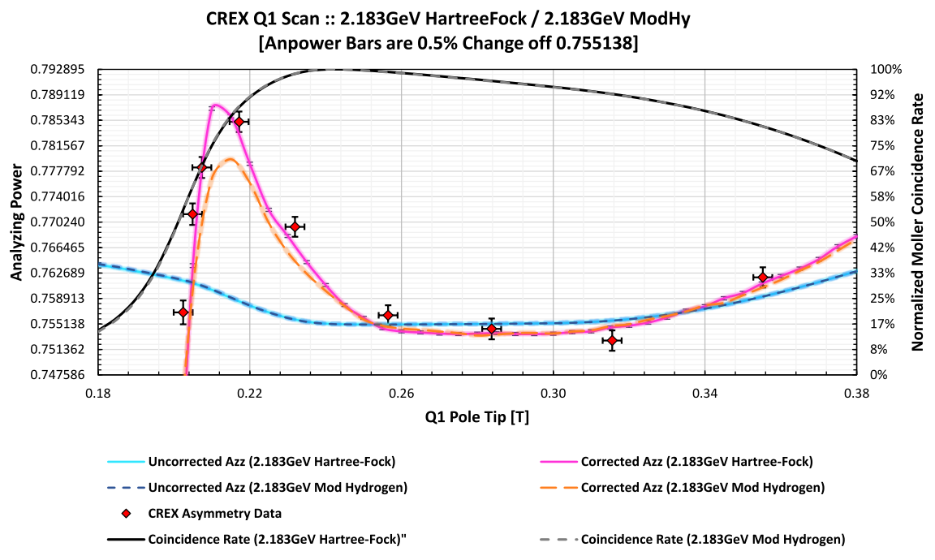
Another recent improvement for A_{zz}
Levchuk correction requires a model of the momentum distributions for polarized and unpolarized electrons in Fe
For past two decades this correction has been done using distributions from modified hydrogen wavefunctions.
Data from CREX showed that this calculation predicted a 30% smaller “peak” than measured.
Reached out to expert John Perdew⃰ at Temple University and his student Aaron Kaplan suggested a Hartree-Fock model and provided the momentum distributions.
➔ Exciting agreement! ⬅
Hartree-Fock Model
Modified Hydrogen Model
CREX Data
⃰ John Perdew is one of the most highly cited scientists of all time with over 150,000 Google citations

Slide 8
CREX Troublesome Systematics
Systematics inflated by foil polarization and high current extrapolation
These two contribute a total of 0.76% and the rest is 0.38%
Likely overestimated (given level of agreement with Compton which had 0.5% uncertainty) but difficult to limit without better measurements

Slide 9
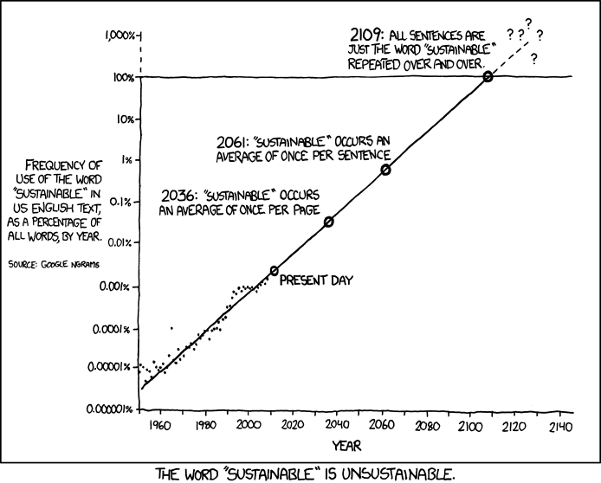
Extrapolation to High Current
Potential to be the limiting systematic unless we measure it.
We will develop a plan to directly measure:
  Beat frequency method used before where the laser is tuned just off the 499 MHz so only every nth pulse actually goes to the hall but full power on photocathode.
  Can investigate what statistics Compton could get at 5 uA for
  8 hrs.

Slide 10
Foil Polarization
Publication nearly ready to submit to NIM that shows Fe foil polarization at saturation known to ±0.24%
Still need to prove that we are at saturation
Sensitivity of degree of saturation on foil and angle and flatness needs to be measured
Potentially large systematic: 1% smaller polarization during PREX-2 when running on a wrinkle
Attempts to measure with Kerr apparatus only partially successful.
Kerr apparatus: modulate polarization at fixed frequency and pull out polarization signal on reflected light from magnetized foil with lock-in amplifier (magnetization rotates polarization)

Slide 11
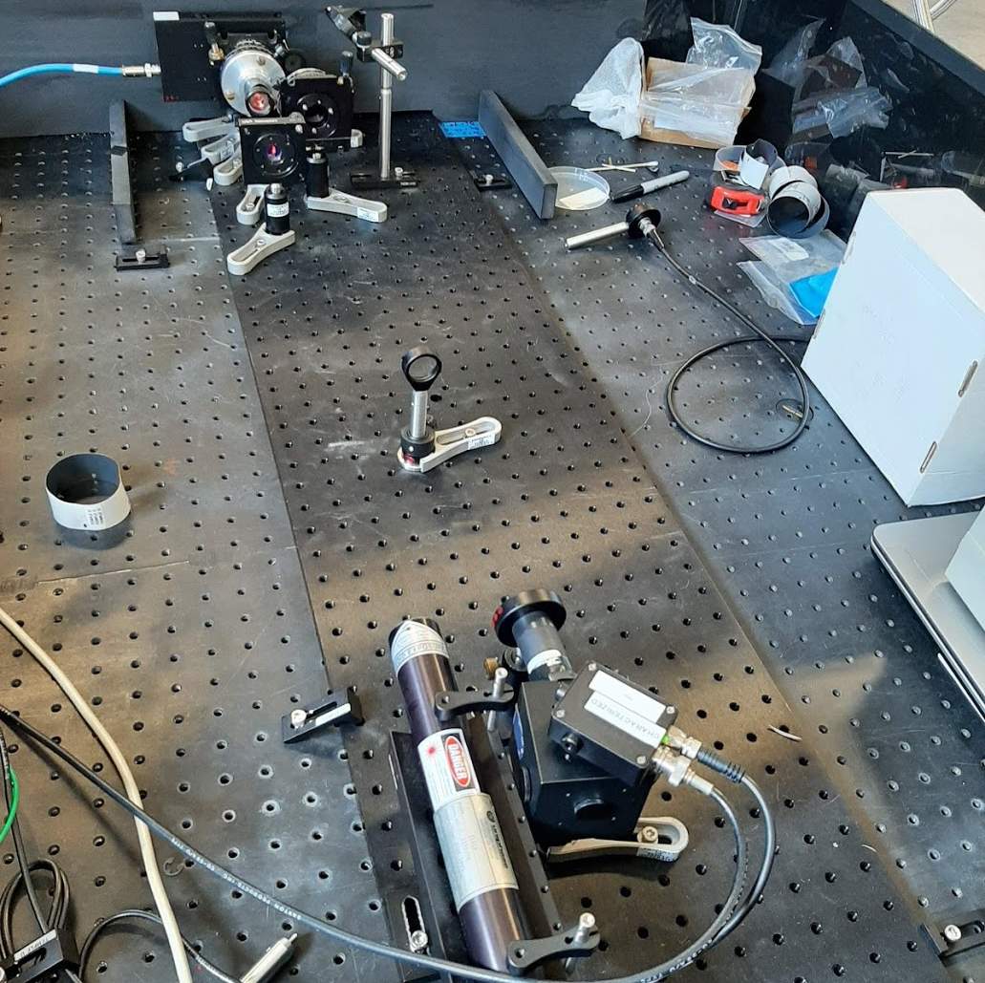
Kerr Apparatus
Not able to conclusively reach saturation but see signature of interference effects.
Longer careful study required but may not be possible.
Need to develop plan for using beam to set upper limit on this systematic
Example saturation curves taken with Kerr apparatus

Slide 12
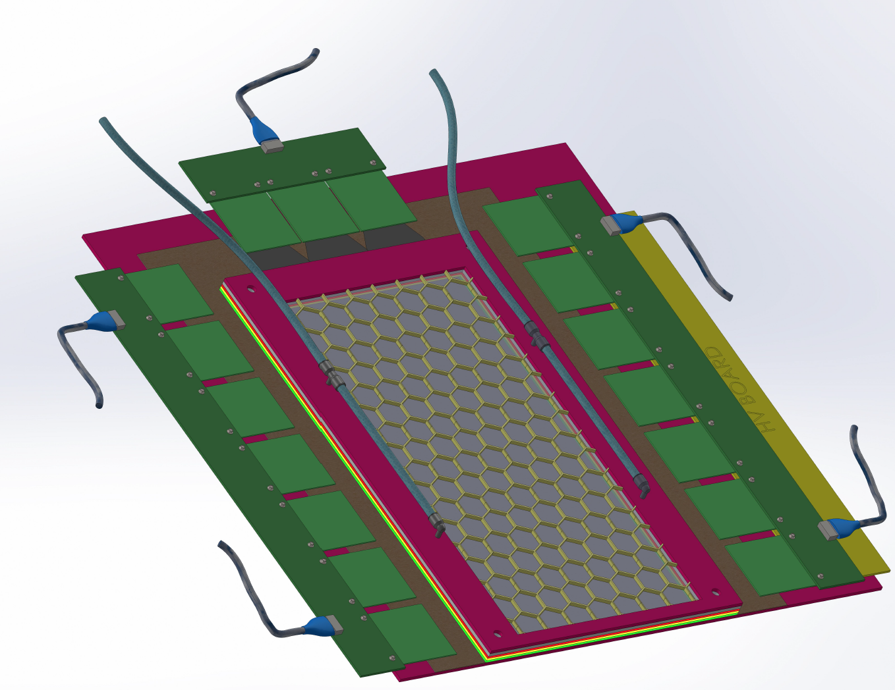
GEMS for the Møller Polarimeter
GEMs are being installed between the dipole and the detector to help verify simulated radiative, Levchuk and multiple scattering effects.
Design recently completed by Nilanga’s group at UVA -- ready for construction
Readout split into right and left required to allow for resolution of left and right coincident Moller electrons
Support structure design to start soon

Slide 13
Collimator
Addition of a collimator is part of the project to help limit systematics
Need more simulation work to decide if this is needed and what its design should be.
  Initial investigation underway
May be required to limit vertical acceptance on detector (remove sensitivity to Levchuk and knowledge of quad optics settings)
Target date set to make design decision by early April

Slide 14


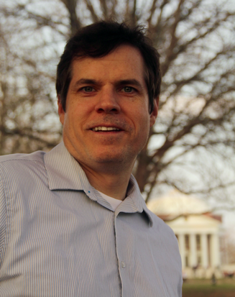
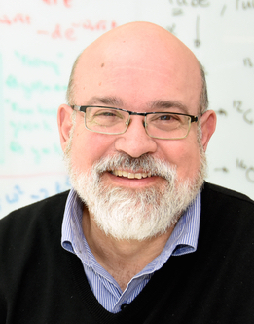

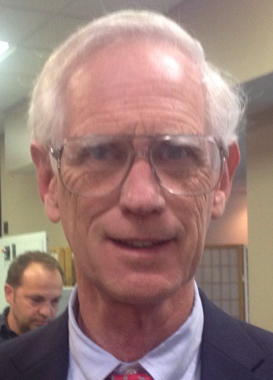
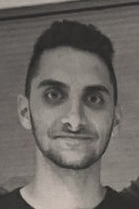
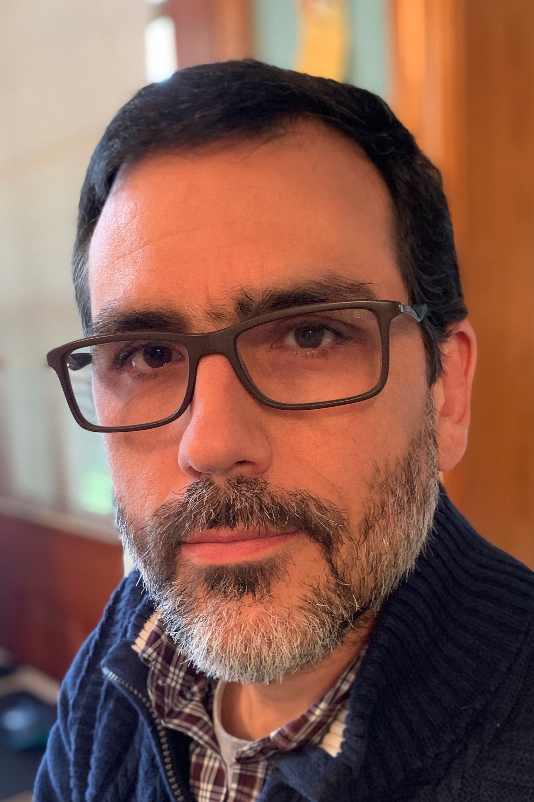
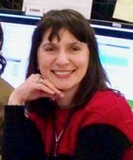


Møller Polarimetry Active Personnel
Donald Jones | Jim Napolitano | Eric King
Paul Souder | Faraz Chahili
David Gaskell | Simona Malace | Bill Henry
Kent Paschke
Working on polarized materials review.
Continued systematics reduction.
Reviewing design issues.
Working on GEM insights.
GEM event reconstruction of simulated events.
Maintain hardware.
Coordinate project deadlines.
Technical operators.
Insight
Advice

Slide 15
Summary
Encouraging progress made on systematics during PREX-2 and CREX
Progress on A_{zz} & Levchuk systematics nearly meet MOLLER requirements
Two systematics (foil polarization and high current extrapolation) are highest priorities and will likely require beam time to limit
Progress is being made on hardware improvements included in the MOLLER project, with
  GEM design complete and support structure design to begin soon
  Collimator design choice made by early Spring.
All systematics being reviewed carefully

