Slide 1
Moller Polarimetry Progress Update
June 2021
Don Jones

Slide 2
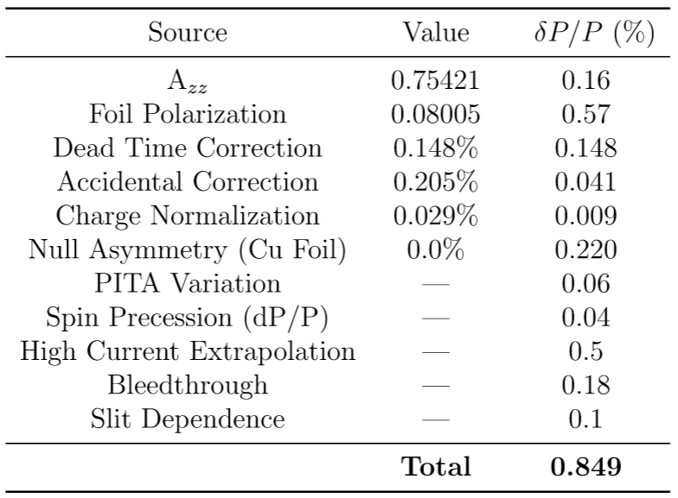
Error Table for CREX
Goal(%)
0.12
0.30
0.10
0.05
0.00
0.10
0.10
0.10
0.10
0.10
0.10
0.42
Most difficult

Slide 3
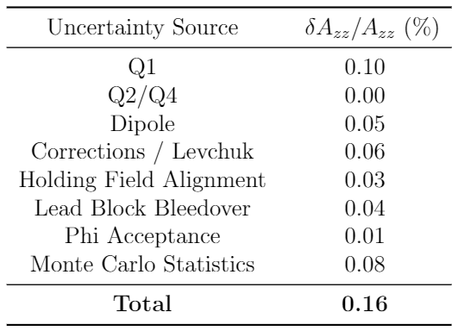
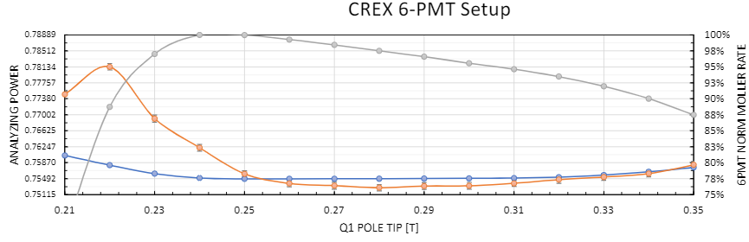
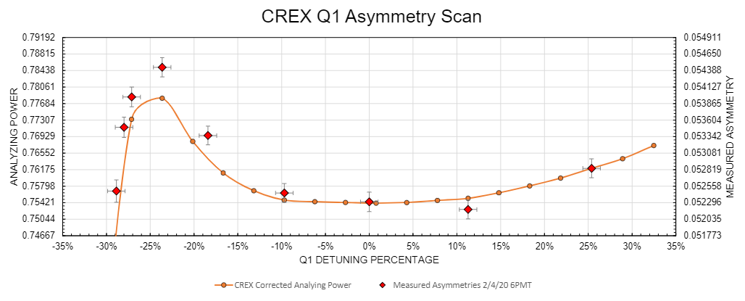
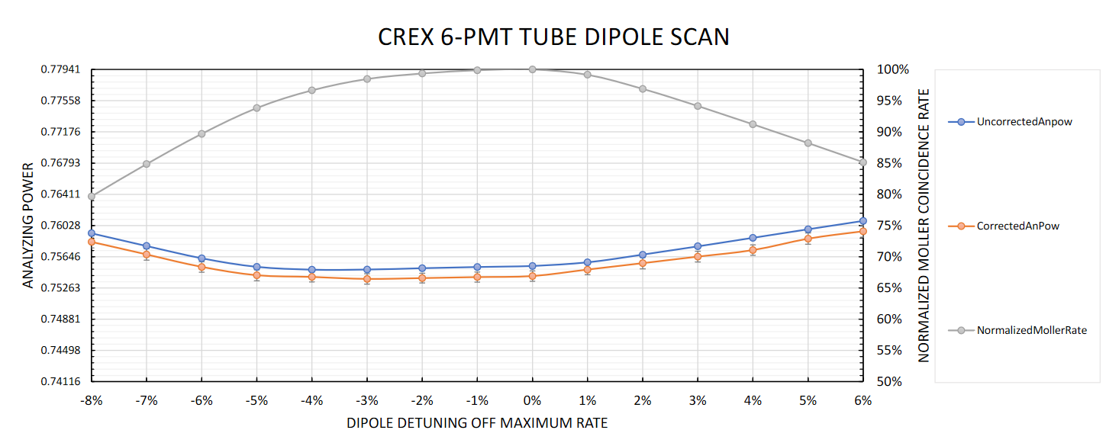
Azz matured during PREX/CREX
CREX errors on Azz
Rate
Uncertainty
Azz
Azz+Levchuk
CREX Quadrupole 1 Pole Tip Field (T)
Flat Rate Region…
Err away from right edge.
Rate
ΔA_{zz} = 3%
ΔA_{zz} = 4%
Azz
Azz+Levchuk
Flat’ish analyzing power
CREX Dipole Tune (% off optimal)

Slide 4
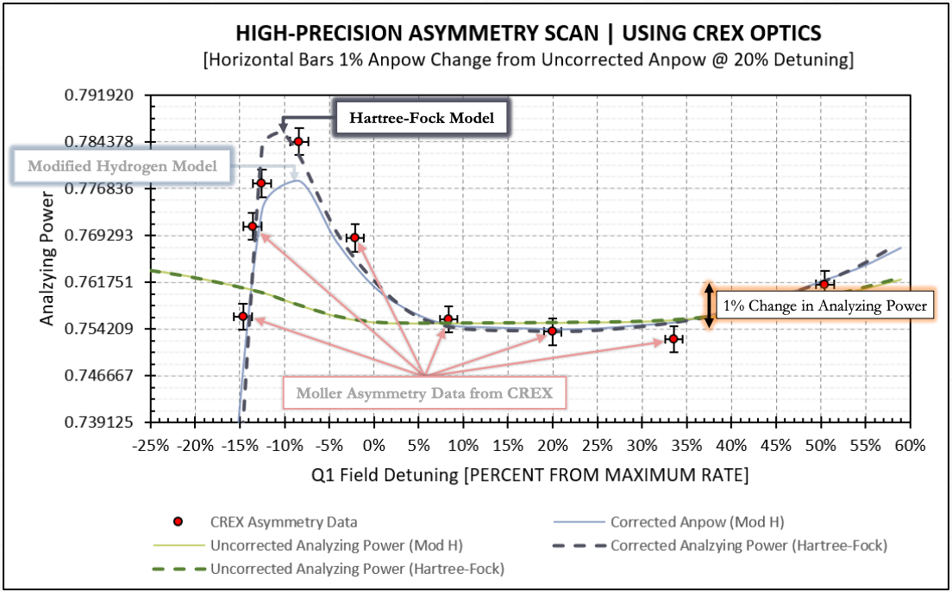
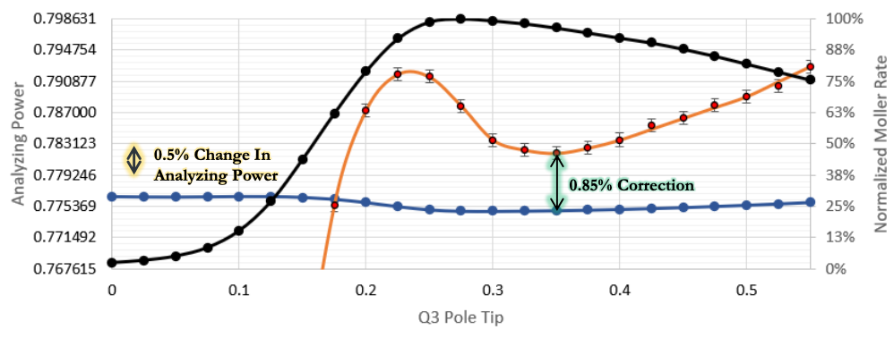
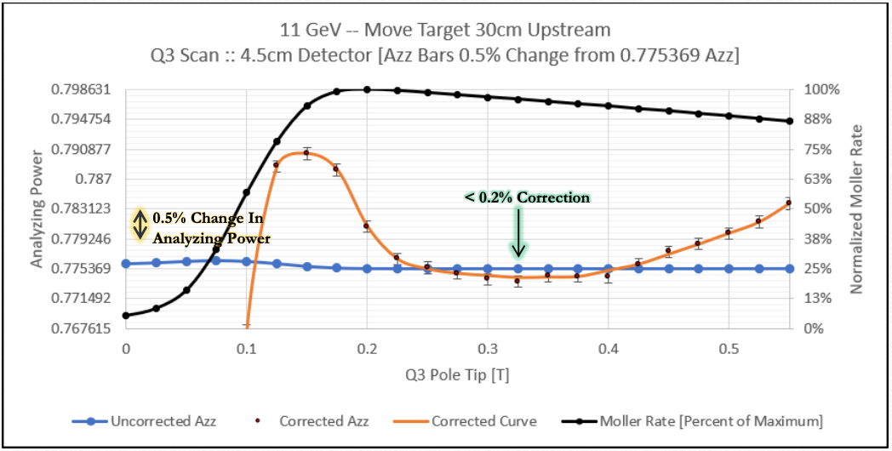
Azz during MOLLER
2. Better Levchuk model essentially eliminates model error uncertainty
1. Moving the target magnet upstream 30cm
Before
Caveat: based on 4.5 cm detector vertical face size, where current detector is 7.5 cm at minimum.
Need to investigate alternate solutions before modifying detector including different optics configurations, moving detector slightly, installing collimator...
After
3. Power supply from former HKS will power the dipole and allow us flexibility to tune optimally at 11 GeV.
Target move now in design!
Final uncertainty depends on details of detector acceptance Q3 tune precision.
Ambitious but plausible to improve CREX’s 0.16% to 0.12%

Slide 5
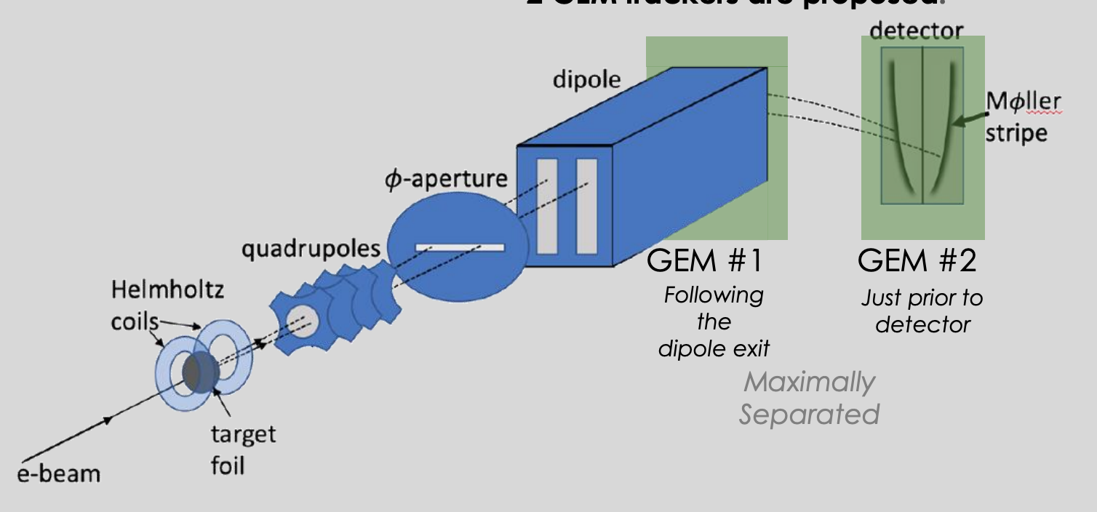
Improving Azz with GEMS
Plan to install two GEMS ~1 m apart between dipole and detector
Help to verify model of Levchuk, multiple scattering and radiative corrections
Studies begun by Syracuse group on how to use information to quantitatively assess model uncertainties in these classes
Caution
In my experience, adding new information/better diagnostics has a significant probability of increasing rather than decreasing the systematics.

Slide 6
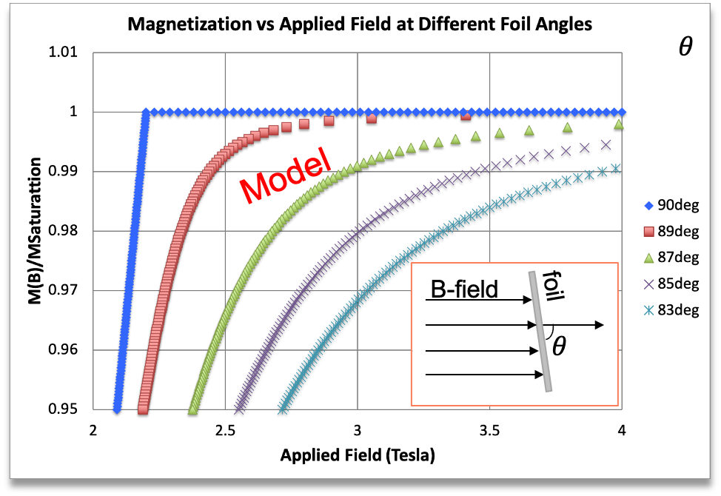
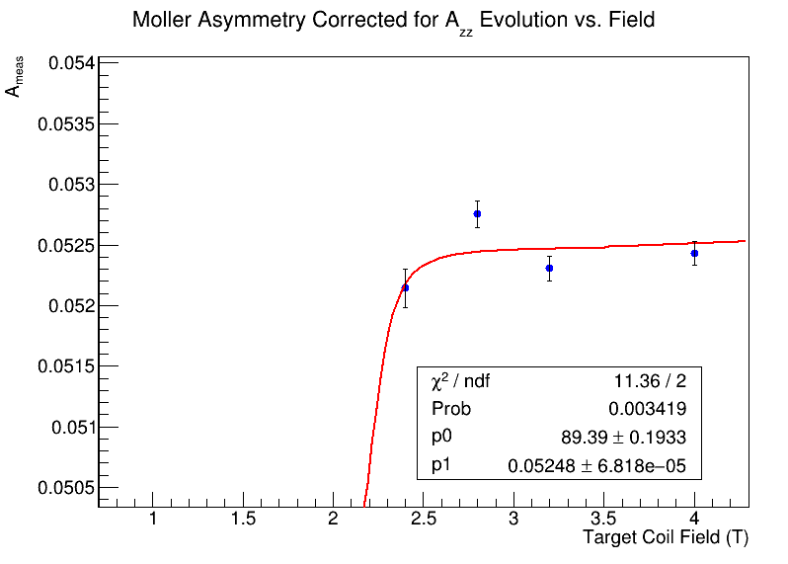
Foil polarization
Target foil polarization is likely our largest systematic error (0.3%)
Known accurately at saturation→sensitive to foil alignment angle
During PREX-2 measured 1% lower polarization on 4 μm foil than on 10 μm (likely running on a wrinkle)
During CREX, scan of asymmetry vs target holding field hard to interpret
  Laser pointing during ramp showed angle changes of a few degrees during ramp but stable above 3T
  Not a well designed study but hope to repeat with better control
Note: according to this model 2 degrees is 99.91%@4T
CREX target field scan

Slide 7
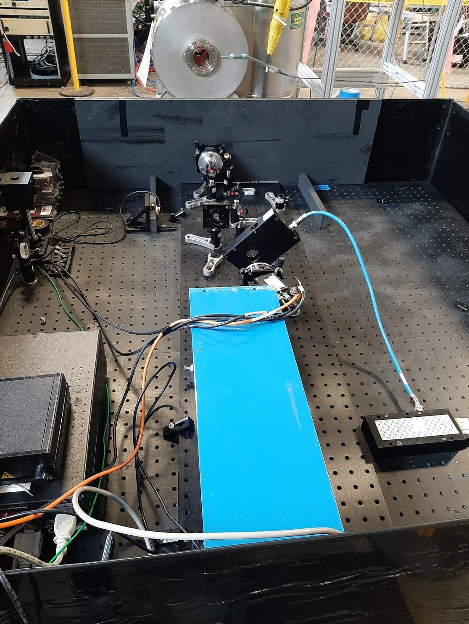
Kerr apparatus
Built Kerr apparatus to quantify our sensitivity to foil angle and flatness
Magnetization causes small polarization rotation of the probe laser
Easy in principle to build, but not so easy in practice at the level of precision we need
Example saturation curves for various foil angles

Slide 8
More corrections
Dead time correction has 100% uncertainty applied since we aren’t sure of the logic/inner workings of the DAQ trigger.
Working on a plan to decrease if not eliminate dead time systematic
Accidental correction taken from trigger delayed by 100 ns. Without evidence of an issue no need to improve. Likely to remain for MOLLER at 20% of the correction size.
Charge normalization error goes away if we calibrate the BCM.
Null asymmetry is statistics dominated. Take enough statistics on Cu foil to show we measure 0 with an unpolarized target.

Slide 9
Moller polarimetry is not concurrent with experiment
Several systematic errors are not errors in the measurement per se but arise from extrapolating from the dedicated measurement to the conditions of the experiment
Laser polarization changes during Aq feedback
Shifts in beam energy and north/south linac loading cause changes in precession
Moller measurements taken at 1 $μA$ but experiment runs at 70 $μA$

Slide 10
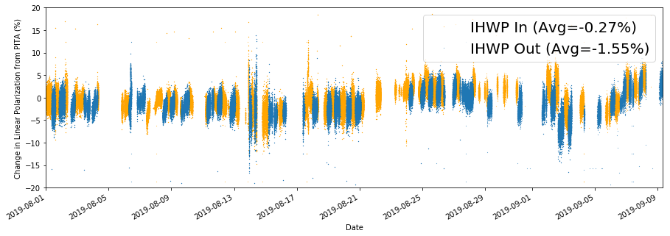
Charge-feedback-induced laser polarization changes
To zero the charge asymmetry, active feedback on the laser polarization is employed
With optimal laser setup, polarization tweaks are negligible, but can be significant as during PREX
Moller measurement not taken in precisely same laser pol state, introduces new syst. error
Solution: optimize laser setup and monitor changes resulted in 0.06% for CREX which is likely sufficient
Charge-Feedback-Induced Changes in Laser (Linear) Polarization during PREX-2

Slide 11
Changes in precession
We set up the beam for optimal longitudinal precession using a spin dance at the nominal energy (+/-2 deg?)
Experience from PREX-2 and CREX where we had to carefully monitor energy showed that changes in beam energy of 0.02% were routine and 0.04% not that uncommon.
Also, energy loading changes between the N and S linacs happens routinely as cavity performance changes
  Polarization changes even if the energy is constant.
At 11 GeV the beam precesses 21,000 degrees between the injector and the hall so
  A 0.02% change in momentum yields a 0.27% change in polarization if you start at fully longitudinal
  If you started 2 deg off longitudinal then a 0.02% change in momentum yields a 0.52% change in polarization
This may well be the hardest systematic error to deal with and may require
Careful monitoring of dp/p and the N/S energy balance
Requests for energy corrections when dp/p>0.02%
More frequent measurements whenever the energy shifts
A good precession model to correct for precession shifts

Slide 12
High current extrapolation, bleedthrough and slit dependence
To ensure that the polarization is not current dependent we need an experimental plan to measure this
  One model is that the cathode polarization depends on laser power/heating
  One idea is to redo a former study from 2008 where they increased the pulse rate of the laser so that only a fraction of the individual electron pulses go through the slit
  Another idea is to use Hall C’s laser to heat the cathode and just dump the current on A2 while measuring with constant current in Hall A (requires dealing with bleedthrough)
Bleedthrough: during CREX we routinely had 0.1% of our Moller rate from Hall C
  Hall C is nominally opposite polarization so factor of 2 uncertainty for uncharacterized “stuff”
  Difficult to control or get rid of without dedicated resources and studies
  One option is to negotiate 30-45 minutes with Hall C off during weekly Moller measurements or opportunistically utilize time when Hall C is naturally off
Slit dependence: we close the slit during Moller measurements to reduce bleedthrough from Hall C
  If we solve the bleedthrough problem, this goes away. Otherwise, need a plan to systematically measure it.

Slide 13
Conclusions
Many sources of error including bleedthrough, slit dependence, accidental, null and charge corrections, and PITA variations from Aq feedback have natural solutions from careful setup and measurement plans
Extrapolation to high current and slit dependence can be measured with dedicated studies
Foil saturation remains a high concern and is currently being investigated
Energy changes at the few parts in ten thousand level that happen routinely in the accelerator can lead to significant polarization changes. Careful planning and monitoring will be required.
Refinement/verification of our simulation model is expected with addition of the GEMs.

Slide 14
To-Do List before MOLLER
Measure and minimize sensitivity to foil alignment/angle
Verify dead time correction method is valid
Investigate options for limiting detector vertical acceptance
Verify new electron wave functions for Fe
Investigate use of new data from GEMs for understanding model
Build and install new GEMs
Incorporate GEMs into existing DAQ and analyzer
Create plan for measuring current dependence of polarization
Create plan for verifying foil alignment in beam
Create plan for dealing with changes in dp/p
Decide how to deal with bleedthrough

