Slide 1

MOLLER Pion Detector Design: Progress Update
Different concrete/lead radius for the new geometry with shielding in the electron and pion generator
The MOLLER Project
Measurement Of a Lepton Lepton Electroweak Reaction
Dr. Wouter Deconinck
Elham Gorgannejad
February 26th, 2021

Slide 2
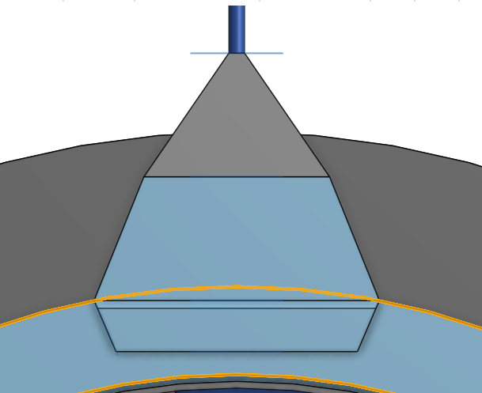
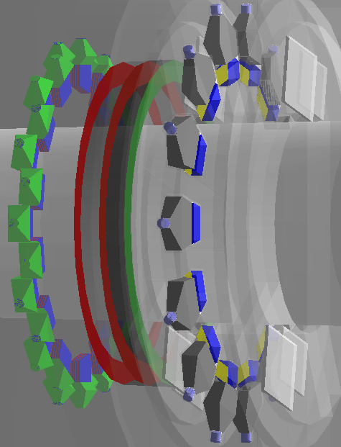
Geometry of Pion detector
PMT shielding
radial thickness of Concrete and Lead
Concrete/lead radius extend 16, 21, 26, 30, 35 cm
keep concrete at 16 cm, extend lead only to 26 cm
keep lead at 16 cm, extend concrete only to 26 cm
fix downstream face of donut, then reduce lead thickness
Concrete
Lead donut (Pb absorber)

Slide 3
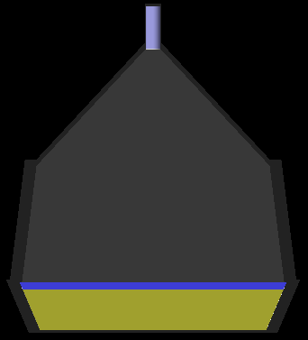
Geometry of Lucite detector
pionDetectorLucitePMTDiameter = 2.54 cm
pionDetectorLucitePMTHousingHeight
= 7.5 cm
pionDetectorLuciteLightGuideHeight
= 20 cm
pionDetectorLuciteReflectorDepth
=2.54 cm
pionDetectorLuciteReflectorWidth=40 cm
pionDetectorLuciteReflectorHeight
= 20 cm
pionDetectorLuciteHeight = 7cm
pionDetectorLuciteOutsideWidth = 45 cm
pionDetectorLuciteWedgeHeight = 1.27 cm
pionDetectorLuciteInsideWidth = 39 cm
pionDetectorLucitePlaneThickness = 2.54 cm

Slide 4
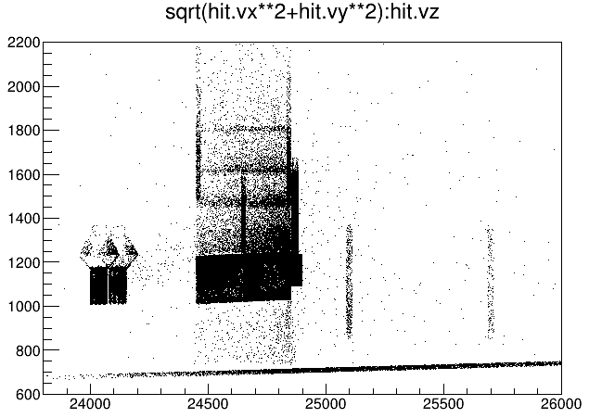
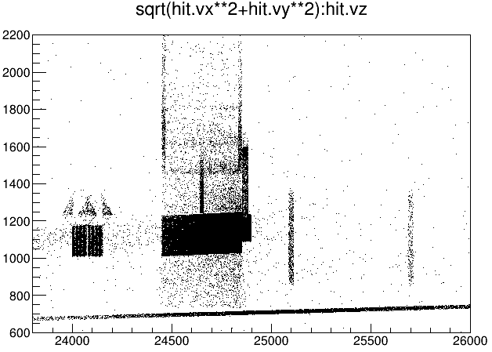
The origin location of all the secondaries anywhere for 5,000,000 events
(16 cm concrete and upstream Lead )
Electron
Pion
hit.trid==1 12
hit.trid==2 10
hit.trid==1 142857
T->Draw("sqrt(hit.vx**2+hit.vy**2):hit.vz>>h1(100,23800,26000,100,600,2200)")

Slide 5
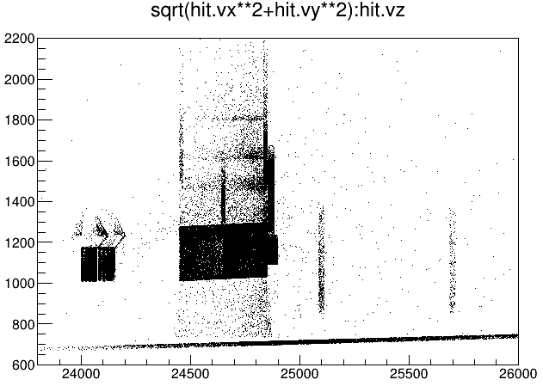
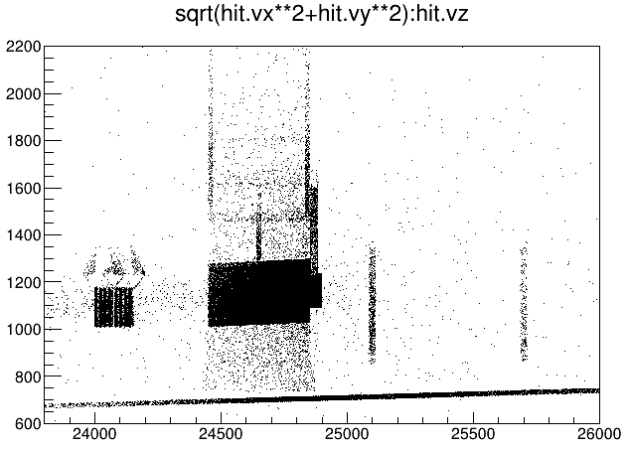
The origin location of all the secondaries anywhere for 5,000,000 events
(21 cm concrete and upstream Lead )
Electron
Pion
hit.trid==1 78
hit.trid==2 82
hit.trid==1 146168
T->Draw("sqrt(hit.vx**2+hit.vy**2):hit.vz>>h1(100,23800,26000,100,600,2200)")

Slide 6
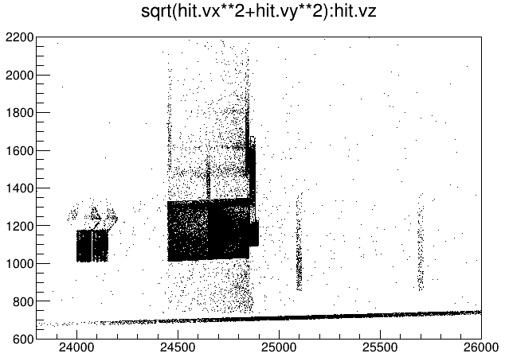
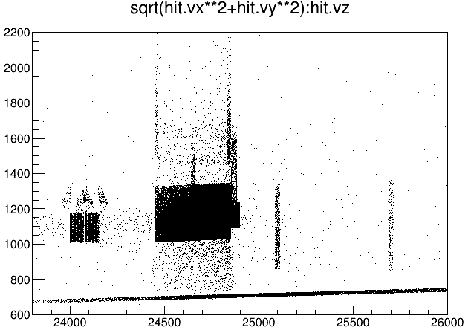
The origin location of all the secondaries anywhere for 5,000,000 events
(26 cm concrete and upstream Lead )
Electron
Pion
hit.trid==1 1
hit.trid==2 0
hit.trid==1 150426
T->Draw("sqrt(hit.vx**2+hit.vy**2):hit.vz>>h1(100,23800,26000,100,600,2200)")

Slide 7
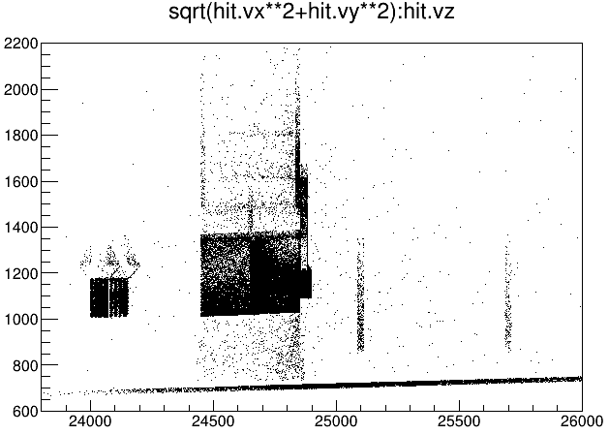
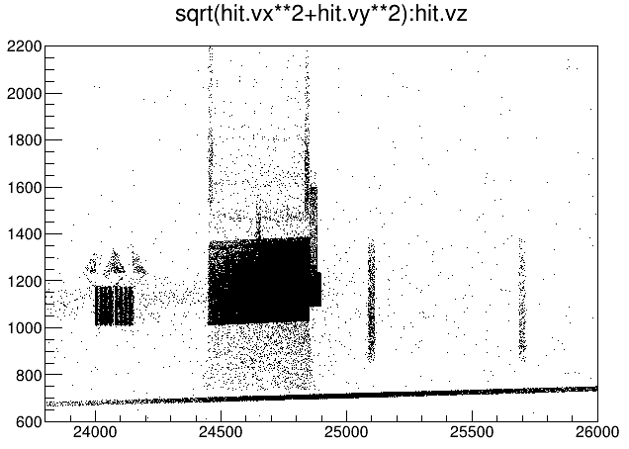
The origin location of all the secondaries anywhere for 5,000,000 events
(30 cm concrete and upstream Lead )
Electron
Pion
hit.trid==1 1
hit.trid==2 1
hit.trid==1 145238
T->Draw("sqrt(hit.vx**2+hit.vy**2):hit.vz>>h1(100,23800,26000,100,600,2200)")

Slide 8

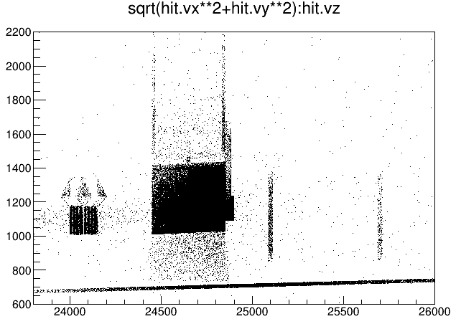
The origin location of all the secondaries anywhere for 5,000,000 events
(35 cm concrete and upstream Lead )
Electron
Pion
hit.trid==1 0
hit.trid==2 0
hit.trid==1 147195
T->Draw("sqrt(hit.vx**2+hit.vy**2):hit.vz>>h1(100,23800,26000,100,600,2200)")

Slide 9
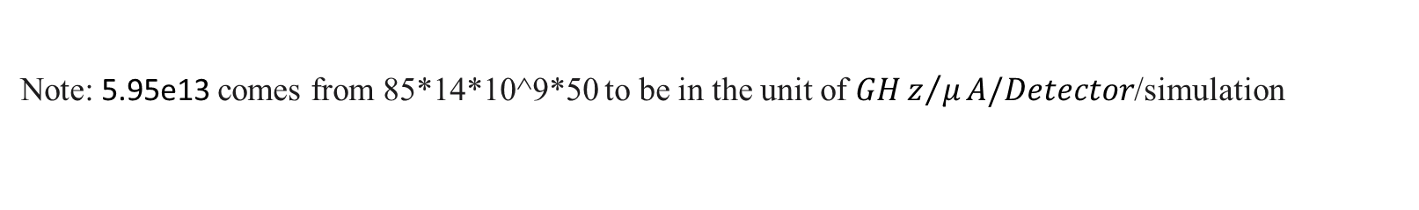
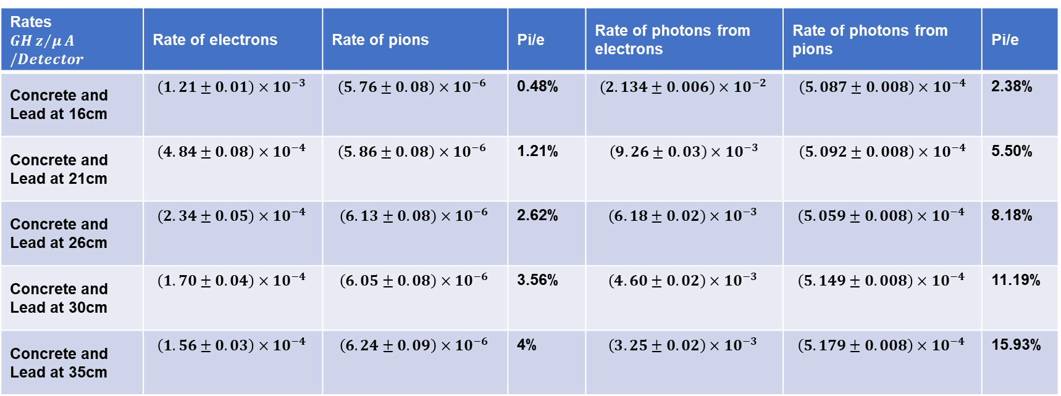
Comparison of rates at the Lucite for 5,000,000 events (Low energy particles, hit.p<2*MeV)
Rates $$GHz/μA/Detector$$ | Rate of electrons | Rate of pions | Pi/e | Rate of photons from electrons | Rate of photons from pions | Pi/e
Concrete and Lead at 16cm | $$\left(1.21±0.01\right)×{10}^{−3 }$$ | $$\left(5.76±0.08\right)×{10}^{−6 }$$ | 0.48% | $$\left(2.134±0.006\right)×{10}^{−2 }$$ | $$\left(5.087±0.008\right)×{10}^{−4}$$ | 2.38%
Concrete and Lead at 21cm | $$\left(4.84±0.08\right)×{10}^{−4 }$$ | $$\left(5.86±0.08\right)×{10}^{−6 }$$ | 1.21% | $$\left(9.26±0.03\right)×{10}^{−3}$$ | $$\left(5.092±0.008\right)×{10}^{−4}$$ | 5.50%
Concrete and Lead at 26cm | $$\left(2.34±0.05\right)×{10}^{−4 }$$ | $$\left(6.13±0.08\right)×{10}^{−6 }$$ | 2.62% | $$\left(6.18±0.02\right)×{10}^{−3 }$$ | $$\left(5.059±0.008\right)×{10}^{−4 }$$ | 8.18%
Concrete and Lead at 30cm | $$\left(1.70±0.04\right)×{10}^{−4 }$$ | $$\left(6.05±0.08\right)×{10}^{−6 }$$ | 3.56% | $$\left(4.60±0.02\right)×{10}^{−3 }$$ | $$\left(5.149±0.008\right)×{10}^{−4 }$$ | 11.19%
Concrete and Lead at 35cm | $$\left(1.56±0.03\right)×{10}^{−4 }$$ | $$\left(6.24±0.09\right)×{10}^{−6 }$$ | 4% | $$\left(3.25±0.02\right)×{10}^{−3 }$$ | $$\left(5.179±0.008\right)×{10}^{−4 }$$ | 15.93%
T->Draw("1","(rate/5.95e13)*(hit.det==8001 && hit.p<2*MeV && (hit.pid==11 || hit.pid==-11 || hit.pid==211 || hit.pid==-211 || hit.pid==13 || hit.pid==-13))")
T->Draw("1","(rate/5.95e13)*(hit.det==8000)")
Note: 5.95e13 comes from 85*14*10^9*50 to be in the unit of $GHz/μA/Detector$/simulation

Slide 10
Comparison of rates at the Lucite for 5,000,000 events (Low energy particles, hit.p<2*MeV)

Slide 11

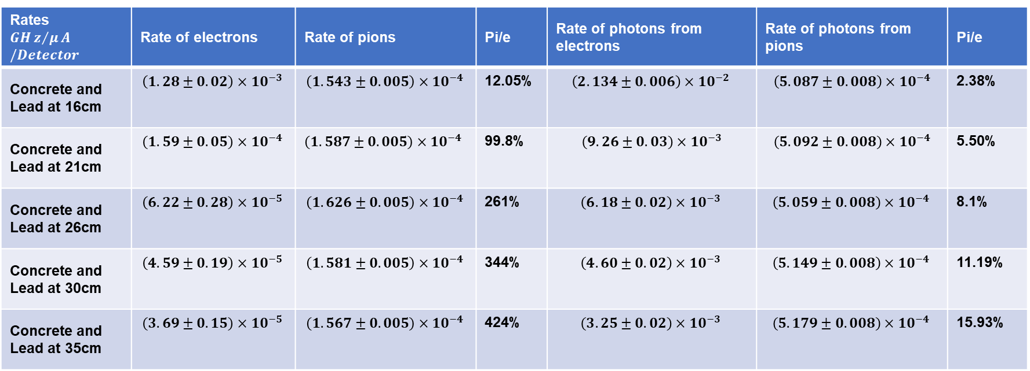
Comparison of rates at the Lucite for 5,000,000 events (High energy particles, hit.p>2*MeV)
Rates $$GHz/μA/Detector$$ | Rate of electrons | Rate of pions | Pi/e | Rate of photons from electrons | Rate of photons from pions | Pi/e
Concrete and Lead at 16cm | $$\left(1.28±0.02\right)×{10}^{−3 }$$ | $$\left(1.543±0.005\right)×{10}^{−4 }$$ | 12.05% | $$\left(2.134±0.006\right)×{10}^{−2 }$$ | $$\left(5.087±0.008\right)×{10}^{−4}$$ | 2.38%
Concrete and Lead at 21cm | $$\left(1.59±0.05\right)×{10}^{−4 }$$ | $$\left(1.587±0.005\right)×{10}^{−4 }$$ | 99.8% | $$\left(9.26±0.03\right)×{10}^{−3}$$ | $$\left(5.092±0.008\right)×{10}^{−4}$$ | 5.50%
Concrete and Lead at 26cm | $$\left(6.22±0.28\right)×{10}^{−5 }$$ | $$\left(1.626±0.005\right)×{10}^{−4 }$$ | 261% | $$\left(6.18±0.02\right)×{10}^{−3 }$$ | $$\left(5.059±0.008\right)×{10}^{−4 }$$ | 8.1%
Concrete and Lead at 30cm | $$\left(4.59±0.19\right)×{10}^{−5 }$$ | $$\left(1.581±0.005\right)×{10}^{−4 }$$ | 344% | $$\left(4.60±0.02\right)×{10}^{−3 }$$ | $$\left(5.149±0.008\right)×{10}^{−4 }$$ | 11.19%
Concrete and Lead at 35cm | $$\left(3.69±0.15\right)×{10}^{−5 }$$ | $$\left(1.567±0.005\right)×{10}^{−4 }$$ | 424% | $$\left(3.25±0.02\right)×{10}^{−3 }$$ | $$\left(5.179±0.008\right)×{10}^{−4 }$$ | 15.93%
T->Draw("1","(rate/5.95e13)*(hit.det==8001 && hit.p>2*MeV && (hit.pid==11 || hit.pid==-11 || hit.pid==211 || hit.pid==-211 || hit.pid==13 || hit.pid==-13))")
T->Draw("1","(rate/5.95e13)*(hit.det==8000)")
Note: 5.95e13 comes from 85*14*10^9*50 to be in the unit of $GHz/μA/Detector$/simulation

Slide 12
Comparison of rates at the Lucite for 5,000,000 events (High energy particles, hit.p>2*MeV)

Slide 13
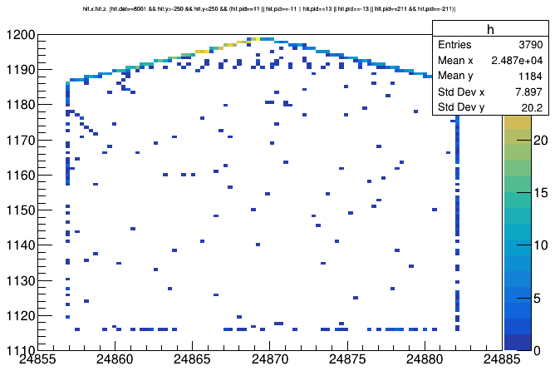
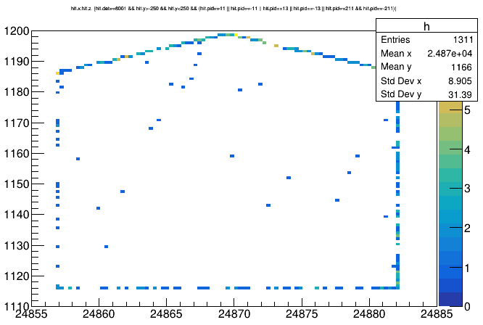
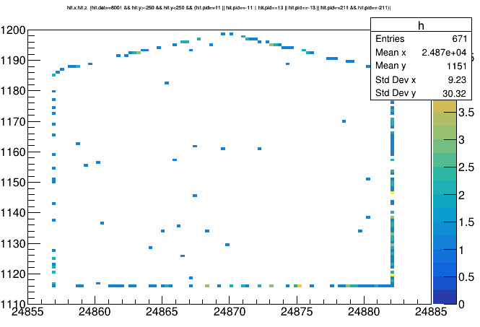
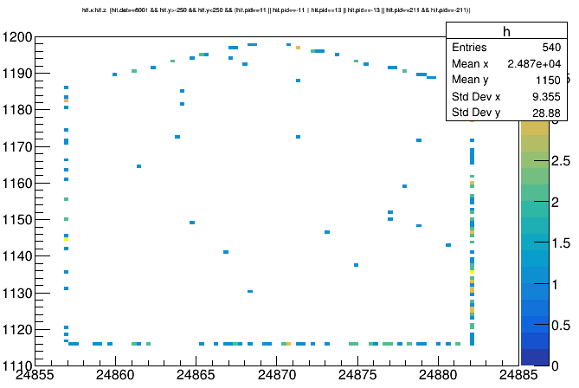
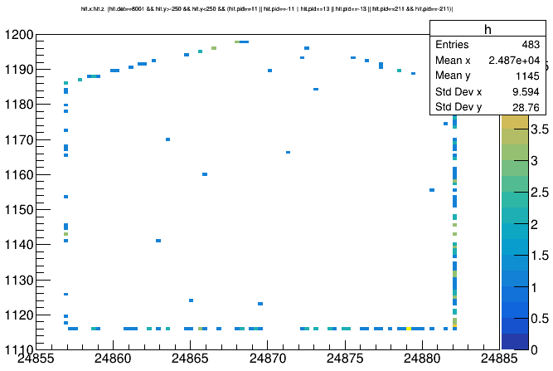
Concrete and Lead at 16cm
Concrete and Lead at 21cm
Concrete and Lead at 26cm
Concrete and Lead at 30 cm
Concrete and Lead at 35cm
T->Draw("hit.x:hit.z >>h(100,24855,24885,100,1110,1200)","hit.det==8001 && hit.y>-250 && hit.y<250 && (hit.pid==11 || hit.pid==-11 || hit.pid==13 || hit.pid==-13 || hit.pid==211 && hit.pid==-211)","colz")

Slide 14
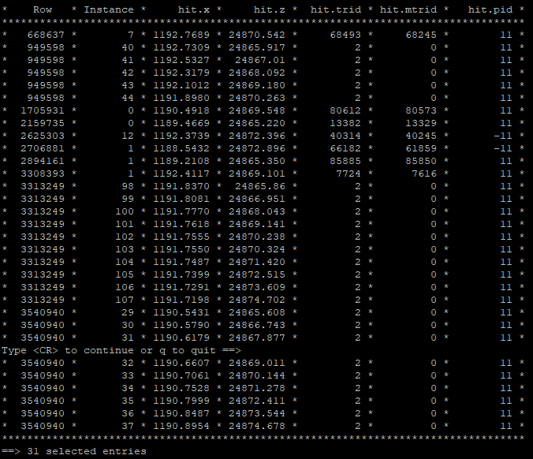
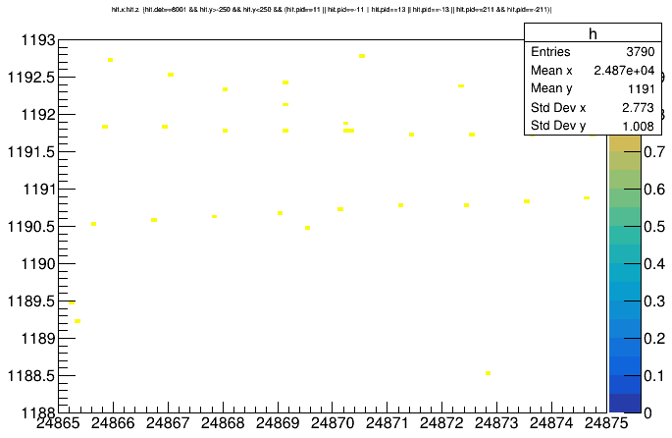
Concrete and Lead at 16cm
T->Draw("hit.x:hit.z >>h(100,24865,24875,100,1188,1193)","hit.det==8001 && hit.y>-250 && hit.y<250 && (hit.pid==11 || hit.pid==-11 || hit.pid==13 || hit.pid==-13 || hit.pid==211 && hit.pid==-211)","colz")
T->Scan("hit.x:hit.z","hit.det==8001 && hit.x>1188 && hit.x<1193 && hit.z>24865 && hit.z<24875 && hit.y>-250 && hit.y<250 && (hit.pid==11 || hit.pid==-11 || hit.pid==-211)")

Slide 15

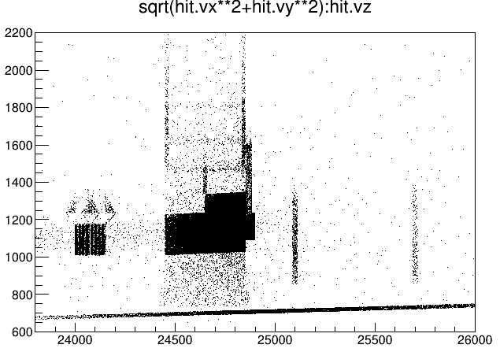
The origin location of all the secondaries anywhere for 5,000,000 events
(16 cm concrete and 26 cm upstream Lead )
Electron
Pion
hit.trid==1 24
hit.trid==2 120
hit.trid==1 147730
T->Draw("sqrt(hit.vx**2+hit.vy**2):hit.vz>>h1(100,23800,26000,100,600,2200)")

Slide 16

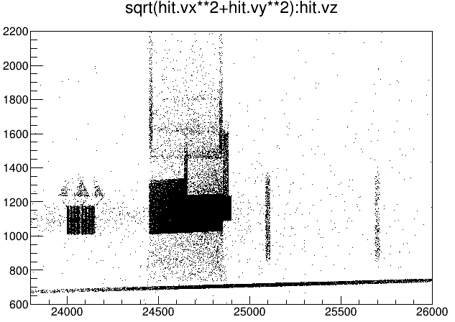
The origin location of all the secondaries anywhere for 5,000,000 events
(26 cm concrete and 16 cm upstream Lead )
Electron
Pion
hit.trid==1 3531
hit.trid==2 2864
hit.trid==1 149559
T->Draw("sqrt(hit.vx**2+hit.vy**2):hit.vz>>h1(100,23800,26000,100,600,2200)")

Slide 17
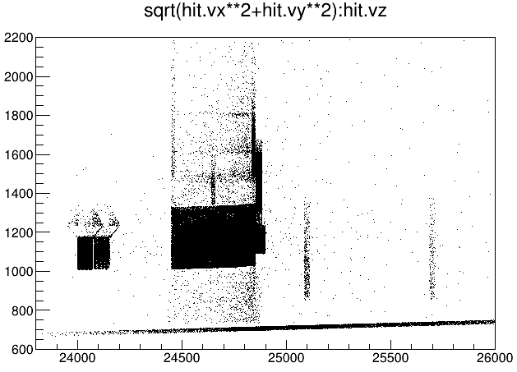

The origin location of all the secondaries anywhere for 5,000,000 events
Fix downstream face of donut, then reduce lead thickness, (10 cm lead thickness and 30cm Concrete thickness)
Electron
Pion
T->Draw("sqrt(hit.vx**2+hit.vy**2):hit.vz>>h1(100,23800,26000,100,600,2200)")

Slide 18
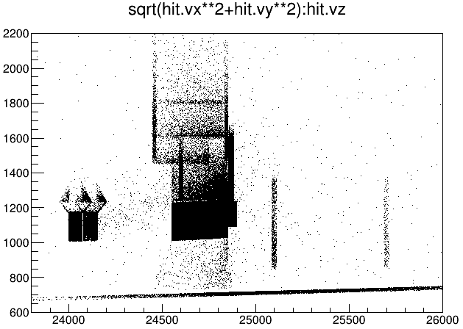
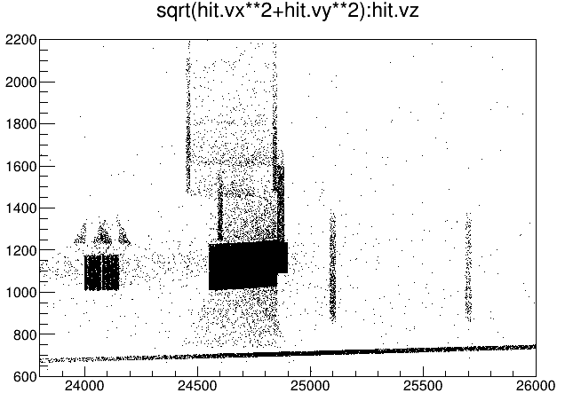
The origin location of all the secondaries anywhere for 5,000,000 events
Fix downstream face of donut, then reduce lead thickness, (10 cm lead thickness and 20cm Concrete thickness)
Electron
Pion
T->Draw("sqrt(hit.vx**2+hit.vy**2):hit.vz>>h1(100,23800,26000,100,600,2200)")

Slide 19

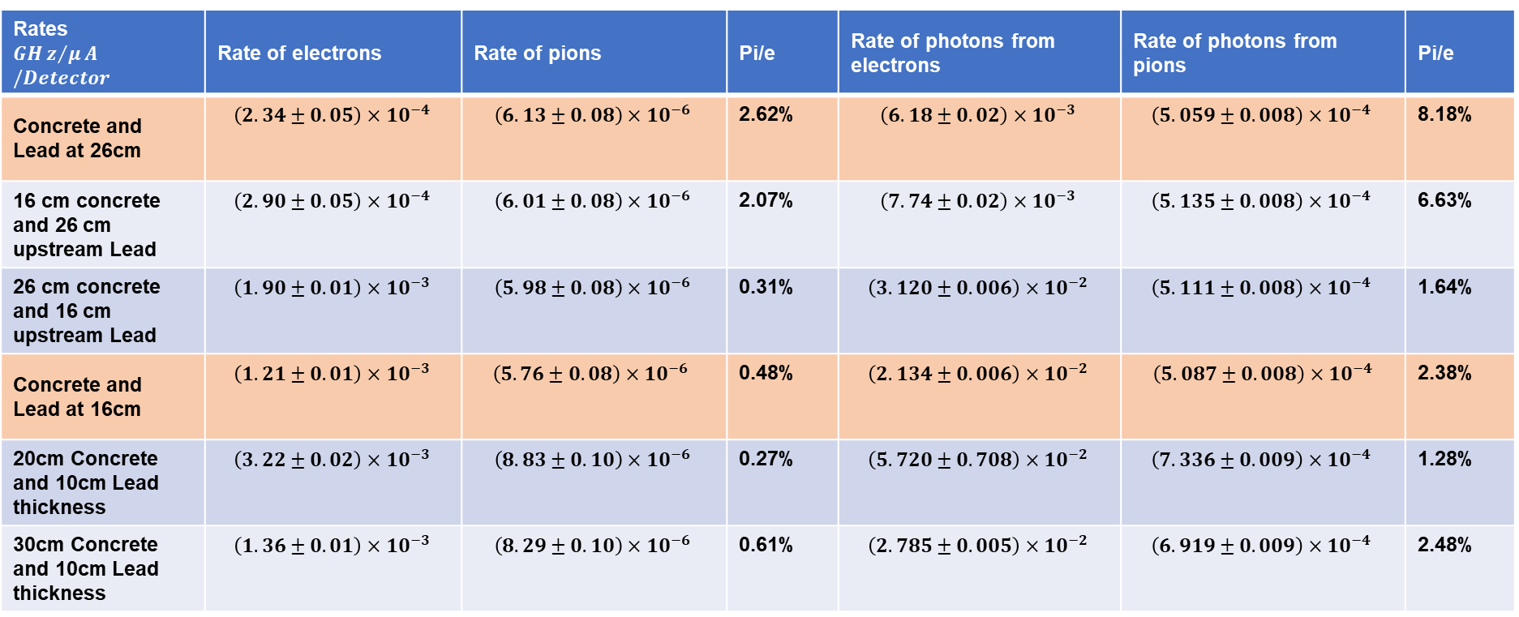
Comparison of rates at the Lucite for 5,000,000 events
Rates $$GHz/μA/Detector$$ | Rate of electrons | Rate of pions | Pi/e | Rate of photons from electrons | Rate of photons from pions | Pi/e
Concrete and Lead at 26cm | $$\left(2.34±0.05\right)×{10}^{−4 }$$ | $$\left(6.13±0.08\right)×{10}^{−6 }$$ | 2.62% | $$\left(6.18±0.02\right)×{10}^{−3 }$$ | $$\left(5.059±0.008\right)×{10}^{−4 }$$ | 8.18%
16 cm concrete and 26 cm upstream Lead | $$\left(2.90±0.05\right)×{10}^{−4 }$$ | $$\left(6.01±0.08\right)×{10}^{−6 }$$ | 2.07% | $$\left(7.74±0.02\right)×{10}^{−3 }$$ | $$\left(5.135±0.008\right)×{10}^{−4 }$$ | 6.63%
26 cm concrete and 16 cm upstream Lead | $$\left(1.90±0.01\right)×{10}^{−3 }$$ | $$\left(5.98±0.08\right)×{10}^{−6 }$$ | 0.31% | $$\left(3.120±0.006\right)×{10}^{−2 }$$ | $$\left(5.111±0.008\right)×{10}^{−4 }$$ | 1.64%
Concrete and Lead at 16cm | $$\left(1.21±0.01\right)×{10}^{−3 }$$ | $$\left(5.76±0.08\right)×{10}^{−6 }$$ | 0.48% | $$\left(2.134±0.006\right)×{10}^{−2 }$$ | $$\left(5.087±0.008\right)×{10}^{−4}$$ | 2.38%
20cm Concrete and 10cm Lead thickness | $$\left(3.22±0.02\right)×{10}^{−3 }$$ | $$\left(8.83±0.10\right)×{10}^{−6 }$$ | 0.27% | $$\left(5.720±0.708\right)×{10}^{−2 }$$ | $$\left(7.336±0.009\right)×{10}^{−4 }$$ | 1.28%
30cm Concrete and 10cm Lead thickness | $$\left(1.36±0.01\right)×{10}^{−3 }$$ | $$\left(8.29±0.10\right)×{10}^{−6 }$$ | 0.61% | $$\left(2.785±0.005\right)×{10}^{−2 }$$ | $$\left(6.919±0.009\right)×{10}^{−4 }$$ | 2.48%
T->Draw("1","(rate/5.95e13)*(hit.det==8001 && hit.p<2*MeV && (hit.pid==11 || hit.pid==-11 || hit.pid==211 || hit.pid==-211 || hit.pid==13 || hit.pid==-13))")
T->Draw("1","(rate/5.95e13)*(hit.det==8000)")
Note: 5.95e13 comes from 85*14*10^9*50 to be in the unit of $GHz/μA/Detector$/simulation

Slide 20

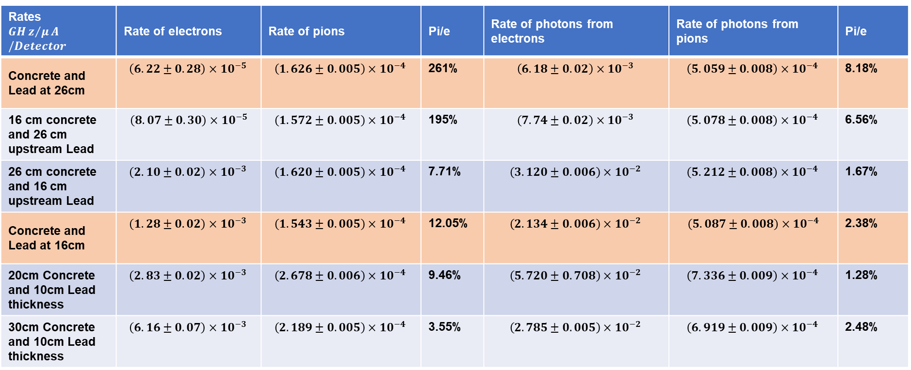
Comparison of rates at the Lucite for 5,000,000 events
Rates $$GHz/μA/Detector$$ | Rate of electrons | Rate of pions | Pi/e | Rate of photons from electrons | Rate of photons from pions | Pi/e
Concrete and Lead at 26cm | $$\left(6.22±0.28\right)×{10}^{−5 }$$ | $$\left(1.626±0.005\right)×{10}^{−4 }$$ | 261% | $$\left(6.18±0.02\right)×{10}^{−3 }$$ | $$\left(5.059±0.008\right)×{10}^{−4 }$$ | 8.18%
16 cm concrete and 26 cm upstream Lead | $$\left(8.07±0.30\right)×{10}^{−5}$$ | $$\left(1.572±0.005\right)×{10}^{−4 }$$ | 195% | $$\left(7.74±0.02\right)×{10}^{−3 }$$ | $$\left(5.078±0.008\right)×{10}^{−4 }$$ | 6.56%
26 cm concrete and 16 cm upstream Lead | $$\left(2.10±0.02\right)×{10}^{−3 }$$ | $$\left(1.620±0.005\right)×{10}^{−4 }$$ | 7.71% | $$\left(3.120±0.006\right)×{10}^{−2 }$$ | $$\left(5.212±0.008\right)×{10}^{−4 }$$ | 1.67%
Concrete and Lead at 16cm | $$\left(1.28±0.02\right)×{10}^{−3 }$$ | $$\left(1.543±0.005\right)×{10}^{−4 }$$ | 12.05% | $$\left(2.134±0.006\right)×{10}^{−2 }$$ | $$\left(5.087±0.008\right)×{10}^{−4}$$ | 2.38%
20cm Concrete and 10cm Lead thickness | $$\left(2.83±0.02\right)×{10}^{−3 }$$ | $$\left(2.678±0.006\right)×{10}^{−4 }$$ | 9.46% | $$\left(5.720±0.708\right)×{10}^{−2 }$$ | $$\left(7.336±0.009\right)×{10}^{−4 }$$ | 1.28%
30cm Concrete and 10cm Lead thickness | $$\left(6.16±0.07\right)×{10}^{−3 }$$ | $$\left(2.189±0.005\right)×{10}^{−4 }$$ | 3.55% | $$\left(2.785±0.005\right)×{10}^{−2 }$$ | $$\left(6.919±0.009\right)×{10}^{−4 }$$ | 2.48%
T->Draw("1","(rate/5.95e13)*(hit.det==8001 && hit.p>2*MeV && (hit.pid==11 || hit.pid==-11 || hit.pid==211 || hit.pid==-211 || hit.pid==13 || hit.pid==-13))")
T->Draw("1","(rate/5.95e13)*(hit.det==8000)")
Note: 5.95e13 comes from 85*14*10^9*50 to be in the unit of $GHz/μA/Detector$/simulation

Slide 21
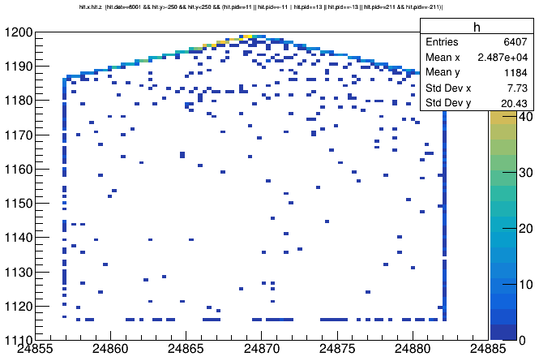
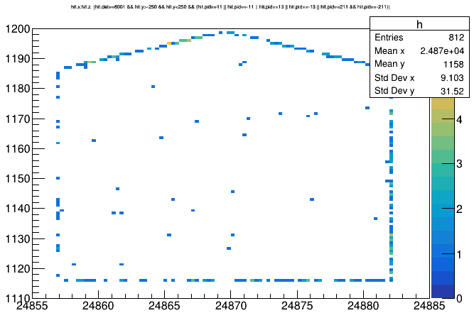
26 cm concrete and lead
26 cm concrete and 16 cm Lead
16 cm concrete and 26 cm Lead
T->Draw("hit.x:hit.z >>h(100,24855,24885,100,1110,1200)","hit.det==8001 && hit.y>-250 && hit.y<250 && (hit.pid==11 || hit.pid==-11 || hit.pid==13 || hit.pid==-13 || hit.pid==211 && hit.pid==-211)","colz")

Slide 22
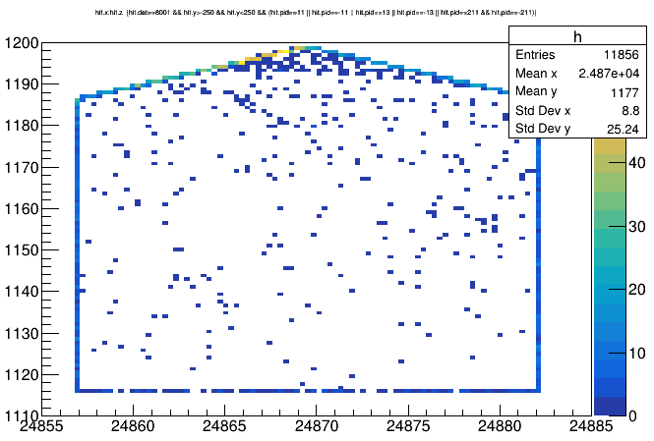
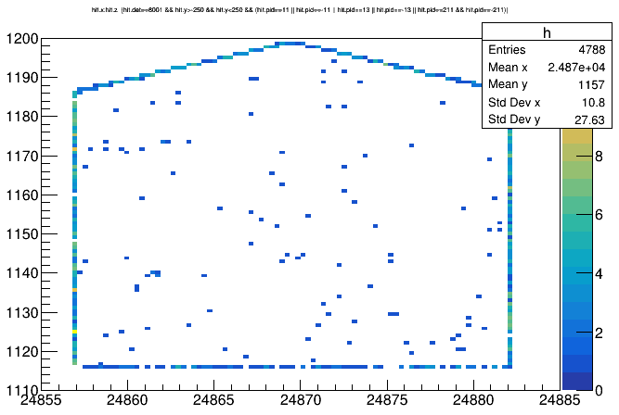
20cm Concrete and 10cm Lead thickness
30cm Concrete and 10cm Lead thickness

Slide 23
Thank you

