Slide 1

Different designs for the newgeometry with shielding in the electron and pion generator
The MOLLER Project
Measurement Of a Lepton Lepton Electroweak Reaction
Dr. Wouter Deconinck
Elham Gorgannejad
February, 2021

Slide 2
Downstream shielding
Shielding
Inner radial shielding
Lucite at 0 degree
Lucite
Lucite at 22.5 degree
Lucite at 45 degree
16 cm
Upstream height
26 cm

Slide 3
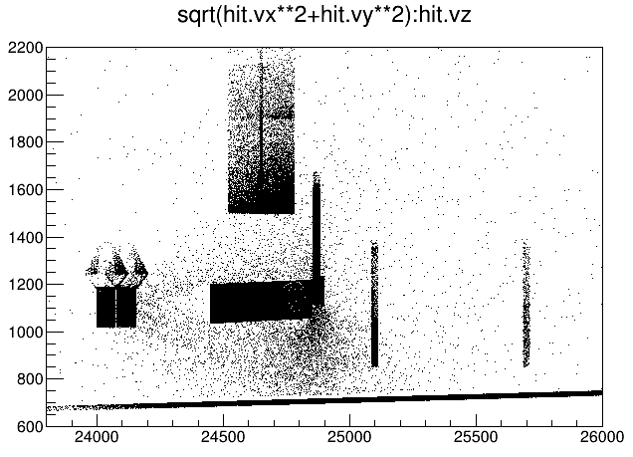
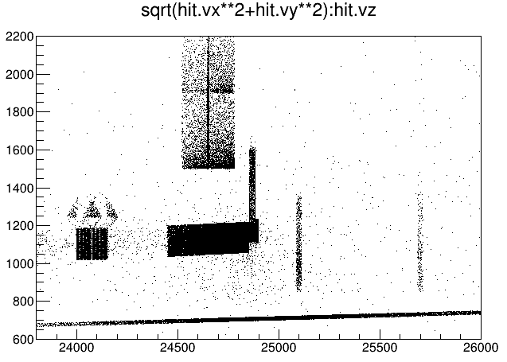
The origin location of all the secondaries anywhere for 5,000,000 events
(Lucite at 0 degree, 16 cm Upstream Lead )
Electron
Pion
hit.trid==1 12
hit.trid==2 10
hit.trid==1 6823
T->Draw("sqrt(hit.vx**2+hit.vy**2):hit.vz>>h1(125,23800,26000,100,600,2200)")

Slide 4
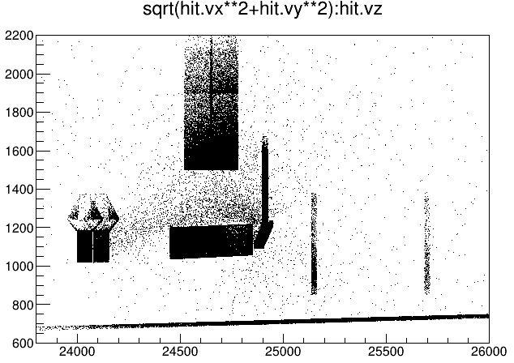

The origin location of all the secondaries anywhere for 5,000,000 events
(Lucite at 22.5 degree, 16 cm Upstream Lead )
Electron
Pion
hit.trid==1 6
hit.trid==2 4
hit.trid==1 6930
T->Draw("sqrt(hit.vx**2+hit.vy**2):hit.vz>>h1(125,23800,26000,100,600,2200)")

Slide 5
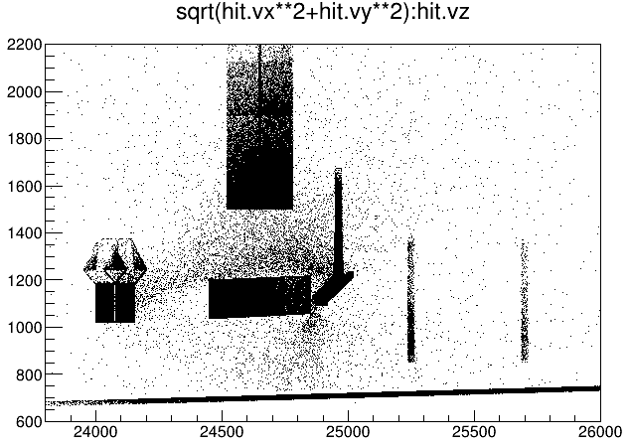
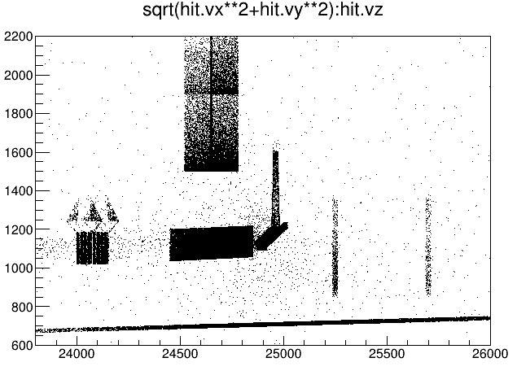
The origin location of all the secondaries anywhere for 5,000,000 events
(Lucite at 45 degree, 16 cm Upstream Lead )
Electron
Pion
hit.trid==1 15
hit.trid==2 13
hit.trid==1 6753
T->Draw("sqrt(hit.vx**2+hit.vy**2):hit.vz>>h1(125,23800,26000,100,600,2200)")

Slide 6
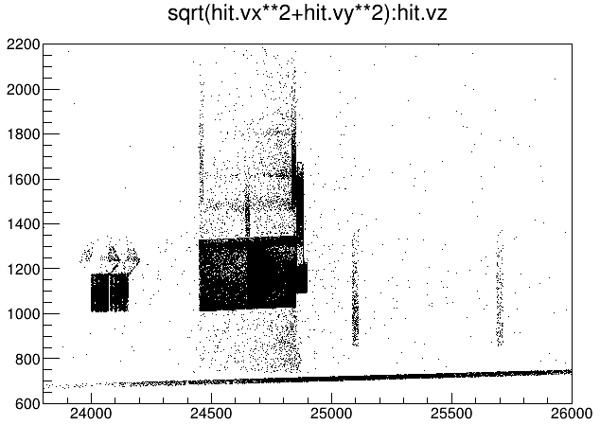
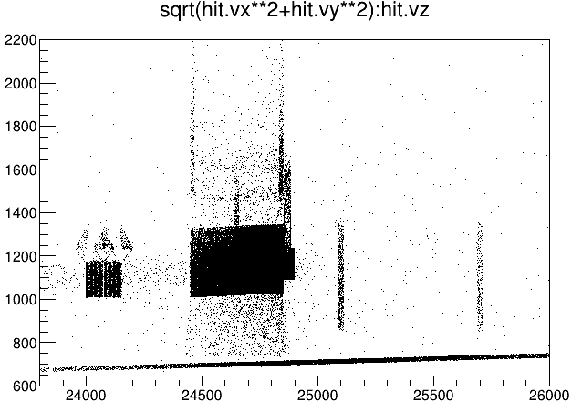
The origin location of all the secondaries anywhere for 5,000,000 events
(Lucite at 0 degree, 26 cm Upstream Lead )
Electron
Pion
hit.trid==1 48
hit.trid==2 0
hit.trid==1 150426
T->Draw("sqrt(hit.vx**2+hit.vy**2):hit.vz>>h1(100,23800,26000,100,600,2200)")

Slide 7
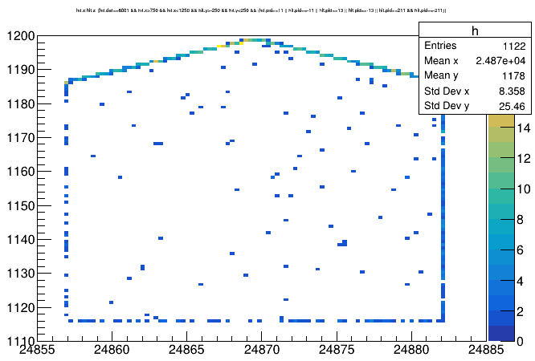
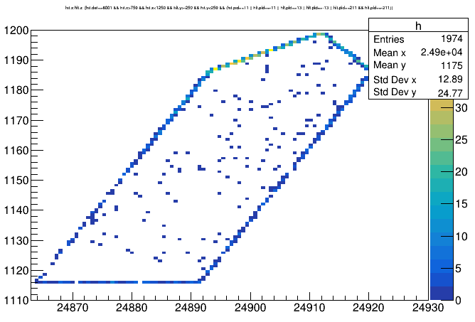
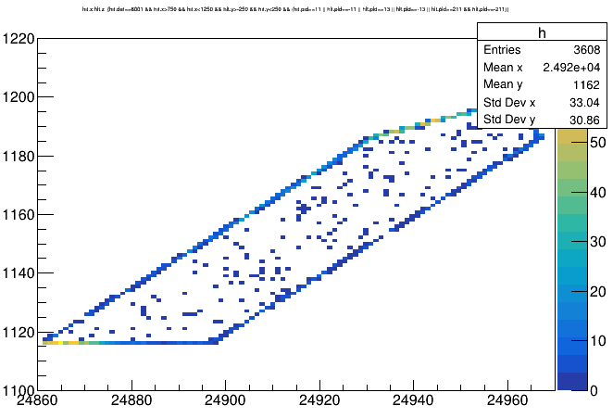
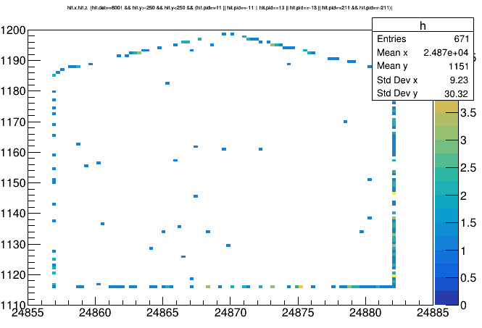
Lucite at 0 degree, 16 cm Upstream Lead
Lucite at 22.5 degree, 16 cm Upstream Lead
Lucite at 22.5 degree, 16 cm Upstream Lead
Lucite at 0 degree, 26 cm Upstream Lead

Slide 8
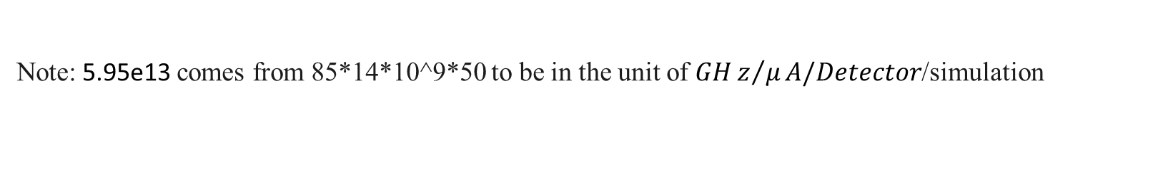
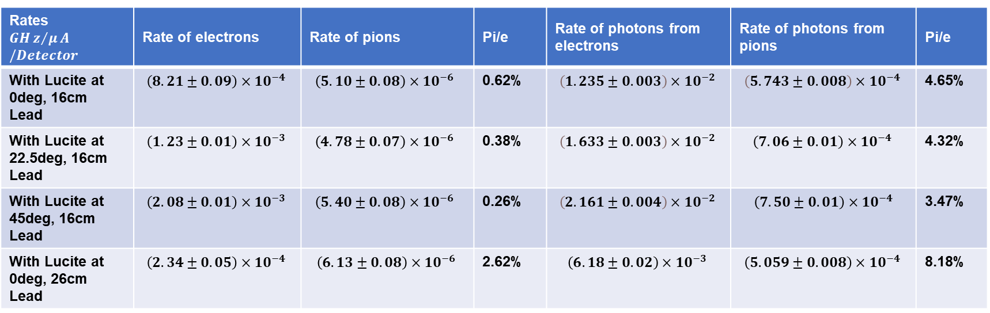
Comparison of rates at the Lucite for 5,000,000 events
Rates $$GHz/μA/Detector$$ | Rate of electrons | Rate of pions | Pi/e | Rate of photons from electrons | Rate of photons from pions | Pi/e
With Lucite at 0deg, 16cm Lead | $$\left(8.21±0.09\right)×{10}^{−4 }$$ | $$\left(5.10±0.08\right)×{10}^{−6 }$$ | 0.62% | $$\left(1.235±0.003\right)×{10}^{−2 }$$ | $$\left(5.743±0.008\right)×{10}^{−4 }$$ | 4.65%
With Lucite at 22.5deg, 16cm Lead | $$\left(1.23±0.01\right)×{10}^{−3 }$$ | $$\left(4.78±0.07\right)×{10}^{−6 }$$ | 0.38% | $$\left(1.633±0.003\right)×{10}^{−2 }$$ | $$\left(7.06±0.01\right)×{10}^{−4 }$$ | 4.32%
With Lucite at 45deg, 16cm Lead | $$\left(2.08±0.01\right)×{10}^{−3 }$$ | $$\left(5.40±0.08\right)×{10}^{−6 }$$ | 0.26% | $$\left(2.161±0.004\right)×{10}^{−2 }$$ | $$\left(7.50±0.01\right)×{10}^{−4}$$ | 3.47%
With Lucite at 0deg, 26cm Lead | $$\left(2.34±0.05\right)×{10}^{−4 }$$ | $$\left(6.13±0.08\right)×{10}^{−6 }$$ | 2.62% | $$\left(6.18±0.02\right)×{10}^{−3 }$$ | $$\left(5.059±0.008\right)×{10}^{−4 }$$ | 8.18%
T->Draw("1","(rate/5.95e13)*(hit.det==8001 && hit.p<2*MeV && (hit.pid==11 || hit.pid==-11 || hit.pid==211 || hit.pid==-211 || hit.pid==13 || hit.pid==-13))")
T->Draw("1","(rate/5.95e13)*(hit.det==8000)")
Note: 5.95e13 comes from 85*14*10^9*50 to be in the unit of $GHz/μA/Detector$/simulation

Slide 9

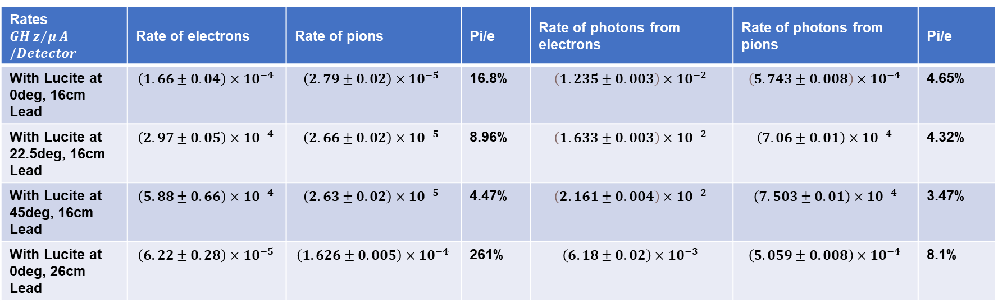
Comparison of rates at the Lucite for 5,000,000 events
Rates $$GHz/μA/Detector$$ | Rate of electrons | Rate of pions | Pi/e | Rate of photons from electrons | Rate of photons from pions | Pi/e
With Lucite at 0deg, 16cm Lead | $$\left(1.66±0.04\right)×{10}^{−4 }$$ | $$\left(2.79±0.02\right)×{10}^{−5 }$$ | 16.8% | $$\left(1.235±0.003\right)×{10}^{−2 }$$ | $$\left(5.743±0.008\right)×{10}^{−4 }$$ | 4.65%
With Lucite at 22.5deg, 16cm Lead | $$\left(2.97±0.05\right)×{10}^{−4 }$$ | $$\left(2.66±0.02\right)×{10}^{−5 }$$ | 8.96% | $$\left(1.633±0.003\right)×{10}^{−2 }$$ | $$\left(7.06±0.01\right)×{10}^{−4 }$$ | 4.32%
With Lucite at 45deg, 16cm Lead | $$\left(5.88±0.66\right)×{10}^{−4 }$$ | $$\left(2.63±0.02\right)×{10}^{−5 }$$ | 4.47% | $$\left(2.161±0.004\right)×{10}^{−2 }$$ | $$\left(7.503±0.01\right)×{10}^{−4}$$ | 3.47%
With Lucite at 0deg, 26cm Lead | $$\left(6.22±0.28\right)×{10}^{−5 }$$ | $$\left(1.626±0.005\right)×{10}^{−4 }$$ | 261% | $$\left(6.18±0.02\right)×{10}^{−3 }$$ | $$\left(5.059±0.008\right)×{10}^{−4 }$$ | 8.1%
T->Draw("1","(rate/5.95e13)*(hit.det==8001 && hit.p>2*MeV && (hit.pid==11 || hit.pid==-11 || hit.pid==211 || hit.pid==-211 || hit.pid==13 || hit.pid==-13))")
T->Draw("1","(rate/5.95e13)*(hit.det==8000)")
Note: 5.95e13 comes from 85*14*10^9*50 to be in the unit of $GHz/μA/Detector$/simulation

Slide 10
Thank you

