Slide 1
Moller Spectrometer
Down Stream Toroid
Coil Design Down Select Decision
J. Mammei / R. Fair
v2.00 – 12.15.2020

Slide 2
Introduction to the two DS coil designs
Coil engineering process
How did we use the Pugh matrix
Physics Criteria – refer to Juliette’s slides
Engineering Criteria
  Design, Fabrication, Assembly, Operation
Schedule Impact
Cost Impact
Summary and Conclusion

Slide 3
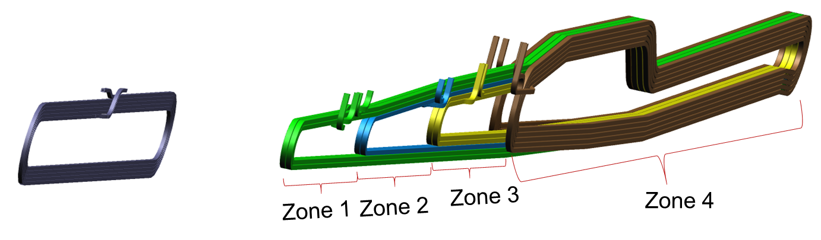
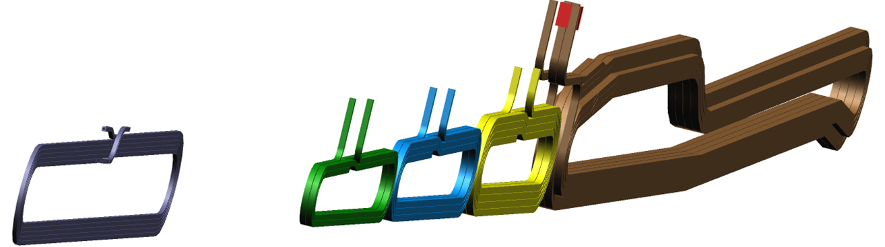
Introduction to the two DS coil designs
DS Hybrid Torus: Co-wound coils
DS Segmented Torus: Independent coils

Slide 4
Coil Engineering - Process
Choose appropriate design goals ^{[1]}
  Current density: 20 A/mm²
  Water Flow Velocity: 15 ft/sec
  Water temperature rise: 35 ºC ( note coolant supply 30 ºC)
Choose a operating differential pressure 100 psid (chosen to allow increase if needed to create flow but not limiting fitting or hose type choice)
Nominal Current (Ampere Turns) by zone provided by collaboration)
Design current is 110% of nominal value provided by the collaboration
Choose a conductor size (H x W x dia) for each coil type and create wind-able design to match collaboration requested current placement geometry and to clear particle tracks
Provide simplified (blocky model) of winding layout to collaboration for evaluation of particle tracking
[1] – Based on review of water-cooled magnets at JLab and SLAC
Magnet type | US | Zone 1 | Zone 2 | Zone 3 | Zone 4
Hybrid | 5358 | 7752 | 10602 | 16862 | 29160
Segmented (15% More than Hybrid DS coil) | 5358 | 8914 | 12192 | 19391 | 33534
Notes:
Go through bullets
Not Segmented needs 15% more current due to reduced coil straight lengths

Slide 5
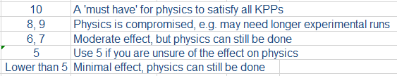
How did we use the Pugh Matrix – this was a team effort
Enter Critical to Quality (CTQs) requirements
  For the Moller spectrometer, the main requirement (obviously) is being able to perform the physics
    This top level requirement can be broken down further to include the engineering requirements. We have divided it into DESIGN, FABRICATION, ASSEMBLY and OPERATION
Give each CTQ a weight – i.e. ask ourselves how important is each CTQ to satisfying the physics requirements? The weights are usually rated from 1 to 10.
Rate each alternative design as better (1), worse (-1) or the same (0) as the ‘baseline design’.
  Here we have selected the ‘baseline design’ to be the Hybrid coil design and the segmented coil design as the alternative

Slide 6
PHYSICS CRITERIA
Juliette

Slide 7
ENGINEERING CRITERIA
Design Criteria
Both coil designs satisfy physics optics requirements
Both coil designs can satisfy all the engineering design goals
  Current density
  Temperature rise
  Water flow velocity
  Pressure drop
Both coil designs can satisfy the clearances to particle envelopes requirements
Power supply cost, number of joints, number of isolation breaks, etc. are similar
The segmented coil design is less technically complex
→ In terms of design, both designs are largely similar

Slide 8
ENGINEERING CRITERIA
Fabrication Criteria
The segmented coil design is less technically complex
  Less complicated winding tooling, jigs and fixtures
  Easier to wind
  Easier to apply Ground wrap insulation
  Easier to pot
  Easier to control fabrication tolerances
  Attachment of water and electrical fittings will be easier
  Carrying out QA/QC checks on individual coils should be easier
→ The segmented design should be more straightforward to fabricate, thereby reducing risk.

Slide 9
ENGINEERING CRITERIA
Assembly Criteria
The segmented coil design is less technically complex
  Handling and assembly should be easier
  However, final alignment may require more effort due to having to align more separate elements
→ The segmented design should be more straightforward to assemble thereby reducing risk.
Operation Criteria
Both designs are very similar with regards to operation – i.e. forces, stresses, thermal growth are comparable
Although the segmented design may be more prone to changes in alignment during operation, any misalignment can be assessed and addressed more easily than for the hybrid.
→ The segmented design should be more straightforward to align for operation

Slide 10
SCHEDULE IMPACT
The one vendor who provided cost and schedule estimates for both designs confirmed that there would be no difference in schedule for coil delivery
DS Torus Production Coil # | Lead time ARO (weeks)
1 | 24
2 | 32
3 | 36
4 | 40
5 | 44
6 | 48
7 | 52
It is likely that additional time will be required for the segmented design as follows:
  Design: 3 weeks (coil strong backs, water-cooled leads and jumpers)
  Fabrication: 6 weeks (coil dies, water-cooled leads and jumpers, coil support and adjusters)
  Assembly: 2 weeks (alignment and survey of coils on strong back and frame)
  Installation: 1 week (alignment and survey)
  Testing and performance: 1 week (alignment and survey)

Slide 11
COST IMPACT
Opting to use the segmented coil design impacts the cost as shown below primarily for the following reasons:
  Additional materials (coil dies, water-cooled leads, prototype coil strong back and coil support and adjusters; note that the segmented coils are approximately $47 K lower in cost)
  Additional alignment time during assembly
  Additional alignment time during installation
  Additional alignment time during testing and performance
Cost Category | $K or Hours
Materials | $52 K
Principal Engineer | 100 hours
Senior Engineer | 16 hours
Mechanical Engineer | 90 hours
Mechanical Designer | 100 hours
Technician | 280 hours

Slide 12
SUMMARY AND CONCLUSION
The result of the Pugh matrix analysis is +84 in favor of the segmented option. Given that the weights can be somewhat subjective, the result was checked with equally weighted criteria, and the result is still in +17 favor of the segmented option.
The results of implementing a finer field map to understand the relatively small differences between the hybrid and segmented are unlikely to change this decision.
Therefore it is the recommendation of the Spectrometer Group that the MOLLER experiment move forward conditionally with a segmented configuration as the new baseline design for the spectrometer.

Slide 13
BACKUP – PUGH MATRIX EXTRACTS

Slide 14
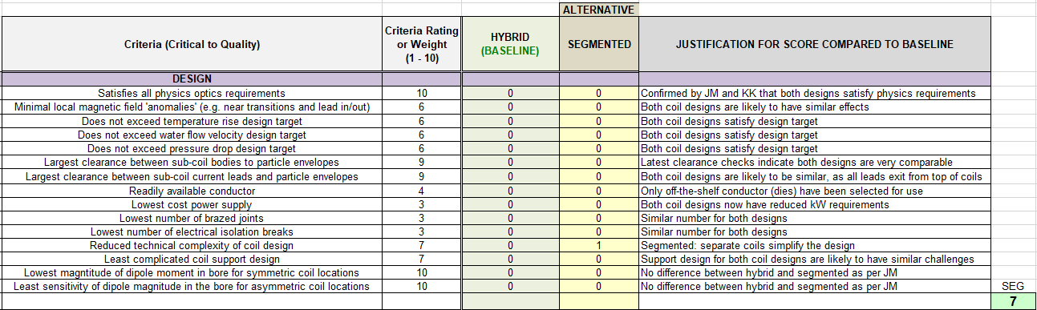
Extract from the Pugh Matrix for the coil design down select

Slide 15
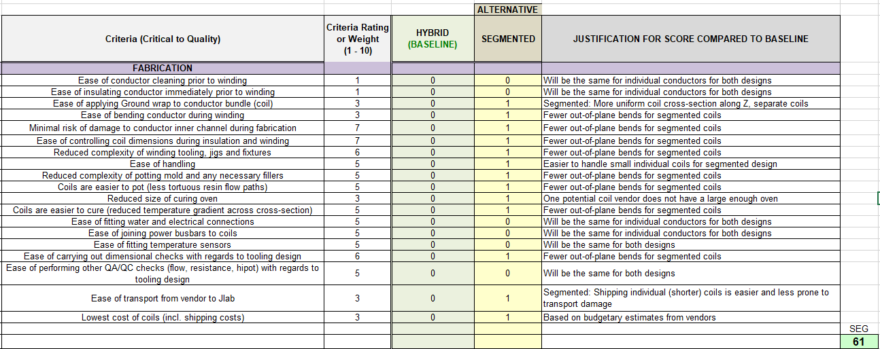
Extract from the Pugh Matrix for the coil design down select

Slide 16
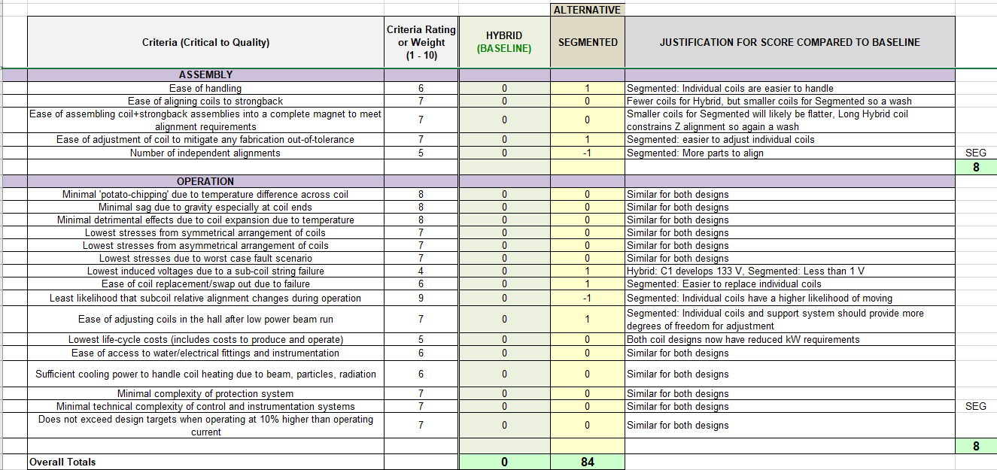
Extract from the Pugh Matrix for the coil design down select

Slide 17
BACKUP – SYSTEM OVERVIEW

Slide 18
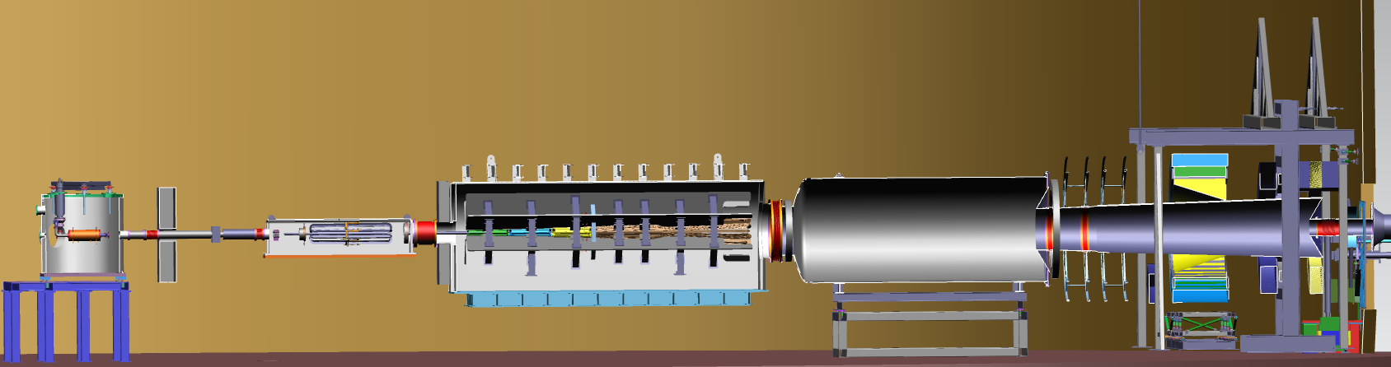
Subsystem Overview
UPSTREAM
Extent of Spectrometer Scope + beam pipes to the dump
DOWNSTREAM
Scattering Chamber and Target
(not included in Spectrometer scope)
Lead Collar
Hybrid Lead Wall
Lead Collar
Lead Collar
Primary beam window
Shield Pipes
Drift Pipe
Drift Pipe
Detector Pipe
Electron beam
Target Lead Wall
Detectors
(Not included in Spectrometer scope)
1.03.06 Blockers #6 and #7
(for calibration and background checks)
1.03.06 Collimator #4
(Secondary acceptance defining collimator)
1.03.07 Downstream Beam Pipes and Windows
1.03.06 Collimator #1
(Primary beam intercepting collimator)
1.03.03 Upstream Torus
(Pre-bending of particles)
1.03.02 Downstream Torus
(Focusing and separation of particles)
Not shown here:
1.03.04 Field measurement system
1.03.05 Water chiller
1.03.08 Shielding supports
1.03.06 Collimator #2
(Primary acceptance defining collimator)
1.03.06 Collimator #5
(Photon-blocking collimator) and Lintels
[Note: There is no Collimator #3]

Slide 19
BACKUP – KPPs

Slide 20
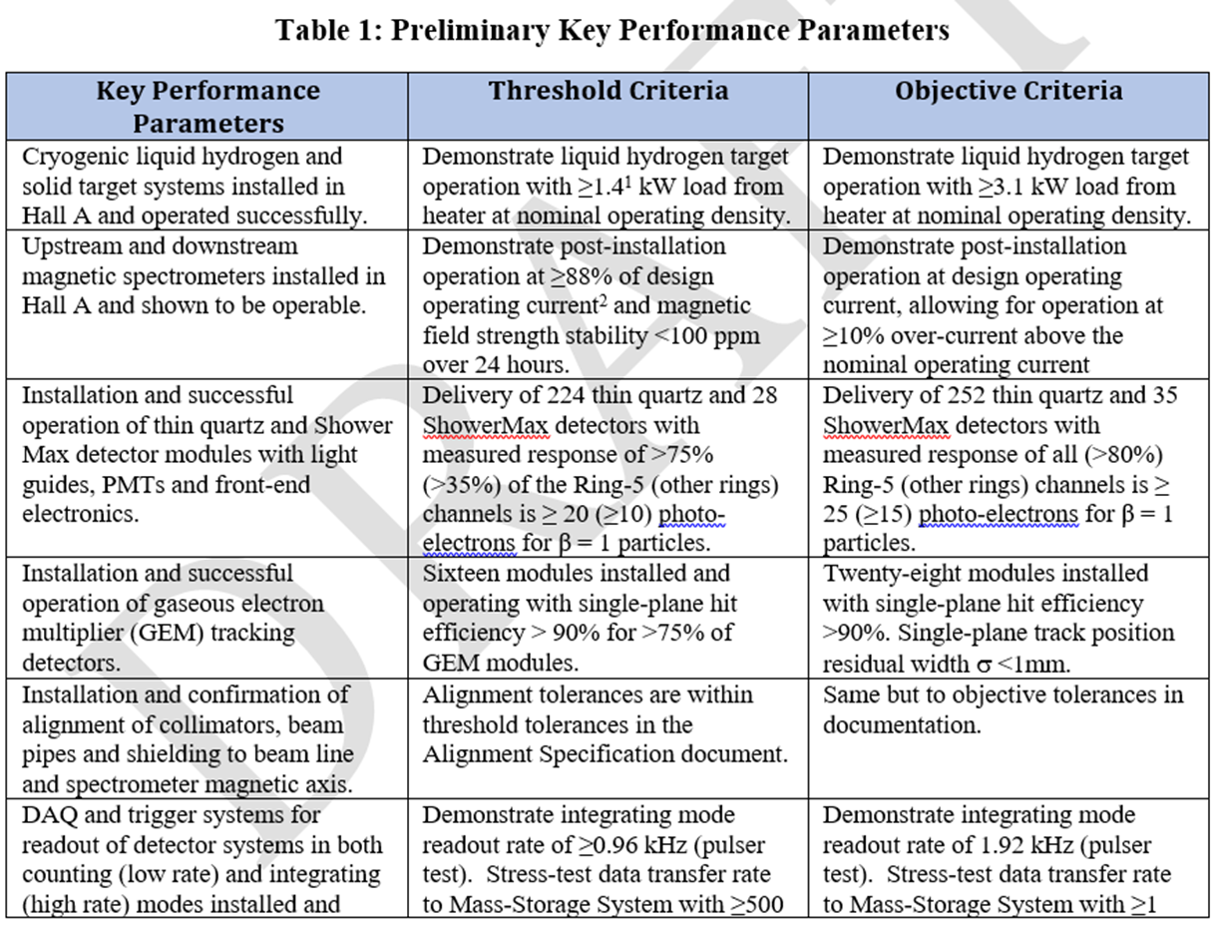

Slide 21
BACKUP – Coil Hydraulic and Electrical Design
O:\Magnet_Design_Tools\Magnet Projects\MOLLER - Hall A\6. Engineering Calculations-Analyses-Simulations\Mechanical\Coil DP calcs
Filename: CDT 110percent - Sept 2020 100psi w_KPP Seg SC 4.xls
Worksheet: Release Sheet_V2

Slide 22
UPSTREAM

Slide 23
HYBRID DS

Slide 24
HYBRID DS

Slide 25
SEGMENTED DS

Slide 26
SEGMENTED DS
5 turns per pancake
4 turns per pancake

Slide 27
BACKUP – Clearances to Particle Envelopes
O:\Magnet_Design_Tools\Magnet Projects\MOLLER - Hall A\5. Preliminary Drawings - uncontrolled\Beamline Cad\ENVELOPE CLEARANCES
Filename: COIL CLEARANCES 2_RRW_dk.xlsx
Worksheet: Nov 2020

Slide 28
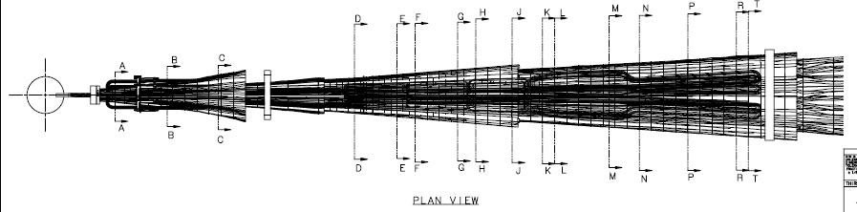
UPSTREAM TOROID
DOWNSTREAM TOROID
SC1
SC2
SC3
SC4

Slide 29
UPSTREAM

Slide 30
DOWNSTREAM – SC1

Slide 31
DOWNSTREAM – SC2

Slide 32
DOWNSTREAM – SC3

Slide 33
DOWNSTREAM – SC4

