Slide 1
Simulation overview and recommendations
Ciprian Gal

Slide 2
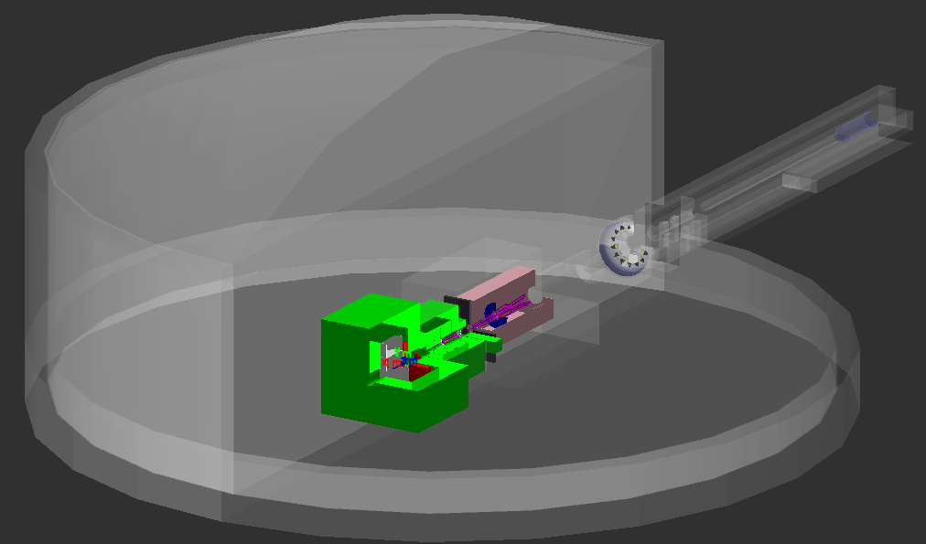
Introduction
Radiation measurements outside hall:
used for personnel protection
boundary dose limit imposed by DOE/Lab is 100/10 mrem per calendar year
Radiation measurements inside hall:
used for equipment protection
needed to be able to make effective use of beam time
can be additional background

Slide 3
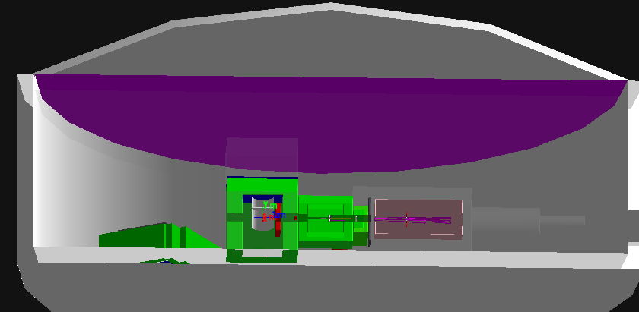
Boundary dose estimation
We evaluate the dose on the boundary by looking at high energy (E>30 MeV) neutrons reaching the roof of the hall
This has been shown by RadCon to be a good proxy
We benchmark this proxy by simulating experimental configurations that produced significant (measurable) boundary dose
We compare the HE neutron integrated power of previous experiment to different MOLLER configurations
This analysis will be strengthened by the PREX and CREX numbers
The current shielding will allow MOLLER to remain under the JLab limit
 | current | Running time | charge on target
MOLLER | 60uA | 30 wks | 585 C
PREX1 | >50 uA | ~8 wks | 82 C
 | mW/uA | boundry/yr
MOLLER | 0.6 | 2.4 mrem
PREX1 | 2.4 | 1.34 mrem

Slide 4
Electronics damage
Category |  | Effect
Single Event effect (Random in time) | Single Event Upset (SEU) | Memory bit flip (soft error) Temporary functional failure
 | Single Event Latchup (SEL) | Abnormally high current state Permanent/destructive if not protected
Cumulative effects (Long term) | Total Ionizing Dose (TID) | Charge build-up in oxide Threshold shift & increased leakage current Ultimately destructive
 | Displacement damage | Atomic displacements Degradation over time Ultimately desctructive

Slide 5
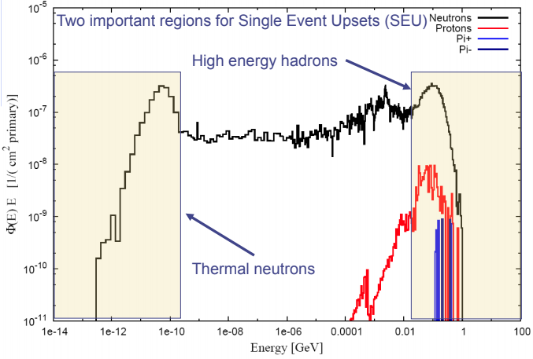
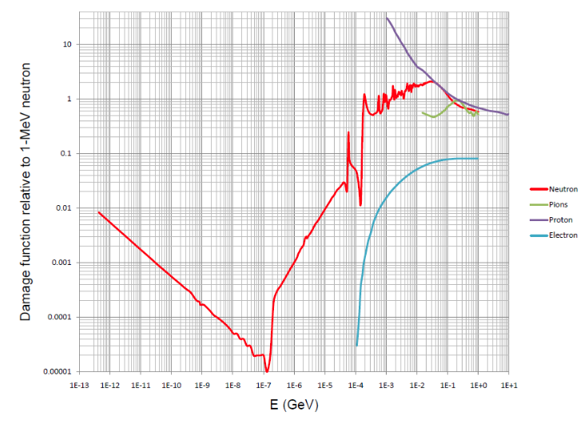
Single event upsets
Permanent damage
We evaluate the entire spectrum for neutrons, pions, protons and electrons and use the FLUKA damage functions to convert them into 1-MeV neutron equivalent damage
Typical commercial semiconductor electronics will show signs of damage at ~1E13 1-MeV n/cm²
We evaluate both the low energy (thermal) neutrons and the high energy hadron flux at locations where we have electronics
We compare to fluxes simulated for experimental setups that ran successfully before at JLab

Slide 6
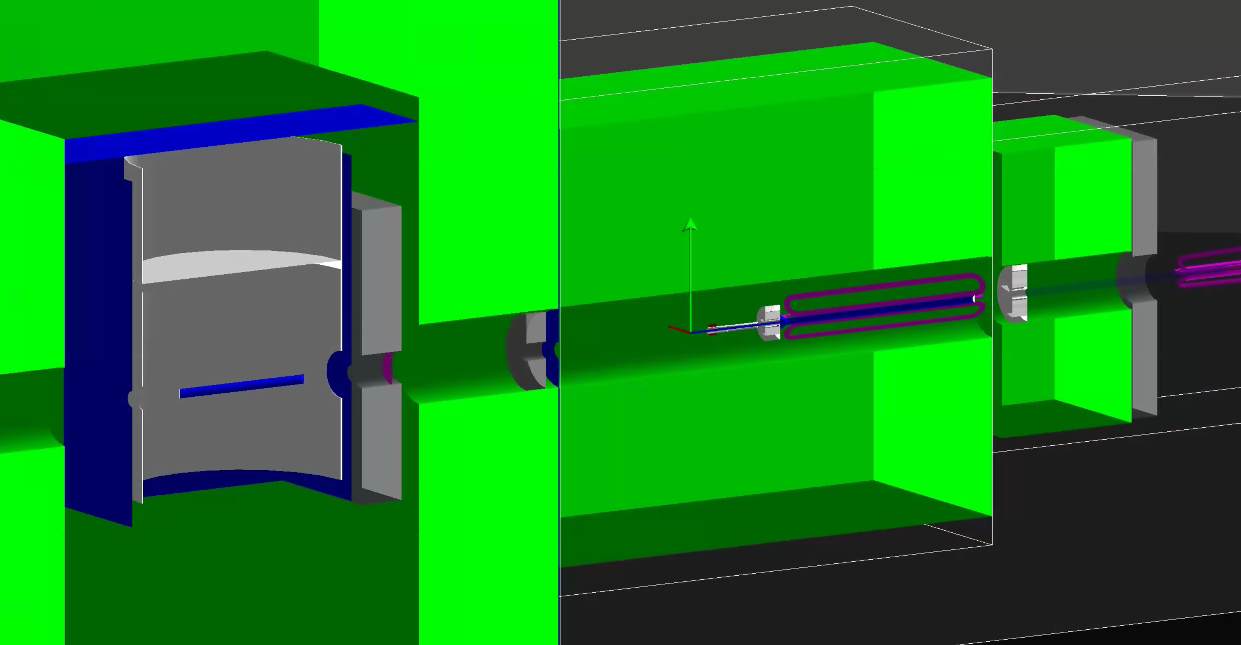
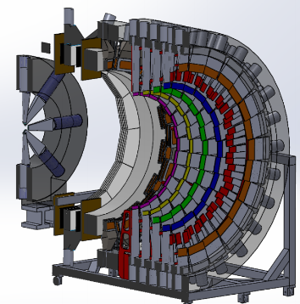
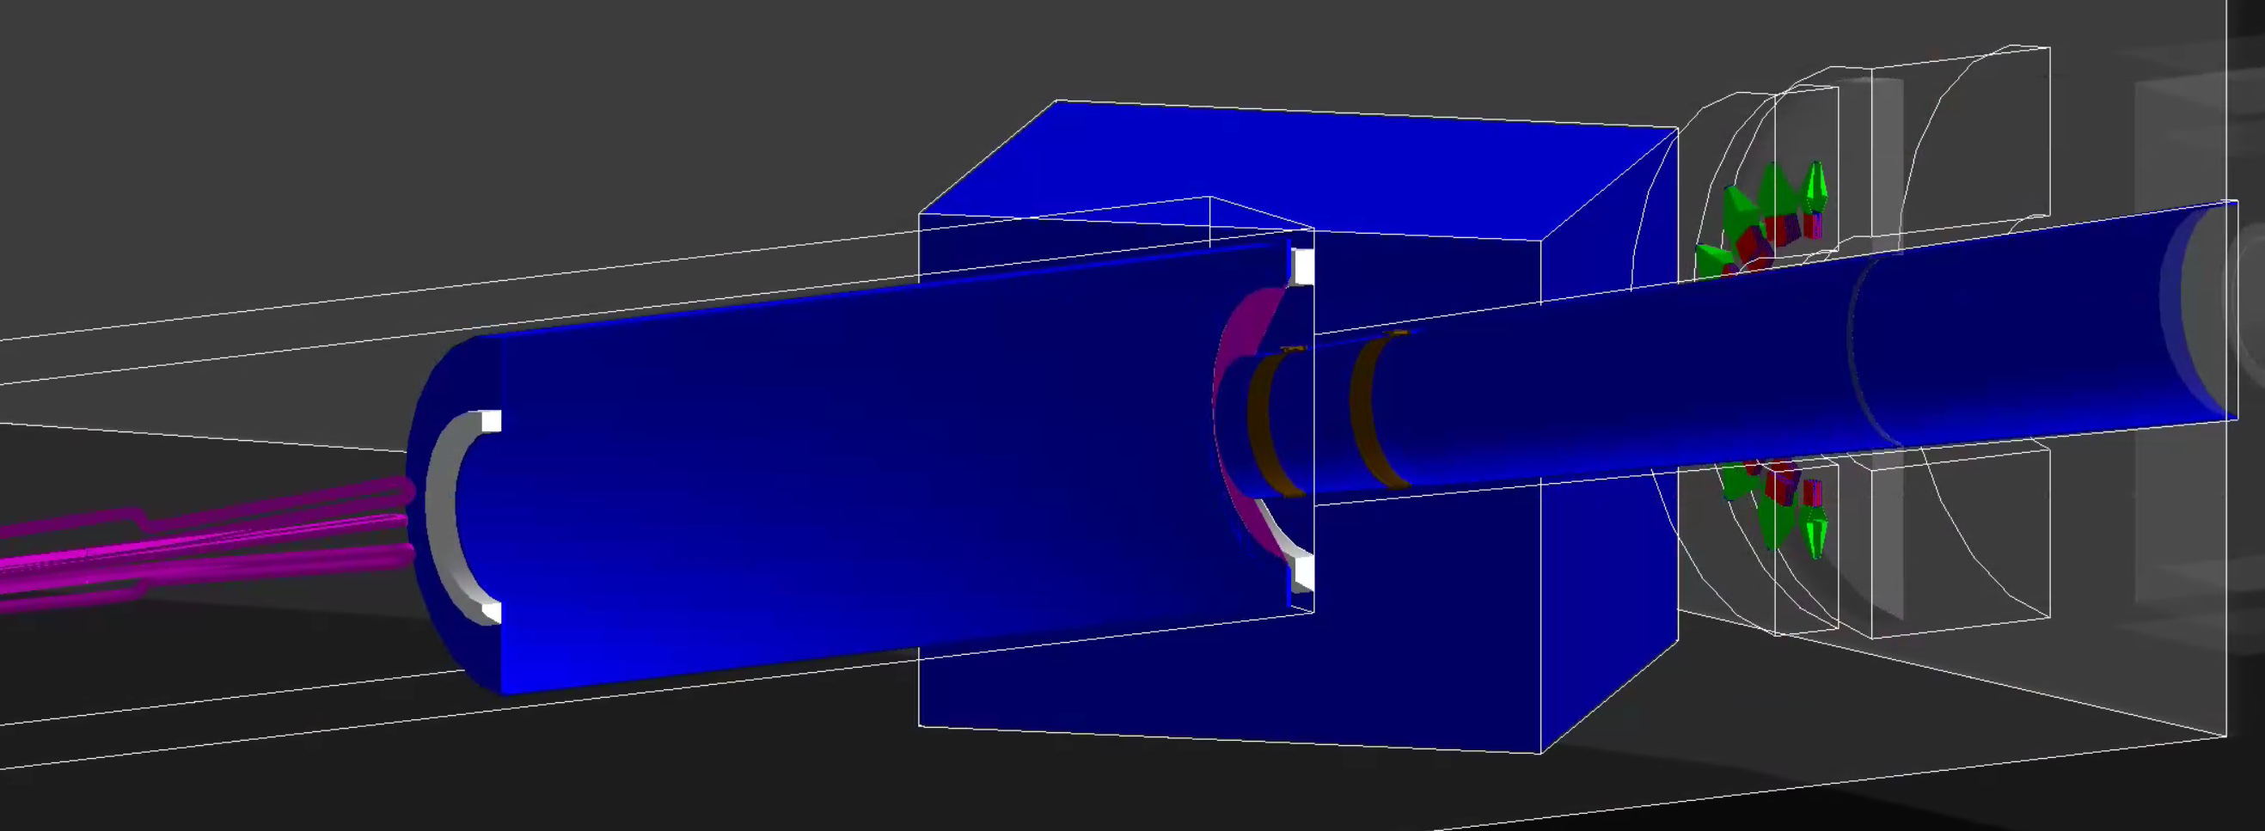
Current geometry
The maximal shielding upstream of the hybrid we had in the previous review has remained the same
Target: 1.4 m of concrete on 5 sides; 40 cm thick Pb shield
Collimator 1&2: 1.5 m concrete all around in phi
Collimator 4: 1m concrete all around in phi; 25cm Pb shield wall
US(Target) vacuum window has been optimized and placed right DS of the target
We have minimized the amount of Vacuum we have in the hall to only beamline regions to allow for showering in the air in the rest of the hall
Drift pipe, collars, detector pipe as well as shower max and pion Pb doughnut
CAD layout of MD

Slide 7
Current geometry
Sensitive area in the location of the Main Detector PMTs and Retracted GEMs used for estimates
Drift pipe, collars, detector pipe as well as shower max and pion Pb doughnut included
Dump tunnel, beampipe (with correct neckdowns), aperture plate, diffuser and water tank included
We didn’t see any hits coming back from the water tank so in the future we will stop the beam downstream of the diffuser
Simulation ran with beam generator with a fringe magnetic field down to R=2mm

Slide 8
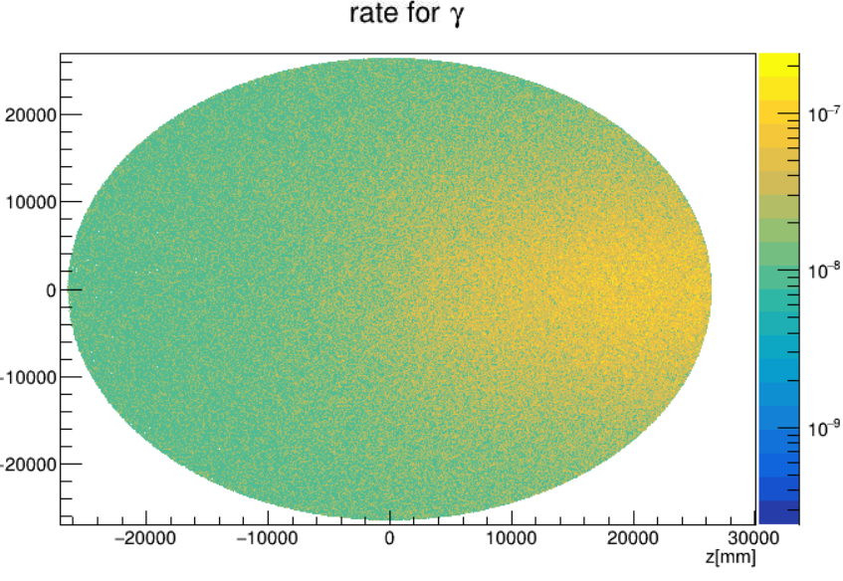
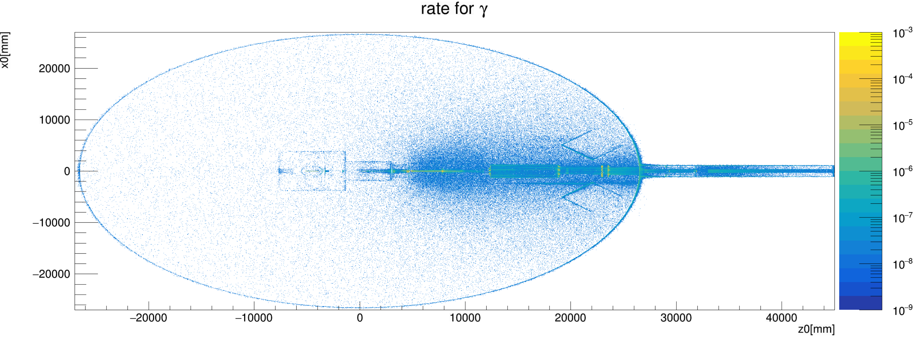
Hall detectors
Roof
The particle density on the roof is peaked close to the wall (we will need to include part of the wall in our boundary estimate)
We can see that although we put more than 5kW of power in the target and collimator 1 each they don’t shine as much as the downstream elements
Source for Roof
Right Hut placed as a test.
NOT NEEDED!

Slide 9
Main detector sources (Rings 1 through 7)

Slide 10
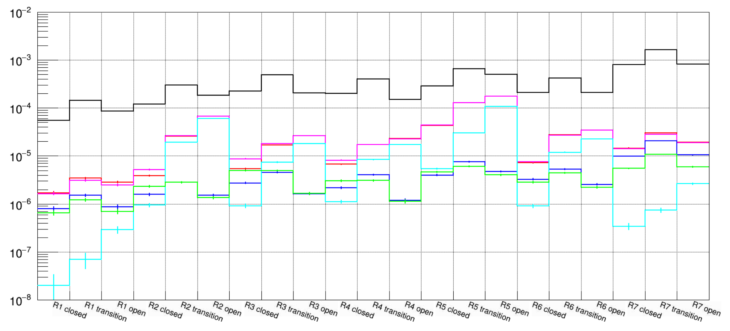
Main detector rates
Moller events
Black: gamma
Red: e- and pi-
Green: e+ and pi+
Blue: neutrons
Magenta: “e+/-” E>1MeV
Cyan: primary E>1MeV

Slide 11
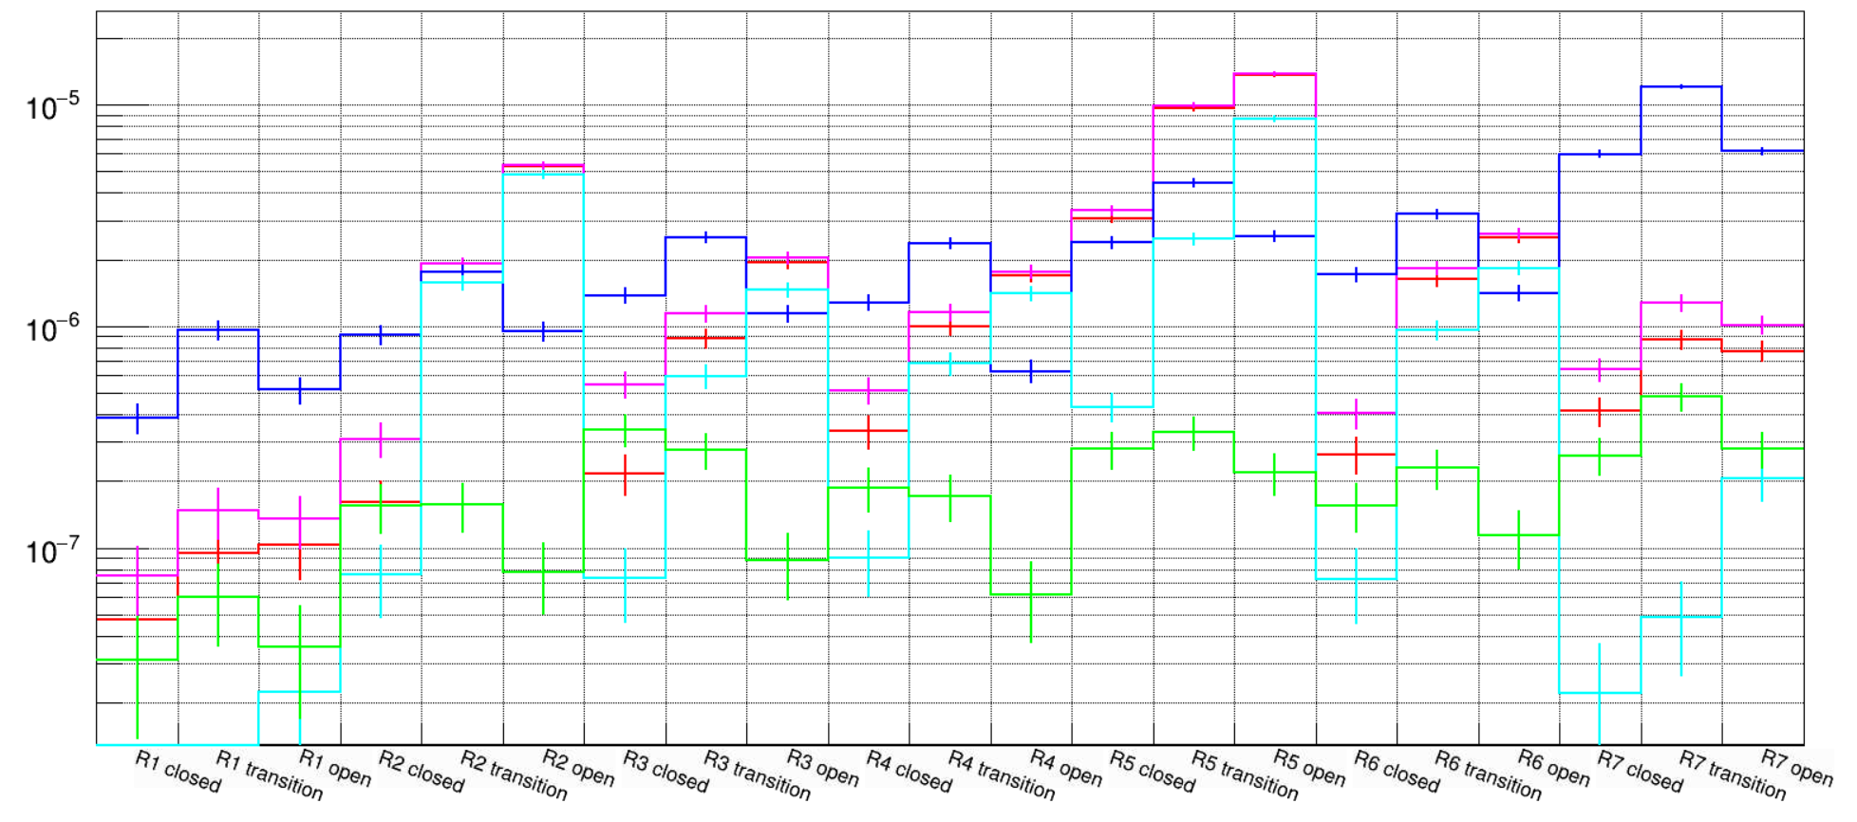
Normalization of NIEL numbers
Black: gamma
Red: e- and pi-
Green: e+ and pi+
Blue: neutrons
Magenta: “e+/-” E>1MeV
Cyan: primary E>1MeV
Counts per electron on target
Scale NIEL numbers in ring 7 by: 1.6e17 (full PAC days)
We can clearly see that we are dominated by neutrons and we reach about 1E12 1-MeV n_{eq}/cm² without any shielding (Chandan has more details about this) for the entire life of the experiment
Closest sensitive electronics to this location will be the PMT bases which will be radially out from Ring 7 and have some local shielding

Slide 12
Project Recommendation: 2016 Dec DR.03.R-04/R-10
R-04: Splashback from the Shower Max Detector should be simulated to see the impact on the Thin Detector ring signals.
R-10: Complete the shielding studies around the beam dump to ensure there is no excessive noise in the main MOLLER detectors.
R1-6 e- Rate | tgt | tgtReg | coll1&2 | USmag | coll3&Pb | usDSmag | coll5 | dsDSmag | collar1 | driftPipe | collar2 | airUSMD | SM & Donut | end of DetPipe | dump Neck Down to Apperture | dump Apperture | Apperture to NeckDown2 | neckDown & Diffuser | ds of Diffuser
all E % | 63% | 0% | 0% | 0% | 0% | 0% | 0% | 0% | 2% | 1% | 5% | 14% | 15% | 0% | 0% | 0% | 0% | 0% | 0%
E<1MeV[%] | 0% | 0% | 0% | 0% | 0% | 0% | 0% | 0% | 0% | 1% | 2% | 47% | 57% | 0% | 0% | 0% | 0% | 0% | 0%
1<E<10MeV% | 0% | 0% | 0% | 0% | 1% | 0% | 0% | 0% | 3% | 3% | 11% | 34% | 47% | 0% | 0% | 0% | 0% | 0% | 0%
10MeV<E% | 88% | 0% | 0% | 0% | 0% | 0% | 0% | 0% | 2% | 0% | 4% | 3% | 0% | 0% | 0% | 0% | 0% | 0% | 0%
We can estimate the impact of the different regions on the detector signal by looking at the rate of electrons reaching the Main Detector quartz area (particularly with energy larger than 1MeV)
Detailed numbers can be found in docDB577 (for MD and PMT regions separated by species)
The target account for about 80% of electrons reaching the MD, the air in front of the detector accounts about the same amount as the SM (8%)
We can see that we don’t get any significant amount of electrons from DS of the SM

Slide 13
Project Recommendation: 2016 Dec DR.03.R-10b
Complete the shielding studies around the beam dump to ensure there is no excessive noise in the main MOLLER electronics.
R7 n Rate*NIEL | tgt | tgtReg | coll1&2 | USmag | coll3&Pb | usDSmag | coll5 | dsDSmag | collar1 | driftPipe | collar2 | airUSMD | SM & Donut | end of DetPipe | dump Neck Down to Apperture | dump Apperture | Apperture to NeckDown2 | neckDown & Diffuser | ds of Diffuser
all E % | 0% | 0% | 0% | 0% | 0% | 0% | 0% | 0% | 1% | 0% | 5% | 1% | 67% | 1% | 2% | 1% | 3% | 14% | 4%
E<1MeV[%] | 0% | 0% | 0% | 0% | 1% | 0% | 0% | 0% | 1% | 0% | 6% | 0% | 79% | 0% | 3% | 1% | 3% | 5% | 2%
1<E<10MeV% | 0% | 0% | 0% | 0% | 0% | 0% | 0% | 0% | 0% | 0% | 5% | 1% | 65% | 1% | 1% | 1% | 3% | 16% | 5%
10MeV<E% | 0% | 0% | 0% | 0% | 0% | 0% | 0% | 1% | 2% | 1% | 3% | 1% | 27% | 3% | 3% | 0% | 4% | 46% | 8%
With respect to noise in electronics closest to the beamline we can look at the NIEL “dose” in Ring 7 separated by the same regions
We can see that while the diffuser dominates the high energy neutron damage the dump overall is not a big issue compared to the SM and Pion doughnut (factor of 5 smaller)
We conclude that the dump will not require significant changes or shielding to allow for uninterrupted experimental running

Slide 14
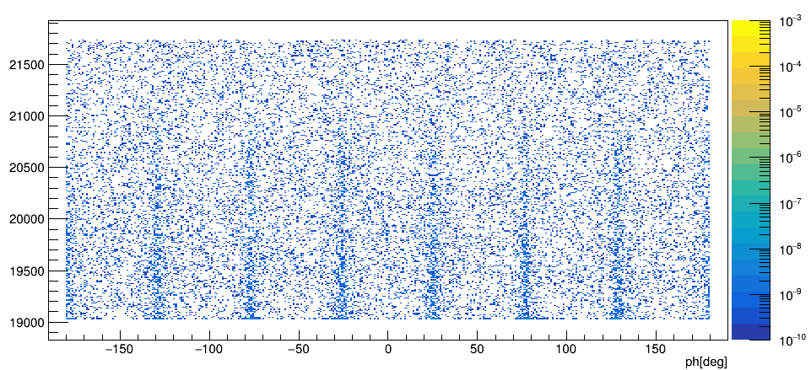
Project Recommendation: 2019 Apr DR.05.R-09
Prepare a plan to handle possible radiation damage to the front end electronics, pending the results of the radiation field estimates.
Estimations inside the electronics hut - 8E10 1-MeV n_{eq}/cm² - and at the location of the retracted GEMs - 4E12 1-MeV n_{eq}/cm² - (see Chandan’s talk) show that we are significantly lower than levels where permanent damage will be an issue
The GEM numbers are highly position dependent and we envision locating the most sensitive components in the closed sectors so that we avoid unnecessary exposure
1E12 1-MeV n_{eq}/cm²

Slide 15
Other recommendations: thoughts
2016 Dec DR.03.R-05 | Cross-talk between detector regions due to showering in the support structure of the Thin Detector should be simulated. |  | Work is progressing and we expect to get results by the end of the summer
2019 Apr DR.04.R-08 | Complete the inclusion of the detailed detector geometry into the detector simulation to confirm design choices, and verify that the final design meets the requirements of the experiment. |  | We will continue integration of the different components as design progresses (including the detector supports and frames).
2016 Dec DR.03.R-09 | Simulations of the combined apparatus and hall are needed, for example, to assess backscattering backgrounds from the dump in the pion detectors. |  | At this point it should be fairly straightforward to add sensitive detectors at the location of the Pion detectors and PMTs and perform a similar analysis as for the other areas.

Slide 16
Some thoughts on next steps
Geometry updates:
Electronics hut requirements can be relaxed (open the top and increase the walls, reduce the thickness of the walls); placement will be revisited once design progresses
Small Angle Monitor region (SAMs with tubes and quartz as well as Pb doughnut) needs to be included in the simulation and optimized to not increase radiation field
Dump tunnel geometry needs to be updated to include the effect of the dirt overbearing
Optimization of the target and collimator 1 region will need to go in parallel with design of the area to catch problems as they appear
Collar 1&2 optimizations will improve the radiation field at the GEMs and the MD PMTs
Collimator 1 and 2 merging and possible redesign for improved heat dissipation
Analysis scheme to evaluate Single Event Upsets occurrence should be developed
Improve analysis of the boundary dose in coordination with RadCon
Evaluate efficiency of the Dump Ion Chambers for machine protection (in particular seeing the radiation field produced by the diffuser)
Re-run analysis with full fringe field

Slide 17
Backup

Slide 18
Radiation issues inside the hall: Mitigation strategy
We focused our efforts on reducing radiation as close as possible to the source (locations with high power depositions)
The target and collimator 1&2 regions are the most important
We investigated the effect of slit scattering and reduced amount of background reaching the detector plane
collimator | Power @65uA, 1.25m Tgt
1 | 6700 W
2 | 2000 W
4 | 126
5+Lintel | 22
Director's Review of Moller, April 2019

Slide 19
Photons reaching full detector plane: GeoV2

Slide 20
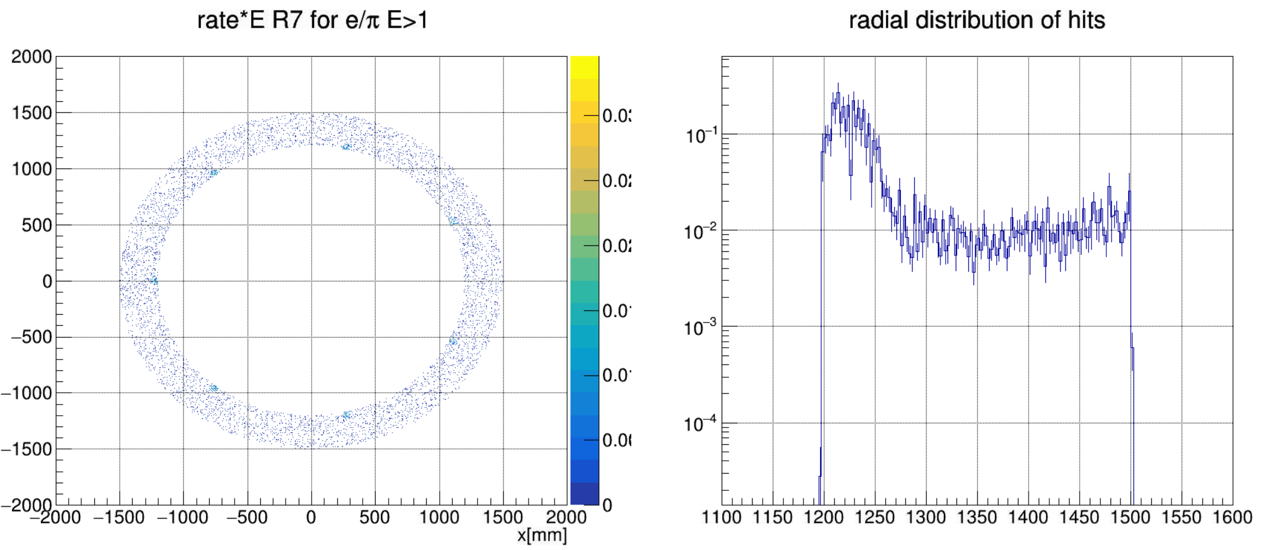
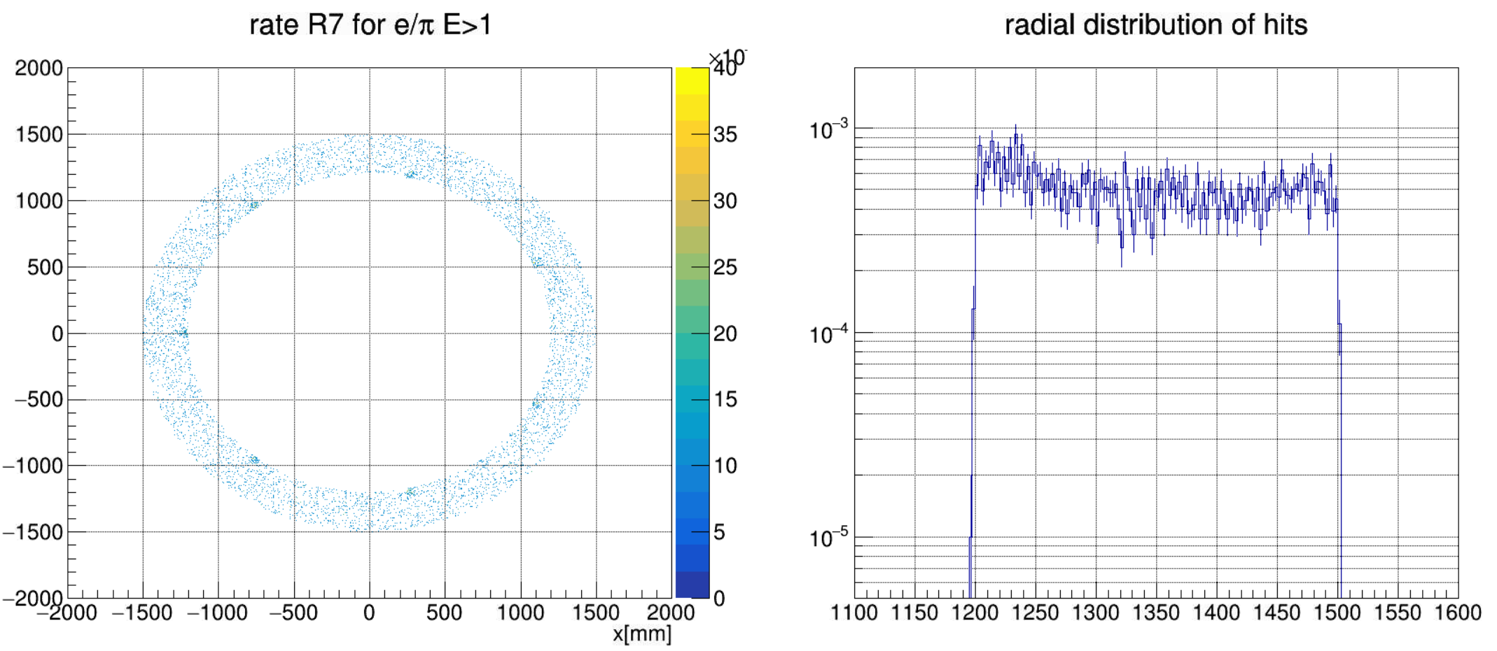
PMT ring : GeoV2
We can see that Collar2 seems to allow high energy particles up to a radius of ~1270mm skewing the PMT numbers
Reason why the rate*E numbers on previous plots see such a large number from the target

Slide 21
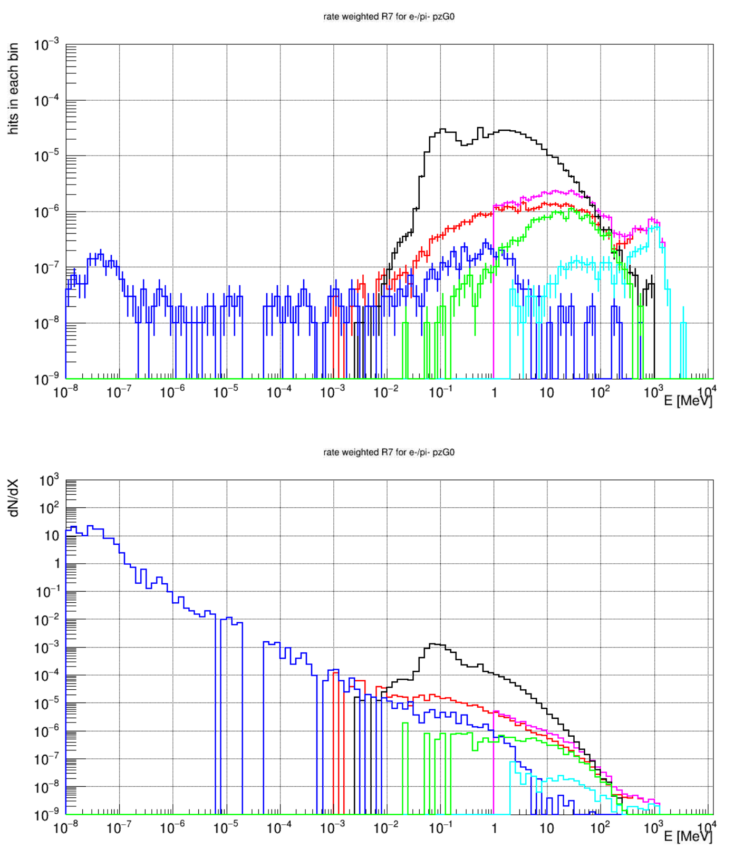
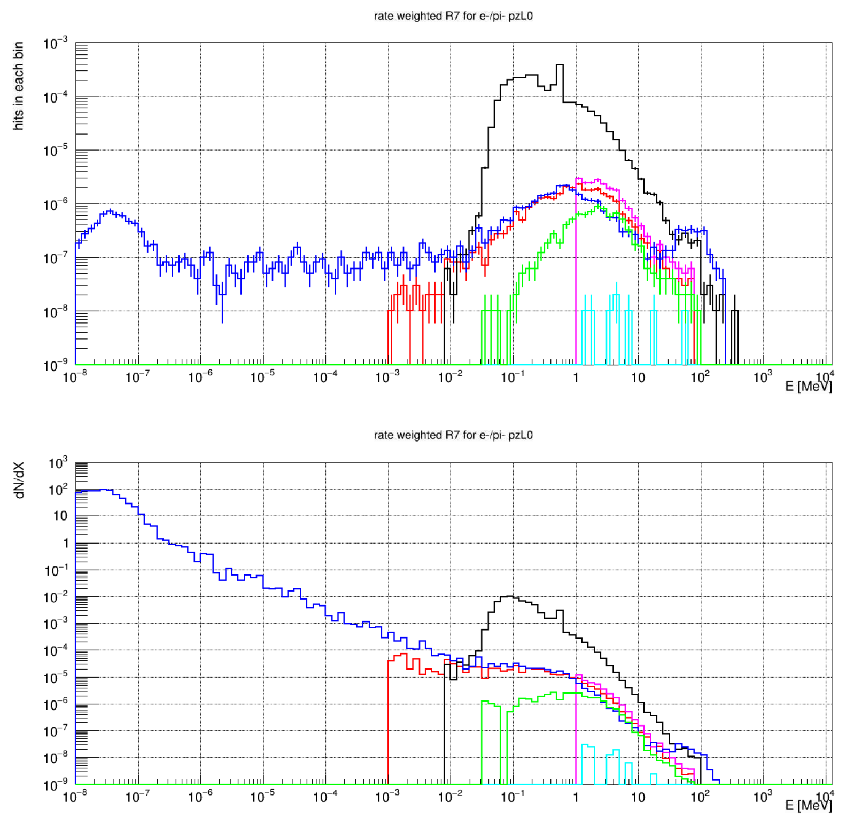
R7 kinE distributions : GeoV2
Black: gamma
Red: e- and pi-
Green: e+ and pi+
Blue: neutrons
Magenta: “e+/-” E>1MeV
Cyan: primary E>1MeV
PZ>0
PZ<0

Slide 22
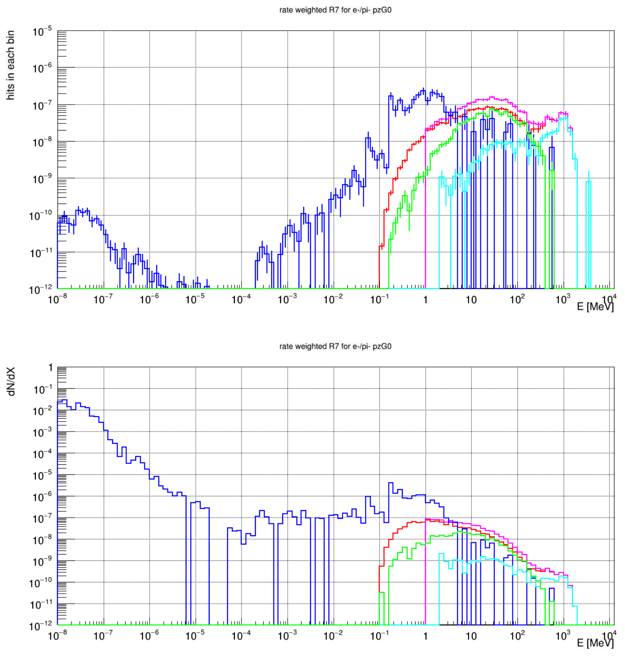
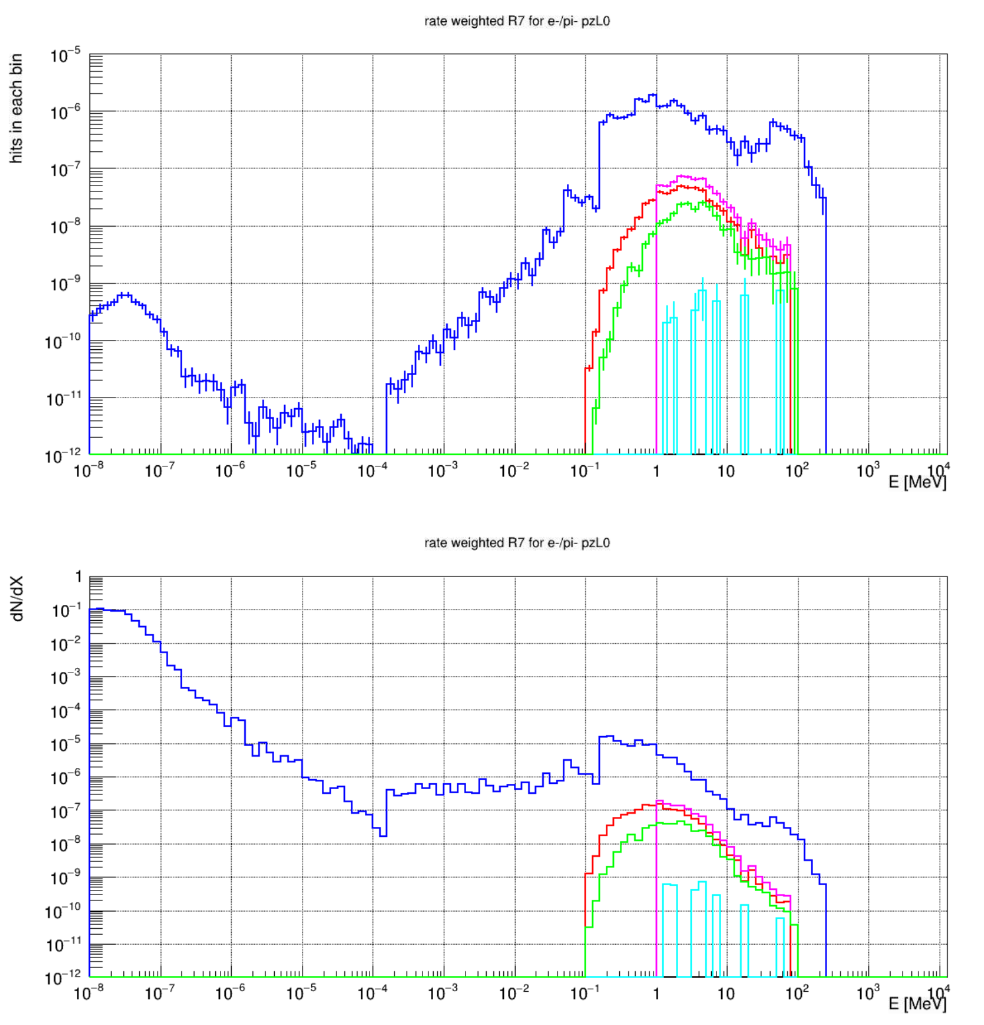
R7 NIEL distributions : GeoV2
Black: gamma
Red: e- and pi-
Green: e+ and pi+
Blue: neutrons
Magenta: “e+/-” E>1MeV
Cyan: primary E>1MeV
PZ>0
PZ<0

Slide 23
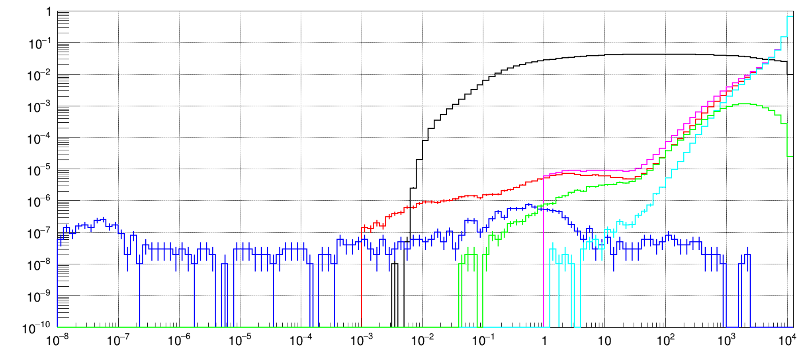
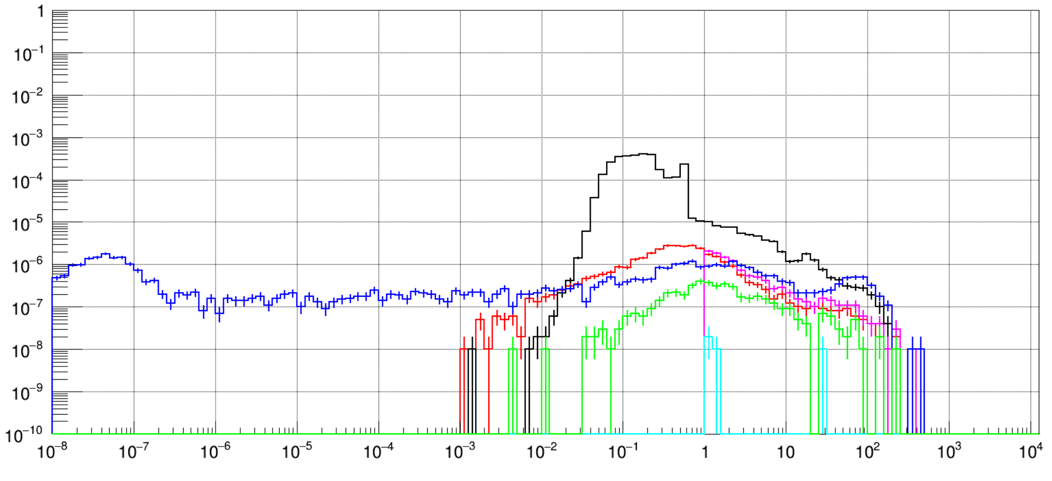
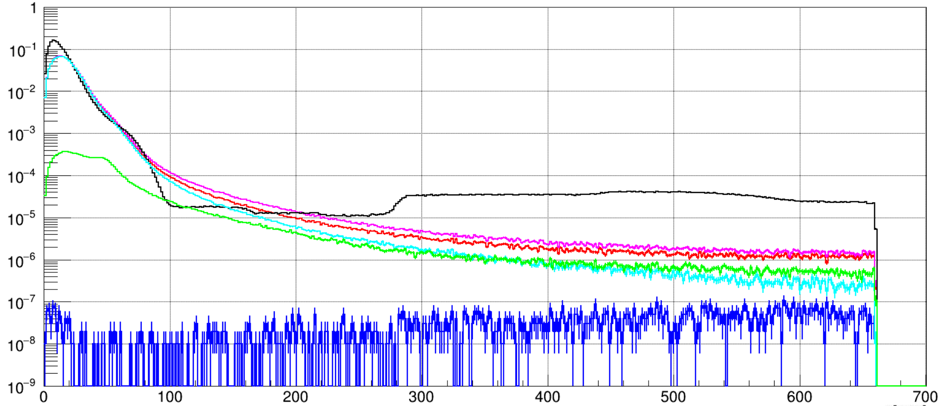
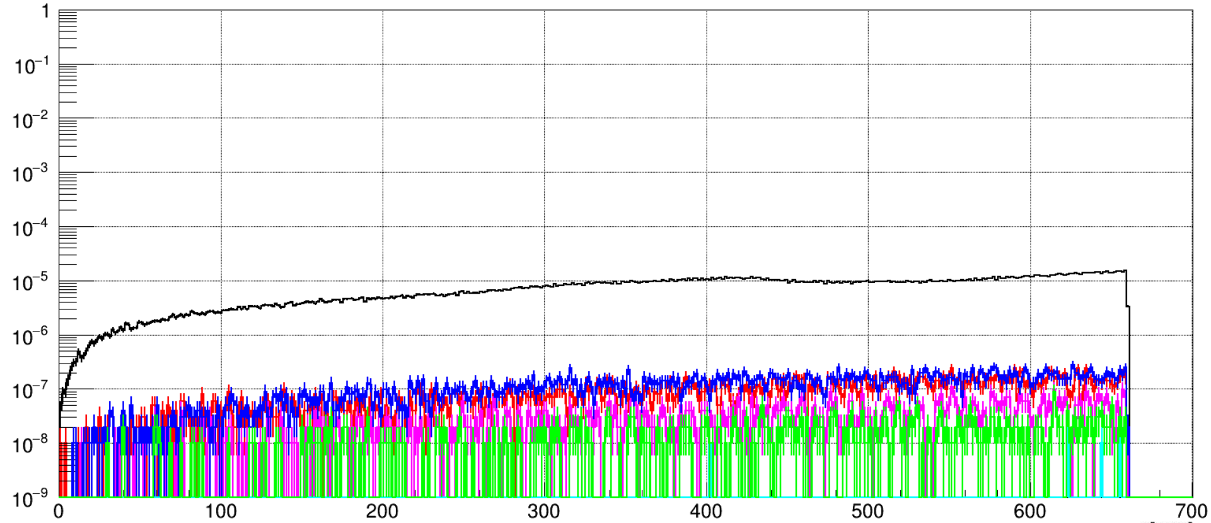
Beamline detectors: SAMs
Towards the dump
From the dump
Black: gamma
Red: e- and pi-
Green: e+ and pi+
Blue: neutrons
Magenta: “e+/-” E>1MeV
Cyan: primary E>1MeV
R: Towards the dump
R: from the dump

Slide 24
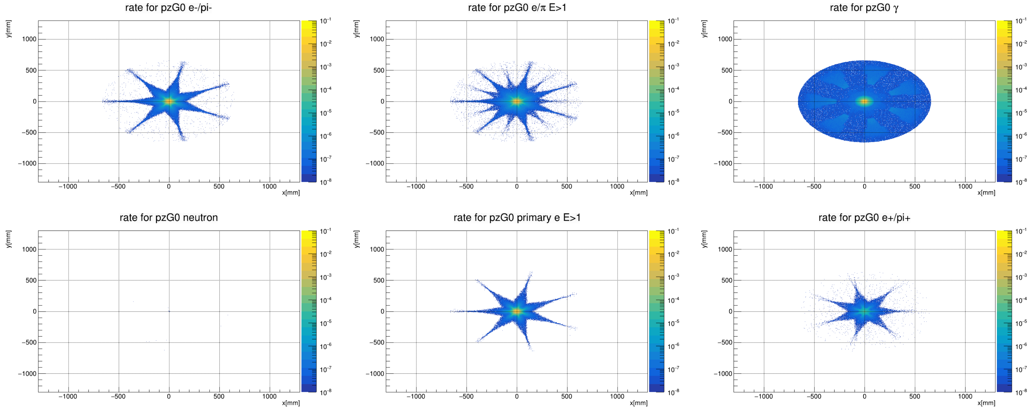
Beamline detectors: SAMs (rate towards the dump)

Slide 25
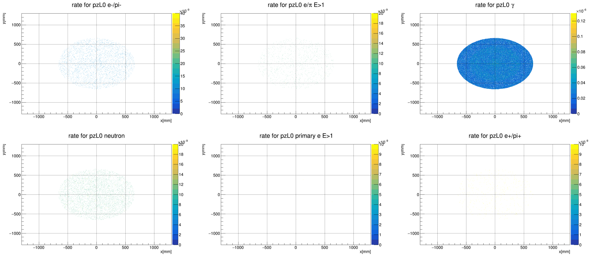
Beamline detectors: SAMs (rate from the dump)

Slide 26
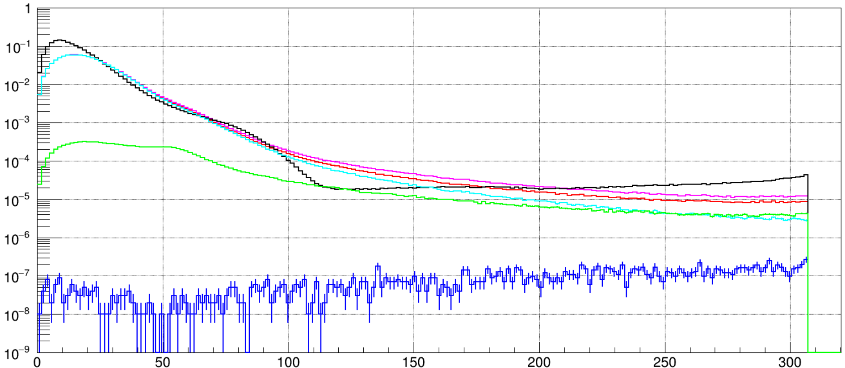
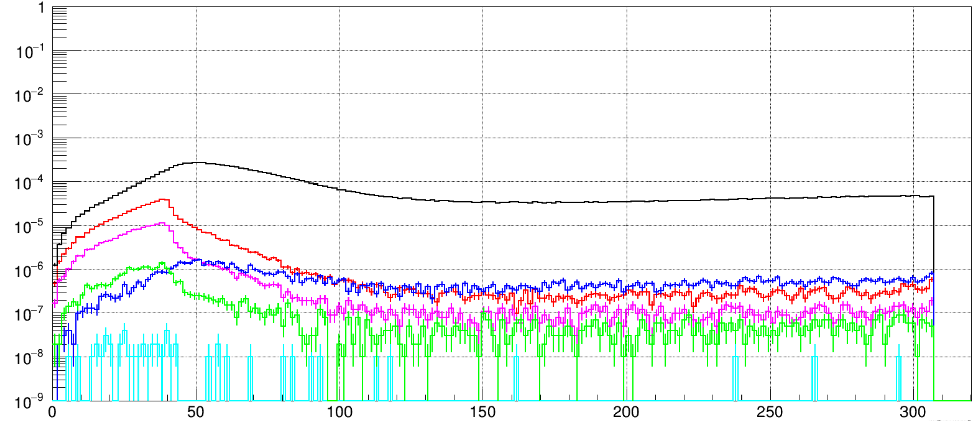
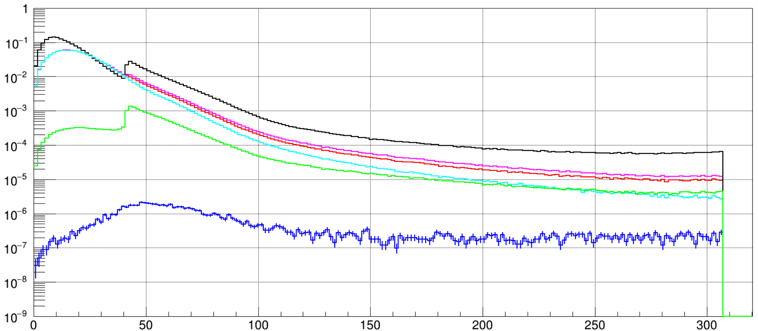
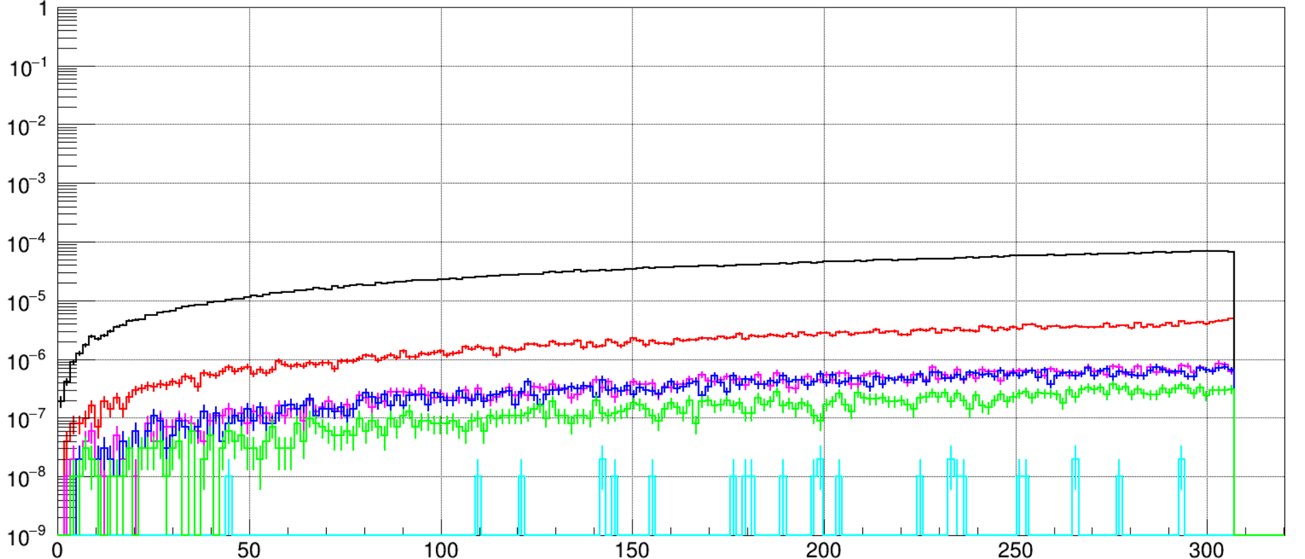
Beamline detectors: back dump donut
Towards the dump: front
From the dump: front
Towards the dump: back
Black: gamma
Red: e- and pi-
Green: e+ and pi+
Blue: neutrons
Magenta: “e+/-” E>1MeV
Cyan: primary E>1MeV
From the dump: back

Slide 27
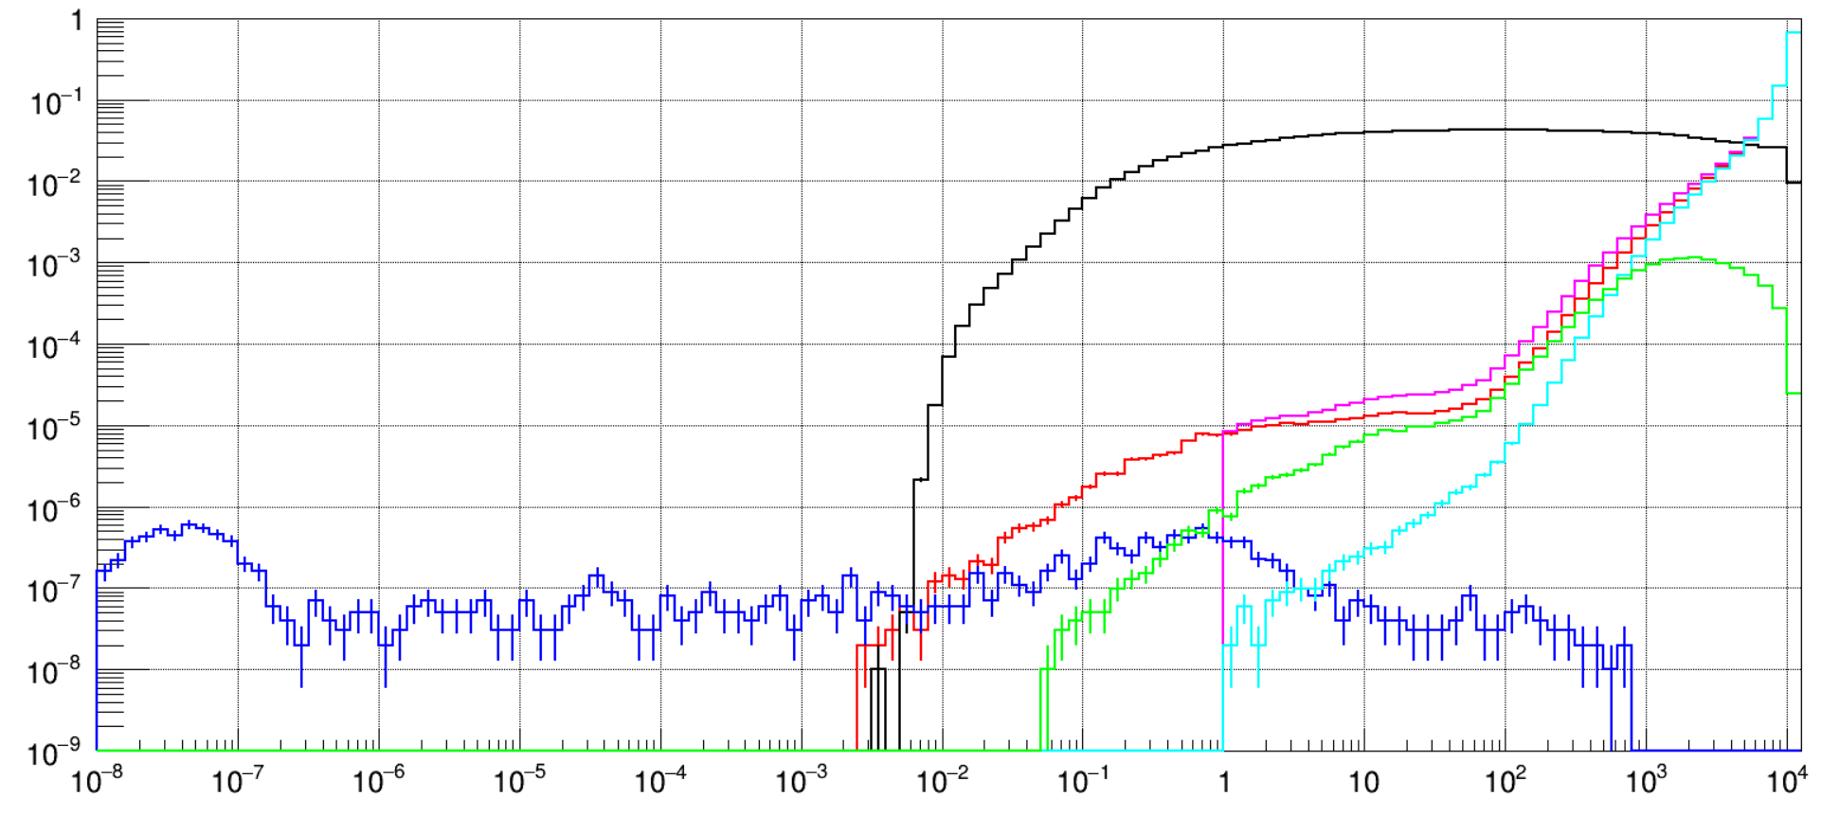
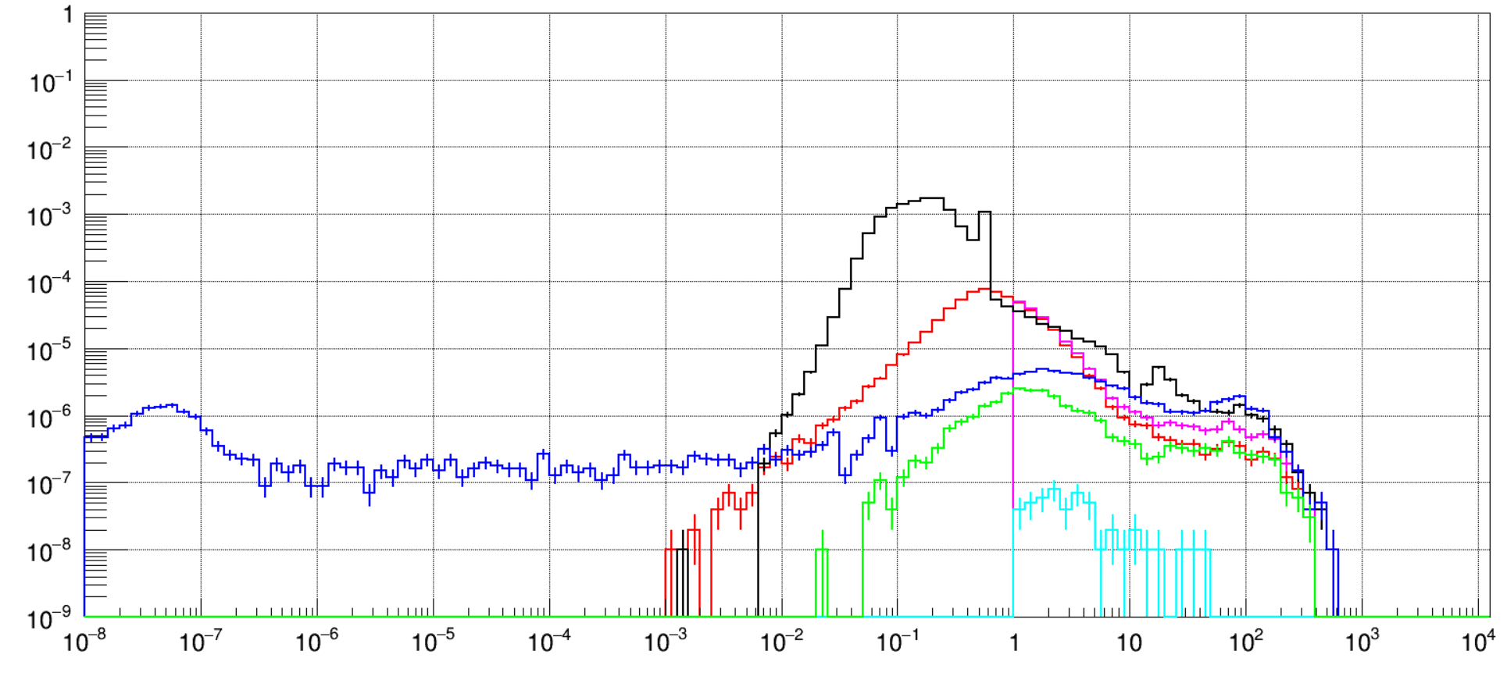
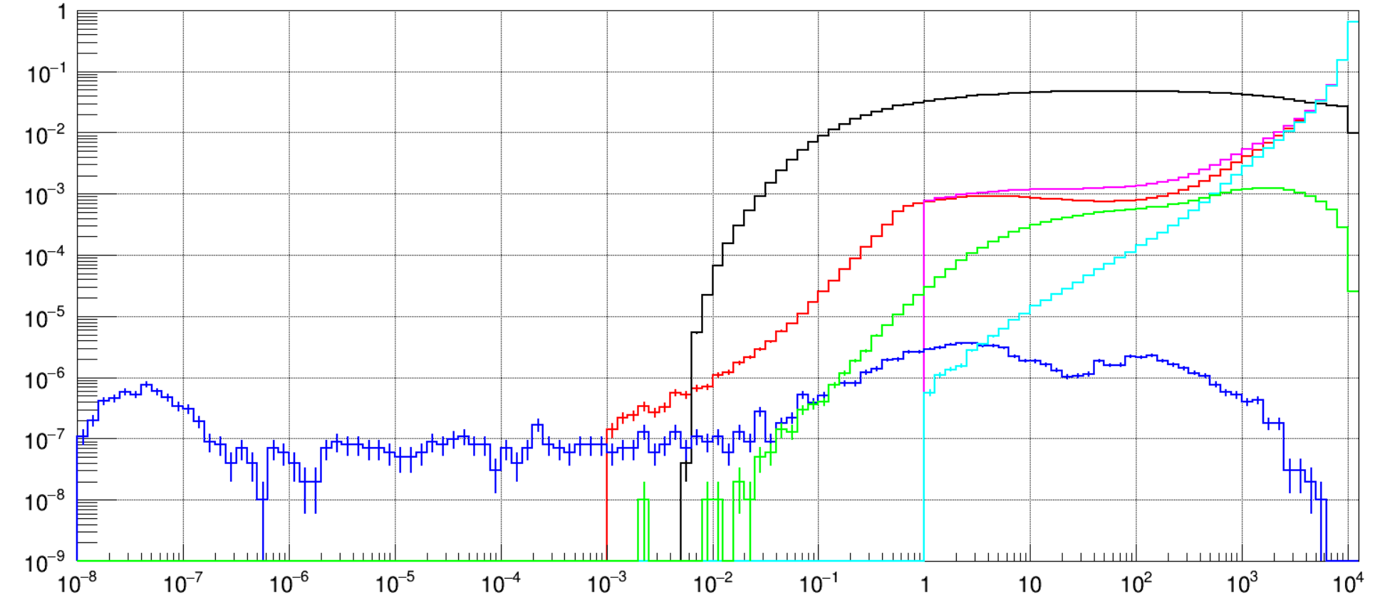
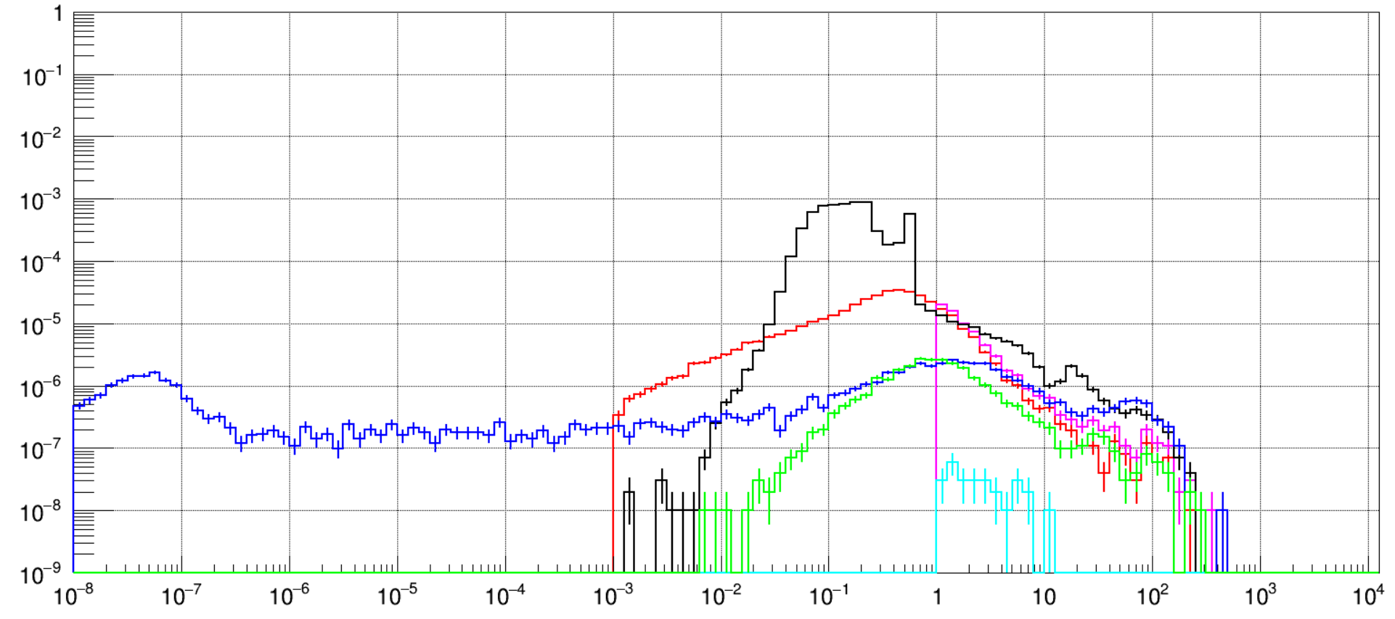
Beamline detectors: dump donut (energy)
Towards the dump: front
From the dump: front
Towards the dump: back
Black: gamma
Red: e- and pi-
Green: e+ and pi+
Blue: neutrons
Magenta: “e+/-” E>1MeV
Cyan: primary E>1MeV
From the dump: back

Slide 28
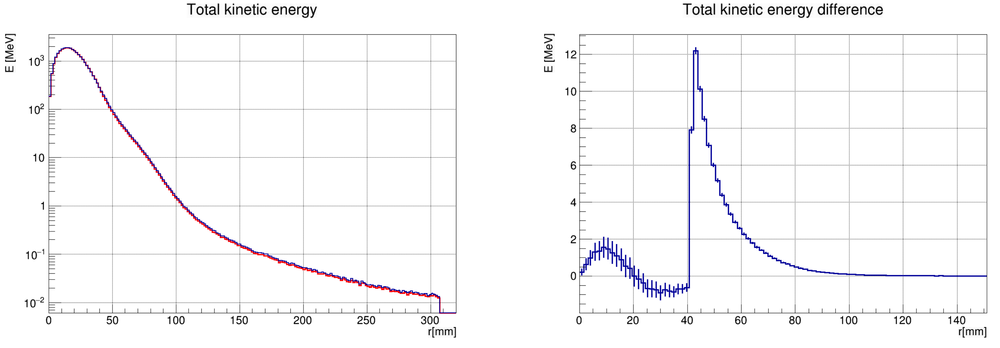
Dump donut energy deposition
Blue: before donut (integral: 29691.9 MeV)
Red: after donut (integral: 29594.6 MeV)
Before-after: integral 97.07 MeV
Scaling the energy deposited in the donut by the current (in uA) we get the energy deposition in W: 6.309kW

