Slide 1
Configurations Tested
Version | Collimator 2 |  | Configuration | Ring 5 Definition
 | R_{inner} | R_{outer}
default | 35.3 | 98 | Det 28 m Target=-750 to 750mm | O (935-1040mm) T (960-1075mm) C (960-1100mm)
1 | 36.15 | 88.88 | Det 27 m Target = -125 to 1125 mm Col 4 and 5 removed | 885-990 mm for all sectors
2 | 45.19 | 88.88
3 | 40 | 88.88
4 | 38 | 88.88
5 | 31 | 98
6 | 40 | 98
7 | 35 | 98
8 | 35 | 108
9 | 35 | 118

Slide 2
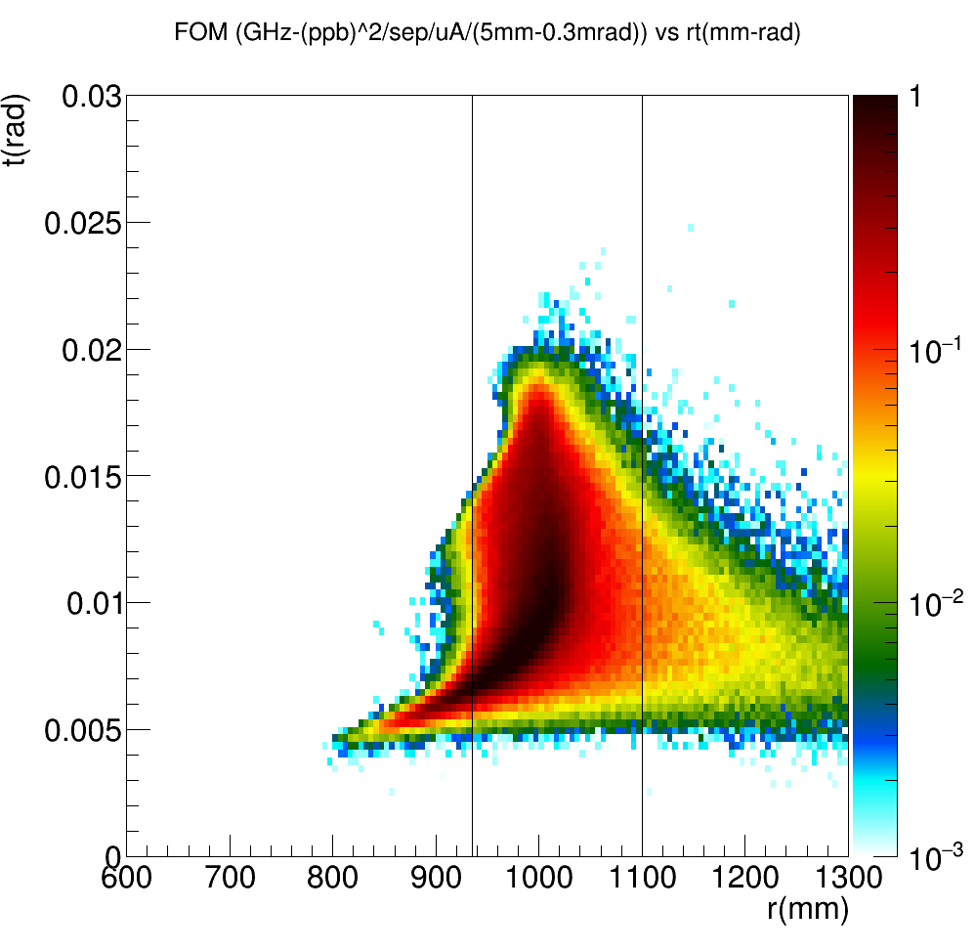
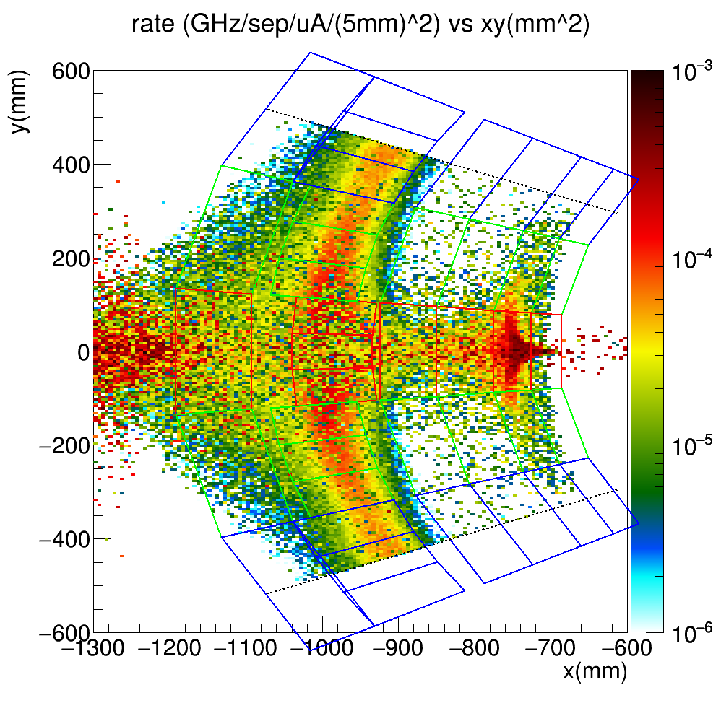
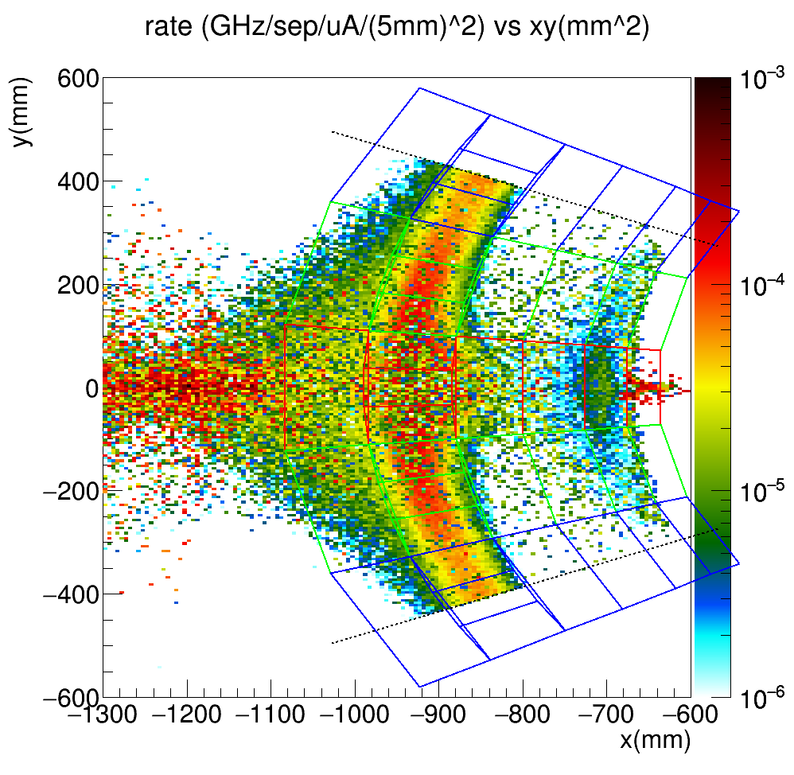
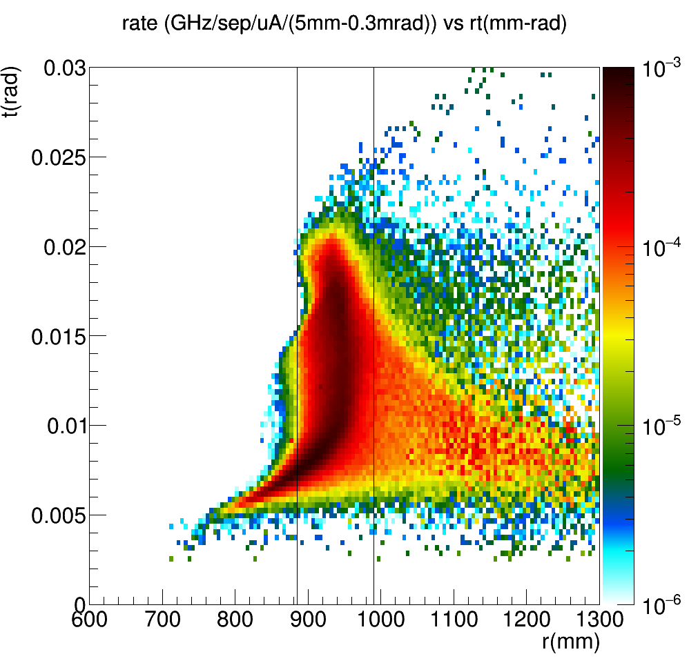
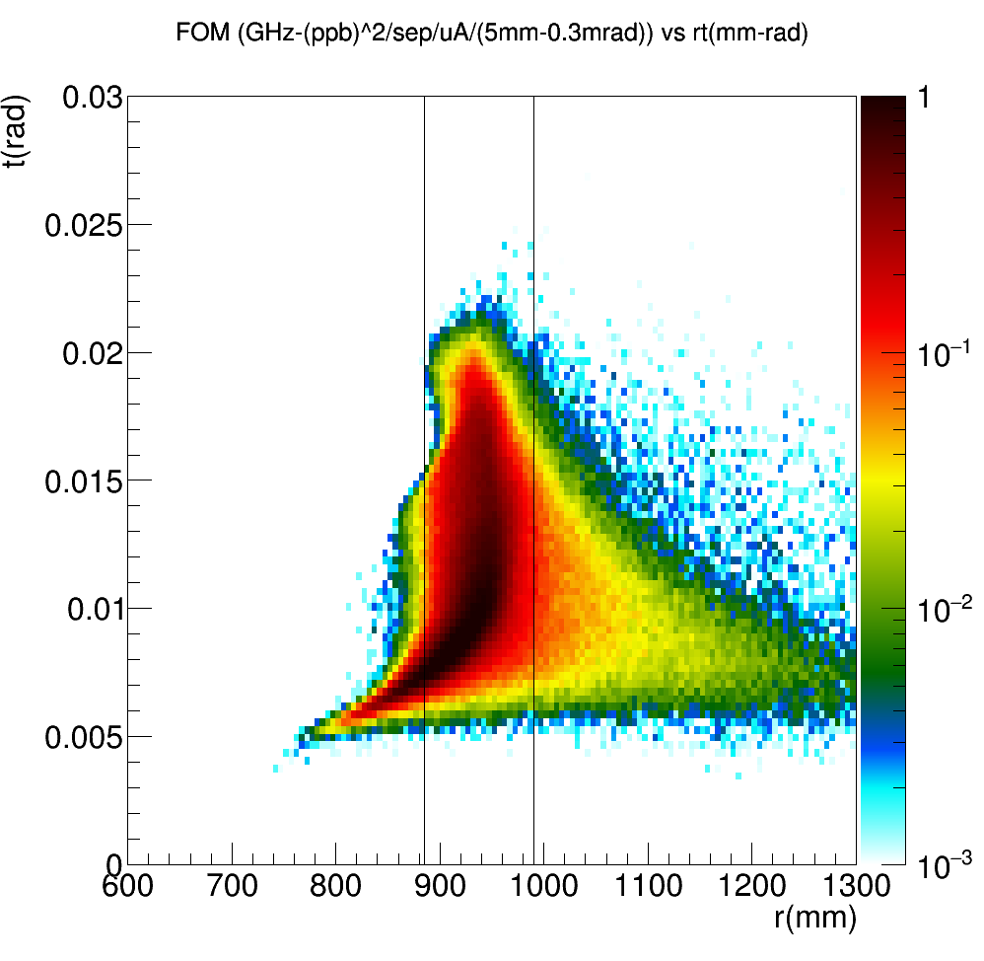
Old Default
V5

Slide 3
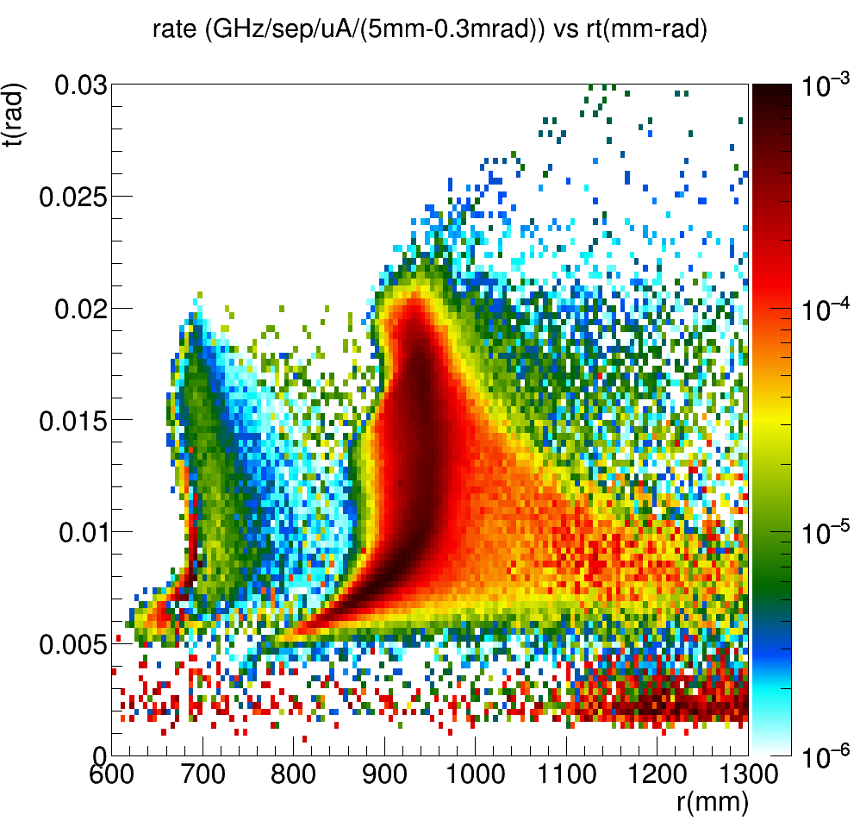
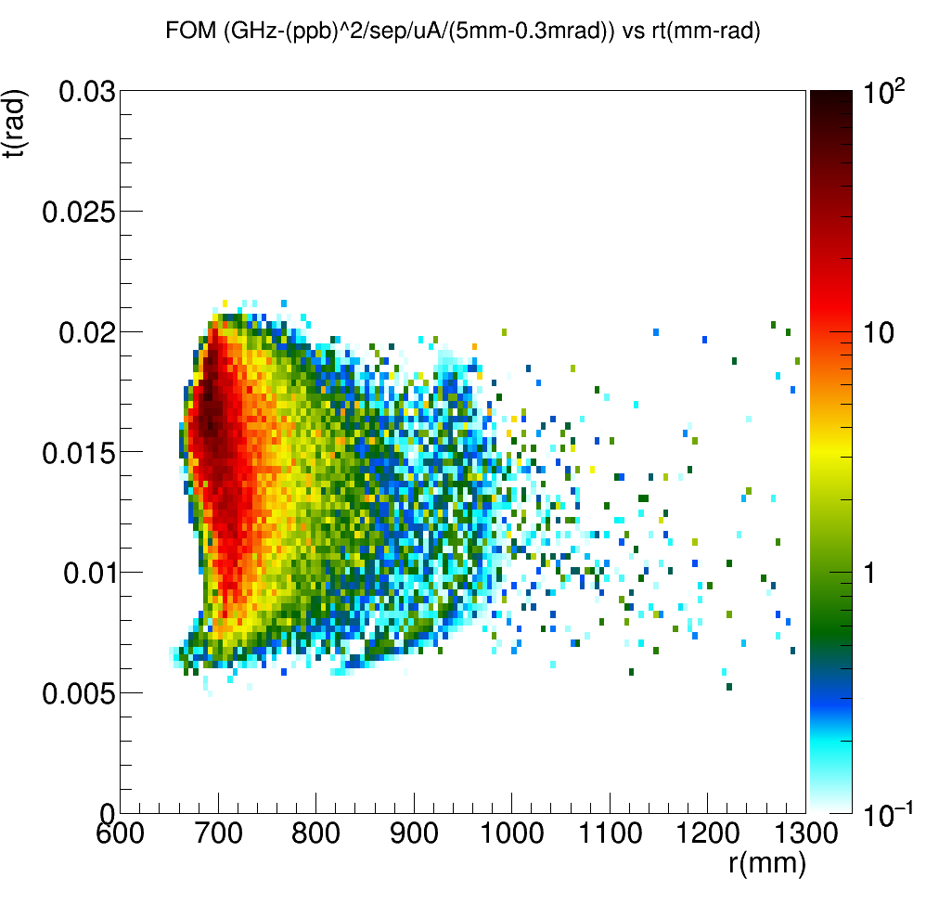
V5, Widest collimator opening
All generators
Left: ee(R), ep(B), in(G)
Top Right: Rate-Weighted
Bottom Right: FOM-Weighted

Slide 4
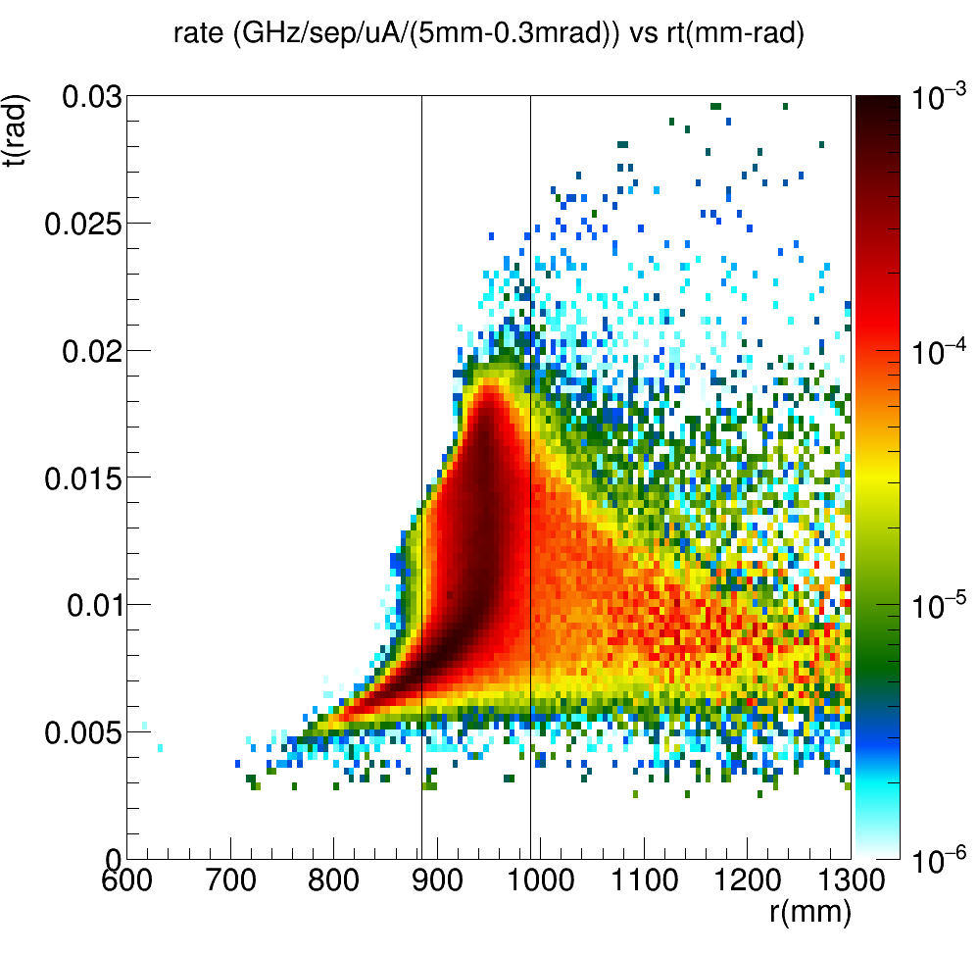
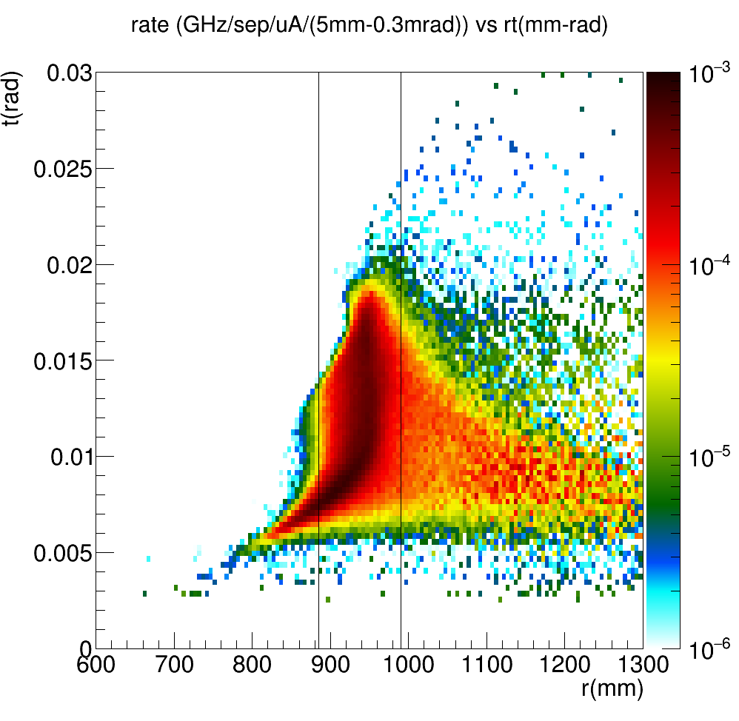
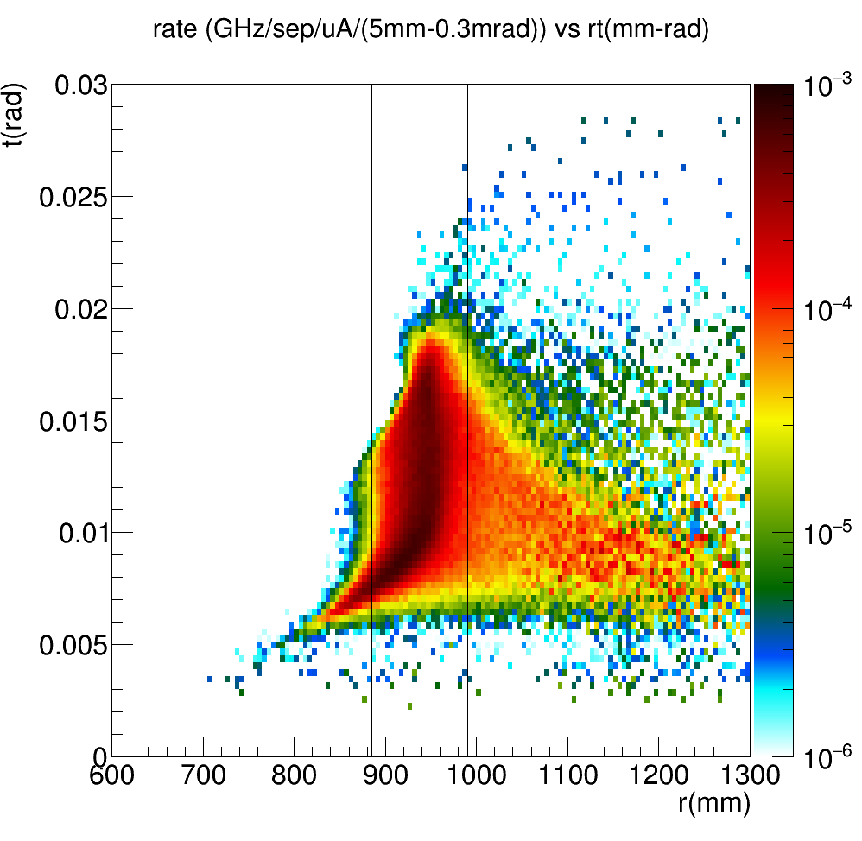
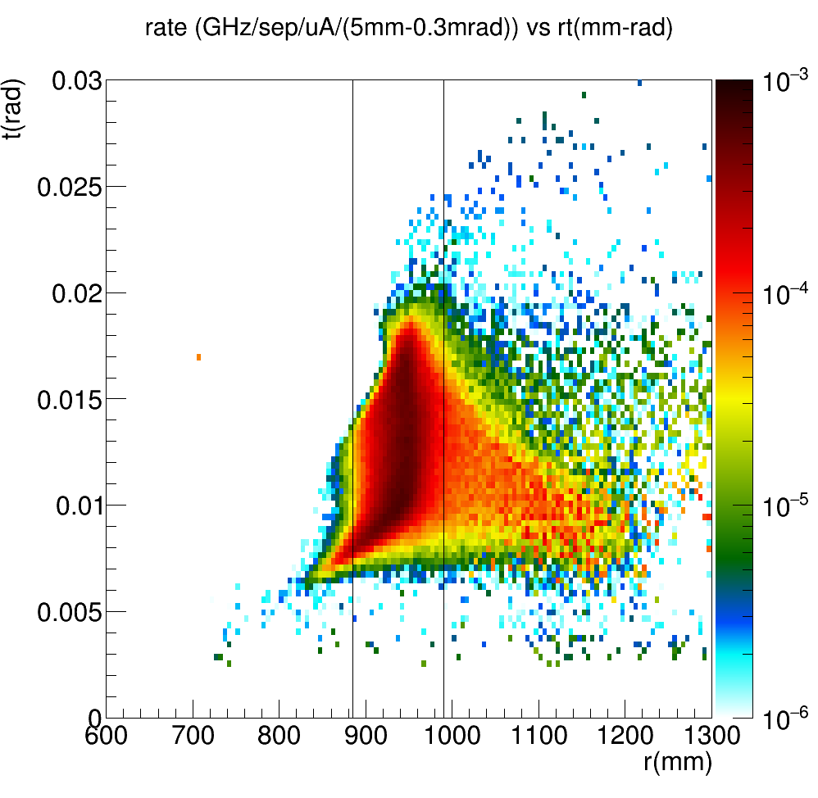
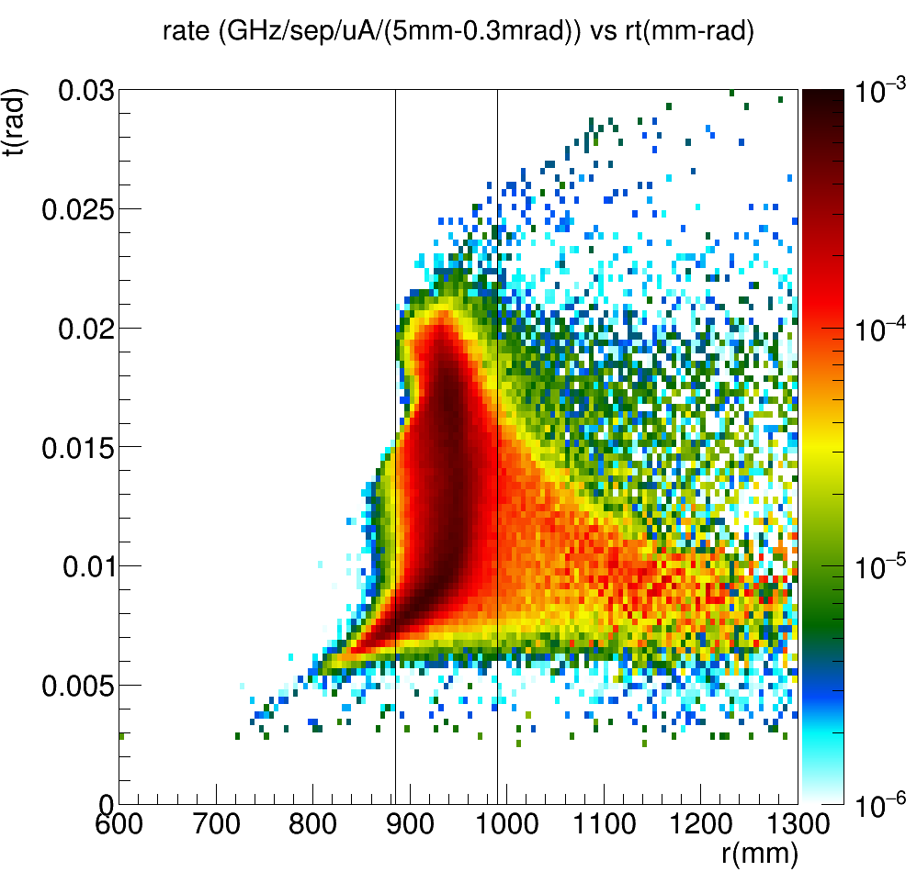
V1
V4
V3
V2
V5
V6

Slide 5
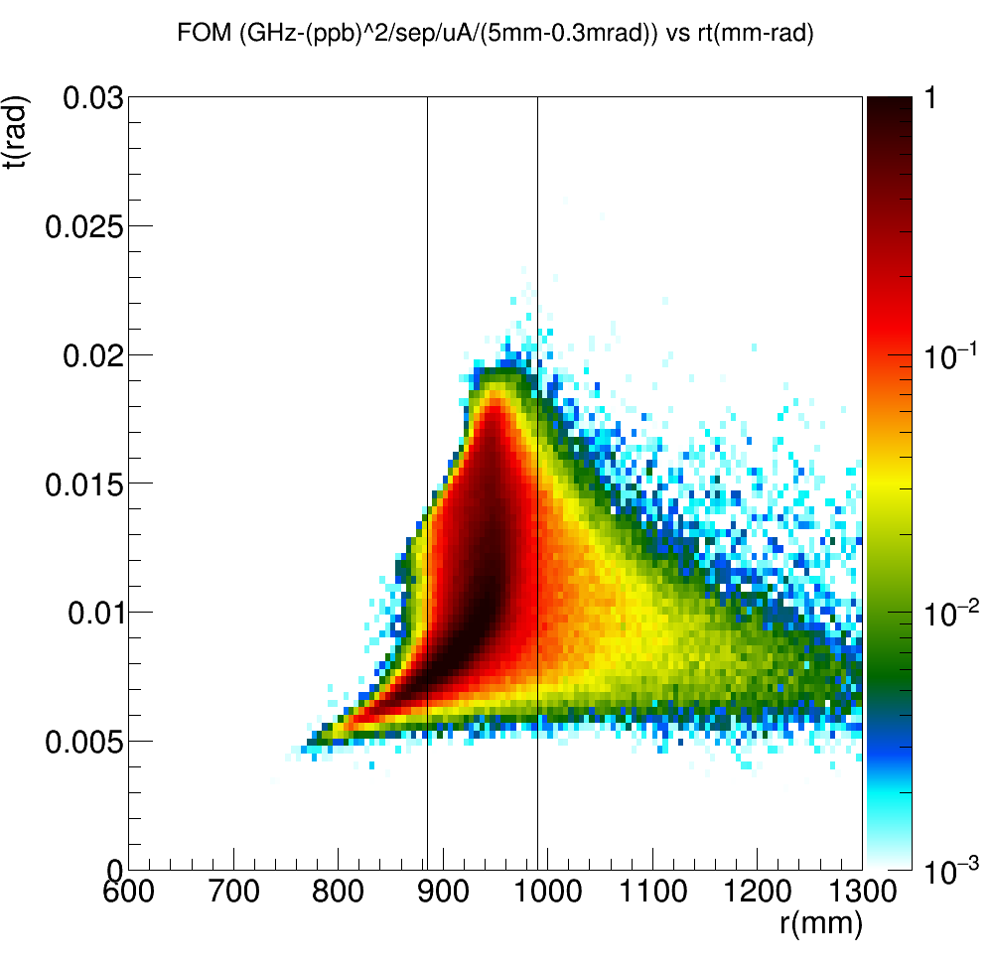
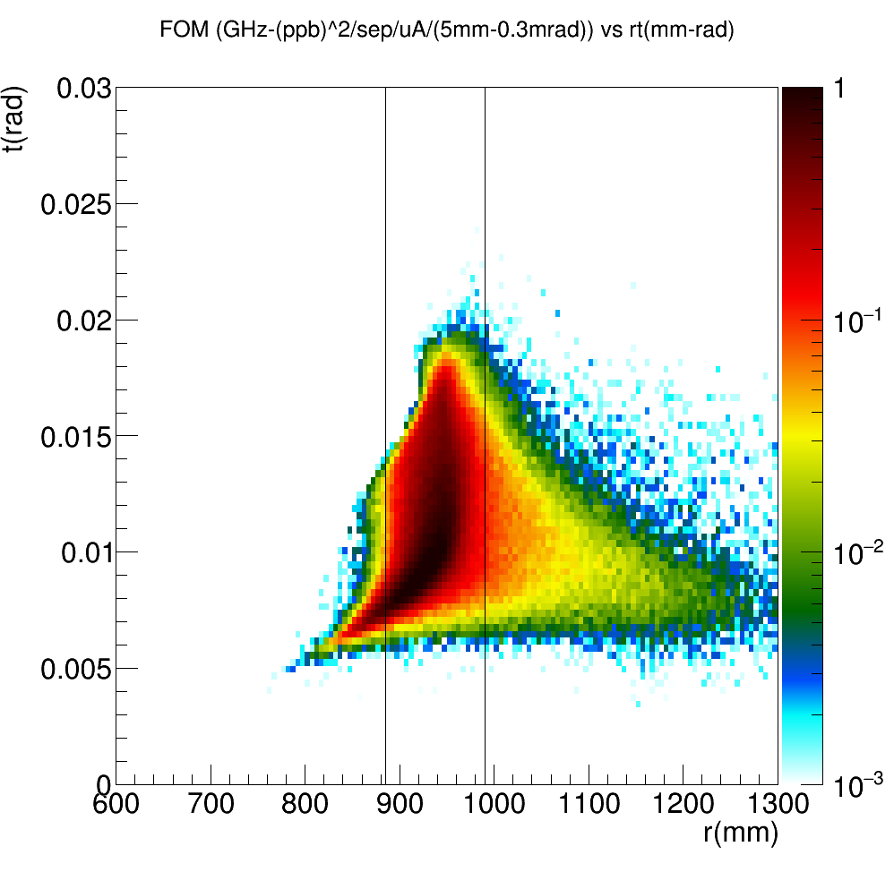
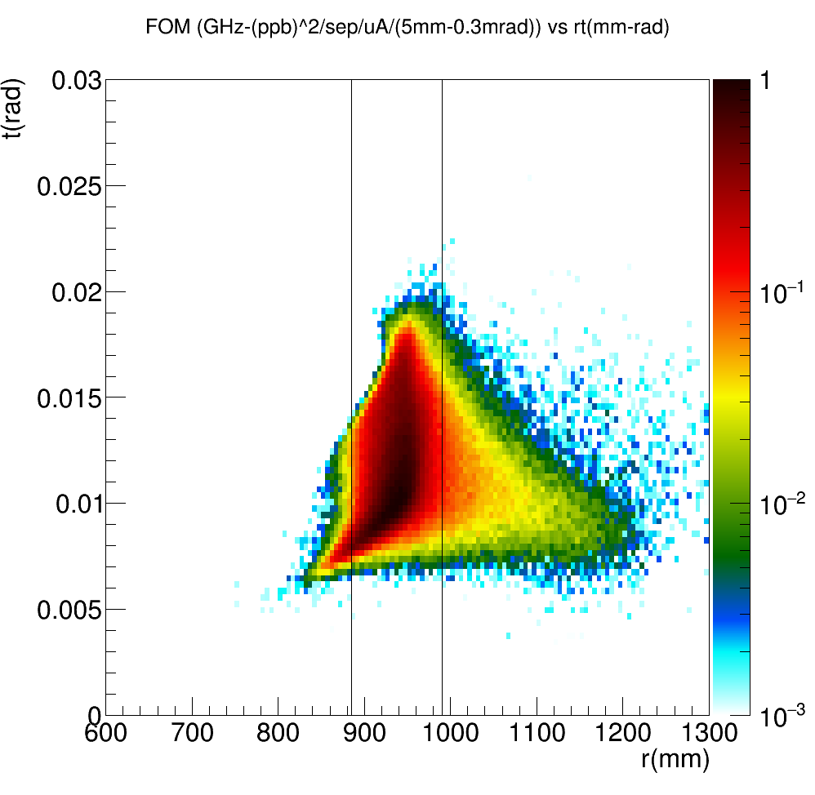
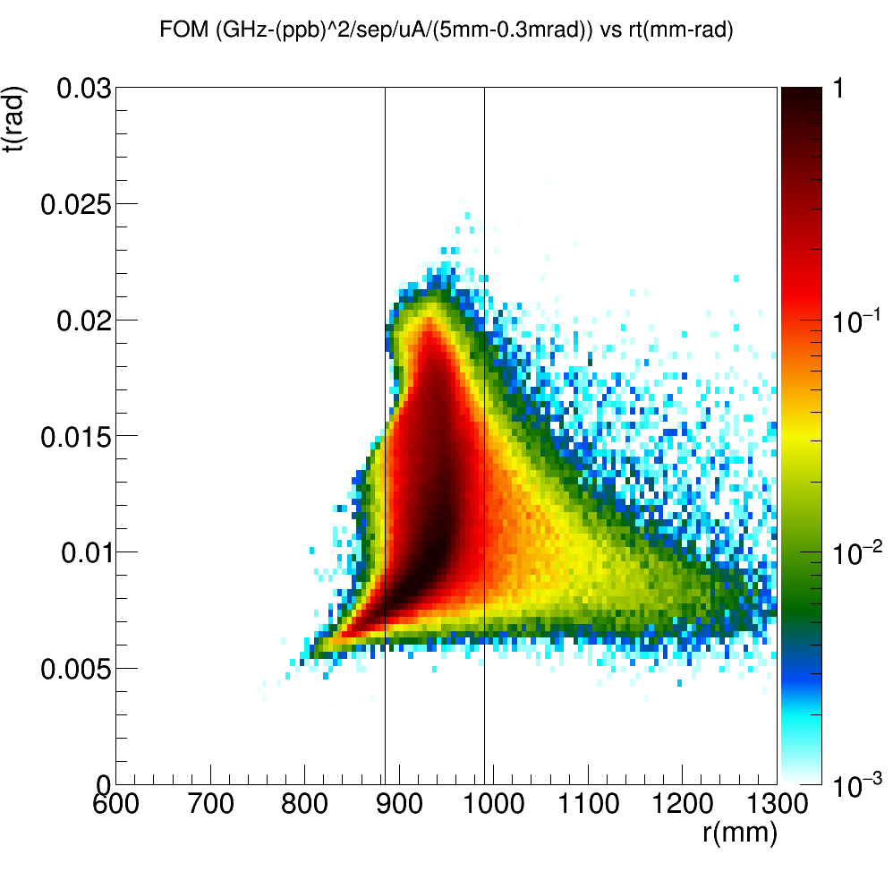
V1
V4
V3
Inner Radius: V5<V1<V4<V3=V6<V2. Increasing the inner radius=>Improves S/N, Worsenes FOM
Outer Radius: V6=V5>V1=V2=V3=V4. Increasing the outer radius=> Improves S/N, Improves FOM
V2
V5
V6

Slide 6
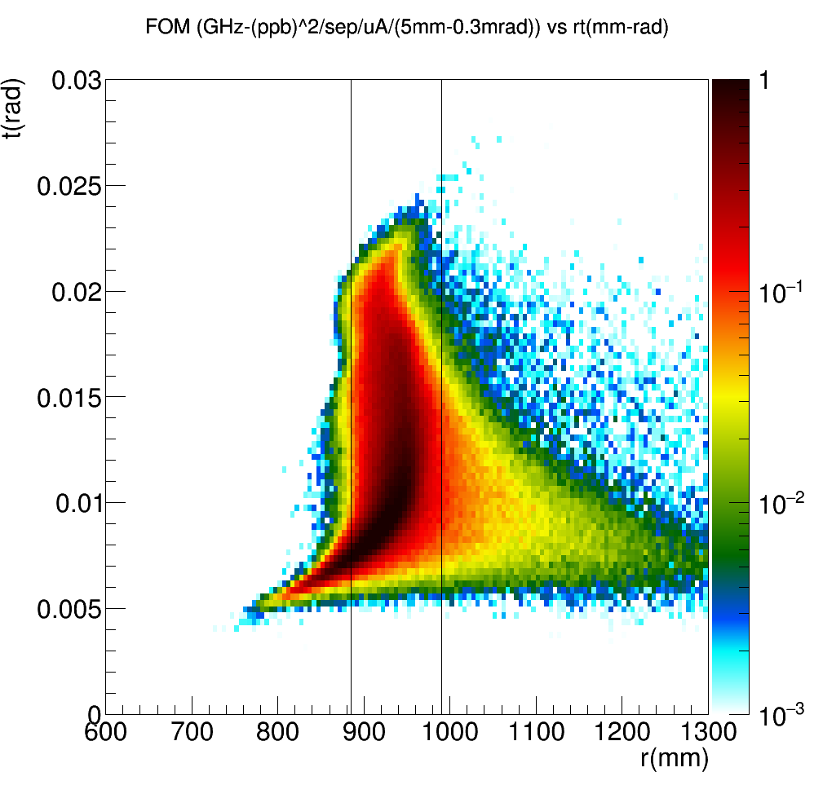
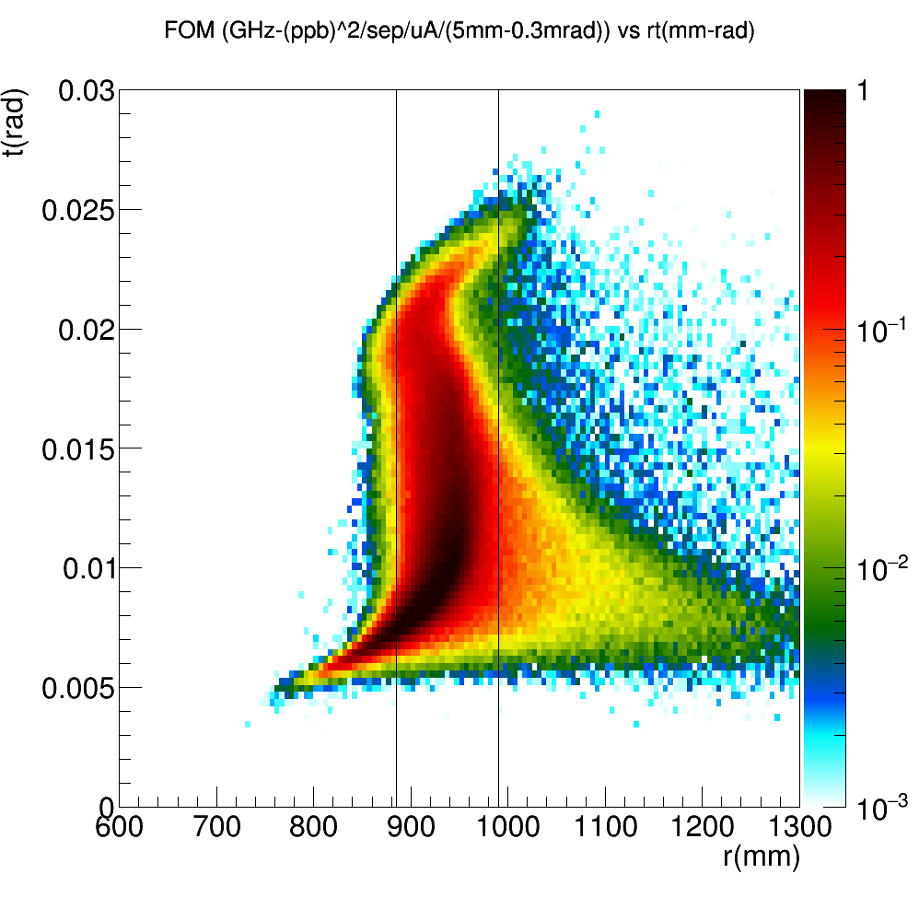
V7
V8
V9
Inner Radius: V7=V8=V9=35mm.
Outer Radius: V7<V8<V9. Increasing the outer radius=> Improves S/N, Improves FOM as expected. Further gains possible by tweaking the sector definitions.
6

Slide 7
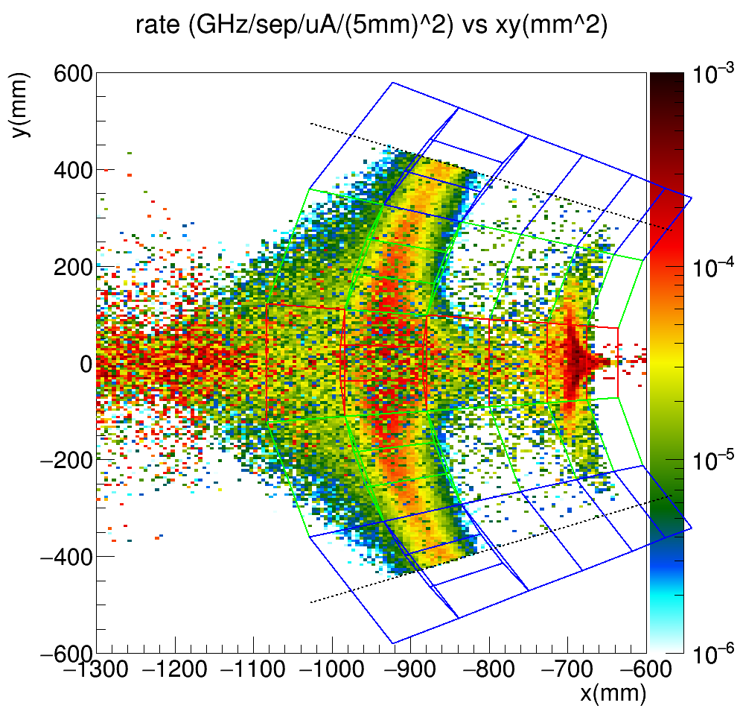
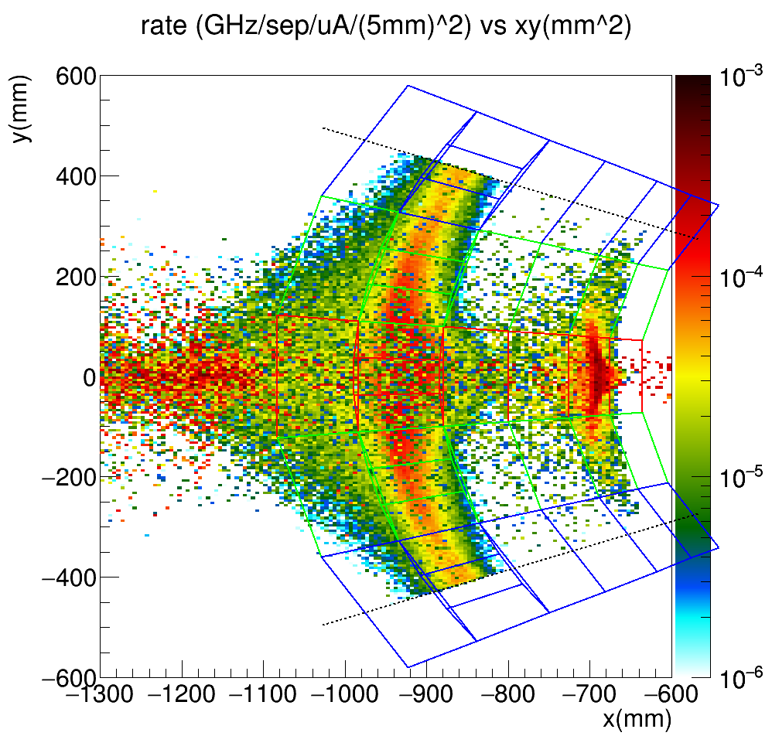
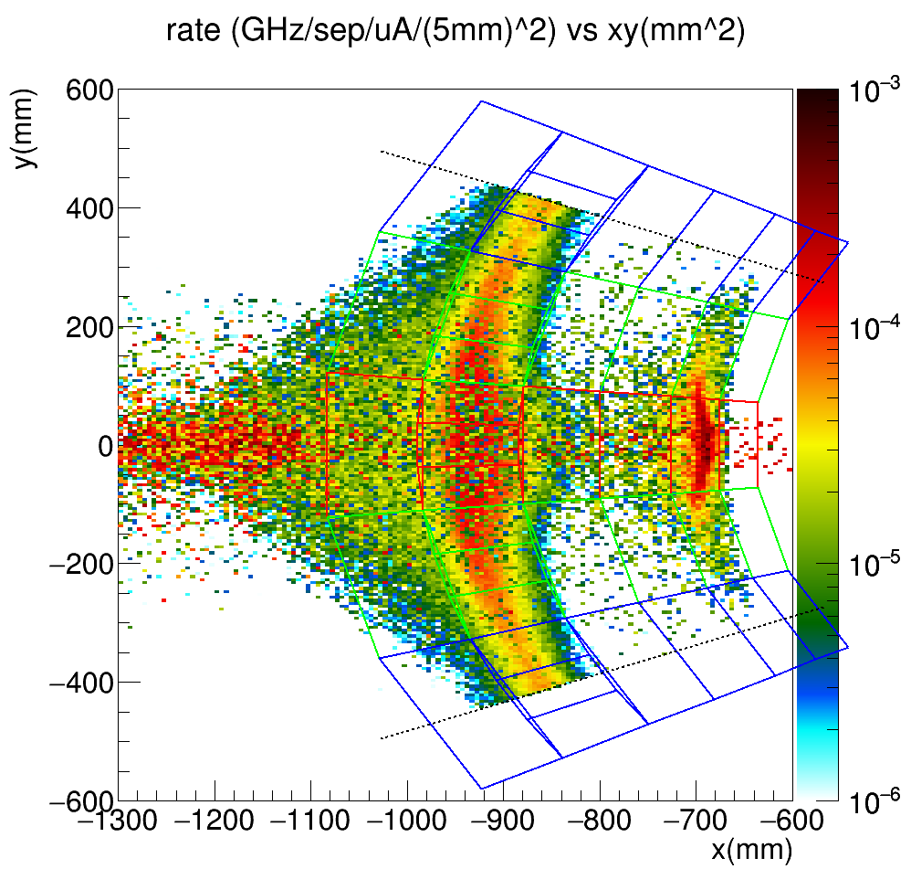
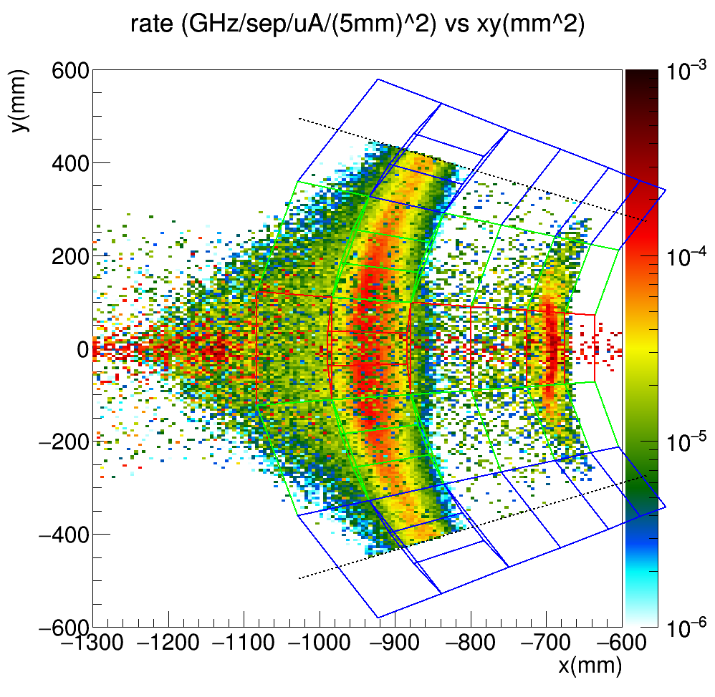
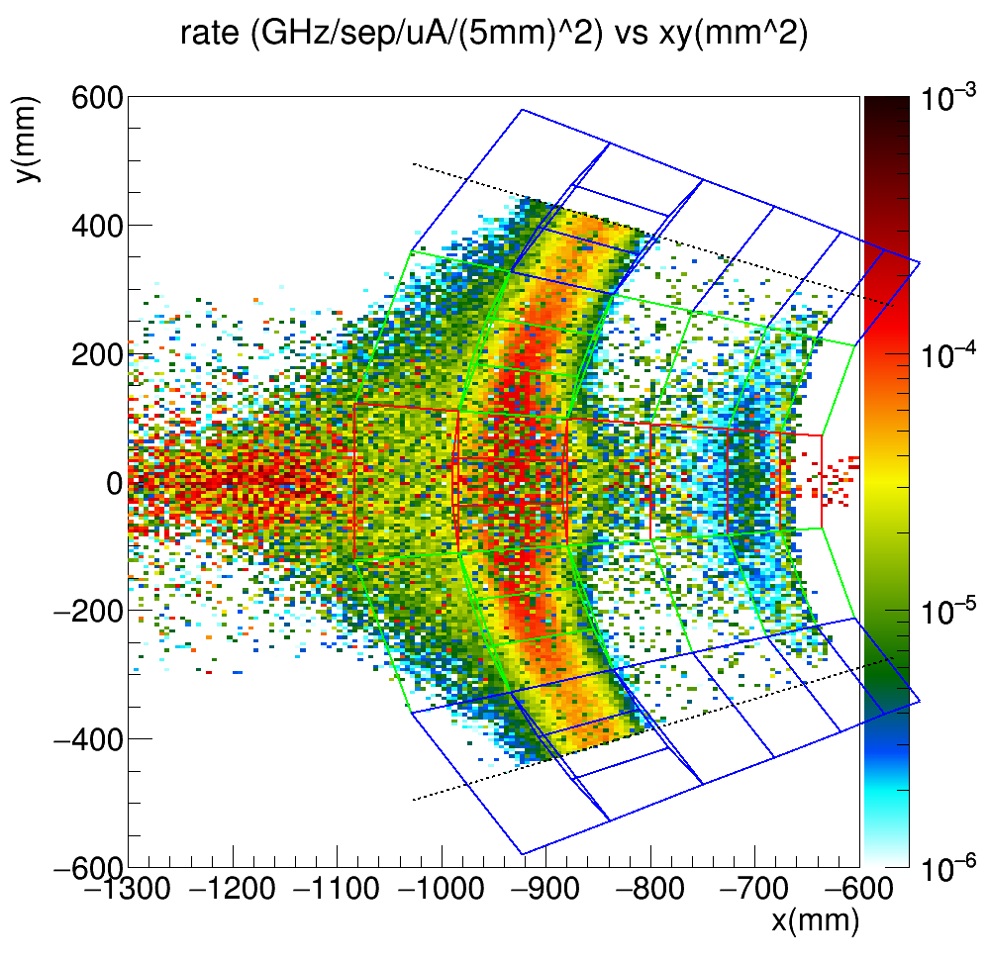
V1
V4
V3
V2
V5
V6

Slide 8
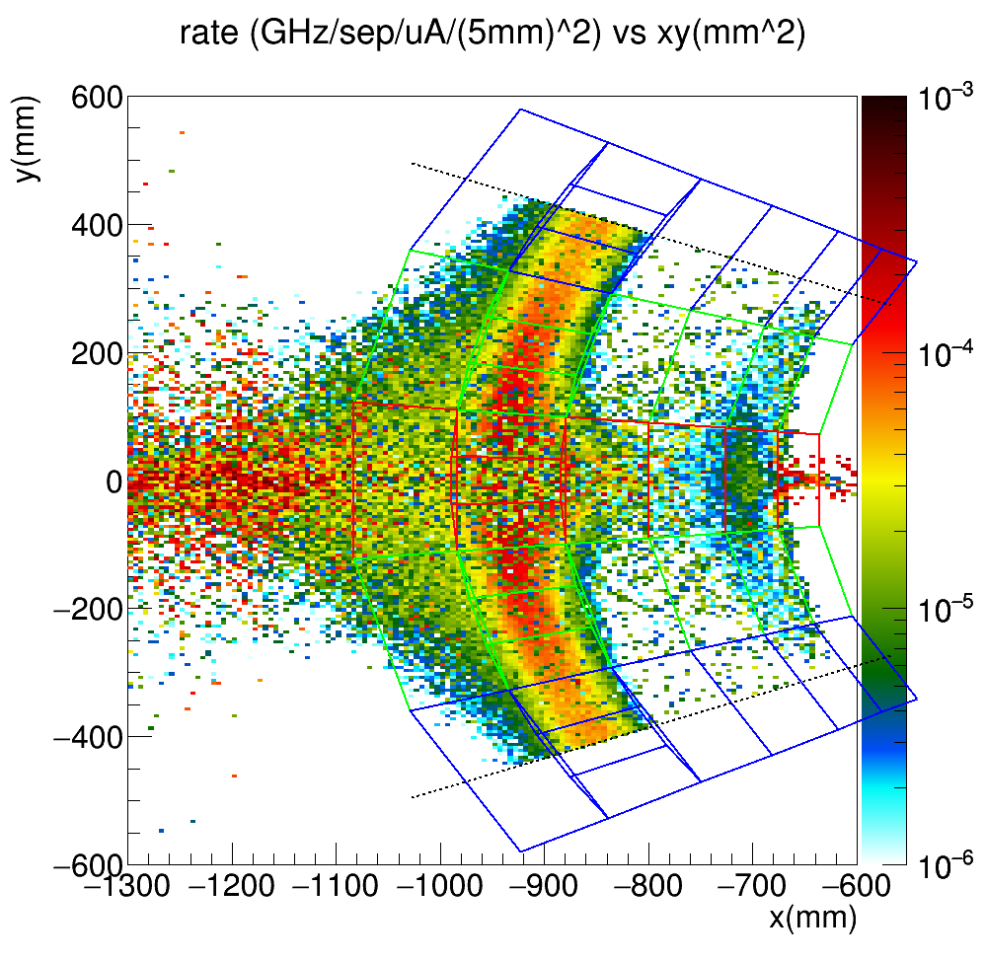
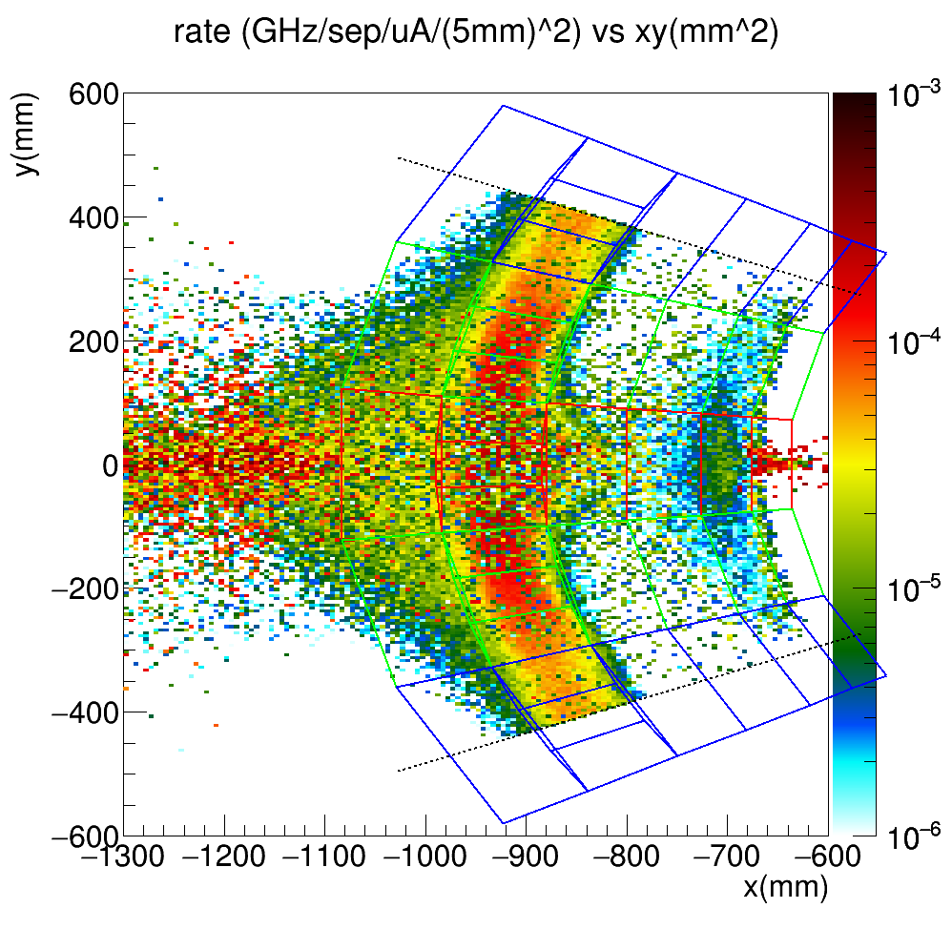
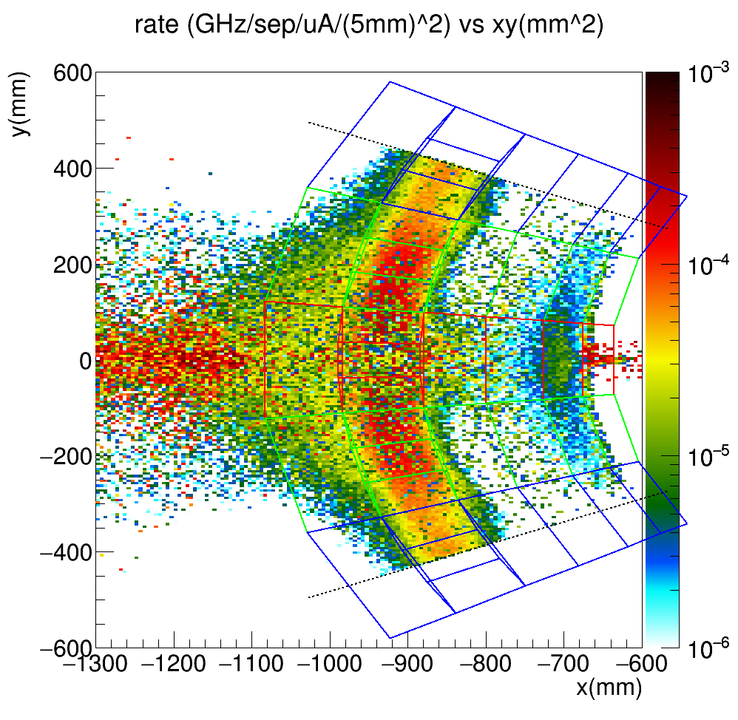
V7
V8
V9

Slide 9
All Sectors
 |  | Rate |  | Asymmetry |  | FOM (Direct Integral) | Ratio Wrt V5 | FOM(Rate*A_mean^2) | Ratio Wrt V5 | %ep | Ratio Wrt V5 | %in | Ratio Wrt V5
d | moller | 0.2561 |  | -33.9612 |  | 307.15 | 0.85 | 295.40 | 0.84 | 11% | 0.73 | 0.00% | N/A
 | elastic | 0.0324 |  | -17.7888
 | inelastic | 0.0000 |  | 0.0000
v1 | moller | 0.1921 |  | -35.0432 |  | 243.09 | 1.05 | 235.94 | 1.04 | 9% | 0.90 | 0.00% | N/A
 | elastic | 0.0191 |  | -18.9435
 | inelastic | 0.0000 |  | 0.0000
v2 | moller | 0.1571 |  | -34.7107 |  | 195.36 | 1.17 | 189.32 | 1.16 | 7% | 1.11 | 0.00% | N/A
 | elastic | 0.0124 |  | -18.6323
 | inelastic | 0.0000 |  | 0.0000
v3 | moller | 0.1792 |  | -35.0957 |  | 227.37 | 1.08 | 220.72 | 1.08 | 9% | 0.93 | 0.00% | N/A
 | elastic | 0.0172 |  | -16.4338
 | inelastic | 0.0000 |  | 0.0000
v4 | moller | 0.1860 |  | -35.1119 |  | 236.14 | 1.06 | 229.37 | 1.05 | 8% | 0.98 | 0.00% | N/A
 | elastic | 0.0168 |  | -19.5256
 | inelastic | 0.0000 |  | 0.0000
v5 | moller | 0.2308 |  | -33.2542 |  | 266.94 | 1.00 | 255.21 | 1.00 | 8% | 1.00 | 0.19% | 1.00
 | elastic | 0.0205 |  | -19.3852
 | inelastic | 0.0005 |  | -525.9108
v6 | moller | 0.2167 |  | -33.1866 |  | 249.74 | 1.03 | 238.67 | 1.03 | 7% | 1.11 | 0.18% | 1.07
 | elastic | 0.0171 |  | -19.5139
 | inelastic | 0.0004 |  | -557.3694
v7 | moller | 0.2295 |  | -33.3174 |  | 266.10 | 1.00 | 254.71 | 1.00 | 8% | 1.04 | 0.20% | 0.98
 | elastic | 0.0195 |  | -20.4859
 | inelastic | 0.0005 |  | -532.5279
v8 | moller | 0.2710 |  | -31.4358 |  | 284.97 | 0.97 | 267.79 | 0.98 | 7% | 1.17 | 0.18% | 1.09
 | elastic | 0.0204 |  | -18.1653
 | inelastic | 0.0005 |  | -511.8148
v9 | moller | 0.3052 |  | -29.9224 |  | 296.29 | 0.95 | 273.25 | 0.97 | 6% | 1.35 | 0.16% | 1.20
 | elastic | 0.0197 |  | -19.4613
 | inelastic | 0.0005 |  | -518.6189

Slide 10
Open
 |  | Rate |  | Asymmetry |  | FOM | Ratio Wrt V5 | FOM(Rate*A_mean^2) | Ratio Wrt V5 | %ep | Ratio Wrt V5 | %in | Ratio Wrt V5
d | moller | 0.1193 |  | -35.2670 |  | 152.11 | 0.84 | 148.37 | 0.84 | 14% | 0.81 | 0.00% | N/A
 | elastic | 0.0196 |  | -16.6448
 | inelastic | 0.0000 |  | 0.0000
v1 | moller | 0.0925 |  | -36.3084 |  | 124.92 | 1.03 | 121.98 | 1.02 | 12% | 0.93 | 0.00% | N/A
 | elastic | 0.0128 |  | -15.8517
 | inelastic | 0.0000 |  | 0.0000
v2 | moller | 0.0590 |  | -36.2348 |  | 79.37 | 1.29 | 77.40 | 1.28 | 11% | 1.06 | 0.00% | N/A
 | elastic | 0.0071 |  | -14.4576
 | inelastic | 0.0000 |  | 0.0000
v3 | moller | 0.0792 |  | -36.6147 |  | 108.58 | 1.10 | 106.19 | 1.09 | 12% | 0.92 | 0.00% | N/A
 | elastic | 0.0111 |  | -13.9257
 | inelastic | 0.0000 |  | 0.0000
v4 | moller | 0.0866 |  | -36.5395 |  | 118.15 | 1.05 | 115.62 | 1.05 | 12% | 0.98 | 0.00% | N/A
 | elastic | 0.0114 |  | -16.0258
 | inelastic | 0.0000 |  | 0.0000
v5 | moller | 0.1032 |  | -35.0571 |  | 131.47 | 1.00 | 126.86 | 1.00 | 11% | 1.00 | 0.23% | 1.00
 | elastic | 0.0133 |  | -16.9590
 | inelastic | 0.0003 |  | -447.8431
v6 | moller | 0.0898 |  | -35.1016 |  | 114.80 | 1.07 | 110.70 | 1.07 | 10% | 1.11 | 0.22% | 1.03
 | elastic | 0.0103 |  | -15.8057
 | inelastic | 0.0002 |  | -486.0193
v7 | moller | 0.1026 |  | -35.1253 |  | 131.02 | 1.00 | 126.62 | 1.00 | 10% | 1.09 | 0.23% | 0.98
 | elastic | 0.0120 |  | -18.0316
 | inelastic | 0.0003 |  | -440.7158
v8 | moller | 0.1162 |  | -33.4058 |  | 136.78 | 0.98 | 129.68 | 0.99 | 10% | 1.17 | 0.22% | 1.02
 | elastic | 0.0126 |  | -16.1129
 | inelastic | 0.0003 |  | -430.2026
v9 | moller | 0.1307 |  | -31.7657 |  | 142.07 | 0.96 | 131.87 | 0.98 | 8% | 1.40 | 0.20% | 1.12
 | elastic | 0.0116 |  | -18.6992
 | inelastic | 0.0003 |  | -437.5788

Slide 11
Transition
 |  | Rate |  | Asymmetry |  | FOM | Ratio Wrt V5 | FOM(Rate*A_mean^2) | Ratio Wrt V5 | %ep | Ratio Wrt V5 | %in | Ratio Wrt V5
d | moller | 0.1014 |  | -33.6166 |  | 120.58 | 0.87 | 114.55 | 0.87 | 9% | 0.62 | 0.00% | N/A
 | elastic | 0.0104 |  | -19.6532
 | inelastic | 0.0000 |  | 0.0000
v1 | moller | 0.0790 |  | -34.6636 |  | 98.08 | 1.06 | 94.91 | 1.05 | 6% | 0.90 | 0.00% | N/A
 | elastic | 0.0054 |  | -26.2623
 | inelastic | 0.0000 |  | 0.0000
v2 | moller | 0.0780 |  | -34.5690 |  | 96.31 | 1.07 | 93.19 | 1.06 | 5% | 1.09 | 0.00% | N/A
 | elastic | 0.0044 |  | -25.6938
 | inelastic | 0.0000 |  | 0.0000
v3 | moller | 0.0795 |  | -34.6837 |  | 98.83 | 1.06 | 95.66 | 1.05 | 6% | 0.96 | 0.00% | N/A
 | elastic | 0.0051 |  | -21.9958
 | inelastic | 0.0000 |  | 0.0000
v4 | moller | 0.0791 |  | -34.6646 |  | 98.21 | 1.06 | 95.04 | 1.05 | 5% | 1.05 | 0.00% | N/A
 | elastic | 0.0046 |  | -27.9212
 | inelastic | 0.0000 |  | 0.0000
v5 | moller | 0.0989 |  | -32.5146 |  | 110.02 | 1.00 | 104.52 | 1.00 | 6% | 1.00 | 0.18% | 1.00
 | elastic | 0.0061 |  | -24.7333
 | inelastic | 0.0002 |  | -602.2163
v6 | moller | 0.0982 |  | -32.5687 |  | 109.58 | 1.00 | 104.18 | 1.00 | 5% | 1.06 | 0.16% | 1.10
 | elastic | 0.0057 |  | -26.2510
 | inelastic | 0.0002 |  | -606.2379
v7 | moller | 0.0983 |  | -32.5702 |  | 109.72 | 1.00 | 104.32 | 1.00 | 6% | 1.02 | 0.18% | 0.99
 | elastic | 0.0059 |  | -26.6160
 | inelastic | 0.0002 |  | -618.5245
v8 | moller | 0.1224 |  | -30.2833 |  | 120.58 | 0.96 | 112.24 | 0.97 | 5% | 1.11 | 0.15% | 1.19
 | elastic | 0.0067 |  | -22.2609
 | inelastic | 0.0002 |  | -600.6310
v9 | moller | 0.1423 |  | -28.5016 |  | 126.76 | 0.93 | 115.58 | 0.95 | 5% | 1.22 | 0.13% | 1.35
 | elastic | 0.0071 |  | -21.0359
 | inelastic | 0.0002 |  | -587.5344

Slide 12
Closed
 |  | Rate |  | Asymmetry |  | FOM | Ratio Wrt V5 | FOM(Rate*A_mean^2) | Ratio Wrt V5 | %ep | Ratio Wrt V5 | %in | Ratio Wrt V5
d | moller | 0.0355 |  | -30.5538 |  | 34.46 | 0.78 | 33.11 | 0.78 | 6% | 0.63 | 0.00% | N/A
 | elastic | 0.0024 |  | -19.2090
 | inelastic | 0.0000 |  | 0.0000
v1 | moller | 0.0206 |  | -30.8193 |  | 20.09 | 1.13 | 19.58 | 1.12 | 4% | 1.04 | 0.00% | N/A
 | elastic | 0.0008 |  | -20.7727
 | inelastic | 0.0000 |  | 0.0000
v2 | moller | 0.0202 |  | -30.8097 |  | 19.67 | 1.14 | 19.17 | 1.13 | 5% | 0.87 | 0.00% | N/A
 | elastic | 0.0010 |  | -18.1084
 | inelastic | 0.0000 |  | 0.0000
v3 | moller | 0.0205 |  | -30.8181 |  | 19.95 | 1.13 | 19.44 | 1.13 | 5% | 0.86 | 0.00% | N/A
 | elastic | 0.0010 |  | -17.0391
 | inelastic | 0.0000 |  | 0.0000
v4 | moller | 0.0204 |  | -30.7774 |  | 19.78 | 1.13 | 19.28 | 1.13 | 4% | 1.06 | 0.00% | N/A
 | elastic | 0.0008 |  | -22.6909
 | inelastic | 0.0000 |  | 0.0000
v5 | moller | 0.0287 |  | -29.3168 |  | 25.45 | 1.00 | 24.66 | 1.00 | 4% | 1.00 | 0.13% | 1.00
 | elastic | 0.0012 |  | -19.7815
 | inelastic | 0.0000 |  | -721.4091
v6 | moller | 0.0287 |  | -29.2997 |  | 25.37 | 1.00 | 24.60 | 1.00 | 4% | 1.02 | 0.13% | 1.02
 | elastic | 0.0012 |  | -20.5695
 | inelastic | 0.0000 |  | -773.2009
v7 | moller | 0.0285 |  | -29.3838 |  | 25.36 | 1.00 | 24.60 | 1.00 | 5% | 0.74 | 0.14% | 0.96
 | elastic | 0.0016 |  | -17.0046
 | inelastic | 0.0000 |  | -758.2951
v8 | moller | 0.0324 |  | -28.7231 |  | 27.62 | 0.96 | 26.73 | 0.96 | 3% | 1.18 | 0.13% | 1.01
 | elastic | 0.0011 |  | -17.2966
 | inelastic | 0.0000 |  | -682.8332
v9 | moller | 0.0322 |  | -28.7190 |  | 27.46 | 0.96 | 26.57 | 0.96 | 3% | 1.32 | 0.12% | 1.05
 | elastic | 0.0010 |  | -17.3287
 | inelastic | 0.0000 |  | -778.6684

Slide 13
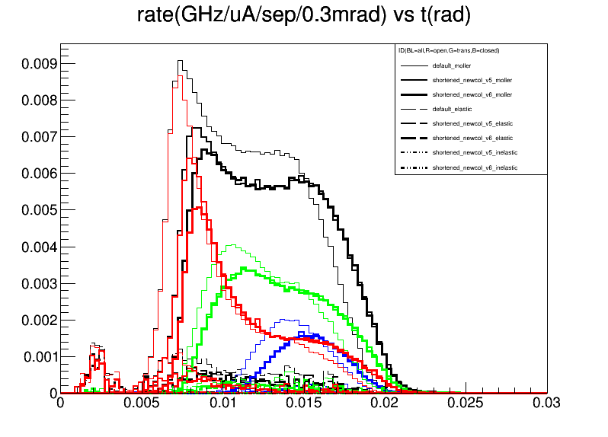
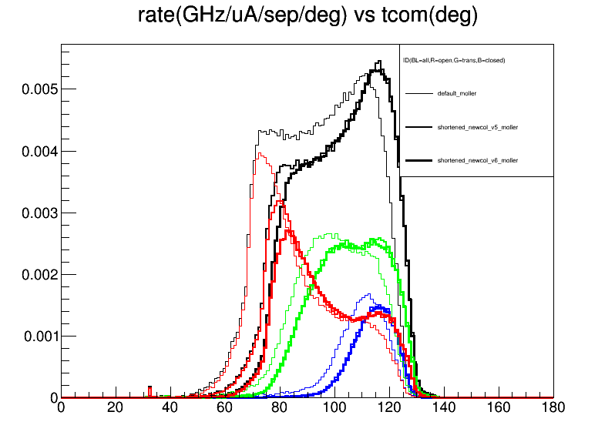
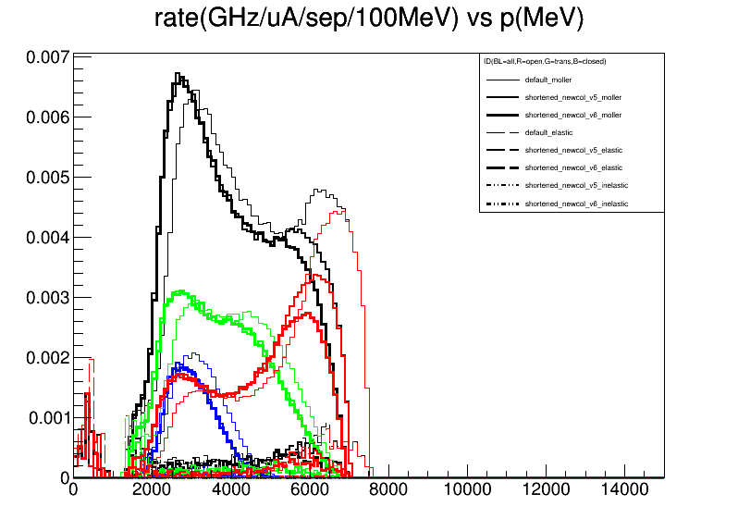

Slide 14
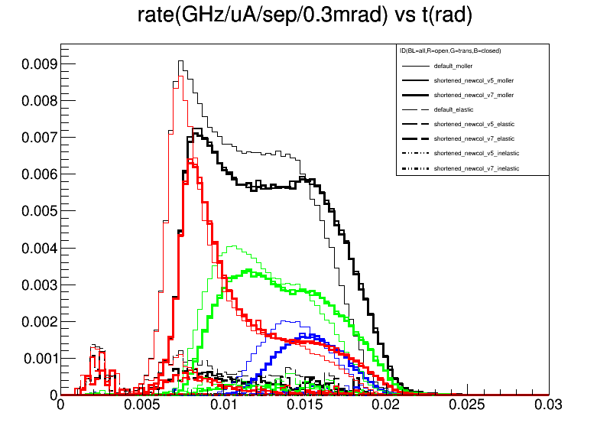
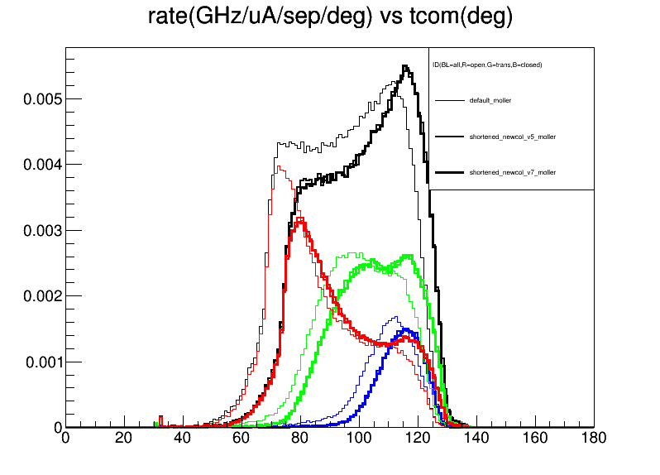
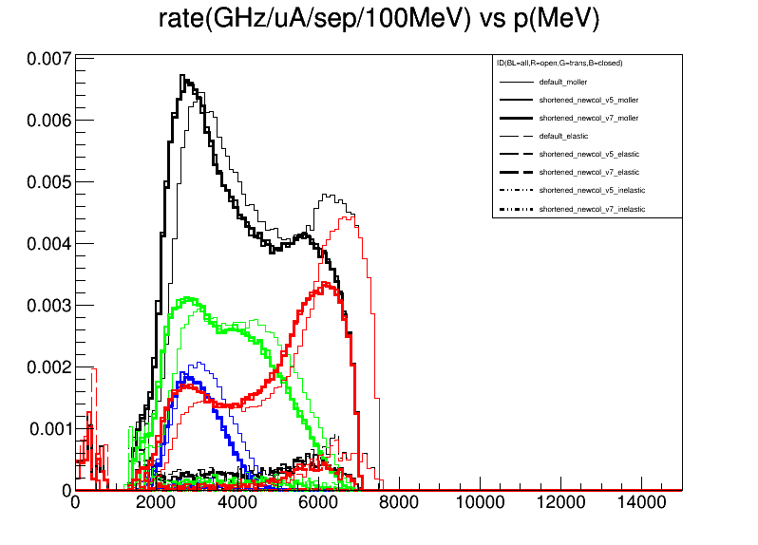

Slide 15
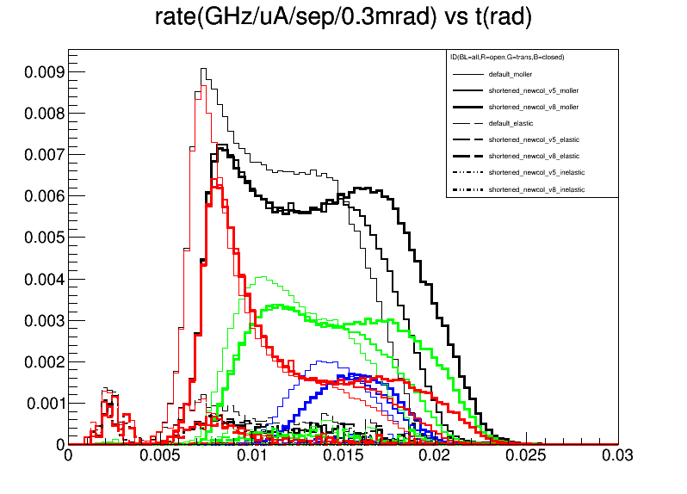
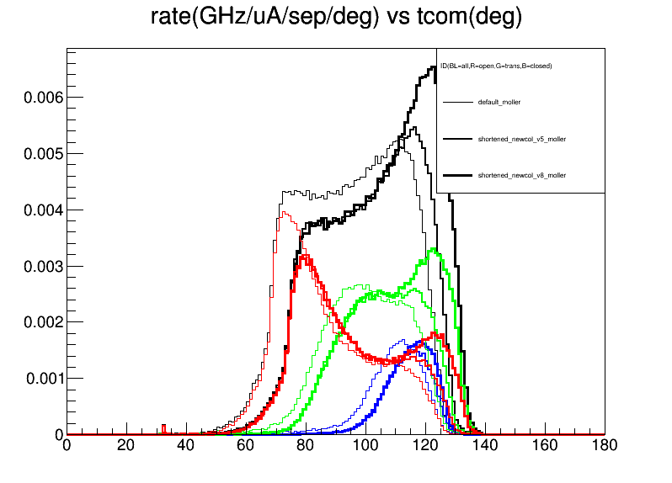
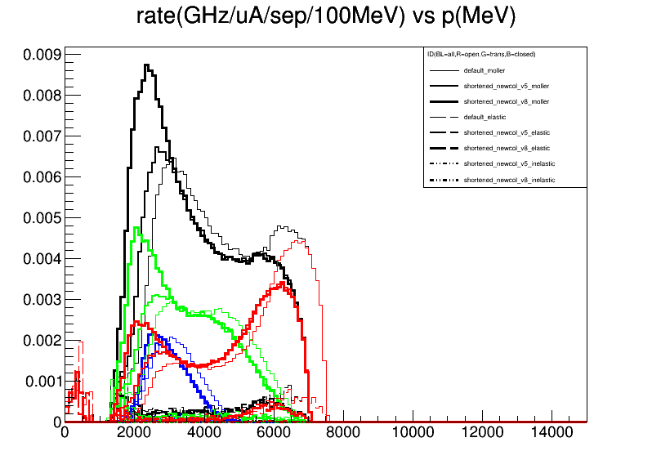

Slide 16
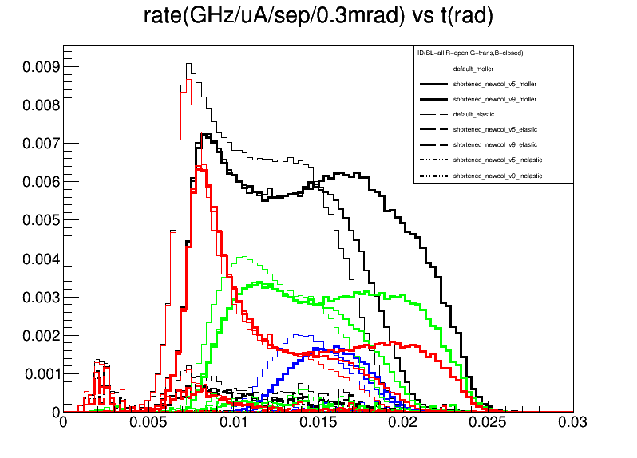
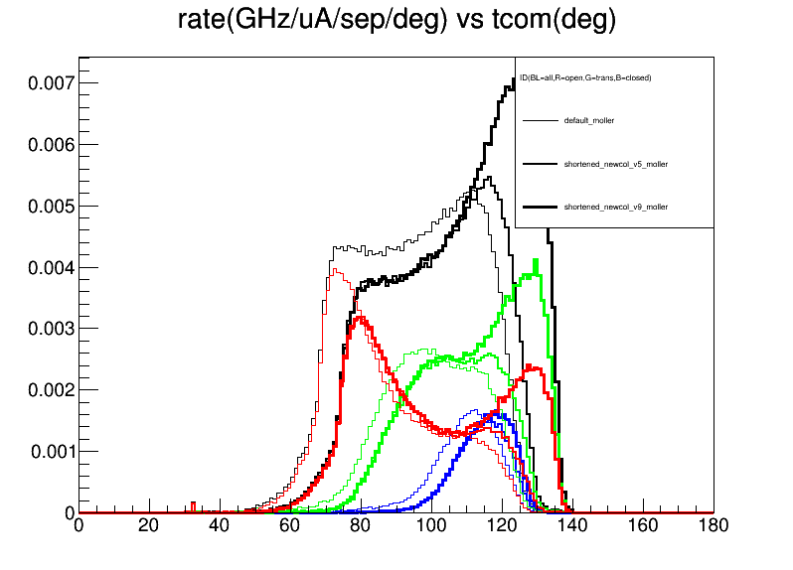
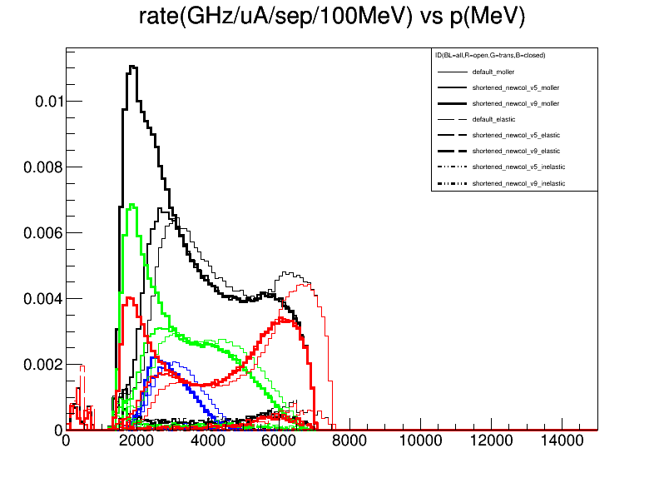

Slide 17
Entire Radial Range

Slide 18
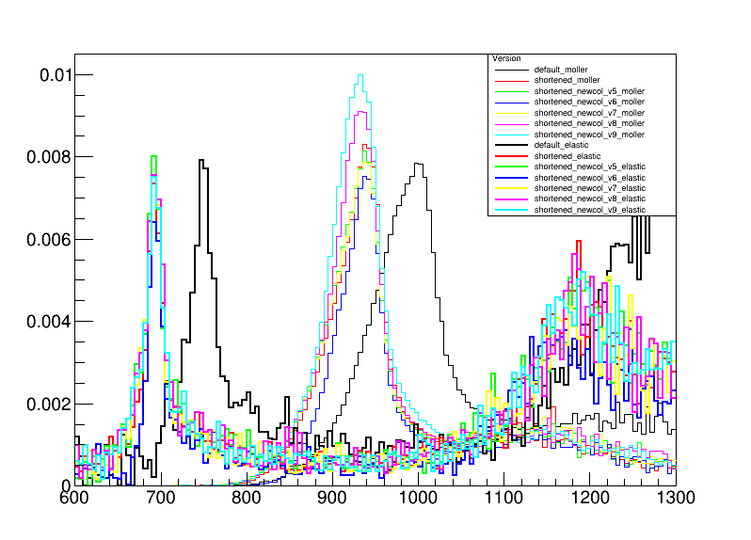
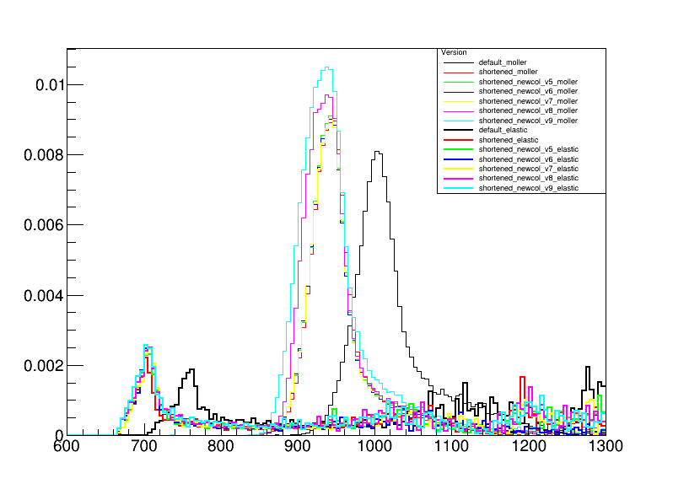
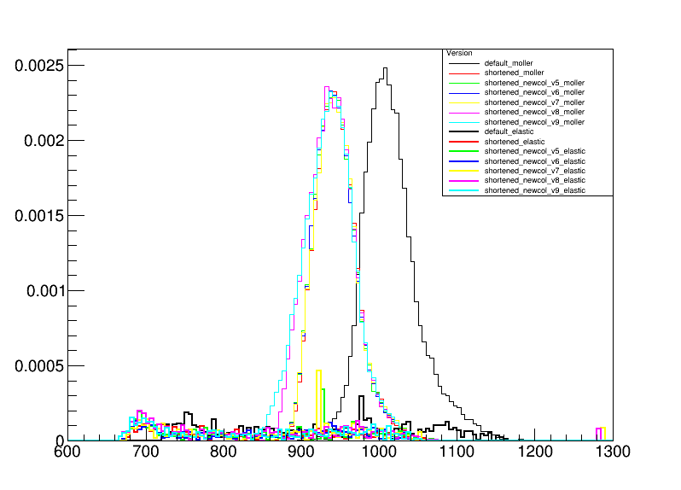
Rate (GHz/uA/sep/5mm) vs r(mm)
open
all
trans
closed

Slide 19
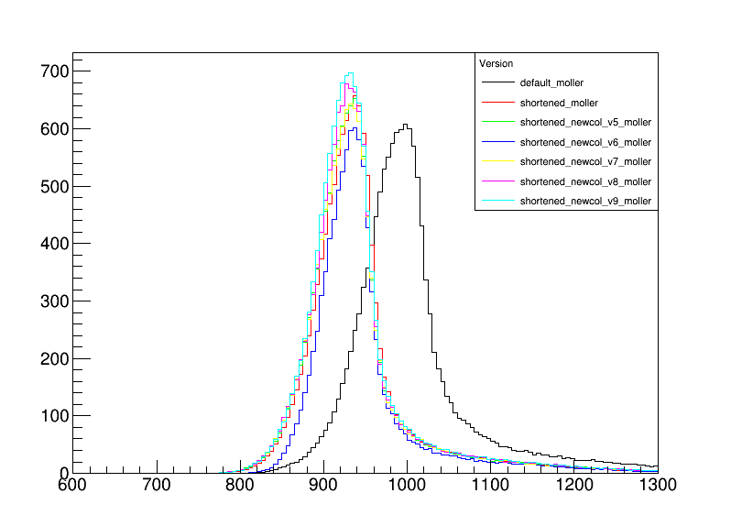
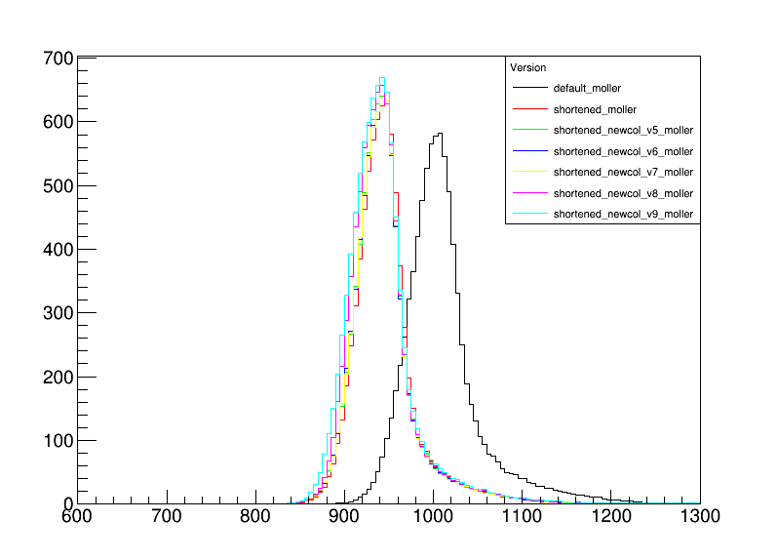
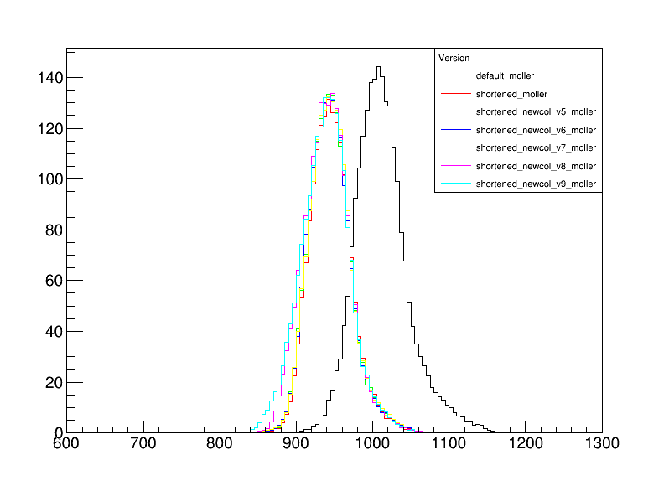
FOM (GHz-(ppb)^2/sep/5mm) vs r(mm)
open
all
Assuming 60 uA current for default and 65 uA current for all other versions
trans
closed

Slide 20
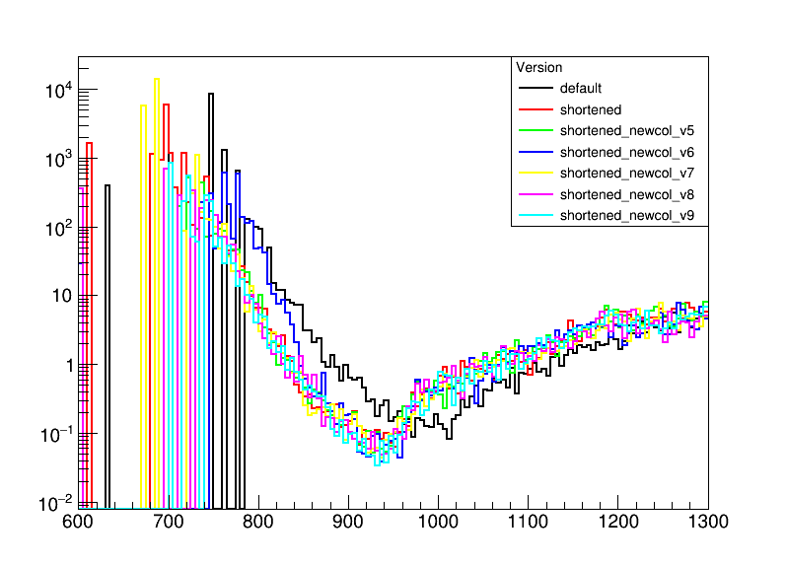
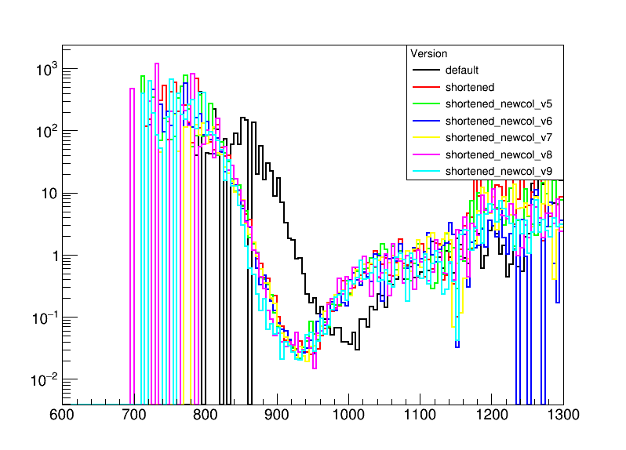
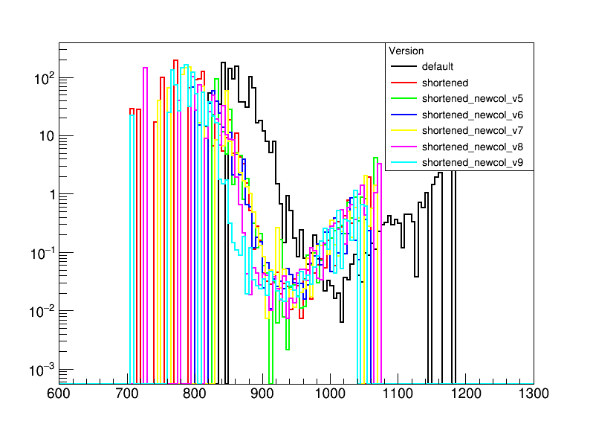
ep/ee vs r(mm)
open
all
trans
closed

Slide 21
Use
cut on the relative ratio of ep/ee cut<=1
cut on the FOM >= 35 for open, trans, >=10 for closed
to determine radial ranges of detectors in ring 5

Slide 22
Detector Ranges
Version | Open | Transition | Closed
shortened_newcol_uv75 | 835-1060 (ee/ep=1) 835-1060 (FOM=35) | 870-1080 (ee/ep=1) 875-1020 (FOM=35) | 870-1065 (ee/ep=1) 880-1010 (FOM=10)
shortened_newcol_uv_JLAB_75 | 855-1100 (ee/ep=1) 855-1075 (FOM=35) | 890-1110 (ee/ep=1) 900-1060 (FOM=35) | 905-1120(ee/ep=1) 915-1055 (FOM=10)
Shortened_newcol12_uv_JLAB_75 | 855-1105 (ee/ep=1) 855-1070 (FOM=35) | 890-1105 (ee/ep=1) 900-1060 (FOM=35) | 905-1105 (ee/ep=1) 915-1055 (FOM=10)

